Slide 2
Mashup the Internet of Things, Azure App Service and Windows 10 to Deliver Business Value
Rob Tiffany
M387

Slide 3
Agenda
The Internet of Things
Windows 10 IoT Core
Azure IoT services
Azure App Services Scenarios

Slide 4
The Internet of Things

Slide 5
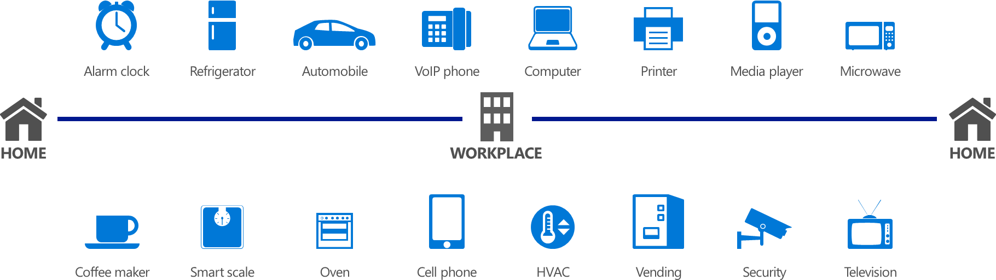
IoT in 2010

Slide 6
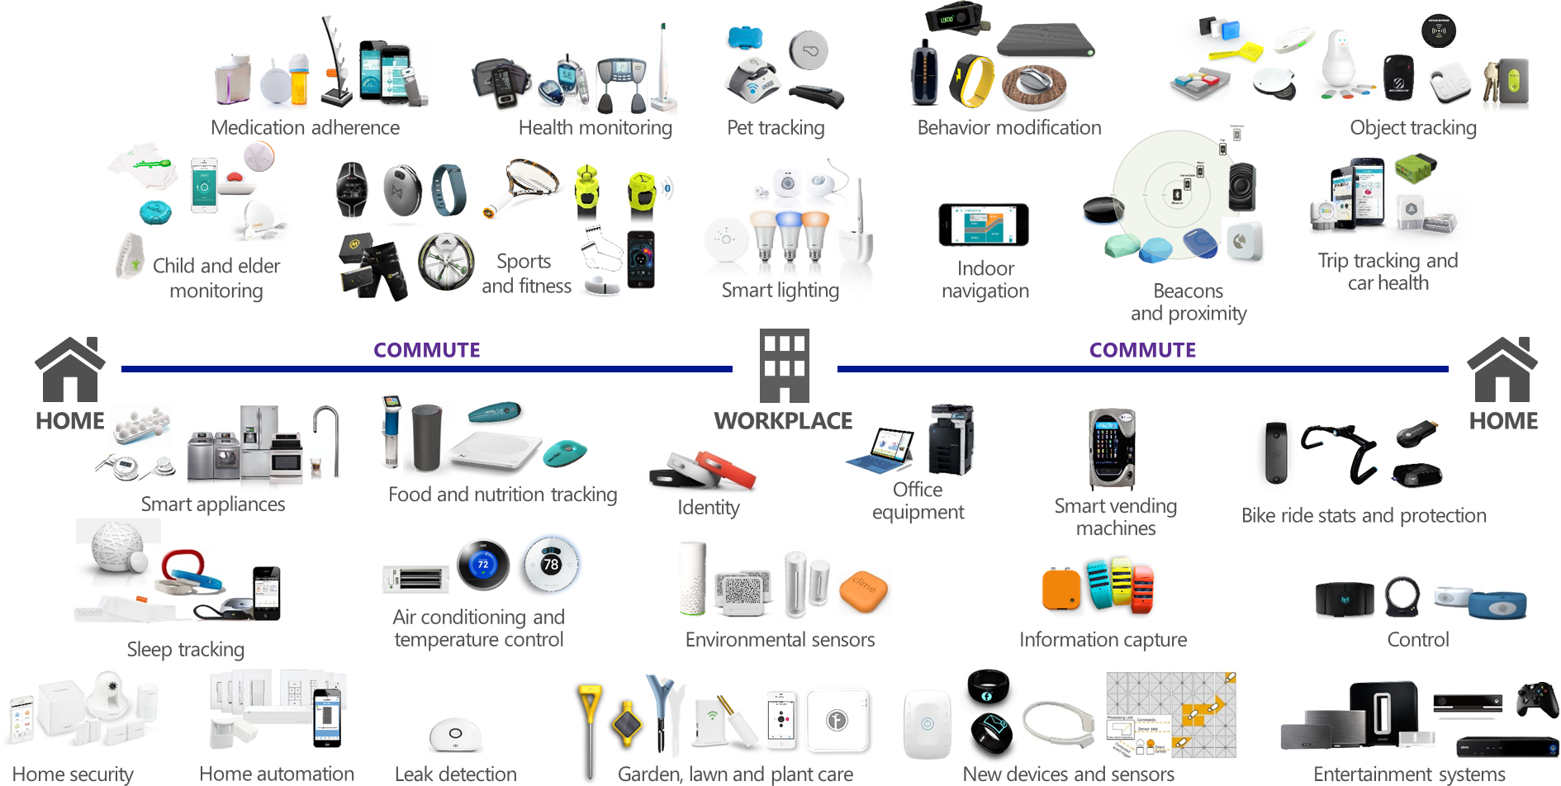
IoT in 2015

Slide 7

Disruptive Forces
Moore’s Law
Metcalf‘s Law
Koomey’s Law
Transistors
Computations
per KWh
10,000,000,000
1.E+14
1,000,000,000
1.E+12
100,000,000
1.E+10
10,000,000
1.E+08
1,000,000
1.E+06
100,000
1.E+04
10,000
1.E+02
1,000
1.E+00
1970
1980
1990
2000
2010
1940
1975
2010

Slide 8
What is the Internet of Things?
Things
Connectivity
Data
Analytics

Slide 9
Connectivity: Radio Protocols
 | Wi-Fi | Bluetooth LE | ZigBee | Z-Wave | Thread | LoRaWAN | Sigfox
Range | 100 m | 100 m | 10-100 m | 30 m | 10–100 m | 15 km | 30 km
Speed | 11 - 800 Mbit/s | 1 Mbit/s | 250 kbit/s | 9.6 – 100 kbit/s | 250 kbit/s | 1 kbit/s | 100 b/s
Frequency | 2.4 GHz 5 GHz | 2.4 GHz | 2.4 GHz | 908 US 868 EU MHz | 2.4 GHz | 915 MHz | 868 EU 902 US MHz
Power | High | Low | Low | Low | Low | Low | Low
Topology | Star | Scatternet | Mesh | Mesh | Mesh | Star | Star

Slide 10
Data: Wire Protocols
AMQP (Advanced Message Queuing Protocol)
MQTT (MQ Telemetry Transport)
CoAP (Constrained Application Protocol)
OMA LWM2M (OMA Lightweight M2M)
XMPP (Extensible Messaging & Presence Protocol)

Slide 11
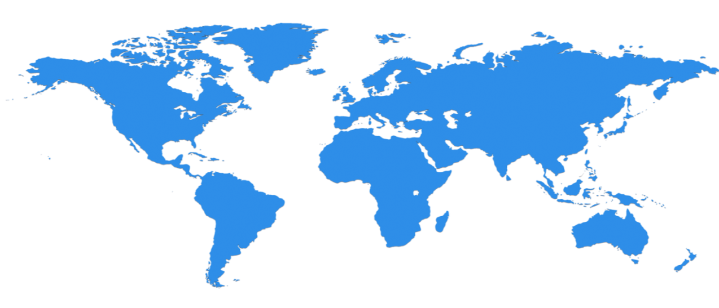
Scale IoT with Microsoft
North Europe
Ireland
West Europe
Netherlands
Central US
Iowa
North Central US
Illinois
US Gov
Iowa
China North *
Beijing
East US
Virginia
Japan East
Saitama
West US
California
China South *
Shanghai
East US 2
Virginia
Japan West
Osaka
India West
TBD
India East
TBD
South Central US
Texas
US Gov
Virginia
East Asia
Hong Kong
SE Asia
Singapore
19 Regions ONLINE…
huge datacenter capacity around the world…and we’re growing
Australia East
Sydney
Brazil South
Sao Paulo
Australia West
Melbourne
Operational
Announced
  * Operated by 21Vianet

Slide 12
Windows IoT Core

Slide 13

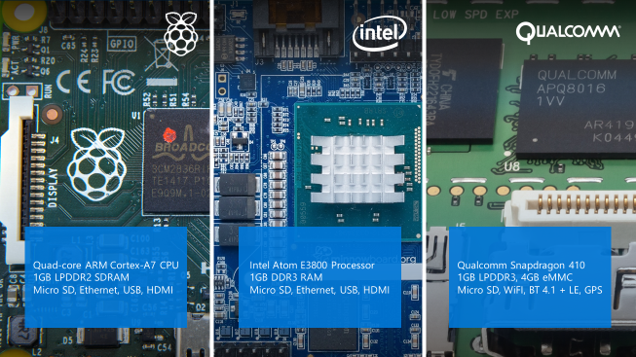
What is Windows 10 IoT Core
Architected to run on ARM and x86 devices.
AllJoyn support facilitates autonomous discovery and interaction with nearby IoT devices.
No Windows shell.
Remotely configure, monitor and deploy apps via SSH, web and PowerShell.

Slide 14
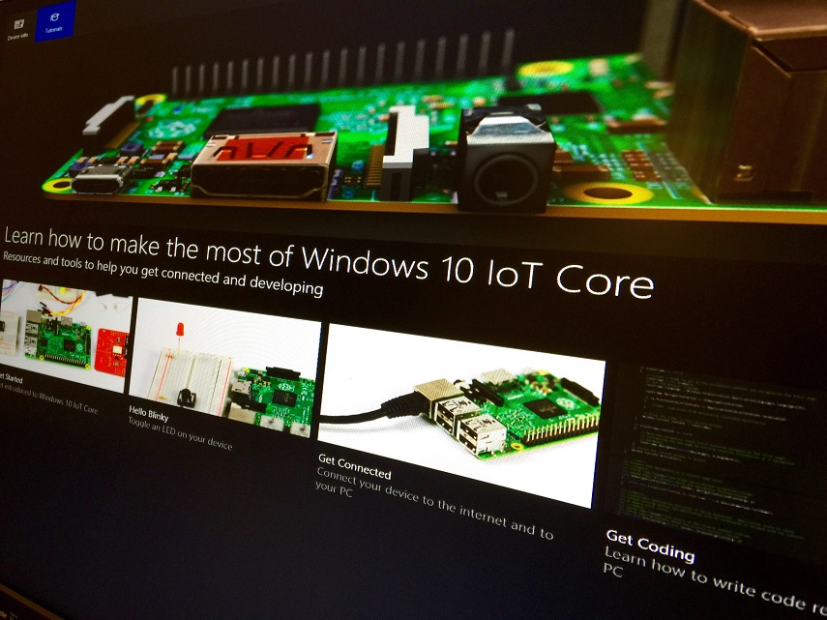
Building Apps for Windows 10 IoT Core
Build Universal Windows Platform apps in C++, C#, JS, and VB.
Node.js and Python too
Get started with Visual Studio 2015 and Windows IoT Core Project Templates from the Visual Studio Gallery.

Slide 15
Windows IoT Core
Demo
Rob Tiffany

Slide 16
Azure IoT services

Slide 17














Devices | Device Connectivity | Storage | Analytics | Presentation & Action
 | Event Hub | SQL Database | Machine Learning | App Service
 |  | Table/Blob Storage | Stream Analytics | Power BI
 |  | DocumentDB | HDInsight | Notification Hubs
 |  | 3rd party Databases | Data Factory | Mobile Services
 |  |  | Data Lake | BizTalk Services
{ }

Slide 18
Heterogeneous Client Libraries
Multi-platform, multi-language client libraries reduce the friction in connecting your disparate sensors and line-of-business assets to Azure Event Hubs.
Clients securely send AMQP telemetry via TLS directly to the cloud or via gateways.
Data is buffered when network is unavailable and messages are batched to improve communication efficiency.

Slide 19
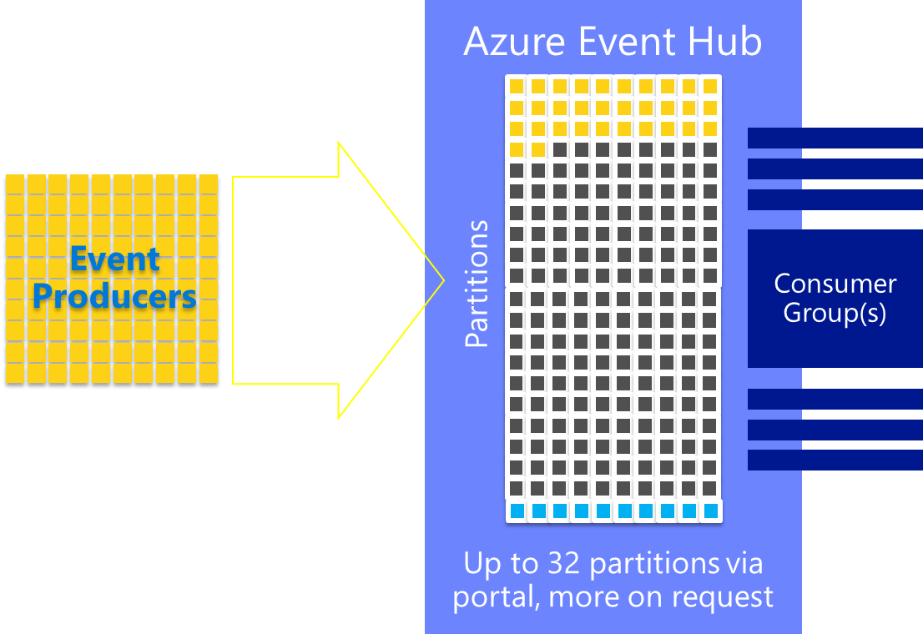
Azure Event Hubs
A scalable service for ingesting data from line-of-business assets and sensors.
Stream millions of events per second with elastic scale.
Security ensured via Shared Access Signature (SAS) tokens to authenticate clients.

Slide 20
Azure Event Hubs
Demo
Rob Tiffany

Slide 21
Azure Stream Analytics
A distributed stream computation service that integrates with Event Hubs to provide low latency, real-time processing of millions of events per second.
Data at Rest vs. Data in Motion
Write queries in SQL with familiar operators and functions to filter and join static and streaming data.

Slide 22
Azure Stream Analytics Demo
Rob Tiffany

Slide 23
Event Processor Host
.NET component that allows you to perform complex event processing over streaming data from Event Hubs via an Azure Worker Role.
A separate instance is created for each partition in use by the Event Hub and a simplified programming model allows you to respond to events that fire when new telemetry arrives.

Slide 24
Event Processor Host Demo
Rob Tiffany

Slide 25
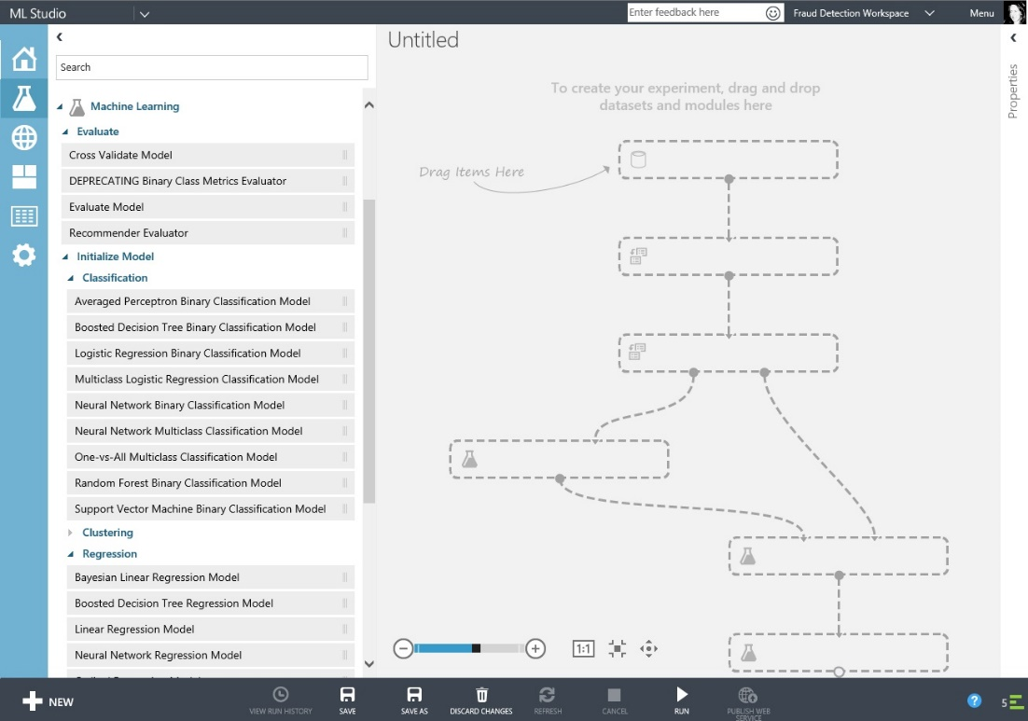
Azure Machine Learning
Harness machine-generated data with powerful, cloud-based predictive analytics.
Machine Learning Studio is a drag and drop visual environment allowing you to build, test and deploy solutions that operate on telemetry.

Slide 26

HDInsight
A managed Hadoop distribution powered by the cloud to process unstructured or semi-structured data.
Spin up Hadoop cluster nodes in minutes to scale to petabytes of data.
Apache Storm open-source stream analytics platform that can process real-time events at large scale.
Apache Spark is an in-memory compute engine with parallel data processing and 100x faster querying on workloads like streaming and machine learning.

Slide 27
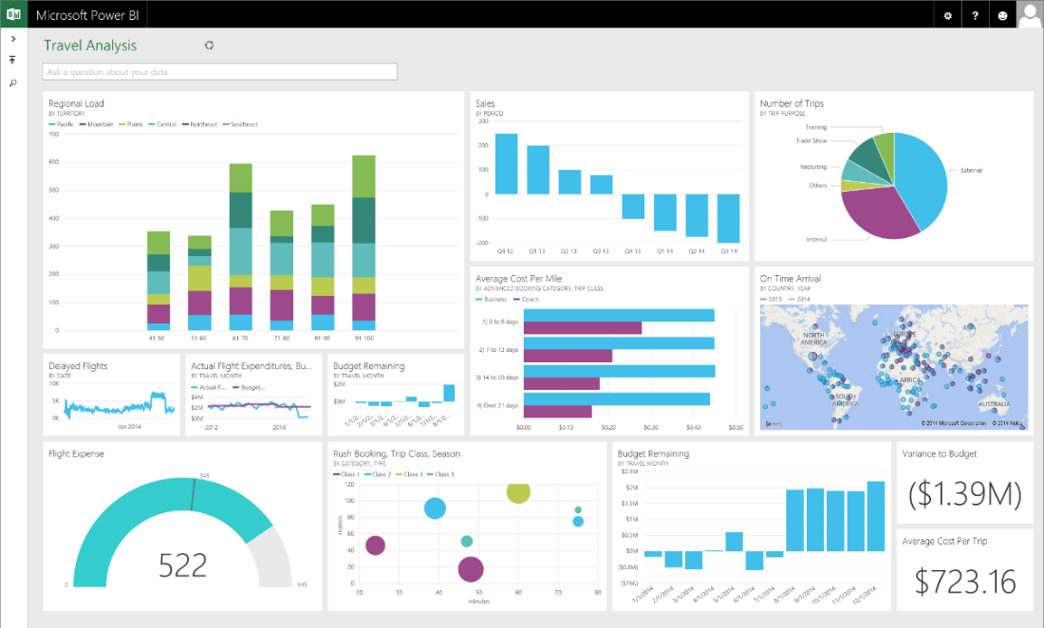
Power BI
A self-service tool that allows you to create powerful business analytics solutions from your favorite data sources.
Power BI Desktop lets you visually explore data via a drag-and-drop canvas, a broad range of visualizations, and easy to use report authoring.

Slide 28
Azure App Services Scenarios

Slide 29


Slide 30



Improving Healthcare via IoT > Alarms
Azure Stream Analytics pulls data out of Event Hub and observes that the patient’s temperature has exceeded a predetermined threshold of 100 degrees.
Remote patient telemetry containing vital signs, medicines being administered and other environmental factors is securely streamed over the Internet to Azure Event Hub.
A push notification with the patient information is sent to the appropriate nurses station where an alert is displayed on the patient health telemetry screen resulting in an immediate visit to the patient.
Azure Notification Hubs is called to facilitate the response to this event.
Azure
Event Hub
Azure
Stream Analytics
Azure
Notification Hubs
Dispatch Nurse
Patient

Slide 31
Increasing Revenue via IoT > Merchandising
Azure Stream Analytics pulls data from Event Hub and determines that employees on the 3rd floor of the building love white powdered donuts and purchase them 3 times more often than any other snack in this particular vending machine.
This vending machine now makes you more money because you’re catering to the needs of a very specific audience.
You act on this granular merchandising information by tripling-up on the number of spirals selling white powdered donuts.
Remote telemetry containing inventory, sales, alarms and other status events are securely sent to Azure Event Hub.
$$
Azure
Event Hub
Azure
Stream Analytics
Thing
Thing

Slide 32
Oil and Gas > Predictive Maintenance
Azure Stream Analytics pulls data out of Event Hub and passes the current state of various drilling components to Azure Machine Learning
Remote drilling telemetry is securely streamed over the Internet to Azure Event Hub via an onsite field gateway.
Azure Notification Hubs is called to facilitate the response to this event.
Machine Learning analyzes the incoming state of drilling components and models them against on-spec values and previously analyzed values to determine that one of them is going to fail.
A push notification with information about the failing component is sent to appropriate repair personnel resulting in a repair that is cheaper than it would be if the component failed. It also means reduced or no loss up uptime.
Drilling
Ops
Azure
Event Hub
Azure
Stream Analytics
Azure
Machine Learning
Azure
Notification Hubs
Repair Personnel

Slide 33
Increasing Revenue via IoT > Location
Azure Stream Analytics pulls data out of Event Hub and inserts the product inventory, GPS location plus the building address and floor in Azure SQL Database.
Remote telemetry containing inventory, sales, alarms and other status events is securely streamed over the Internet to Azure Event Hub.
A match between inventory, customer preferences and location is made, resulting in a sale.
A smartphone app provided by the vending machine owner combines location based services along with snack and drink preferences entered by the customer to find a nearby vending machine with the items the customer is searching for.
GPS
$$
Azure
Event Hub
Azure
Stream Analytics
Azure
SQL Database
Thing
Thing

Slide 34
Find Parking via IoT > Location
An event processor pulls data out of Event Hub and inserts it into Azure SQL Database while calling Azure Notification Hubs so it can respond to the update.
A magnetic sensor embedded in the street sends remote telemetry containing the presence of a car and location to a field gateway mounted on a nearby street light which securely streams this data over the Internet to Azure Event Hub.
A push notification is sent to the smartphone, tablet, or in-dash Azure Mobile Services app which then syncs with Azure SQL Database to alert the nearby driver of the location of the open parking space.
GPS
Azure
Notification Hubs
Azure
Event Hub
Driver Looking for Parking
Street Parking
Azure
SQL Database

Slide 35


Increasing Revenue via IoT > Beacons
If the vending machine has a snack or drink the customer wants, it makes a standard or discount offer via the app and a sale is made.
The smartphone app makes an API call to query the Azure SQL Database with the unique beacon identifier and the customer’s preferences.
A customer with a beacon-enabled smartphone with a beacon-aware app from the vending machine owner receives an advertisement from the beacon when walking near the vending machine.
The use of Bluetooth Low Energy beacons allows vending machines to notify customers that they contain the snack or drink item the person is looking for as they walk by.
Remote telemetry containing inventory, sales, alarms, the unique beacon identifier and other status events is securely streamed over the Internet to Azure Event Hub, through Stream Analytics and inserted into Azure SQL Database.
$$
Bluetooth LE
Bluetooth LE
Beacon
Beacon
Azure
SQL Database
Thing
Thing

Slide 36


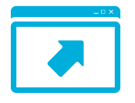

Microsoft delivers on IoT
Devices and assets
Cloud and infrastructure
Analytics Tools
Drive Insights
A
Power BI
Devices
Agent
1010101001100011010101011101001101010101010011011101111011100101010000110101010111010011010
1010111010011101010101011010011010101010101001101100010101111010011101010101011011110100111
Azure Machine Learning
1010101001100011010101011101001101010101010011011101111011100101010000110101010111010011010
1010111010011101010101011010011010101010101001101100010101111010011101010101011011110100111
Sensors
User
input
Alerts
Gateway
Customer portal
StreamInsights
HDInsight
Value

Slide 37
we’re done

Slide 38

Related Ignite NZ Sessions
Required Slide
*delete this box once you have listed content that is related to your session.
Speakers, please list the other Breakout Sessions that relate to your session.
Also indicate where and when they can find you, to continue the discussion.
If you’re going to be at Hub Happy Hour (5.30-6.30pm Wed and Thu, let them know)
1
Azure Consistent Service Delivery Overview
NZ1 Wed 10:00am
5
Security and Assurance Overview
NZ4 Fri 9:00am
6
What’s New in System Centre for Management
NZ1 Fri 11:00am
2
Server Virtualisation Overview
NZ2 Wed 1:30pm
3
Networking Overview
SKYCITY Theatre Thu 11:00am
Find me later at…
Hub Happy Hour Wed 5:30-6:30pm
Hub Happy Hour Thu 5:30-6:30pm
Closing drinks Fri 3:00-4:30pm
4
Storage Overview
SKYCITY Theatre Thu 3:30pm

Slide 39





Resources
Microsoft Virtual Academy
TechNet & MSDN Flash
  Free Online Learning
http://aka.ms/mva
  Subscribe to our fortnightly newsletter
http://aka.ms/technetnz http://aka.ms/msdnnz
  Sessions on Demand
http://aka.ms/ch9nz

Slide 40

Complete your
session evaluation
now and win!

