Slide 2
Managing Windows Embedded devices with System Center 2012 Configuration Manager SP1
Bryan Keller
Hema Rajalakshmi
UD-B318

Slide 3
Agenda
What’s an embedded device?
Write filters and overlays
Support for write filter enabled devices in ConfigMgr 2012 SP1
Why Maintenance Windows Matter
Persistence
Other Improvements in SP1
Questions and Feedback

Slide 4






Enabling users to be productive, responsibly
Finding the right balance
Devices & Experiences Users Want
Controlled access to data with seamless authentication
Applications and data across devices, anywhere
Empower User Productivity
Unified Management Infrastructure
Common Identity
Access and Information Protection

Slide 5




Unified Device Management
Empower User Productivity
Unified Management Infrastructure
+
Device choice
Application self-service
Personalized application Experience
Non-intrusive management
Single management interface
Integrated security and compliance
Improve IT efficiency
Reduced infrastructure complexity

Slide 6









Simplifying Management Across Platforms
Devices & Platforms
Windows PCs
(x86/64, Intel SoC),
Windows to Go
Windows Embedded
Mac OS X
  Single admin
  console
Windows RT
Windows Phone 8
iOS
Android
IT

Slide 7
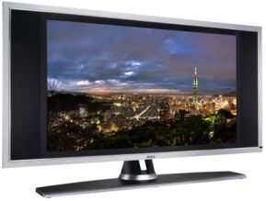
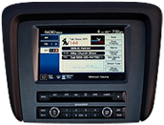
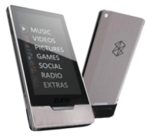
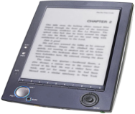
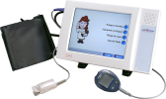
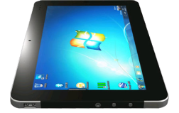
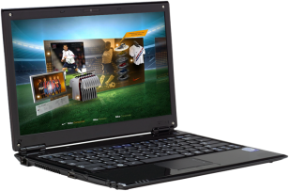
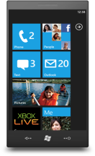

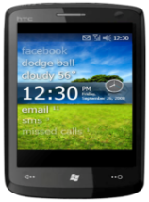
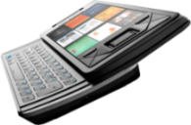


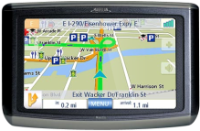


GROWTH OF EMBEDDED DEVICES
100’s Millions
IDC, Gartner
Billions
IDC, Consumer
Electronics Association
10’s Billions
VDC market reach, IDC
PCs/SLATES
PHONES
EMBEDDED DEVICES

Slide 8
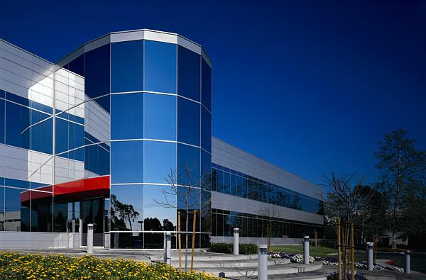

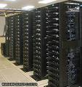

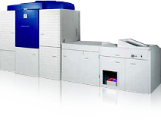
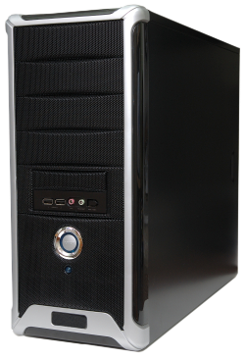
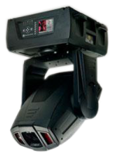
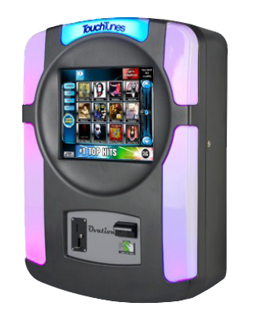
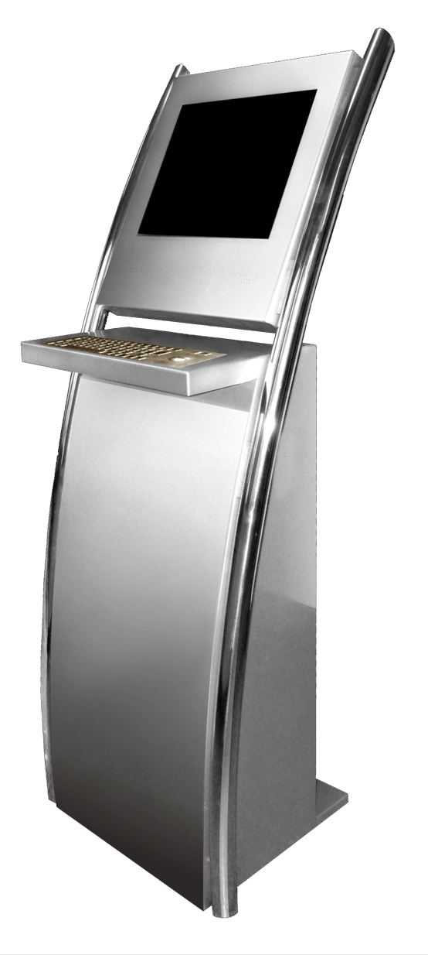

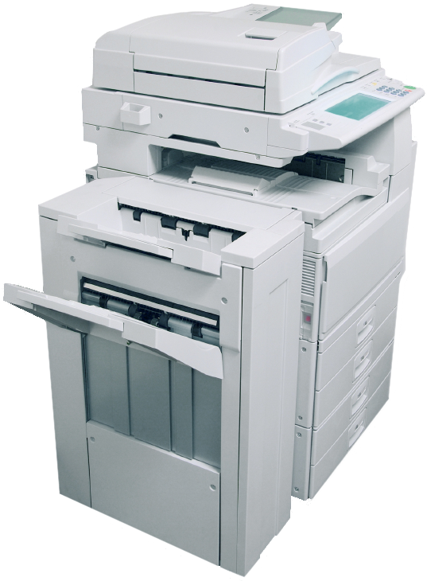
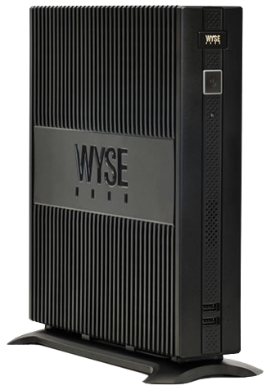
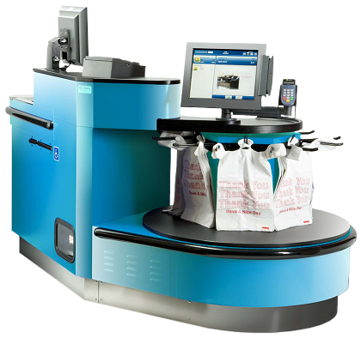
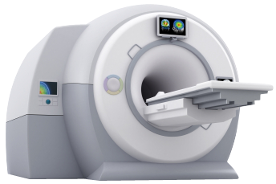

HOW EMBEDDED DEVICES ARE MANAGED TODAY
Enterprise IT Pro
Device Manufacturer /
Service Provider
Industry Specific Device

Slide 9

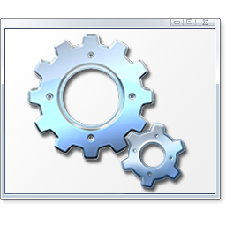

CHALLENGES MANAGING EMBEDDED DEVICES
Embedded devices OS are customized vs. the homogeneous OS in PCs/Servers
Identifying Windows Embedded devices in ConfigMgr
Write Filters are used to help maintain embedded devices
Embedded devices are widely varied vs. PCs/Servers
Updating the OEM embedded device/image

Slide 10
What is supported in SP1?
CM 2012 SP1 capabilities extended
Thin Clients
POS
Digital Signage
Kiosks
Thin PCs
Manage additional devices
Additional software not required

Slide 11


Supported Embedded Operating Systems
Thin Clients
Windows XP Embedded
Windows Embedded
Standard 2009
Windows Embedded
Standard 7
POS / Kiosk
Windows XP Embedded
Windows Embedded
Standard 2009
Windows Embedded
Standard 7
POS Ready 2009
POS Ready 7
Digital Signage
Windows Embedded
Standard 2009
Windows Embedded
Standard 7
Repurposed PC
Windows Thin PC

Slide 12
System Center 2012 SP1
Embedded Management Capability Overview
Operating System Deployment
Uses Windows ADK
Software Update Management
OS Servicing
Application Management
Win32 / Windows 8
Settings/Configuration Management
Baselines
Monitoring/Reporting
Health/Compliance
Endpoint Protection
On-Premise
x86/64
Intel SoC
Cloud
Windows Phone
Windows RT
Antimalware
Single Pane of Glass

Slide 13
Native Support for Key Embedded Scenarios in SP1
Write filter orchestration
Maintenance windows
Opportunistic and forced persistence
SCEP client installation
SCEP updates
No additional software/license

Slide 14
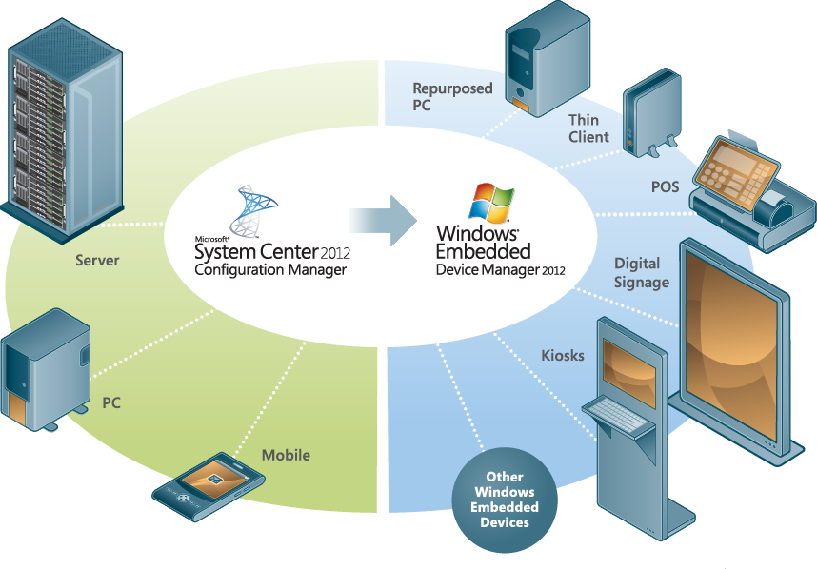
Write Filters and Overlays

Slide 15
Demo

Slide 16
Why Maintenance Windows Matter
ASAP

Slide 17
Without a Maintenance Window
Get deployment notice
Download content
Reboot immediately to disable WF
Content gone; re-download
Install content
Reboot to enable WF

Slide 18
With a Maintenance Window
Waits for maintenance window
Get deployment notice
Maintenance window arrives
Disables WF; reboots
Downloads content
Install contents; reboots

Slide 19
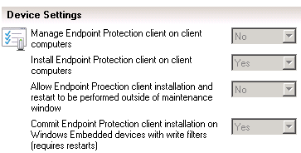
Endpoint Protection
SCEP installs will persist through the supported write filters
Updates come frequently
  Write filter exceptions allow definition updates to persist
  Can be manually set or defined in a module
New setting for Endpoint Protection client installation

Slide 20
With Persistence
Translation: I want to commit this change ASAP, so do the write filter thing at the deadline, or, better yet, at the maintenance window

Slide 21
Without Persistence
Translation: Just put it in the overlay. When another deployment comes along with persistence, we’ll commit the change then.

Slide 22
What can be forced to persist?
These have a forced persistence option
  Applications
  Packages & programs
  Software Updates
  Task sequences
These are persisted opportunistically
  Client agent settings
  Settings management (aka DCM set)
  Power management

Slide 23

One More Persistence Issue
First inventory data
Delta data
? ! ? ! ?

Slide 24
With File Based Write Filters
First inventory data
Delta data

Slide 25
Supported Write Filters
File Based Write Filters (FBWF)
Redirects all writes targeted for protected volumes to overlay
Folder/file exclusions can be used
Enhanced Write Filters (EWF) RAM
Stores overlay information in RAM
Information on overlay discarded on reboot
Unified Write Filters (UWF)
Sector-based write filter to protect storage media
Use Hibernate Once/Resume Many (HORM) or file and registry filtering exclusions
Servicing mode via the UWF WMI provider
ELM outside of Configuration Manager

Slide 26
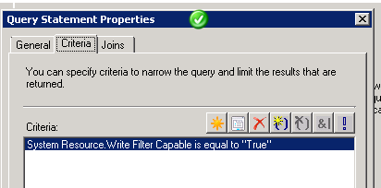
Improvements
Operating System Deployment Improvements
“Apply operating system”
“SMSTSPostAction”
Discovery Improvements
Write filter capable now identified in Discovery Data Record

Slide 27
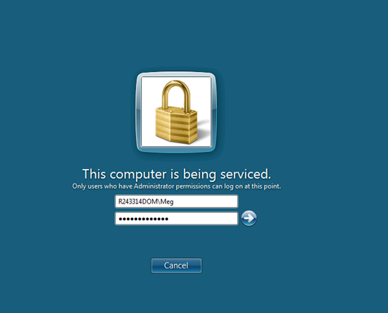
Client Side Improvements
Non-admins cannot log on while device is being serviced
Software Center blocks installation if write filters are enabled
Users cannot change their business hours
Users cannot postpone deployments to non-business hours

Slide 28
Write Filter considerations
Settings management not write filter aware
Manual write filter handling
Opportunistic persistence during maintenance window
Windows 8 applications registered during user login
For fewer applications, re-register
Admin to login to finalize app registration

Slide 29
Best Practices
Use maintenance windows
  Make sure your max run time fits inside the maintenance window
Plan for persistence
Make deployments “required” instead of “available”
Use File Based Write Filters
Configure these exceptions to persist state and inventory data
  CCMINSTALLDIR\*.sdf
  CCMINSTALLDIR\ServiceData
  HKEY_LOCAL_MACHINE\SOFTWARE\Microsoft\CCM\StateSystem
Use WMI provider to manage other filters

Slide 30
Related Content
Breakout Sessions
UD-B309 Deploying and Configuring Mobile Device Management Infrastructure
UD-B310 Deploying and Managing Windows 8 with Configuration Manager 2012 SP1
UD-B317 Manageability of Mac & Linux Using System Center 2012 Configuration Manager SP1
UD-B318 Managing Embedded Devices with Configuration Manager 2012
UD-B325 System Center 2012 Configuration Manager SP1 Overview
UD-B330 System Center 2012 Configuration Manager SP1 and Windows Intune: Unified Modern Device Management
UD-B331 System Center 2012 Endpoint Protection Integration With Configuration Manager 2012 SP1
UD-B332 What’s New with Microsoft Deployment Toolkit 2012 Update 1
UD-B333 What's New: Configuration Manager 2012 SP1 Infrastructure Improvements and Hierarchy Design
UD-B335 Windows Intune Overview
UD-B403 Infrastructure Changes for System Center 2012 Configuration Manager SP1: Advanced Topics and Troubleshooting

Slide 31
Related Content
Instructor-led and Hands-on Labs
  UD-IL301 Basic Software Distribution
  UD-IL302 Deploying a Configuration Manager Hierarchy
  UD-IL303 Deploying Configuration Manager
  UD-IL304 Deploying Windows 8 to Bare Metal Clients
  UD-IL306 Implementing Endpoint Protection
  UD-IL307 Implementing Role-Based Administration
  UD-IL308 Implementing Settings Management
  UD-IL309 Introduction to Configuration Manager
  UD-IL310 Managing Applications
  UD-IL311 Managing Clients
  UD-IL312 Managing Content
  UD-IL313 Managing Microsoft Software Updates
  UD-IL314 Migrating from Configuration Manager 2007 to Configuration Manager 2012
  UD-IL315 New for SP1: Deploying Windows 8 Applications in Configuration Manager 2012 SP1
  UD-IL316 New for SP1: Expanding a Configuration Manager 2012 SP1 Hierarchy
  UD-IL317 New for SP1: Implementing App-V 5.0 in Configuration Manager 2012 SP1
  UD-IL318 New for SP1: Implementing Database Replication Controls in Configuration Manager 2012 SP1
  UD-IL319 New for SP1: Implementing Linux Clients in Configuration Manager 2012 SP1
  UD-IL320 New for SP1: Upgrading from Configuration Manager 2012 to Configuration Manager 2012 SP1
  UD-IL401 Advanced Software Distribution

Slide 32
Evaluation
We want to hear from you!
Complete your session evaluations today and enter to win prizes daily.
Provide your feedback at a CommNet kiosk or log on at www.2013mms.com.
Upon submission you will receive instant notification if you have won a prize.
Prize pickup is at the Information Desk located in Attendee Services in the Mandalay Bay Foyer.
Entry details can be found on the MMS website.

Slide 33
Resources
Access MMS Online to view session recordings after the event.
http://channel9.msdn.com/Events

Slide 34

© 2013 Microsoft Corporation. All rights reserved. Microsoft, Windows and other product names are or may be registered trademarks and/or trademarks in the U.S. and/or other countries.
The information herein is for informational purposes only and represents the current view of Microsoft Corporation as of the date of this presentation. Because Microsoft must respond to changing market conditions, it should not be interpreted to be a commitment on the part of Microsoft, and Microsoft cannot guarantee the accuracy of any information provided after the date of this presentation. MICROSOFT MAKES NO WARRANTIES, EXPRESS, IMPLIED OR STATUTORY, AS TO THE INFORMATION IN THIS PRESENTATION.

