Slide 2
Securing User Access with Multi-Factor Authentication
Sarah Fender, Director of Product Marketing
Steve Dispensa, Partner Dev Manager/PhoneFactor CTO
WS-B338

Slide 3








Authentication in motion

Slide 4
Multi-factor authentication
Any two or more of the following factors:
Something you know - a password or PIN
Something you have - a phone, credit card or hardware token
Something you are - a fingerprint, retinal scan or other biometric
Stronger when using two different channels (out-of-band)
Types of multi-factor authentication:
Smart Cards
Hardware OTP Tokens
Software OTP Tokens
Certificates
Biometrics
Out-of-band Authentication

Slide 5
Introducing PhoneFactor
Multi-factor authentication using any phone
Works with the user’s existing phone, anywhere in the world
Offers out-of-band protection from malware threats
Verifies user logins, financial transactions, and more
Features built-in support for leading on-premises applications
and cloud services
Streamlines user management and enrollment
Backed by a scalable cloud service

Slide 6

Securing corporate data and applications
  Authenticates employee/contractor/partner access to on-premises and cloud applications
  Provides off-the-shelf integration with leading VPNs, virtual desktops, web apps, and more
  Synchronizes with existing user directories
  Supports federated identities
  Simplifies user enrollment and management
  Low TCO and a better user experience are driving migration from security tokens
  Addresses strengthening regulatory requirements for multi-factor authentication
Jerry is working from home today. He logs into the corporate network using his user ID & password. Instantly, he receives a call from PhoneFactor. He answers the call and presses # to verify his login.

Slide 7

Securing customer data and applications
  Authenticates customer access to online portals and applications, as well as financial transactions
  Direct SDK and Web Services available for implementation with websites and custom applications
  Out-of-band methods require no interface changes, work seamlessly across all user devices
  Scales to meet the needs of large global user communities
  The Standard for strongly authenticating customer access (eg: Xbox, Facebook, Apple, Google)
Julie logs in to her online account with her user ID & password to transfer money. Before the transfer goes through, a notification is pushed to her phone. She reviews the details and taps Authenticate to authorize the transfer.

Slide 8
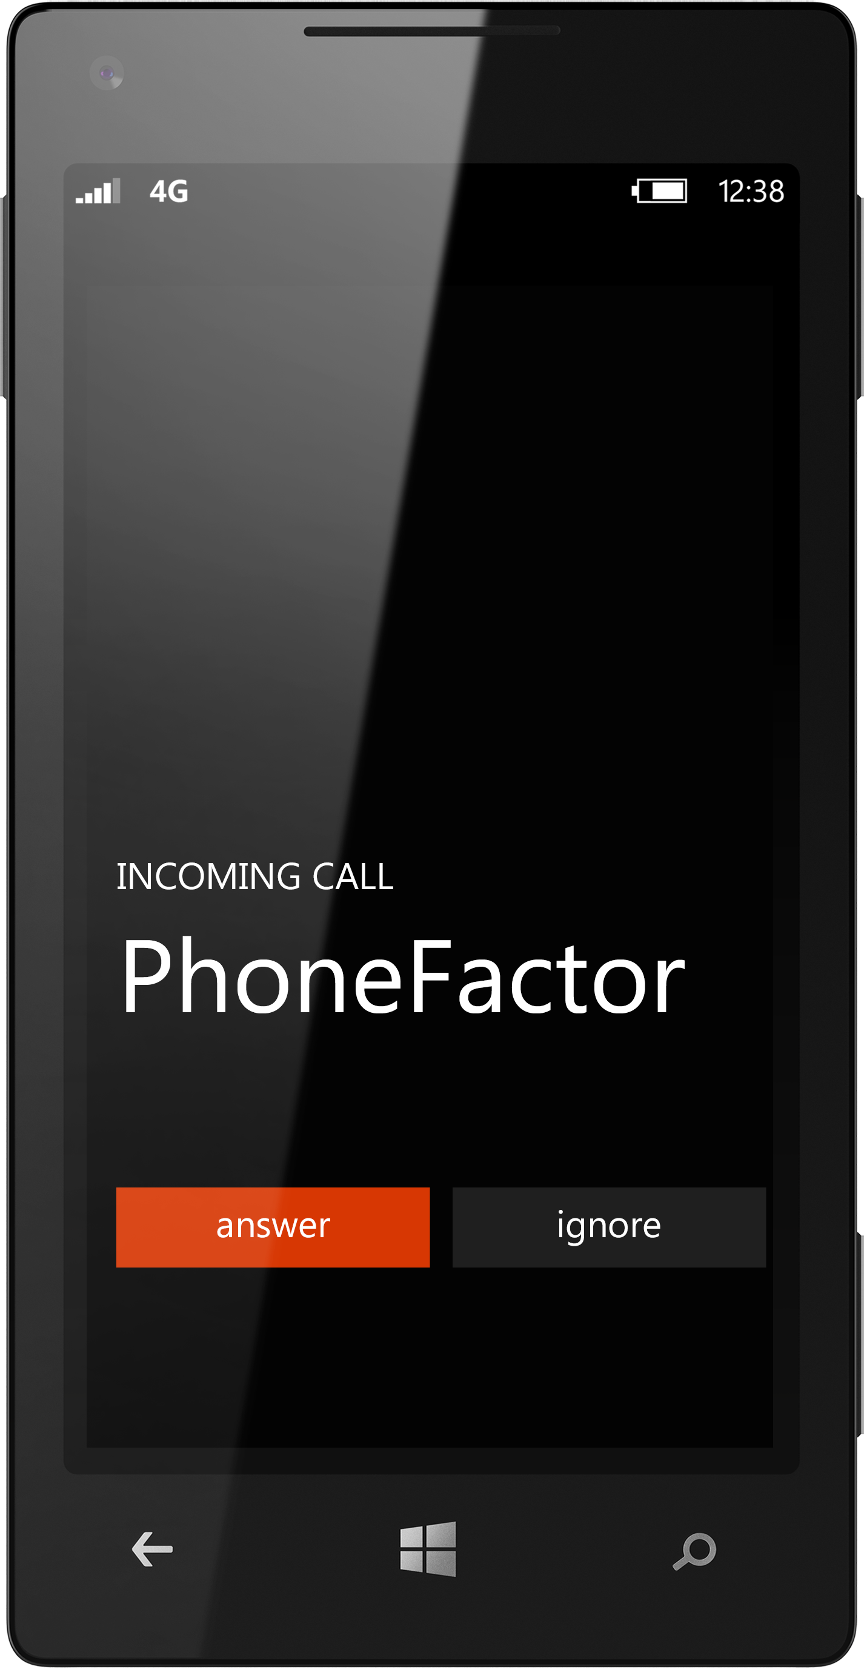
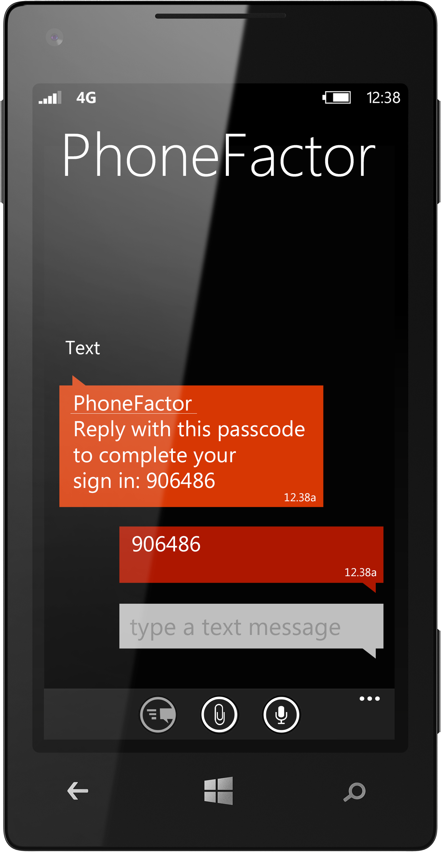
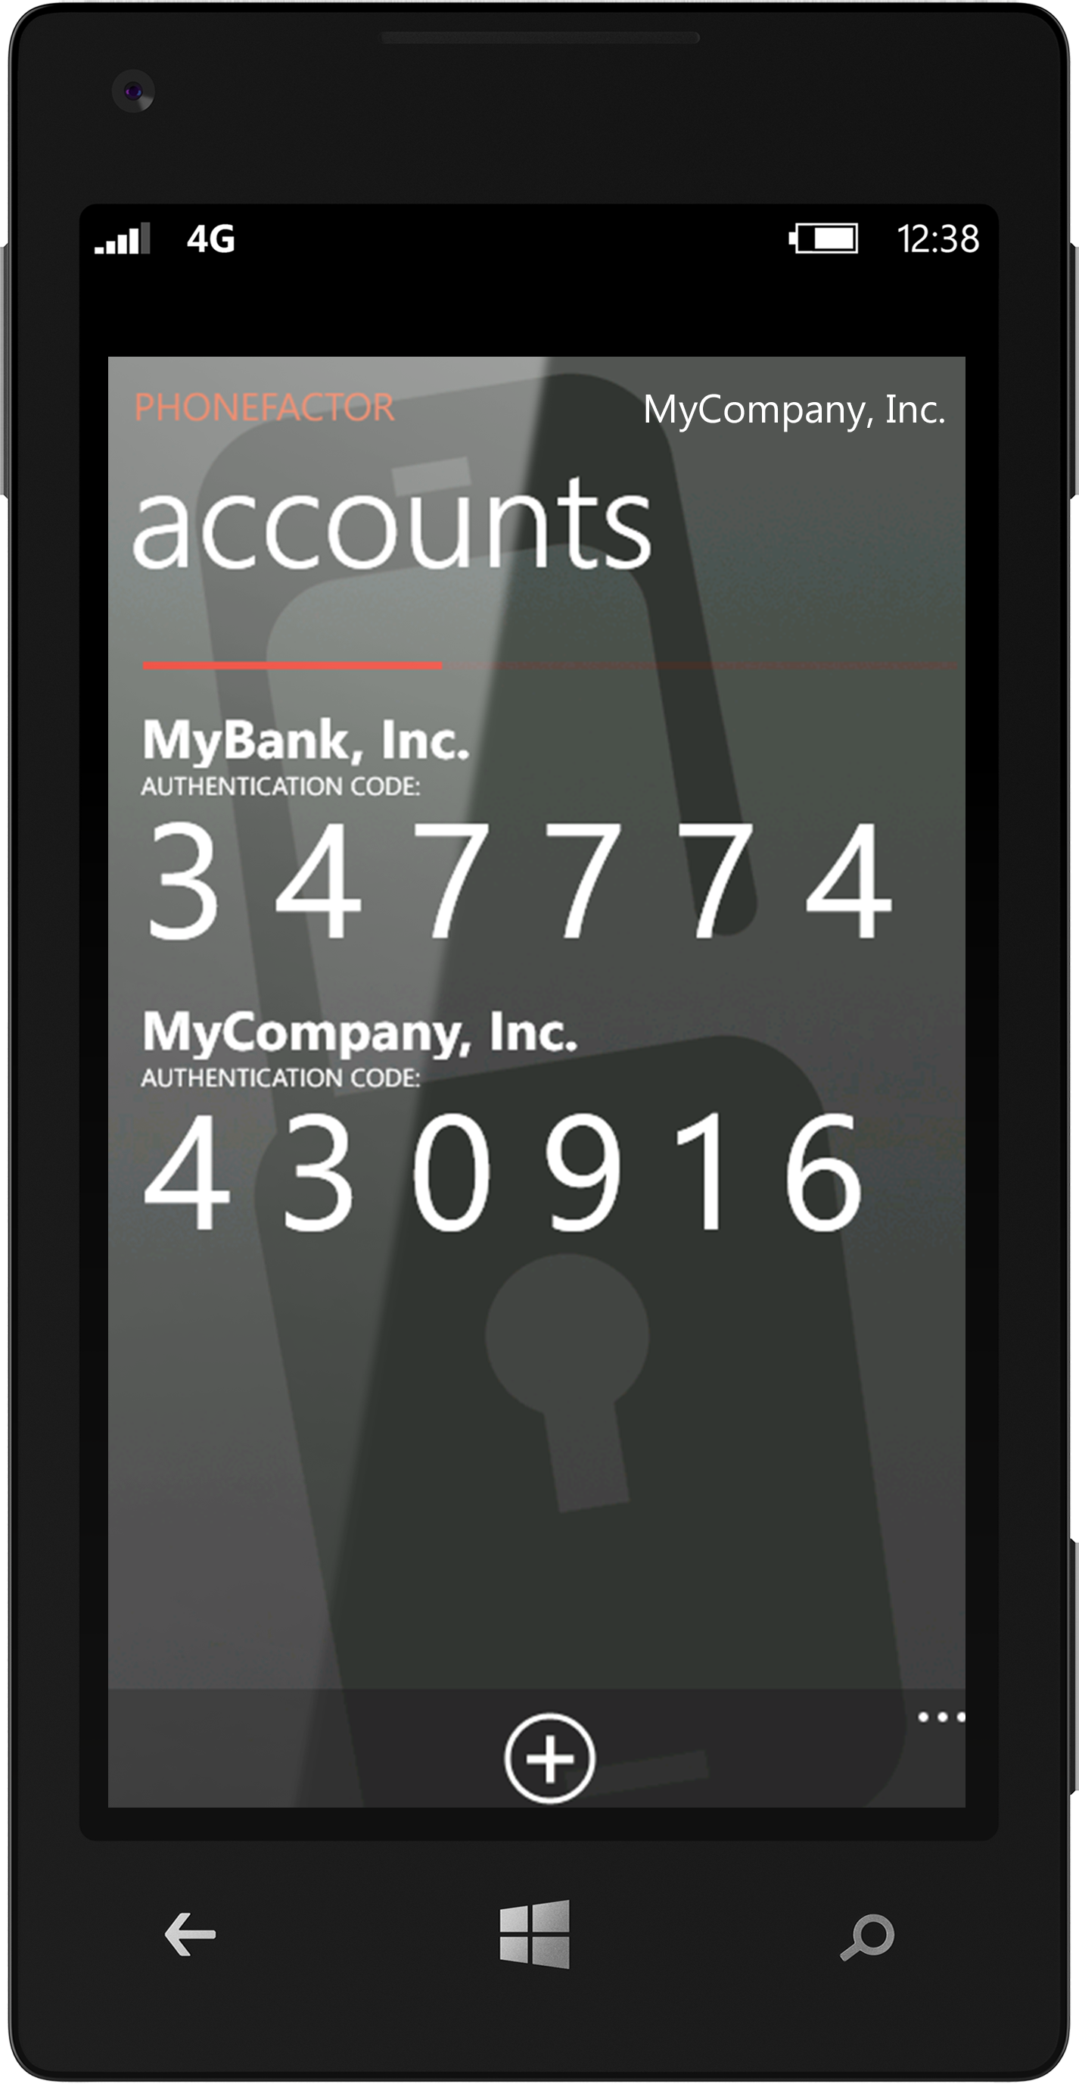
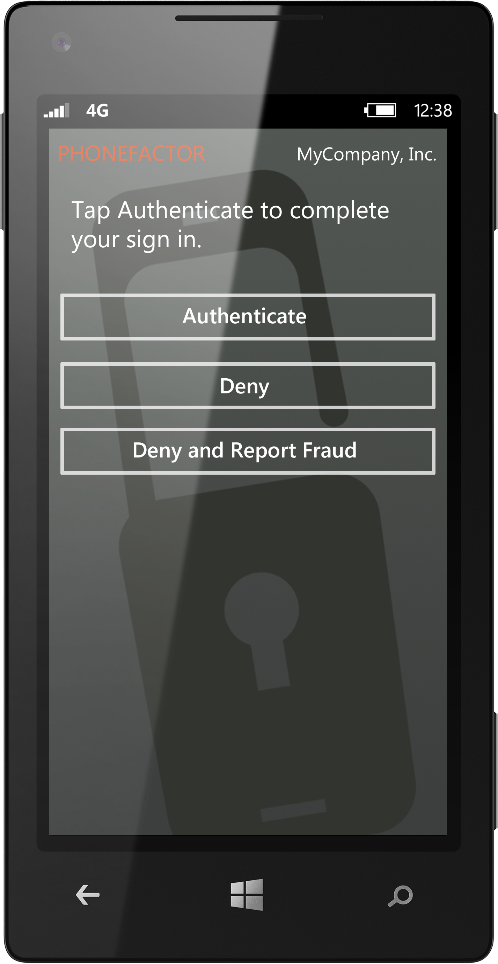
Out-of-Band and OTP Methods
Phone Call
Text Message
Mobile Apps

Slide 9
Demo:
Authentication Process

Slide 10
Additional security capabilities
PIN Security
Require users to also enter a secret PIN to authenticate.
Fraud Alerts
Receive instant notification if a user’s credentials have been compromised and an attack is in progress.
Voice Biometrics
Verify the user’s voiceprint during the authentication call.

Slide 11

Architecture
Step
1
Step
2
Remote
Login
Cloud
Login
Funds
Transfer
PHONE NETWORK
SSL
PhoneFactor
User Portal
Agent
Web Services | Gateway
Direct SDK
.NET | Java | More
Mgmt.
Portal
PhoneFactor Service
Custom
Applications
RADIUS
AD/LDAP
SQL

Slide 12
Current Microsoft authentication scenarios
On-Premises Applications
Microsoft VPN/RRAS (RADIUS)
Universal Access Gateway (RADIUS)
Terminal Services (Windows)
SharePoint (IIS)
Outlook Web Access (IIS)
Remote Desktop Gateway (RADIUS)
Remote Desktop Web (IIS)
AD Federation Services (IIS)
Cloud Services
Office 365 (ADFS)
Azure AD Admin Logins
More To Come…

Slide 13
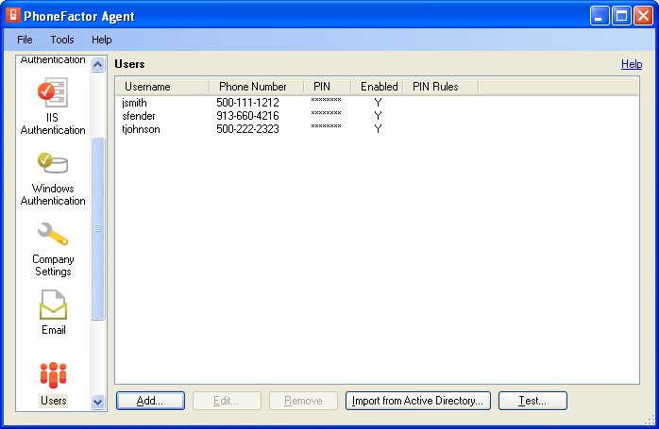
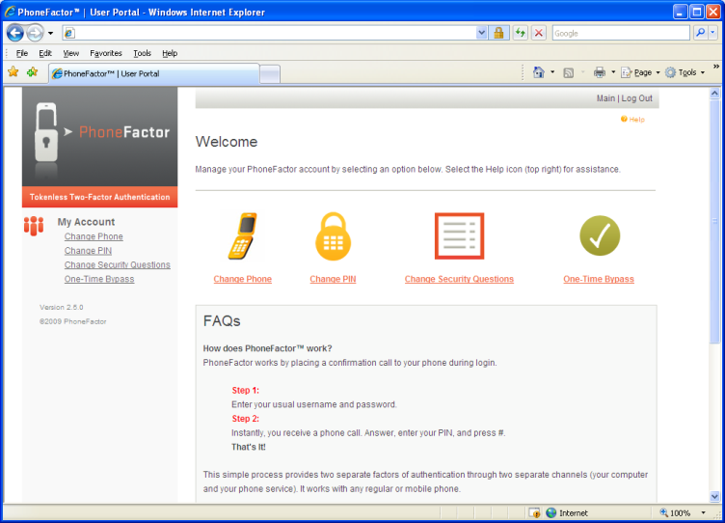
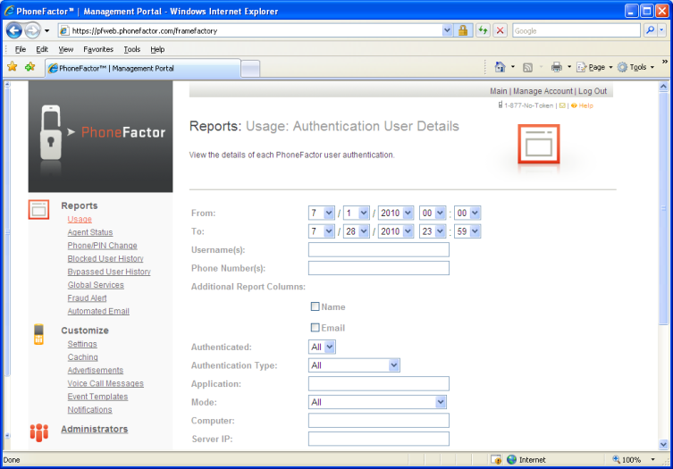
System components
Agent
User Portal
Mgmt. Portal
On-premises software
Manages settings and users
Synchronizes with Active Directory
Supports RADIUS, IIS, Forms-Based Auth, Windows Auth, SAML
Web Services APIs
On-premises web portal
Enables user self-enrollment and user account management
Offers interface for IT and help desk staff to support end users
Part of the cloud service
Configures authentication settings
Offers centralized usage reports

Slide 14
Demo:
Setup and Enrollment

Slide 15
Scale, performance, and security
PhoneFactor cloud service designed for stability and performance
Agent optimized to support large numbers of users
and authentications
Extensive reporting and logging capabilities
PhoneFactor integrates security at every point
Scalable operational capabilities
24/7 support

Slide 16
Why PhoneFactor?
BUSINESS IMPACTS
Decreased risk of a breach
Regulatory compliance – PCI, HIPAA, NIST, etc.
Rapid deployment
Limited maintenance
Increased employee productivity
Significant savings over tokens and other two-factor solutions
Strong Security
Convenient for Users
Easy for IT to Deploy
and Maintain
Supports Wide Range of Authentication Scenarios

Slide 17
Questions?

Slide 18
Resources
Online Demos
Free Download
Whitepapers
www.phonefactor.com

Slide 19
Evaluation
We want to hear from you!
Complete your session evaluations today and enter to win prizes daily.
Provide your feedback at a CommNet kiosk or log on at www.2013mms.com.
Upon submission you will receive instant notification if you have won a prize.
Prize pickup is at the Information Desk located in Attendee Services in the Mandalay Bay Foyer.
Entry details can be found on the MMS website.

Slide 20

© 2013 Microsoft Corporation. All rights reserved. Microsoft, Windows and other product names are or may be registered trademarks and/or trademarks in the U.S. and/or other countries.
The information herein is for informational purposes only and represents the current view of Microsoft Corporation as of the date of this presentation. Because Microsoft must respond to changing market conditions, it should not be interpreted to be a commitment on the part of Microsoft, and Microsoft cannot guarantee the accuracy of any information provided after the date of this presentation. MICROSOFT MAKES NO WARRANTIES, EXPRESS, IMPLIED OR STATUTORY, AS TO THE INFORMATION IN THIS PRESENTATION.

