Slide 2
A Journey to the Dark Side of Social Networking!
ATC-B202
Andy Malone MVP, MCT
Quality Training (UK) Senior Instructor / Consultant
Andrew.malone@quality-training.co.uk
www.divedeeperevents.com

Slide 3
Warning! This Presentation Contains Occasional Bad Language & Subject Matter that some May find Disturbing

Slide 4
A Journey to the Dark Side of Social Networking!
ATC-B202
Andy Malone MVP, MCT
Quality Training (UK) Senior Instructor / Consultant
Andrew.malone@quality-training.co.uk
www.divedeeperevents.com

Slide 5
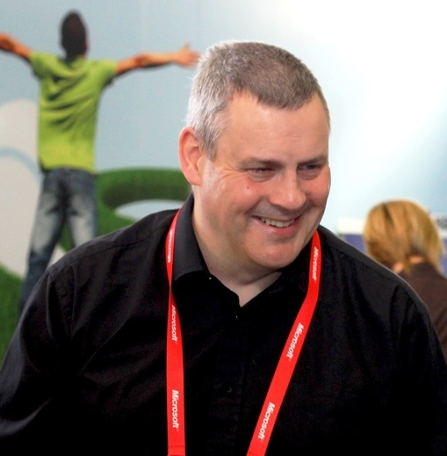
Andy Malone
Follow me on Twitter #AndyMalone
Microsoft MVP (Enterprise Security)
Founder: Cybercrime Security Forum!
Microsoft International Event Speaker
MCT (18 Years)
Winner: Microsoft Speaker Idol 2006

Slide 6
Agenda This Session will cover:
The Rise of the Social Technical Society
The Changing Face of Social Media
The Evolving Change
Threats Lurking inside Social Media
The Human Cost… When Social Networking Goes Wrong!
Security Challenges
Privacy - Compliance - Security
Review & Q&A

Slide 7
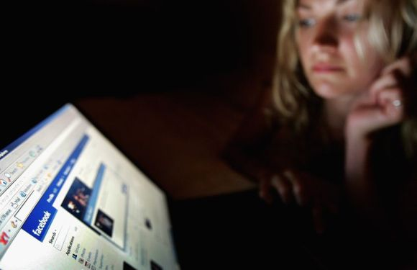
The Rise of the Socio - Technical Society
The interaction between society's complex infrastructures and human behaviour
Facebook: 0 to 1 Billion Users in 11 Years…

Slide 8
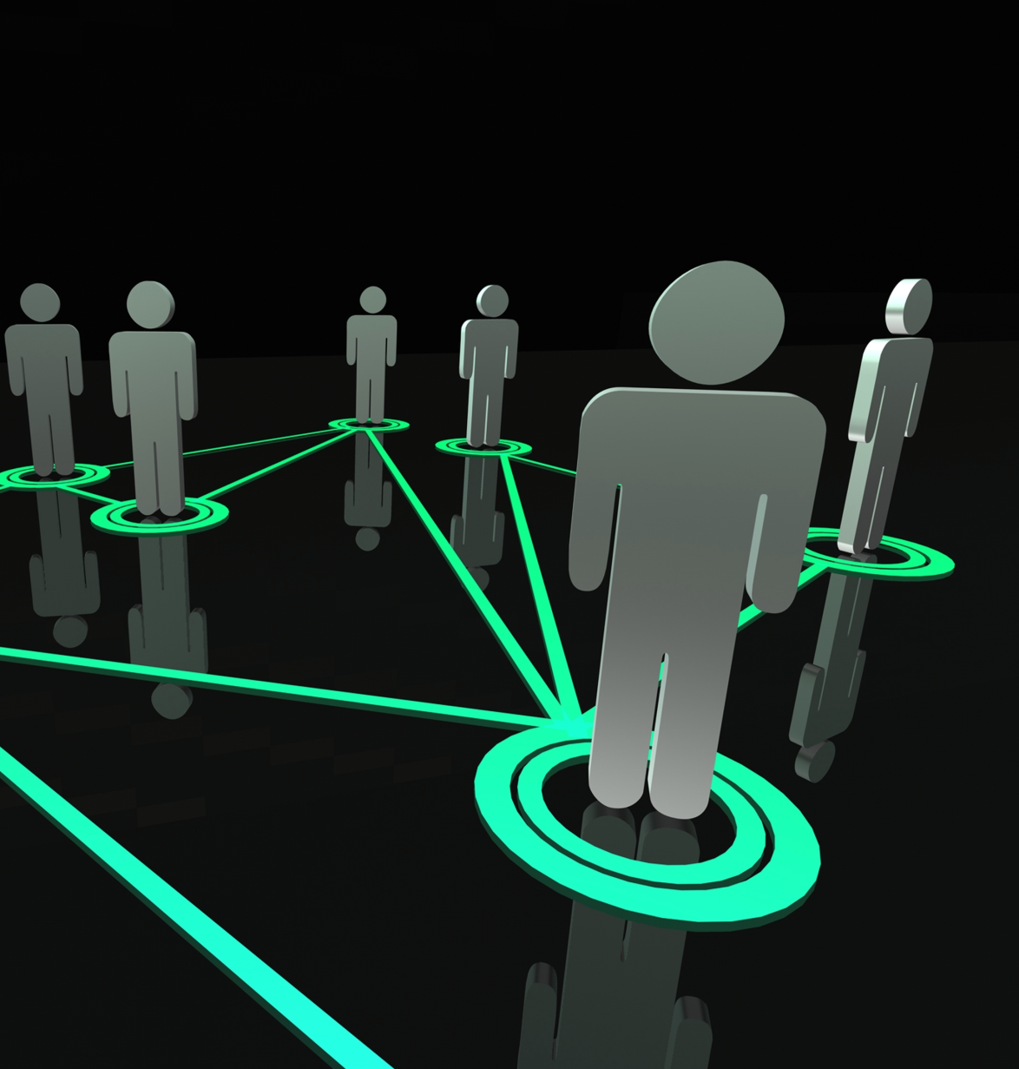
Social Networking Evolution Vs. Revolution
Apparently we’re Living in the Socio Technical Society.
It’s a massive shift in how we Communicate, Interact and Socialize.
There are Hundreds of Social Networking Sites on almost any topic
Facebook alone Now has over 1 Billion Users. If it was a Country it Would be the 4th Largest Country on Earth
Are we Powerless to Stop it?
How do we Control it?
Wait a Minute that Sounds like CENSORSHIP!

Slide 9
What is a Social Network?
A social network is a social structure made up of a set of actors (such as individuals or organizations) and the dyadic ties between these actors (such as relationships, connections, or interactions)

Slide 10
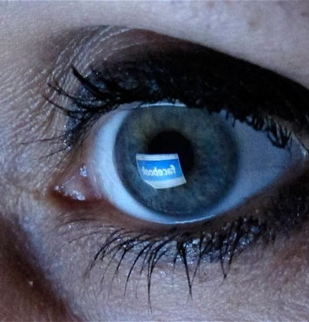
The Psychology of Social Networking The Need to Belong!
One hypothesis is that "popular" people will have connections both in the real as well as in the virtual world
Another hypothesis may be that people who are less popular in the real world may somehow "compensate" for their lack of charm by over-indulging in virtual social networking sites (and, thus, spend more time in the virtual world than in the real world

Slide 12
http://www.intelfreepress.com

Slide 13
Social Networking The Business Pro’s
Free Advertising
Generate Business Trust through Openness
Reach a Worldwide Market
It’s Replacing traditional media, such as Advertising, Yellow Pages etc. Potentially Saving Thousands
Allows Companies to Push it’s Corporate Image
Keep Customers Informed
It’s Very Low Cost!!

Slide 14
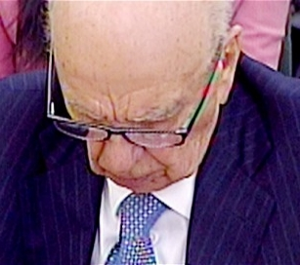
Social Networking The Business Con’s
Loss of Corporate media Control
One slip of the Tongue or Finger on the Keyboard Could Cost you Everything!
Remember Once it’s out there, You can’t Take it Back!
Plausible Deniability
Public Opinion Can Differ Greatly from Corporate Image

Slide 15
Social Networking The Business Moral Dilemma
Social media sites are Making Organizations Rethink External Communication
How should a Company Confront a crisis? – Can Social Media Help or Hinder
Should Employees be Empowered to participate
Consider Policies and Guidelines in Social Media Participation
It’s a Minefield…

Slide 16
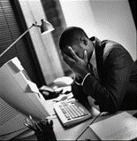
Social/Digital Exhaustion Perhaps the Beginning of the End!
Facebook has broke the 1 billion user mark in 2012, but its numbers have flattened out in the U.S and are expected to fall!
Twitter is growing; it may have as many 700 million users, but no one knows how many people are really active users
Google+ is growing steadily, but is still well behind the two most established networks and much of the public is unaware of its existence

Slide 17
Just What are the Risks?
Threats to Individuals
Threats to Computers
Predators
Cyberbullies
Trolls
File-sharing abuses
Invasion of privacy
Disturbing content
Threats to Personal Safety
Spam
Online fraud and phishing
Hoaxes
Identity theft
Viruses
Worms
Trojans
Spyware

Slide 18
Video
Internet Safety Campaign

Slide 19
Creepy Technologies…

Slide 20
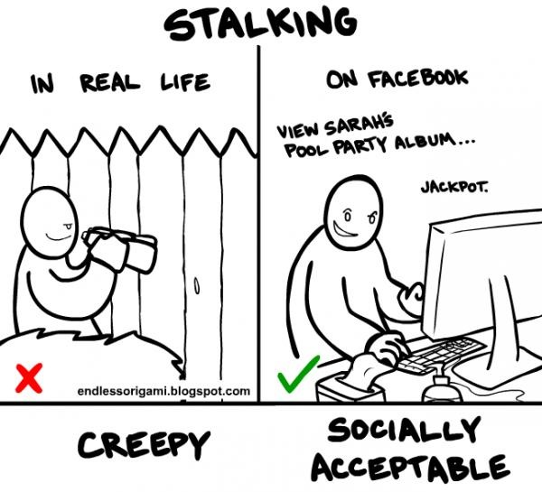

Slide 21
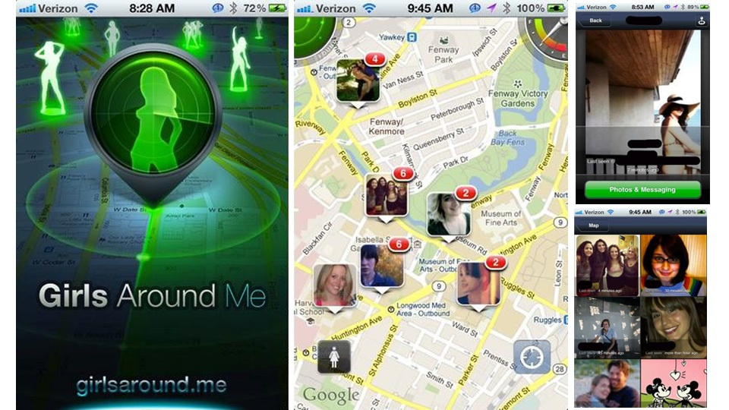

Slide 22
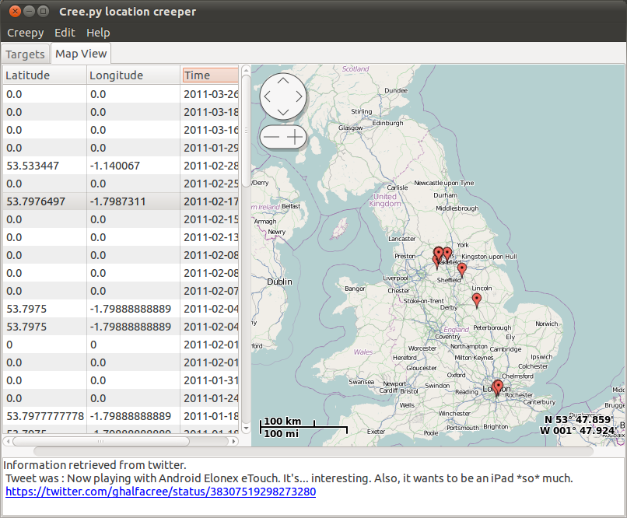

Slide 24
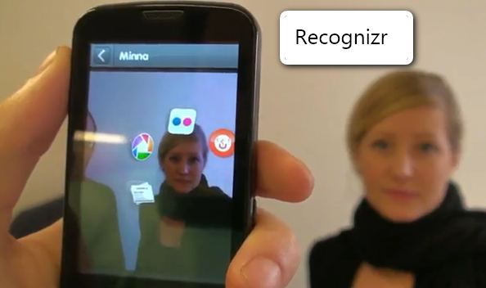

Slide 25
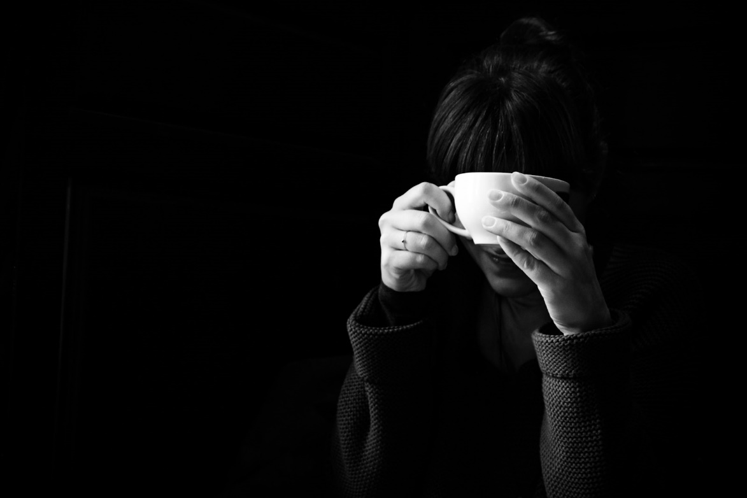
Geotagging Creepy or What!
More and more cameras have GPS built right into them
The moment you take a photo, your camera records exactly where you took it
You can then locate the co-ordinates in you favourite mapping tool
Then I can Find You…

Slide 26
Now I Know where you are…
Demo

Slide 27
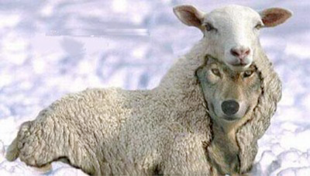
What Lies Beneath…

Slide 28
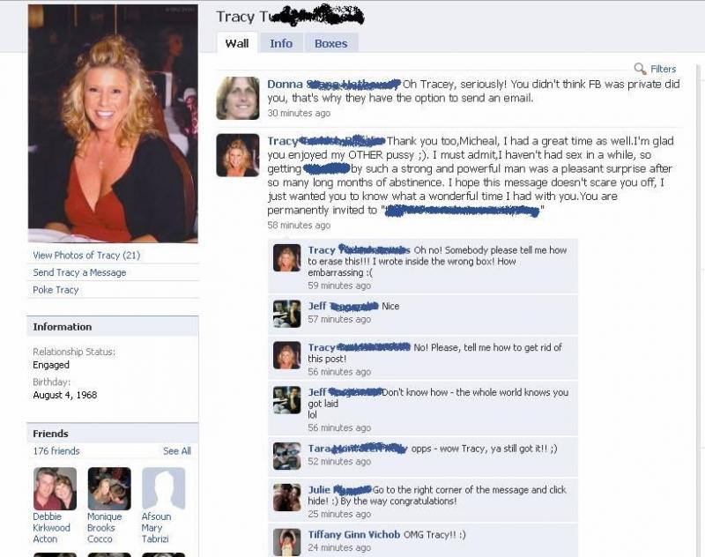
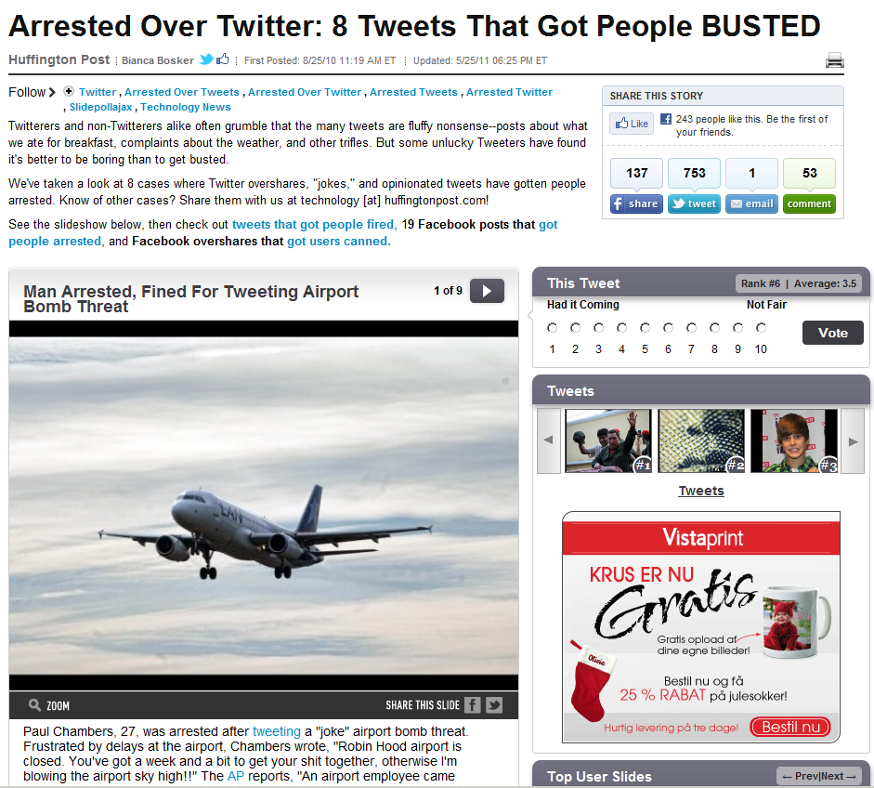
Your Social Network could be a liability

Slide 29
Technical Threats Lurking Inside Social Media What Lies Beneath…
Rise in Malicious Malware
Rise in Anti Social Media
The Rise of the Middle Man
Improved Social Media Attacks
Massive Growth in Cybercrime Predicted
Cyber bullying Trend looks set to get Worse…

Slide 30
Technical Threats Lurking inside Social Media
Malware – Net Autorun – USB Autorun – Social engineering LARGEST 65%
1900s Fake letters / seals long lost family
Scalability - Can now talk to all rather than 1 to 1
Reach – All of you!
Anonymous – Plausible deniability
Jurisdiction
Economics – Microsoft online help > help to clean up machine, Scammer
RSA Attack – 2011 recruitment plan
Attracted to free stuff! – USB Keys

Slide 31
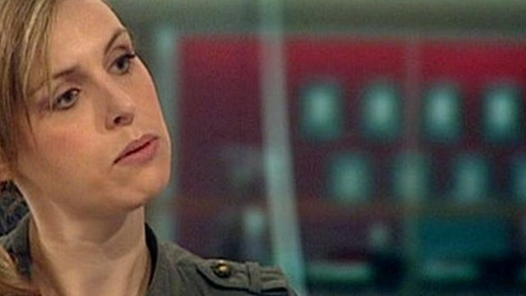
Threats Lurking Inside Social Media What Lies Beneath…
Poor Privacy / Compliance Management
Commercially Driven
Weak Identity Controls
Lack of Regulatory Ownership & Control
Plausible Deniability
Gross Misuse of Technology
Poor Child Protection
Inadequate Training for User

Slide 32
Video
The Dark Side of Social networking

Slide 33
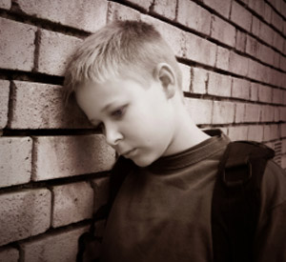
Cyber-bullying hurts
“Electronic or Cyber-bullying includes the use of email, cell phones, text messages, and internet sites to threaten, harass, embarrass, socially exclude, or damage reputations and friendships.”
http://prevnet.ca/Bullying/tabid/94/Default.aspx

Slide 34
Spotting the Problem!
How to Spot Problems:
Changes in eating or sleeping habits
Headaches or stomachaches
Poor concentration
Anxiety and depression
Refusal to go to school
Self-mutilation
Remember it’s Not Just Kids!!

Slide 35
Cyber Bullying From Bully to Troll
Huge Growth
Has Directly Caused Both Children & Adults to Commit Suicide
Affects Millions of Users
Trolls are Individuals who’s primary aim is to cause distress and anger
The Law Seems very Weak in Punishing this type of Criminal Behaviour

Slide 36
The Internet Troll The Lowest of the Low!
In Internet slang, a troll is someone who posts inflammatory, extraneous, or off-topic messages in an online community, such as an online discussion forum, chat room, or blog, with the primary intent of provoking readers into an emotional response] or of otherwise disrupting normal on-topic discussion
mass media has used troll to describe "a person who defaces Internet tribute sites with the aim of causing grief to families

Slide 37
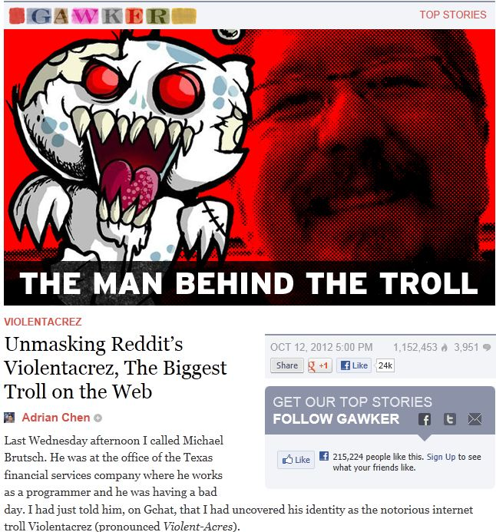
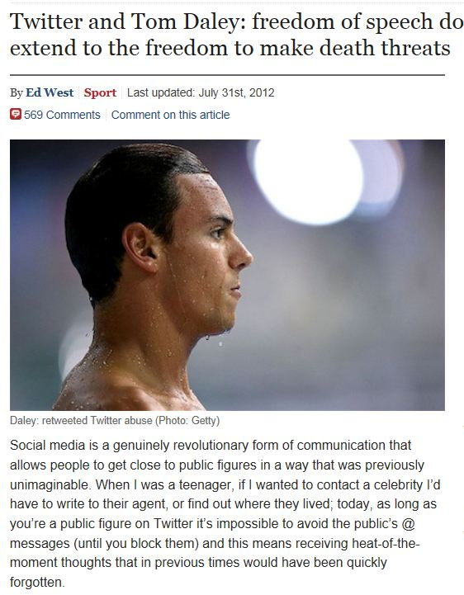

Slide 38
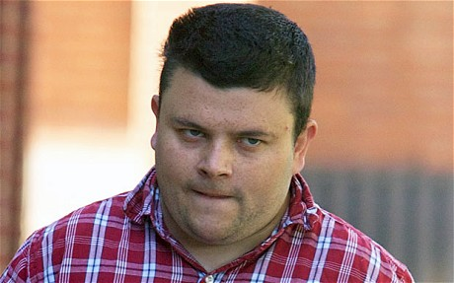
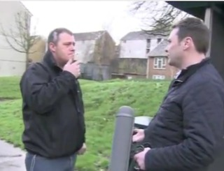
The Internet Troll: Types
Playtime Trolls: Their attacks or provocation is fairly blatant, and the persona is fairly two-dimensional.
Tactical Trolls: More serious, creates a credible persona to gain confidence of others, and provokes strife in a subtle and invidious way.
Strategic Trolls: Involves production of an overall strategy that can take months or years to develop. Can also involve a number of people acting together.
Domination Trolls: Strategy extends to the creation and running of apparently bona-fide mailing lists.
Psycho Trolls: Have an unconscious psychological need to feel good by making others feel bad. Such people may use their real names on the internet, and they may not even realise that they are "trolling".

Slide 39
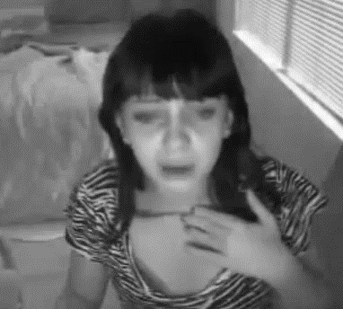
The Victim! Jessica Leonhardt (Screen Name Jessie Slaughter) Age 11

Slide 41
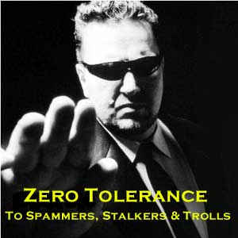
Time to Fight Back!
Before you trust - either emotional or financial Verify their nature from multiple known, reliable and independent sources.
Beware of off-list emails that praise and flatter, or seem to evoke sympathy. Ask first: how much do I know about them from real life sources?
If you do get involved with anyone via the internet, seek out verifiable data. Real people will provide information about themselves that is open-ended and leads to a myriad of sources which enable you to verify their genuine status.
if you are concerned by email list/group postings, write to the List master about it. List masters can also make their lists restricted, and conduct a security analysis of each list application before allowing them to subscribe. This is probably easier to do in areas that have professional associations or qualifications.

Slide 42
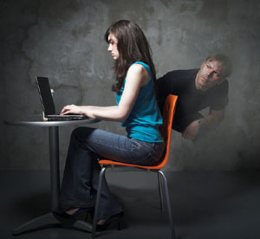
Good Advice!
The longer you communicate, the more likely that you would reveal information about yourself
The more data/pictures you put online, the more you endanger your privacy
The more friends you have, the easier you could be tracked, exploited
Bullying, abuse, exploitation, threats, intimidation, etc. are on the rise
“Facebook seems to be a place where people aren't being cautious enough” - DeDomenico-Payne (The dark side of social media)

Slide 43
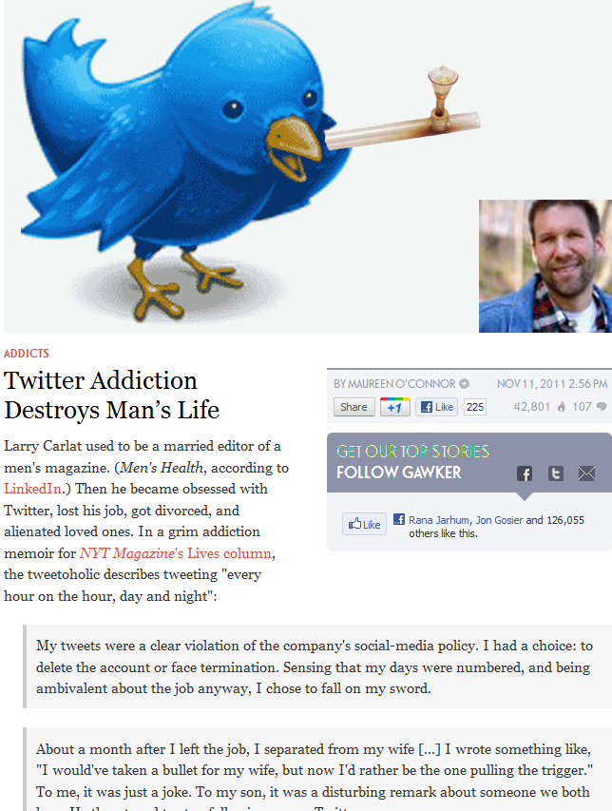
Social Network Addiction is No Joke!

Slide 44
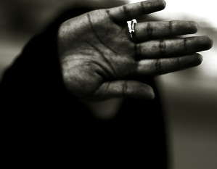
Social Networking The Privacy Dilemma
Social-networking sites allow seemingly trivial gossip to be distributed to a worldwide audience, sometimes making people the butt of rumours shared by millions of users across the Internet
Public sharing of private lives has led to a rethinking of our current conceptions of privacy
Existing law should be extended to allow some privacy protection for things that people say and do in what would have previously been considered the public domain

Slide 45
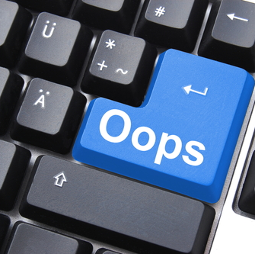
Be careful Once Online Always Online!

Slide 46
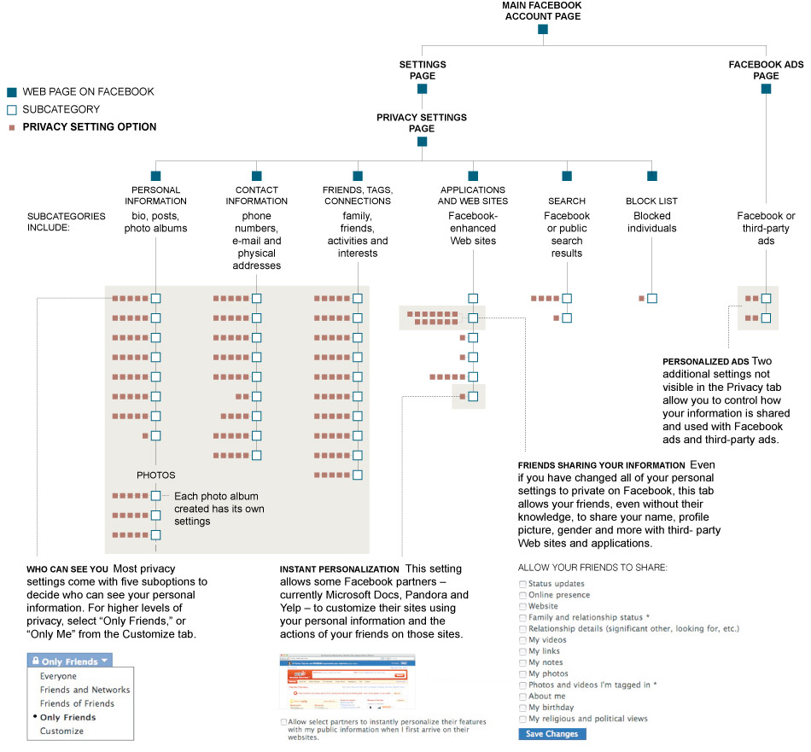
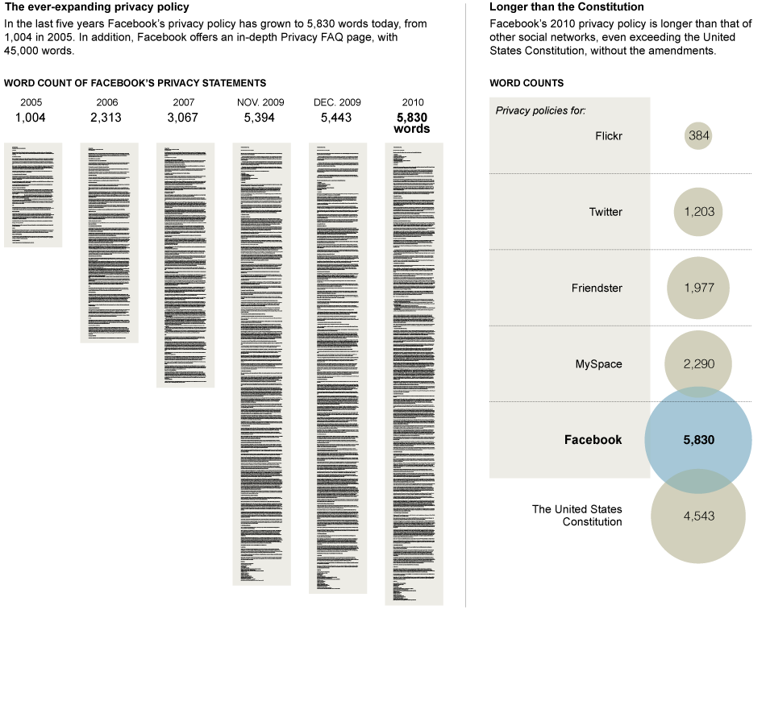
Facebook Privacy…Confusing!

Slide 47
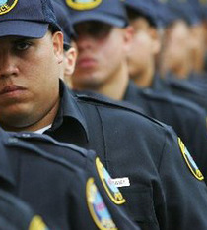
Social Networking & The Law!
Regulators have told Social Networking sites to take notice and to offer the same warnings they did more than a decade ago when e-mail and instant messaging (IM) became common.
However, controlling communications on social networking Web sites is far more complex for companies
Companies attempting to control communications on Web sites that are outside their IT systems and that are almost continuously changing or adding to the number of applications that can be used to network.
Unlike Email / IM Social Media uses Common Ports & Protocols which Make it Difficult to Lock Down
So it looks like the Big Guns are moving in!

Slide 48
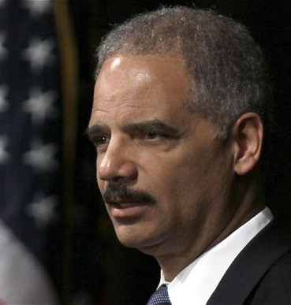
Social Networking Regulations & Compliance
ENISA (European Network and Information Security Agency), Andreas Pirotti, recently called for expanding EU legislation "to cover the taking of photos of people and posting them on the Internet,"
the U.S. hasn't considered social network regulation before, although here it often focuses on the safety of children. We have the controversial "Deleting Online Predators Act," (DOPA)
BUT…What are the Privacy Implications if SN’s are Regulated?

Slide 49
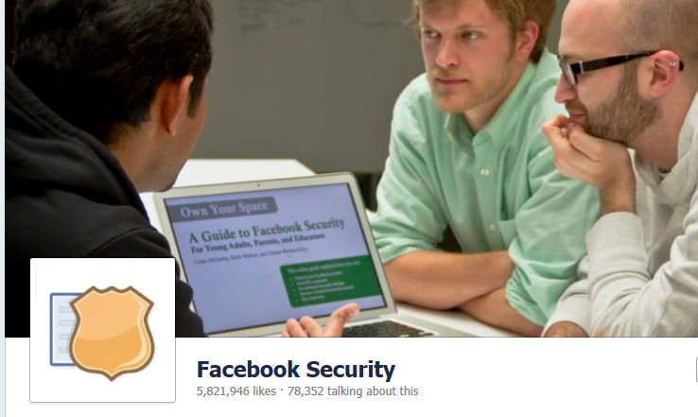
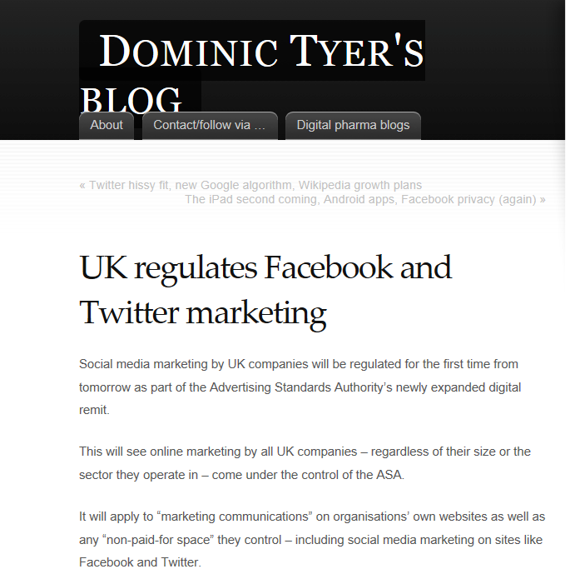
Social Networking Regulations & Compliance

Slide 50
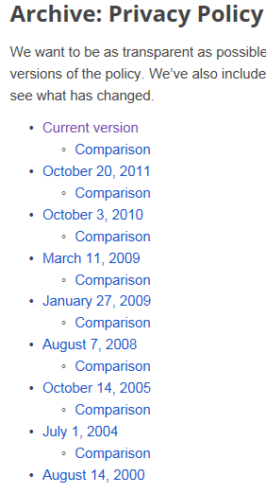
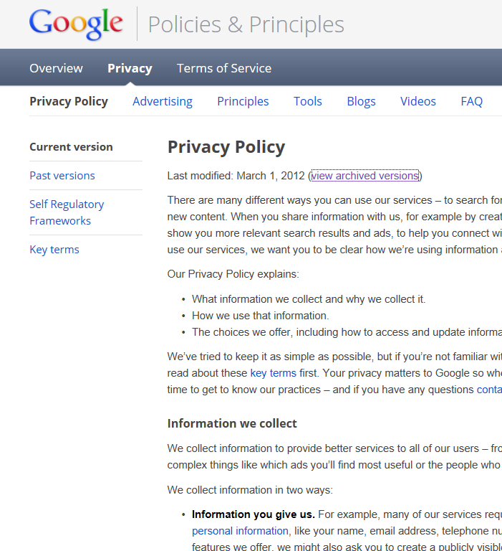
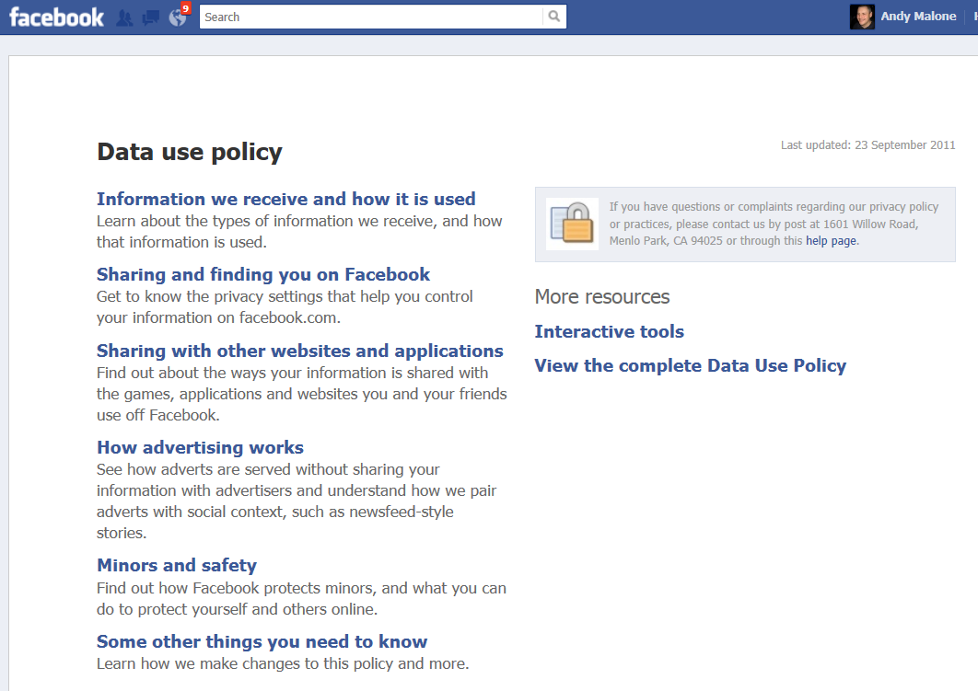
Social Networking Regulations & Compliance

Slide 51
Protecting your Privacy (Canadian Style)
Video

Slide 52
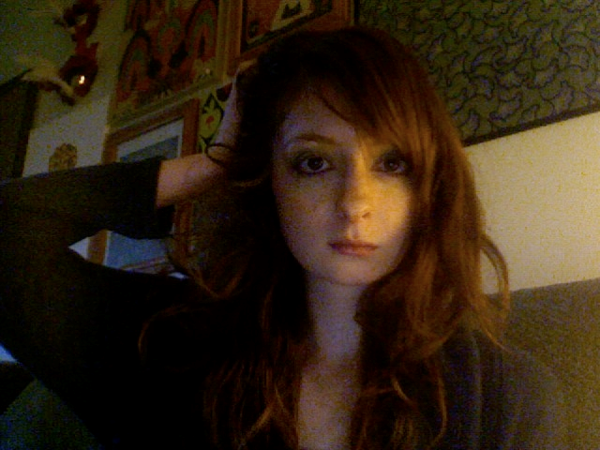
Final Thoughts: Social Networking The Seven Deadly Sins
Over-sharing company activities
Avoid Mixing personal with professional
Avoid in Engaging in Tweeting (or Facebook/LinkedIn/Myspace) rage
Believing he/she who dies with the most connections wins
Avoid Password sloth
Be careful with the Trigger finger (clicking everything, especially on Facebook)
Endangering yourself and others
Birthday’s Photo’s etc

Slide 53
What do you think?
Q&A

Slide 54
Review:
The Changing Face of Social Media
The Rise of the Social Technical Society
The Evolving Change
Threats Lurking inside Social Media
The Human Cost… When Social Networking Goes Wrong!
Security Challenges
Privacy - Compliance - Security
Review & Q&A
“All Logos & trademarks used with permission & remain the property of their respective owners.”

Slide 55
Related content
ATC-B306 - Cybercrime: The 2013 Ultimate Survival Guide
ATC-B312 – Security Panel Discussion
ATC-B202 – A Journey to the Dark Side of Social Networking!
ATC-B314 - The Inside Man: Surviving the Ultimate Cyber Threat
ATC-B201 - 1984: 21st Century Security Surveillance vs. the Erosion of Freedom!
ATC-B213 - The Cloud: Making the Move to a Hybrid World
SES-B307 - Office 365 Identity Solutions: Notes from the Field
Find Me Later At...Trustworthy Computing / Cloud Security Table at the Ask the Experts Session.

Slide 56
Trustworthy Computing Resources
Trustworthy Computing (TwC) is a long-term, collaborative effort to deliver more secure, private, and reliable computing experiences for everyone.
Learn more at:
http://microsoft.com/twc
Cloud Security Readiness Tool
Pass the Hash Guidance
Data, Insights and Guidance (Security Intelligence Report, volume 14)
and more…

Slide 57
Resources
Learning
Sessions on Demand
Microsoft Certification & Training Resources
http://channel9.msdn.com/Events/TechEd
www.microsoft.com/learning
TechNet
msdn
Resources for IT Professionals
Resources for Developers
http://microsoft.com/technet
http://microsoft.com/msdn

Slide 58
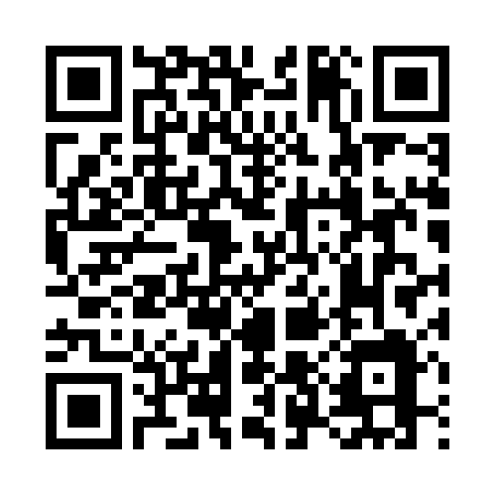
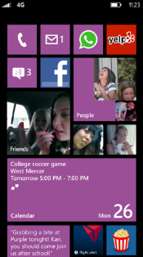
Evaluate this session
Required Slide
*delete this box when your slide is finalized
Your MS Tag will be inserted here during the final scrub.
Scan this QR code to
evaluate this session.

Slide 59
© 2013 Microsoft Corporation. All rights reserved. Microsoft, Windows and other product names are or may be registered trademarks and/or trademarks in the U.S. and/or other countries.
The information herein is for informational purposes only and represents the current view of Microsoft Corporation as of the date of this presentation. Because Microsoft must respond to changing market conditions, it should not be interpreted to be a commitment on the part of Microsoft, and Microsoft cannot guarantee the accuracy of any information provided after the date of this presentation. MICROSOFT MAKES NO WARRANTIES, EXPRESS, IMPLIED OR STATUTORY, AS TO THE INFORMATION IN THIS PRESENTATION.

