Slide 2
Adventures in Underland: What Passwords Do When No One Is Watching
ATC-B301
Paula Januszkiewicz
MVP: Enterprise Security, MCT
CQURE: CEO, Penetration Tester | paula@cqure.pl
IDesign: Security Architect | paula@idesign.net

Slide 3
Agenda
Passwords Idea
AppPasswordGet()
1
2
3
4
SystemPasswordGet()
Summary

Slide 4

The Longest
Password ’Ever’
During a recent password audit by a company, it was found that an employee was using the following password:
“MickeyMinniePlutoHueyLouieDeweyDonaldGoofySacramento”
When asked why she had such a long password, she rolled her eyes and said:
“Hello! It has to be at least 8 characters and include at least one capital.”

Slide 5
How often do you share your password with others?

Slide 6







90 percent of user-generated passwords at risk of being compromised in 2013
[2013] Deloitte Technology Report
75 percent of people use same password for social portal and email
[2010] BitDefender Study
…hackers may have stolen passwords of 250,000 users
… 6 million passwords stolen
…hacker group has apparently dumped 453,492 usernames and passwords obtained in plaintext
…personal data for more than 50 million users was stolen
Blah. Blah. blah.

Slide 7

Conclusions
  We share our passwords with others
  Because solution requires it
  Because we need to confirm that we are who we are
  We believe that others will use it wisely
  But we do not know how this data is stored
  Major conclusion: Intentions != Skills

Slide 8
Demo: Introduction
File to be a little bit zilla

Slide 9
Agenda
Passwords Idea
SystemPasswordGet()
1
2
3
4
AppPasswordGet()
Summary

Slide 10
Chasing the obvious: NTDS.DIT, SAM
  To perform an analysis on NTDS.DIT the following information sources are needed from the domain controller:
    NTDS.DIT
    Registry hives (at least the SYSTEM hive)
  SAM, ntds.dit are stored locally on the server’s drive
  They do not contain passwords
The above means:
To read the clear text password you need to struggle!

Slide 11
CPAU: Information
  Created by and found on:
  http://www.joeware.net/freetools/
  Used by administrators by years
  Unofficially this is a runas replacement
  Allows to create job files, that encodes:
  ID, password and command line in a file so it can be used by normal users

Slide 12
CPAU: Getting the Password
  Wait for the application to react
  Whatever the cryptography is used, let’s allow application to use the password
  Wait for password to go out
  Send through the network, stored in logfiles, etc.
  Loaded in the memory
  Wait for password to be internally used
  In between operating system mechanisms that can be listened to
New Security Motto: Know how your app works!

Slide 13

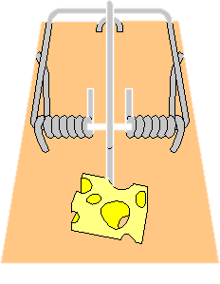
CPAU: Waiting for the reaction
[PUSH to Stack]
lpProcessInfo | lpStartupInfo… | lpPassword | lpDomain | lpUsername
1
Return
OS [POP Parameters]
5
Buahahaha!
6
Application
2
4
[Call API Function]
CreateProcessWithLogonW
OS [Start API Function]
3
Trap = DBG

Slide 14
Demo: CPAU
… get the password now!

Slide 15
Agenda
Passwords Idea
SystemPasswordGet()
1
2
3
4
AppPasswordGet()
Summary

Slide 16
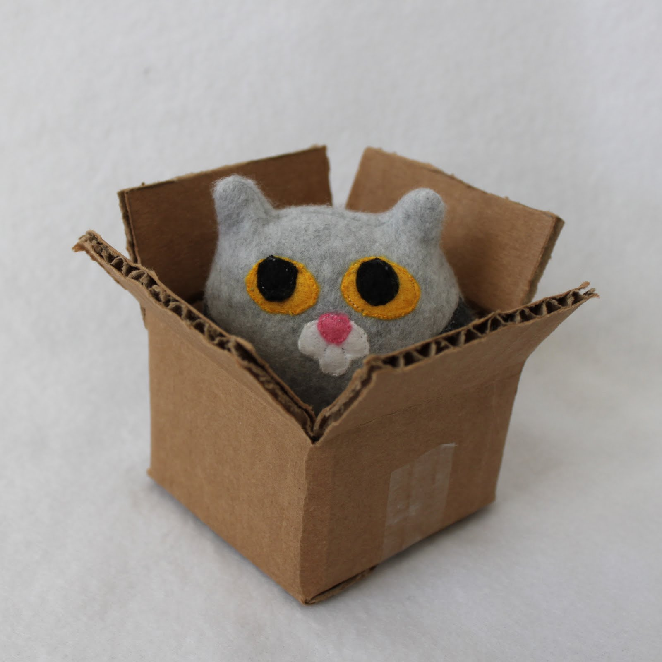
Data Protection API
Based on the following components:
  Password, data blob, entrophy
Is not prone to password resets!
  Protects from outsiders when being in offline access
  Effectively protects users data
Stores the password history
  You need to be able to get access to some of your passwords from the past
Conclusion: OS greatly helps us to protect passwords

Slide 17
Demo: DPAPI
Positive scenario first!

Slide 18
Demo: DPAPI
Negative scenario last!

Slide 19
Application Pools
Used to group one or more Web Applications
  Purpose: Assign resources, serve as a security sandbox
Use Worker Processes (w3wp.exe)
  Their identity is definded in Application Pool settings
  Processes HTTP and non-HTTP resources
Passwords for AppPool identity can be ’decrypted’
  They are stored in the encrypted form in applicationHost.config
Conclusion: Another place where passwords are stored

Slide 20
Demo: Application Pools
Getting password from IIS configuration

Slide 21
Demo: Application Pools
Encrypt the configuration file

Slide 22
Services
Store configuration in the registry
  Always need some identity to run the executable!
Local Security Authority (LSA) Secrets
  Must be stored locally, especially when domain credentials are used
  Can be accessed when we impersonate to Local System
Their accounts should be monitored
  If you cannot use gMSA, MSA, use subscription for svc_ accounts (naming convention)
Conclusion: Never run service on Administrative account,
use gMSA

Slide 23
Demo: Services
Getting password from LSA Secrets

Slide 24
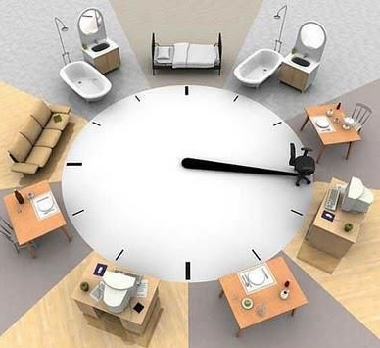
Scheduled Tasks
Run on a specific account
  As in case of services – password can be revealed
Passwords
  Saved in user’s Credential Manager
  User’s password can be used to get access to the task’s password
History
  After changing the password – it still runs
Conclusion: Use less privileged accounts

Slide 25
Demo: Scheduled Tasks
Getting password from LSA Secrets

Slide 26
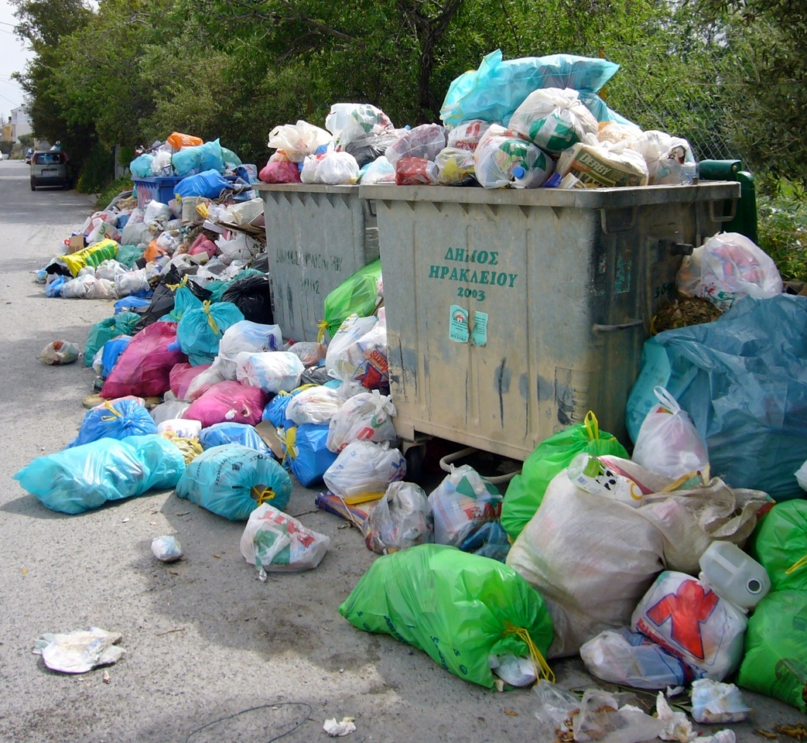
Memory Dumps: For ’troubleshooting’
Whatever runs – it is in the memory
  Whatever sensitive was used – it is in the memory
Done automatically
  Used for detect suspicious behaviour of processes
  Saved in %windir%
Sharing is caring
  Published carelessly on the public forums
Conlusion: Never share your memory dump!

Slide 27
Demo: Memory dumps
Sharing is caring!

Slide 28
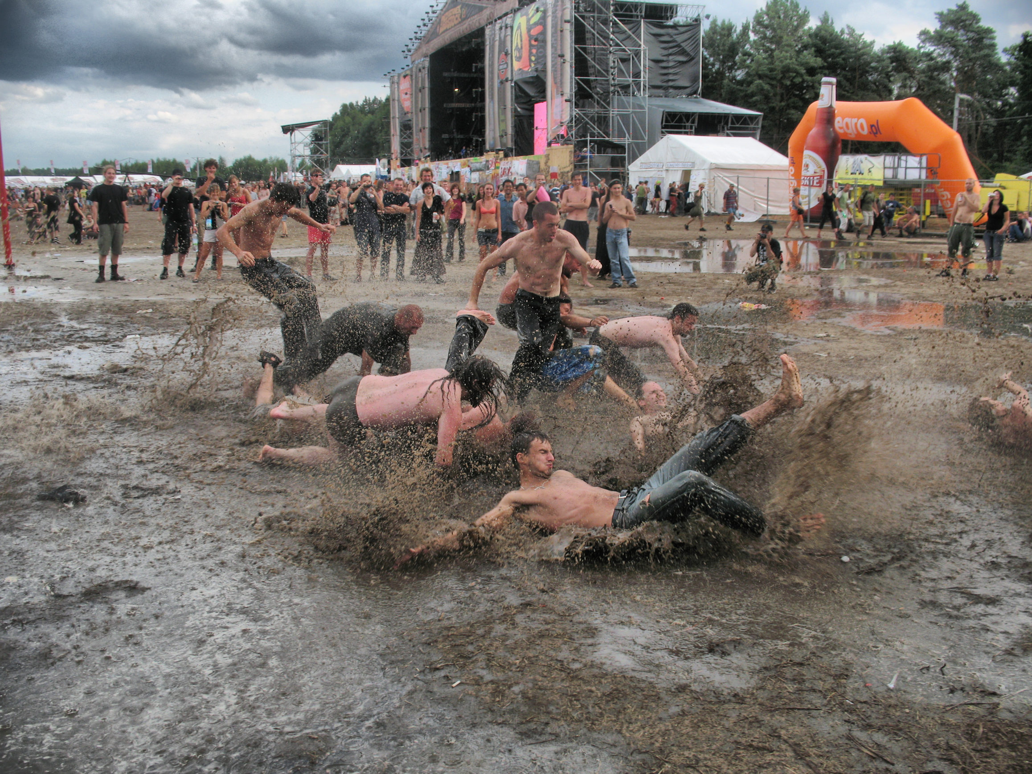
Dirty Games: Remotely
Windows Debugging
  Through the network since Windows 8
Sensitive information revealed
  You allow somebody to dig into the kernel of your OS
  Each chunk of your data is exposed
Command to enable debugging
  Bcdedit /debug ON – invisible!
Conclusion: Debugging = Full Control

Slide 29
Demo: Debugging over Network
Well, well, well…

Slide 30
Agenda
Passwords Idea
SystemPasswordGet()
1
2
3
4
AppPasswordGet()
Summary

Slide 31

Summary: Man-In-The-Middle
  Know how your application works
  Pay attention to installation wizard
  Eliminate services running on the high privileged accounts
  Use password history policy
  Audit your environment
Source: Heard.TypePad.com

Slide 32

Trustworthy Computing Resources
Trustworthy Computing (TwC) is a long-term, collaborative effort to deliver more secure, private,
and reliable computing experiences for everyone.
Learn more at:
http://microsoft.com/twc
Cloud Security Readiness Tool
Pass the Hash Guidance
Data, Insights and Guidance (Security Intelligence Report, volume 14)
and more…

Slide 33

Resources
Learning
  Sessions on Demand
  Microsoft Certification & Training Resources
http://channel9.msdn.com/Events/TechEd
www.microsoft.com/learning
TechNet
msdn
  Resources for IT Professionals
  Resources for Developers
http://microsoft.com/technet
http://microsoft.com/msdn

Slide 34
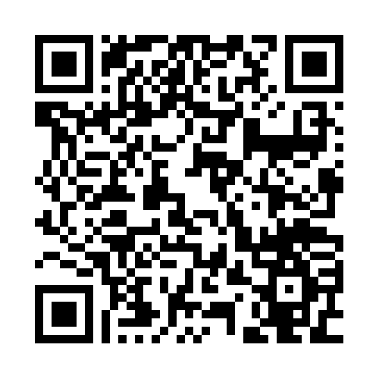


Evaluate this session
Required Slide
*delete this box when your slide is finalized
Your MS Tag will be inserted here during the final scrub.
Scan this QR code to
evaluate this session.

Slide 35

© 2013 Microsoft Corporation. All rights reserved. Microsoft, Windows and other product names are or may be registered trademarks and/or trademarks in the U.S. and/or other countries.
The information herein is for informational purposes only and represents the current view of Microsoft Corporation as of the date of this presentation. Because Microsoft must respond to changing market conditions, it should not be interpreted to be a commitment on the part of Microsoft, and Microsoft cannot guarantee the accuracy of any information provided after the date of this presentation. MICROSOFT MAKES NO WARRANTIES, EXPRESS, IMPLIED OR STATUTORY, AS TO THE INFORMATION IN THIS PRESENTATION.

