Slide 2
Cybercrime Practical Overview
ATC-B305
Thanassis Diogos
Senior Premier Field Engineer
CISSP

Slide 3
Goals
Everybody talks about it but …
Techniques & tools used by malware operators
Security updates management
Keeping up-to-date is hard but …
KYE
Know Your Enemy?

Slide 4
Cybercriminals goals!

Slide 5
Know Your Enemy, through honeypots!
Exposed computer systems
Monitor OS & Network
Analysis provides valuable output

Slide 6
Demo
FTP Server under attack
Administrator
P@ssw0rd

Slide 7
Demo
…could allow remote code execution….
MS08-67

Slide 8
Botnet types and operations
IRC Based
Bots (infected computers) connect to an IRC channel specially modified for botnet operation
Large footprint
Http Based
Communication between bot and C&C uses http protocol
Difficult to identify and more sophisticated
Small footprint
Other
Aurora was using UDP protocol for the whole communication
Mariposa was also using UDP protocol for communications

Slide 9
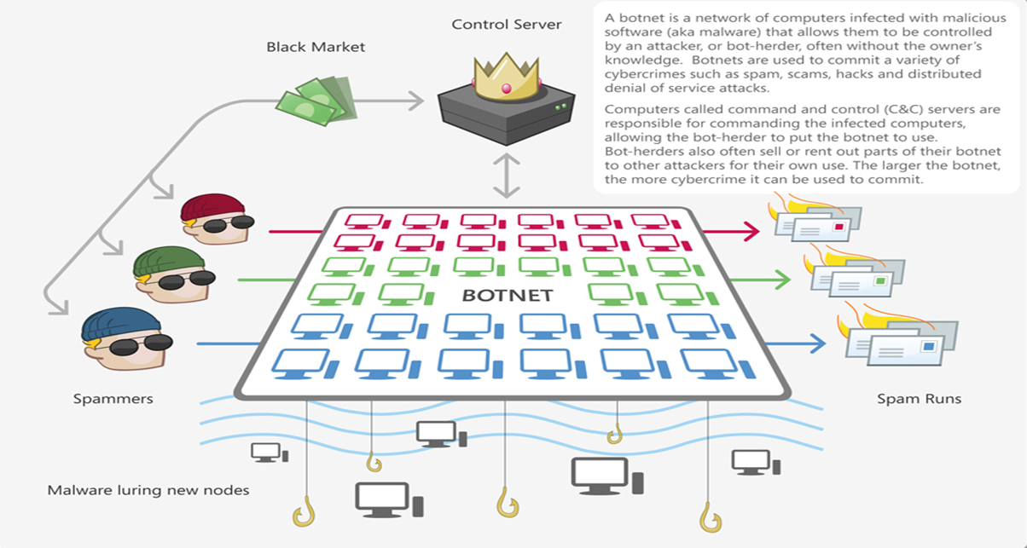
Waledac

Slide 10
Demo
IRC Botnet
Waiting orders ☺

Slide 11
Demo
You got mail !
Emmm, spam?

Slide 12
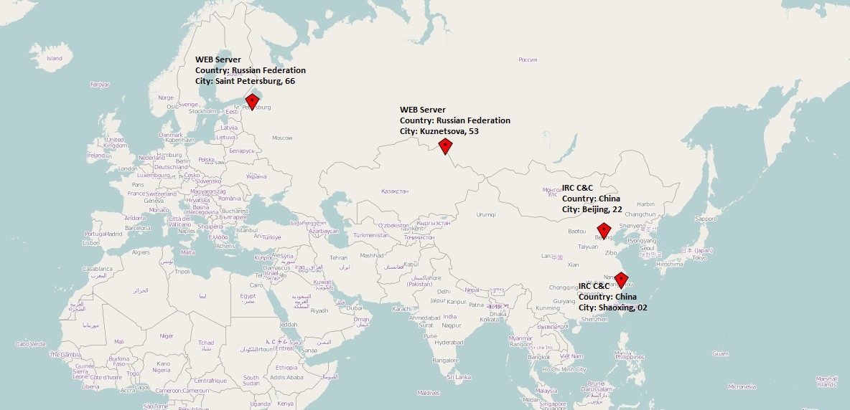
Further analysis

Slide 13
Exploitation as a Service (EaaS)
Automated ways of exploitation and payload transfer
Victim connects “somehow” to the kit
Victim gets scanned for a number of vulnerabilities
Successful exploitation equals malware infection
Exploit Kits

Slide 14
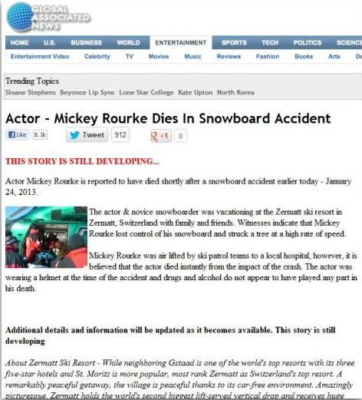
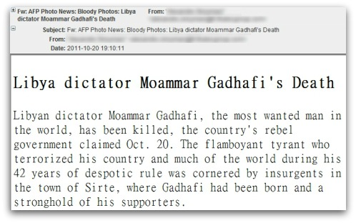
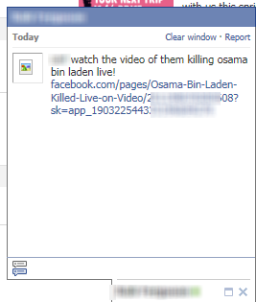
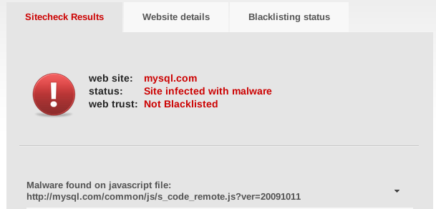
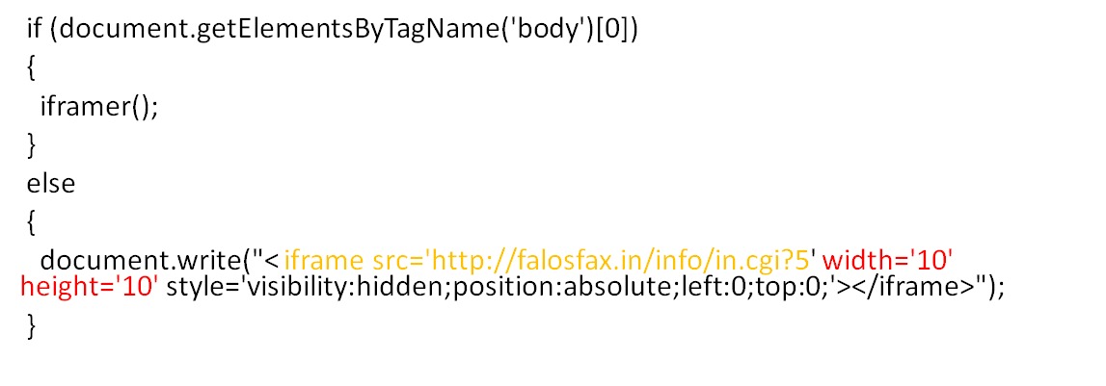
New ways of attracting victims
Amy Winehouse
Moammar Gadhafi
Osama Bin Landen
Mickey Rourke
Mysql.com

Slide 15
Demo
Exploit Kits
New business models

Slide 16
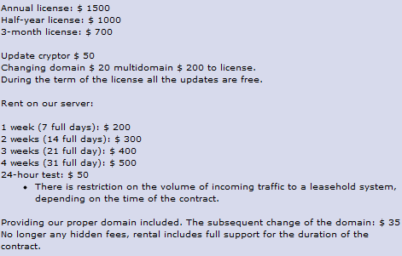
Exploit kits, $$$
Exploit kit creator provides “updates”
The number of vulnerabilities define the price
Almost 50 different kits exist for you to choose

Slide 17
Sophisticated Botnets (http)
Zeus
Spyeye
Zemra
Carberp
Citadel
Etc….

Slide 18
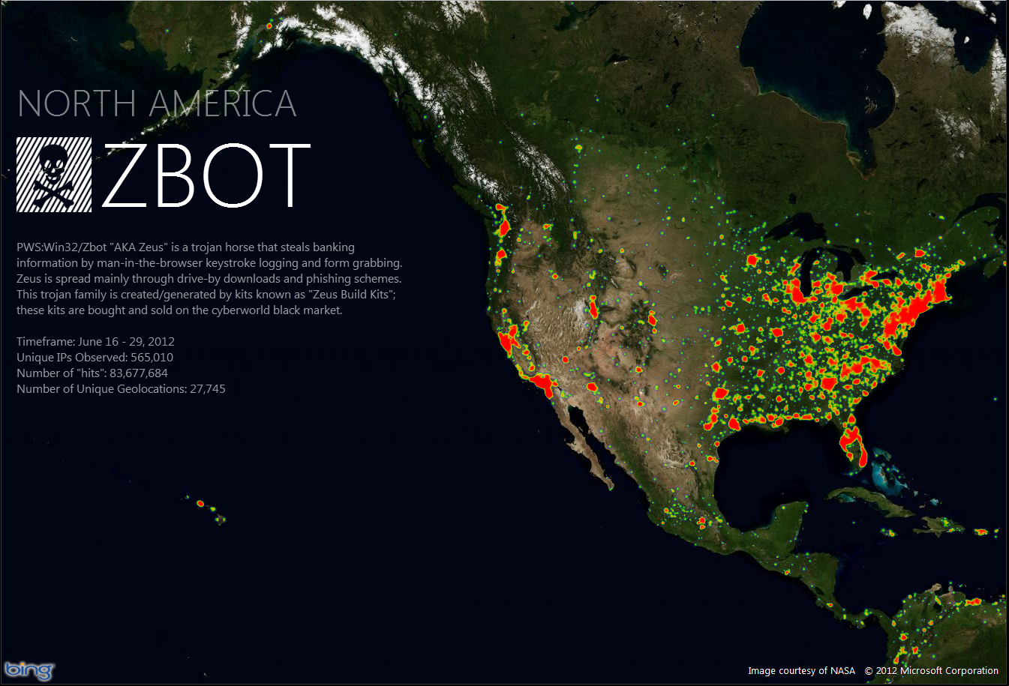
Damage caused by Zeus??
2 Jul 2012: Microsoft Names Defendants in Zeus Botnets Case; Provides New Evidence to FBI
Source: http://blogs.technet.com/b/microsoft_blog/archive/2012/07/02/microsoft-names-defendants-in-zeus-botnets-case-provides-new-evidence-to-fbi.aspx

Slide 19
Extra info
Zeus
https://zeustracker.abuse.ch/
Spyeye
https://spyeyetracker.abuse.ch/

Slide 20
Demo
I love pdf files
and sophisticated botnets ☺

Slide 21
Long way we ‘ve come…
Passwords, weak authentication
Software staying secure, not only MS!
People staying alert, exploit kits, training
Know Your Enemy?
Know Your Environment

Slide 22
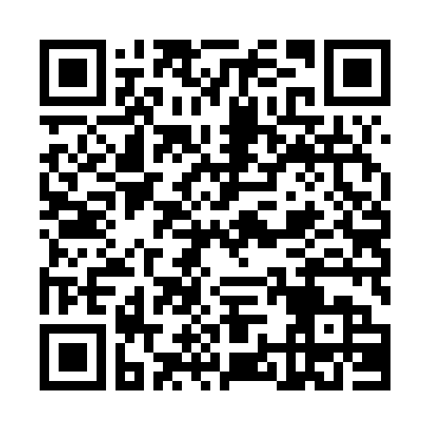
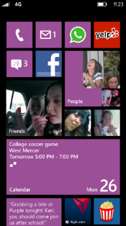
Evaluate this session
Required Slide
*delete this box when your slide is finalized
Your MS Tag will be inserted here during the final scrub.
Scan this QR code to
evaluate this session.

Slide 23
© 2013 Microsoft Corporation. All rights reserved. Microsoft, Windows and other product names are or may be registered trademarks and/or trademarks in the U.S. and/or other countries.
The information herein is for informational purposes only and represents the current view of Microsoft Corporation as of the date of this presentation. Because Microsoft must respond to changing market conditions, it should not be interpreted to be a commitment on the part of Microsoft, and Microsoft cannot guarantee the accuracy of any information provided after the date of this presentation. MICROSOFT MAKES NO WARRANTIES, EXPRESS, IMPLIED OR STATUTORY, AS TO THE INFORMATION IN THIS PRESENTATION.

