Slide 2
The Extras…
Follow @AndyMalone & Get my SkyDrive Link

Slide 3
Cybercrime: The 2013 Ultimate Survival Guide
ATC-B306
Andy Malone MVP, MCT
Quality Training (UK) Senior Instructor / Consultant
Andrew.malone@quality-training.co.uk
www.divedeeperevents.com

Slide 4
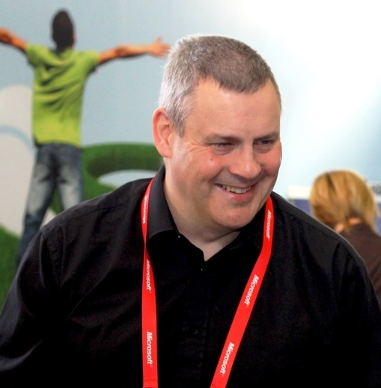
Andy Malone
Follow me on Twitter @AndyMalone
Microsoft MVP (Enterprise Security)
Founder: Cybercrime Security Forum!
Microsoft International Event Speaker
MCT (18 Years)
Winner: Microsoft Speaker Idol 2006

Slide 5
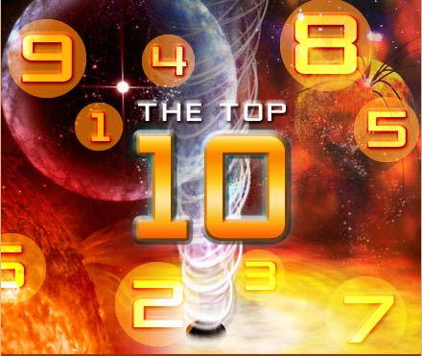
The Cybercrime
Top 10

Slide 6
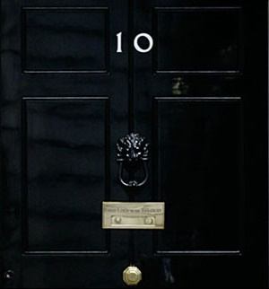

Slide 7
A Zombie Will Rise!”

Slide 8
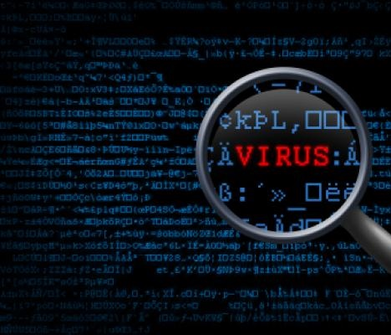
A Weapon of Mass Destruction!
Botnets are used for everything from delivering spam and phishing attacks, to distributed denial-of-service attacks
Most botnets sell "space" or "services" on the botnet to bidders who may then deliver additional malware or use it for additional malicious purposes
These botnets-for-hire make it difficult to define what any specific botnet is intended to do, as that intent may change depending on the bidder

Slide 9
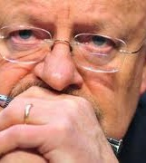
An Ideal Attack Platform
Fully Automated Delivery
Spam forwarding (75% of all spam?)
Click fraud (Drive by Attack)
Key logging
Distributed denial of service attacks (DDos)
Growing & Serious problem
For Governments, banks, online merchants
Vint Cerf: ¼ of hosts connected to Internet

Slide 10
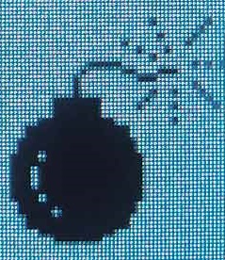
Choose your Weapon!
Asprox Botnet
Gumblar Botnet
Koobface Botnet
Mariposa Botnet
Storm Botnet
Waledec Botnet
Zeus Botnet
Plus Many More…

Slide 11
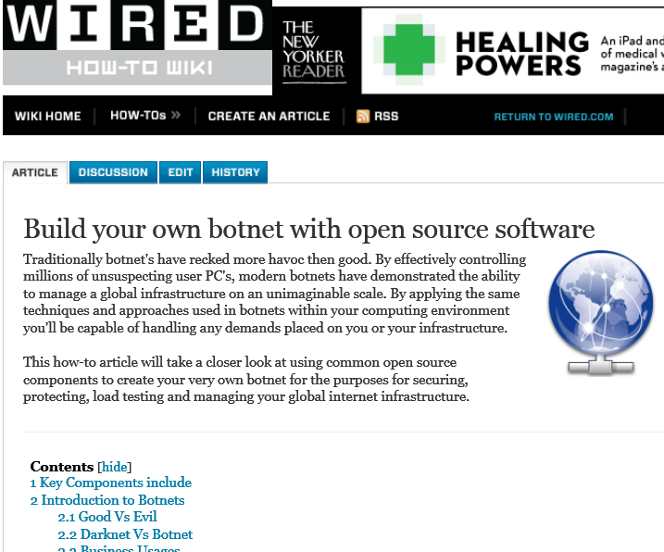
DIY Kits…

Slide 12
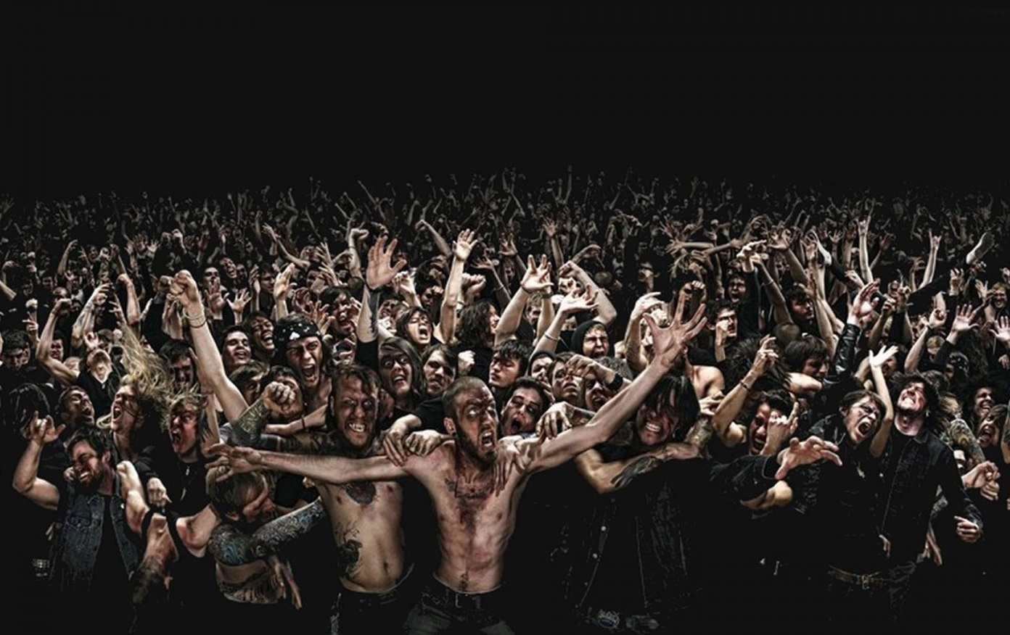
Contain the Infection!

Slide 13
Mitigation
Requirements for protection
End User Education
Host-based anti-virus & Anti Spyware
Many Cloud based Services Exist to help Reduce Risks
Ensure Firewall is Enabled
Implement a Network Intrusion Detection / Prevention
Prevention signatures sets
Beware!
Evidence now shows that more bots are capable of launching multiple exploits
Are becoming Harder to Detect
Larger botnets attacks

Slide 15
Distributed Denial of Service Attack DDOS

Slide 16
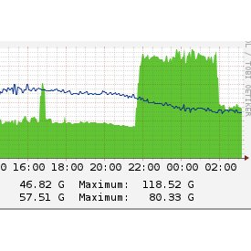
What is a DDOS?
A Denial of Service attack simply overloads the victim's servers by flooding them with data, more data than the servers can handle.
This can disrupt the victim's business, or knock its website offline

Slide 17
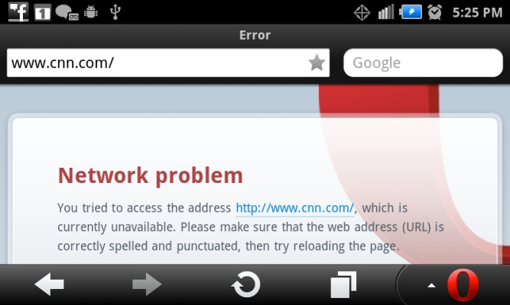

Slide 18
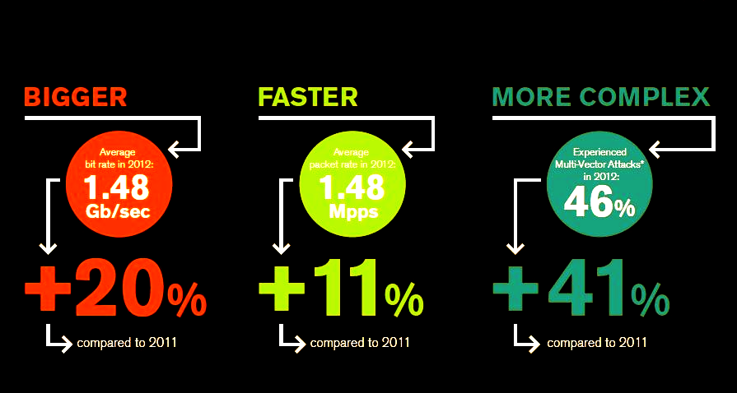
What is a DDOS?
A Denial of Service attack simply overloads the victim's servers by flooding them with data, more data than the servers can handle. This can disrupt the victim's business, or knock its website offline

Slide 19
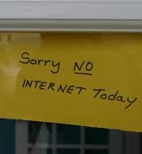
DDOS: Recent Victims
Spamhaus
BitCoin
WordPress
CNN
The White House
Ascent Builders
Bank of the West
…

Slide 20
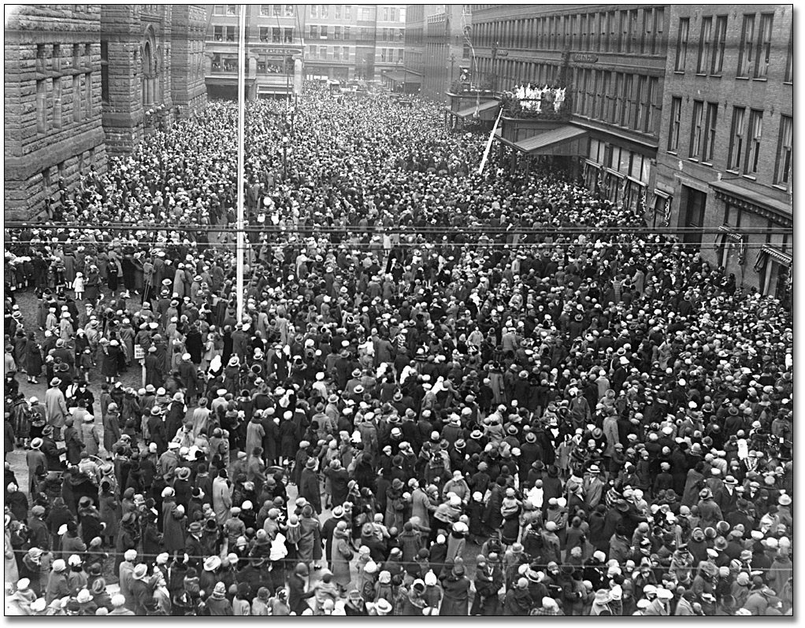
Types of Attack!
Volumetric attacks
Overwhelm WAN circuits with tens of gigabits per second of meaningless traffic
So-called ICMP or UDP floods

Slide 21
Types of Attack!
Layer 3 attacks abuse TCP. For example, SYN floods overload network equipment by starting but never completing thousands of TCP sessions using forged sender addresses
SYN floods can be in excess of 1 million packets per second
Layer 7 floods use HTTP GET or POST requests to overload application and Web servers. From the attacker's perspective, L7 exploits aren't anonymous. The attacking client's identity (IP address) is exposed because a TCP handshake must be completed.

Slide 22
Demo
DDos Software

Slide 23
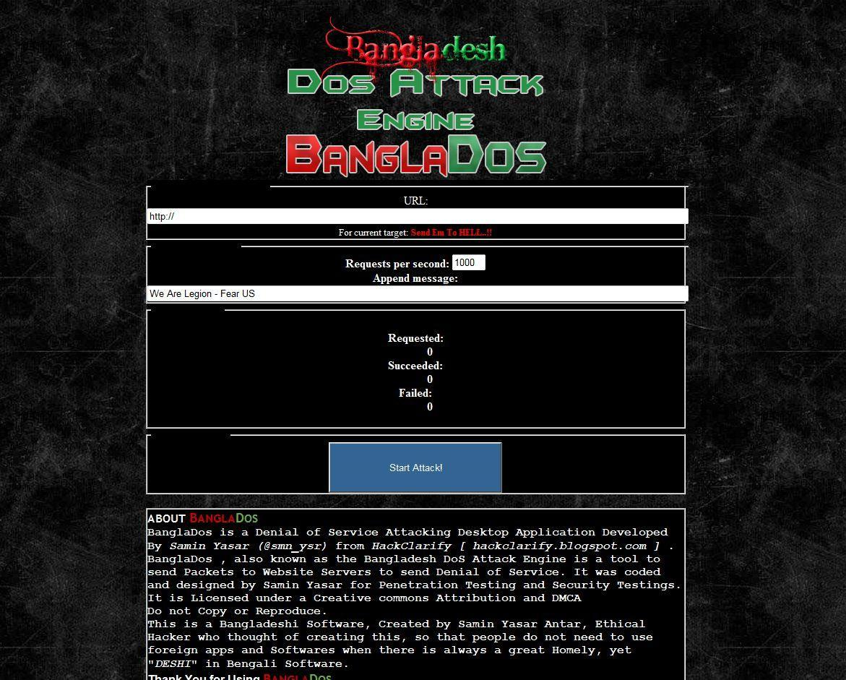

Slide 25
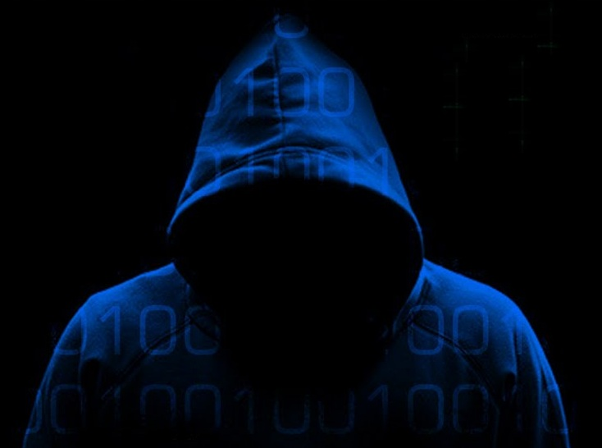
Mitigation
Unfortunately there is No single answer
Awareness! In a Recent Survey 85% Recipients did not know what a DDOS Attack was!
Create a DDOS Response Plan
Implement On Premises Defence Measures, IDS, IPS and establish legitimate usage profiles in order to identify suspicious traffic and respond accordingly
Implement DNS Sec on your DNS Servers
Disable recursion on authoritative name servers
Limit recursion to authorized clients, and
Rate limit responses of recursive name servers

Slide 26
Mitigation
Utilise your web host’s anti-DDoS settings.
Redundancy of web services allow a backup for your clients in case of attack.
Ensure you have sufficient bandwidth and CPU overhead, and investigate other methods of handling extreme traffic.
Keep your DNS records’ TTL settings low so changes are detected quickly.
Internal and external monitoring for quick alerting of attacks.
Have a plan in case of attack.

Slide 27
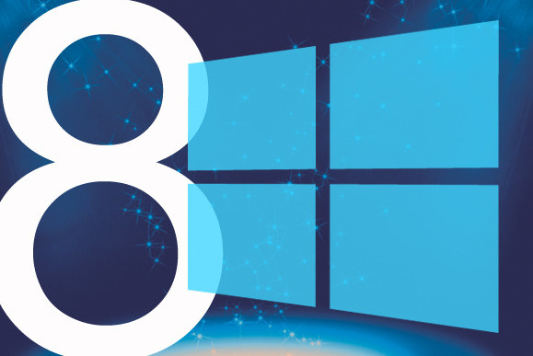

Slide 28
“So Just how safe is my stuff in the Cloud?”

Slide 29
Cloud Computing: The 7 Deadly Sins
Ignorance – Implementing cloud services without the knowledge or approval of senior management or the IT department, and without a full understanding of the potential security risks
Ambiguity – Agreeing to contracts with external cloud service providers without proper authorization or review, and without addressing the security risks or requirements
Doubt – Obtaining little or no assurance regarding cloud providers’ security arrangements and how they will protect a company’s information, leading to difficulty in auditing such arrangements
Trespass – Putting data in the cloud is potentially illegal, and by storing data in unknown locations, organizations may be in breach of privacy and data controls

Slide 30
Cloud Computing: The 7 Deadly Sins
Disorder – information placed in the cloud is not classified correctly, stored appropriately or destroyed completely. For highly regulated industries, like finance and pharmaceuticals, this lack of formalized access control procedures could be very damaging
Conceit – a misguided belief that enterprise infrastructure is ready for the cloud when it is not. There is no corporate security architecture defined for cloud services and no standard approach to identity and access management. The security of organizations’ encryption solutions could also be compromised, as keys are also stored in cloud providers’ systems
Complacency – most purchasers of cloud services assume they will have full availability, but experience shows that a variety of incidents can, and often do, cause cloud outages.

Slide 31
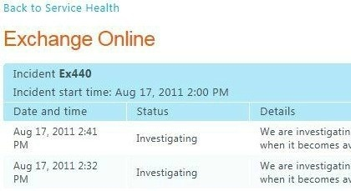
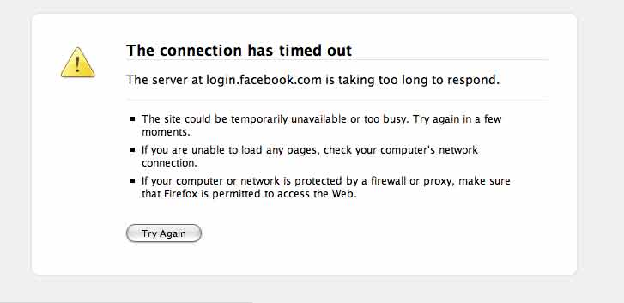
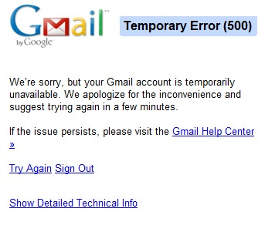
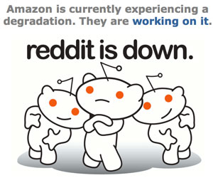

Slide 32
Cloud Computing: Mitigations
As a business, do not rely on FREE Services
Try Before you Buy!
Ensure you Back up your Data
Scrutinize the vendors SLA
What Compliance features does the Vendor guarantee?
Consider using 3rd Party Encryption Tools.
Check the Vendor does not “Share” you Information etc
Be Aware of your Responsibilities

Slide 33
Eg: How Office 365 Secures Data
Email content is encrypted on disk using BitLocker 256-bit AES Encryption.
Protection covers disks on mailbox servers, including databases, transaction logs, search content index files, transport database files, transaction loga and page file OS system disk tracing / message tracking logs
Office 365 also transports and stores Secure/Multipurpose Internet Mail Extensions (S/MIME) messages. Office 365 will transport and store messages that are encrypted using client-side, third-party encryption solutions such as PGP.
Office 365 does not host the public keys, nor does it provide key repository, key management, or key directory services.
For SharePoint – data is not encrypted at rest. The customer can use RMS and client side encryption can do this. However, if SharePoint-land is not setup as a trusted endpoint it does impact some areas of functionality (web apps, search indexing etc)

Slide 34
Demo
Ensuring Security & Compliance in the Cloud with Office 365

Slide 35
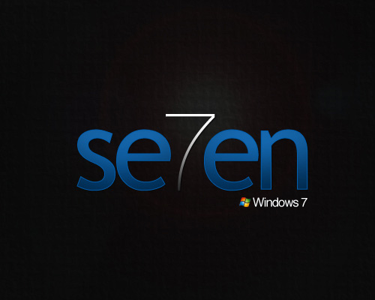

Slide 36
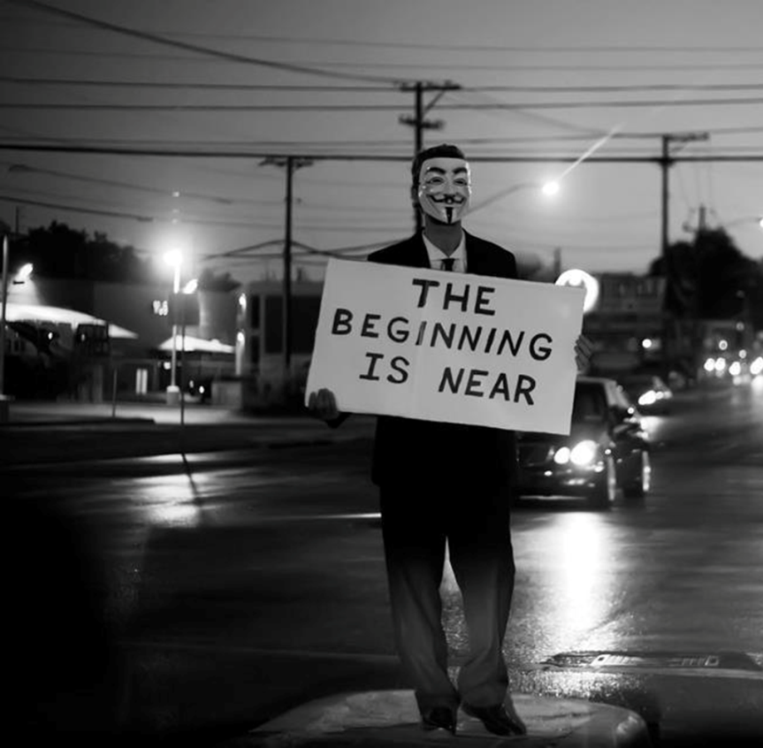
The Rise of the Hactivist

Slide 37
Hactivists
Hactivists are motivated by religious or political beliefs.
They are unpredictable and will inflict harm without regard for profit.
Anonymous is the most famous activist hactivist group.
They are known for supporting WikiLeaks by launching DDOS attacks against Amazon, PayPal, MasterCard and Visa.
Most recently, they attacked the North Korean Government
LulzSec is an up and coming group who made headlines this year by hacking into PBS, Sony and InfraGard.

Slide 38
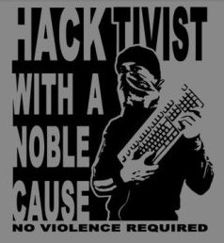
Anonymous: Principles?
To Work Together as One Body
Present a Unified Voice
Defend Truth & Justice
Honesty & Openness
Freedom from Oppression
Intellectual Freedom
Religious Freedom

Slide 39
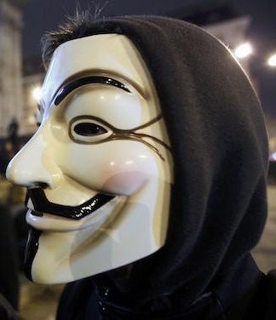
The Dangers of Being “Anonymous”
With no leader or structure, the group is fragmented and lacks cohesion
Easily Infiltrated by Government Agencies
Plausible Deniability “Anyone can be Anonymous”
Now heavily Monitored via US & European Cyber control Centres
Easily infiltrated by terrorist organisations
Known members monitored and brought to justice

Slide 40
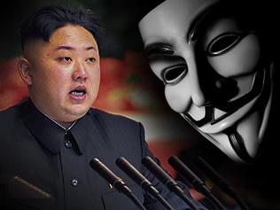
Plausible Deniability!!

Slide 41
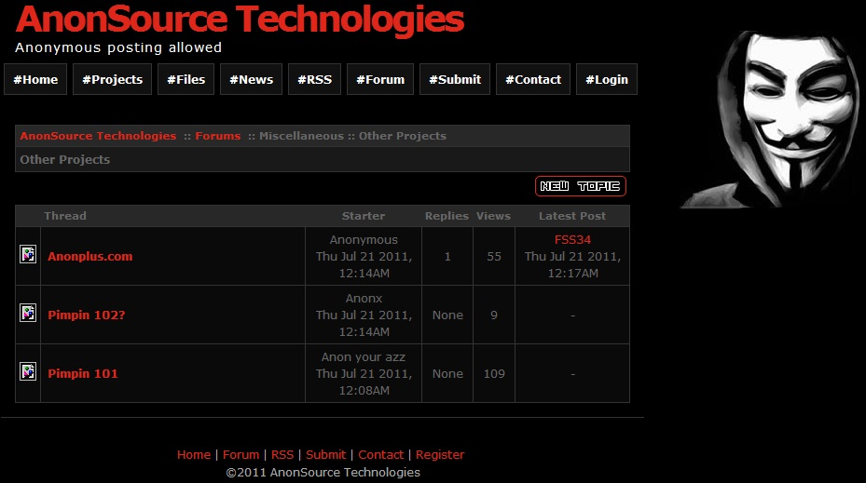

Slide 42
Activist Vs. Fanatic What is the Tipping Point?…

Slide 45
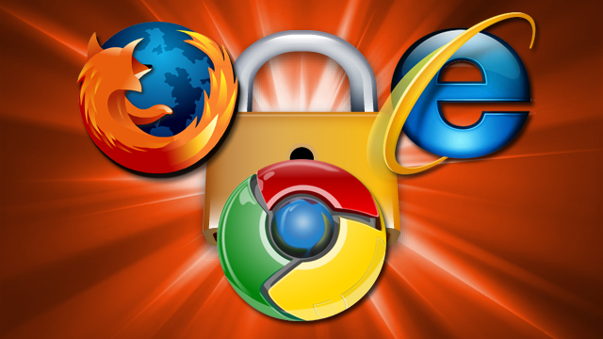

Slide 46
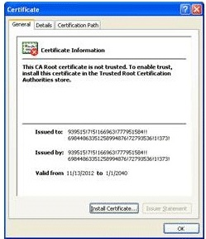
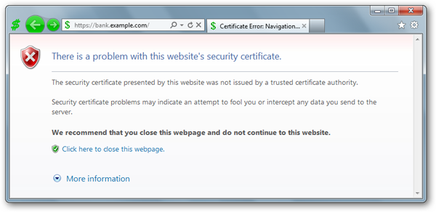
Beware False Prophets!

Slide 47
The Internet & the Trust Dilemma
Individuals & Organisations rely more and more on the Internet as a mechanism for delivering products and services
Moving to the Internet expands the threat landscape from local threats, to regional or even global
Must be diligent to protect both ourselves and customers from unwanted attacks

Slide 48
Mitigation
Secure website – All sign-in pages and forms should be secure (encrypted via SSL); however, it is best to totally secure the website
Train staff & Customers to look for the normal indications of a secure website (Padlock) or https://
Testing – Conduct regular external security Audits to see how visible and vulnerable you are from the outside
Ensure staff know how to spot malicious webpages & emails

Slide 49
Mitigation
Firewall, Intrusion Detection System (IDS), patch management, antivirus software, etc.
Multifactor authentication can be used to authenticate or verify the identity of a person
The can Include: something you know (i.e. password), something you have (i.e. debit card), and something you are (i.e. finger print).

Slide 50
Demo
Discovering Web Site Weakness

Slide 52
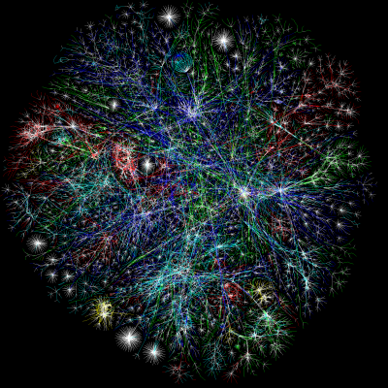
Organised Crime
&
State Sponsored Crime

Slide 53
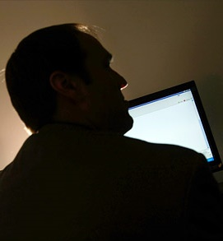
Basic Cybercrime Organizations
Fluid and often change members frequently
Will form and disband on a “per project” basis
Rife with amateurs, take a lot of risk considering the small payoffs
Although the most troublesome, they are considered the bottom feeders
Think criminal script kiddies
This is usually who the Feds get, not the big guys

Slide 54
Advanced Cybercrime Gangs
Well organised gangs have developed Cyber-divisions
Financially Motivated!!!
Often seen as a “Safer” option than drugs or prostitution
Often used to Compliment other illicit activities
Recruit hackers through chat rooms, boards, security conferences etc
Common attack methods include Drive by attacks, Malware, Fake websites, Spam, Malicious mobile software.
Getting in is often easy, Getting out…Not so Much!

Slide 55
“State-sponsored cybercrime is now taking place on an industrial scale“
Sir Johnathan Evans – MI5

Slide 56
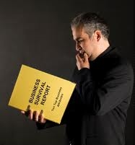
Mitigation
Many attacks are “Professionally” Delivered so Detection is Difficult
Awareness! In a Recent Survey 85% Recipients did not know what a DDos Attack was!
Create a Attack Response & Recovery Plan
Implement On Premises Defence Measures, IDS, IPS and establish legitimate usage profiles in order to identify suspicious traffic and respond accordingly
Implement DNS Sec on your DNS Servers

Slide 58
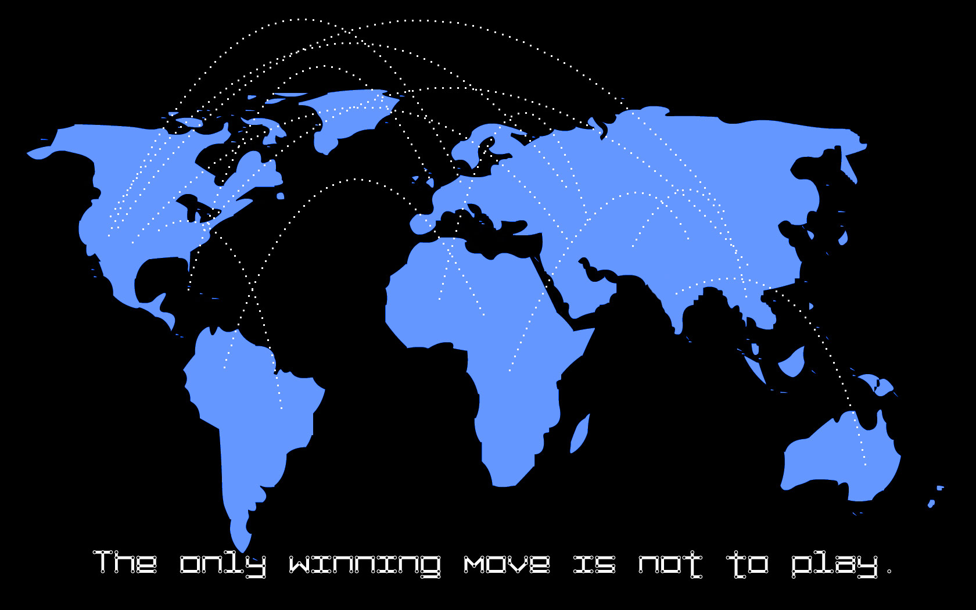
This time it’s Cyber War…

Slide 59
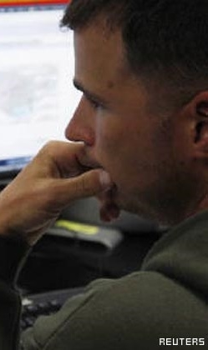
Cyber-War: This is no Game!
Cyberwarfare refers to politically motivated hacking to conduct sabotage and espionage
It is a form of information warfare sometimes seen as analogous to conventional warfare
Attacks Can Include:
Espionage and national security breaches
Sabotage
Denial-of-service attack
Hospitals and medical units are protected under the rules governing traditional warfare (NATO)

Slide 60
Cyber-War: This is no Game!
Whether it malware to infiltrate Iranian nuclear systems, or who would want to break into computers at a Japanese submarine manufacturing plants, or the British speaking bullishly about its willingness to launch a pre-emptive strike across the internet against aggressors
It would be naive to think that countries are not using the net for such purposes

Slide 61
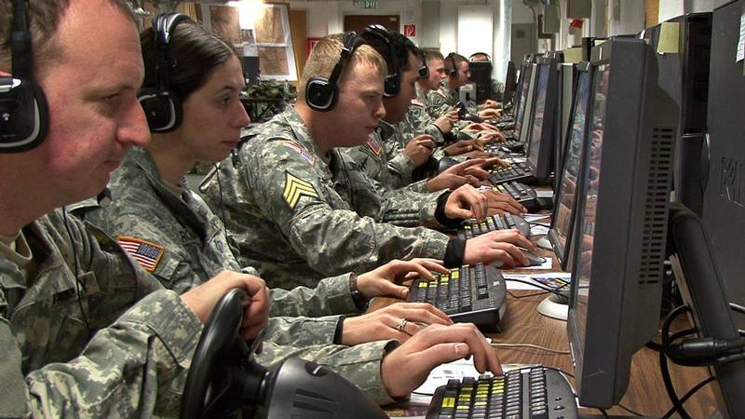

Slide 62
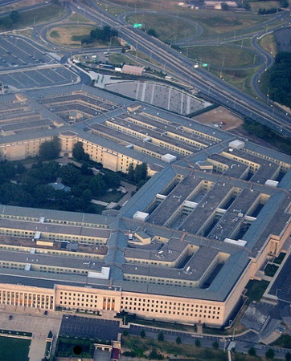
Possible Attack Scenarios:
Power grid Disruption
Internet & Communications
Air Traffic Control Disruption
Water / Food Pollution
Financial Infrastructure Damage
Cell Phone Jamming
GPS Tracking Disruption
Satellite Communication Disruption
Transportation Disruption / Lockdown
Denial of Service Attacks
May Coincide with Military Operations

Slide 63
Mitigation: Classified

Slide 64
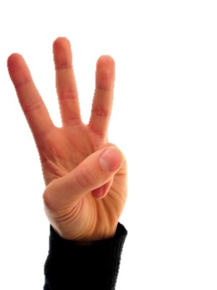

Slide 65
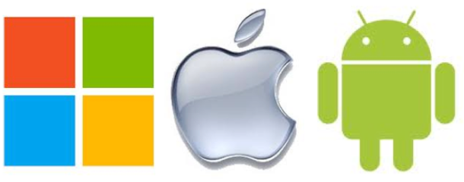
“A Game of Phones”
The New Modern…”Attack Surface”

Slide 66
Invasion of the Android Malware!
Geinimi Trojan
SMS Android Trojan
3D Anti-terrorist
TapSnake
Red Bunny Trojan
Ikee Worm
…
{{

Slide 67
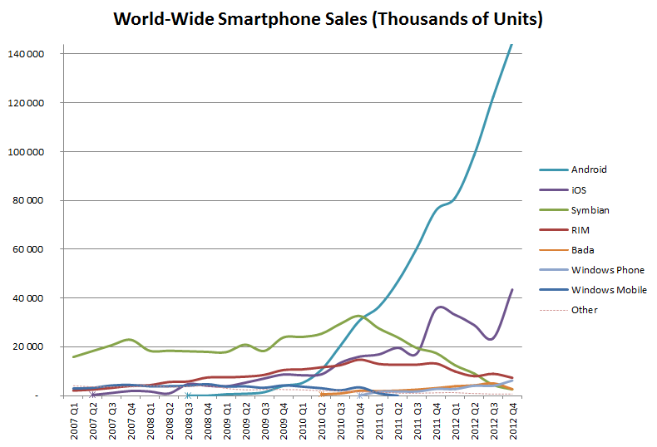

Slide 68
Mobile Malware: A Worrying Trend!
163% Increase in 1 year
Source: NQ Mobile

Slide 69
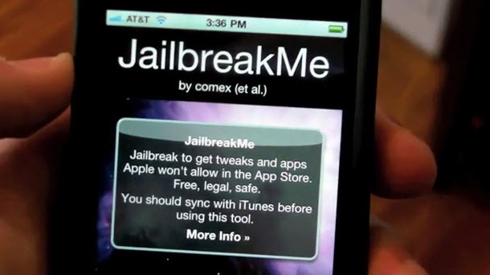

Slide 70
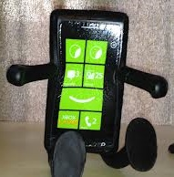
Mitigations
Don’t Jailbreak Phones
Use a PIN Number
Install reputable Anti Virus Software
Consider subscribing to a Phone tracking Service
Implement Phone Security Policies (Remote Wipe etc)
Remember there is no such thing as a Free Lunch! Only Download from Reputable Sources.

Slide 71
Mitigations
Microsoft Exchange - iPhones and Windows Mobile devices can be managed through Exchange including remote wipe, enforce password, minimum password length, maximum failed password attempts, password complexity, and lock after inactivity.
Blackberry Server – Managed through a central Blackberry Server, and security controls can be pushed through IT policies., including password controls, remote wipe, and encryption.
Patch management – Vulnerabilities in smart phones continue to be found, and new patches are released; however, for most smart phones, there is currently not a good way to force patches to the devices. In many cases, updating the software on smart phones turns into a manual process.
Training – Train employees to treat their smart phones (phones that receive email or store data) similar to a laptop. Keep it safe and secure, and report it immediately if it is lost or stolen.

Slide 72
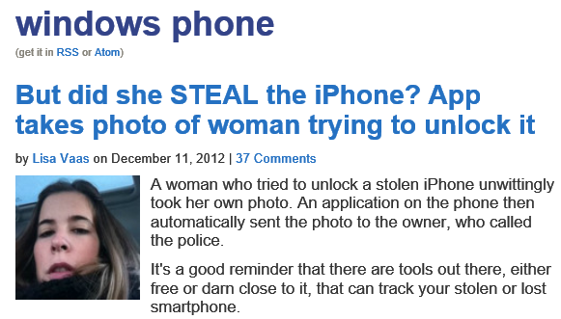

Slide 74
The Rise & Rise
of the Dark Web!

Slide 75
The Dark Web
1000s of Reputed Websites, boards, chartrooms, hosting “Black market” goods & services. Weapons, Drugs, Prostitution, Children and even Slaves
Rumoured to be Larger than the Internet!
Heavily controlled / influenced by Organised Crime
With stealth IP addressing & bogus DNS servers, tracing becomes difficult
Sites have seen a massive growth in the use of Bit Coin virtual currency. Often seen as an avenue to money laundering

Slide 76
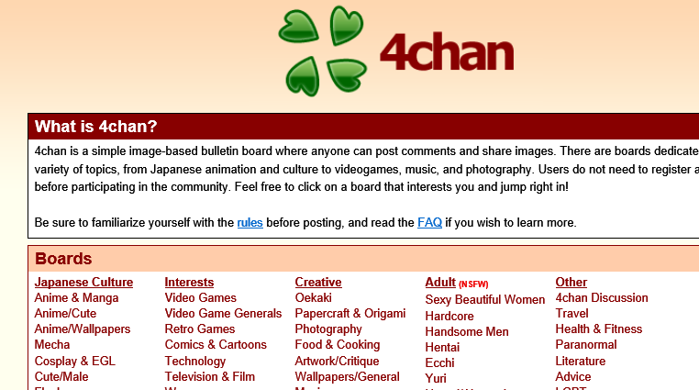

Slide 78
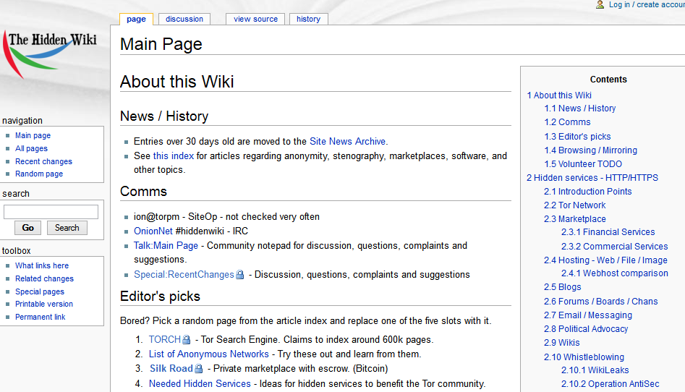

Slide 79
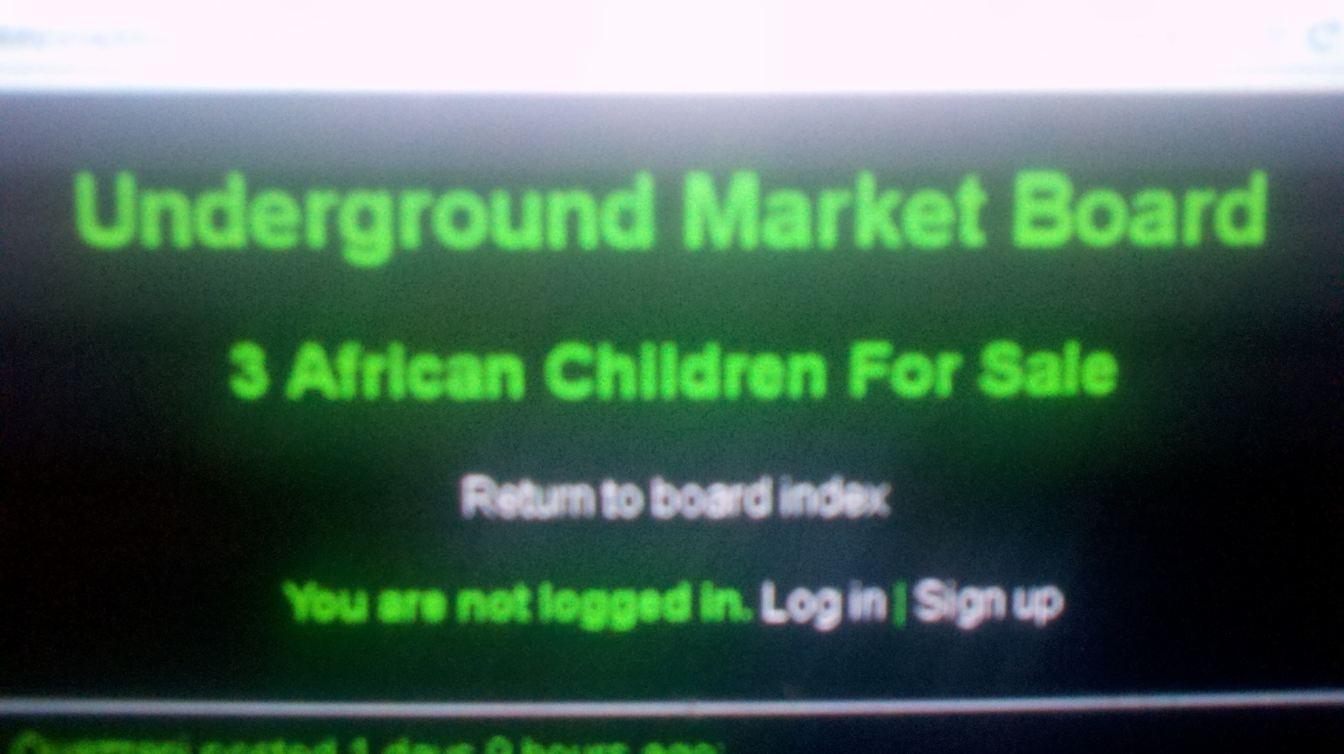

Slide 80
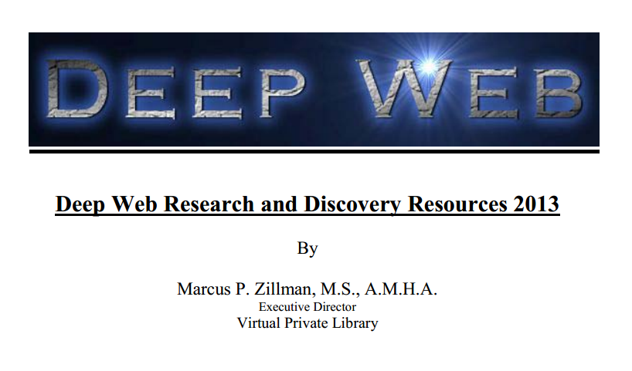

Slide 81
Demo
The Rise & Rise of the Dark Web

Slide 82
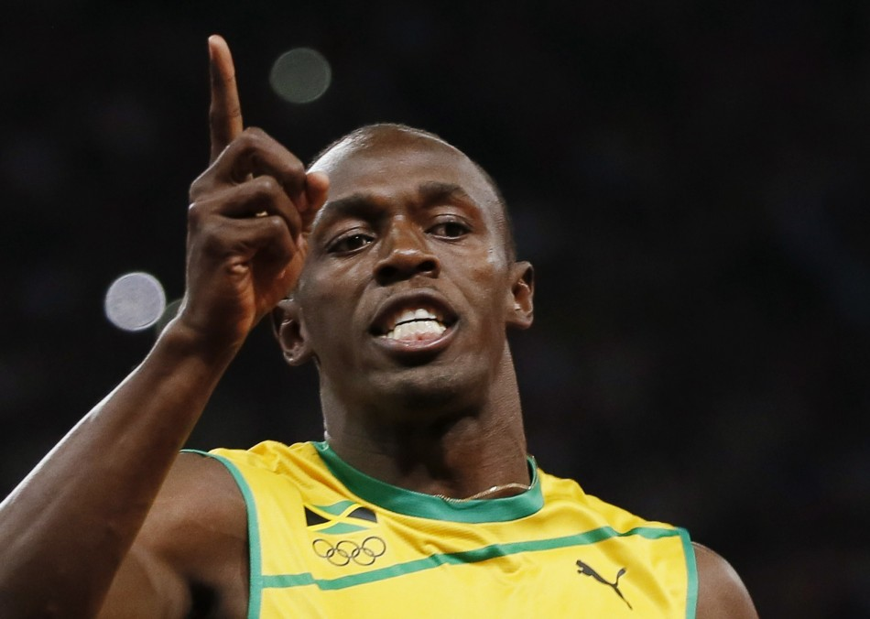

Slide 83
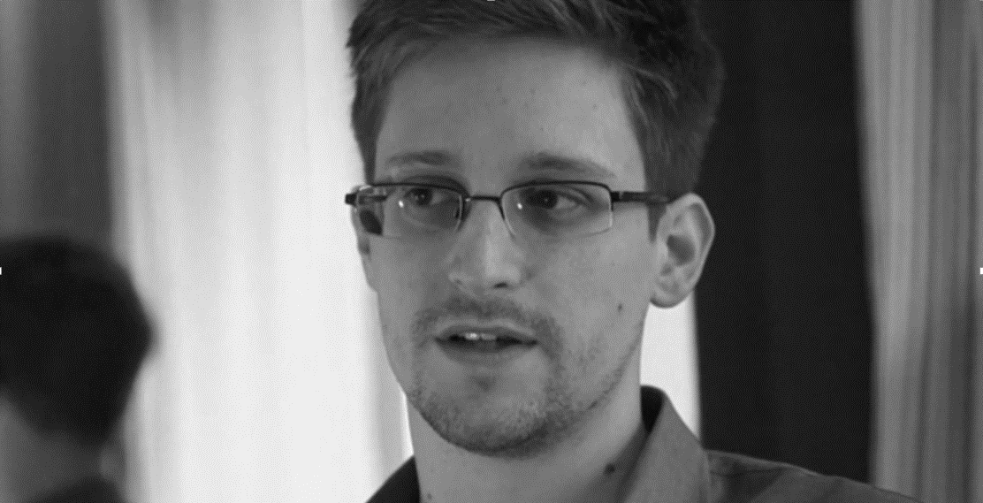
The Weakest Link…

Slide 84
Ignorance is No Excuse!

Slide 85
The Fear Factor…

Slide 86
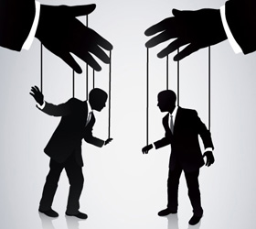
Don’t be too Social…

Slide 87
The One Rotten Apple!

Slide 88
Mitigation
Develop sound HR & Security Policies that include:
Full & On-Going Background Checks
Social Network Checks
Resume & Reference Checking
Implement an On-going Employee development Programme
Action on Internal Review Processes
If Problems Occur have steps in place to deal with offenders

Slide 89
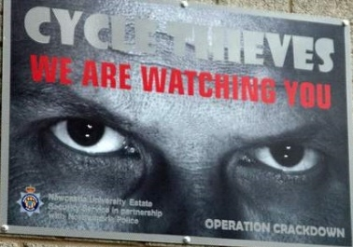
This poster reduced theft in Newcastle by Two Thirds in Twelve Months… Deterrent's Work!
A Final Thought!

Slide 90
So There you Have it!
The Security Top 10 Nightmares 2013
People – Still the Weakest Link!
The Rise & Rise of the Dark web
Attack of the Phones
This time it’s Cyber-war!
Traditional Cybercrime Vs State Sponsored Cybercrime
The Failure of Trust
The Rise of the Hactivist!
How Safe is Your Cloud?
Distributed Denial Of Service Attacks
Botnet & Zombie Networks
Review

Slide 91
Related content
ATC-B306 - Cybercrime: The 2013 Ultimate Survival Guide
ATC-B312 – Security Panel Discussion
ATC-B202 – A Journey to the Dark Side of Social Networking!
ATC-B314 - The Inside Man: Surviving the Ultimate Cyber Threat
ATC-B201 - 1984: 21st Century Security Surveillance vs. the Erosion of Freedom!
ATC-B213 - The Cloud: Making the Move to a Hybrid World
Find Me Later At...Trustworthy Computing / Cloud Security Table at the Ask the Experts Session.

Slide 92
Track resources
Required Slide
*delete this box when your slide is finalized
Track PMs will supply the content for this slide, which will be inserted during the final scrub.
Resource 1
Resource 2
Resource 3
Resource 4

Slide 93
Resources
Learning
Sessions on Demand
Microsoft Certification & Training Resources
http://channel9.msdn.com/Events/TechEd
www.microsoft.com/learning
TechNet
msdn
Resources for IT Professionals
Resources for Developers
http://microsoft.com/technet
http://microsoft.com/msdn

Slide 94
Complete an evaluation on CommNet and enter to win!

Slide 95
MS tag
Scan the Tag to evaluate this session now on myTechEd Mobile

Slide 96
© 2013 Microsoft Corporation. All rights reserved. Microsoft, Windows and other product names are or may be registered trademarks and/or trademarks in the U.S. and/or other countries.
The information herein is for informational purposes only and represents the current view of Microsoft Corporation as of the date of this presentation. Because Microsoft must respond to changing market conditions, it should not be interpreted to be a commitment on the part of Microsoft, and Microsoft cannot guarantee the accuracy of any information provided after the date of this presentation. MICROSOFT MAKES NO WARRANTIES, EXPRESS, IMPLIED OR STATUTORY, AS TO THE INFORMATION IN THIS PRESENTATION.

