Slide 2
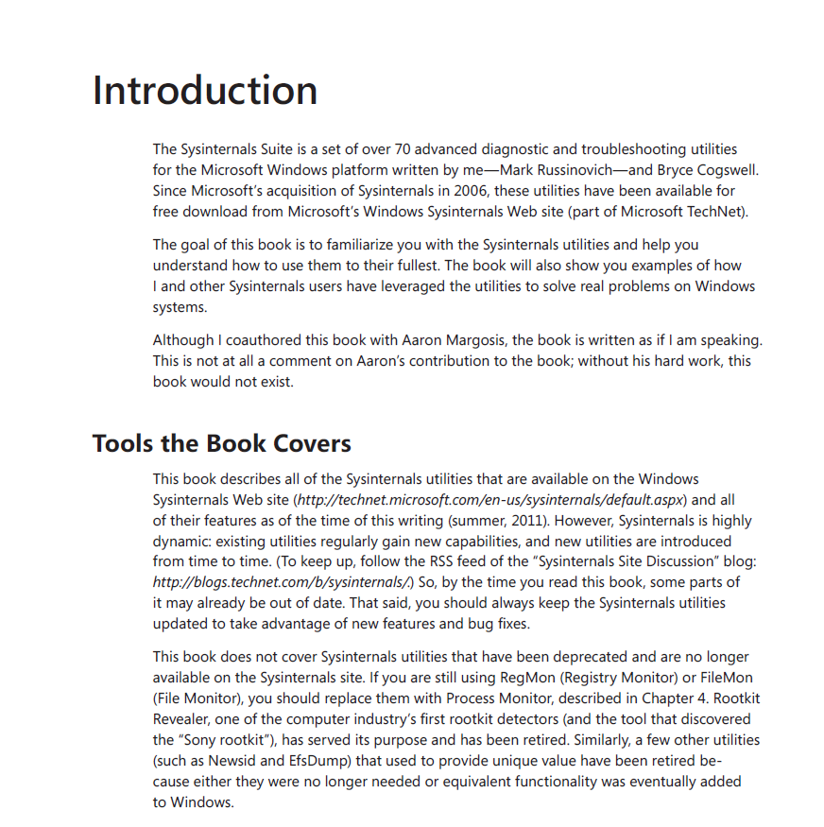
Sysinternals Primer: TechEd 2013 Edition
Aaron Margosis
Principal Consultant
Microsoft Cybersecurity Svcs

Slide 3
Sysinternals Primer: TechEd 2013 Edition
Aaron Margosis
Principal Consultant
Microsoft Cybersecurity Svcs

Slide 4
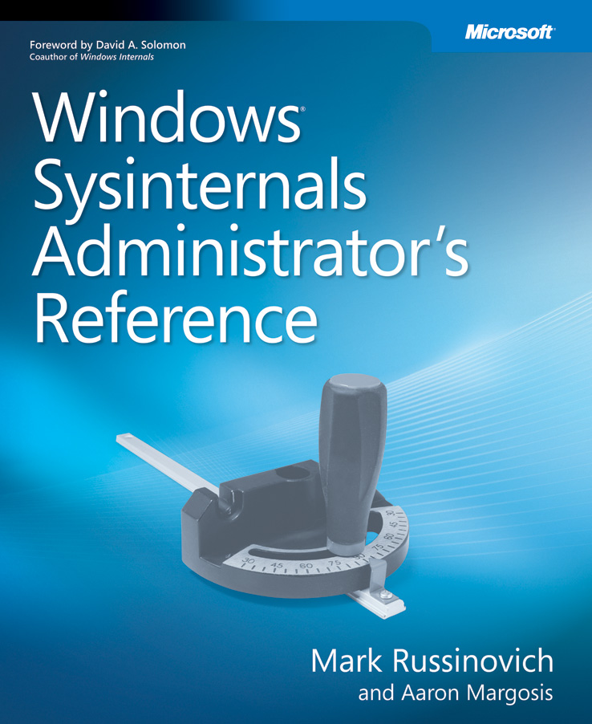
The Sysinternals Administrator’s Reference
The official guide to the Sysinternals tools
Covers every tool, every feature, with tips
Written by Mark Russinovich and Aaron Margosis
Full chapters on the major tools:
Process Explorer
Process Monitor
Autoruns
Other chapters by tool group
Security, process, AD, desktop, …
Case of the Unexplained

Slide 5
The Sysinternals Primer Series
TechEd 2010: Process Explorer, Process Monitor, PsExec
TechEd 2011: Autoruns, Disk2Vhd, ProcDump, BgInfo, AccessChk
TechEd 2012: “Gems” (Procmon tricks, nerd-out on TS sessions/winsta/desktops, LogonSessions, DU)
TechEd 2013: What’s New/Updated Since the Book

Slide 6
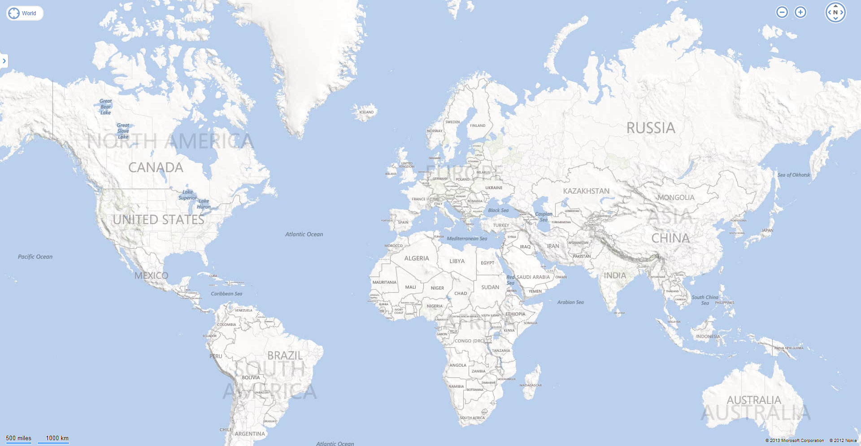
{

Slide 8
Updates for x64 support
Autologon
RegJump
MoveFile
PendMoves

Slide 9
Updates for Windows 8 support
Process Explorer
Process Monitor
ProcDump
DebugView
LiveKd
AccessChk
Desktops
TcpView
RAMMap
FAQ: Any Sysinternals for Windows RT?
No.
Notes:
Including using new Win8 private ETW logger which enables better coexistence with other ETW tools.

Slide 10
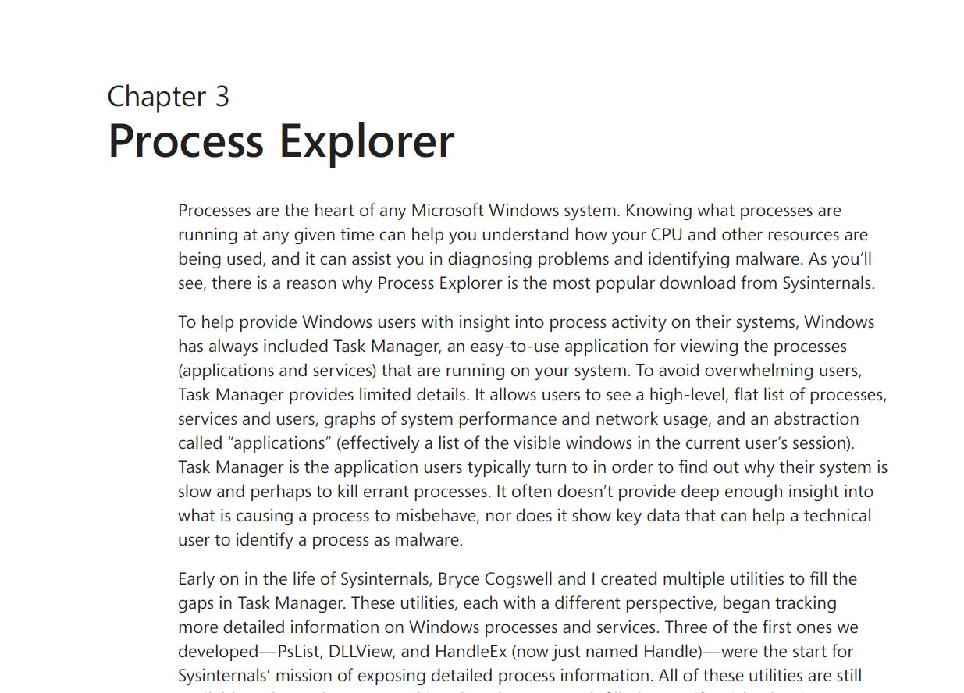
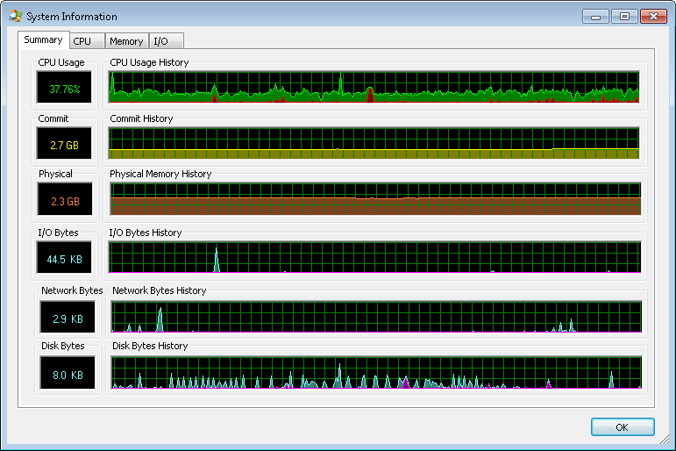
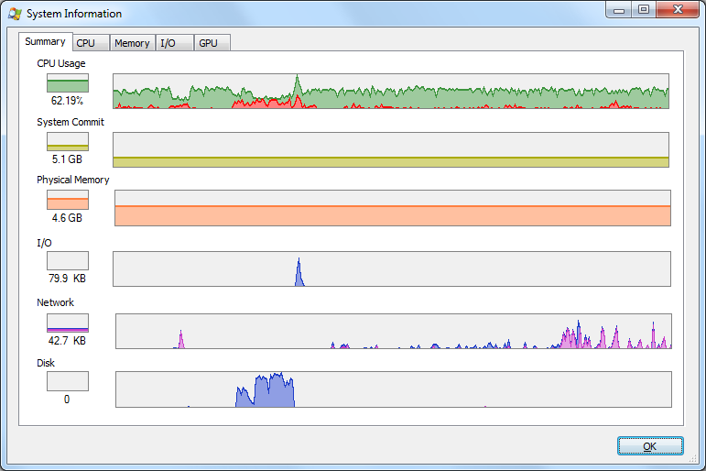
Main window:
Heat map for CPU, commit, working set, and GPU columns (new!)
New highlight color for “immersive” apps
Suspended processes say “Suspended” in the CPU column
Tooltips: tasks in Win8 Taskhostex processes; Win8 app package names
Process context menu: “create dump” creates 32-bit dumps for 32-bit processes (new!); background priority (which sets the CPU, memory and I/O priorities of a process to Low).
New columns: GPU usage and memory, Win8 app package name, paged pol, non-paged pool, Autostart location, process timeline
Find dialog: reports types of items found.
Process Details:
Image tab: Win8 ASLR types, Autostart location + Explore to (DLL property dialog too)
Security tab: Win8 AppContainer and Capability SIDs, LSA logon session ID, sortable columns, view protected processes
Services tab: restart
Threads: show stacks of .NET processes
DLL View: Autostart column, property
GPU support: utilization and memory monitoring (Vista+)
Modern color scheme

Slide 11
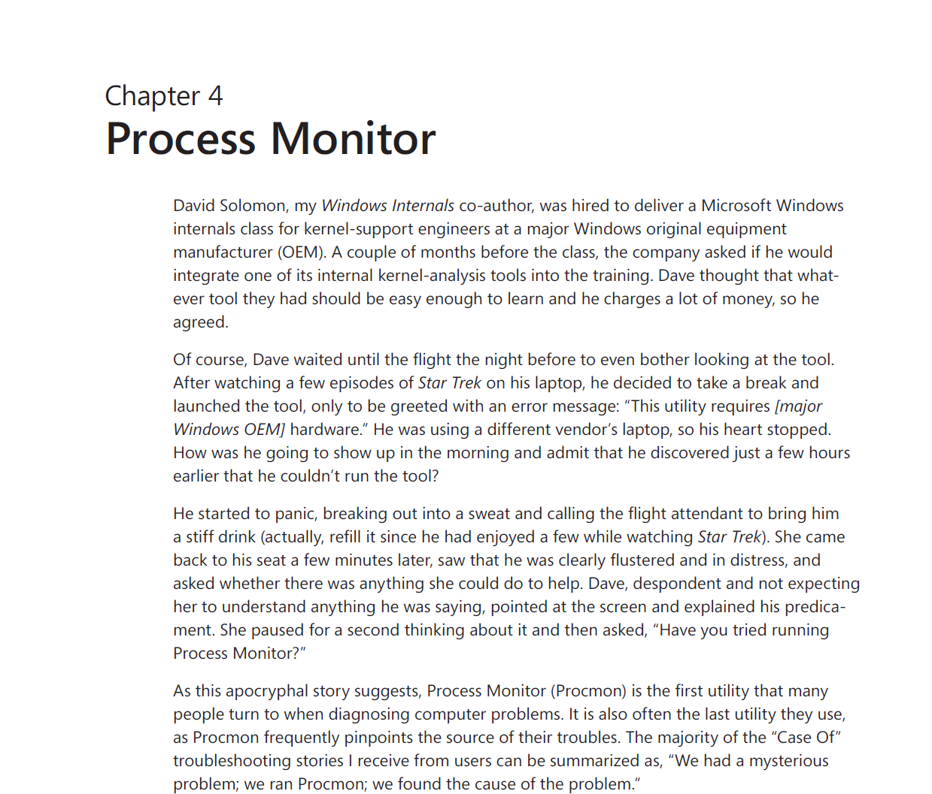
Bookmarks:
Toggle with Ctrl+B
Navigate with F6, Shift+F6
Saved in PML log files
Convert Highlight filters to Include filters
Navigate highlighted events with F4, Shift+F4
Process Start events capture current directory and environment variables
Support for Windows 8 control codes

Slide 12
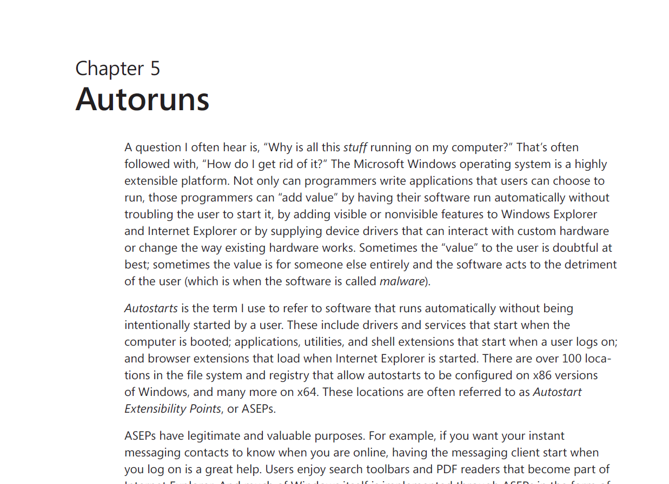
New autostart locations
“Jump to image”
Timestamp of image file
Highlights suspicious images (unsigned, no company name or description)
Active filter in the status bar
Better support for browsing folders on WinPE
File association for *.ARN files
Better reporting of targets of shortcuts, Rundll32 and other host executables
AutorunsC: switches for file hashes and for autostarts for all users
AutorunsC: reports Authenticode SHA1 and SHA256 hashes

Slide 13
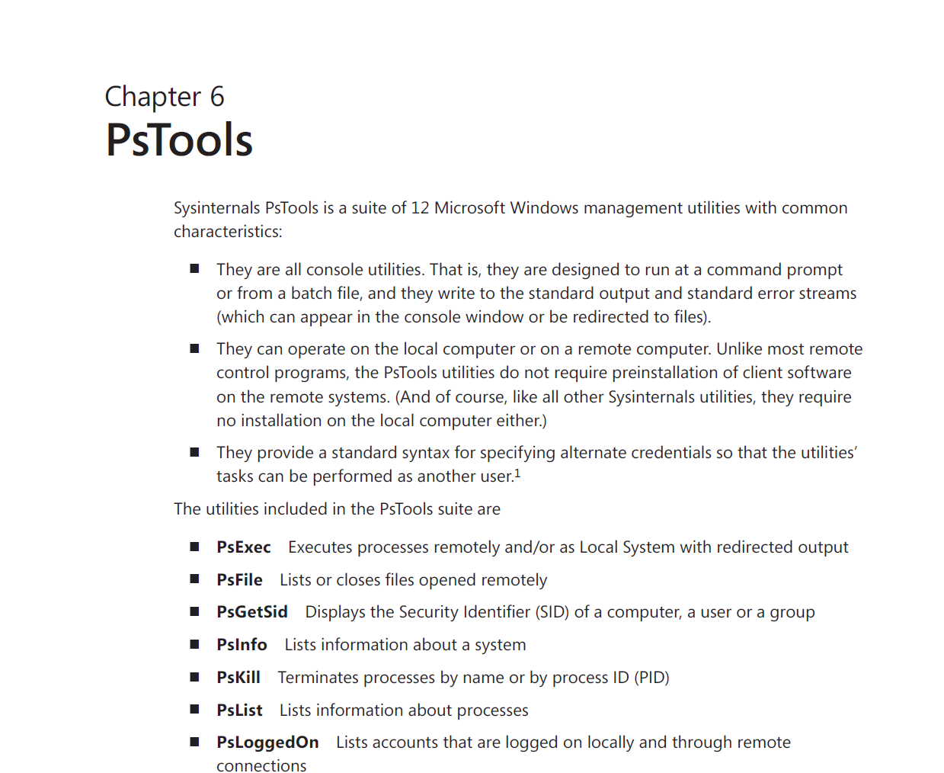
PsExec 2.0 (not yet released): adds [-r servicename]
PsPasswd: book version released Oct 2011 (new syntax for domain accounts)
PsPing: new utility!

Slide 14
PsPing
Measures network performance to 0.01 ms resolution
Standard ICMP ping functionality
TCP connection latency
TCP round-trip time
TCP bandwidth
Generates histograms

Slide 15
ICMP ping usage
psping [[-6]|[-4]] [-h [buckets]] [-i <interval>] [-l <requestsize> [-q] [-t|-n <count>] [-w <count>] <destination>
-h Print histogram (default bucket count is 20).
-i Interval in seconds. Specify 0 for fast ping.
-l Request size.
-n Number of pings.
-q Don't output during pings.
-t Ping until stopped with Ctrl+C and type Ctrl+Break
for statistics.
-w Warmup with the specified number of iterations (default is 1).
-4 Force using IPv4.
-6 Force using IPv6.
For high-speed ping tests use -q and -i 0.

Slide 16
TCP ping usage
psping [[-6]|[-4]] [-h [buckets]] [-i <interval>] [-l <requestsize> [-q] [-t|-n <count>] [-w <count>] <destination:destport>
-h Print histogram (default bucket count is 20).
-i Interval in seconds. Specify 0 for fast ping.
-l Request size.
-n Number of pings.
-q Don't output during pings.
-t Ping until stopped with Ctrl+C and type Ctrl+Break
for statistics.
-w Warmup with the specified number of iterations (default is 1).
-4 Force using IPv4.
-6 Force using IPv6.
For high-speed ping tests use -q and -i 0.

Slide 17
TCP latency usage
server: psping [[-6]|[-4]] <-s source:sourceport>
client: psping [[-6]|[-4]] [-h [buckets]] [-r] <-l requestsize>] <-n count> [-w <count>] <destination:destport>
-h Print histogram (default bucket count is 20).
-l Request size.
-n Number of sends/receives.
-r Receive from the server instead of sending.
-w Warmup with the specified number of iterations (default is 5).
-4 Force using IPv4.
-6 Force using IPv6.
The server can serve both latency and bandwidth tests and remains active until you terminate it with Control-C.

Slide 18
TCP bandwidth usage
server: psping [[-6]|[-4]] <-s source:sourceport>
client: psping [[-6]|[-4]] -b [-h [buckets]] [-r] <-l requestsize> <-n count> [-i <outstanding>] [-w <count>] <destination:destport>
-b Bandwidth test.
-h Print histogram (default bucket count is 20).
-i Number of outstanding I/Os (default is min of 16 and 2x CPU cores).
-l Request size.
-n Number of sends/receives.
-r Receive from the server instead of sending.
-w Warmup for the specified iterations (default is 2x CPU cores).
-4 Force using IPv4.
-6 Force using IPv6.
The server can serve both latency and bandwidth tests and remains active until you terminate it with Control-C.

Slide 19
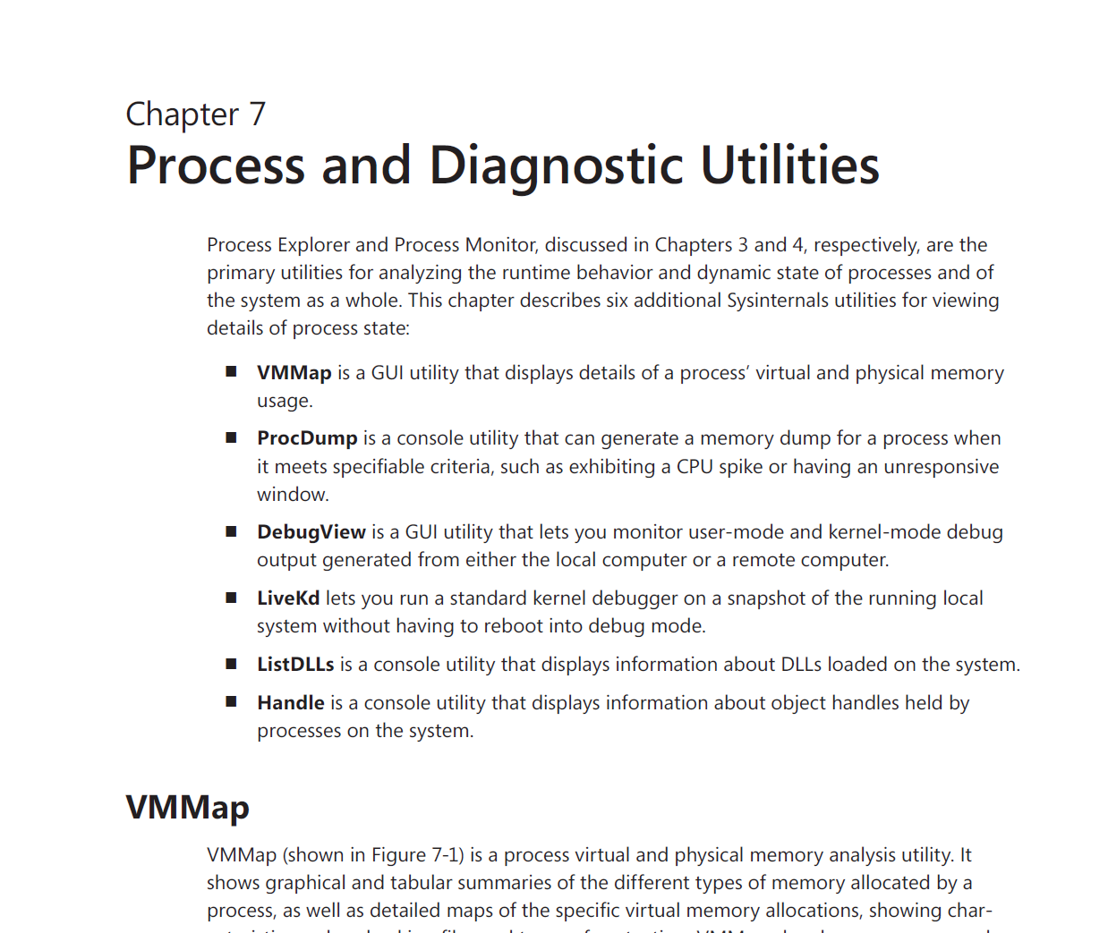
VMMap
Shows the ASLR status of image regions
Shows “unusable” virtual memory regions
Timeline shows commit usage instead of working set
ProcDump
Three major updates, four minor updates (!!!)
DebugView
Book describes 4.77 (published Sept 2011) with big syntax changes
Captures output generated by “modern apps” on Windows 8
Option /q to terminate a running instance. (Not yet released)
LiveKd
-m option (“mirror dump”) captures a fully-consistent kernel dump of a running system
Support for Windows 8
Supports newer Intel processors that implement the XSAVE instruction
ListDLLs
-v option dumps full file version information including signatures
-u option reports only unsigned DLLs
Handle
Updated to match Process Explorer’s new driver

Slide 20
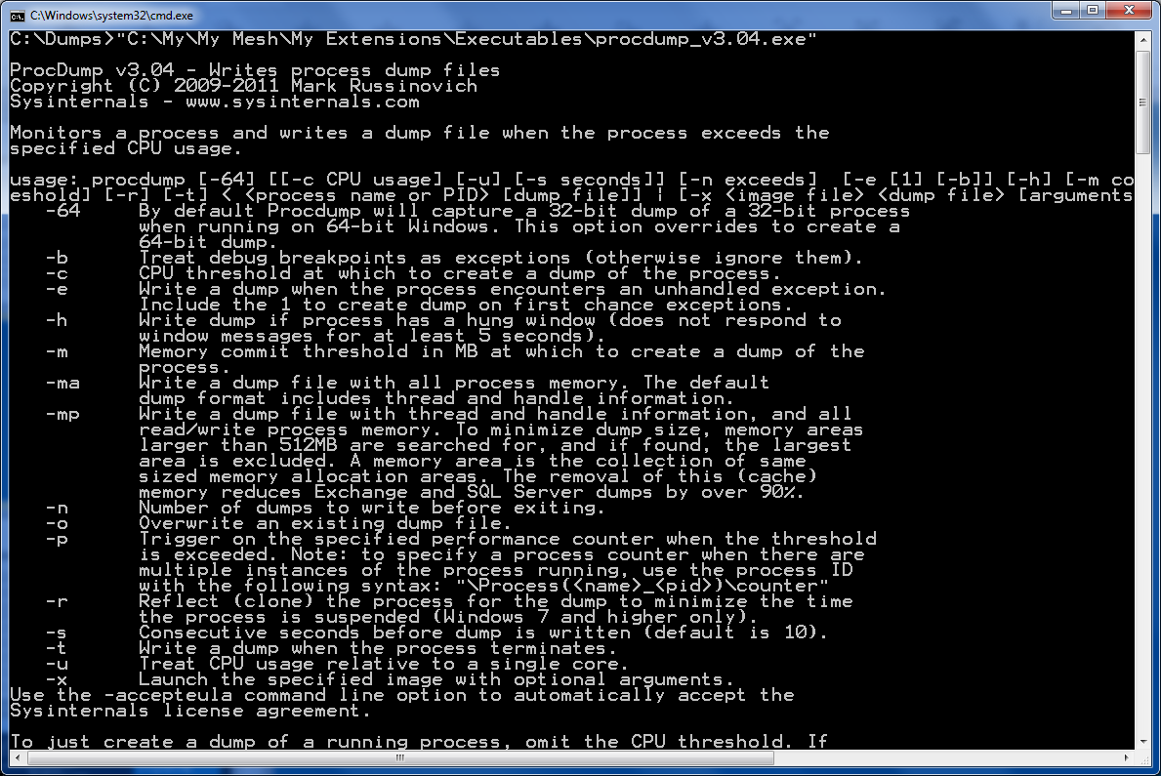
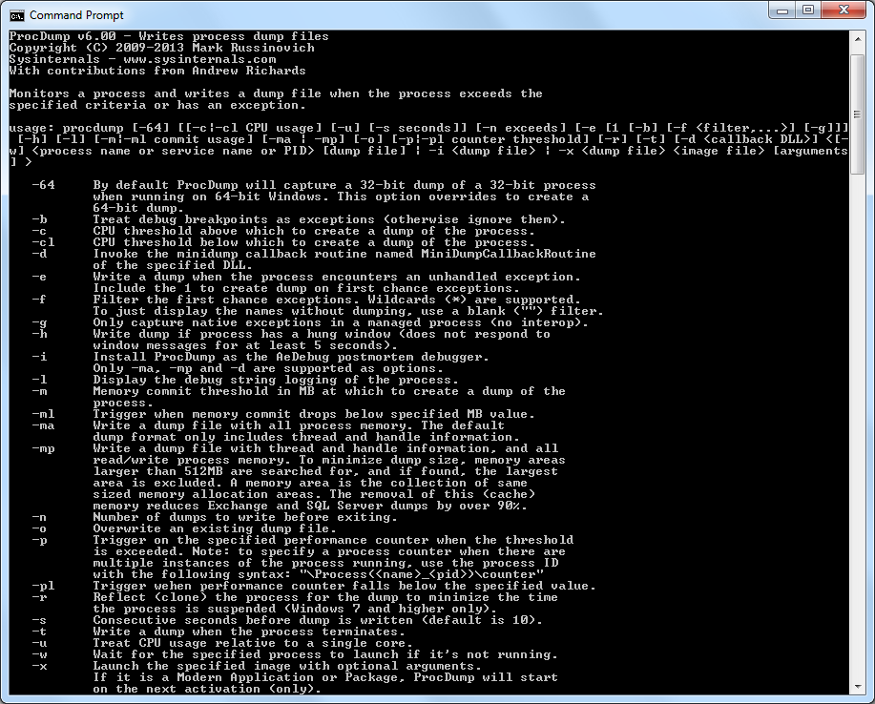
CL
E
F
G
I
L
ML
PL
X

Slide 21
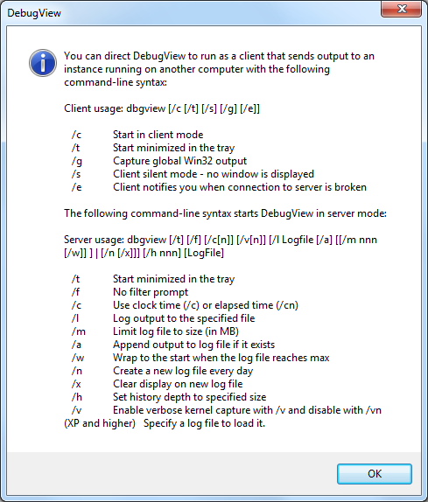
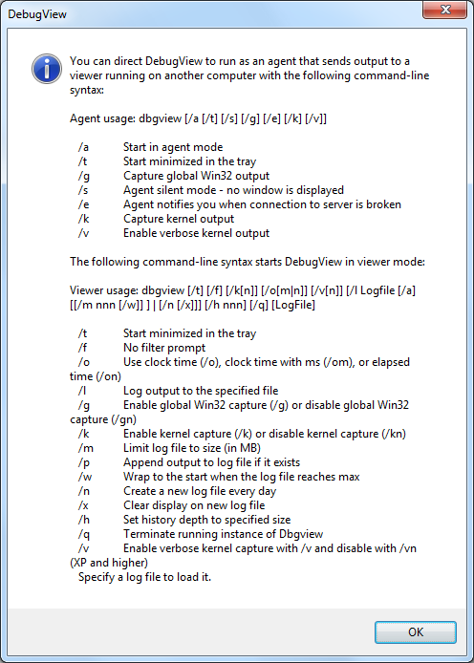
“Client” → “Agent”
“Server → “Viewer”
Ver 4.76
Ver 4.82

Slide 22
VMMap
Shows the ASLR status of image regions
Shows “unusable” virtual memory regions
Timeline shows commit usage instead of working set
ProcDump
Two major updates, five minor updates (!!!)
DebugView
Book describes 4.77 (published Sept 2011) with big syntax changes
Captures output generated by “modern apps” on Windows 8
Option /q to terminate a running instance. (Not yet released)
LiveKd
-m option (“mirror dump”) captures a fully-consistent kernel dump of a running system
Support for Windows 8
Supports newer Intel processors that implement the XSAVE instruction
ListDLLs
-v option dumps full file version information including signatures
-u option reports only unsigned DLLs
Handle
Updated to match Process Explorer’s new driver

Slide 23
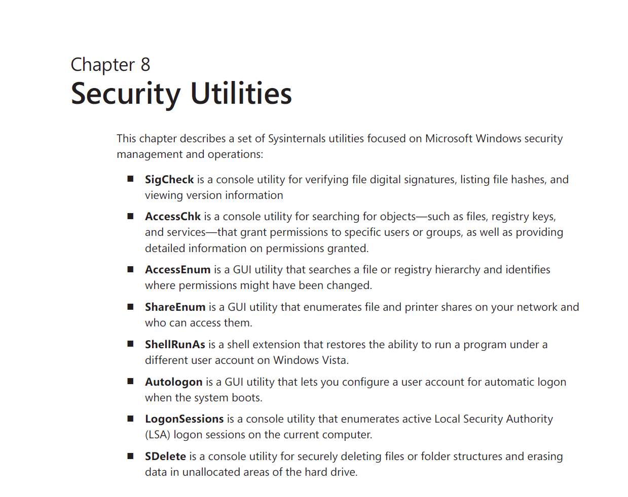
SigCheck
-i now reports detailed certificate information
For unsigned PE images, the embedded link date is reported instead of file system date
Returns exit code that can be used in scripts (0 for all signed, 1 if any not signed)
Reports Authenticode SHA256 hashes
AccessChk
-l option shows more security descriptor detail, including object owner and flags
Reports Windows 8 claims and capabilities in token contents
Includes RemoteInteractive in access rights
Prefixes AppContainer SIDs with “Package\”
SDelete
Meanings of –z and –c swapped (book is correct)

Slide 24
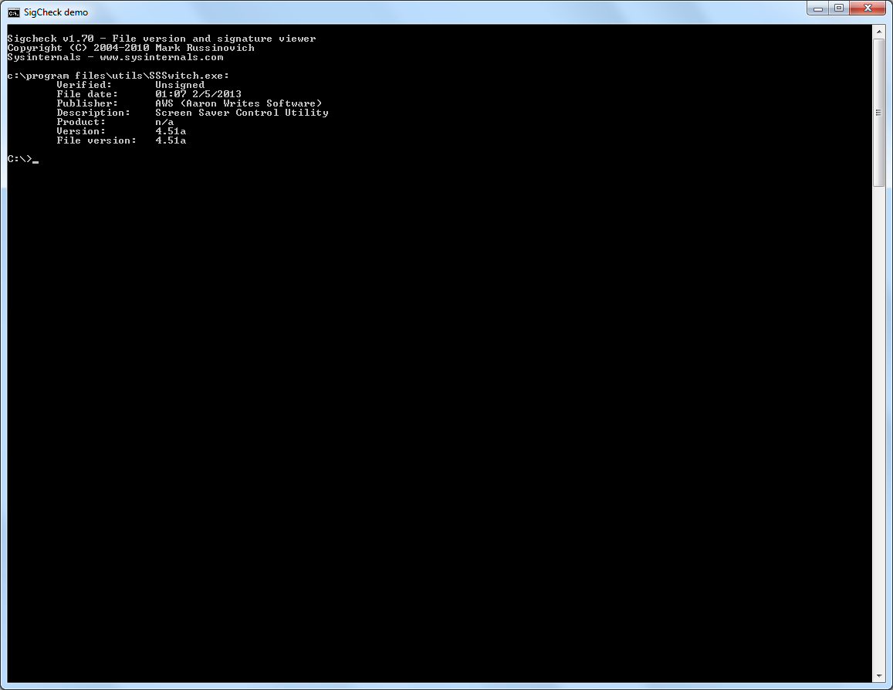
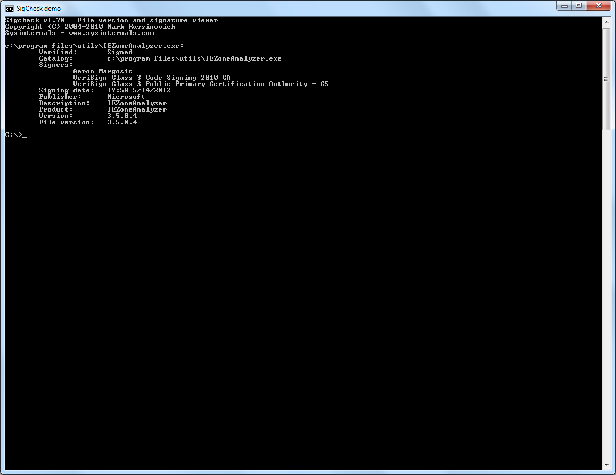
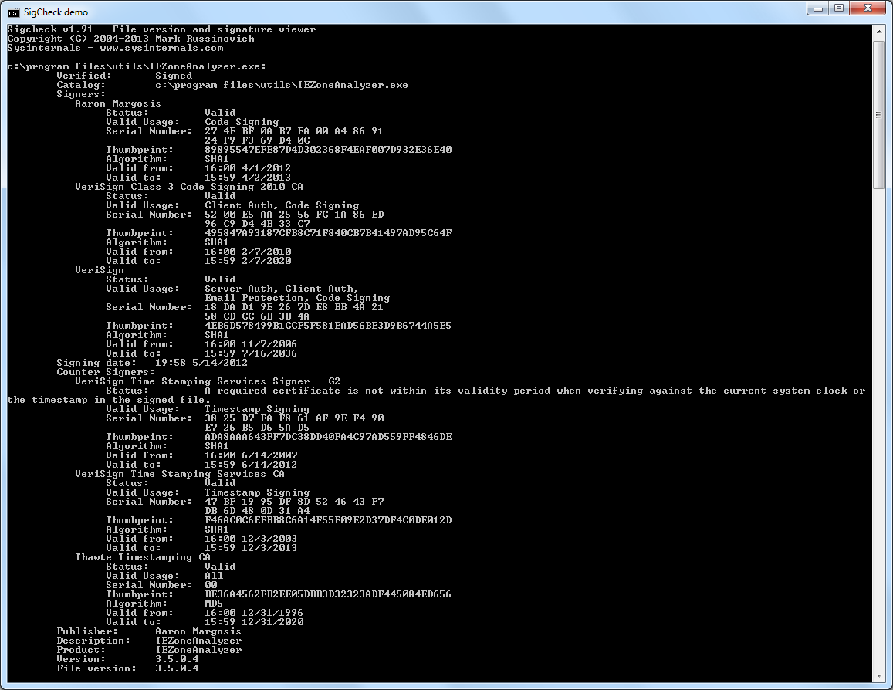
SigCheck v1.70
shows signed file
SigCheck v1.91
shows signed file
SigCheck v1.70
shows unsigned program file
SigCheck v1.91
shows unsigned program file

Slide 25
BgInfo
Reports Windows 8 (not yet released!)
Desktops
Compatible with Windows 8
ZoomIt
Configure for autostart
Specify initial default zoom level
Disable animation

Slide 26
Strings
-f option specifies file offset at which to start scanning
Disk Usage (DU)
-c and -ct options to print output as CSV
Additional data with CSV
-u option to count each instance of a hardlinked file

Slide 27
Contig
Supports defragmentation of NTFS metadata files, including the MFT
More detailed fragmentation analysis reporting
-f option to analyze free space fragmentation
-l option to set data length for quick file creation

Slide 28
Whois
-v option prints verbose information about domain registration referrals

Slide 29
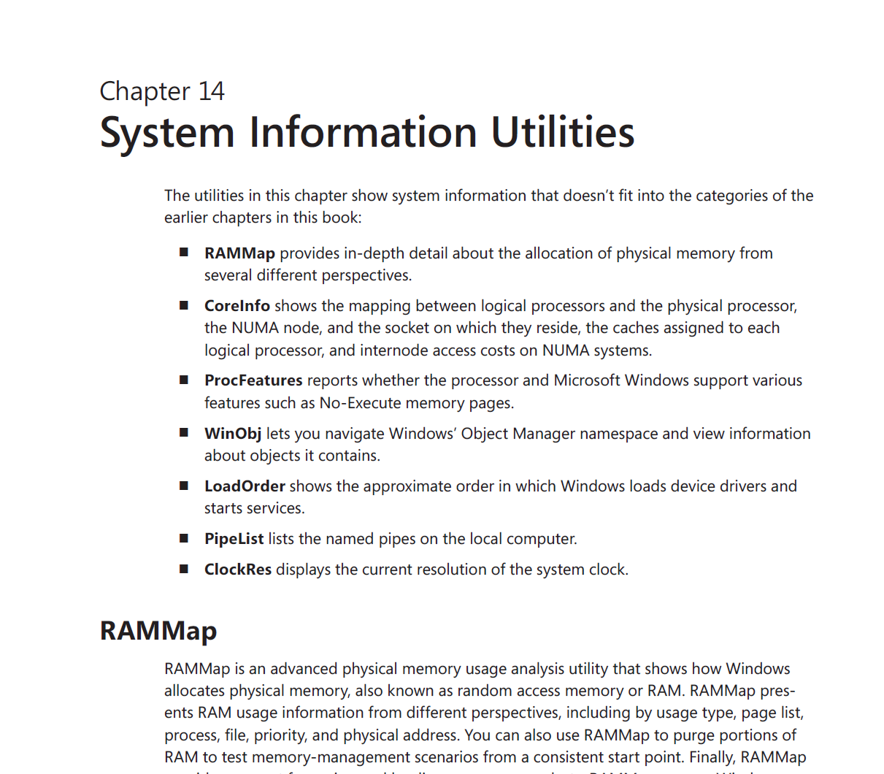
RU: new utility!
RAMMap
Command line options to scan to a file and to import from a saved file; creates a file association.
Support for Windows 8 and for systems with more than 16GB RAM.
CoreInfo
New command line options:
-f reports only core feature information
-v reports only virtualization-related features (requires admin rights on Intel systems)
Support for many additional features, including: hardware-assisted virtualization, SLAT, SMAP, RDSEED, BMI1, ADX, HLE, RTM, INVPCID, RDRAND, LAHF/SAHF, Prefetchw, Intel Speedstep, hyperthreading support on AMD multicore systems, TSC (timestamp counter) Invariant support, Microsoft’s SLAT term for Intel’s Extended Page Table, and AMD’s Nested Paging virtualization features.

Slide 30
RU – Registry Usage
New utility, released March 27
Shows per-key registry usage
Helps find registry bloat
Syntax identical to that of DU

Slide 31
RU – Registry Usage
usage: ru [-c[t]] [-l <levels> | -n | -v] [-q] <path>
-c Print output as CSV. Specify -ct for tab delimiting.
-l Specify subkey depth of information (default is one level).
-n Do not recurse.
-q Quiet (no banner).
-v Show size of all subkeys.
CSV output is formatted as:
Path,CurrentValueCount,CurrentValueSize,ValueCount,KeyCount,KeySize

Slide 32
Sysinternals Primers at TechEd
Process Explorer, Process Monitor, and PsExec
http://channel9.msdn.com/Events/TechEd/NorthAmerica/2010/WCL314
Autoruns, Disk2Vhd, ProcDump, BgInfo and AccessChk
http://channel9.msdn.com/Events/TechEd/NorthAmerica/2011/WCL312
"Gems"
http://channel9.msdn.com/events/TechEd/Europe/2012/SIA311

Slide 33
Sysinternals Resources
Sysinternals web site
http://www.Sysinternals.com http://technet.microsoft.com/sysinternals
Sysinternals blog (announces updates)
http://blogs.technet.com/b/sysinternals
Mark Russinovich’s blog:
http://blogs.technet.com/MarkRussinovich
Windows Sysinternals Administrator’s Reference
http://shop.oreilly.com/product/0790145316974.do
http://www.amazon.com/Windows-Sysinternals-Administrators-Reference-Russinovich/dp/073565672X

Slide 34
More Sysinternals Resources
Blog posts and utilities by Aaron Margosis
http://blogs.msdn.com/aaron_margosis
http://blogs.technet.com/fdcc
Andrew Richards’ blog & Defrag Tools on Channel 9
http://blogs.msdn.com/b/andrew_richards/
http://channel9.msdn.com/Shows/Defrag-Tools
Defrag Tools programs about ProcDump:
http://channel9.msdn.com/Shows/Defrag-Tools/Defrag-Tools-9-ProcDump
http://channel9.msdn.com/Shows/Defrag-Tools/Defrag-Tools-10-ProcDump-Triggers
http://channel9.msdn.com/Shows/Defrag-Tools/Defrag-Tools-11-ProcDump-Windows-8--Process-Monitor
Andrew Richards in MSDN Magazine: Writing a Plug-in for Sysinternals ProcDump v4.0
http://msdn.microsoft.com/en-us/magazine/hh580738.aspx

Slide 35
Related sessions
Breakout Sessions (session codes and titles) ATC-B308 - License to Kill: Malware Hunting with the Sysinternals Tools ATC-B318 - Windows 8 Security Internals WCA-B306 - Case of the Unexplained 2013: Windows Troubleshooting with Mark Russinovich WCA-B303 - App Compat for Nerds WCA-B401 - Hardcore Debugging
Webcast Defrag Tools Live – http://channel9.msdn.com (Thurs noon)

Slide 36
Resources
Learning
Sessions on Demand
Microsoft Certification & Training Resources
http://channel9.msdn.com/Events/TechEd
www.microsoft.com/learning
TechNet
msdn
Resources for IT Professionals
Resources for Developers
http://microsoft.com/technet
http://microsoft.com/msdn

Slide 37
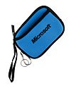
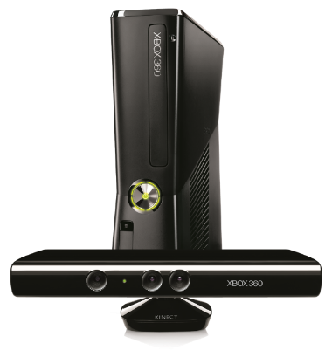
Complete an evaluation on CommNet and enter to win!

Slide 38
MS tag
Required Slide
*delete this box when your slide is finalized
Your MS Tag will be inserted here during the final scrub.
Scan the Tag to evaluate this session now on myTechEd Mobile

Slide 39
© 2013 Microsoft Corporation. All rights reserved. Microsoft, Windows and other product names are or may be registered trademarks and/or trademarks in the U.S. and/or other countries.
The information herein is for informational purposes only and represents the current view of Microsoft Corporation as of the date of this presentation. Because Microsoft must respond to changing market conditions, it should not be interpreted to be a commitment on the part of Microsoft, and Microsoft cannot guarantee the accuracy of any information provided after the date of this presentation. MICROSOFT MAKES NO WARRANTIES, EXPRESS, IMPLIED OR STATUTORY, AS TO THE INFORMATION IN THIS PRESENTATION.

