Slide 2
Microsoft SQL Server 2014 In-Memory OLTP: Overview
DBI-B204
Jos de Bruijn
jodebrui@microsoft.com

Slide 3
Context
In-Memory OLTP is one of many SQL Server initiatives to take advantage plentiful memory and processor cores
Specialized database engines for particular workloads:
Column store indexes for SQL Server 2012/2014 and PDW
In-Memory Analytics – Power Pivot for Excel 2010
App Fabric Cache - mid tier caching solution
Stream Insight : Real time data stream analytics
In-Memory OLTP for SQL Server 2014
SQL Server is well positioned to take full advantage of changing hardware trends and application requirements

Slide 4
Myths About In-Memory OLTP
SQL Server In-Memory OLTP is a recent response to competitors’ offerings
In-Memory OLTP is like DBCC PINTABLE
In-Memory Databases are new separate products
You can use In-Memory OLTP in an existing SQL Server app with NO changes whatsoever
Since tables are in memory, the data is not Durable or Highly Available – I will lose it after server crash

Slide 5
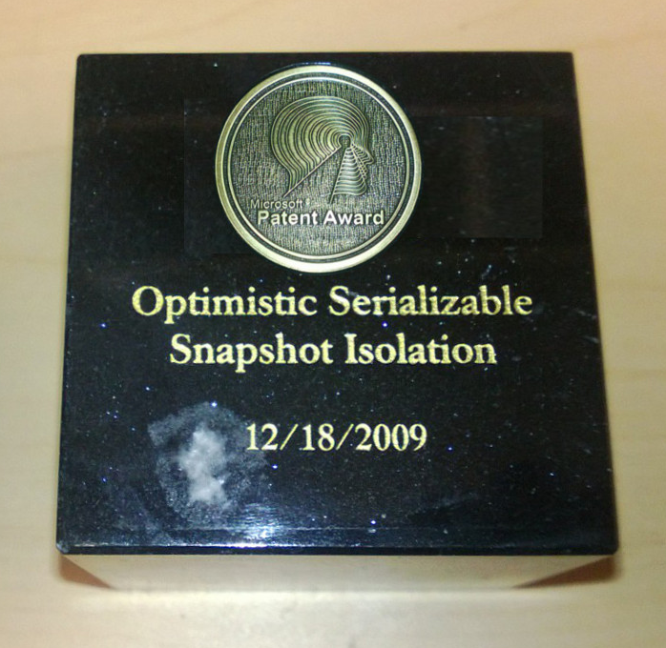
Myth #1:
SQL Server In-Memory OLTP is a recent response to competitors’ offerings
Reality
Project “Hekaton” was started around 4 years ago in response to business and hardware trends

Slide 6
Business Trends
Market need in OLTP space
ever higher throughput
lower latency
at a lower cost
Examples
Credit-card transactions: validate, authorize and complete the transaction
Online-betting: Ability to place the bet quickly

Slide 7
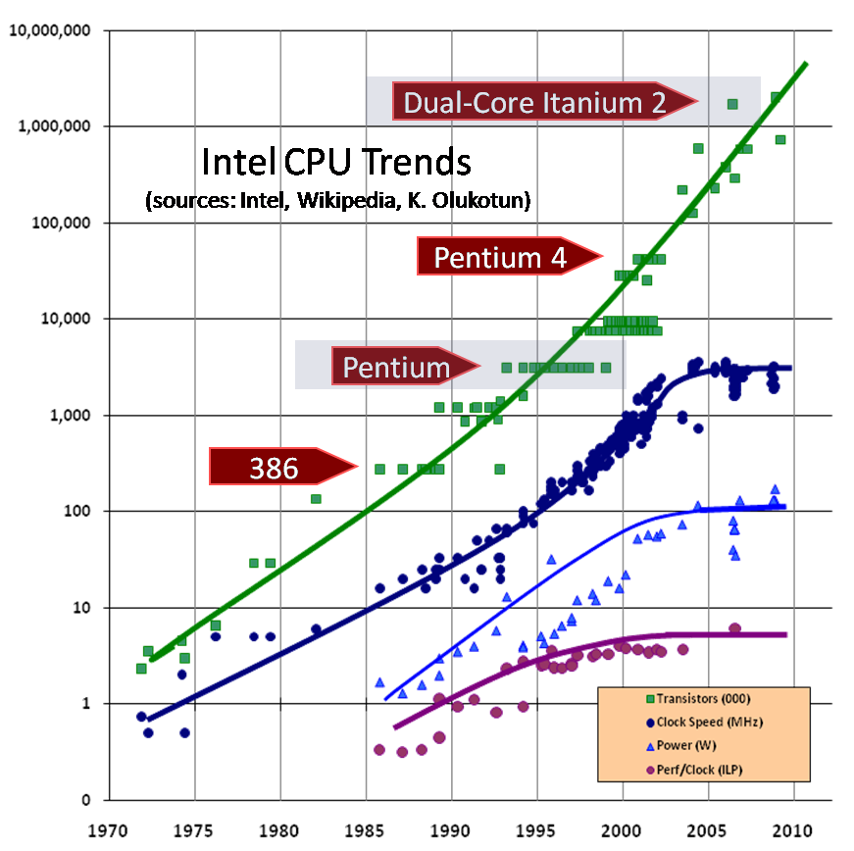
Hardware Trends
Moore’s Law means more transistors and therefore cores, but…
CPU clock rate stalled…
Meanwhile RAM cost continues to drop
Chart reference http://www.gotw.ca/publications/concurrency-ddj.htm

Slide 8
What is SQL Server In-Memory OLTP?
1. High performance
2. Main memory-optimized
3. OLTP scenarios
4. Integrated into SQL Server
5. Architected for modern hardware trends

Slide 9
Myth #2:
In-Memory OLTP is like DBCC PINTABLE
Reality
In-memory OLTP is completely new design to optimize for efficient In-Memory data operations.
There are no pages or buffer pool for memory-optimized tables.

Slide 10
In-Memory OLTP – Architectural Pillars
Customer Benefits
High performance data operations
Efficient business-logic processing
Frictionless scale-up
Hybrid engine and integrated experience
Architectural Pillars
Main-Memory Optimized
T-SQL Compiled to Machine Code
High Concurrency
SQL Server Integration
Optimized for in-memory data
Indexes (hash and range) exist only in memory
No buffer pool, B-trees
Stream-based storage
T-SQL compiled to machine code via C code generator and VC
Invoking a procedure is just a DLL entry-point
Aggressive optimizations @ compile-time
Multi-version optimistic concurrency control with full ACID support
Core engine uses lock-free algorithms
No lock manager, latches or spinlocks
Same manageability, administration & development experience
Integrated queries & transactions
Integrated HA and backup/restore
Drivers
Hardware trends
Business
Steadily declining memory price, NVRAM
Stalling CPU clock rate
Many-core processors
TCO

Slide 11
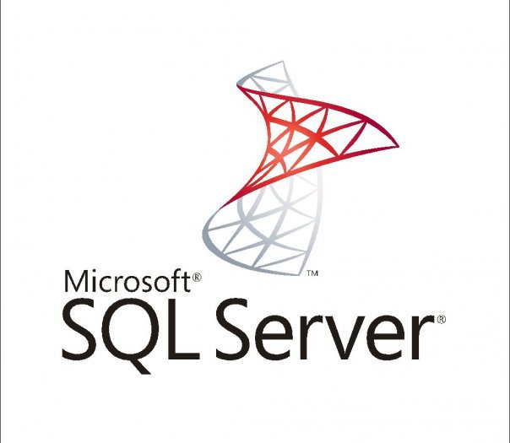
Myth #3:
In-Memory Databases are new separate products
Reality
In-Memory OLTP is a feature fully integrated into SQL Server 2014

Slide 12
In-Memory OLTP Integration and Application Migration
Client App
TDS Handler and Session Management
Key
SQL Server.exe
Parser, Catalog, Optimizer
T-SQL Query Execution
Existing SQL Component
Natively Compiled SPs and Schema
Native Compiler
Non-durable table
In-mem OLTP Component
Memory Optimized Tables & Indexes
Query Interop
Buffer Pool for Tables & Indexes
T1
T2
T3
Generated .dll
Tables
Indexes
Memory Optimized Data Filegroup
Transaction Log
Data Filegroup
T1
T2
T3
T1
T2
T3

Slide 13
Myth #4:
You can use In-Memory OLTP in an existing SQL Server app with NO changes whatsoever
Reality
There are at least some changes, at minimum
changing some of the schema

Slide 14
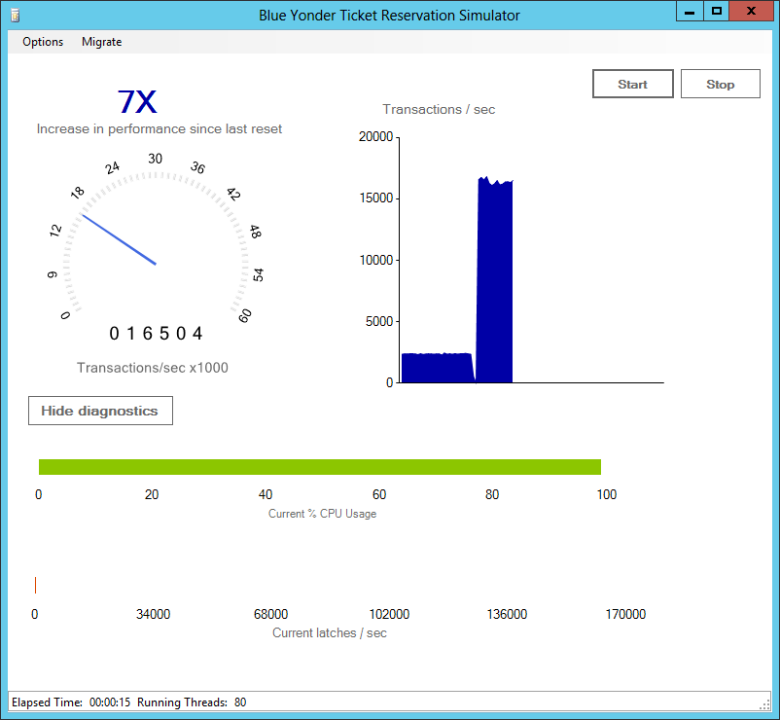
Code Changes for the Demo (I)

Slide 15
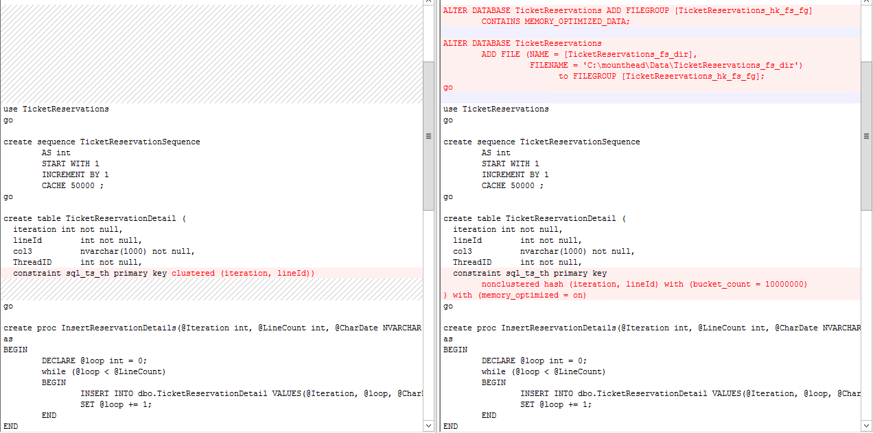
Code Changes for the Demo (I)

Slide 16
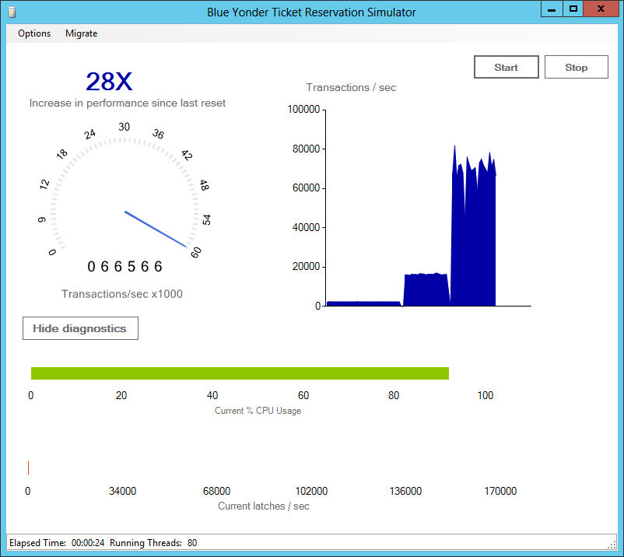
Code Changes for the Demo (II)

Slide 17
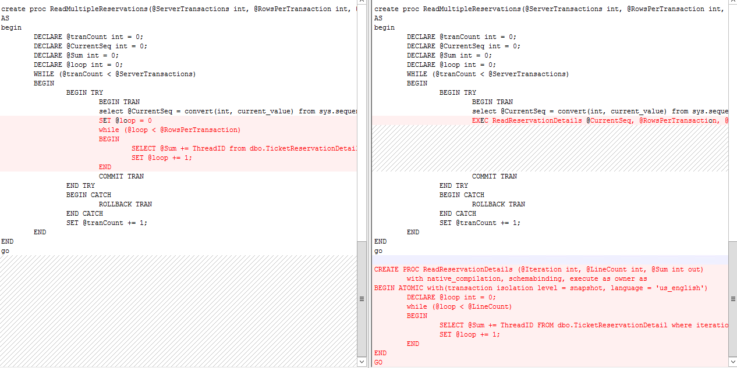
Code Changes for the Demo (II)

Slide 18
Myth #5:
Since tables are in memory, the data is not Durable or Highly Available – I will lose it after server crash
Reality
In-Memory OLTP is fully durable, and includes several HA features, including AlwaysOn
Data is persisted on disk, and will survive server crash

Slide 19
Performance Gains
Client App
TDS Handler and Session Management
SQL Server.exe
Key
No improvements in communication stack, parameter passing, result set generation
Parser, Catalog, Optimizer
Existing SQL Component
Native Compiler
T-SQL Query Execution
In-mem OLTP Component
Natively Compiled SPs and Schema
10-30x more efficient
Generated .dll
Removes lock and latch contention
Query Interop
Buffer Pool for Tables & Indexes
Engine for Memory_optimized Tables & Indexes
Reduced bandwidth. Latency remains
Memory-optimized Table Filegroup
Transaction Log
Data Filegroup
Persistence uses sequential IO

Slide 20
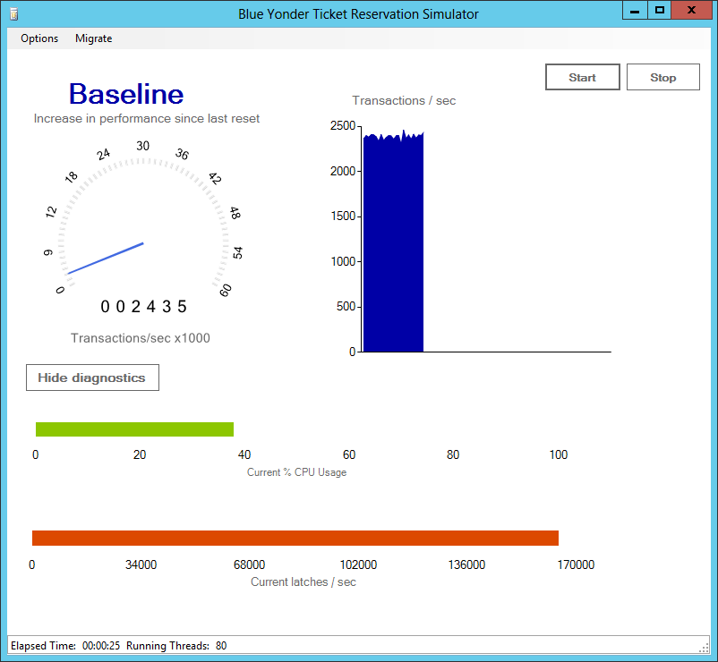
Performance gains in the demo (I)
Migrate table
Performance Bottleneck:
Latch contention
Bottleneck resolved:
7X perf gain

Slide 21
Performance gains in the demo (II)
Migrate stored procedures
Performance Bottleneck:
CPU
More efficient use of CPU: another 4X perf gain

Slide 22
Suitable Application Characteristics
Application is suited for in-memory processing
All performance critical data already fits in memory
Transaction locking or physical latching causing stalls and blocking
Application is “OLTP-Like”
Relatively short-lived transactions
High degree of concurrent transactions from many connections
Examples: Stock trading, travel reservations, order processing
Application migration simplified if
Stored procedures used
Performance problems isolated to subset of tables and SPs

Slide 23
Demo
Performance of Natively Compiled Stored Procedures

Slide 24
Related content
Breakout Sessions
DBI-B307 Microsoft SQL Server 2014 In-Memory OLTP: DB Developer Deep Dive – Wed 15:15
DBI-B308 Microsoft SQL Server 2014 In-Memory OLTP: Management Deep Dive – Thu 15:15
Hands-On Lab: SQL Server Project “Hekaton”
Find Me Later At…
MSE – Server Cloud Tools….This evening and Friday
Ask The Experts…..Thursday evening

Slide 25
Resources
Learning
Sessions on Demand
Microsoft Certification & Training Resources
http://channel9.msdn.com/Events/TechEd
www.microsoft.com/learning
TechNet
msdn
Resources for IT Professionals
Resources for Developers
http://microsoft.com/technet
http://microsoft.com/msdn

Slide 26
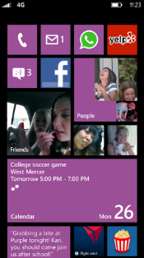
Evaluate this session
Required Slide
*delete this box when your slide is finalized
Your MS Tag will be inserted here during the final scrub.
Scan this QR code to
evaluate this session.

Slide 27
© 2013 Microsoft Corporation. All rights reserved. Microsoft, Windows and other product names are or may be registered trademarks and/or trademarks in the U.S. and/or other countries.
The information herein is for informational purposes only and represents the current view of Microsoft Corporation as of the date of this presentation. Because Microsoft must respond to changing market conditions, it should not be interpreted to be a commitment on the part of Microsoft, and Microsoft cannot guarantee the accuracy of any information provided after the date of this presentation. MICROSOFT MAKES NO WARRANTIES, EXPRESS, IMPLIED OR STATUTORY, AS TO THE INFORMATION IN THIS PRESENTATION.

