Slide 2
Microsoft SQL Server Management Basics for Non-DBAs
DBI-B205
Denny Cherry
mrdenny@dcac.co
twitter.com/mrdenny

Slide 3
mrdenny@dcac.co
www.dcac.co
Denny
Cherry
@mrdenny

Slide 4
Agenda
Files, File Groups, Disks
Backups
Recovery Model
Database Maintenance
Compression
Corruption
Compatibility Level
Indexes

Slide 5
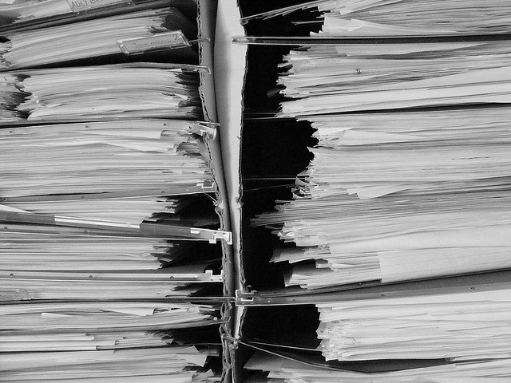
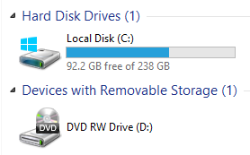
Files, File Groups, Disks
File Groups are made up of files
Files hold the data
Disks Hold Files
http://www.flickr.com/photos/photomequickbooth/4011249096/

Slide 6
Files, File Groups, Disks
Each database is made up of at least two files
One file is data
One file is transaction log
http://www.flickr.com/photos/photomequickbooth/4011249096/

Slide 7
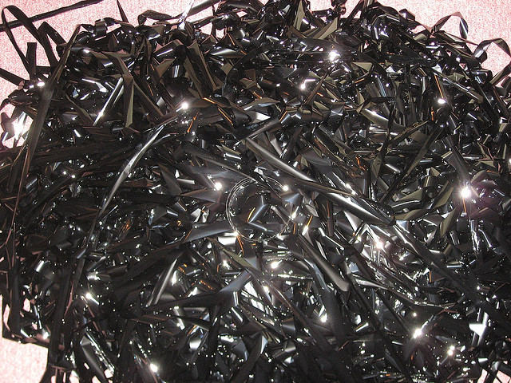
Backups
3 Different Kinds of Backups
Full Backups
Differential Backups
Transaction Log Backups
Advanced Backup Options
File Group Backups
Backups Saved On Another Machine
http://www.flickr.com/photos/gemstone/406866312/

Slide 8
Full Backups
Makes a point in time copy of the database
Database is in the state the database was at the end of the backup
Should be done daily or weekly

Slide 9
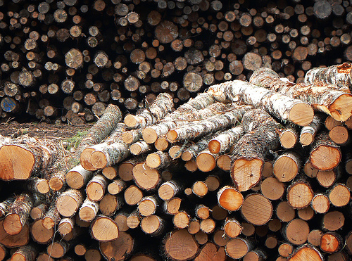
Recovery Models
Three Recovery Models Available
Simple
Bulk-Logged
Full
Used to control amount of logging
Controls recoverability
http://www.flickr.com/photos/decade_null/142235888/

Slide 10
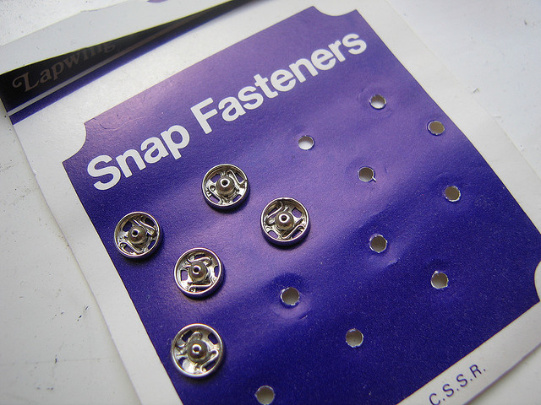
Snapshot Recovery Model
Minimal Logging
No Point In Time Recovery
Does Not Disable Logging
http://www.flickr.com/photos/noii/1337970464/

Slide 11
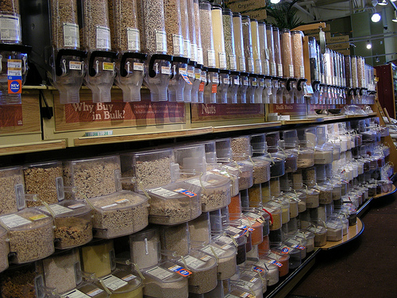
Bulk Logged Recovery Model
Some commands are bulk logged
Most commands are fully logged
Point In Time Recovery Supported
http://www.flickr.com/photos/4nitsirk/3778043845/

Slide 12
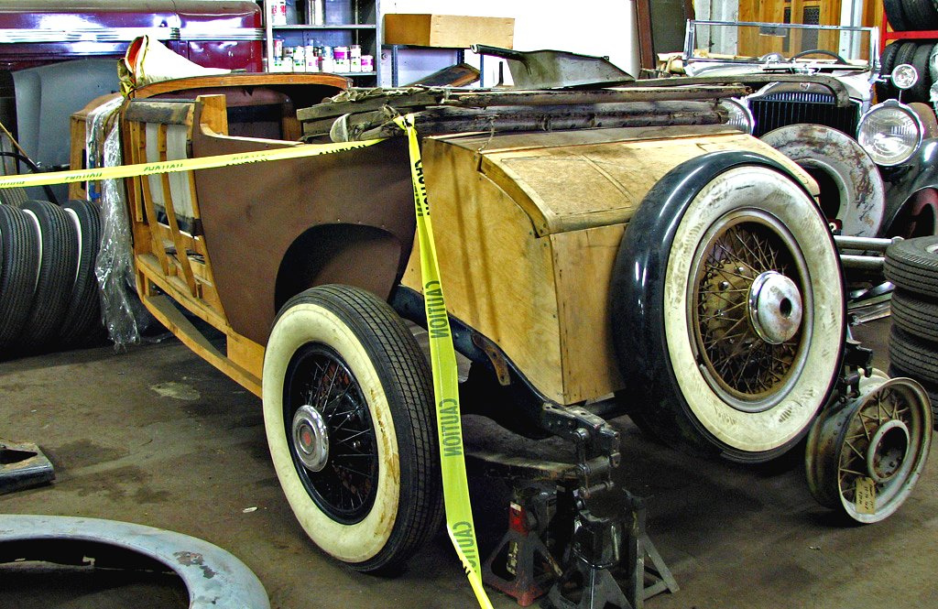
Full Recovery
Almost nothing is bulk logged
Point in time recovery is supported
Full Data Protection
http://www.flickr.com/photos/dok1/5623000758/

Slide 13
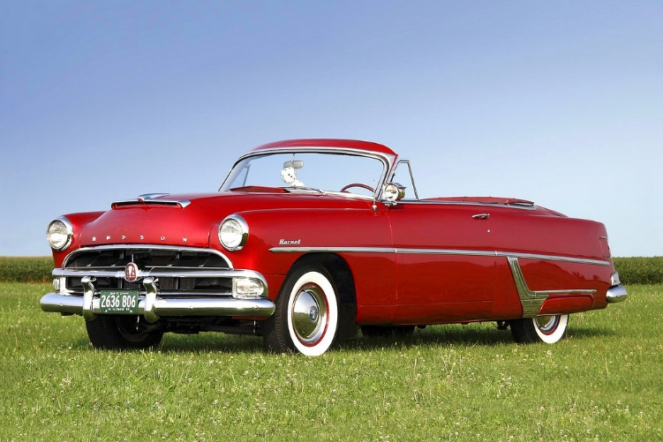
Restoring Data
Full Restore
Differential Restore
Transaction Log Restore
Page Level Restore
File Group Restore
http://www.flickr.com/photos/fun_flying/2959307155/

Slide 14
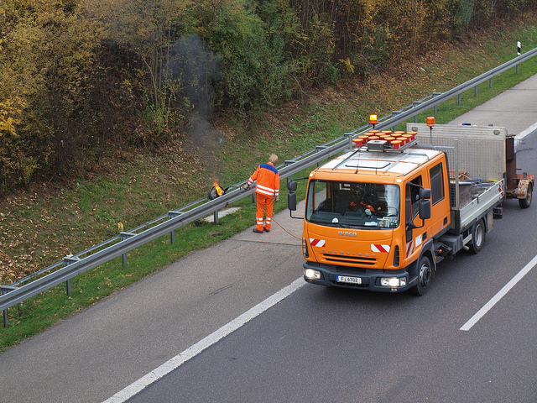
Database Maintenance
Databases need TLC
Index Rebuilding
Index Defragmenting
Update Statistics
http://www.flickr.com/photos/wjlonien/6309343565/

Slide 15
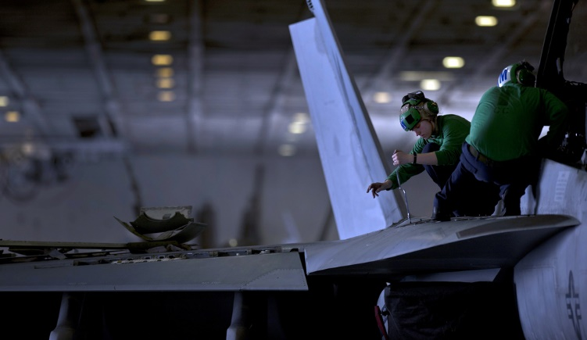
Database Maintenance
Index Defrag
Index Rebuild
Can be online or offline depending on version, edition and column data types
Creates new indexes then drops old index
Updates Statistics on index
Always Online
Moves data around pages row by row
Only moves rows that need to be moved
http://www.flickr.com/photos/usnavy/5488581781/

Slide 16
Statistics?
How SQL Server figures out how to access data
Statistics are used to create an execution plan
Statistics are a sampling of the values within a table or index
Statistics contain up to 200 samples of the values within the table
Statistics track the number of values between sampled values
http://www.flickr.com/photos/franganillo/3676227162/

Slide 17
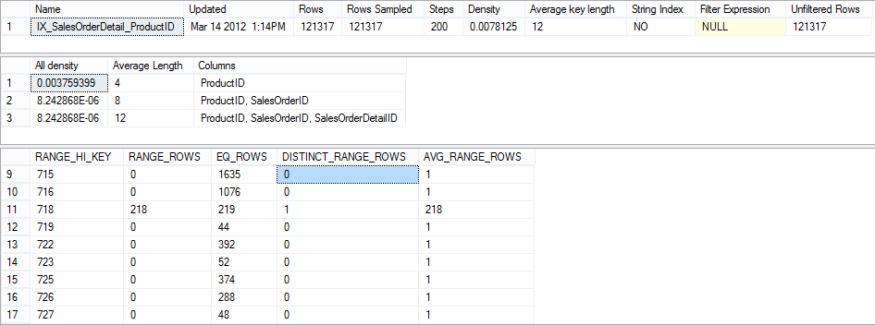
Statistics?

Slide 18
Compression
Saves space within:
The database
Memory
Backups
Costs CPU speed, but usually worth it
Data Compression is Page or Row
Backup Compression is an on or off
http://www.flickr.com/photos/aussiegall/316350537/

Slide 19
Corruption
All databases can become corrupt
Corruption is usually a hardware problem
Corruption should be checked for regularly
Depending on what is corrupt it may be repaired without data loss
Corruption is checked for and repaired using DBCC CHECKDB
Corruption will happen, how you prepare for it will determine how easily you can survive it
Some corruption can’t be repaired and must be restored from a backup

Slide 20
Compatibility Level
Compatibility levels tell SQL Server which language syntax to support
Does not effect the version of the SQL Server the database can be restored to
SQL Supports several down level compatibility levels.
SQL 2012 supports SQL 2005 and up
SQL 2008 R2 and below support SQL 6.5 and up

Slide 21
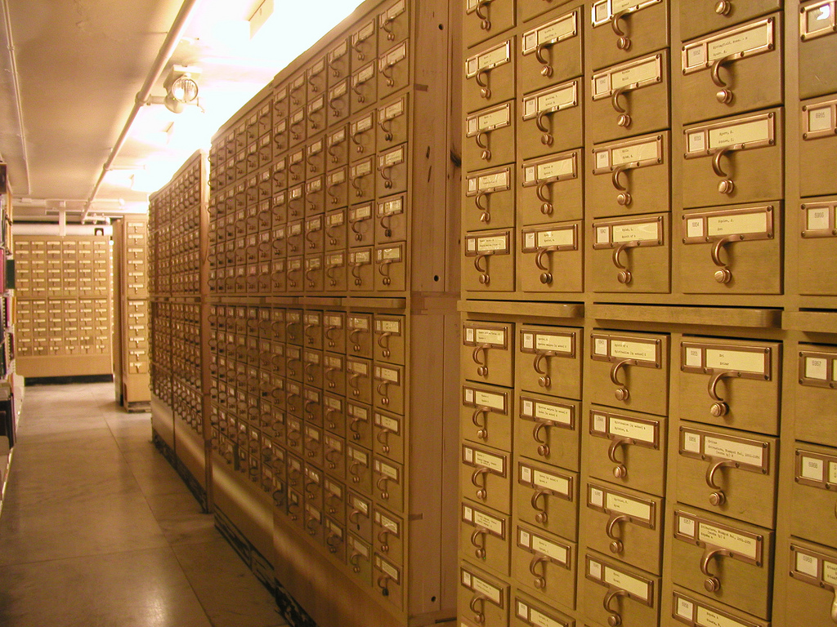
Indexes
Used to speed up queries
Sorted based on the columns within the index
Causes duplicate data to be stored
Trades space for speed
Indexes are ½ art and ½ science
http://www.flickr.com/photos/annarbor/4350627292/

Slide 22
Indexes
Clustered
Nonclustered
Full Text
Spatial
ColumnStore
XML
Semantic Search
http://www.flickr.com/photos/tryingyouth/2456237/

Slide 23
Indexes

Slide 24
Indexes

Slide 25
Indexes
Indexes aren’t free
Every index added slows down INSERT/UPDATE/DELETE operations
Only create indexes where the cost of having the index is worth it
Unused indexes can be removed from the database

Slide 26
Additional Reading…
http://dcac.co/res/teched2013

Slide 27
Denny Cherry
mrdenny@dcac.co
http://www.dcac.co
http://www.twitter.com/mrdenny

Slide 28
Evaluate this session
Required Slide
*delete this box when your slide is finalized
Your MS Tag will be inserted here during the final scrub.
Scan this QR code to
evaluate this session.

Slide 29
© 2013 Microsoft Corporation. All rights reserved. Microsoft, Windows and other product names are or may be registered trademarks and/or trademarks in the U.S. and/or other countries.
The information herein is for informational purposes only and represents the current view of Microsoft Corporation as of the date of this presentation. Because Microsoft must respond to changing market conditions, it should not be interpreted to be a commitment on the part of Microsoft, and Microsoft cannot guarantee the accuracy of any information provided after the date of this presentation. MICROSOFT MAKES NO WARRANTIES, EXPRESS, IMPLIED OR STATUTORY, AS TO THE INFORMATION IN THIS PRESENTATION.

