Slide 2
Building BI Solutions with Microsoft SQL Server Parallel Data Warehouse (PDW)
DBI-B335
Igor Stanko
igorstan@microsoft.com

Slide 3
Agenda What we’ll be covering today…
Industry Trends
How SQL Server 2012 PDW Fits In?
What’s New In SQL Server 2012 PDW?
Demos

Slide 4
Industry Trends
Data Explosion
10-fold increase in data volume every 5 years
“DW has shifted almost entirely towards the appliance model due to speed of the balanced appliance and scalability of scale out (MPP) solutions”.
– Jim Cobelius, Forrester Research
Big Data
Mobile and social technologies are driving an explosion of unstructured data
At the same time, Gartner estimates that by 2016 over 70% of existing data warehouses will require replacement as they fail to provide Big Data integration

Slide 5
Agenda What we’ll be covering today…
Industry Trends
How SQL Server 2012 PDW Fits In?
What’s New In SQL Server 2012 PDW?
Demos

Slide 6
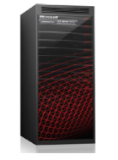
SQL Server PDW is a SQL Server appliance that is:
Scalable
Scales from 10s to PBs of data
Implemented as Massively Parallel Processing (MPP) system
Standards based
Leverages commodity hardware
Speaks SQL Server language (T-SQL)
Flexible
Offers hardware of choice (HP/Dell)
Supports multiple h/w architectures
Cost effective
Low price/TB ratio
Recap:
What is PDW?
Scale out

Slide 7
The actual user data resides on control nodes, and steps of the global execution plan are executed on each compute node
SQL Server PDW Appliance
Recap:
Shared-nothing MPP
Client
Control Node
Compute Node 1
The control node handles global query execution, and generates a distributed execution plan
Compute Node 2
.
.
.
The user connects to ‘the appliance’ like he would to a ‘normal’ SQL Server, and sends his request
Compute Node N
SQL Server PDW is a shared nothing MPP system, meaning user data is distributed across the nodes*. Data Movement Service is responsible for moving data around so that individual nodes can satisfy queries that need data from other nodes.

Slide 8
results
SELECT count(*) FROM SalesWeb
TempTable
Recap:
Simple query example
PDW Engine
a1
Control Node
SELECT count(*)
FROM SalesWeb
SELECT count(*)
FROM SalesWeb
into TempTable: SELECT count (*) FROM SalesWeb
SalesWeb
SalesWeb
a1 | a2
1 | 10
2 | 10
a1 | a2
3 | 10
4 | 10
Compute Node 1
Compute Node 2

Slide 9
Agenda What we’ll be covering today…
Industry Trends
How SQL Server 2012 PDW Fits In?
What’s New In SQL Server 2012 PDW?
Demos

Slide 10
SQL Server 2012 PDW
Release themes
Next-Generation Performance at Scale
Engineered for Optimal Value
Built for Big Data
xVelocity in SQL Server 2012 PDW
5-10x performance improvement in customer workloads
2-3x compression improvement
New HW/SW Architecture
Scalability: ¼ rack to 5 PB
Double the memory, 70% better disk IO
Continued investment into DMS and PDW Engine
Lower acquisition costs
½ the cost in terms of hardware
Moving from SAN to JBODs
Virtualization to reduce overhead costs
Matching size and requirements
Smaller entry point and smaller increments
Lower operational costs
Solution simplicity
Alignment with SQL Server ecosystem and tools
High performance access to data from hadoop
Integrated native query, fully parallelized w/o user intervention
Without loading into PDW first
Query across structured and unstructured data
Full SQL support
Full metadata support
Normal tools (PowerView etc.) function

Slide 11
Window Server 2012
PDW engine
DMS Manager
SQL Server
Shell DBs just as in AU3+
Host 1
General Details
Windows Server 2012 on all hosts and VMs.
Fabric and workload activity happens in VMs
Fabric VMs, MAD01 and CTL share 1 server, lower overhead costs especially for small topologies
Windows Storage Spaces handles mirroring and spares, allows us to use lower cost DAS (JBODs) rather than SAN
VM based provisioning cuts down time and complexity for setup and other maintenance tasks
PDW Workload Details
SQL Server 2012 Enterprise Edition (PDW build) is used on control node and compute nodes for PDW workload
CTL
MAD 01
FAB AD
VMM
SQL Server 2012 PDW
New HW and Software Architecture
Host 2
Host 3
JBOD
Compute 1
IB &
Ethernet
Host 4
Compute 2
Direct attached SAS
Window Server 2012
DMS Core
SQL Server 2012
Similar layout relative to V1, but more files per filegroup to leverage larger number of spindles in parallel

Slide 12
Engineered for Optimal Value
Comparison to PDW V1
Control Node
Pure hardware costs are ~50% lower
Price per raw TB is close to 70% lower due to higher capacity
70% more disk I/O bandwidth
Mgmt. Node
LZ
Backup Node
Infiniband & Ethernet
Infiniband & Ethernet
Fiber Channel
CONTROL RACK
DATA RACK
RACK 1
160 cores on 10 compute nodes
1.28 TB of RAM on compute
Up to 30 TB of temp DB
Up to 150 TB of user data
128 cores on 8 compute nodes
2TB of RAM on compute
Up to 168 TB of temp DB
Up to 1PB of user data
$
Estimated Total HW component List Price: $1MM
$
Estimated Total HW component List Price: $500K

Slide 13
HP | Compute | Incr. | Spare | Raw disk: 1TB | Raw disk: 3TB | Capacity
Quarter-rack | 2 | N/A | 1 | 15.1 | 45.3 | 53-227 TB
Half | 4 | 100% | 1 | 30.2 | 90.6 | 106-453 TB
Three-quarters | 6 | 50% | 1 | 45.3 | 135.9 | 159-680 TB
Full rack | 8 | 33% | 1 | 60.4 | 181.2 | 211-906 TB
One-&-quarter | 10 | 25% | 2 | 75.5 | 226.5 | 264-1133 TB
One-&-half | 12 | 20% | 2 | 90.6 | 271.8 | 317-1359 TB
Two racks | 16 | 33% | 2 | 120.8 | 362.4 | 423-1812 TB
Two and a half | 20 | 25% | 3 | 151 | 453 | 529-2265 TB
Three racks | 24 | 20% | 3 | 181.2 | 543.6 | 634-2718 TB
Four racks | 32 | 33% | 4 | 241.6 | 724.8 | 846-3624 TB
Five racks | 40 | 25% | 5 | 302 | 906 | 1057-4530 TB
Six racks | 48 | 20% | 6 | 362.4 | 1087.2 | 1268-5436 TB
Seven racks | 56 | 17% | 7 | 422.8 | 1268.4 | 1480-6342 TB
Scaling from 10s of TB to Petabytes:
Available Topologies
Start small, then easily scale to petabytes
2 to 56 compute nodes
15TB to 1.3PB raw
Up to 6PB user data
Capacity additions at small increments
DELL | Compute | Incr. | Spare | Raw disk: 1TB | Raw disk: 3TB | Capacity
Quarter-rack | 3 | N/A | 1 | 22.65 | 67.95 | 79-340 TB
2 thirds | 6 | 100% | 1 | 45.3 | 135.9 | 159-680 TB
Full rack | 9 | 50% | 1 | 67.95 | 203.85 | 238-1019 TB
One and third | 12 | 33% | 2 | 90.6 | 271.8 | 317-1359 TB
One and 2 third | 15 | 25% | 2 | 113.25 | 339.75 | 396-1699 TB
2 racks | 18 | 20% | 2 | 135.9 | 407.7 | 476-2039 TB
2 and a third | 21 | 17% | 3 | 158.55 | 475.65 | 555-2378 TB
2 and 2 thirds | 24 | 14% | 3 | 181.2 | 543.6 | 634-2718 TB
Three racks | 27 | 13% | 3 | 203.85 | 611.55 | 713-3058 TB
Four racks | 36 | 33% | 4 | 271.8 | 815.4 | 951-4077 TB
Five racks | 45 | 25% | 5 | 339.75 | 1019.25 | 1189-5096 TB
Six racks | 54 | 20% | 6 | 407.7 | 1223.1 | 1427-6116 TB

Slide 14
Broadly usable
Improved Performance
Performance at Scale
xVelocity in SQL Server 2012 PDW
Supports all PDW data types
Full DML Support
Support for Create table, CTAS, Alter Table, partition switching, etc.
Uses PDW cost model
Mixed-mode processing: presence of row operators does not prevent operators to be executed in the batch mode
Batch mode spilling
More operators supported (e.g., inner and outer joins, union all, local aggs)
Overarching goal:
Offer the same functionality as row store, while providing the performance boost.
CREATE TABLE user_db.dbo.user_table (C1 int, C2 varchar(20))
WITH (DISTRIBUTION = HASH (id), CLUSTERED COLUMNSTORE INDEX)
Column store is the preferred storage engine for SQL Server 2012 PDW

Slide 15
Dramatic performance increases
5-10x on customer workloads
Confirmed with TAP customer workloads
Improved compression on disk and in backups
2-3x better compression vs. row store
Preserved appliance model
Few tuning knobs
Improved memory management
Run-time memory mgmt. respects resource governor
Batch processing can now spill
Performance at Scale
xVelocity

Slide 16
Built for Big Data
Introducing Polybase
Traditional schema-based DW applications
Sensor & RFID
Social Apps
How to overcome the ‘Impedance Mismatch’?
Web Apps
Mobile Apps
Hadoop
RDBMS
Unstructured data
Structured data
Increasingly massive amounts of unstructured data driven by new sources
At the same time, vast amounts of corporate data and data sources, and the bulk of their data analysis
Polybase addresses this challenge for advanced data analytics by allowing native query across PDW and Hadoop, integrating structured and unstructured data

Slide 17
Keeping data in-place
Define external table and query data using standard TSQL
Persistently storing data from HDFS in PDW tables
Fully parallelized via CREATE TABLE AS SELECT (CTAS) with external tables as source table and PDW tables (either distributed or replicated) as destination
Polybase
Reading Hadoop data
CREATE EXTERNAL TABLE ClickStream(url varchar(50), event_date date, user_IP varchar(50))
WITH (LOCATION =‘hdfs://MyHadoop:5000/tpch1GB/employee.tbl’, FORMAT_OPTIONS (FIELD_TERMINATOR = '|'));
CREATE TABLE ClickStream_PDW WITH DISTRIBUTION = HASH(url) AS SELECT url, event_date, user_IP FROM ClickStream
CTAS
Results
Sensor & RFID
Social Apps
Traditional DW applications
External Table
Query Examples
Web Apps
Mobile Apps
Enhanced
PDW query engine
1
SELECT top 10 (url) FROM ClickStream where user_IP = ‘192.168.0.1’
Parallel HDFS Reads
Parallel Importing
2
Hadoop
HDFS bridge
SELECT url.description FROM ClickStream cs, Url_Description url WHERE cs.url = url.name and cs.url=’www.cars.com’;
DMS Reader 1
DMS Reader N
PDW
…
Unstructured data
Structured data
3
SELECT user_name FROM ClickStream cs, Users u WHERE cs.user_IP = u.user_IP and cs.url=’www.microsoft.com’;

Slide 18
Push data to Hadoop
Fully parallelized via CREATE EXTERNAL TABLE AS SELECT (CETAS) with external tables as destination table and PDW tables as source
‘Round-trip of data’ possible with first importing data from HDFS, joining it with relational data, and then exporting results back to HDFS
Polybase
Writing data to Hadoop
CREATE EXTERNAL TABLE ClickStream (url, event_date, user_IP) WITH (LOCATION =‘hdfs://MyHadoop:5000/users/outputDir’, FORMAT_OPTIONS (FIELD_TERMINATOR = '|')) AS SELECT url, event_date, user_IP FROM ClickStream_PDW
CETAS
Results
Traditional DW applications
Sensor & RFID
Social Apps
External Table
Web Apps
Mobile Apps
Enhanced
PDW query engine
Parallel HDFS Writes
Parallel Reading
HDFS data nodes
HDFS bridge
DMS Writer 1
DMS Writer N
PDW
…
Unstructured data
Structured data

Slide 19
Query all (structured and non-structured) your data through Polybase
Scale-out SQL Server to Petabytes of data
Known TSQL Interface (use existing BI technology)
Store more data with same storage footprint
Up to 10x query performance improvement when using columnstore
PDW Benefits

Slide 20
Connect to SQL Server PDW 2012 just like to any other SQL Server instance
But, deliver benefits mentioned earlier.
Large investment in supported TSQL statements in V2 timeframe.
Supported client drivers:
SNAC 10 R2, SNAC 11.
Supported MSFT tools:
Excel, PowerPivot, PowerView, Data Explorer, Report Builder 2 and 3, SSAS, SSRS.
Both 2012 and 2008 version of the tools supported.
Supported 3rd party tools:
Business Objects, Cognos, Tableau, QlickView.
Microsotrategy (9.3.1 version – adapter available through MSTR).
BI Tools Integration
Use existing means to work with PDW…

Slide 21
Demos ☺
Setup:
‘Internet Sales’ fact data stored in HDInsights
‘Product’ and ‘Reseller Sales’ information stored in PDW
Requirements:
Leverage existing BI tools and skillset

Slide 22
© 2013 Microsoft Corporation. All rights reserved. Microsoft, Windows, Windows Vista and other product names are or may be registered trademarks and/or trademarks in the U.S. and/or other countries.
The information herein is for informational purposes only and represents the current view of Microsoft Corporation as of the date of this presentation. Because Microsoft must respond to changing market conditions, it should not be interpreted to be a commitment on the part of Microsoft, and Microsoft cannot guarantee the accuracy of any information provided after the date of this presentation. MICROSOFT MAKES NO WARRANTIES, EXPRESS, IMPLIED OR STATUTORY, AS TO THE INFORMATION IN THIS PRESENTATION.

Slide 23
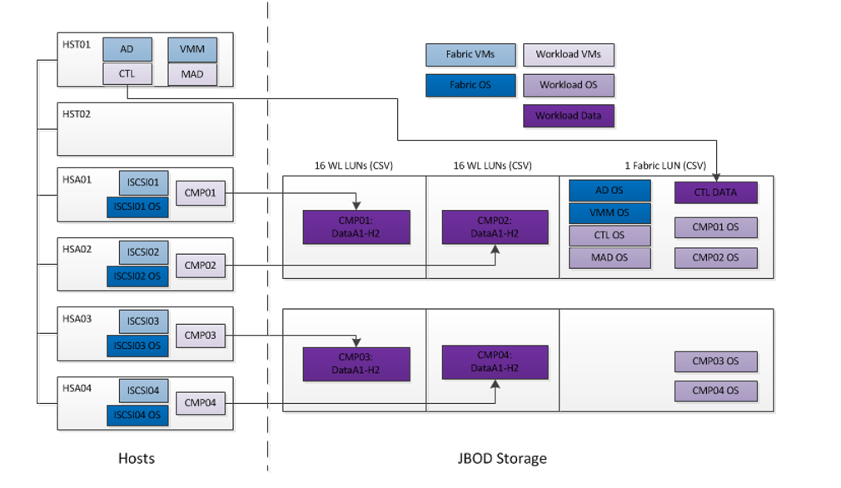
Windows 2012 Storage Spaces

Slide 24
Default Behavior
1 concurrency slot
Medium priority
~0.4 GB mem alloc.
MediumRC
3 concurrency slots
Medium priority
~1.2 GB mem alloc.
LargeRC
7 concurrency slots
High priority
~2.8 GB mem alloc.
XLarge RC
21 concurrency slots
High priority
~8.4 GB mem alloc.
Performance at Scale
Resource Classes
Resource classes are implemented as pre-built server roles, the user (DBA) can add or remove members into/from resource classes: ALTER SERVER ROLE resource_class_name { { ADD | DROP } MEMBER server_principal }
Each resource class maps to pre-built resource governor settings on compute nodes (control node is not governed).
PDW honors resource classes at run-time, no need to reconnect (though running queries continue unchanged)
By default, the product preserves current (V1) behavior. One has to explicitly opt-in to use resource classes.

