Slide 2
Fraud Detection: Notes from the Fields
DBI-B403
Dejan Sarka

Slide 3
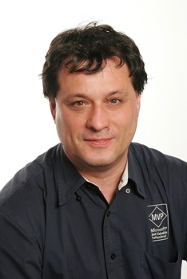
About Me
Dejan Sarka
dsarka@solidq.com
Mentor, SolidQ
Data Scientist
MCT, SQL Server MVP
25+ years of data modeling, data mining and data quality
11 books, writing more
3 courses

Slide 4
Agenda
Introduction
Data Preparation and Overview
Directed Models
Undirected Models
Measuring Models
Continuous Learning
Results

Slide 5
Introduction to Fraud Analysis
Fraud detection = outlier analysis
Graphical methods
OLAP cubes help in multidimensional space
Statistical methods
Single variable – must know distribution properties
Regression analysis – analysis of residuals
Data Mining methods
Directed models – must have existing frauds flagged
Undirected models – sort data from most to least suspicious

Slide 6
Resolving Frauds
Blocking procedure
Reject all suspicious rows
Consecutive (sequential) procedure
Test least likely outlier first, then next most extreme outlier, etc.
Learning procedure
Find frauds with directed mining methods and check as many as possible
Test from most to least likely outliers with undirected mining methods and check limited number of rows
Measure efficiency of the models and constantly change them

Slide 7
What Is an Outlier? (1)
About .96 of the distribution is between mean +- two standard deviations

Slide 8
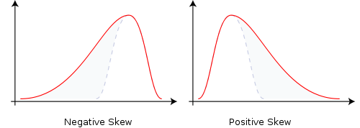
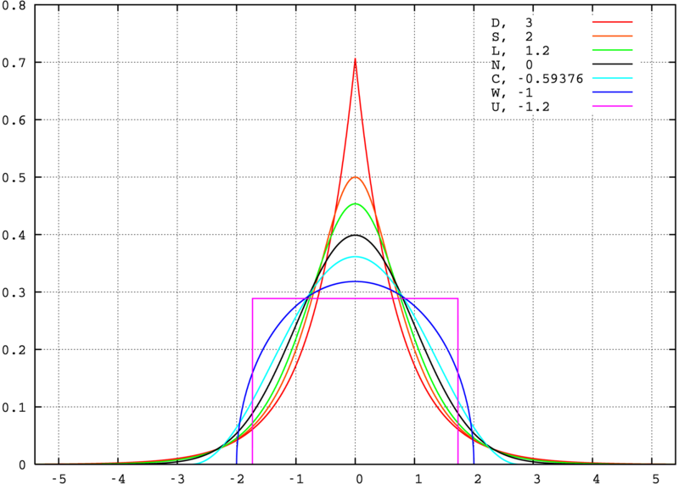
Skewness and Kurtosis
Skewness is a measure of the asymmetry of the probability distribution of a real-valued random variable
Kurtosis is a measure of the "peakedness" of the probability distribution of a real-valued random variable
Source of the graphs: Wikipedia

Slide 9
What Is and Outlier (2)
Outliers must be at least two (three, four,…) standard deviations from the mean, right?
Well, if the distribution is skewed, not true on one side
If it has long tails on both sides (high Kurtosis), not true on both sides
So, how much from mean should we go?
No way to get a definite answer
Start from other direction: how many rows can you inspect?
One person can inspect ~10,000 rows per day
Define outliers by the max. number of rows to inspect

Slide 10
Learning Procedure
Sure frauds reported by customers
Flagged and used for training directed models
Models predict frauds before customers reports
Still, a clerk has to do a check before blocking
Some rows tested with no previous knowledge
Patterns change, directed models become obsolete
Some frauds might even not be noticed and reported
Instead of random checks, use undirected models for sorting data from most to least likely frauds
Change and retrain directed models when obsolete
Learn when a model is obsolete through measuring

Slide 11
Two Examples
Italian bank – through Italian partner
Frauds in on-line transactions
Around 0.7% rows reported and flagged as frauds
Around 10,000 rows checked manually daily before the project
OLAP cubes already in place
Macedonian bank – through Macedonian partner
Frauds in credit card transactions
Around 0.5% rows reported and flagged as frauds
No rows checked manually before the project
OLAP cubes already in test

Slide 12
Data Preparation (1)
Problem: low number of frauds in overall data
Oversampling: multiply frauds
Undersampling: randomly select sample from non-fraudulent rows
Do nothing
What to use depends on algorithm and data
Microsoft Neural Networks work the best when you have about 50% of frauds
Microsoft Naïve Bayes work well with 10% frauds
Microsoft Decision Trees work well with any percentage of frauds

Slide 13
Data Preparation (2)
Domain knowledge helps creating useful derived variables
Flag whether we have multiple transactions from different IPs and same person in defined time window
Flag whether we have transactions from multiple persons and same IP in defined time window
Are multiple persons using the same card / account
Is amount of transaction close to the max amount for this type of transaction, or close to the min amount
Time of day, is day a holiday
Frequency of transactions in general
Demographics and more

Slide 14
Data Overview (1)
Graphical presentation
Excel
OLAP cubes & Excel, ProClarity, PowerPivot
Graphical packages
Statistics
Frequency distributions for discrete variables
First four population moments
Shape of distribution – can discretize in equal range buckets
Statistical packages

Slide 15
Data Overview (2)
SQL Server has not enough tools out of the box
Can enrich the toolset
Transact-SQL queries
CLR procedures and functions
OLAP cubes and PowerPivot
Office Data Mining Add-Ins
Standard and Power View reports
Nevertheless, for large projects might be worth investing in 3rd party tools

Slide 16
Demo
Enriching SQL Server toolset with custom solutions for data overview

Slide 17
Directed Models (1)
Create multiple models on different datasets
Different over- and undersampling options
Play with different time windows
Measure efficiency and robustness of the models
Split data in training and test sets
Lift chart for efficiency
Cross-validation for robustness
We are especially interested in true positive rate
Use Naïve Bayes to check Decision Trees input variables

Slide 18
Directed Models (2)
How many models should we create?
Unfortunately, the answer is only one: it depends
Fortunately, models can be built quickly, after the data is prepared
Prepare as many as time allows
How many cases should we analyze?
Enough to make the results “statistically significant”
Rule of thumb: 15,000 – max. 100,000

Slide 19
Demo
Directed models and evaluation of the models

Slide 20
Clustering (1)
Clustering is the algorithm to find outliers
Expectation – Maximization only
K-Means useless for this task
Excel Data Mining Add-Ins use Clustering for the Highlight Exceptions task
Simple to use
No way to influence on algorithm parameters
No way to create multiple models and evaluate them
Don’t rely on the column highlighted

Slide 21
Clustering (2)
How many clusters fit for input data the best?
The more the model fits to the data, the more likely is that outliers really are frauds
Create multiple models and evaluate them
No good built-in evaluation method
Possibilities
Make models predictive, and use Lift Chart
MSOLAP_NODE_SCORE
ClusterProbability Mean & StDev
Use average entropy inside clusters to find the model with best fit (with potential correction factor)
$$H\left(x\right)=\left(−1\right)∗\sum_{i=1}^{n}{(P(x_{i}})∗\log_{2}{(x_{i}))}$$

Slide 22
Demo
Clustering models and evaluation of the models

Slide 23
Harvesting Results
Harvest the results with DMX queries
Use ADOMD.NET to build them in an application
Actual results very good
Predicted 70% of actual frauds with Decision Trees
Had 14% of all frauds in first 10,000 rows with Clustering (20x lift to random selection!)
Be prepared on surprises!
However, also use common sense
Too many surprises typically mean bad models

Slide 24
Continuous Learning
Measure the efficiency of the models
Use Clustering models on data that was not predicted correctly by directed models to learn whether additional or new patterns exist
Use OLAP cubes to measure efficiency over time
For directed models, measure predicted vs. reported frauds
For clustering models, measure number of actual frauds in limited data set
Fraud detection is never completely automatic
Thieves learn, so we must learn as well!

Slide 25
Continuous Learning Cycle
Flag reported frauds
Create directed models
Predict on new data
Refine models
Check with control group
Cluster rest of data
Measure over time
Check with control group

Slide 26
Demo
Harvesting the results and measuring over time

Slide 27
Questions?

Slide 28
Related content
Predictive Analytics with Microsoft Big Data (DBI-B402)
Enriching Big Data for Analysis (DBI-B401)
Developing a Microsoft SQL Server 2012 Tabular BI Semantic Model Using SQL Server Data Tools (DBI-H205)
Exam 70-463: Implementing a Data Warehouse with Microsoft SQL Server 2012
Find Me Later At...

Slide 29
Resources
Learning
Sessions on Demand
Microsoft Certification & Training Resources
http://channel9.msdn.com/Events/TechEd
www.microsoft.com/learning
TechNet
msdn
Resources for IT Professionals
Resources for Developers
http://microsoft.com/technet
http://microsoft.com/msdn

Slide 30
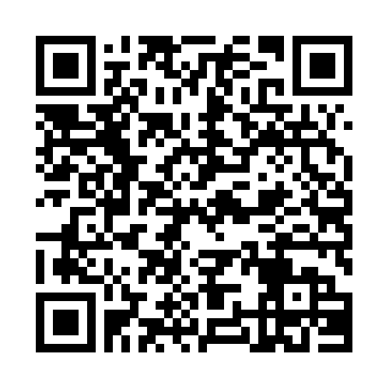
Evaluate this session
Required Slide
*delete this box when your slide is finalized
Your MS Tag will be inserted here during the final scrub.
Scan this QR code to
evaluate this session.

Slide 31
© 2013 Microsoft Corporation. All rights reserved. Microsoft, Windows and other product names are or may be registered trademarks and/or trademarks in the U.S. and/or other countries.
The information herein is for informational purposes only and represents the current view of Microsoft Corporation as of the date of this presentation. Because Microsoft must respond to changing market conditions, it should not be interpreted to be a commitment on the part of Microsoft, and Microsoft cannot guarantee the accuracy of any information provided after the date of this presentation. MICROSOFT MAKES NO WARRANTIES, EXPRESS, IMPLIED OR STATUTORY, AS TO THE INFORMATION IN THIS PRESENTATION.

