Slide 2
Tips and Tricks for Building Real-World International Windows Store Apps
DEV-B206
Yasser Makram
Independent Consultant

Slide 3
Opportunity

Slide 4
International Opportunity
Reach
200+ Countries
60+ Languages
Developers Can Submit from 121 Countries
Payment via Local Currency in 70+ Countries
Reference: http://msdn.microsoft.com/en-us/library/windows/apps/hh694064.aspx
http://msdn.microsoft.com/en-us/library/windows/apps/jj657969.aspx
Platform Support
Enhanced Windows Language Preferences
Extended Platform Support
Improved Tooling

Slide 5
Technical Challenges

Slide 6
Strings - HTML
Store string resources in JSON formatted RESJSON files
Name your resource files resources.resjson to be auto loaded.
Bind resource with data-win-res custom attribute.
Binding format: data-win-res=“{property1: ‘resourceid1’, property2: ‘resourceid2’}”.
Property name cannot be reserved JavaScript keyword, for example use className instead of class.
Don't forget to call WinJS.Resources.processAll.
Use WinJS.Resource.getString(‘resourceis’) to get a resource string programmatically.
Use ResourceManager for more advanced tasks like loading resource of specific cultures

Slide 7
Strings - XAML
Store string resources in XML formatted RESW files
Name your resource files resources.resw to be auto loaded.
Bind resource with x:Uid
Use resourceId.PropertyName to bind to a specific property
Resource binding is not limited to string properties.
You can bind to BackgroundColor for example by specifying Red or #FFFF0000 in the resource file.
Custom converters are not supported directly. The workaround is to bind to a custom resource loader.
Binding to attached properties is supported. But you have to use the fully qualified name. Example resourceId.[using:Windows.UI.Xaml.Controls]Grid.Column

Slide 8
Multilingual App Toolkit
Manage translation workflow.
Works with both HTML and XAML
Use pseudo language for testing localization.
Make sure that your default language has all resource values.
Translations are stored in OASIS standard XLIFF files.
Start by auto machine translation.
Manage the translation review process with MAT GUI or 3rd party tools.

Slide 9
Demo
Localizing Text with Multilingual App Toolkit

Slide 10
Images and File Resources
Use ms-appx, or ms-resource URI to load resource files
Applies to images, audio, video, even script, XAML and css files.
File loading qualifiers
Culture
Scale
Contrast
You can use WinJS.xhr with ms-appx URI
You cannot use relative URIs from code
Use StorageFile.GetFileFromApplicationUriAsync to load resource files.

Slide 11
Culture Specific Layout
File loading heuristic is not limited to static files.
Culture specific HTML and XAML files can be used.
Script loading follows the same rules.
Use -ms-lang pseudo class
Useful for enabling/disabling features for specific cultures
Useful for cultures requiring tweaked layout like RTL languages

Slide 12
Demo
Localizing Images and Files

Slide 13
Dates, Numbers and Currency
Use Windows.Globalization instead of CultureInfo
Use Windows.Globalization.DateTimeFormatting.DateTimeFormatter to format and parse dates
Use Windows.Globalization.NumberFormatting to format and parse decimals, percentages, and currency
Use INumberFormatterOptions.NumeralSystem to get or set the glyphs to represent numbers

Slide 14
General Tips
Localize app name
Respond to system prederences change
Your default language should have all resource identifiers defined
Let the user override the default system language preferences for our app
Use online services that supports localization, for example bing maps.

Slide 15
Demo
Putting it all together

Slide 16
Q & A http://www.silverlightrecipes.com http://www.barm.ag yasser@silverlightrecipes.com @yassermakram

Slide 17
Resources
Learning
Sessions on Demand
Microsoft Certification & Training Resources
http://channel9.msdn.com/Events/TechEd
www.microsoft.com/learning
TechNet
msdn
Resources for IT Professionals
Resources for Developers
http://microsoft.com/technet
http://microsoft.com/msdn

Slide 18
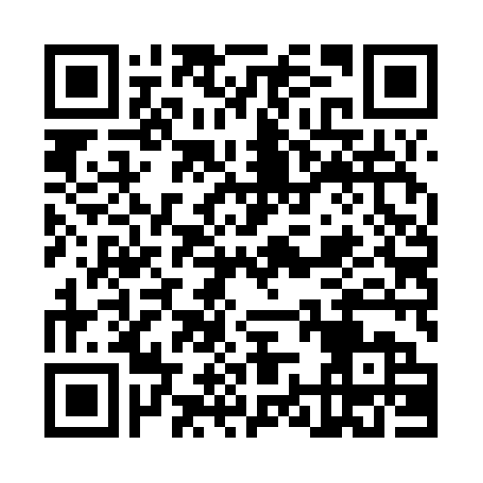
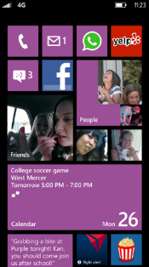
Evaluate this session
Required Slide
*delete this box when your slide is finalized
Your MS Tag will be inserted here during the final scrub.
Scan this QR code to
evaluate this session.

Slide 19
© 2013 Microsoft Corporation. All rights reserved. Microsoft, Windows and other product names are or may be registered trademarks and/or trademarks in the U.S. and/or other countries.
The information herein is for informational purposes only and represents the current view of Microsoft Corporation as of the date of this presentation. Because Microsoft must respond to changing market conditions, it should not be interpreted to be a commitment on the part of Microsoft, and Microsoft cannot guarantee the accuracy of any information provided after the date of this presentation. MICROSOFT MAKES NO WARRANTIES, EXPRESS, IMPLIED OR STATUTORY, AS TO THE INFORMATION IN THIS PRESENTATION.

