Slide 2
Getting a Designer/Developer Workflow That Works
DEV-B208
Chris Klug
chris@activesolution.se
@ZeroKoll

Slide 3
Who is that guy?

Slide 4
Juicy Salif
Source: Alessi

Slide 5
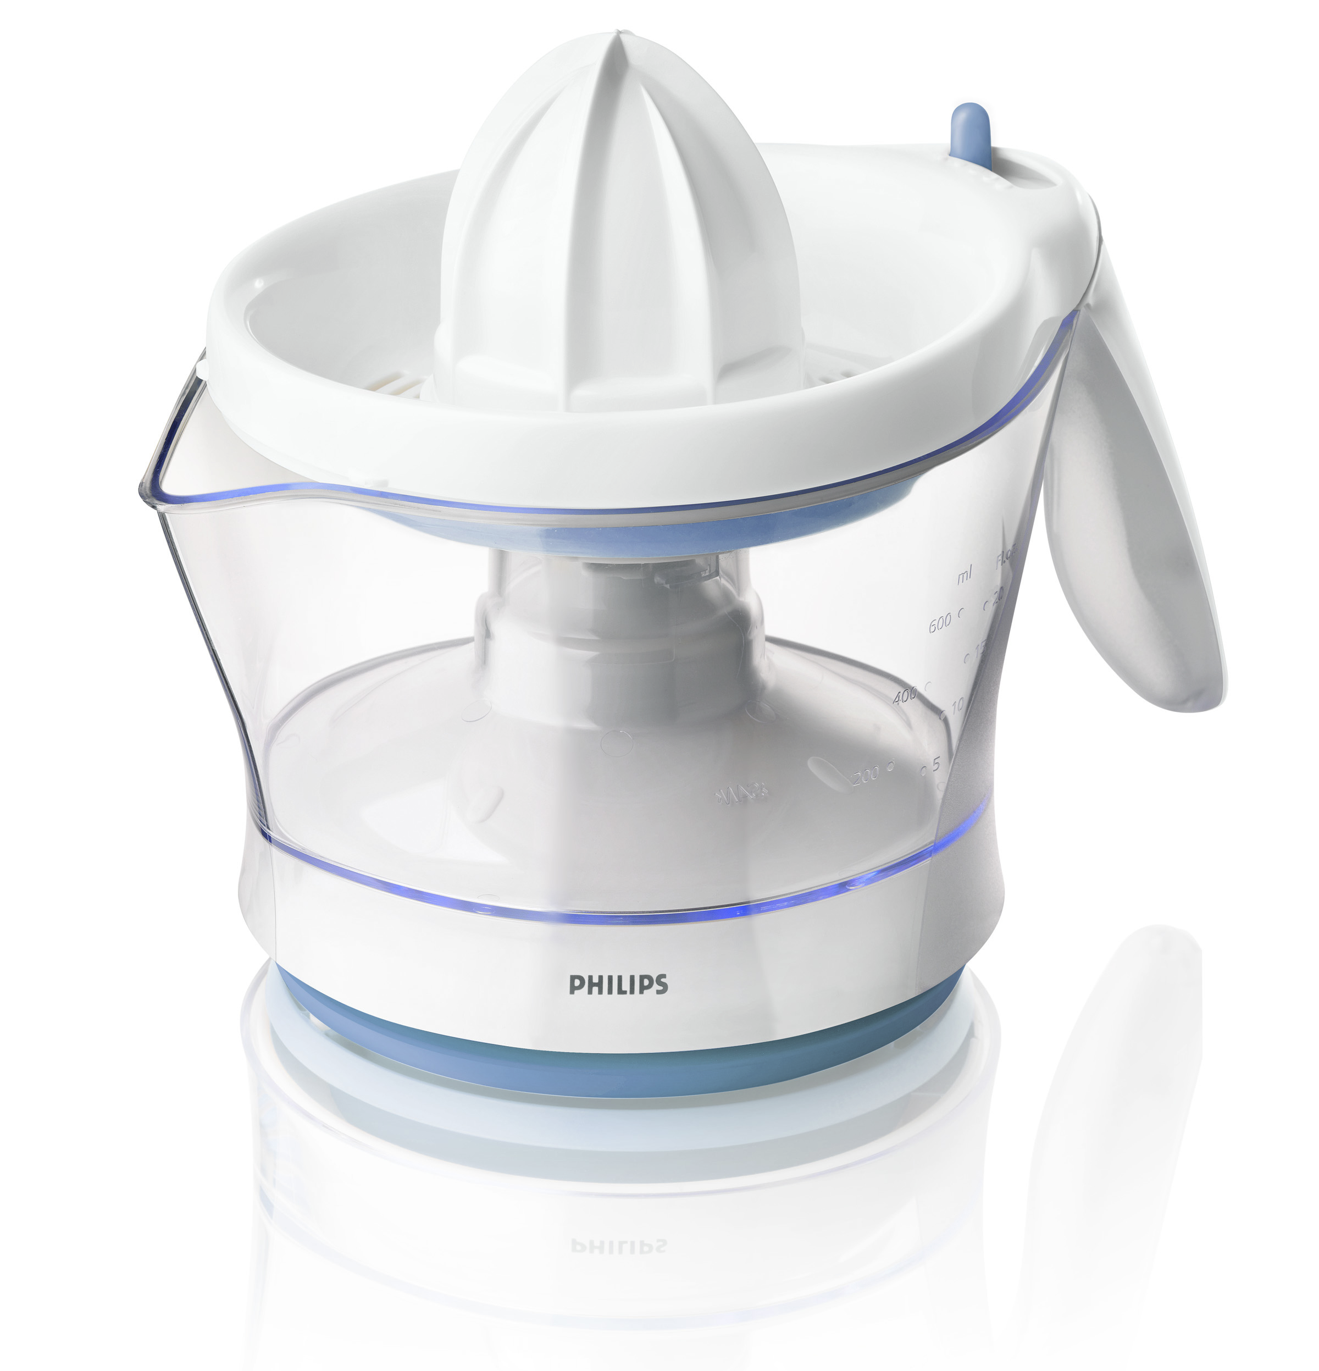
Philips HR2744/40
Source: Alessi

Slide 6
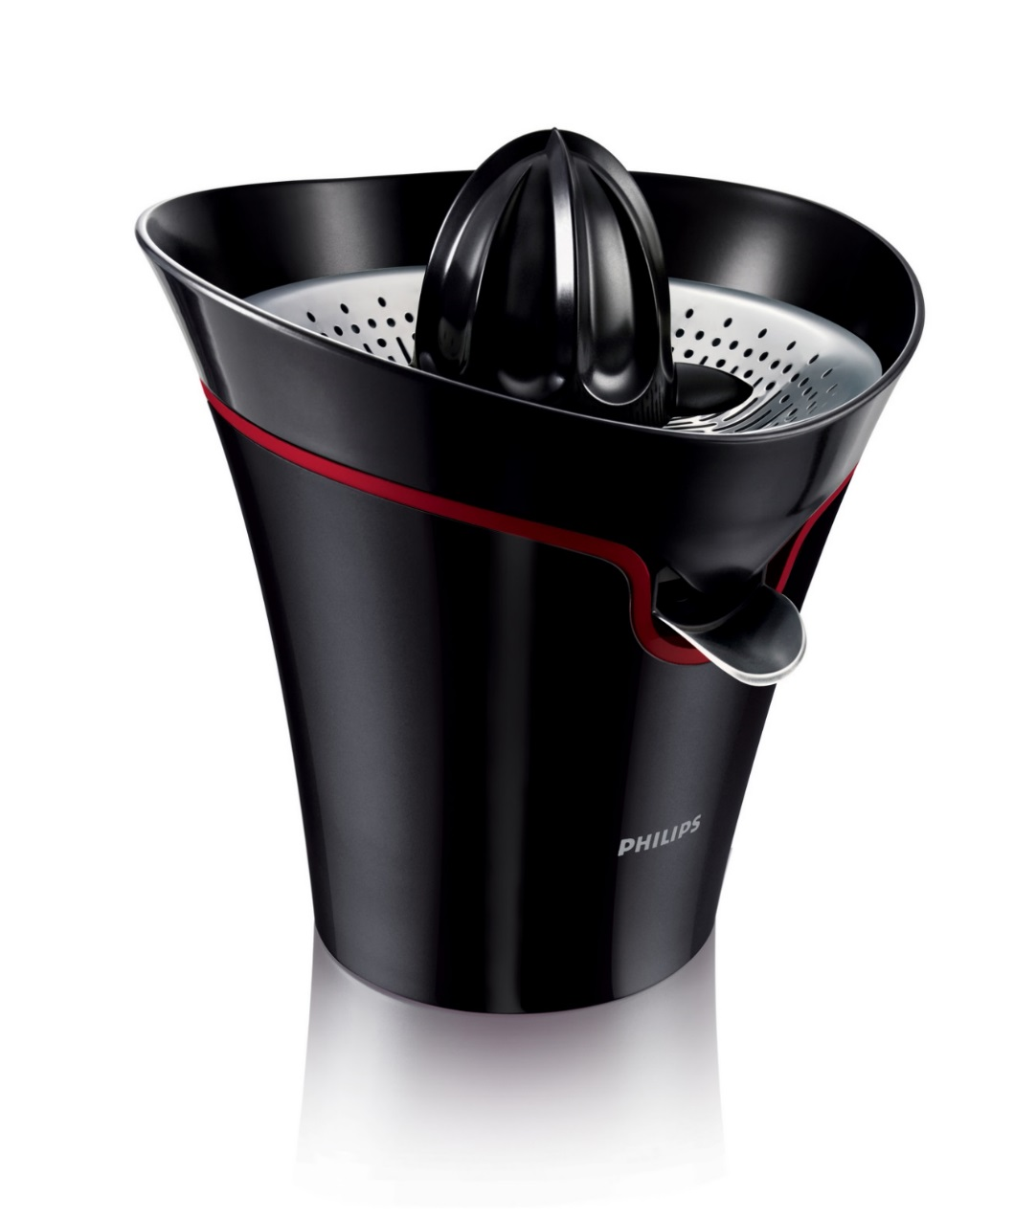
Philips HR2752/90
Source: Alessi

Slide 7
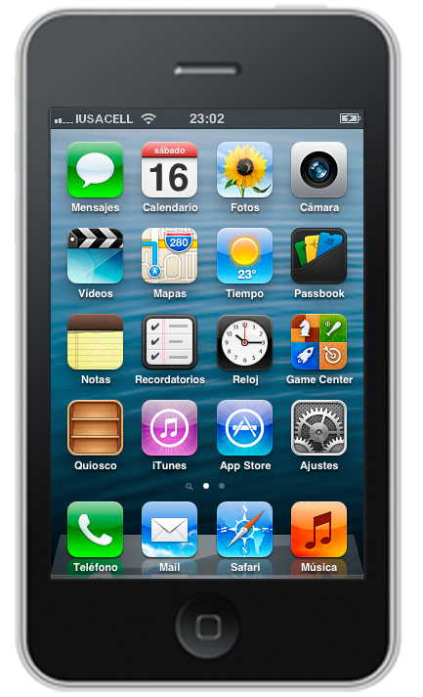
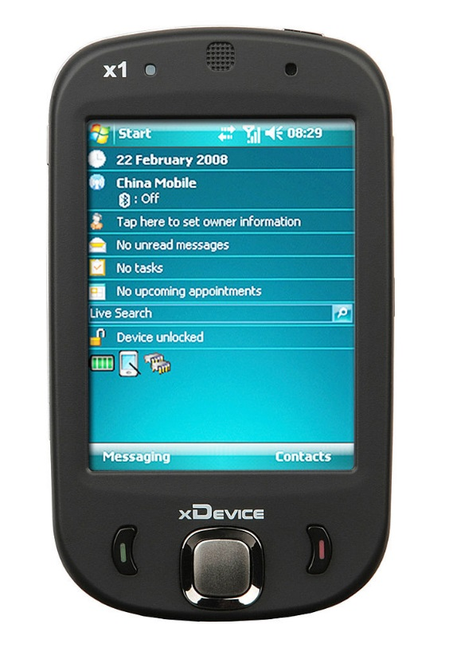
By S.SAMNAD.S (Own work) [CC-BY-SA-3.0 (http://creativecommons.org/licenses/by-sa/3.0)], via Wikimedia Commons
By Miosw (Own work) [CC-BY-SA-3.0 (http://creativecommons.org/licenses/by-sa/3.0)], via Wikimedia Commons
By FanHabbo (Own work) [CC-BY-SA-3.0 (http://creativecommons.org/licenses/by-sa/3.0)], via Wikimedia Commons
By Pietro Schirano [Attribution],
via Wikimedia Commons

Slide 8
“There is no such thing as no design, only bad design”

Slide 9
I believe…

Slide 10
I don’t believe…

Slide 11
Disclaimer Feelings might get hurt during presentation due to the speakers generalizations and assumptions. Do not feel bad if they do. Generalization and assumptions are used to simplify and highlight…

Slide 12
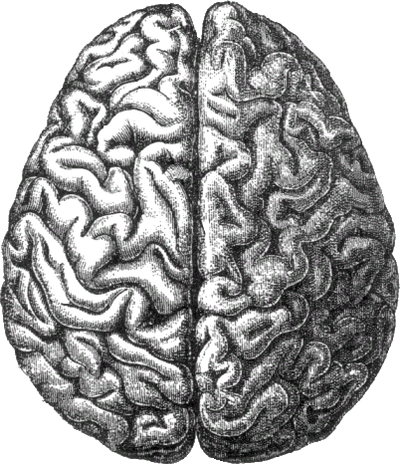

Slide 13
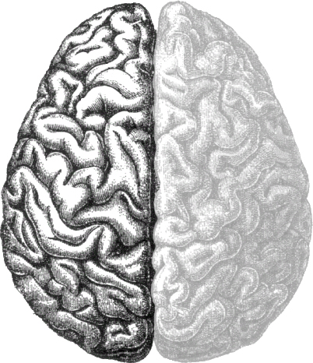
Logical / Developer

Slide 14
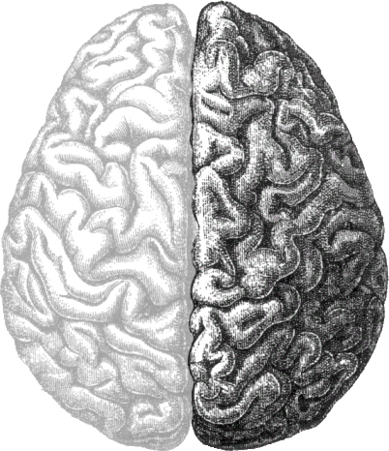
Creative / Designer

Slide 16
The “Players”

Slide 17
Developer “Makes it work” Builds functionality Writes code Adds bugs Fixes bugs

Slide 18
Designer “Makes it an experience” Defines application layout Ensures usability Creates visual design Adds “client feeling”

Slide 19
Communication Team lead Development team “Product owner”

Slide 20
Communication Customer “Product owner”

Slide 21
Tools Visual Studio Expression Blend Team Foundation Server Bing/Google

Slide 22
Tools Paper & Sharpie Balsamiq Adobe Suite (Expression Design)

Slide 23
Combining left & right Introducing the “devigner”

Slide 24
Devigner “Converts visuals to functional UX” Adds transitions and other UX features Combines data and functionality from the VM in the View

Slide 25
Communication Development Team Designer Customer

Slide 26
Tools Adobe Suite Expression Blend Visual Studio Team Foundation Server

Slide 27
Enough fluff…

Slide 28
Tweet-a-licious A desperately contrived example using Twitter

Slide 29
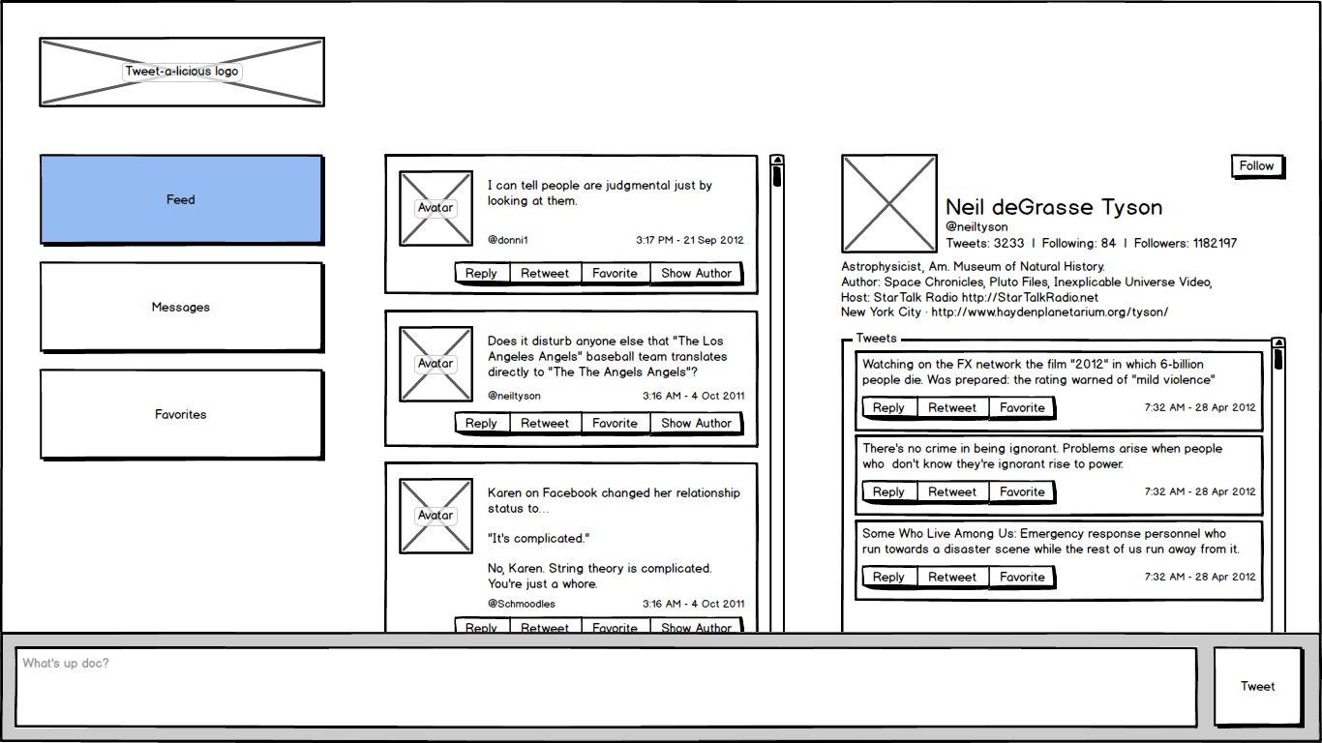

Slide 30
Client approval

Slide 31
Pulling wireframes apart But…we just built them…

Slide 32
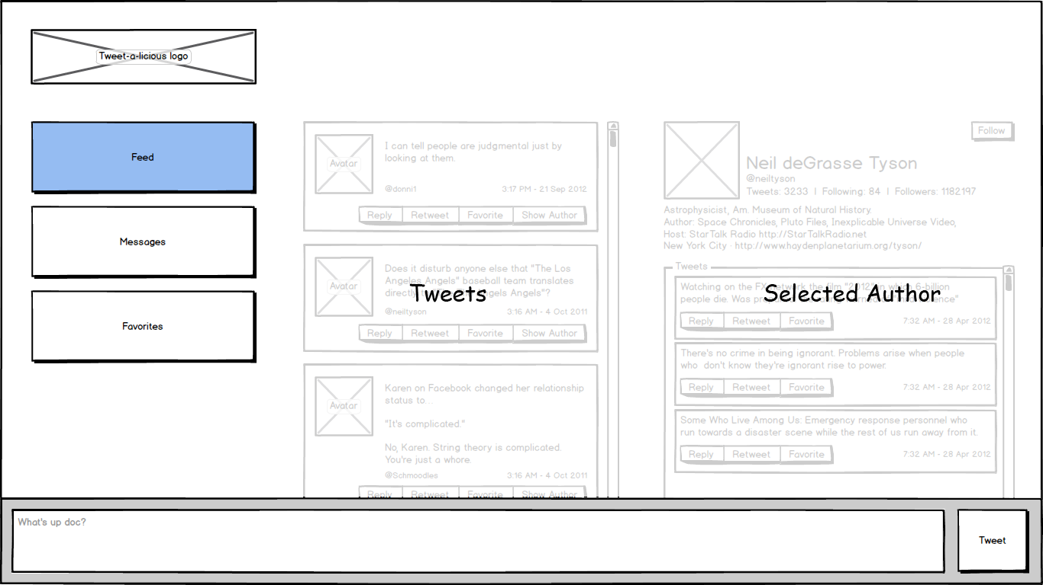
public class MainViewModel {
public string TweetText { get; set; }
public bool IsLoadingTweets { get; }
public IEnumerable<TweetViewModel > Tweets { get; }
public bool IsLoadingAuthor { get; }
public AuthorViewModel SelectedAuthor { get; }
public ICommand ShowFeed { get; } public ICommand ShowMessages { get; } public ICommand ShowFavorites { get; } public ICommand SendTweet { get; } }

Slide 33
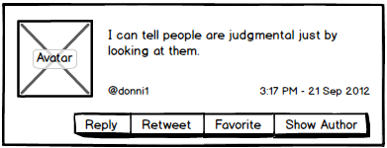
public class TweetViewModel {
public string Text { get; }
public string Author { get; }
public DateTime Published { get; }
public ImageViewModel Avatar { get; }
public ICommand Reply { get; } public ICommand Retweet { get; } public ICommand Favorite { get; } public ICommand ShowAuthor { get; }
}
public class ImageViewModel {
public ImageSource Image { get; }
public bool IsLoading { get; }
}

Slide 34
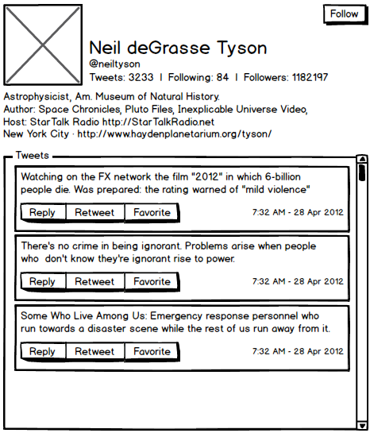
public class AuthorViewModel {
public string Name { get; }
public string Handle { get; }
public string Introduction { get; }
public ImageViewModel Avatar { get; }
public int TweetCount { get; }
public int FollowCount { get; }
public int FollowerCount { get; }
public bool IsLoadingTweets { get; }
public IEnumerable<TweetViewModel > Tweets { get; }
public ICommand Follow { get; }
}

Slide 35
Outcome? Mutual understanding, love and peace…and VM-stub interfaces of course…

Slide 36
Time to multitask Finishing early is often appreciated when it comes to software development

Slide 37
Create visual design

Slide 38
Set up Set up solution Create stub VMs Create basic UI Configure basic UI to use stubs

Slide 39
Be helpful

Slide 40
Demo: Dev UI and stub VMs

Slide 41
Hand over visual design Hand over visual design to “devigner” Explain visual design to “devigner” Go into supporting mode

Slide 42
Create application structure Add frameworks Set up DI etc

Slide 43
Get understanding of visual design

Slide 44
Demo: Setting up DI

Slide 45
Implement functionality Define & implement services Implement VM functionality

Slide 46
Convert Visual Design To XAML/HTML Add transitions etc to UI Behaviors, jQuery etc

Slide 47
Demo: Styling the UI

Slide 48
Switch application from stub VMs to real VMs

Slide 49
Demo: Setting up VM location

Slide 50
Application done! It might not be bug free, but it is running…

Slide 51
Potential tweaks Duplicate views Automated view tests Design-time data from Blend Merging roles Conditional design-time assembly reference

Slide 52
Considerations When to introduce roles during project Behavior library Design-time data differences between Blend & VS

Slide 53
Questions? ”There is no such thing as a stupid question” chris@59north.com @ZeroKoll http://chris.59north.com/

Slide 54
Resources
Learning
Sessions on Demand
Microsoft Certification & Training Resources
http://channel9.msdn.com/Events/TechEd
www.microsoft.com/learning
TechNet
msdn
Resources for IT Professionals
Resources for Developers
http://microsoft.com/technet
http://microsoft.com/msdn

Slide 55
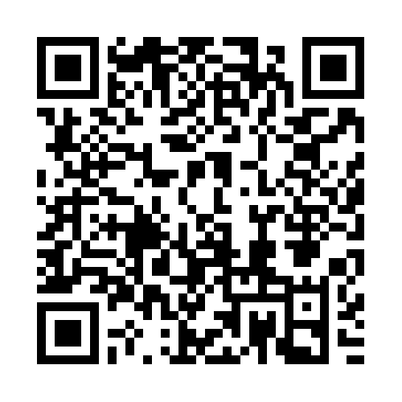
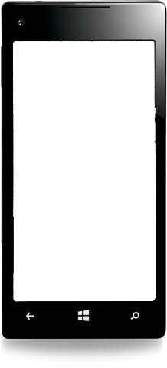
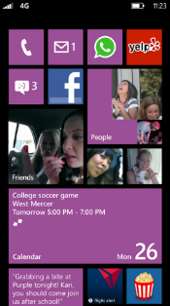
Evaluate this session
Required Slide
*delete this box when your slide is finalized
Your MS Tag will be inserted here during the final scrub.
Scan this QR code to
evaluate this session.

Slide 56
© 2013 Microsoft Corporation. All rights reserved. Microsoft, Windows and other product names are or may be registered trademarks and/or trademarks in the U.S. and/or other countries.
The information herein is for informational purposes only and represents the current view of Microsoft Corporation as of the date of this presentation. Because Microsoft must respond to changing market conditions, it should not be interpreted to be a commitment on the part of Microsoft, and Microsoft cannot guarantee the accuracy of any information provided after the date of this presentation. MICROSOFT MAKES NO WARRANTIES, EXPRESS, IMPLIED OR STATUTORY, AS TO THE INFORMATION IN THIS PRESENTATION.

