Slide 2
Agile Software Development with Microsoft Visual Studio ALM
DEV-B212
Gregg Boer Martin Woodward

Slide 3
What is this talk?
Tune continually
Set game rules
Control Debt
Measure based on output
Trust your teams
Visual Studio ALM Transformation

Slide 4
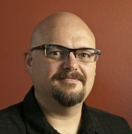
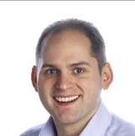
DEV-B321
Improving Developer Productivity and Software Quality with Microsoft Visual Studio Application Lifecycle Tools
DEV-B323
Deep Dive into the Team Foundation Server Agile Planning Tools
DEV-B330
Flexible Source Control with Team Foundation Service and Git
DEV-B215
Taking ALM to the Cloud with the Team Foundation Service

Slide 5
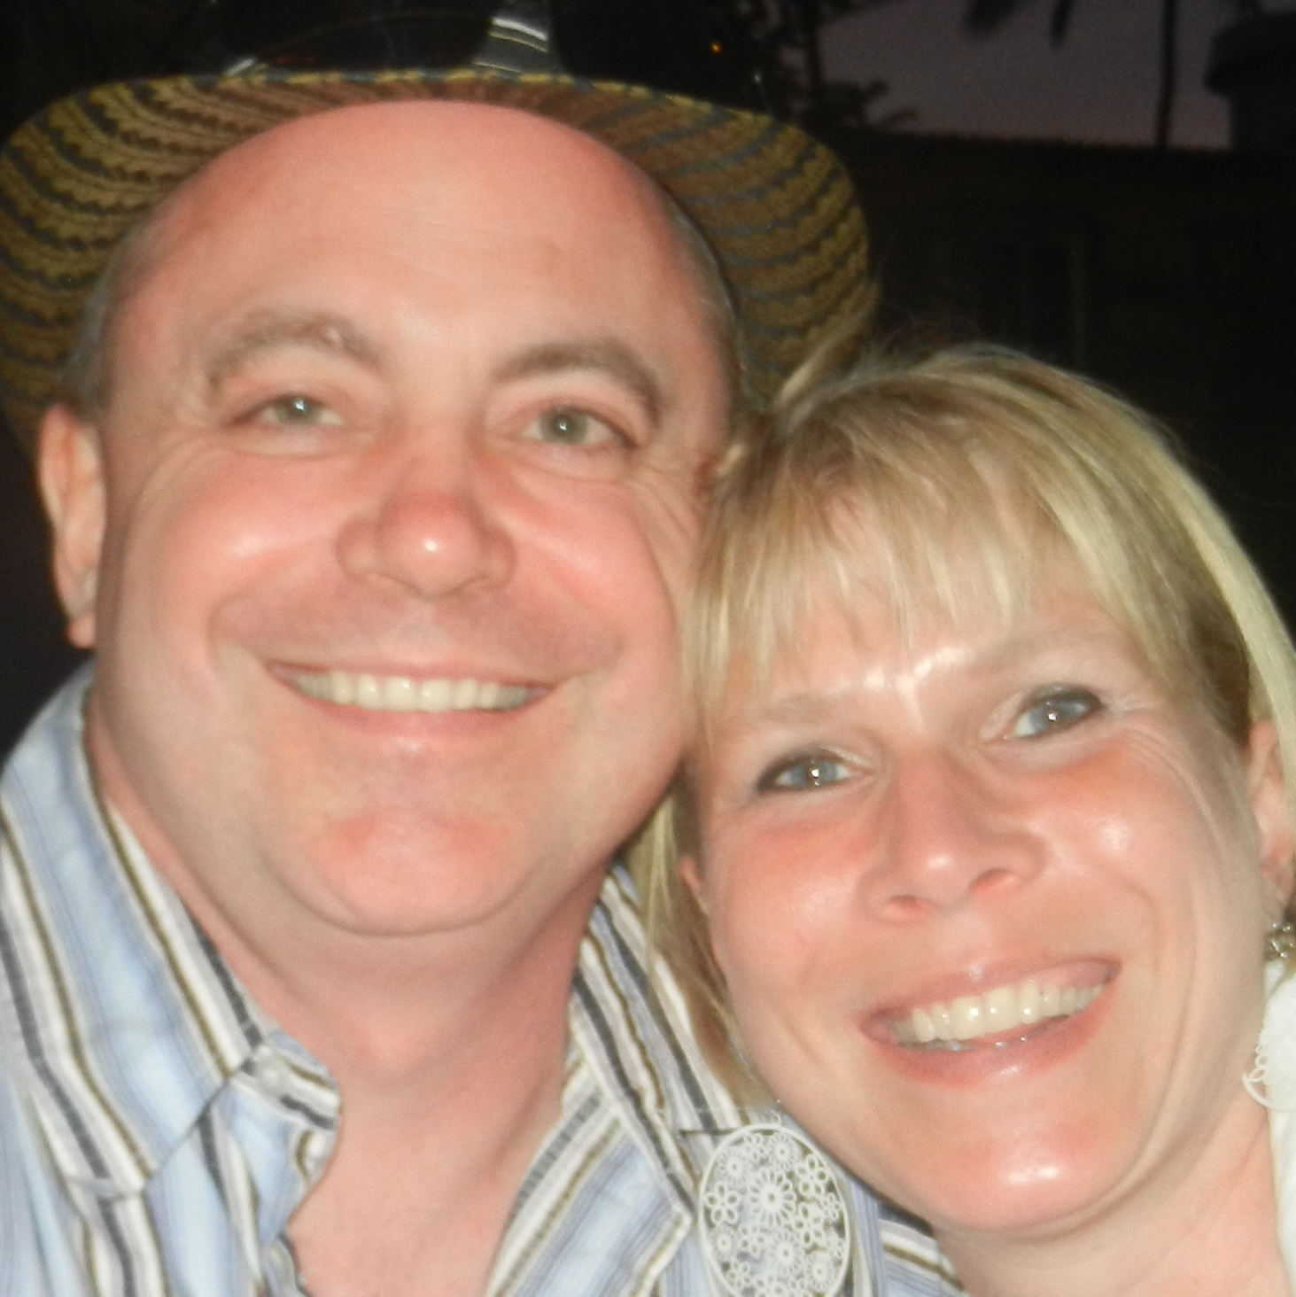
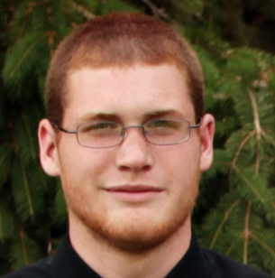
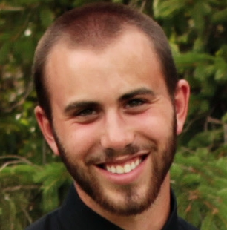
Who is Gregg?
Iowa farm boy
Married (25 years)
3 boys
Home-brewing
26 years in software
8 years @ Microsoft
Agile
Married
25
years
Home Brewing

Slide 6
Martin Woodward
martinwo@microsoft.com
@martinwoodward
http://woodwardweb.com
http://radiotfs.com

Slide 7
tinyurl.com/ proalm12

Slide 8
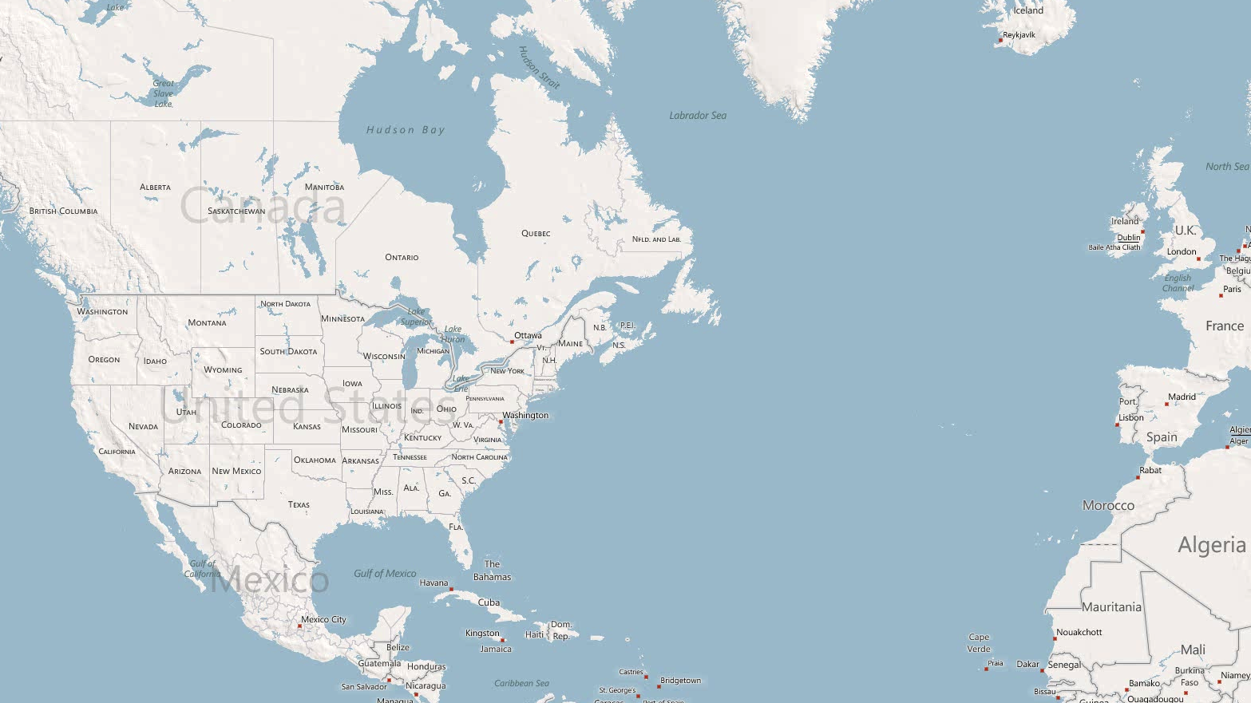

Slide 9
A
B

Slide 10
Our transition
Planning
Feature Development
Stabilization
2 years
3 months
3 wks

Slide 11
What’s Changed?
TFS 2008
10 – 12 weeks
TFS 2010
6 weeks
TFS 2012
3 weeks
Jan
Feb
Mar
Apr

Slide 12
A shift from control…
Control
Environment

Slide 13
… environment
Control
Environment

Slide 14
Control vs. Environment What’s your focus?

Slide 15
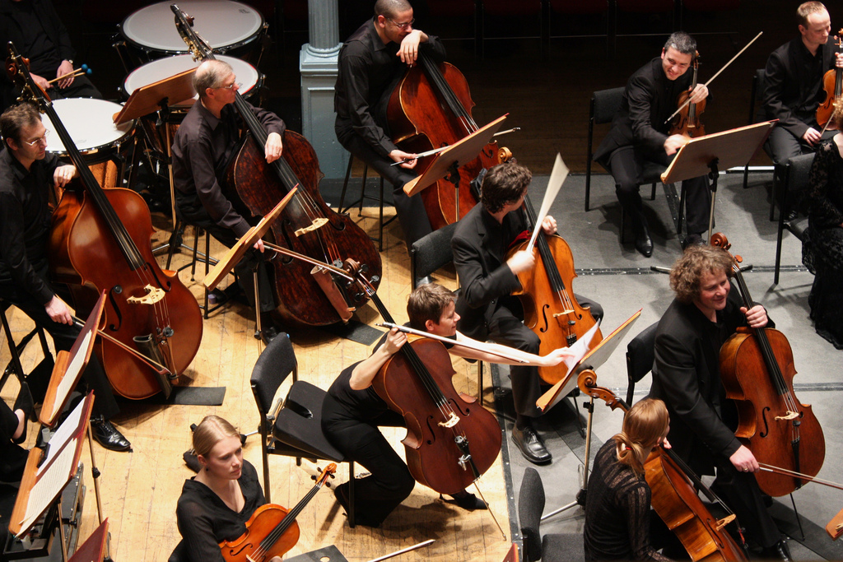
Retrospectives
At regular intervals, the team reflects on how to become more effective, then tunes and adjusts its behavior accordingly.
Tune and adjust
The teams behavior

Slide 16
Retrospectives
At regular intervals, the team reflects on how to become more effective, then tunes and adjusts its behavior accordingly.
Tune and adjust
The teams behavior

Slide 17
Retrospectives
At regular intervals, the team reflects on how to become more effective, then tunes and adjusts its behavior accordingly.
Tune and adjust
The teams behavior

Slide 18
Retrospectives
At regular intervals, the team reflects on how to become more effective, then tunes and adjusts its behavior accordingly.
Tune and adjust
The teams behavior

Slide 19
Retrospectives
At regular intervals, the team reflects on how to become more effective, then tunes and adjusts its behavior accordingly.
Tune and adjust
The teams behavior

Slide 20
Retrospectives
What did we do well
What could we do better
How do we improve
Tune and adjust
The teams behavior

Slide 21
Retrospectives
TFS 2008
10 – 12 weeks
TFS 2010
6 weeks
TFS 2012
3 weeks
Jan
Feb
Mar
Apr

Slide 22
Is your team regularly adjusting its behavior?

Slide 23
Play the same game
What is the object?
What are the rules?
How do you keep score?
Rules
Score

Slide 24
Alignment vs. Autonomy

Slide 25
Iteration Length
VS
TFS
VSTS
VS
TFS
VS
VSTS
TFS
VSTS
VS
TFS
VSTS
2008
2010
2012
2013

Slide 26
Area Paths – Where is the work?
2008
2010
2012
2013
Relative count of root area paths used in Visual Studio releases

Slide 27
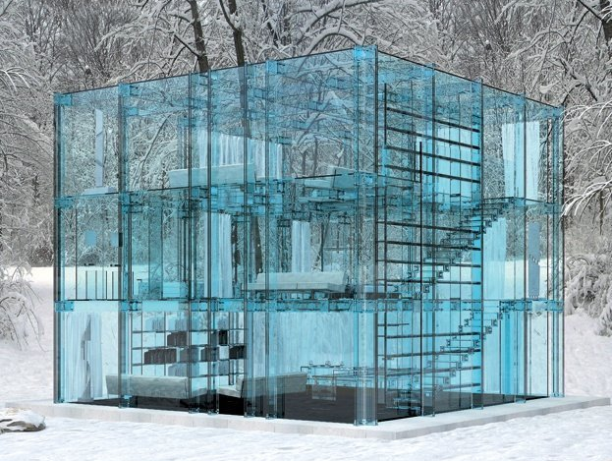
Data Transparency

Slide 28
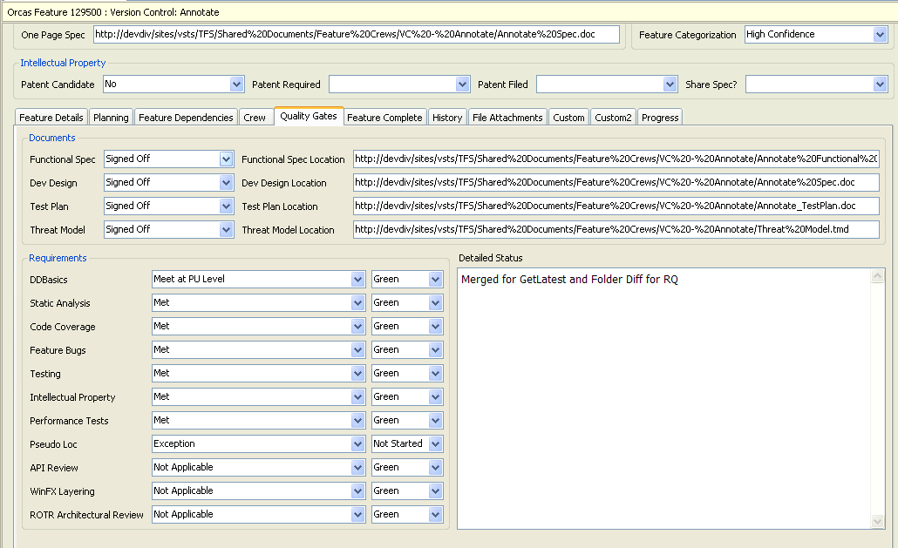
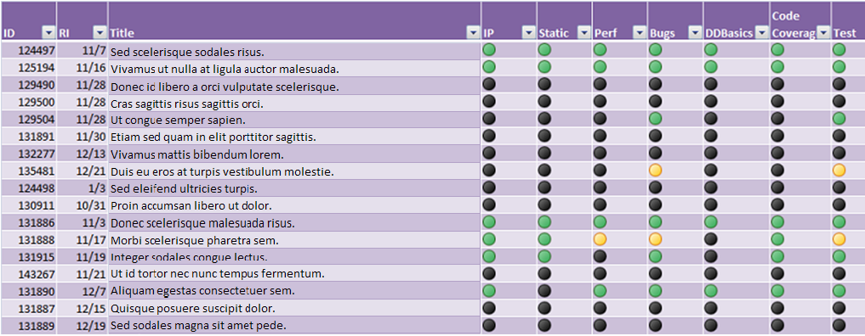
Exit Criteria - 2008

Slide 29
Exit Criteria - 2013
Performance
Globalization
Localization
Accessibility
Security
Test runs
3 months
3 wks

Slide 30
Are your teams playing the same game you are?

Slide 31
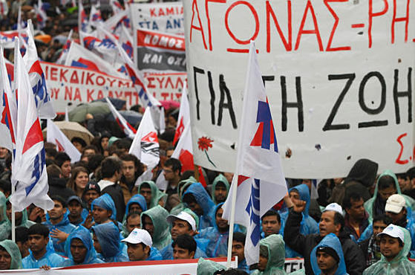
Debt
Bugs debt
Technical debt
Feature debt
Done, Done debt
Bugs
Interest

Slide 32
Bug Debt

Slide 33
Bug Cap

Slide 34
Technical Debt

Slide 35
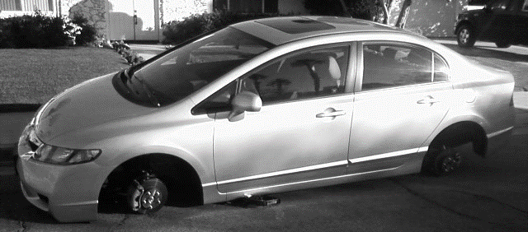
Feature Debt

Slide 36
Done, Done Debt
Performance
Globalization
Localization
Accessibility
Security
Test runs

Slide 37
How much debt are your teams carrying?

Slide 38
You Get What You Measure
Measurement affects outcomes
Tools enable new ways to measure, but should you?
Outcomes
Tools

Slide 39
Planning for debt
Doh!
Yay, we’re done!
Construction
Stabilize
1 year
1 year

Slide 40
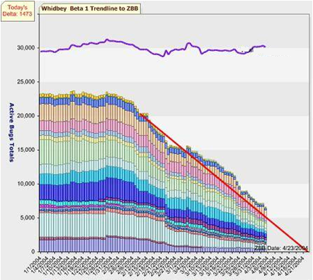
A bug creation machine?
When management tracks features using bugs as the primary measure…
You get piles of code, and piles of bugs.

Slide 41
What do we measure now?
Features Completed
Bug Cap
Performance
Globalization
Localization
Accessibility
Security
Test runs

Slide 42
It all comes down to this:
Definition of Done

Slide 43
What are you measuring? What does that produce? What should you be measuring?

Slide 44
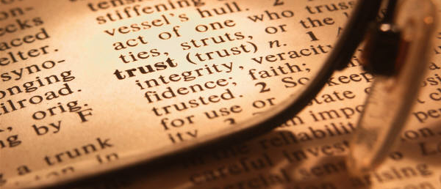
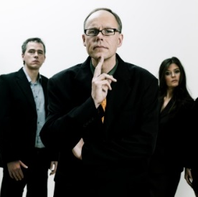
Trust
Leadership needs to trust the team to deliver production quality software
The team needs to trust themselves to deliver production quality software

Slide 45
Are your teams trusted to ship software?
Every team?

Slide 46
Summary
Tune continually
Set game rules
Control Debt
Measure based on output
Trust your teams
Environment

Slide 47
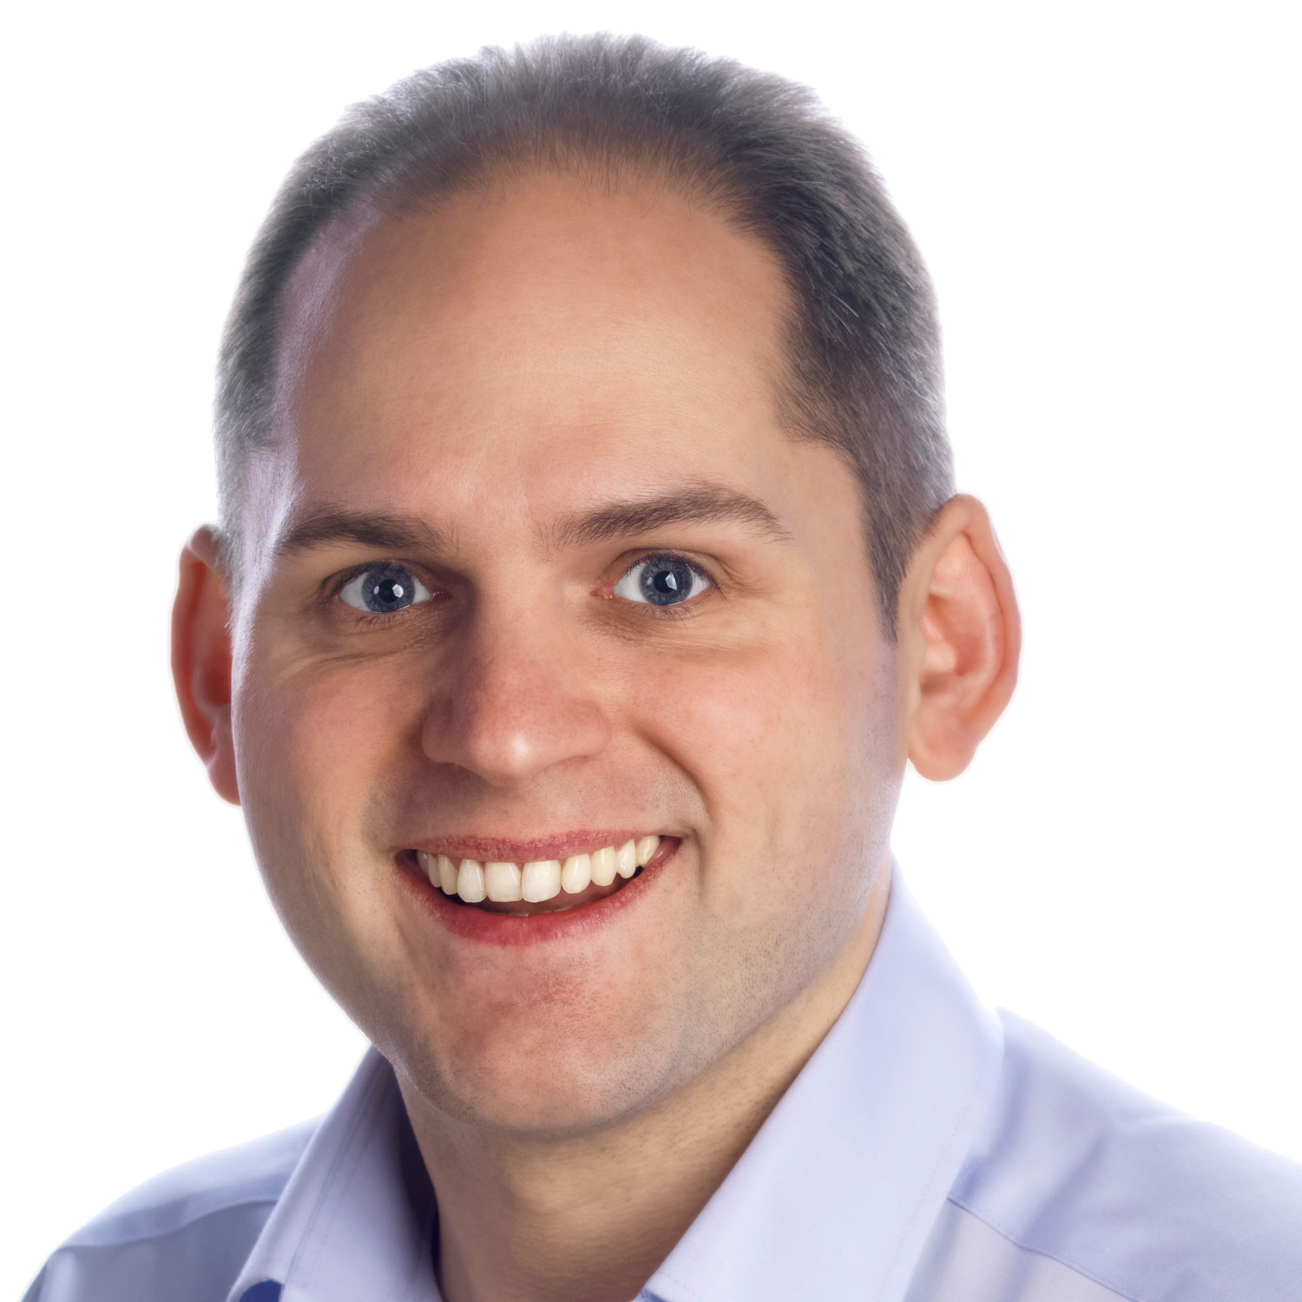
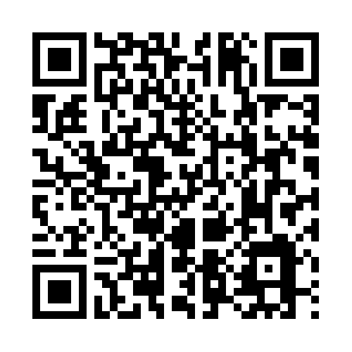
Thanks!
Gregg Boer
Program Manager
greggboe@microsoft.com
@greggboer
Marin Woodward
Program Manager
martinwo@microsoft.com
@martinwoodward

Slide 48
ALM Sessions - Tuesday
FDN05: Modern Application Lifecycle Management
Brian Keller
DEV-B321: Improve Developer Productivity and Software Quality with Visual Studio Application Lifecycle Tools
David Starr - 5:00 to 6:15 PM @ Hall 4-4

Slide 49
ALM Sessions - Wednesday
DEV-B323: Deep Dive into the Team Foundation Server Agile Planning Tools
Greg Boer - 8:30 to 9:45 AM @ Hall 4-4
DEV-B330: Flexible Source Control with Team Foundation Service and Git
Martin Woodward - 12:00 to 1:15 PM @ Hall 4-5

Slide 50
ALM Sessions – Thursday
DEV-B327: Software Testing with Microsoft Test Manager 2012 and Lab Management 2012
Brian Keller - 10:15 to 11:30 am @ Hall 4-5
WAD-B304: Cloud-powered Load Testing with Team Foundation Service
Anu Bharadwaj - 10:15 to 11:30 am @ Hall 4-4

Slide 51
Resources
Learning
Sessions on Demand
Microsoft Certification & Training Resources
http://channel9.msdn.com/Events/TechEd
www.microsoft.com/learning
TechNet
msdn
Resources for IT Professionals
Resources for Developers
http://microsoft.com/technet
http://microsoft.com/msdn

Slide 52
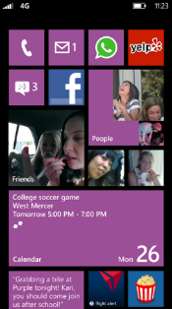
Evaluate this session
Required Slide
*delete this box when your slide is finalized
Your MS Tag will be inserted here during the final scrub.
Scan this QR code to
evaluate this session.

Slide 53
© 2013 Microsoft Corporation. All rights reserved. Microsoft, Windows and other product names are or may be registered trademarks and/or trademarks in the U.S. and/or other countries.
The information herein is for informational purposes only and represents the current view of Microsoft Corporation as of the date of this presentation. Because Microsoft must respond to changing market conditions, it should not be interpreted to be a commitment on the part of Microsoft, and Microsoft cannot guarantee the accuracy of any information provided after the date of this presentation. MICROSOFT MAKES NO WARRANTIES, EXPRESS, IMPLIED OR STATUTORY, AS TO THE INFORMATION IN THIS PRESENTATION.

