Slide 2
Partner Solutions for Modernizing .NET apps Application s
DEV-B218
Cesar De Ia Torre, Microsoft
Federico Zoufaly, Mobilize.Net
Dean Ellis, Xamarin
Bruce Franson, Citrix Labs

Slide 3
Cesar De la Torre
.NET Product Manager
Microsoft Corp.
cesardl@Microsoft.com
@cesardelatorre

Slide 4
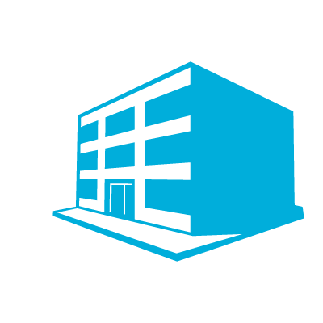
Modern Business Applications
Emerging application patterns
Elastic Cloud
and Hybrid
New
Experiences
End-user centric
Innovation
Mobility & Cloud
Established application patterns
Small/Medium
Business Applications
Large Mission-Critical
Business Applications
Extending
Evolving
Foundational applications for the business
Web and desktop applications
Centered on existing business processes
Long-Term
Core-Business
Productivity
Easy to get started
Foundational
Business
Fixed
On-Premises

Slide 5
Bring Your Applications to the Future: The case for VB6
Federico Zoufaly, Mobilize.Net

Slide 6
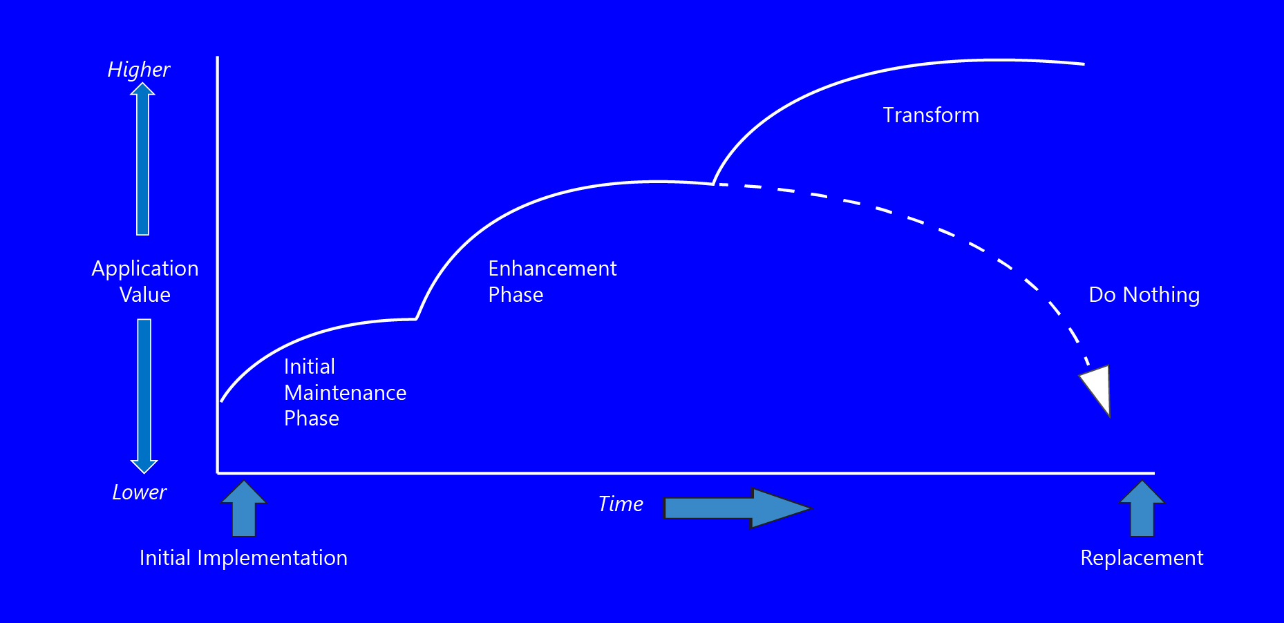
Application Value Lifecycle

Slide 7
Windows XP is Pervasive, So is VB6
Less than half of enterprises have started shift off XP¹
Customers tethered to XP because of legacy apps²
VB 6 is the most popular and successful development tool
Gartner estimates 24 billion lines of VB6 in production*
A developer survey conducted by Microsoft in UK showed 85% of the people interviewed are from organizations maintaining VB6 applications.
Win7
WinXP
10 B LOC
¹Camwood, 2013
²Paul Thurrott,, The Next Web, Apr 10, 2013

Slide 8
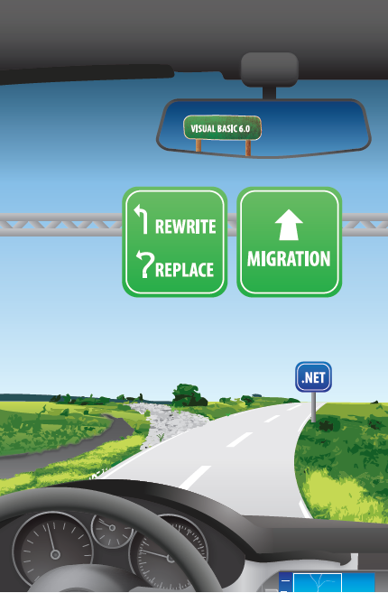
What Now?

Slide 9
Application Renewal Options
Re-write
Migrate
Custom
Business Value
Replace
Reuse
Standard
Low
High
Application Quality

Slide 10
Options for Modernizing Abound
Manual Rewrite
Replicate existing functionality for modern platforms
Rewrite costs 4 times more than migration
Huge failure rates*
Packaged Software
Purchase commercial off-the-shelf LOB apps
Business forced to adapt to applications
Re-training of employees and IT to support
Do Nothing
Keep running the legacy application
Security, compliance issues like Sarbanes-Oxley
High cost in maintenance, talent and resources
Automation Tools
Automated code conversion to new platform
Preserve and leverage existing business rules / IP
Fast and efficient (on time, on budget, at quality…)
Highest success rate with highest customer satisfaction
*Standish Group, 2010, “70% of software rewrites fail”

Slide 11
11
Mobilize.Net: Typical Modernization Project

Slide 12
Demo
From VB6 to .NET to WEB

Slide 13
Mobilize.Net: Some of our Customers
13
Thousands of Satisfied Customers and Partners
Enterprise
ISVs
Global SIs

Slide 14
Matchine Technology (patents pending)
2nd generation, modular, optimizing, source factoring and modernization engine
VB6
WinForms
ASP
Java
Informix4GL
Unisys LINC
Oracle
PowerBuilder
HTML5
Javascript
.NET (C#/VB)
ASP.NET
Java / J2E

Slide 15
More Information
Available
Now
Mobilize.Net– http://www.Mobilize.Net/
Federico Zoufaly: Federico.Zoufaly@Mobilize.Net
Solutions – http://mobilize.net/solution/
Trials: http://mobilize.net/solution/legacy-solutions/download-vbuc/
Additional Resources– http://mobilize.net/Resources/
Federico.Zoufaly@Mobilize.Net

Slide 16
Xamarin Crash Course - Native Enterprise Mobile Applications in C#
Dean Ellis –
Software Engineer

Slide 17
Mobile SDK for Windows Apps
Bruce Franson, Citrix Labs

Slide 18
Q&A
Required Slide
*delete this box when your slide is finalized
Your MS Tag will be inserted here during the final scrub.
Cesardl@Microsoft.com
Federico.Zoufaly@Mobilize.Net
dean.ellis@xamarin.com
Bruce.Franson@Citrix.com

Slide 19
By the numbers…
$2.6B revenue
8,000+ employees
250,000+ customers
10,000+ partners in 100 countries
#1 Desktop & App virtualization
#2 Cloud Networking
#1 Public Clouds
#2 Web Collaboration

Slide 20
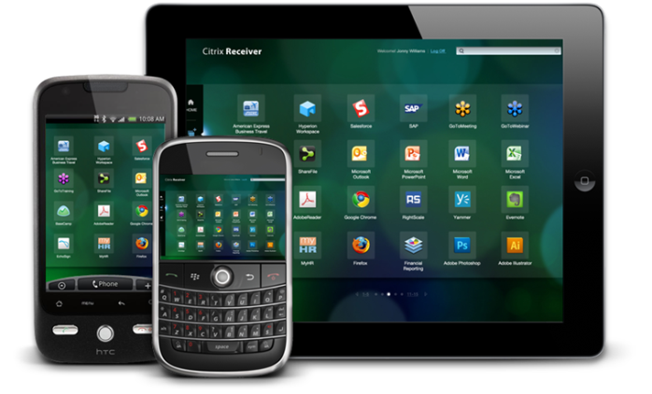
It’s a mobile first world! Apps, Devices, Usability
Users want access to corporate apps and content / data from mobile devices
Touch-based mobile device diversity
Thousands of Windows business apps… …expecting mouse, keyboard, and large screens
Too few enterprise apps can be used productively on touch-based mobile devices
Mobile Work Styles and BYOD… …security, compliance, risk management
Usable
Mobile
Devices
Traditional
Windows
Apps

Slide 21
Mobile SDK for Windows Apps
Rich toolkit for
Windows / .NET developers
Over 100 mobility focused APIs
Enables touch-friendly interfaces
Auto device detection
Access to mobile device functionality

Slide 22
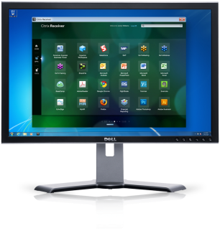
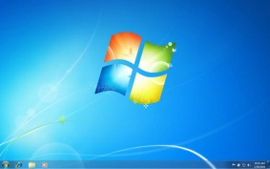
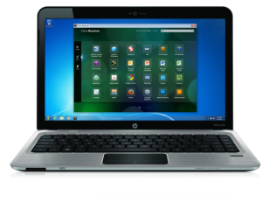
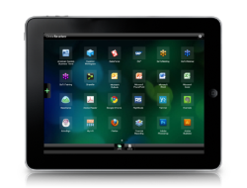
Application & Desktop Virtualization Some terminology to set the stage…
Data Center
Citrix Receiver
SSL 1011011010 SSL 1011011010 SSL 101101110 SSL 1011
Citrix XenApp / XenDesktop Server(s)
Server: XenApp and XenDesktop
Client: Receiver
Secure Protocol: HDX

Slide 23
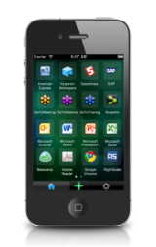
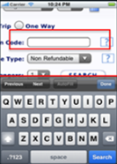
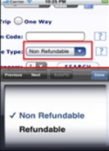
SDK provides access to local controls, sensors, and location
Mobile Receiver and Location
Virtual Channels
Windows Applications executing on
XenApp / XenDesktop Servers

Slide 24
API Functional Areas
Capture
Device
Properties
Messages
Display
Events
Buttons
Keyboard
Location

Slide 25
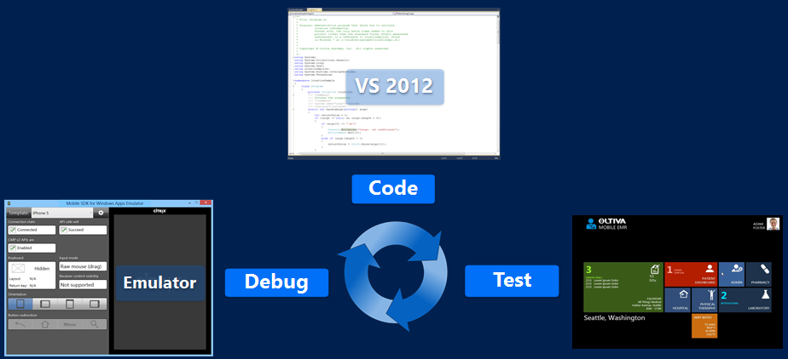
Application Development Workflow
System Requirements & Components
Runtime Architecture
Build, Debug & Deployment Flow
Application Execution
Debugging tips

Slide 26
Runtime Architecture
Client Device OS
Citrix XenApp Server
User Session
Citrix Receiver
Native
App
Managed
App
Hosted Mobile Mail
Receiver
Core
HDX
Native Library
.NET Assembly
Mobile Device Services
Mobile Device Services Runtime Layer
Citrix
3rd Party Apps

Slide 27
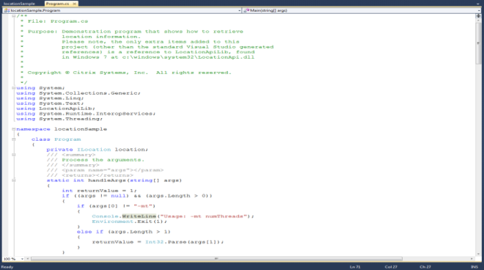
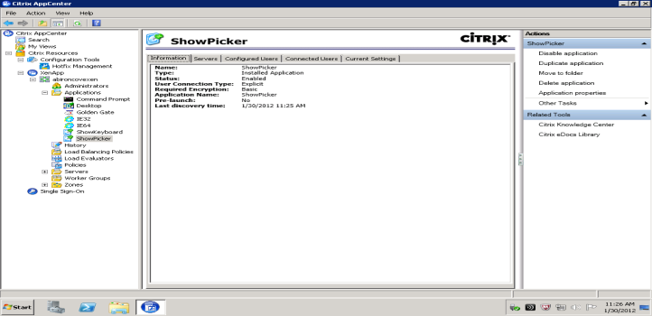
Build and Deployment Flow
Development Machine – Windows 7
XenApp Server – Windows 2008 R2
C:\samples\showpicker.exe
VS 2012
Build
Copy
Publish
Bin\Release\showpicker.exe
Citrix App Center

Slide 28
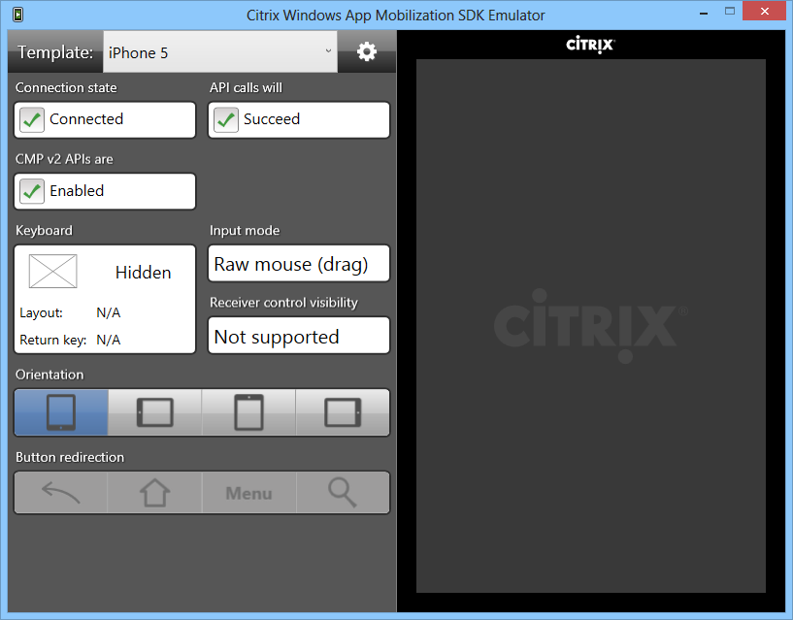
SDK Emulator
Mobile SDK for Windows Apps Emulator
Installed as part of the Mobile SDK for Windows Apps
Emulates a mobile device running Citrix Receiver
Simplifies development of apps
Test your app on your development machine without a XA server setup
Ships with several device templates
Supports custom device templates
Note
Does not perform hardware emulation

Slide 29
Demo
Demo Video

Slide 30
More Information
Available
Now
Mobile SDK for Windows Apps – http://www.citrix.com/mobilitysdk/
SDK Reference – http://www.citrix.com/mobilitysdk/docs
Videos – http://www.citrix.com/mobilitysdk/docs/videos/RapidStarts.htm
Mobile SDK Forum – http://forums.citrix.com/forum.jspa?forumID=1366
Software Downloads – http://www.mycitrix.com

Slide 31
Resources
Learning
Sessions on Demand
Microsoft Certification & Training Resources
http://channel9.msdn.com/Events/TechEd
www.microsoft.com/learning
TechNet
msdn
Resources for IT Professionals
Resources for Developers
http://microsoft.com/technet
http://microsoft.com/msdn

Slide 32
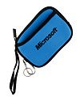
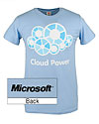
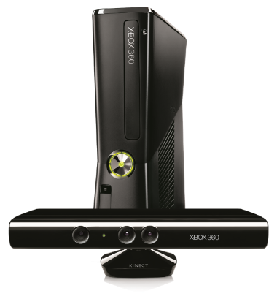
Complete an evaluation on CommNet and enter to win!

Slide 33
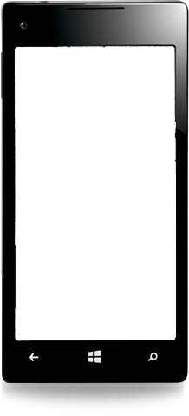
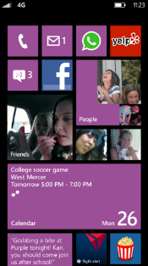
MS tag
Required Slide
*delete this box when your slide is finalized
Your MS Tag will be inserted here during the final scrub.
Scan the Tag to evaluate this session now on myTechEd Mobile

Slide 34
© 2013 Microsoft Corporation. All rights reserved. Microsoft, Windows and other product names are or may be registered trademarks and/or trademarks in the U.S. and/or other countries.
The information herein is for informational purposes only and represents the current view of Microsoft Corporation as of the date of this presentation. Because Microsoft must respond to changing market conditions, it should not be interpreted to be a commitment on the part of Microsoft, and Microsoft cannot guarantee the accuracy of any information provided after the date of this presentation. MICROSOFT MAKES NO WARRANTIES, EXPRESS, IMPLIED OR STATUTORY, AS TO THE INFORMATION IN THIS PRESENTATION.

