Slide 2
Entity Framework 6
DEV-B335
Glenn Condron

Slide 3
Agenda
Open source
Developer workflows
What’s new in EF6
EF6 demos

Slide 4
Open source
EntityFramework.codeplex.com
Not just the code
Source code
Nightly builds
Issue tracking
Feature specs
Design meeting notes

Slide 5
Open source
Accepting contributions
Only EF team has commit rights
Same code review process as internal changes
25 pull requests, 21 accepted
8 contributors
Only affects how we develop, not how we ship
Same license
Same support
Same quality

Slide 6
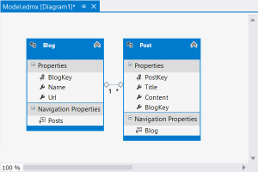
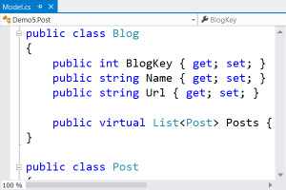
Developer workflows
Designer Centric
Code Centric
New Database
Model First
Create model in EF Designer
Generate database from model
Classes auto-generated from model
Code First
Define classes and mapping in code
Database created from code
Migrations apply model changes to database
Existing Database
Database First
Reverse engineer model in EF Designer
Classes auto-generated from model
Code First
Define classes and mapping in code
EF Power Tools provide reverse engineer

Slide 7
What’s new in EF6?
Code First & EF Designer
Asynchronous query and save
Connection resiliency
Code-based configuration
Database command interception/logging
Performance improvements
Code First Only
Custom conventions
Insert, update, & delete stored procedures

Slide 8
What else is new in EF6?
From the EF team
Nested entity types
Improved transaction Support
Multiple contexts per database
DbModelBuilder.HasDefaultSchema
Configurable migrations history table
Creating context with an open connection
Enums, spatial and better performance on .NET 4.0
Default transaction isolation level changed to READ_COMMITTED_SNAPSHOT
From our contributors
Custom migrations operations
Improved warm up time for large models
Pluggable pluralization & singularization service
DbModelBuilder.Configurations.AddFromAssembly
DbSet.AddRange/RemoveRange

Slide 9
EF6 demos
Designer Centric
Code Centric
New Database
Model First
Create model in EF Designer
Generate database from model
Classes auto-generated from model
Code First
Define classes and mapping in code
Database created from code
Migrations applies model changes to database
Existing Database
Database First
Reverse engineer model in EF Designer
Classes auto-generated from model
Code First
Define classes and mapping in code
EF Power Tools provide reverse engineer

Slide 10
Custom Code First conventions
What is it?
Bulk configuration for multiple entities/properties
Why did we build it?
Avoid repetitive, error prone configuration
When should you use it?
Patterns in your model don’t match Code First conventions (e.g. primary key naming)
You don’t like the default conventions (e.g. column naming, data types, etc.)

Slide 11
Database command logging
What is it?
Log of every command/query sent to database
Why did we build it?
Easy way to see what’s happening ‘under the hood’
When should you use it?
Understanding and learning Entity Framework
Debugging unexpected behavior/results
Troubleshooting performance issues

Slide 12
Code First stored procedure mapping
What is it?
Configuring stored procedures for insert, update & delete
Why did we build it?
Many enterprises require the use of stored procedures
When should you use it?
Mapping to existing database that uses stored procedures
Business mandates the use of stored procedures
Need to run additional save logic best performed within database
EF can’t map to your database schema

Slide 13
Async query & save
What is it?
Task based async pattern for query and save
Why did we build it?
Appropriate use of async can improve performance and scalability
When should you use it?
Reduce server resource usage by freeing up blocked threads
Improve client UI responsiveness by not blocking main thread
Parallelism – but not on the same context instance

Slide 14
Code-based configuration
What is it?
Code centric alternative to <entityFramework> section in web/app.config
Why did we build it?
Code is easier and more discoverable than xml
When should you use it?
Any time you want to change configuration (e.g. database providers)
Using an IoC container to control configuration

Slide 15
Code-based configuration
DbConfiguration
Simple, discoverable methods to perform configuration
Automatically discovered within same assembly as your context
Dependency Resolver
Exposed from DbConfiguration
Flexible but more complex than simple DbConfiguration methods
Web/App.config wins over code-based config

Slide 16
What next?
Vote | ef.mswish.net
Learn | msdn.com/data/ef
Contribute | EntityFramework.codeplex.com
Follow | twitter.com/efmagicunicorns | facebook.com/efmagicunicorns

Slide 17
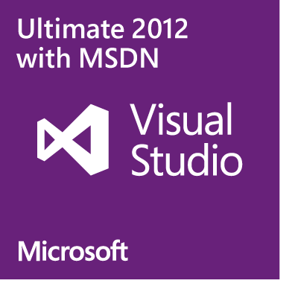
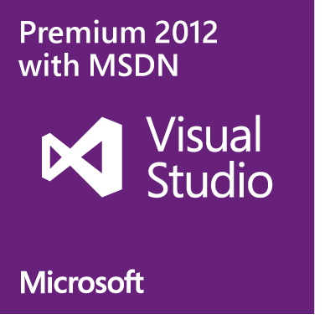
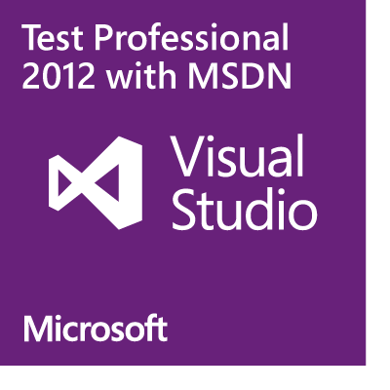
Plan details and subscriber benefits
Free Plan for up to 5 users
Included for certain paid MSDN subscribers:
Version control (TFVC or Git)
Comment on changesets & commits
Work item tracking and tagging
Team rooms
Agile planning tools
Feedback Management
Agile Portfolio Management*
Build*
Web-based test case management*
Load testing*
New!
New!
New!
New!
Additional information at http://tfs.visualstudio.com
* Capability in preview – limits may apply. Authoring load tests requires Visual Studio Ultimate 2013 Preview.

Slide 18
MSDN Subscribers – Accelerate Your Development & Test using Cloud VMs We’ve enhanced the Windows Azure MSDN benefit and added cloud use rights for select MSDN software. You’ve already got it, now use it!
Activate and try out your Windows Azure MSDN benefit today & you could win an Aston Martin V8 Vantage!
Learn more and activate today at http://aka.ms/AzureContest

Slide 19
Resources
Learning
Sessions on Demand
Microsoft Certification & Training Resources
http://channel9.msdn.com/Events/TechEd
www.microsoft.com/learning
TechNet
msdn
Resources for IT Professionals
Resources for Developers
http://microsoft.com/technet
http://microsoft.com/msdn

Slide 20
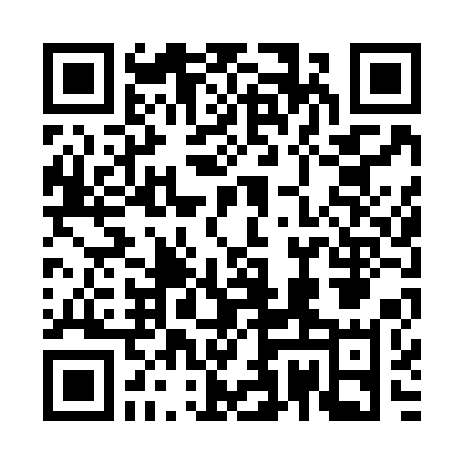
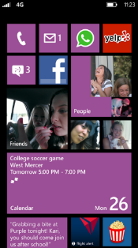
Evaluate this session
Required Slide
*delete this box when your slide is finalized
Your MS Tag will be inserted here during the final scrub.
Scan this QR code to
evaluate this session.

Slide 21
© 2013 Microsoft Corporation. All rights reserved. Microsoft, Windows and other product names are or may be registered trademarks and/or trademarks in the U.S. and/or other countries.
The information herein is for informational purposes only and represents the current view of Microsoft Corporation as of the date of this presentation. Because Microsoft must respond to changing market conditions, it should not be interpreted to be a commitment on the part of Microsoft, and Microsoft cannot guarantee the accuracy of any information provided after the date of this presentation. MICROSOFT MAKES NO WARRANTIES, EXPRESS, IMPLIED OR STATUTORY, AS TO THE INFORMATION IN THIS PRESENTATION.

