Slide 2
Master Navigation in Windows Store apps
DEV-B341
Brian Noyes
CTO, Solliance Inc.
@briannoyes

Slide 3
About Brian Noyes
Solliance (www.solliance.net)
CTO
Microsoft Regional Director
Microsoft MVP
Pluralsight author
www.pluralsight.com
Web API Insider, Windows Azure Insider,
Window Store App Insider, C#/VB Insider
e
brian.noyes@solliance.net
t
@briannoyes
http://briannoyes.net

Slide 4
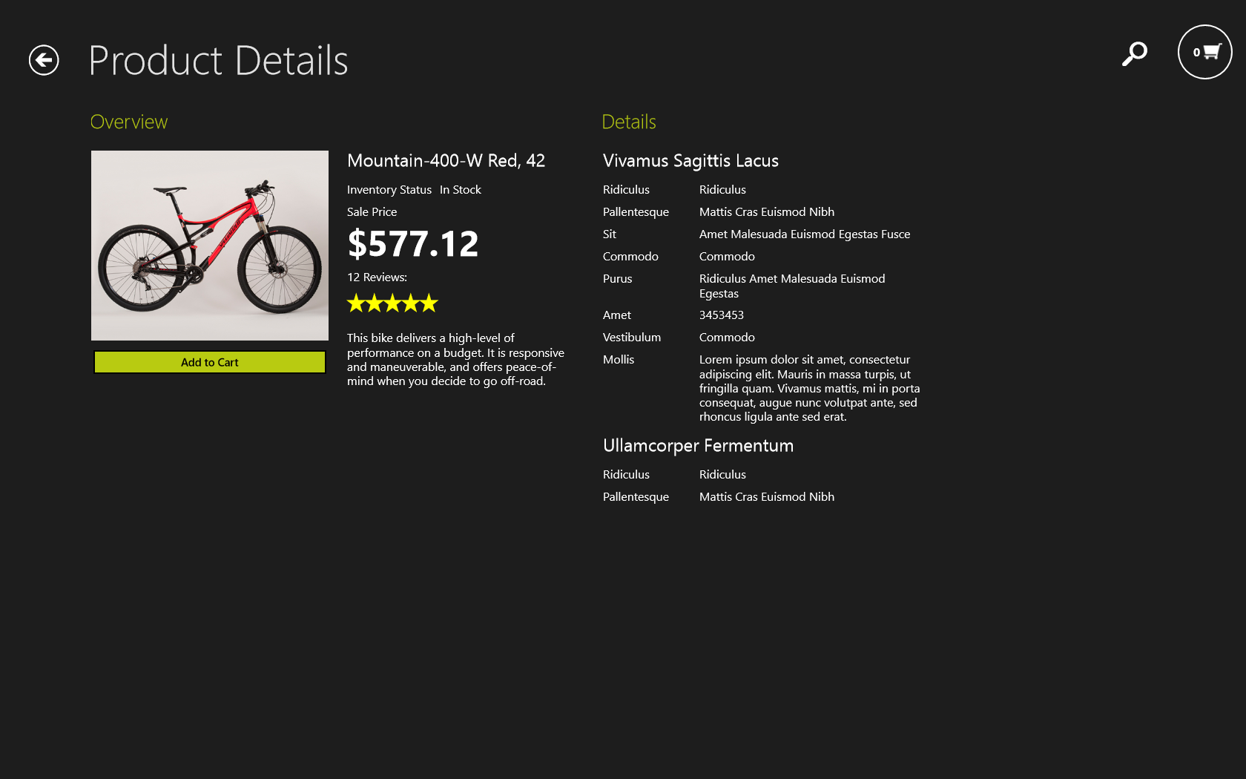
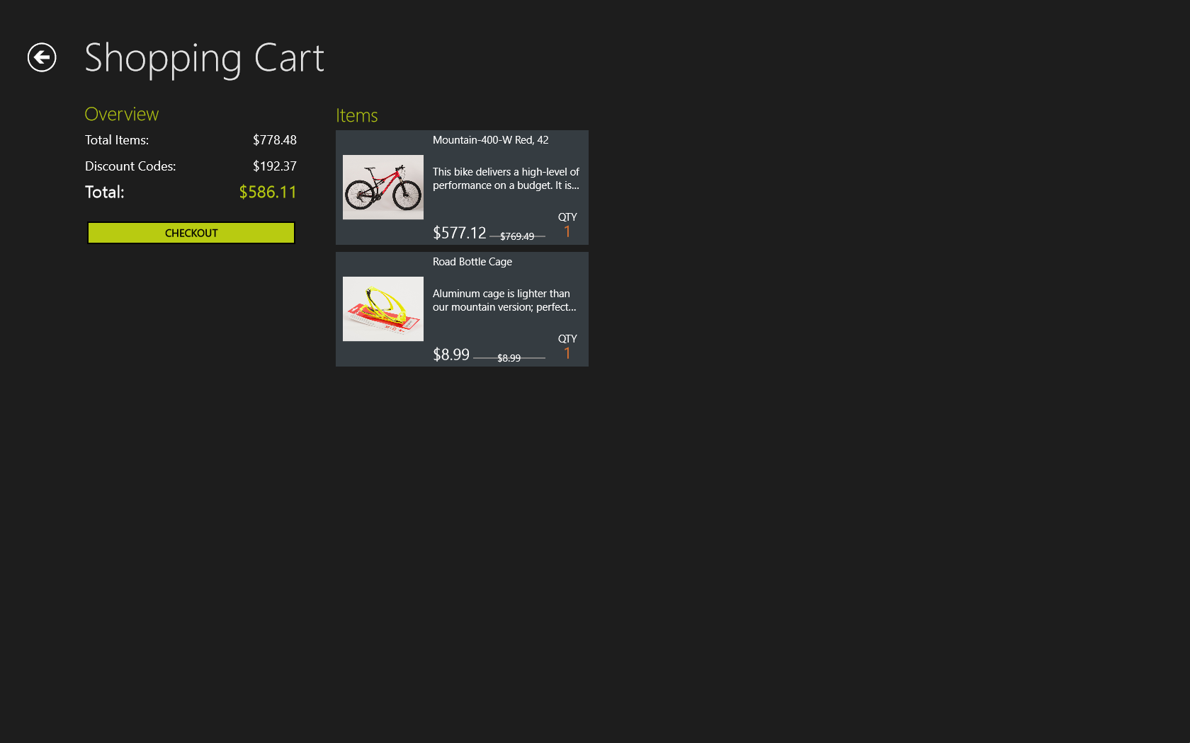
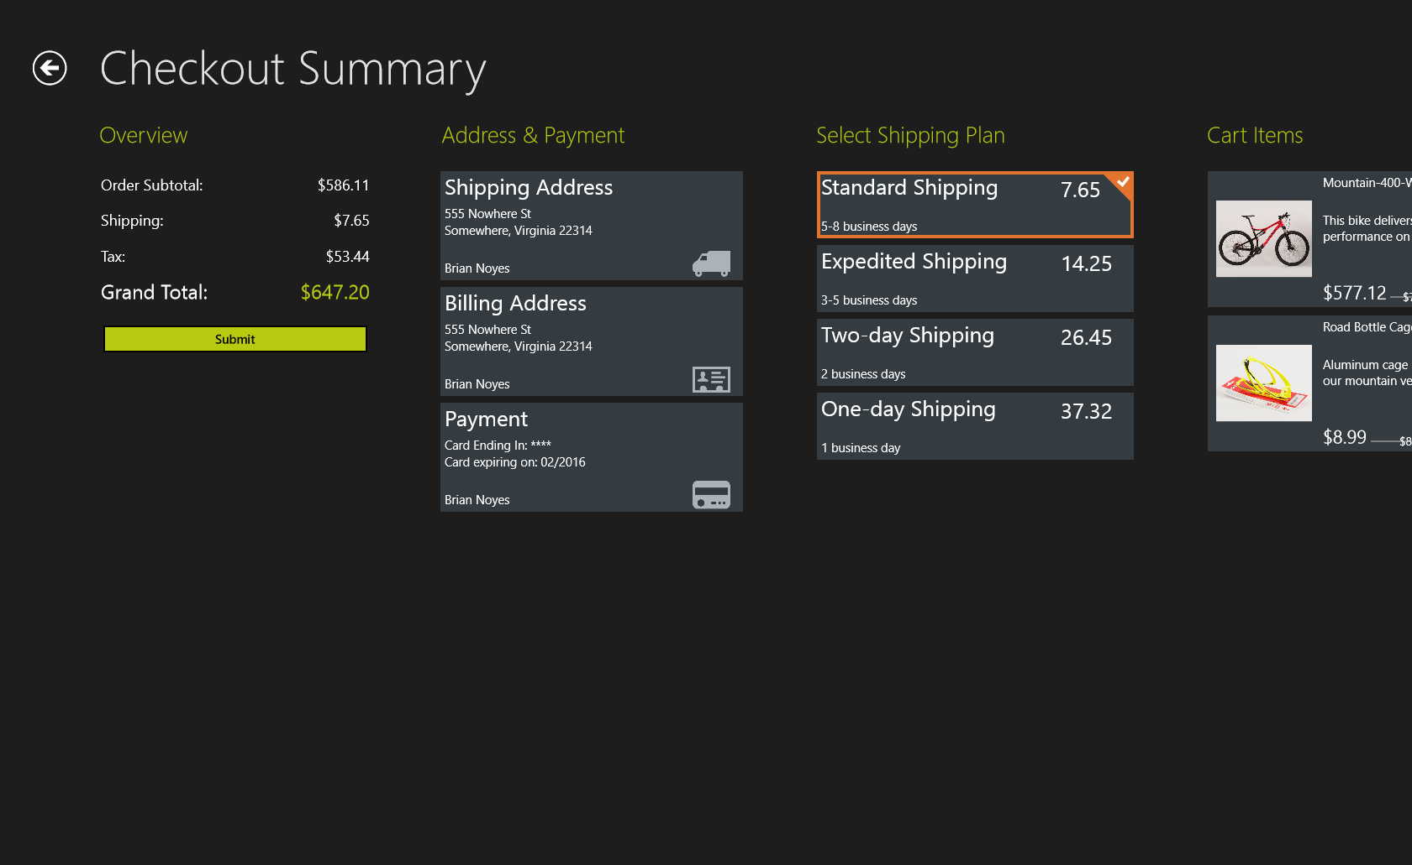
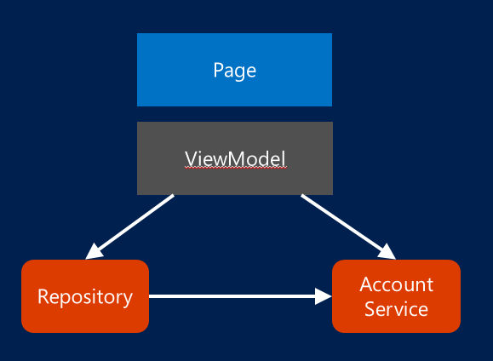
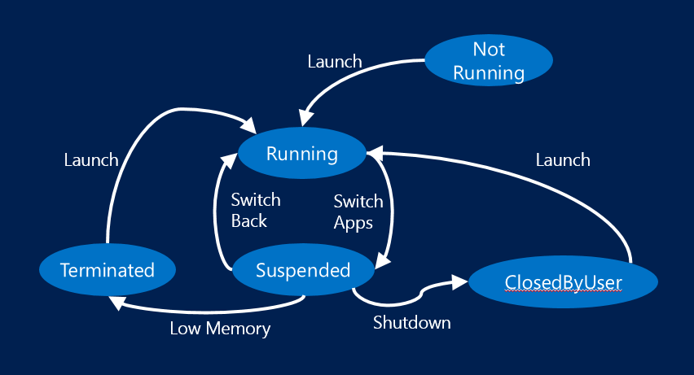
Agenda

Slide 5
Navigation schemes
Hierarchical
Hub
Section
Section
Detail
Detail
Detail
Detail
Flat
Doc
Doc
Doc
Doc

Slide 6
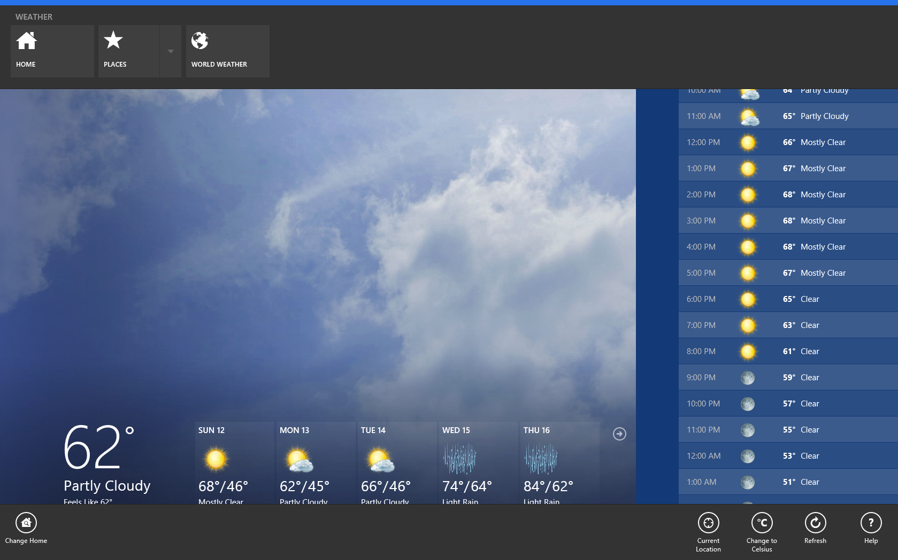
Commanding Navigation

Slide 7
Demo
Navigation scheme examples

Slide 8
WinRT XAML navigation classes
Frame
Container for Pages
Exposes primary navigation APIs
Maintains the navigation stack
Page
Top level UIs
Called when navigation happens (to/from)
Access to the Frame through base class property
Application
Lifecycle (launch/suspend) event handling
Initial navigation control

Slide 9
WinJS Navigation
WinJS.Navigation
Command navigation
Navigation events
Navigation stack and state properties
WinJS.UI.Pages.define
ready handler – initialize your page
WinJS.Application
activated event – initial navigation to home page
PageControlNavigator template code
Navigation project template
Wraps navigation management

Slide 10
WinRT application lifecycle
Not
Running
Launch
Running
Launch
Launch
Switch
Back
Switch
Apps
Terminated
Suspended
ClosedByUser
Low Memory
Shutdown

Slide 11
Visual Studio XAML common classes
LayoutAwarePage
Overrides for Load/Save state
Derives from Page – access to Frame class
Cascades Visual State changes down to child controls
SuspensionManager
Manages a dictionary per page
Automatic persistence / load of state on suspend / launch from terminate

Slide 12
Demo
Working with navigation in XAML

Slide 13
Demo
Working with navigation in WinJS

Slide 14
MVVM
Page
Navigation awareness
ViewModel
Navigation control
State management
Repository
Account
Service

Slide 15
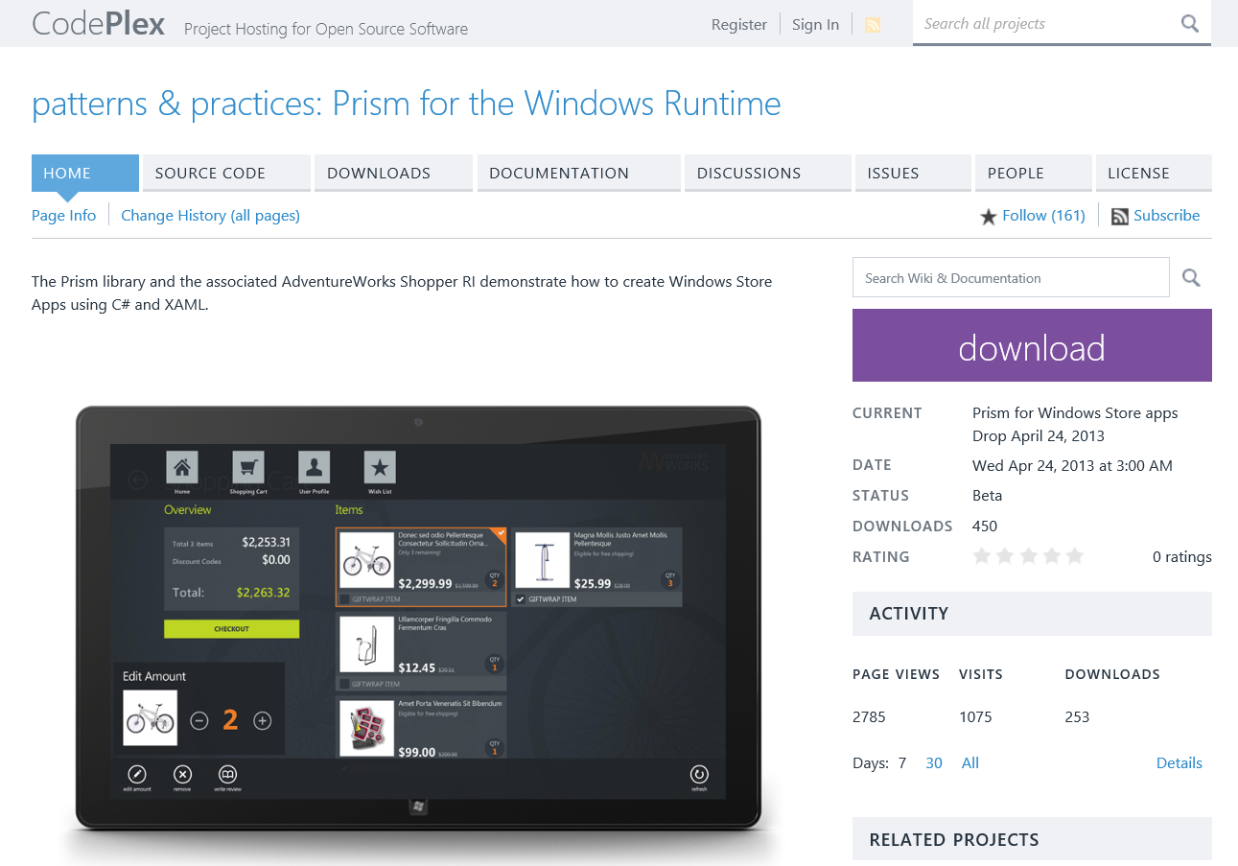
Prism for Windows Runtime

Slide 16
Prism for Windows Runtime navigation
FrameNavigationService : INavigationService
Wraps Frame class
Can inject into ViewModels to command navigation
ViewModel : INavigationAware
Called by FrameNavigationService – OnNavigatedTo / OnNavigatedFrom
Initialize / clean up ViewModel state and events
RestorableState / SessionStateService
Automatic persistence and loading of transient state on suspend / launch from terminate
Lets ViewModels and client side services manage transient state

Slide 17
Demo
MVVM Navigation with Prism for Windows Runtime

Slide 18
Resources
Modern UI Design Guidelines
http://msdn.microsoft.com/en-US/windows/apps/hh779072
Building Windows Store Business Apps with Prism
http://tinyurl.com/prismrtcourse
WinRT Business Apps with Prism article series
http://tinyurl.com/prismrtseries

Slide 19
Related content
Breakout Sessions
DEV-B309 Design Guidance for Windows Store Line of Business Apps

Slide 20
Resources
Learning
Sessions on Demand
Microsoft Certification & Training Resources
http://channel9.msdn.com/Events/TechEd
www.microsoft.com/learning
TechNet
msdn
Resources for IT Professionals
Resources for Developers
http://microsoft.com/technet
http://microsoft.com/msdn

Slide 21
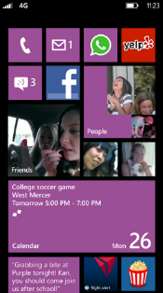
Evaluate this session
Required Slide
*delete this box when your slide is finalized
Your MS Tag will be inserted here during the final scrub.
Scan this QR code to
evaluate this session.

Slide 22
© 2013 Microsoft Corporation. All rights reserved. Microsoft, Windows and other product names are or may be registered trademarks and/or trademarks in the U.S. and/or other countries.
The information herein is for informational purposes only and represents the current view of Microsoft Corporation as of the date of this presentation. Because Microsoft must respond to changing market conditions, it should not be interpreted to be a commitment on the part of Microsoft, and Microsoft cannot guarantee the accuracy of any information provided after the date of this presentation. MICROSOFT MAKES NO WARRANTIES, EXPRESS, IMPLIED OR STATUTORY, AS TO THE INFORMATION IN THIS PRESENTATION.

