Slide 2
Building Modern, HTML5-based Business Apps for SharePoint 2013 with Visual Studio LightSwitch
DEV-B342
Heinrich Wendel

Slide 3
What is LightSwitch?
Development environment in Visual Studio for building data-based business productivity apps and data services quickly
Plumbing is all handled for you, the only code you write is the business logic
LightSwitch provides a roadmap for the application as its needs and user base grows
  Flexible deployment model
  Publish On-Prem, Windows Azure or Office 365 / SharePoint
“LightSwitch is simple on the outside but rich on the inside.”

Slide 4
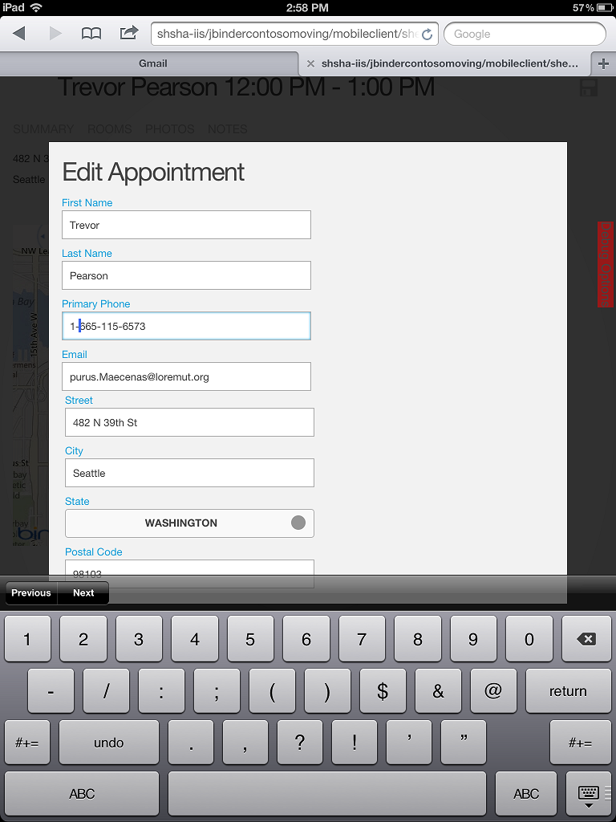
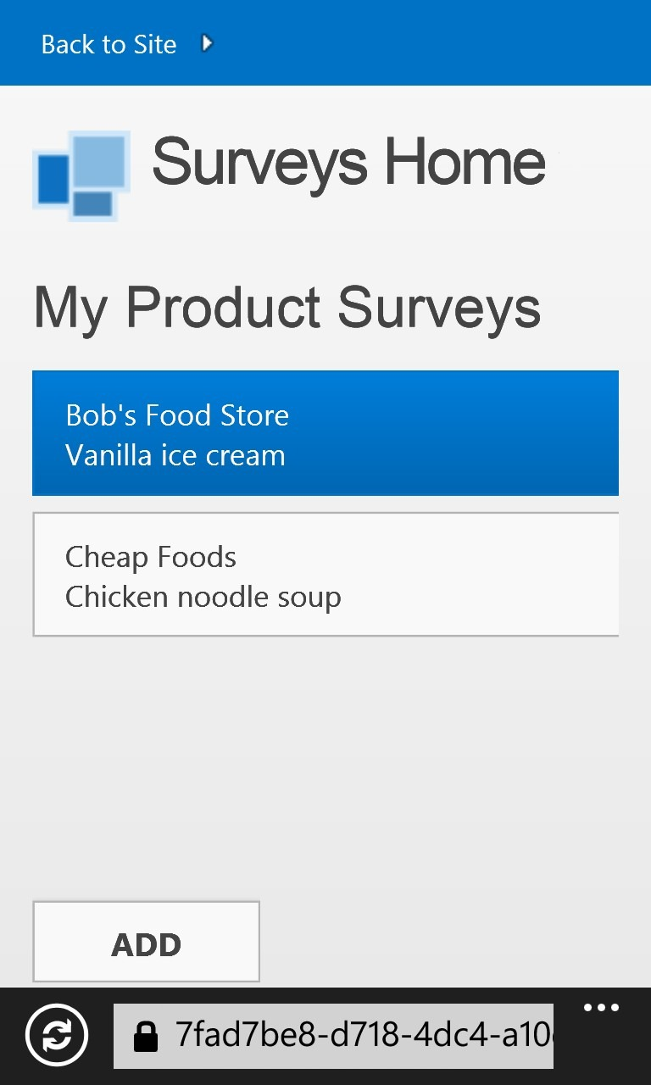
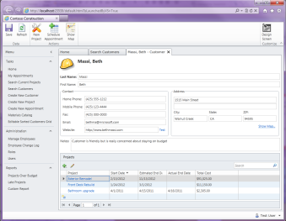
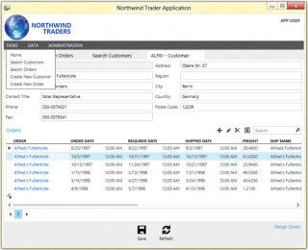
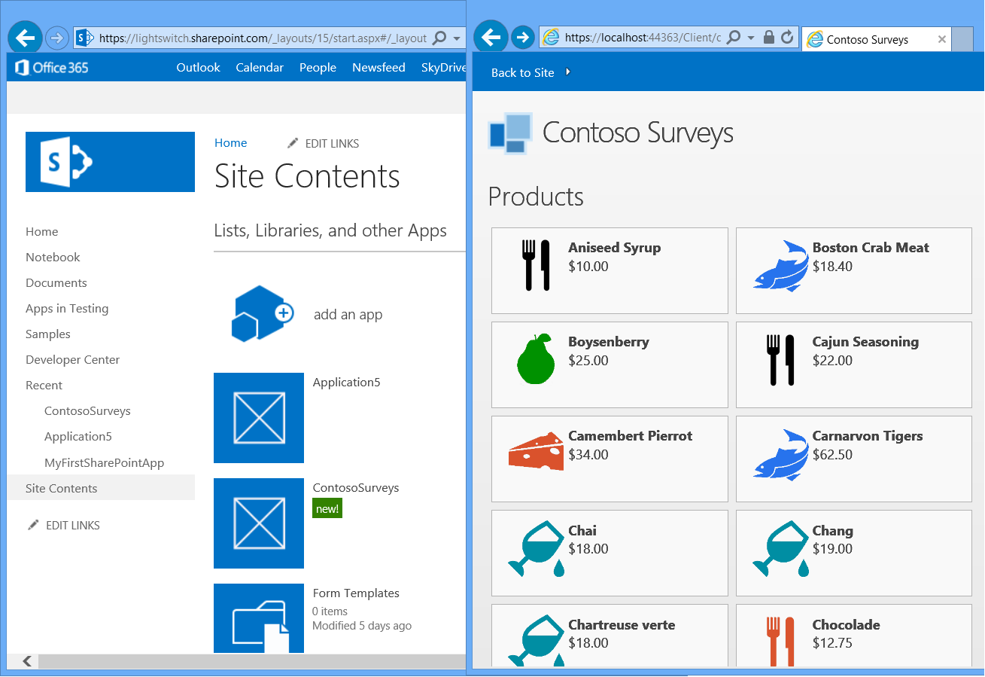
LightSwitch Sweet Spots
Mobile Web Business Apps
  Optimized for touch devices on multiple platforms (iOS, Android, WP8, WinRT)
  Default screen templates provide no-code experiences that can target multiple form factors
Desktop Business Apps
  Optimized for heavy data entry, mouse & keyboard scenarios, with legacy app integration (i.e. COM)
  Default screen templates provide no-code experiences for manipulating data in a variety of ways
Office 365 / SharePoint 2013 with Provider Hosting
  Leverage experiences and infrastructure for app access, organizational identity, and lifecycle management
  Provider hosting (IIS, Azure) allows flexible operational infrastructure choices

Slide 5
LightSwitch Version
Roadmap
May 2013: HTML Client Runtime Update 1 (NuGet opt-in)
Support for jQuery Mobile 1.3
V3
April 2013: Visual Studio 2012 Update 2
HTML5 Mobile Client, SharePoint/O365 Integration
V2
August 2012: Visual Studio 2012
OData Services, Azure Websites
V1
July 2011: Visual Studio 2010 (Out-of-band)
Silverlight In-Browser & Desktop apps, Azure Cloud Services

Slide 6
Visual Studio 2012 Update 2
LightSwitch Key Features
HTML Client
  Responsive design supports multiple form factors
  Produces Single-Page-Applications (SPAs)
  jQueryMobile 1.3 support
  Streamlined screen creation and navigation
  Command bars
  Popups and Screens as dialogs
  Semantic types
SharePoint 2013 apps
  Connect to SharePoint 2013 Lists as Entities
  Access SharePoint assets via CSOM
  Provider-hosted & autohosted deployment
  SharePoint On-Prem or Office 365
Other
  Localize app in multiple languages
  Globalization
  LINQ queries over DataWorkspace
  ServerApplicationContext for custom services
Performance
  App load: minification, static compression
  OData: reduced payload size (JSON lite)

Slide 7
The LightSwitch Development Experience
Start
Describe your data
Create screens for common tasks
Extend
Explore ecosystem components
Create custom controls
Integrate with custom data sources
Refine
Author business logic
Customize screen layouts / branding
Define custom queries

Slide 8




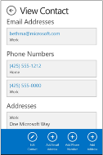
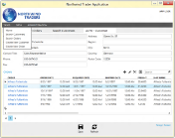
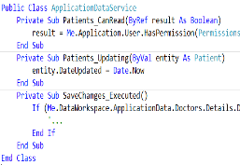
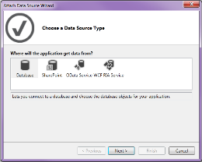
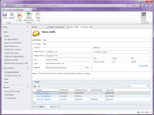
LightSwitch Architecture
Client Tier
Middle Tier
Data Sources
Screens
Methods
Controls
Submit Pipeline
Queries
Data Workspace
Data Workspace
WCF Data Service
WCF Data Service
SQL Server
Azure
OData Services
SharePoint
OData Service *
Other…
Silverlight5
HTML5
ASP.NET 4.0+
Desktop
Mobile
IIS 7
* Clients connect via OData, enabling custom clients (Excel, Windows Store apps, WPF, etc.) access to the middle-tier services also

Slide 9
LightSwitch Hosting Options
SharePoint 2013 Apps (option)
Desktop:
Windows, Mac
Mobile:
HTML5 Browsers
Cloud
- Windows Azure
-SQL Azure
Office 365
On-Prem
- IIS on your premises
- SQL Server
On-Prem SharePoint 2013
HTML client optimized for iOS 5/6, Android 4, WinRT, Win Phone 8. Desktop uses Silverlight 5 in-browser (Windows, Mac) or out-of-browser (Windows only)
IIS 7+ is recommended,
IIS6 supported
Hosting the LS intrinsic database requires an edition of SQL Server (Express to Enterprise 2005 + higher). External data sources can be other types
LightSwitch SharePoint apps can be hosted in Azure for both O365 & SharePoint 2013 on premises. HTML or in-browser Silverlight clients supported.

Slide 10
SharePoint Hosting Options
Provider-hosted app
Provide your own hosting environment
SharePoint
Your web server
LightSwitch apps are Cloud-hosted apps
- Use server code
- Use OAuth to access SP
Autohosted app
Windows Azure + SQL Azure provisioned automatically as apps are installed
SharePoint
Azure
SharePoint-Hosted app
- Use SP artifacts & out-of-box web parts
- Use HTML & JavaScript for UI & client-side logic
- Use Workflows for middle tier logic
Server-free, client-side only. Not Applicable to LightSwitch
SharePoint

Slide 11
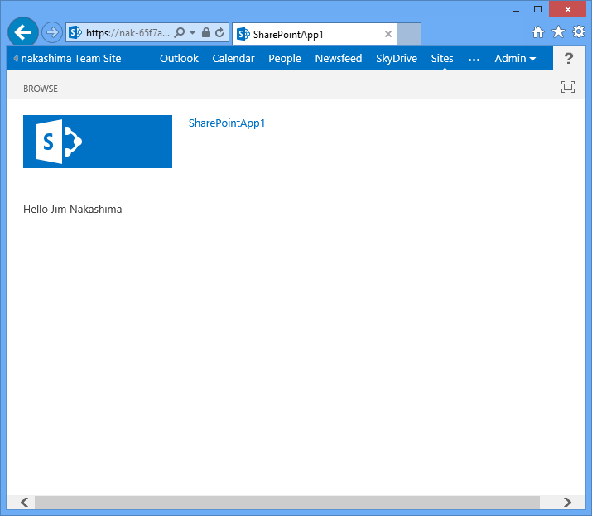
Anatomy of a Cloud Hosted SharePoint App
Office Store
SharePoint App Catalog
Manifest
SharePoint
Web Server
(LightSwitch)
Web Browser

Slide 12
SharePoint Features in LightSwitch
Enable/Disable SharePoint
  Migrate existing apps
Hybrid Auth Code
  S2S or ACS with no changes to code
SharePoint List Attach uses user’s identity (not app pool)
Application.SharePoint & Application.User
Automatically add references
Enables use of CSOM
Publishing

Slide 13
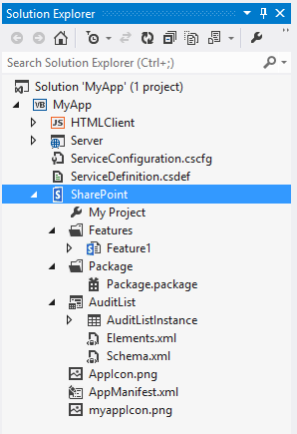
SharePoint Project System
The same SharePoint project that you use in VS 2012 is created in your LightSwitch solution
This allows you to add and deploy additional SharePoint assets with your LightSwitch app
CSOM references are added to Server project automatically

Slide 14
HTML Client Design Goals
Touch-oriented, immersive applications that run on all modern devices
  “Mobile-first” - Enable all modern tablet & mobile devices to create connections to LightSwitch services
  Allow easy integration of JavaScript ecosystem widgets/controls for specific customization
Consistent design experience
Standards based
  JQuery / JQueryMobile based
  CSS 3.0
  HTML5

Slide 15
HTML Client Supported Platforms
iOS 5/6
Android 4
Windows RT
Windows Phone 8
Some limitations: Android 2.3, Windows Phone 7.5

Slide 16
Building a LightSwitch SharePoint App

Slide 17
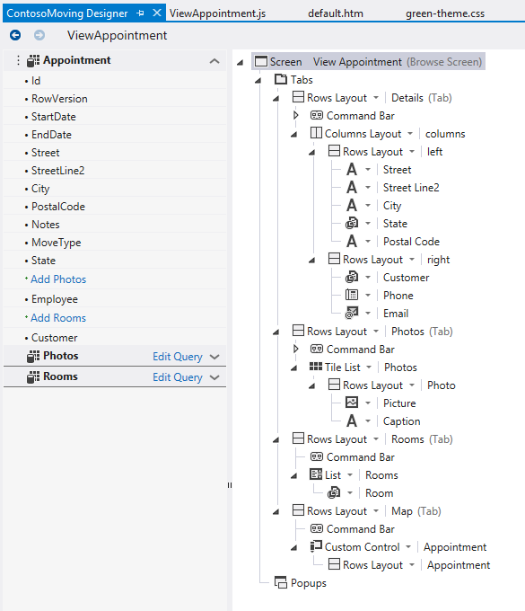
Design-time Experience
Template driven UI design
Consistent design experience
  View Model
  Content Tree

Slide 18
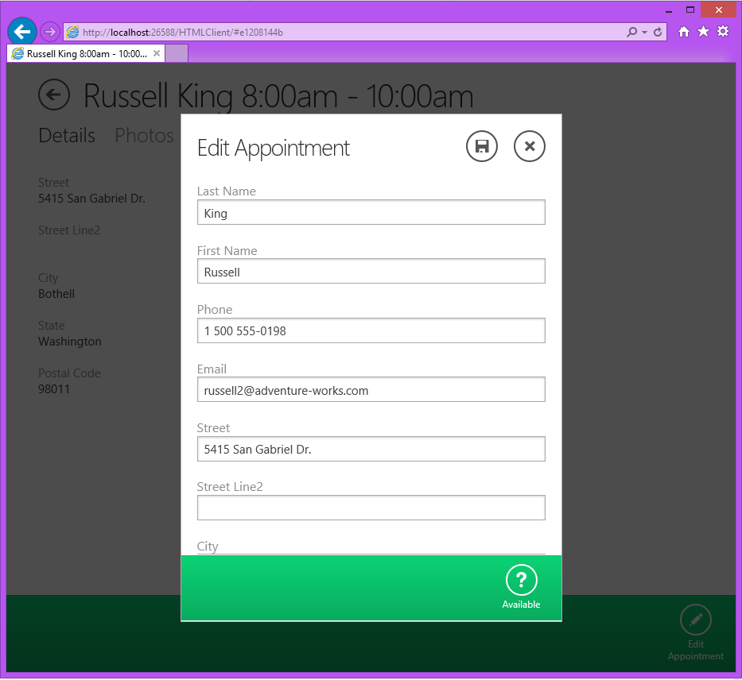
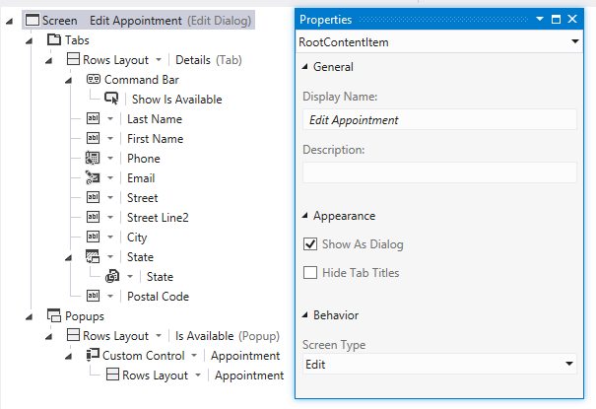
Enhanced To Support Common Patterns
Support for “Dialogs” & Reusable Screens
  Lightbox UI pattern
  Similar usage to modal dialogs
Support for Command bars
Consistent design-time experience

Slide 19
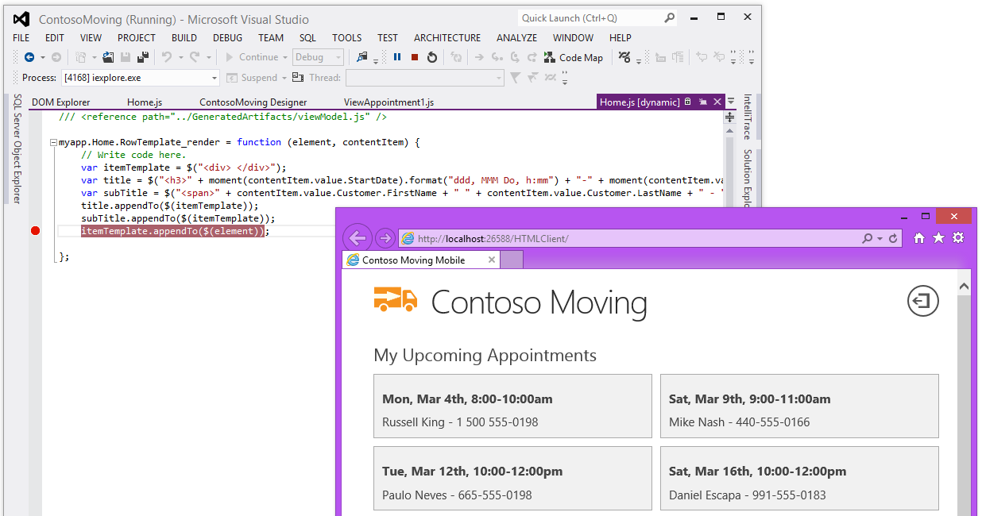
Customization via HTML/JS

Slide 20
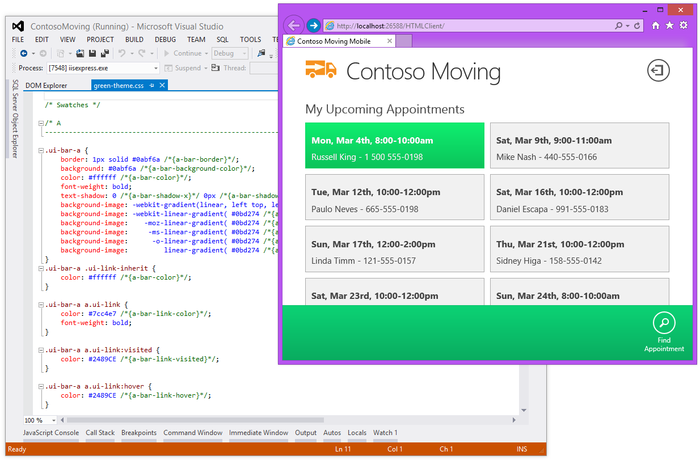
Customize Look and Feel via CSS

Slide 21
LightSwitch Hands-On-Labs
DEV-H306:
  Developing SharePoint Applications Using Microsoft Visual Studio LightSwitch
DEV-H304:
  Building JavaScript and HTML5 Mobile Applications with Microsoft Visual Studio LightSwitch

Slide 22
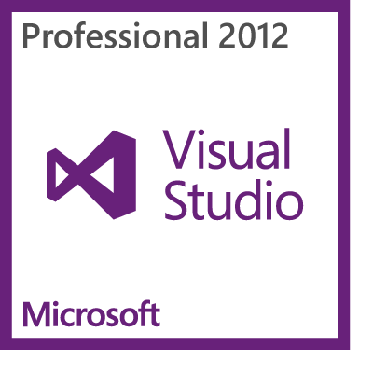
LightSwitch in Visual Studio 2012
The simplest way to build modern business applications for the enterprise
VS Update 2
  Desktop Clients
  w/Silverlight 5
  HTML Client Released
  April 2013

Slide 23
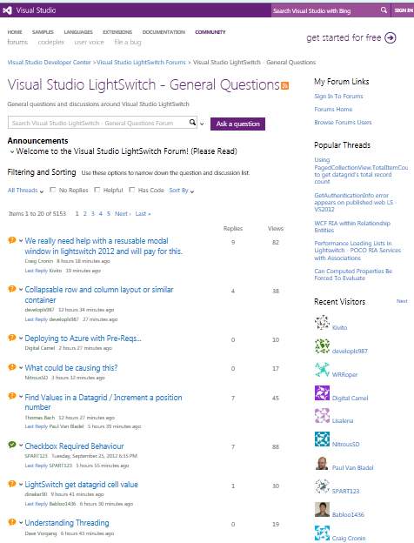
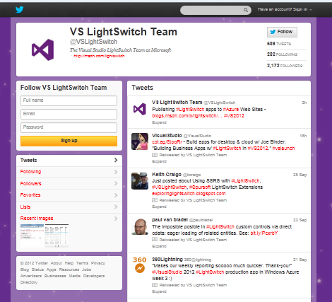
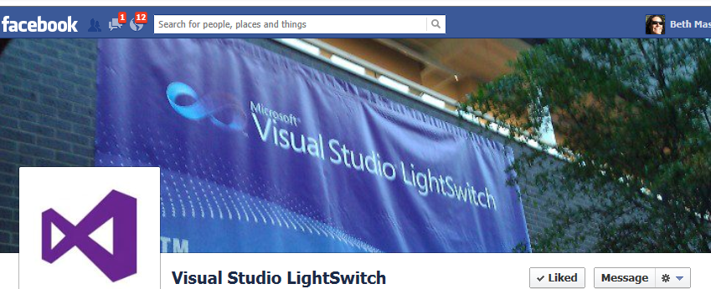
Resources – Join the Community!
HTML Client & SharePoint Support = VS 2012 Update 2
LightSwitch Team Blog: blogs.msdn.com/LightSwitch
Developer Center: msdn.com/LightSwitch
Forums: bit.ly/LightSwitchForums
Facebook: www.facebook.com/VSLightSwitch
Twitter: @vslightswitch

Slide 24

Resources
Learning
  Sessions on Demand
  Microsoft Certification & Training Resources
http://channel9.msdn.com/Events/TechEd
www.microsoft.com/learning
TechNet
msdn
  Resources for IT Professionals
  Resources for Developers
http://microsoft.com/technet
http://microsoft.com/msdn

Slide 25
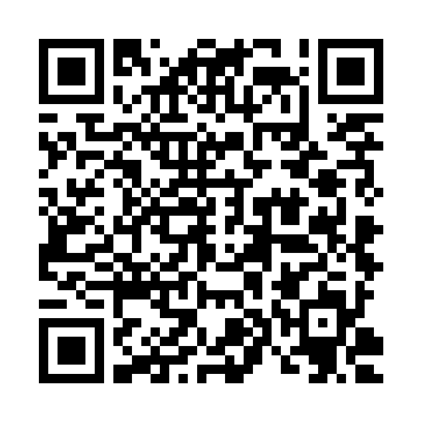
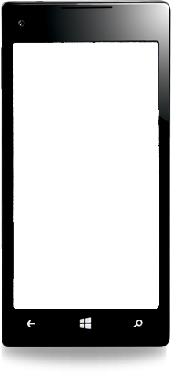

Evaluate this session
Required Slide
*delete this box when your slide is finalized
Your MS Tag will be inserted here during the final scrub.
Scan this QR code to
evaluate this session.

Slide 26

© 2013 Microsoft Corporation. All rights reserved. Microsoft, Windows and other product names are or may be registered trademarks and/or trademarks in the U.S. and/or other countries.
The information herein is for informational purposes only and represents the current view of Microsoft Corporation as of the date of this presentation. Because Microsoft must respond to changing market conditions, it should not be interpreted to be a commitment on the part of Microsoft, and Microsoft cannot guarantee the accuracy of any information provided after the date of this presentation. MICROSOFT MAKES NO WARRANTIES, EXPRESS, IMPLIED OR STATUTORY, AS TO THE INFORMATION IN THIS PRESENTATION.

