Slide 2
Mastering ASP.NET MVC4 in Just One Day
DEV-B402
Tiberiu Covaci
@tibor19

Slide 3
Who am I
Tiberiu ’Tibi’ Covaci
Software engineer, 20 years experience
MCT since 2004, teaching .NET
Senior Trainer & Mentor in Romania (Transylvania)
MVP for Windows Azure
Father & Geek
Twitter: @tibor19 / #msteched

Slide 4
Agenda
Advanced options for Breakpoints
Tools for Debugging ASP.NET Applications
Profiling ASP.NET Applications
Load Testing ASP.NET Applications
Post Mortem Debugging

Slide 5
DEMO
Tiberiu Covaci

Slide 6
Thank you!

Slide 7
Questions ?

Slide 8
Related content
Breakout Sessions (session codes and titles)
DEV-B353 Visual Studio Tips and Tricks
WCA-B401 Hardcore Debugging
WCA-W306 Case of Unexplained
Hands-on Labs (session codes and titles)
DEV-H310 IntelliTrace
DEV-H311 Unit Testing, Code Coverage
Find Me after the session at the Developer Booth

Slide 9
Track resources
http://blogs.msdn.com/tess

Slide 10
Resources
Learning
Sessions on Demand
Microsoft Certification & Training Resources
http://channel9.msdn.com/Events/TechEd
www.microsoft.com/learning
TechNet
msdn
Resources for IT Professionals
Resources for Developers
http://microsoft.com/technet
http://microsoft.com/msdn

Slide 11
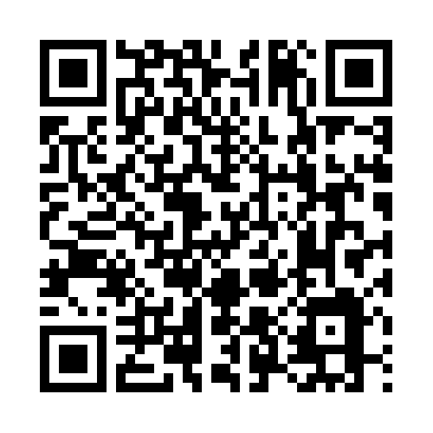
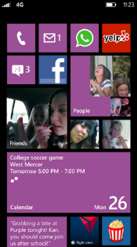
Evaluate this session
Required Slide
*delete this box when your slide is finalized
Your MS Tag will be inserted here during the final scrub.
Scan this QR code to
evaluate this session.

Slide 12
© 2013 Microsoft Corporation. All rights reserved. Microsoft, Windows and other product names are or may be registered trademarks and/or trademarks in the U.S. and/or other countries.
The information herein is for informational purposes only and represents the current view of Microsoft Corporation as of the date of this presentation. Because Microsoft must respond to changing market conditions, it should not be interpreted to be a commitment on the part of Microsoft, and Microsoft cannot guarantee the accuracy of any information provided after the date of this presentation. MICROSOFT MAKES NO WARRANTIES, EXPRESS, IMPLIED OR STATUTORY, AS TO THE INFORMATION IN THIS PRESENTATION.

