Slide 2
Deploying Applications in Microsoft System Center 2012 - Virtual Machine Manager Using Services
MDC-B203
Kurt Scherer
Program Manager
Microsoft

Slide 3
Session Objectives
Understand the service model
Learn how to deploy services
Manage service updates

Slide 4
Agenda
Services
Justification
Components
Implementation
Lifecycle

Slide 5
VM Templates versus Service Templates
VM Template
Starting point for VMs
Specifies Hardware, Guest Profile, Disks
Specifies single machine
“Fire and Forget”
Service Template
Starting point for services
Defines multi-machine distributed application
Specifies multiple machines across multiple tiers
“Source of Truth”

Slide 6
Service Justification

Slide 7
Why Services
Composition
Logical Groupings
Granular Scaling
Redistribution

Slide 8
Service Components

Slide 9
Components
Machine Tiers
Application Hosts
Tier Settings
Service Settings

Slide 10
Building Blocks
Hardware Profile
VM Template
Service Template
Service Tier
Guest OS Profile
Service Tier
Service Tier
Application Profile
SQL Server Profile

Slide 11
Building Blocks Tour

Slide 12
Service Implementation

Slide 13
Process
Determine Requirements
Machine
Application
Tier
Networking
Prepare Resources
Build Templates
Add Scripts
Test and Validate
Deploy

Slide 14
Service Template Creation

Slide 15
Other Considerations
Resource Preparation
Generalization and Service Settings

Slide 16
Generalizing

Slide 17
Sharing Templates
Exporting Template
Importing Templates

Slide 18
Importing and Exporting

Slide 19
Service Lifecycle

Slide 20
Service Lifecycle Management
Create Template
Customize Deployment
Deploy
Service Instance
Service Instance
Apply
Update Template

Slide 21
Deployment Process
Per Service
Per Host
Per Guest
Per Application
Select Tier Based on Deployment Order
Create New VM from Template
Power On and Wait for VM
Install VMM guest agent
Application Profile Level Pre-Install GCE
Application Pre-Install GCE
Install Application
Done
Add to Load Balancer
Application Profile Level Post-Install GCE
Application Post-Install GCE
Built-In Step
GCE Step

Slide 22
Deploying Services

Slide 23
In Place Update Process
Per Service
Per VM
Per Application
Select Tier Based on Deployment Order
Select VM Based On Upgrade Domain
Remove From Load Balancer
Application Profile Level Pre-Install GCE
Application Pre-UnInstall GCE
Application Pre-Install GCE
Uninstall Application
Install Application
Application Post-UnInstall GCE
Application Post-Install GCE
Done
Add to Load Balancer
Application Profile Level Post-Install GCE
Built-In Step
GCE Step

Slide 24
Image-Based Update Process
Per Service
Per VM
Per Application
Select Tier Based on Deployment Order
Remove From Load Balancer
Application Store State GCE
Application Pre-Install GCE
Add Data Disk
Server App-V Backup State
Select VM Based On Upgrade Domain
Install Application
Swap OS Disk
Application Post-Install GCE
Customize OS
Application Profile Level Pre-Install GCE
Server App-V Restore State
Done
Add to Load Balancer
Application Profile Level Post-Install GCE
Application Apply State GCE
Built-In Step
GCE Step

Slide 25
Updating Services

Slide 26
What’s New

Slide 27
Features Added in R2
VHDX Disk Image Sharing
Additional Script Hooks
Intrinsic Service Settings

Slide 28
VHDX Disk Sharing Usage
Add a new disk to VM tier in a service
Select the option to share the disk for the tier

Slide 29
Requirements for Shared VHDX Templates
Must be a SCSI disk
Service Template must be HA
Hosts must be Server 2012 R2
Hosts must be clustered

Slide 30
Shared VHDX

Slide 31
New Script Hooks
New hooks include
First VM Creation
Other VM Creation
Other VM Deleted
Last VM Deleted
Guest clustering scripts become simpler

Slide 32
New Script Hooks

Slide 33
Intrinsic Service Settings
Specific Service Settings passed to scripts
Useful for complicated script logic
Scripts can be aware of environment details
New Settings include:
@ServiceName@
@ServiceId@
@TierName@
@TierId@
@ComputerName@
@VMId@
@ServiceVMComputerNames@

Slide 34
Additional Resources
Application Management Track on Building Clouds Blog http://blogs.technet.com/building_clouds
Test Lab Setup and VMM Service Guides http://www.microsoft.com/en-us/download/details.aspx?id=38837
Other Test Lab Guides http://social.technet.microsoft.com/wiki/contents/articles/1262.test-lab-guides.aspx

Slide 35
Related Sessions
MDC-B357 | What’s New in System Center 2012 R2 – Virtual Machine Manager
MDC-B202 | Running and Managing Linux and UNIX with Hyper-V and Microsoft System Center
MDC-B203 | Deploying Applications in Microsoft System Center 2012 – Virtual Machine Manager using Services
MDC-B318 | Enabling Multi-Tenant IaaS Clouds in Microsoft System Center and Windows Server
MDC-B344 | Storage Management: Spanning the Enterprise to Low Cost Scalable Solutions
MDC-B350 | How to Design and Configure Networking in Microsoft System Center - Virtual Machine Manager and HyperV (Part 1 of 2)
MDC-B351 | How to Design and Configure Networking in Microsoft System Center - Virtual Machine Manager and HyperV (Part 2 of 2)
MDC-B364 | Enabling on-premises IaaS solutions with “Windows Azure Services for Windows Server”

Slide 36
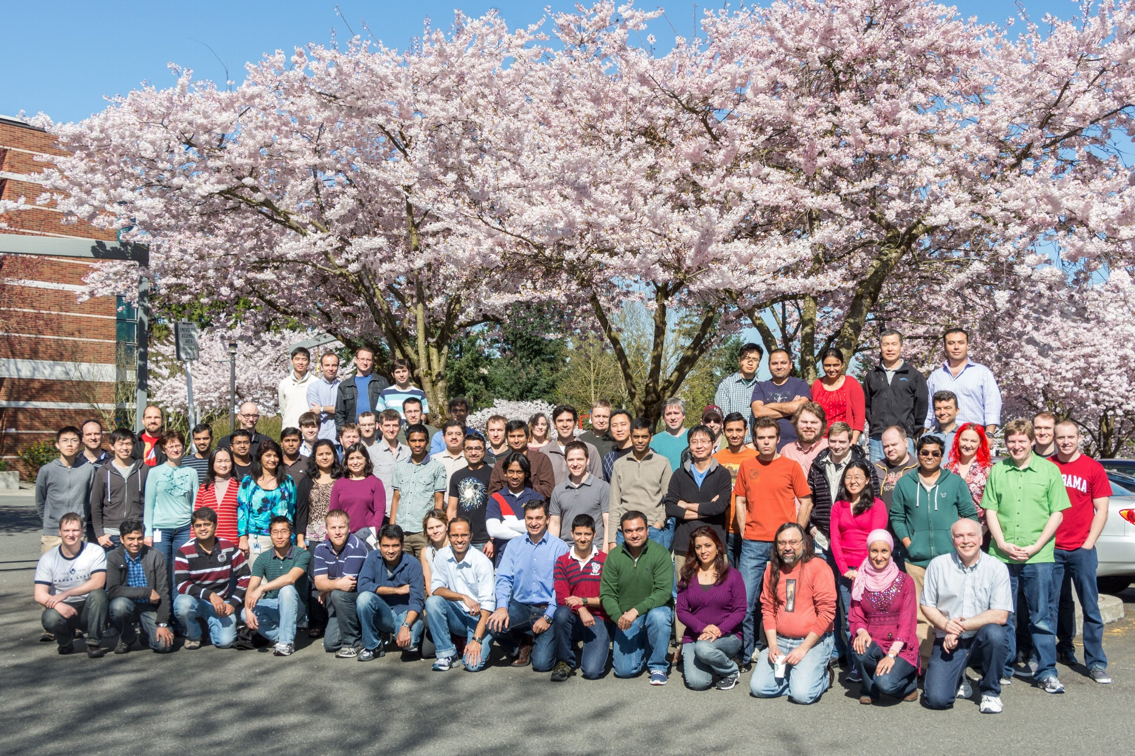
The Virtual Machine Manager Team

Slide 37
Resources
Learning
Sessions on Demand
Microsoft Certification & Training Resources
http://channel9.msdn.com/Events/TechEd
www.microsoft.com/learning
TechNet
msdn
Resources for IT Professionals
Resources for Developers
http://microsoft.com/technet
http://microsoft.com/msdn

Slide 38
© 2013 Microsoft Corporation. All rights reserved. Microsoft, Windows and other product names are or may be registered trademarks and/or trademarks in the U.S. and/or other countries.
The information herein is for informational purposes only and represents the current view of Microsoft Corporation as of the date of this presentation. Because Microsoft must respond to changing market conditions, it should not be interpreted to be a commitment on the part of Microsoft, and Microsoft cannot guarantee the accuracy of any information provided after the date of this presentation. MICROSOFT MAKES NO WARRANTIES, EXPRESS, IMPLIED OR STATUTORY, AS TO THE INFORMATION IN THIS PRESENTATION.

