Slide 2
Microsoft System Center 2012 R2, Operations Manager Overview & What’s New
MDC-B208
Daniel Savage
Joseph Chan
Principal PMs

Slide 3

Overview

Slide 4

SC 2012 Operations Manager investments
Infrastructure and Workloads
DevOps
Experience
Topology simplification
Network monitoring
Linux/Unix authoring
OM manageability
Scale Improvement (50%)
.NET Application Performance Monitoring
JEE Monitoring
Extensible dashboards

Slide 5
SP1 Investments
Infrastructure and Workloads
DevOps
Experience
Virtual fabric monitoring
Storage monitoring
New Linux distributions
Global Service Monitor
Enhanced APM: WCF, MVC, .NET Windows services, IIS8
TFS & Intellitrace Integration
360 dashboards
DevOps scenarios

Slide 6

What’s New?

Slide 7
R2 Investments
Infrastructure and Workloads
DevOps
Experience
360 Infrastructure Monitoring
Better integration with VMM
Improved Azure Monitoring
Improved Management Packs
Advisor Attach including support for SC infrastructure components
Java APM
Enhanced Intellitrace integration
Enhanced TFS integration
Improving dashboard performance
New Widgets*
*delivery/scope TBD

Slide 8
Infrastructure Monitoring
Private, Public , Hybrid…..

Slide 9
Private Cloud Monitoring

Slide 10
Platform Support in R2
Support for Windows Server 2012 R2
  Monitoring of…
  Running on…
  Management Packs available
  AT RTM!

Slide 11
Private Cloud Monitoring in R2
The infrastructure admin should be able to see an at a glance view of cloud health, and health of the underlying fabric/VMs
Ensure the infrastructure admin can do root cause analysis by linking to existing dashboards such as network monitoring dashboards
Improve the VMM diagram view (rollups) and ensure it reflects recent improvements in network and storage monitoring

Slide 12
Private Cloud Monitoring
Daniel Savage

Slide 13
Workload Monitoring

Slide 14
Management Packs Updates for Workloads
Best of breed Monitoring for Workloads
Consistent, World-Class Manageability
  http://blogs.technet.com/b/momteam/archive/2013/03/12/mp-blog-consistent-world-class-manageability.aspx
Community Involvement (MVPs, MS Teams)
Knowledge, Knowledge, Knowledge
  http://blogs.technet.com/b/momteam/archive/2013/03/27/mp-blog-knowledge-knowledge-knowledge.aspx
Continued investment
  45 MPs (new or updated) released since January 2012
  http://social.technet.microsoft.com/wiki/contents/articles/16174.microsoft-management-packs.aspx
Updated Sustained Engineering Process
Upcoming Authoring Tools and MPBPA

Slide 15
Public Cloud Monitoring - Windows Azure Management Pack

Slide 16
Management Pack for Windows Azure
Simplified configuration experience
Cloud Service monitoring
Virtual Machine monitoring (Availability)
Storage Account monitoring (Availability and Size)
Certificate health monitoring (expiration)
Azure Distributed Application Template (hybrid scenarios)
New monitoring dashboards and views
  Service Availability Dashboard

Slide 17
Management Pack for Windows Azure
Daniel Savage

Slide 18
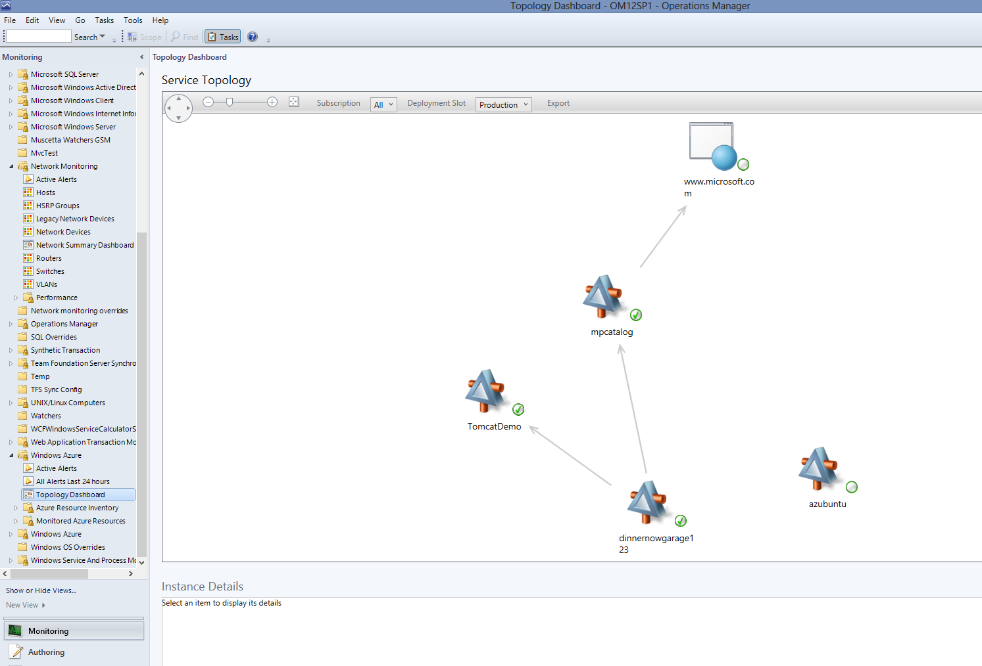

Slide 19
Proactive Monitoring - System Center Advisor

Slide 20

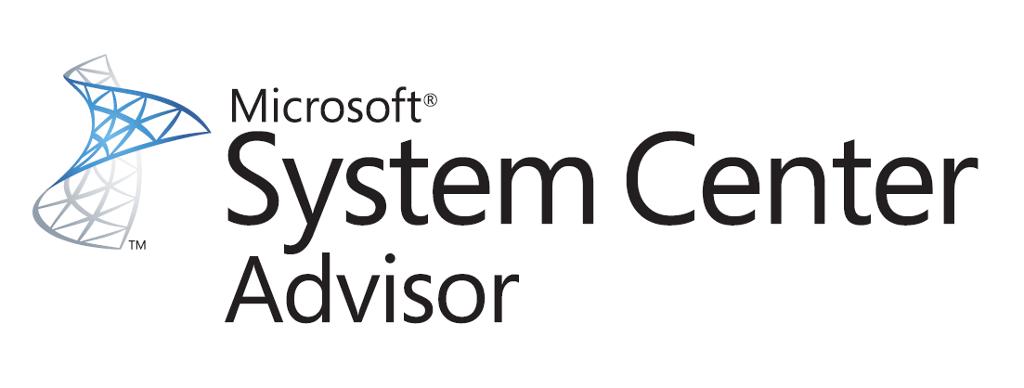
Proactive Monitoring with SC Advisor
CUSTOMER CONFIGURATIONS
BEST PRACTICE CONFIGURATION
Microsoft Customer Service and Support
Knowledge Base
Lync Server
SharePoint
SQL Server
Exchange Server
Windows Server
Fabric Components

Slide 21

Benefits & Features
PROACTIVELY AVOID CONFIGURATION PROBLEMS
REDUCE DOWNTIME
AND IMPROVE PERFORMANCE
RESOLVE ISSUES FASTER

Slide 22
Benefits of SC Advisor as an Attached Service
EASY ENABLEMENT
VIEW ADVISOR ALERTS
IN OM CONSOLE
LEVERAGE OM’S NOTIFICATION, TICKETING INTEGRATION AND USER ROLE CAPABILITIES
    Use your existing SCOM agents & management servers – no more manual certificate, agent & gateway download & provisioning needed

Slide 23

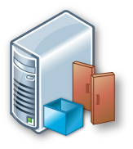
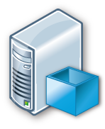
How it works
1
Sign up and Onboard Advisor
8
Advisor processes cab files and generates alerts
2
Management Group is registered in Advisor Account
Advisor Service
3
Opt-In Agents
7
Management Servers upload
cab files to Advisor
4
Management Servers download management certificate and Advisor management pack
Management Server
Management Server
Operations Manager Console
9
Management Servers sync
Advisor alerts
5
Agents download the MP from Management Server
6
Agents scan managed servers and upload cab file to management server

Slide 24
Data privacy
Complete Privacy Statement available
Advisor only has visibility into servers with Agents deployed on them (+ data queried from Active Directory about objects associated with that server)
Uploads are archived on-premise (5 days by default) for audit trail and to enable you to inspect the data
Upload time is configurable; you can stop uploading at any time
You can close your account and request to remove data from Advisor servers (account cleanup happens within 90 days)
Your organization will be the only non-Microsoft party who will have access to your individual organization’s data
Microsoft will not use this data for sales/licensing validation

Slide 25
SC Advisor
Joseph Chan

Slide 26
Application Monitoring
- DevOps

Slide 27

Application Lifecycle – common challenges
No actionable feedback resulting in high MTTR
Operations
Production incidents are hard to debug
PROBLEM ASSIGNED TO ENGINEERING
Develop
Rapid reaction to feedback
Development & testing
Users detect defects in production
Fix
Monitor
Operate
Software to value delivery
Unable to reproduce error in development environment
OPS
BACKLOG
Isolated operations tools and workflows
Long deployment cycle times
WORKING SOFTWARE

Slide 28
360 Application Monitoring
Joseph Chan

Slide 29
Java APM
Performance and Exception Events within SCOM Application Advisor
  Method and Resource timing for Performance Events
  Stack Traces for Exception Events
  Java Specific counters for events (JVM Memory, Class Loader etc)
  Subset of standard APM Reports Supported
Ops Manager Level Alerting on Java Application Server counters
  Requests / Second
  Perf Events / Second
  Exception Events / Second
  Average Request Time

Slide 30
Java APM – Supported Configurations
Tomcat (v 5.5,6,7)
  Windows
  Linux
Java JDK (5,6)
Web Technologies
  GenericServlet
  Struts
  Struts2
  Axis2

Slide 31
JAVA APM
Joseph Chan

Slide 32

Related content
MDC-B314 Operations Manager Panel Discussion immediately after this session in Hall 4.5

Slide 33
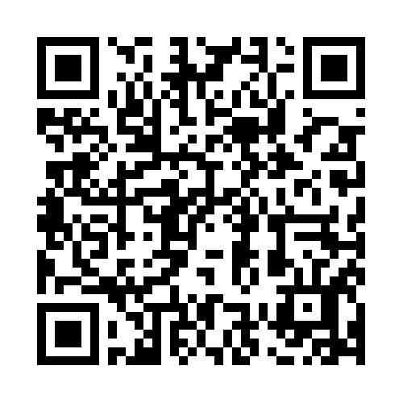


Evaluate this session
Required Slide
*delete this box when your slide is finalized
Your MS Tag will be inserted here during the final scrub.
Scan this QR code to
evaluate this session.

Slide 34

© 2013 Microsoft Corporation. All rights reserved. Microsoft, Windows and other product names are or may be registered trademarks and/or trademarks in the U.S. and/or other countries.
The information herein is for informational purposes only and represents the current view of Microsoft Corporation as of the date of this presentation. Because Microsoft must respond to changing market conditions, it should not be interpreted to be a commitment on the part of Microsoft, and Microsoft cannot guarantee the accuracy of any information provided after the date of this presentation. MICROSOFT MAKES NO WARRANTIES, EXPRESS, IMPLIED OR STATUTORY, AS TO THE INFORMATION IN THIS PRESENTATION.

