Slide 2
Software Defined Networking Solution from Microsoft
MDC-B210
Ravi Rao
Dhananjay Mahajan

Slide 3
Agenda
Context - what is the problem, what is SDN
Technologies enablers to realize SDN
Ecosystem – what vendor choice do I have

Slide 4
Context – why it matters

Slide 5

The big picture – Transform the datacenter
  Datacenter without boundaries
  Cloud Innovation everywhere
  Dynamic application delivery

Slide 6
Networking gets in the way
Aggregation
Switches
VLAN tags
ToR
ToR
VMs
Topology limits VM mobility and requires reconfiguration of production switches

Slide 7
Requirements to transform networking
Deliver networking as part of pooled, automated infrastructure
Ensure multitenant isolation, scale and performance
Expand datacenter capacity seamlessly as per business needs
Reduce operational complexity

Slide 8
What is Software-defined Networking (SDN)?
Enables software to dynamically manage the network
Abstracting the physical network with virtual networks
Spanning policies across physical and virtual networks
Controlling datacenter
traffic flow

Slide 9
Technologies to realize SDN

Slide 10

1. Hyper-V Switch as the policy edge
  What the Hyper-V Switch does:
  Provides L2 layer connectivity for VMs
  Extends the network edge to the host
Hyper-V Host
Virtual Machine
Virtual Machine
VM NIC
VM NIC
  Features
    Isolation
    Traffic Shaping
    Security
    Diagnostics
    Switch Extensibility
Virtual Switch
Physical NIC
Physical Network

Slide 11
Hyper-V switch extensibility
Virtual Machine
Virtual Machine
  Benefits
    Open platform to fuel plug-ins
    Free core services
    Reliability and quality
    Unified management
    Easier to support
Parent Partition
VM NIC
Host NIC
VM NIC
Virtual Switch
Extension Protocol
Extension A
Capture Extensions
Extension C
Filtering Extensions
Extension D
Forwarding Extension
Extension Miniport
Physical NIC
Hyper-V Extensible Switch architecture

Slide 12

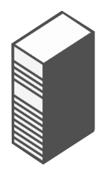
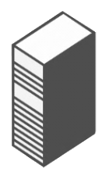
2. Hyper-V Network Virtualization (HNV) as the tenant network overlay
  How network virtualization works
  Overlays physical network
    Encapsulation using NVGRE protocol
Contoso virtual machine
Fabrikam virtual machine
Contoso network
Fabrikam network
  Problems solved
  VM mobility across datacenter, hoster cloud or Azure
  Ability to import customer IP addresses and network topology
VIRTUALIZATION
Physical server
Physical network
Notes:
12

Slide 13


Hyper-V Network Virtualization: What’s really happening?
Contoso sees
SQL Server
Web
Fabrikam sees
SQL Server
Web
10.1.1.2
10.1.1.3
10.1.1.2
10.1.1.3
10.1.1.2 | 192.168.1.10
10.1.1.3 | 192.168.2.12
10.1.1.2 | 192.168.1.10
10.1.1.3 | 192.168.2.12
192.168.n.n
PROVIDER ADDRESS SPACE (PA)
192.168.1.10
192.168.2.12
Hyper-V Host 1
Hyper-V Host 2
10.1.1.2 | 192.168.1.10
10.1.1.3 | 192.168.2.12
10.1.1.2 | 192.168.1.10
10.1.1.3 | 192.168.2.12
10.1.1.2 | 192.168.1.10
10.1.1.3 | 192.168.2.12
10.1.1.2 | 192.168.1.10
10.1.1.3 | 192.168.2.12
10.1.1.1
10.1.1.1
10.1.1.2
10.1.1.2
SQL Server
SQL Server
Web
Web
CUSTOMER ADDRESS SPACE

Slide 14
Hyper-V Network Virtualization: What’s new in Windows Server 2012 R2
Contoso sees
SQL Server
Web
Fabrikam sees
  Dynamically Learned Customer Addresses
  Highly available Windows gateways, hosts, VMs
  Performance Improvements
  NIC Teaming Integration
  NVGRE Task Offload Enabled NICs
  Enhanced diagnostics of virtual networks
SQL Server
Web
10.1.1.2
10.1.1.3
10.1.1.2
10.1.1.3
10.1.1.2 | 192.168.1.10
10.1.1.3 | 192.168.2.12
10.1.1.2 | 192.168.1.10
10.1.1.3 | 192.168.2.12
192.168.n.n
PROVIDER ADDRESS SPACE (PA)
192.168.1.10
192.168.2.12
Hyper-V 1
Hyper-V Host 2
10.1.1.2 | 192.168.1.10
10.1.1.3 | 192.168.2.12
10.1.1.2 | 192.168.1.10
10.1.1.3 | 192.168.2.12
10.1.1.2 | 192.168.1.10
10.1.1.3 | 192.168.2.12
10.1.1.2 | 192.168.1.10
10.1.1.3 | 192.168.2.12
10.1.1.1
10.1.1.1
10.1.1.2
10.1.1.2
SQL Server
SQL Server
Web
Web
CUSTOMER ADDRESS SPACE

Slide 15
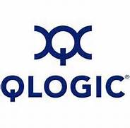
Emulex NVGRE optimized VNeX

Slide 16
Mellanox ConnectX-3 Pro 10 GBe 10GbE Performance
65%
80%
Higher
Is Better
Lower
Is Better

Slide 17
Hyper-V Network Virtualization enhances Hyper-V Switch Extensions
Introduces new hybrid forwarding
  HNV forwards HNV traffic
  Forwarding Extension forwards non-HNV traffic
Richer switch extensions
  Extensions can view CA and PA packets
Enables 3rd party network virtualization
  Forwarding extensions can modify packet headers on both ingress and egress
vSwitch
vSwitch
Extension
Extension
Ingress
Egress
Extension
Ingress
Egress
Extension
Extension
Extension
Native
Policies
Egress
ACL
Native
Policies
Egress
ACL
3rd Party
Fwd Ext
Ingress
Egress
3rd Party
Fwd Ext
Ingress
Egress
MS Forwarding
HNV
MS
Forwarding
HNV
NIC Team
NIC Team
pNIC
pNIC
Windows Server 2012
Windows Server 2012 R2

Slide 18
Demo: Cisco N1KV and Hyper-V Network Virtualization co-existence

Slide 19
3. Multi-tenant gateways for hybrid connectivity
Challenges
Hoster wants to provide isolated networks for tenant VMs with integrated S2S VPN and NAT
Enterprises want to dynamically expand capacity
Solution
Multitenant VPN for Site-to-Site connectivity
Multitenant aware NAT for Internet access
Forwarding gateway for in datacenter physical machine access
DNS
SQL
DC
Contoso Corp.
Fabrikam Corp.
SPS VPN
Internet
SPS VPN
Multi-tenant VPN Gateway
Host Datacenter
Network Virtualization Fabric
Host
Host

Slide 20
Demo: F5 software-based Hyper-V Network Virtualization gateway

Slide 21

4. OMI and PowerShell to control physical infrastructure
  How switch management works
  Standards-based CIM model
  Switches running Open Management Infrastructure (OMI)
  Switch Management PowerShell Cmdlets
PowerShell CIM Cmdlets
  Problems solved
  Common management interface across multiple network vendors
  Automate common network management tasks
  Logo Program enables customers to find/buy switches that “just work”
Communicating using
WS-MAN
OMI
OMI
OMI
Notes:
21

Slide 22
Demo: Arista OMI managed switch

Slide 23
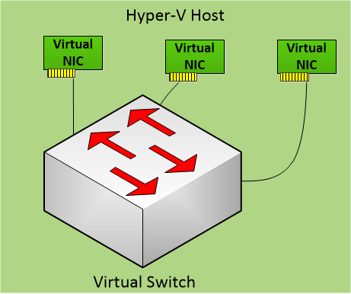
5. SCVMM and Windows Azure Pack for automation
Challenges
  Manage a large number of physical and virtual switches and networks.
  Integrate management of physical and virtual networks
Solution
  Logical Network
    Organizes and simplifies network assignments for hosts, virtual machines and services
    Integrated physical and virtual switch VLAN policy
  VM Network
    Creation/deletion of isolated virtual network overlay (HNV) on physical network
Virtual
VM Network
VM Network
Logical NW
Extension
Extension
VLAN 25
Subnet 10.0.0.0/26
Extension
Fabric
Logical NW
Physical Network

Slide 24
Managing SDN with System Center 2012 R2 Virtual Machine Manager (contd.)
Challenges
  Allow seamless migration of VM while maintaining network policy
Solution
  Logical Switch
    Single logical entity spanning hosts
    Consistent policy and configuration
  Management of Hyper-V Extensible Switch
    Installation and configuration of switch extensions
    Configuration of network policies
  Network policies automatically move with the VM
    Includes 3rd party extensions
Virtual
VM Network
VM Network
Logical NW
Extension
Extension
VLAN 25
Subnet 10.0.0.0/26
Extension
Fabric
Logical NW
Physical Network

Slide 25
Enabling tenant self-service
Using Windows Azure Pack for Windows Server
  Tenants create their own networks
  Consistent experience with Windows Azure
  Configuration of topology and border gateway protocol (BGP)
  Reporting and chargeback
Service Provider Foundation (SPF) provides REST API to enable Hosters and Private cloud providers to build own portal
Support for guest clusters and guest specified IP addresses with network virtualization

Slide 26
The technology enablers for SDN
Hyper-V Switch as the policy edge
Hyper-V Network Virtualization for tenant network overlays
Multi-tenant gateways for hybrid connectivity
OMI and Powershell for controlling physical infrastructure
SCVMM and Windows Azure Pack for automation

Slide 27
SDN ecosystem

Slide 28
SDN partner ecosystem
Hyper-V Switch extensions
NVGRE-aware hardware
  Switching ASICs
  Task offload enabled NICs
HNV gateways
  Hardware, Appliances and Software Gateways
OMI managed switches
Contoso Corp.
External network
HNV Gateway
Fabrikam Corp.
Host Datacenter
Network Virtualization Fabric
SPS VPN
OMI
SPS VPN
pNIC
pNIC
Host
Host

Slide 29
Video: Huawei Hyper-V Network Virtualization gateway

Slide 30
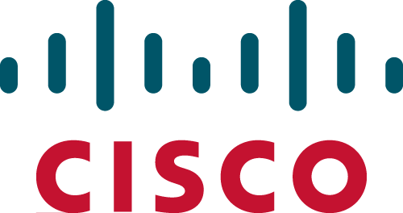

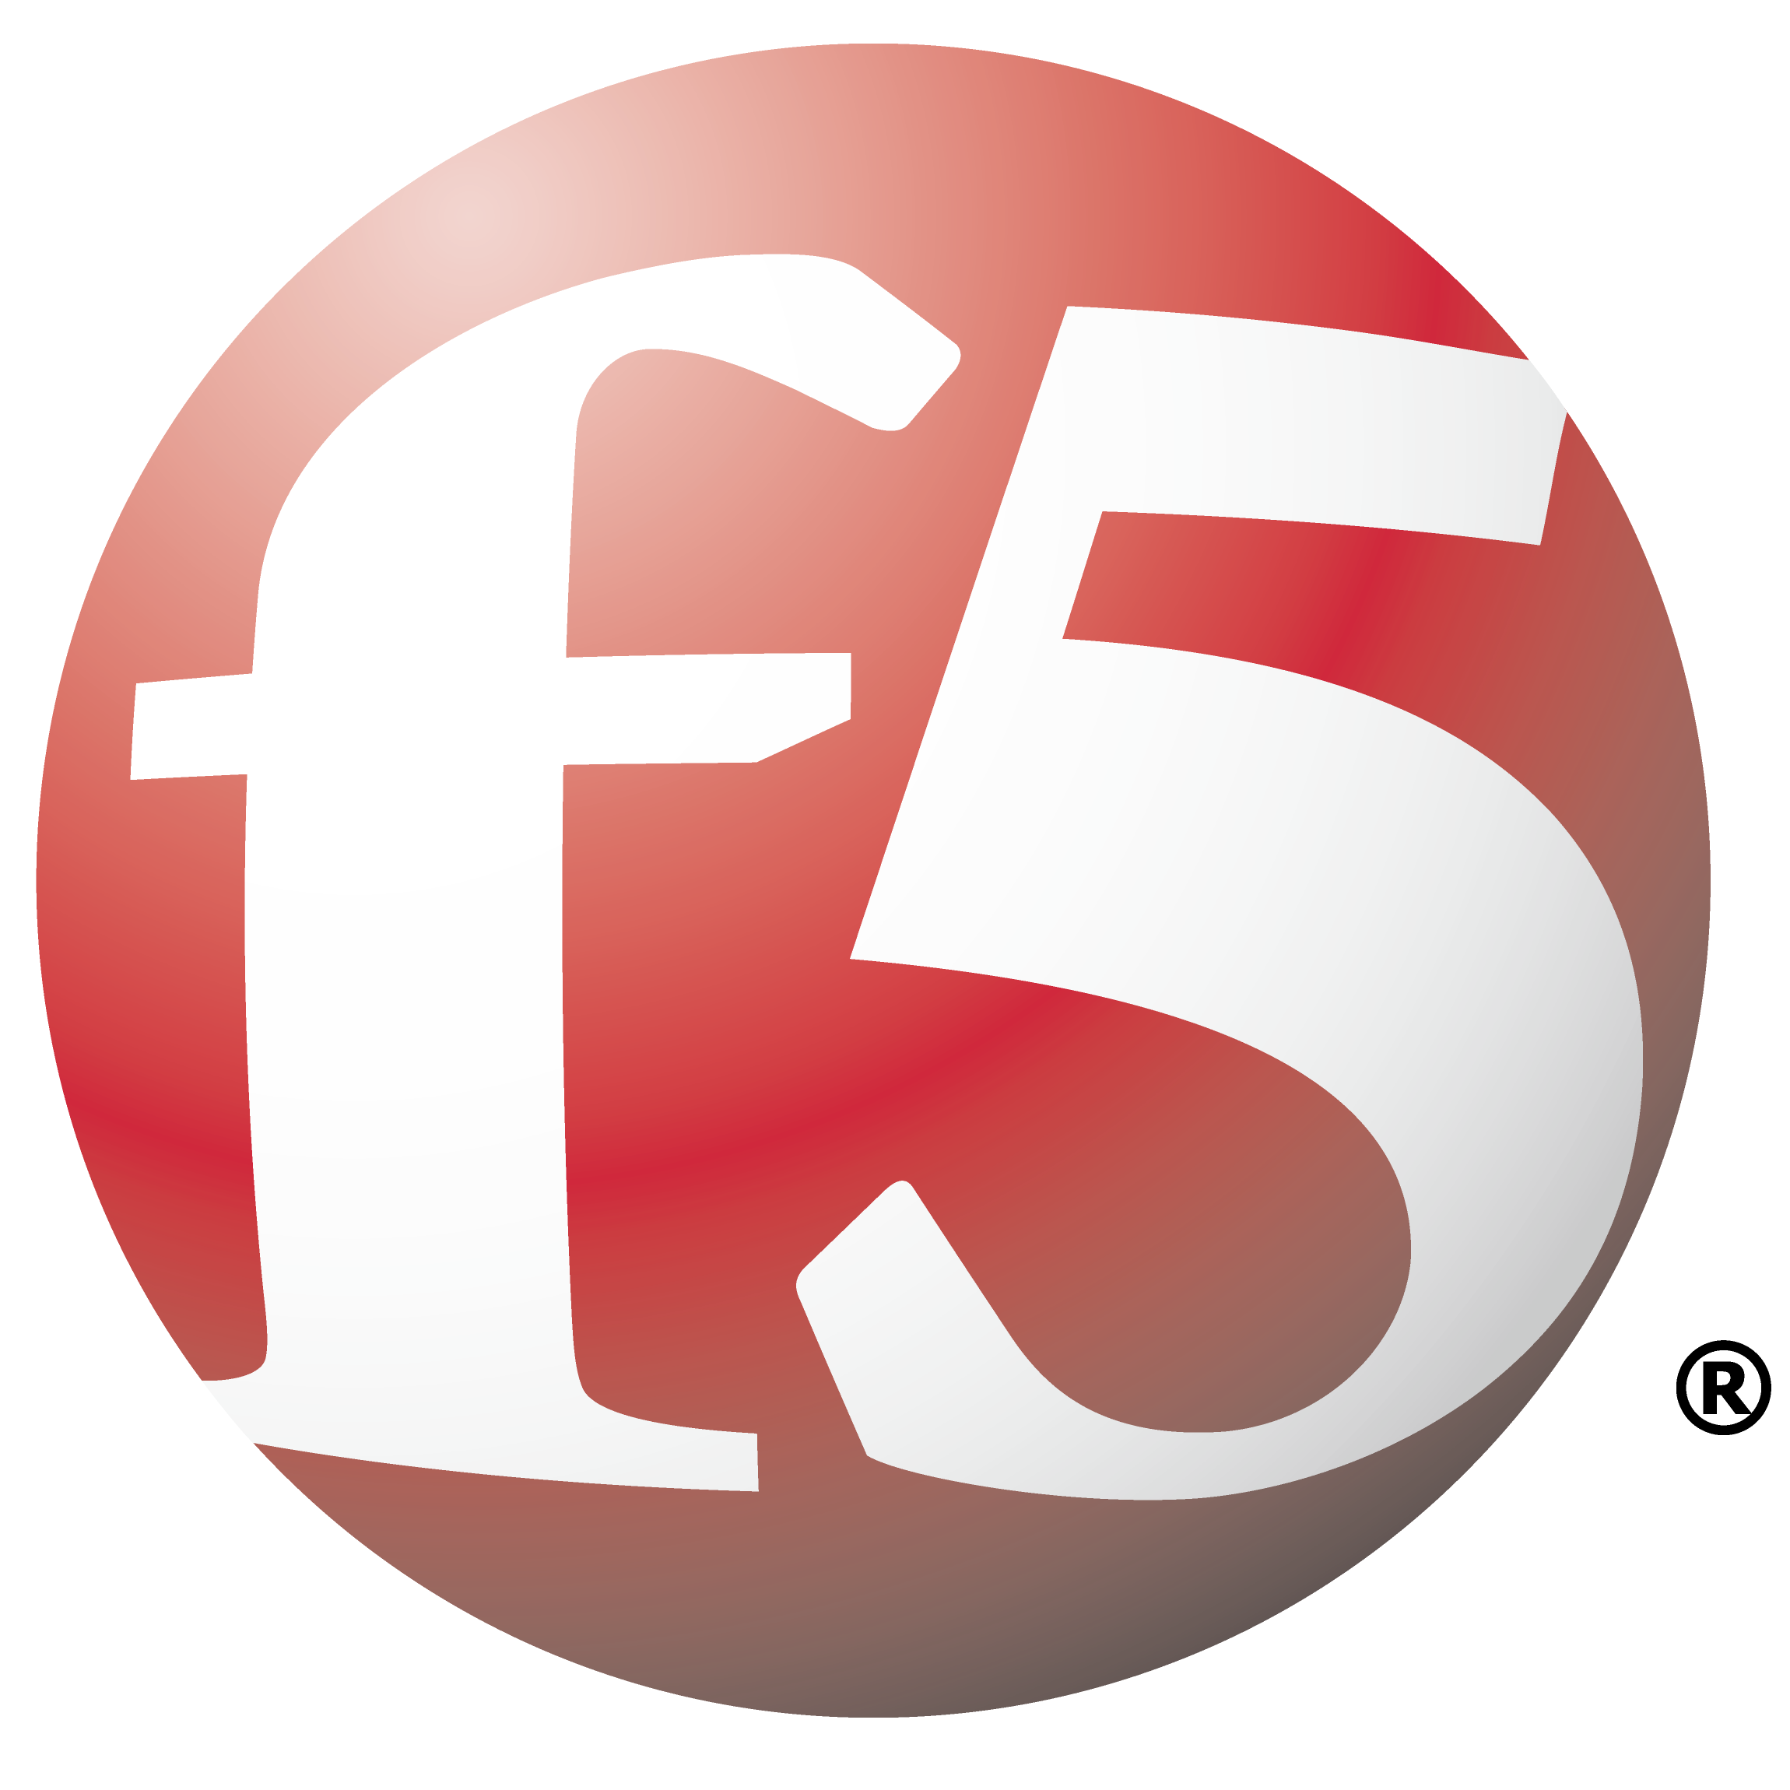

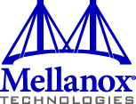

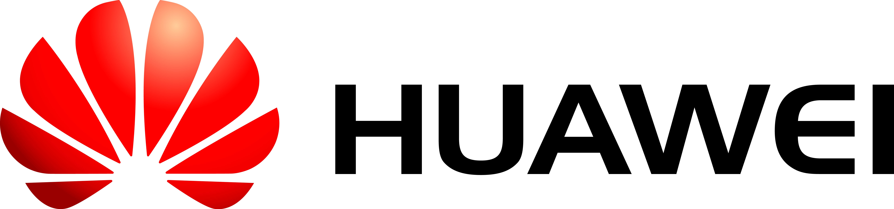
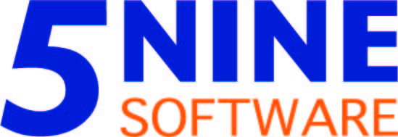

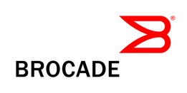


SDN partner ecosystem
Gateway appliances
OMI-based
switch
Hyper-V switch
extensions
NVGRE-aware
hardware

Slide 31
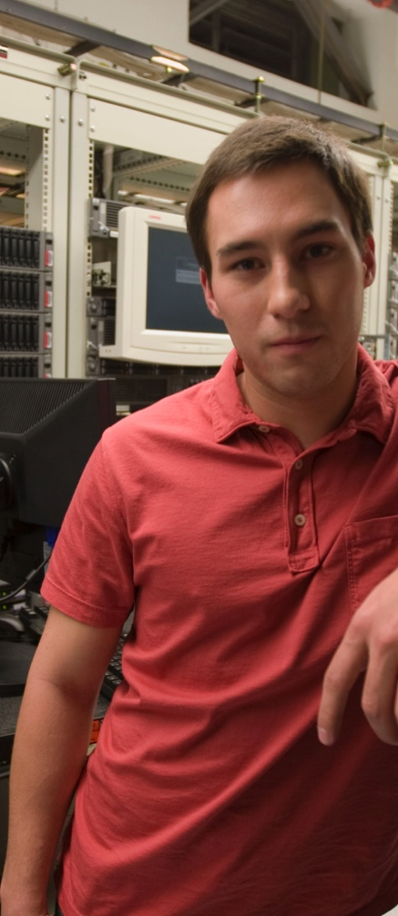
SDN in Windows Server 2012 R2 and
System Center 2012 R2
Flexibility by abstracting
the physical network
  Hyper-V Network Virtualization
  Hyper-V Extensible Switch
  Network switch management
  Built-in Software gateways
Automation for deploying
policy on the virtual/physical
network
System Center 2012 R2 Virtual Machine Manager
Windows Azure pack (tenant self service)
Control over datacenter traffic
with policy enforcement
Partner extensions

Slide 32
Summary
Microsoft will continue to bring innovation and learning from operating large scale cloud services to your datacenters
SDN is a key facet towards transforming your datacenter. It is easy to use Windows Server and System Center to build it.
Microsoft provides an open, extensible, standards-based SDN solution in Windows Server and System Center

Slide 33

Related content
Breakout Sessions (session codes and titles)
  MDC-B350 How to Design and Configure Networking in Microsoft System Center - Virtual Machine Manager and Hyper-V Part 1
  MDC-B351 How to Design and Configure Networking in Microsoft System Center - Virtual Machine Manager and Hyper-V Part 2
  MDC-B380 Deep dive on Hyper-V Network Virtualization in Windows Server 2012 R2
  MDC-B216 What’s new in Windows Server 2012 R2 Networking
Find Me Later At...
  Ask the experts: Halls GH - Table 18
  Ask the experts: Expo – Tuesday 12:30 – 1:30 PM

Slide 34
Track resources
Learn more about Windows Server 2012 R2 Preview, download the datasheet and evaluation from:
http://aka.ms/WS2012R2
Learn more about System Center 2012 R2 Preview, download the datasheet and evaluation from:
http://aka.ms/SC2012R2

Slide 35

Resources
Learning
  Sessions on Demand
  Microsoft Certification & Training Resources
http://channel9.msdn.com/Events/TechEd
www.microsoft.com/learning
TechNet
msdn
  Resources for IT Professionals
  Resources for Developers
http://microsoft.com/technet
http://microsoft.com/msdn

Slide 36

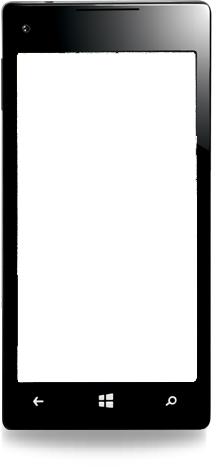

Evaluate this session
Required Slide
*delete this box when your slide is finalized
Your MS Tag will be inserted here during the final scrub.
Scan this QR code to
evaluate this session.

Slide 37

© 2013 Microsoft Corporation. All rights reserved. Microsoft, Windows and other product names are or may be registered trademarks and/or trademarks in the U.S. and/or other countries.
The information herein is for informational purposes only and represents the current view of Microsoft Corporation as of the date of this presentation. Because Microsoft must respond to changing market conditions, it should not be interpreted to be a commitment on the part of Microsoft, and Microsoft cannot guarantee the accuracy of any information provided after the date of this presentation. MICROSOFT MAKES NO WARRANTIES, EXPRESS, IMPLIED OR STATUTORY, AS TO THE INFORMATION IN THIS PRESENTATION.

Slide 38
NVGRE Optimized VNeX™ Network Virtualization
Offload Technology Performance Optimizations
Emulex has announced planned support for VNeX™ Network Virtualization Offload Technology optimized to improve the performance of NVGRE
NVGRE optimized offloads increase network throughput by 130%
  These are early test results
  CPU utilization is critical
Benefits
  Improved VM density
  Better network throughput
  Lower CPU utilization for NVGRE
Note:
  Results are illustrative and based on early engineering testing and will vary based on VM density, CPU utilization, and other configuration parameters.
Throughput normalized to 10Gb/s
to demonstrate the performance
impact of no NIC offloads.
CPU utilization is an important
parameter impacting network
throughput.

