Slide 2
IaaS Hosting a Microsoft SharePoint 2013 Farm on Windows Azure
MDC-B213
Michael Washam
Principal Cloud Architect
Aditi - @MWashamMS

Slide 3

What we do at Aditi
ACCELERATE INNOVATIONS USING CLOUD
TO THE CLOUD.
THE RIGHT WAY.
DIFFERENTIATE WITH DESIGN AND USER EXPERIENCE
DELIVER SCALE AND AGILITY

Slide 4




Cloud OS Workload Mobility
PUBLIC
PRIVATE
HOSTED

Slide 5
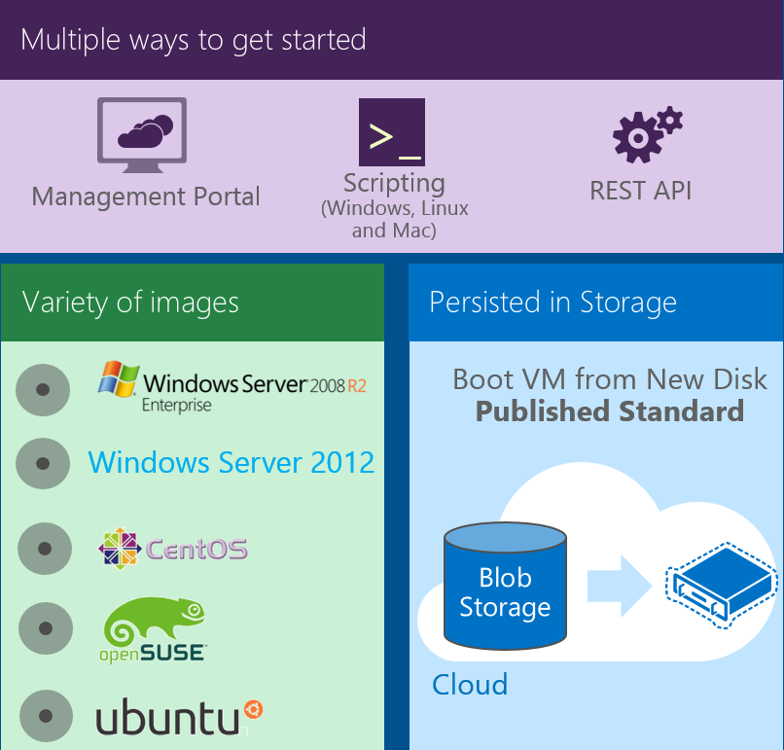
Infrastructure Services on Windows Azure
  IT Pro experience

Slide 6

Infrastructure Services on Windows Azure
  IT Pro experience
SharePoint 2010
SharePoint 2013
  Support for key server apps
SQL Server 2008 R2 Web
SQL Server 2008 R2 Standard
SQL Server 2008 R2 Enterprise
SQL Server 2012 Express
SQL Server 2012 Web
SQL Server 2012 Standard
SQL Server 2012 Enterprise
BizTalk Server 2013
Dynamcis GP 2013+
Dynamics NAV 2013+
Forefront Identity Manager 2010 R2
Project Server 2013
System Center Suite
Team Foundation Server

Slide 7
Demo
Windows Azure Virtual Machines

Slide 8

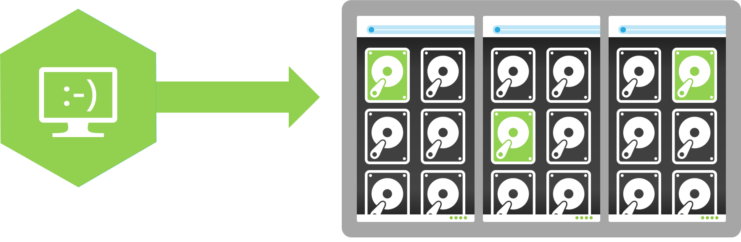

Infrastructure Services on Windows Azure
Windows Azure
  IT Pro experience
  Support for key server apps
  Storage Manageability and Mobility
Windows Server 2012
Your Data Center

Slide 9
Infrastructure Services on Windows Azure
  IT Pro experience
  Support for key server apps
  Storage Manageability and Mobility
  High availability features

Slide 10
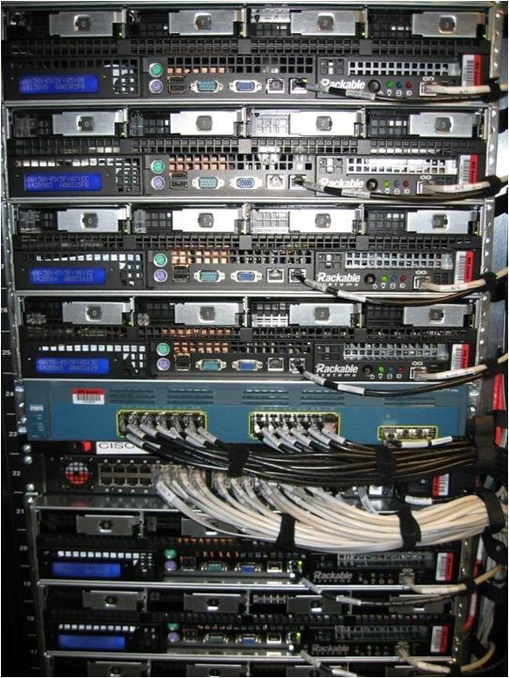
High availability features
Physical Machines
Power Unit
Rack Switch

Slide 11

High availability features
Looking for more on DR? MDC-B371
Load Balancer
Load-Balanced Set
Physical Machines
Power Unit
Rack Switch
VM1
VM2
VM2
VM1
VM2
Availability Set
Availability SLA: 99.95%

Slide 12
Demo
Highly Available Virtual Machines

Slide 13
Infrastructure Services on Windows Azure
  IT Pro experience
  Support for key server apps
  Storage Manageability and Mobility
  High availability features
  Advanced Hybrid Networking

Slide 14


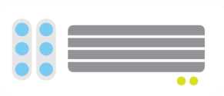
Virtual Networks – Site-to-Site
Windows Azure
<subnet 1>
<subnet 2>
<subnet 3>
Virtual Network
Site-to-Site VPN
DNS Server
On-premises
WA Gateway
Hardware VPN or
Windows RRAS
Your datacenter

Slide 15


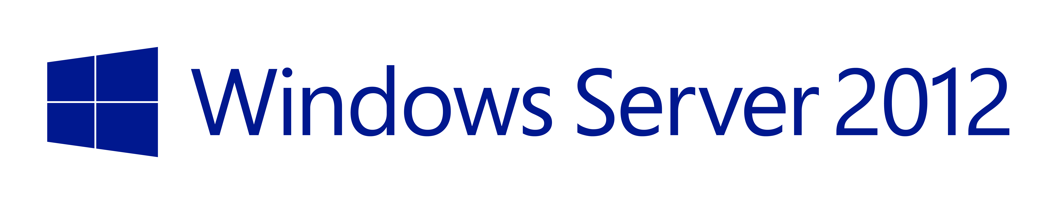
More Options for Getting Your Virtual Network Started
Looking for more on Virtual Networks? MDC-B360
New: Software based
VPN gateway
Windows Server
Routing and Remote Access Service (RRAS)
Generic VPN devices
must support
IKE v1, IKE v2
AES 128, 256
SHA1, SHA2

Slide 16
Virtual Networks – Point-to-Site
Windows Azure
Looking for more on Point-to-site? MDC-B360 and MDC-B370
<subnet 1>
<subnet 2>
<subnet 3>
Virtual Network
Site-to-Site VPN
DNS Server
On-premises
WA Gateway
Hardware VPN or
Windows RRAS
Your datacenter
Point-to-Site
VPN
Individual
computers behind
corporate firewall
Remote workers

Slide 17
Infrastructure Services on Windows Azure
  IT Pro experience
  Support for key server apps
IaaS and PaaS together
Pay by the minute
VMs Stops/Payment Stops
MSDN agility
  Storage Manageability and Mobility
  High availability features
  Advanced Hybrid Networking
  IaaS, PaaS, and Agility

Slide 18
Pay by the minute!
No minimums. No rounding-up. First 5 minutes free!
$
60
45
30
15
18

Slide 19
Billing stops when you stop!
Stopping instance, stops billing
No need to delete your virtual machine
Start back with same disks attached & same end-points configured
$$$$$$
$$$$$$
$$$$$$
$$$$$$
$$$$$$
$$$$$$
$$$$$$
$$$$$$
$$$$$$
$$$$$$
$$$$$$
$$$$$$
$$$$$$
$$$$$$
$$$$$$
$$$$$$
$$$$$$
19

Slide 20
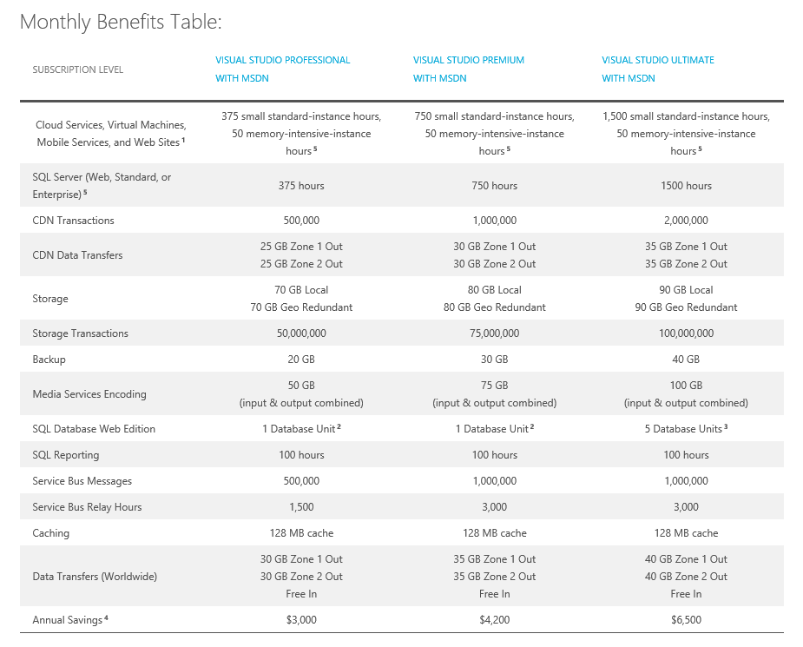
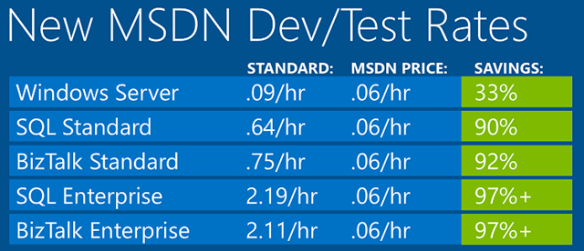
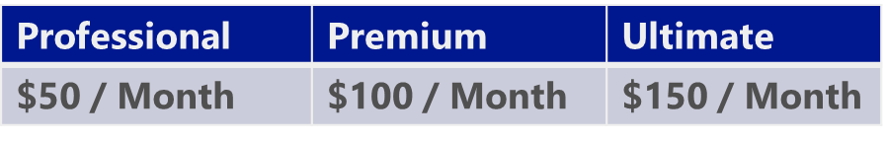
MSDN Usage Improvements
Looking for more on Dev/Test? MDC-B370
MSDN products can be used on Virtual Machines
Single monetary credit instead of plethora of meters.
Focusing on Dev/Test Usage
Professional | Premium | Ultimate
$50 / Month | $100 / Month | $150 / Month

Slide 21
1,800 SharePoint lab VMs on Windows Azure

Slide 22
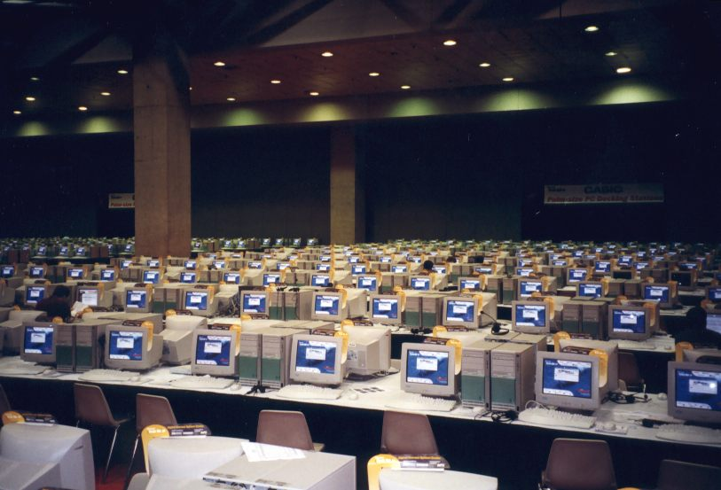
2 Datacenters
14 Subscriptions
1800 VMs
13 TB Memory
14,400 Cores

Slide 23
SharePoint 2013 in Windows Azure IaaS

Slide 24
Small Farm Goals
Follow best practices for deploying SharePoint
  Start with the SharePoint Product Line Architecture (PLA)
  Nearly identical to installing SharePoint on premise
Balance performance and cost
  Use the smallest VM possible
  Use the smallest number of VMs possible
Test in the cloud
  Load test using Microsoft Visual Studio Team System Test Edition
  Scripted 78 different business test scenarios
How Big is Small?
  300,000 users at about 250 requests per second (sub 2 second response times)
  400,000 unique documents for 220GB content database

Slide 25
Small Farm Architecture Tips
IOPS Most Important Factor
  SharePoint relies heavily on TempDB – Split and move TempDB to data disks (do not use D: )
  Split content database into multiple files
  Put log files on separate data disk
  Format data disks with Read Caching and 64kb blocks
  Only SharePoint is on the C: drive
Scale Out Not Up
  Move content databases to separate SQL Servers
  Move search databases to separate SQL Servers
  Add more WFE for scaling SharePoint services
  Add dedicated Search Servers and SQL Server

Slide 26



SharePoint Farm Configuration
LB
WFE
AppSvr
SQL
AD/DC/DNS
WFE
1
APP
1
SQL
1
AD
1
AD
2
AD
1
WFE
2
APP
2
SQL
2
Cloud Svc
80/443
WFE
3
APPS
DATA
DATA
VPN Tunnel
Cloud Svc
OnPrem Network
Virtual Network
2013
Azure
OnPrem

Slide 27
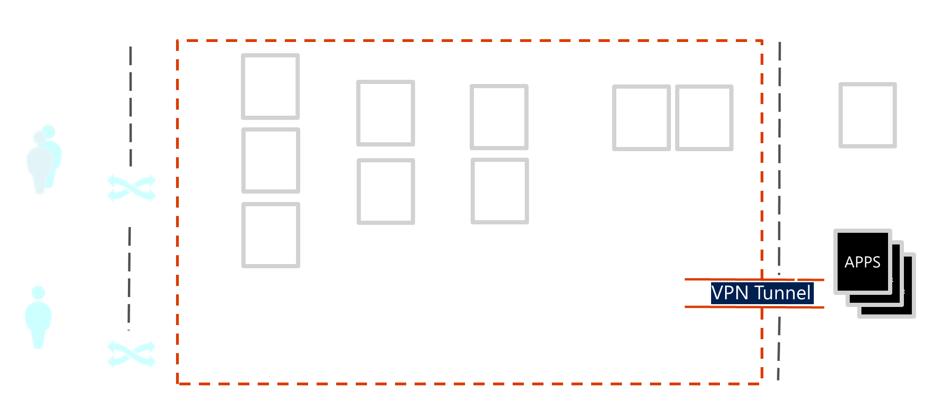
Web Front End Tier

Slide 28
App Server Tier

Slide 29
Data Server Tier

Slide 30
  Windows Azure and SharePoint
  Deploy Using a Virtual Network
  Virtual Machines deployed into a virtual network have an infinite DHCP lease – This is required for Active Directory in the Cloud!
  Use Multiple Data Disks
  Spread the IOPs around (up to 16 1TB Data Disks per VM with XLarge+ VMs)
  Group Multiple VM Tiers into Availability Sets
  Remember: Availability Sets give your VMs hardware level high availability
  Use HTTP Health Probes on Web Front Ends
  Have the load balancer help determine when your web front ends are available for additional HA.
  Automate as Much as Possible
  Deploying and managing SharePoint in the cloud can be scripted.
  Remember a Stopped VM doesn’t charge you!

Slide 31
Highly Available
Farm Demo
Michael Washam

Slide 32
Automation

Slide 33
DevOps
What you have heard
IT and development working closely during the product life cycle
What it really means:
Writing code to automate tasks that were traditionally manual processes
Benefits
Shorter development cycles and more agile
Reduced costs
Fewer deployment issues
Shared responsibilities between developers and IT

Slide 34




Traditional Deployment w/o Automation
Setup Network Infrastructure
LB
WEB
APP
SQL
Setup Server Infrastructure
Install and Patch OS
Install and Configure Apps
80
Multiple Environments?
Rinse and Repeat
Networking Infrastructure

Slide 35
Cloud Deployment w/o Automation
Configure Network Settings
LB
WEB
APP
SQL
Create Virtual Machines w/OS
Patch OS
Install and Configure Apps
80
Multiple Environments?
Rinse and Repeat
Virtual Network

Slide 36
Cloud Deployment with Automation
Identify Repeatable Processes
LB
WEB
APP
SQL
Create Configurable Automation
Execute
Perform Non-Repeatable Tasks
80
Multiple Environments?
Change Variable and Execute
Virtual Network

Slide 37
What tasks are good for automation?
Tasks that are repetitive
  Deploying Web Server for Development and Test
Tasks that are complex
  Deploying AD, SQL and SharePoint for lab environments / development and testing.
Tasks that can save you money
  Scheduled Shutdown of Compute Instances
Domain Expertise
  Security Hardening – Loss in translation from the experts

Slide 38
Windows Azure Automation
Windows Azure Fabric Controller
Service Management API (RDFE)
Windows Azure
WA PowerShell
Rich Apps/Services
X-Plat CLI
External Clients

Slide 39
SharePoint 2013 Automation Scripts
PowerShell Scripts that use Remote PowerShell for automated deployment of Active Directory, SQL Server and SharePoint 2013.
Two Sample Configurations Available
HighlyAvailable and SingleVMs
Download from GitHub
https://github.com/windowsazure/azure-sdk-tools-samples

Slide 40

Highly Available Template
Web Tier
2 x Large
(4 Cores & 7 GB)
App Tier
2 x Large
(4 Cores & 7 GB)
Data Tier
2 x A6
(4 Cores & 28 GB)
1 x Small (Quorum)
(1 Core & 1.75 GB)
Identity Tier
2 Small
(1 Core & 1.75 GB)
LB
WEB
APP
SQL
AD/DC/DNS
AVSET
SPWEB
AVSET
SPAPP
AVSET
SQLHA
AVSET
DCSET
80
Cloud Service
20000
Virtual Network
Windows Azure

Slide 41
Single Virtual Machines Template
LB
WEB/APP
SQL
AD/DC/DNS
Web/App Tier
1 x Large
(4 Cores & 7 GB)
Data Tier
1 x A6
(4 Cores & 28 GB)
Identity Tier
1 Small
(1 Core & 1.75 GB)
80
Cloud Service
20000
Virtual Network
Windows Azure

Slide 42
Automated SharePoint Farm Deployment
Michael Washam
Looking for more on WA PowerShell? WAD-B305

Slide 43
Virtual Machine
Billing
Michael Washam

Slide 44
Questions
Email: michaelwa@aditi.com
Twitter: MWashamMS
Blog: http://michaelwasham.com

Slide 45
SharePoint Resources
Getting Started with SQL Server in Windows Azure Virtual Machines
http://msdn.microsoft.com/en-us/library/windowsazure/dn133151.aspx#sqlserver
Performance Considerations for SQL Server in Windows Azure Virtual Machines
http://msdn.microsoft.com/en-us/library/windowsazure/dn133149.aspx
Visual Studio Load Test in Windows Azure Overview
http://msdn.microsoft.com/en-us/library/windowsazure/hh674501.aspx
Introducing the SharePoint PLA
http://blogs.technet.com/b/pla/archive/2013/04/09/introducing-the-microsoft-product-line-architecture.aspx
Follow “Plan for SharePoint” on Technet
http://technet.microsoft.com/en-us/library/cc261834.aspx

Slide 46
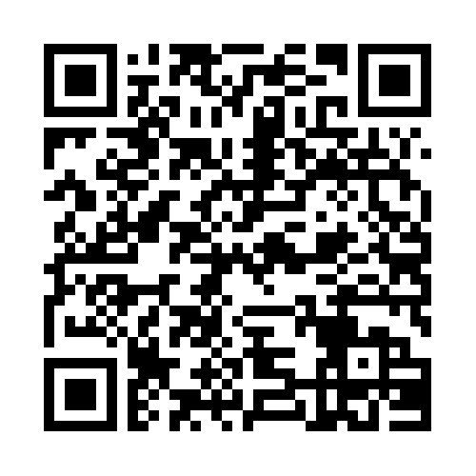


Evaluate this session
Required Slide
*delete this box when your slide is finalized
Your MS Tag will be inserted here during the final scrub.
Scan this QR code to
evaluate this session.

Slide 47

© 2013 Microsoft Corporation. All rights reserved. Microsoft, Windows and other product names are or may be registered trademarks and/or trademarks in the U.S. and/or other countries.
The information herein is for informational purposes only and represents the current view of Microsoft Corporation as of the date of this presentation. Because Microsoft must respond to changing market conditions, it should not be interpreted to be a commitment on the part of Microsoft, and Microsoft cannot guarantee the accuracy of any information provided after the date of this presentation. MICROSOFT MAKES NO WARRANTIES, EXPRESS, IMPLIED OR STATUTORY, AS TO THE INFORMATION IN THIS PRESENTATION.

