Slide 2
Managing Multi-Hypervisor Environments with System Center 2012
MDC-B304
Mike Resseler
Microsoft Evangelist
@MikeResseler

Slide 3
Agenda
Overview of the Private Cloud
No Comparison
Virtual Machine Manager
Operations Manager
Orchestrator
Examples

Slide 4
System Center Helps Deliver IT as a Service
Configure
App Controller
Orchestrator
Deploy
Public Cloud
Service Delivery and Automation
Self Service
Virtual Machine Manager
Service Model
Operations Manager
Configuration Manager
Private Cloud
App
Owner
Data Protection Manager
DC Admin
Service Manager
Service Manager
Virtual
Monitor
Operate
Physical
Application Management
Service Delivery and Automation
Infrastructure Management

Slide 5
This is not a comparison!

Slide 6
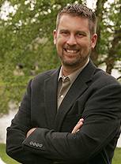
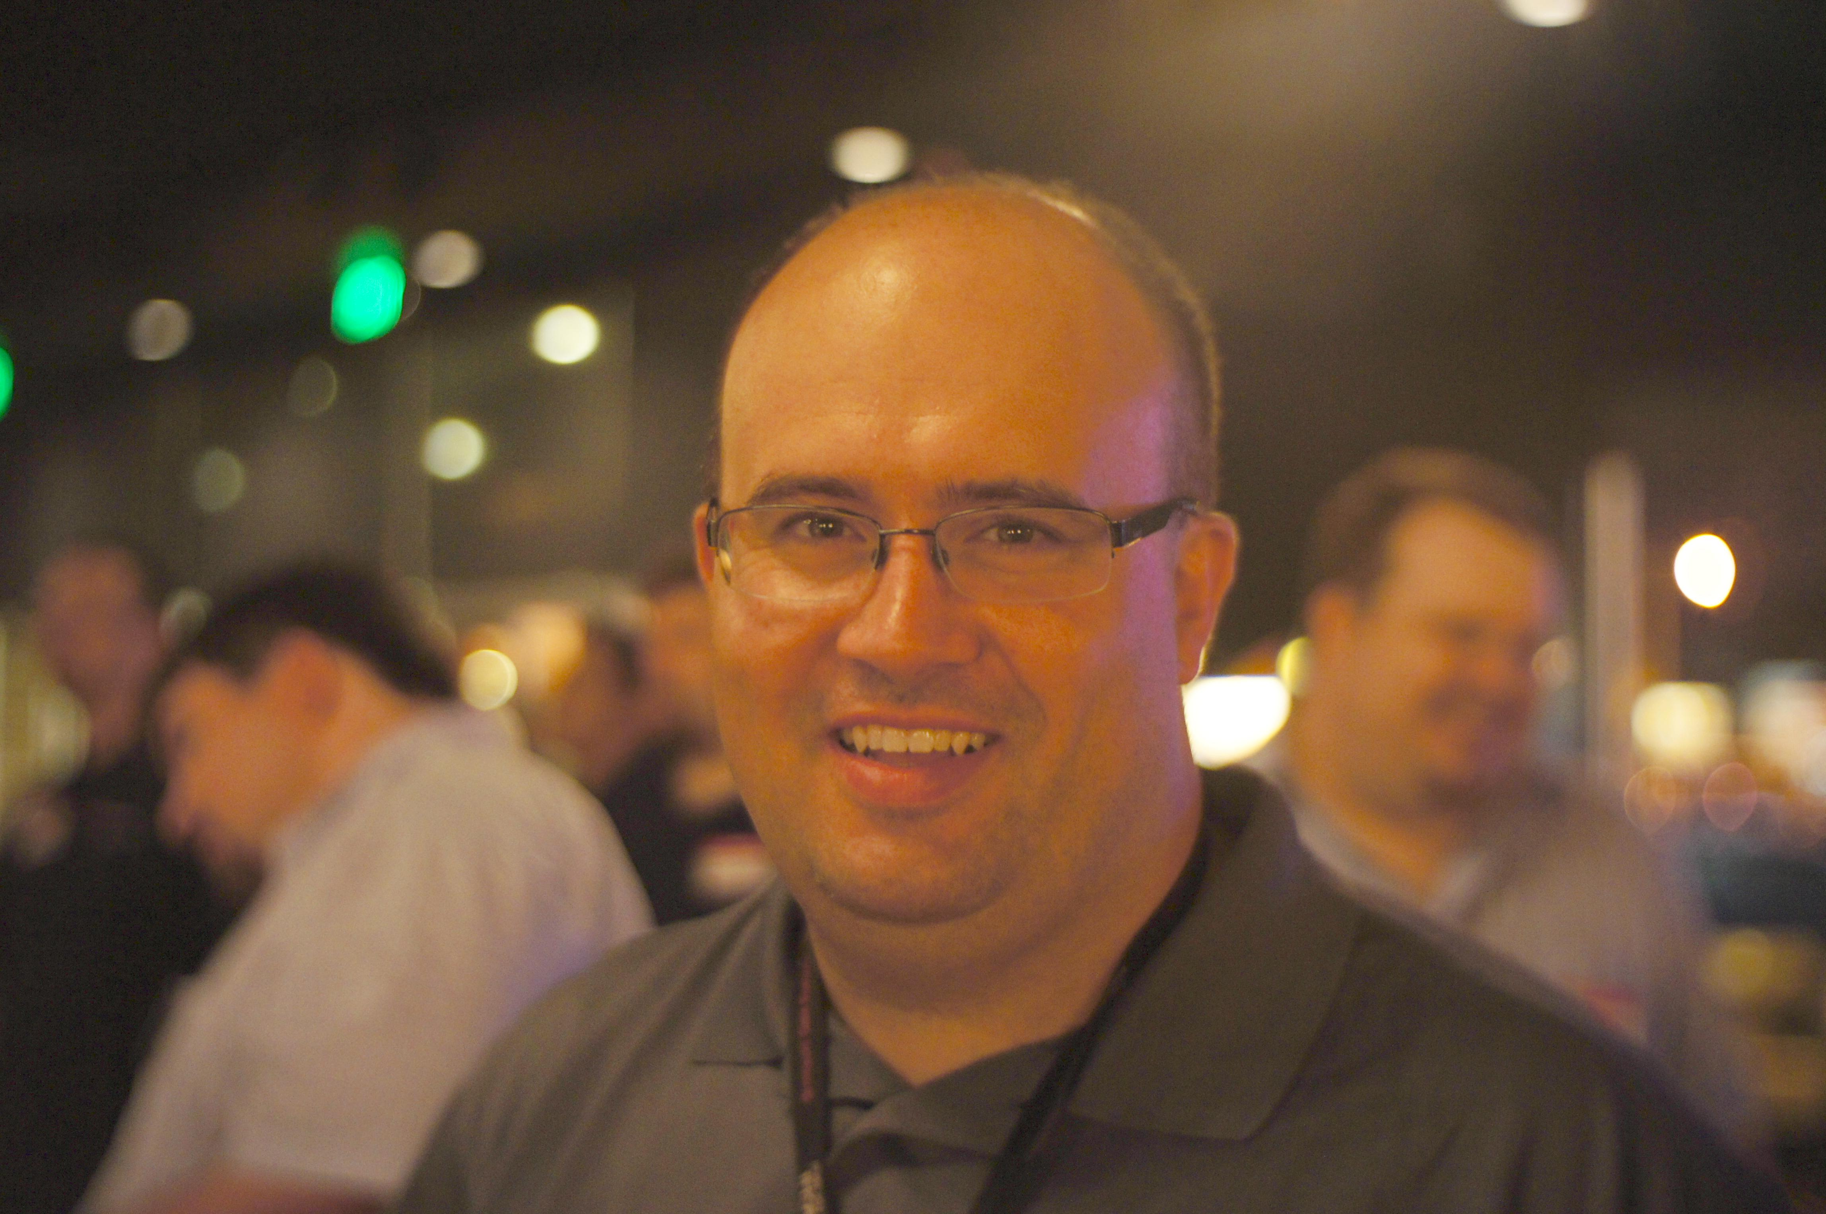
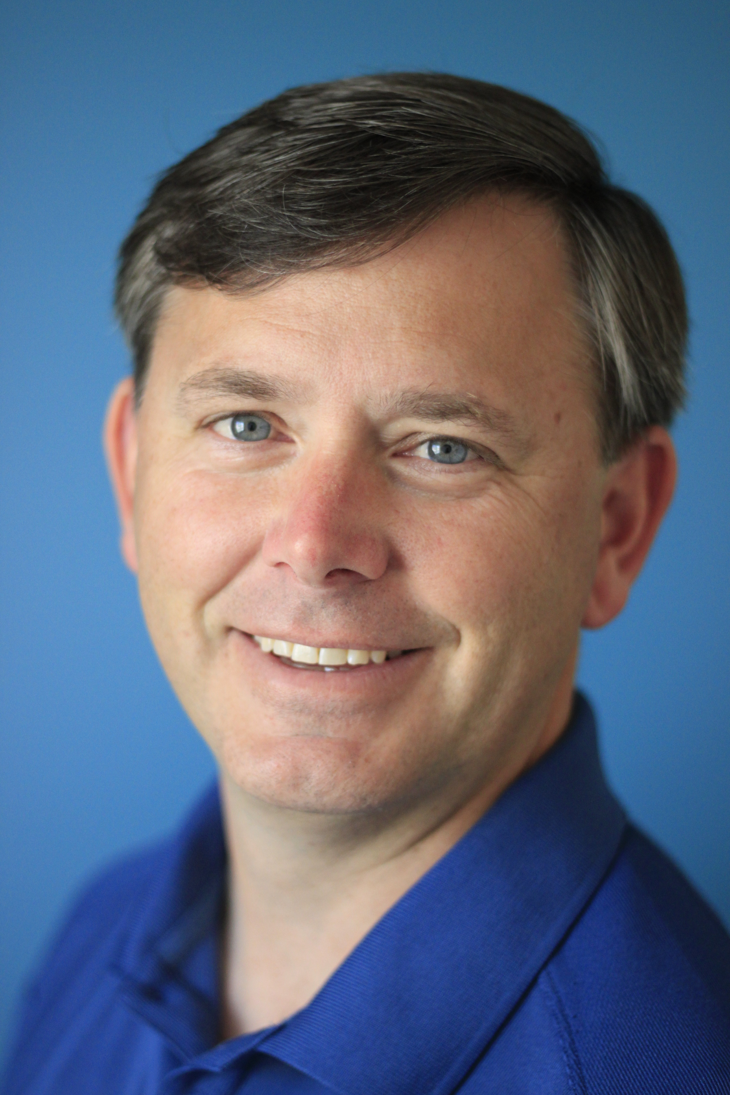
The Boss!
The Monitoring Guy!
The Virtual Guy!
The Storage Guy!
The Service Desk Guy!

Slide 7
Virtual Machine Manager

Slide 8
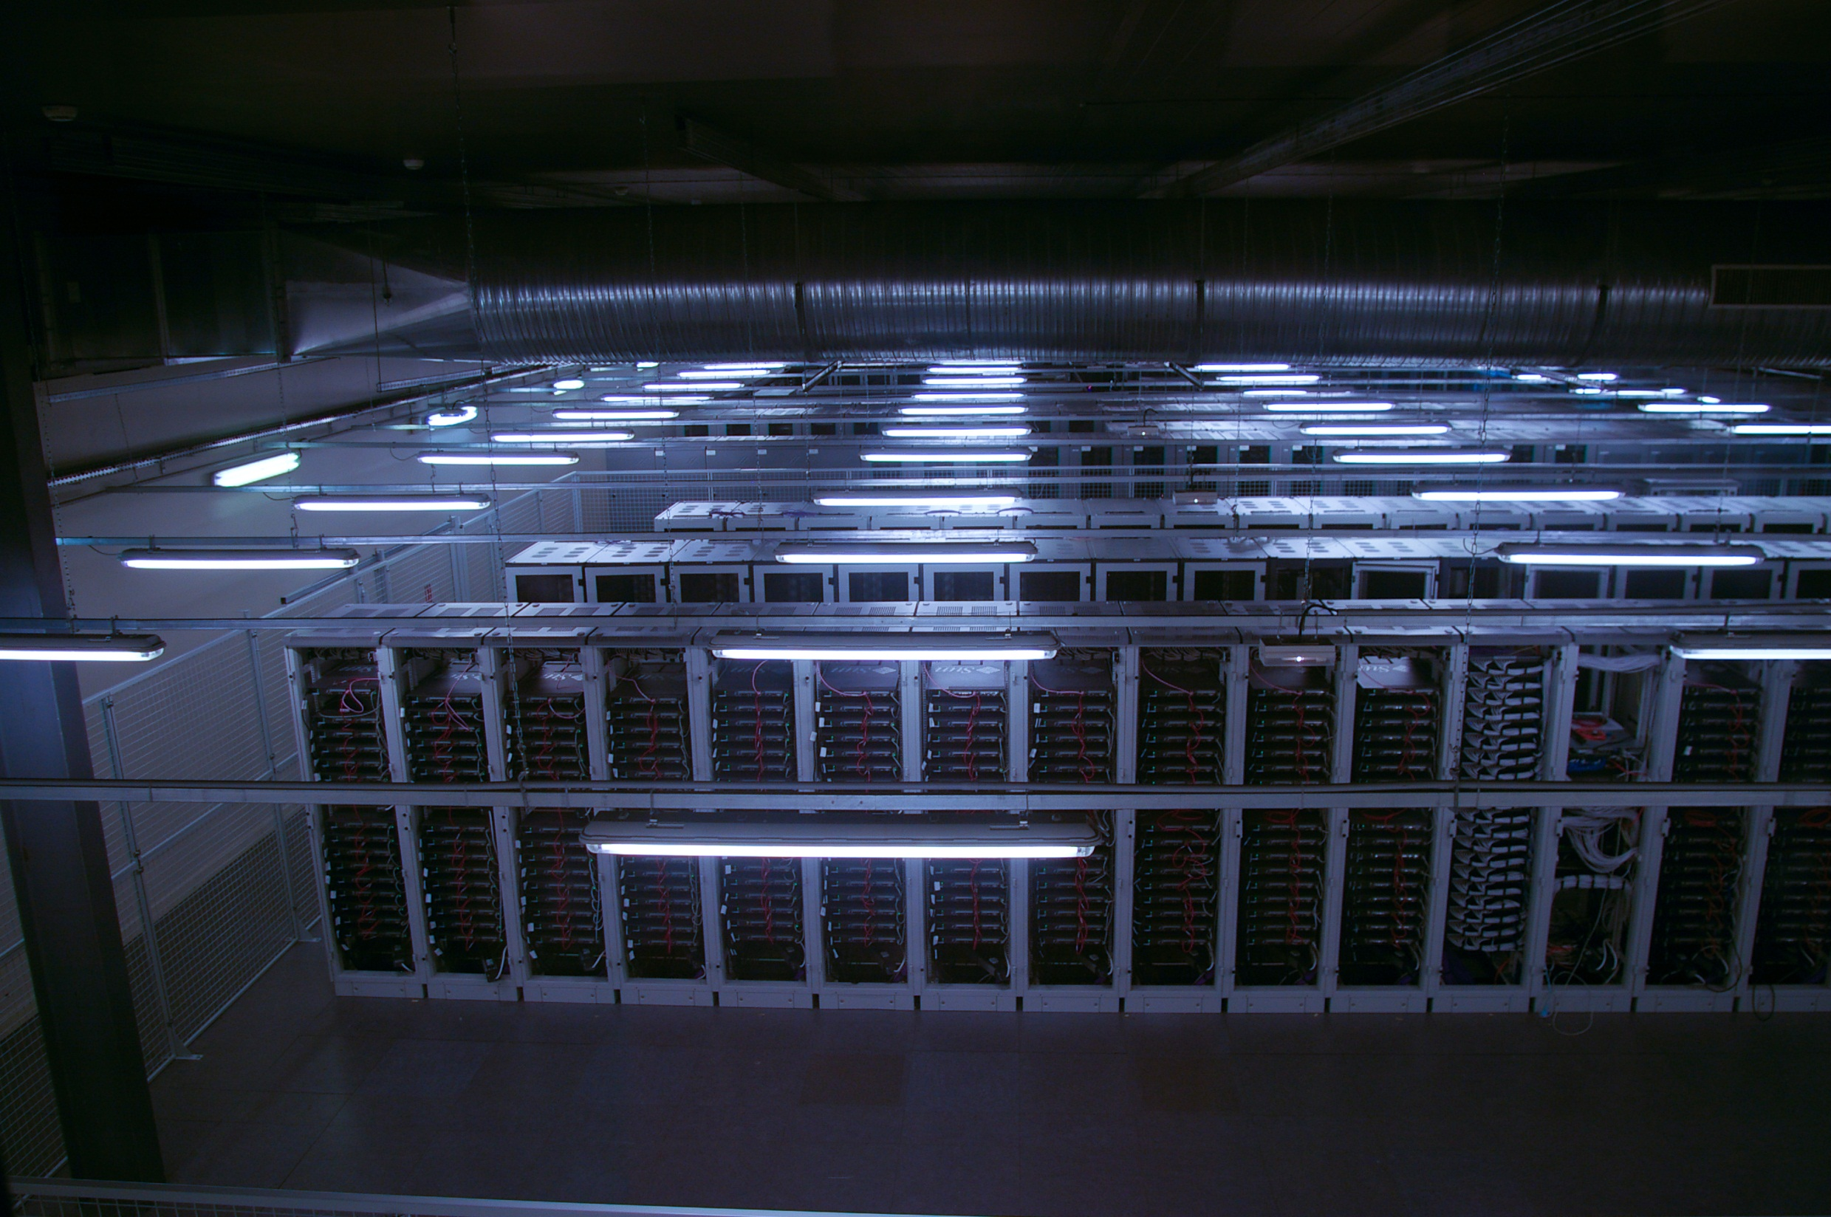
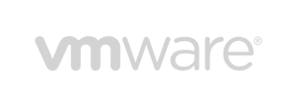
Virtual Servers
Compute
Storage
Network
Cluster

Slide 9
Adding Xenservers
Prerequisites
XenServer 6.0
Microsoft System Center Integration Pack
Additional requirements
DHCP server
SCVMM library is Windows Server 2008: BITS
Directly Managed

Slide 10
Features
VMM Command Shell
Adding XenServer hosts and pools
Placement
Services
Private clouds
Dynamic Optimization and Power Optimization
Migration
Maintenance mode
Library
XenServer Templates
VMM Templates
Networking
Storage
Virtual machine management
Conversion
Performance and Resource Optimization (PRO)

Slide 11
Not supported
VMM does not support the host-to-host migration of stopped virtual machines (LAN migration) between XenServer and other hosts
Update management through VMM is not supported for XenServer hosts. You must use your existing solution to update XenServer hosts
The conversion of a bare-metal computer to a virtual machine host, and cluster creation through VMM is not supported with XenServer

Slide 12
Adding Host / Troubleshooting
Ping / DNS
Verify Supplement Pack
winrm enum http://schemas.citrix.com/wbem/wscim/1/cim-schema/2/Xen_HostComputerSystem -r:https://<HOSTNAME>:5989 -encoding:utf-8 -a:basic -u:<ROOT USER> -p:<PASSWORD> -skipcacheck –skipcncheck

Slide 13
Adding VMware servers
vCenter 4.1, 5.0, 5.1 (VMM 2012 SP1)
ESX 4.1
ESXi 4.1, 5.0, 5.1

Slide 14
Features
VMM command shell
Placement
Services
Private clouds
Dynamic Optimization and Power Optimization
Migration
Maintenance mode
Library
Templates
Networking
Storage
Conversion
Performance and Resource Optimization (PRO)

Slide 15
Not supported
Update management through VMM is not supported for ESX hosts. You must use your existing solution to update VMware ESX hosts
The conversion of a bare-metal computer to a virtual machine host, and cluster creation through VMM is not supported for ESX hosts
The Dynamic Memory feature is not supported on ESX hosts. Dynamic Memory is only supported on Hyper-V hosts that are running an operating system that supports Dynamic Memory

Slide 16
Demo: VMware in SCVMM
Roundtrip

Slide 17
Operations Manager

Slide 18
Discovery
Monitoring
Visualization
Reporting

Slide 19
Operations Manager
SCVMM Management Pack
Hyper-V Management Pack
Xen Management Pack
VMware Management Pack

Slide 20
Xen Management Pack
Created by Comtrade (http://www.managementproducts.comtrade.com/)
Monitoring pools & shared storage
Identifying & Alerting
Performance Reporting
Topology Map
Agentless

Slide 21
VMware Management Pack
Created by Veeam (http://www.veeam.com/vmware-microsoft-esx-monitoring.html)
Monitoring
Reporting
Topology
Agentless

Slide 22
SCVMM Management Pack
Configure OpsMgr Integration
Have prerequisites MP’s
PowerShell 2.0
OpsMgr console installed on VMM server

Slide 23
Demo:Monitoring VMware
Seeing from the App to the Metal

Slide 24
Orchestrator

Slide 25
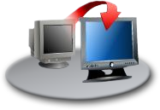
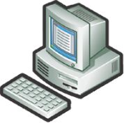
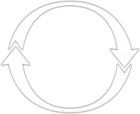
Orchestrate
Service Management
Backup
Hardware Provisioning
Disaster Recovery
IT Automation
Multivendor Integration
Performance and Health Monitoring
Virtual Workload Provisioning
OS / Software Deploy, Patching and State Mgmt
Notes:
25

Slide 26
Integration Packs
SCVMM Integration Pack
VMware Integration Pack

Slide 27
SCVMM Integration Pack
Create CheckPoint
Create New Disk from VHD
Create Network Adapter
Create New Disk
Create User Role
Create VM from Template
Create VM from VHD
Create VM from VM
Remove User Role
Get CheckPoint
Get Disk
Get Network Adapter
Get User Role
Get VM
Manage CheckPoint
Move VM
Remove VM
Repair VM
Resume VM
Run VMM PowerShell Script
Shut Down VM
Start VM
Stop VM
Suspend VM
Update Disk
Update Network Adapter
Update VM
Update User Role Property
Update User Role Quota

Slide 28
VMware Integration Pack
Add Network Adapter
Add VM Disk
Clone Linux VM
Clone Windows VM
Create VM
Customize VM
Delete Network Adapter
Delete VM
Delete VM Disk
Get Cluster Properties
Get Datastore Capacity
Get Host Datastores
Get Host Properties
Get Hosts
Get Resource Pool Properties
Get Resource Pools
Get VM List
Get VM Properties
Get VM Status
Maintenance Mode
Migrate VM
Modify VM Disk
Move VM
Reconfigure VM
Reset VM
Revert VM Snapshot
Set VM CD/DVD to ISO Image
Set VM Networks
Start VM
Stop VM
Suspend VM
Take VM Snapshot

Slide 29
XEN
But wait? What about Xen?
Use SCVMM IP
Use PowerShell

Slide 30
Demo: Orchestration
Every 1 minute spent on automation saves 10 minutes in the future

Slide 31
Building Private Cloud: Examples

Slide 32
Related content
MDC-B201 Orchestrator: Crash Course
MDC-B325 Mission: IT Operations for a Good Night’s Sleep
MDC-B292: SCDPM and Veeam: Better Together
MDC-B354: What’s new in System Center 2012 SP1
MDC-B329: Effective Capacity Planning of your Infrastructure Resources with Microsoft System Center 2012 – Operations Manager Reporting
MDC-B324: Key Metrics and Pracctices for Monitoring Virtualization Platforms
Find Me Later At booth #1001

Slide 33
Track resources
Learn more about Windows Server 2012 R2 Preview, download the datasheet and evaluation bits on http://aka.ms/WS2012R2
Learn more about System Center 2012 R2 Preview, download the datasheet and evaluation bits on http://aka.ms/SC2012R2

Slide 34
Resources
Learning
Sessions on Demand
Microsoft Certification & Training Resources
http://channel9.msdn.com/Events/TechEd
www.microsoft.com/learning
TechNet
msdn
Resources for IT Professionals
Resources for Developers
http://microsoft.com/technet
http://microsoft.com/msdn

Slide 35
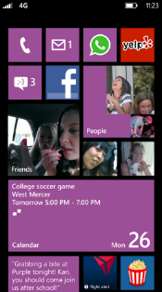
Evaluate this session
Required Slide
*delete this box when your slide is finalized
Your MS Tag will be inserted here during the final scrub.
Scan this QR code to
evaluate this session.

Slide 36
© 2013 Microsoft Corporation. All rights reserved. Microsoft, Windows and other product names are or may be registered trademarks and/or trademarks in the U.S. and/or other countries.
The information herein is for informational purposes only and represents the current view of Microsoft Corporation as of the date of this presentation. Because Microsoft must respond to changing market conditions, it should not be interpreted to be a commitment on the part of Microsoft, and Microsoft cannot guarantee the accuracy of any information provided after the date of this presentation. MICROSOFT MAKES NO WARRANTIES, EXPRESS, IMPLIED OR STATUTORY, AS TO THE INFORMATION IN THIS PRESENTATION.

Slide 37
Picture References
Comparison: http://www.flickr.com/photos/ozchris/5291291144/sizes/l/in/photostream/
Building: http://www.flickr.com/photos/25228175@N08/6317811370/sizes/o/in/photostream/
Building blocks: http://www.flickr.com/photos/22856604@N05/3093969560/sizes/o/in/photostream/

