Slide 2
Implementing Enterprise-Scale Disaster Recovery with Hyper-V Recovery Manager, Windows Server and System Center Virtual Machine Manager
MDC-B306
Abhishek Agrawal
Senior Program Manager
Windows Server & System Center
Microsoft Corporation

Slide 3
Session Objectives and Takeaways
Challenges in Business Continuity & Disaster Recovery
Disaster Recovery platform for Windows Server and System Center
Deep-dive into Hyper-V Recovery Manager

Slide 4
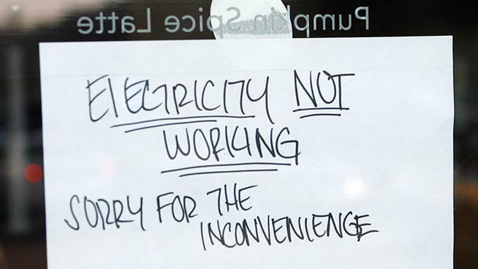
http://www.nbcconnecticut.com/news/local/Biz-Owners-Angry-over-Losses-Due-to-Outages-133320143.html

Slide 5
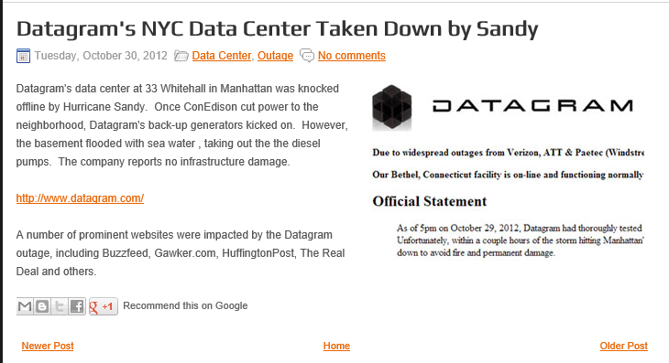
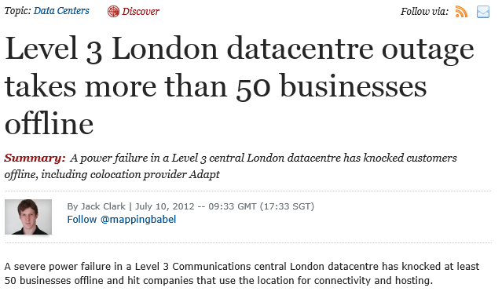
Power outage during Hurricane Sandy takes down Huffington Post, BuzzFeed
UPS problems downs datacenter 7 hours
http://www.convergedigest.com/2012/10/datagrams-nyc-data-center-taken-down-by.html
http://www.zdnet.com/level-3-london-datacentre-outage-takes-more-than-50-businesses-offline-7000000560/

Slide 6
Business continuity challenges
Costs
Need to reduce the costs related to downtime
Disaster recovery solutions are expensive
Complexity
Manual configuration of protection & recovery of the many virtual machines that compose services can be complex and time-consuming - procedures need to be documented and tested
Remote Monitoring
Constant monitoring of services can be challenging
Protecting Many Workloads
Some workloads that could benefit from protection go unprotected due to costs and complexity

Slide 7
DR Journey
Hyper-V Replica
Hyper-V Replica Enhanced
2012
2012 R2

Slide 8


Hyper-V Replica Overview
Inbox replication
DR scenarios
Application agnostic
Storage agnostic
Simple
Affordable
Flexible
MDC-B373 - Understanding Hyper-V Replica: Performance, Networking and Automation

Slide 9
DR Journey
Hyper-V Recovery Manger (HRM)
SCVMM
Hyper-V Replica
Hyper-V Replica Enhanced
2012
2012 R2

Slide 10
Introducing Windows Azure Hyper-V Recovery Manager
Azure Service for managing cross-site protection & recovery of System Center Virtual Machine Manager based datacenters
Simple, at scale, configuration of VM protection
Reliable cloud based recovery plans
Consistent user experience for remote management
Extensible from ground up

Slide 11


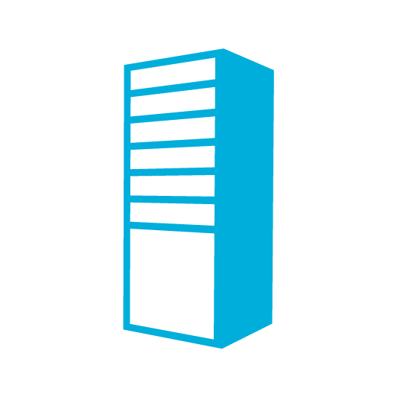
Windows Azure Hyper-V Recovery Manager (HRM) Overview
Hyper-V Recovery Manager
DR Orchestration
DR Orchestration
SCVMM
SCVMM
DRP
DRP
Extensible Data Channel
(Hyper-V Replica)
Compute
Storage
Networks
Compute
Storage
Networks
Primary Site
Secondary Site

Slide 12
Demo
Setup and Registration

Slide 13


Secure Communication
Only System Center Virtual Machine Manager communicates with Windows Azure
Hyper-V Recovery Manager
All communication to Hyper-V Recovery Manager is encrypted
SC Virtual Machine Manager
Proxy
Http
Proxies can be used and only need outbound https configured
Datacenter

Slide 14
Stages in protection & recovery
Getting Started
Registration
Cloud Configure
Networks
Enable Protection
Recovery Plans
Jobs
Resources
Drill
Planned Failover
Unplanned Failover
Setup
Configure
Protect
Monitor
Recovery

Slide 15
Configure Settings and Protection
Large number of hosts
Heterogeneous setups – clusters/hosts
Numerous settings
Lifecycle management
Ensure security and compliance

Slide 16
Demo
Configure Protection at cloud-scale

Slide 17


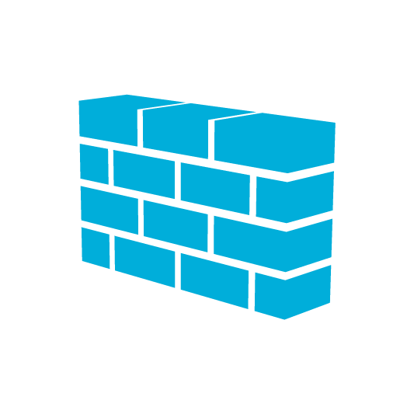

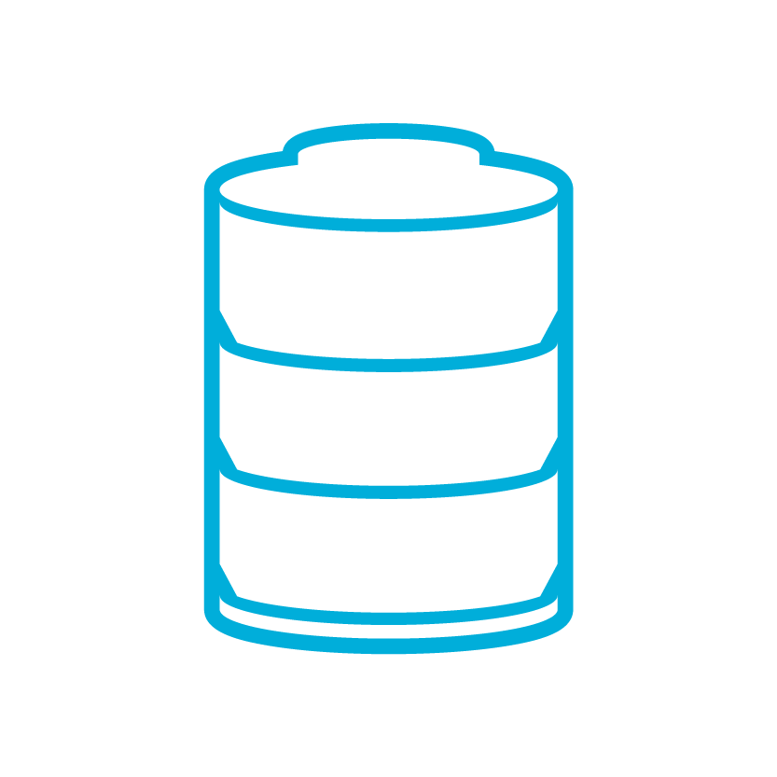
Cloud Configuration
Install Certificate
HVR Settings
Install certificates
Firewall Rules
Firewall Rules
Hyper-V Recovery Manager
HVR Settings
Amsterdam
London
Chicago Site
Cluster
Cluster
Primary Cloud
CSV
SMB
Recovery Cloud
Certificates
Firewall Rules
Hyper-V Replica Broker + Hyper-V Replica Setting
Certificates
Firewall Rules
Hyper-V Replica Broker + Hyper-V Replica Setting

Slide 18
Configure
Many hosts configured
Heterogeneous setups supported
Varied settings rightly set up
Auto-configures
Security
Delivered at cloud scale

Slide 19
Enable VM Protection
Ensure optimal placement of replica VMs on Recovery Cloud
Self-Service experience for App Admins
Work with VMs/VM templates

Slide 20
Demo
Enable VM Protection

Slide 21
Configuring Networks
Failed Over VMs need to be connected to right network
Manual configuration for large number VMs and VM network can be tedious
Complexity with Static IPs, VLANs, Windows Network Virtualization

Slide 22

Network mapping
London
Amsterdam
Network Marketing
Network Marketing Recovery
IP Pool Marketing
IP Pool Marketing Recovery
Enable Recovery
Gold Cloud
Gold Cloud Recovery
IP Pool Sales
IP Pool Sales Recovery
Network Sales
Network Sales Recovery

Slide 23
Demo
DR Networking simplified

Slide 24
Resource mapping - networks
London
Amsterdam
Network Marketing
Network Marketing Recovery
Network Mapping
IP Pool Marketing
IP Pool Red Recovery
Enable DR
Enable DR
Gold Cloud
Gold Cloud Recovery
IP Pool Sales
IP Pool Blue Recovery
Network Mapping
Network Sales
Network Sales Recovery

Slide 25
Configuring Networks for DR
Replica VMs are placed on hosts with right networks available
Replica VMs connected to network mapped to network of primary VM
IP is assigned to replica VM if IP Pools defined on secondary site

Slide 26
Recovery
Need is for a “Single click failover” for Applications
But..
  Applications have complex dependencies
  Need for customization with scripts
  Everything cannot be automated

Slide 27
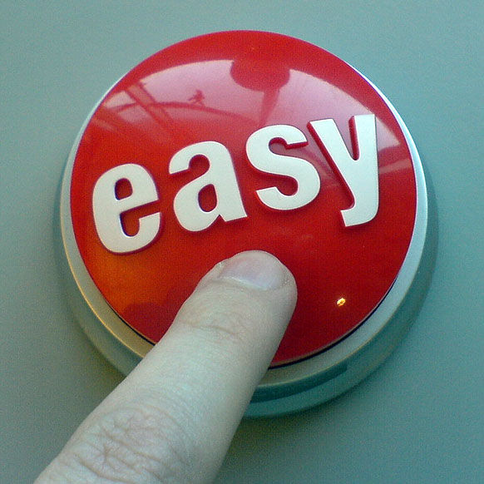
Demo
Single click failover for applications
Recovery Plan Authoring
http://globalmoxie.com/blog/on-demand-printing.shtml

Slide 28
Recovery
Shutdown of primary site
Sequence groups for datacenter dependencies
Extensible orchestration
  Scripts support
  Manual actions with observations

Slide 29
DR Drills
Compliance requires DR preparedness
DR Drills needed for training
Cannot afford down-time during DR drills
DR drill should be as close as possible to the real failover
Consistency of experience needed

Slide 30
Demo
DR Drills

Slide 31
DR Drill (Example using WNV)
Test Environment
London
Amsterdam
Network Red Recovery
Network Red
Network Mapping
Network Red Recovery -Test
IP Pool Red Recovery -Test
IP Pool Red
IP Pool Red Recovery
CA Pool
10.0.0.1-255
CA Pool - Test
10.0.0.1-255
Enable DR
Enable DR
Red VM - Test
Gold Cloud
Gold Cloud Recovery
IP Pool Blue
IP Pool Blue Recovery
Network Mapping
Network Blue
Network Blue Recovery

Slide 32
DR Drills
Automatically create test networks
Test VMs on same hosts as Replica
No impact on production site
User experience consistent with real failover experience

Slide 33
Number of sites
2
3
4
5+

Slide 34
Windows Azure Hyper-V Recovery Manager (HRM) Overview
DR Orchestration
Hyper-V Recovery Manager
DR Orchestration
DR Orchestration
DR Orchestration
DR Orchestration
SCVMM
SCVMM
DRP
DRP
Site A
Site C
Compute
Storage
Networks
SCVMM
Compute
Storage
Networks
DRP
Extensible Data Channel
(Hyper-V Replica)
Primary Site
Secondary Site
Site B
Compute
Storage
Networks

Slide 35
Hyper-V Recovery Manager Supports…
System Center Virtual Machine Manager
VMM 2012 SP1
VMM 2012 R2 Preview
Windows Server
Windows Server 2012
Windows Server 2012 R2 Preview

Slide 36
Call to Action
Sign up for Hyper-V Recovery Manager Preview
http://www.windowsazure.com/en-us/services/preview/
Easy-to-implement cloud-based recovery orchestration for System Center clouds using Windows Azure technologies
Extends out-of-the-box features into a service recovery solution
Simple setup and configuration
Remote monitoring of application availability
Fully customizable recovery plans
A cloud-based solution that will grow and scale over time while controlling costs

Slide 37
Related content
MDC-B373 - Understanding Hyper-V Replica: Performance, Networking and Automation
MDC-B357-What’s New in System Center 2012 R2 – Virtual Machine Manager
MDC-H203 - Getting Started with Windows Server 2012 Hyper-V Replication (Hands-on lab)
Find Me Later At Cloud And Datacenter Management booth

Slide 38

Resources
Learning
  Sessions on Demand
  Microsoft Certification & Training Resources
http://channel9.msdn.com/Events/TechEd
www.microsoft.com/learning
TechNet
msdn
  Resources for IT Professionals
  Resources for Developers
http://microsoft.com/technet
http://microsoft.com/msdn

Slide 39



Evaluate this session
Required Slide
*delete this box when your slide is finalized
Your MS Tag will be inserted here during the final scrub.
Scan this QR code to
evaluate this session.

Slide 40

© 2013 Microsoft Corporation. All rights reserved. Microsoft, Windows and other product names are or may be registered trademarks and/or trademarks in the U.S. and/or other countries.
The information herein is for informational purposes only and represents the current view of Microsoft Corporation as of the date of this presentation. Because Microsoft must respond to changing market conditions, it should not be interpreted to be a commitment on the part of Microsoft, and Microsoft cannot guarantee the accuracy of any information provided after the date of this presentation. MICROSOFT MAKES NO WARRANTIES, EXPRESS, IMPLIED OR STATUTORY, AS TO THE INFORMATION IN THIS PRESENTATION.

