Slide 2
Enabling Multi-Tenant IaaS Clouds in Windows Server, System Center and Windows Azure Pack
MDC-B318
Cheng Wei
Vybava Ramadoss

Slide 3
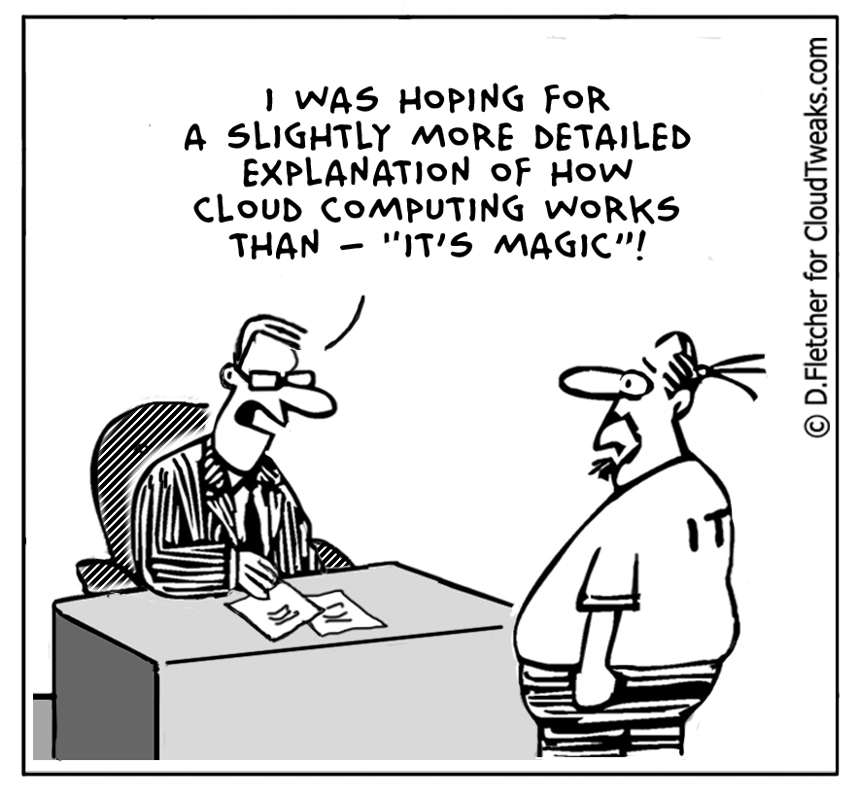

Slide 4
What we’ve heard
“Help me understand how IaaS works in System Center and Windows Azure Pack”
“How does multi-tenancy work across the layers of the WSSC IaaS Cloud?”
“I know VMM, but don’t know how it works with SPF and the Portal”
“I know Azure, but am not sure how those concepts connect to VMM.”
“Which API should I use, the Service Management API or SPF?”
“I need an SI to help me set up Windows Azure Pack”
“It’s going to take a month to get a proof of concept going.”
“Can you please share some tips on getting each of the pieces working?

Slide 5
Session Goals
Review the architecture and design principles of Microsoft IaaS solution powered by Windows Server, System Center and Windows Azure Pack
Demystify the bootstrap configuration process to setup your own IaaS solution
Demonstrate How to setup and configure a multi-tenant IaaS cloud in an hour, and share best practices and tips

Slide 6
Review Microsoft IaaS Solution Architecture

Slide 7

The Cloud OS: three datacenters
Modern platform for the world’s apps
CUSTOMER
Transforms
the datacenter
Empowers
people-centric IT
1
CONSISTENT
PLATFORM
WINDOWS AZURE
SERVICE PROVIDER
Unlocks insights
on any data
Enables
modern apps
DEVELOPMENT
MANAGEMENT
DATA
IDENTITY
VIRTUALIZATION

Slide 8

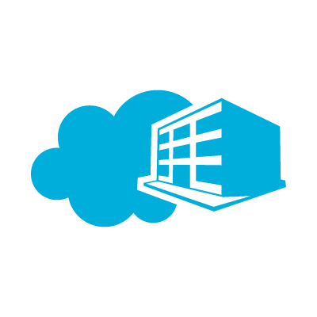






Cloud OS Consistent Experiences
Windows Azure
Customer
Service Provider
Web Sites
Apps
Database
VMs
Service
Plans
Users
Web Sites
Apps
Database
VMs
Subscriber Self-Service
Portal
Self Service Portal Moves On-Premises
Provider Portal
Consumer Self-Service
Portal
Service Management API
Common Mgt. Experience
Service Management API
Future Services
Worker
Role
Web
Sites
VM
Role
SQL
Service
Bus
Caching
Other
Services
CDN.
Media,, etc.
Cloud-Enabled Services Move On-Premises
Web
Sites
VMs
SQL
Service
Bus
R2 w/ Service Provider Foundation
Workload Portability
Consistent Dev. Experience

Slide 9
Building Your Private Cloud

Slide 10
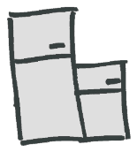

Let’s Whiteboard Your Private Cloud
Configure and deploy:
Fibre Channel SAN
Scale-out file servers from bare metal
Clustered Hyper-V hosts
VM
VM
AdditionalService Provider Capacity
Networking
IP address management
Logical switches
Logical networks
Virtual networks
Delegated capacity for departments
VM
VM
VM
Expanding your network / capacity to a service provider
VM
VM
VM

Slide 11
Think of “stamps” for consistency
A unit of compute, storage and networking
Managed by System Center
One datacenter could have multiple stamps

Slide 12
Lets draw a Stamp!!!
Rack 1
Rack 2
Management (Run as VM’s on Clustered Hyper-V hosts)
Rack 3
Rack 4
Management
Edge components
Edge components
Edge components
VMM VM
OM VM
SPF VM
Etc
Edge
Edge components
Compute
Compute
Compute
Network Virtualization Gateway
Top of rack (TOR) switch
Clustered Compute Nodes
Compute
Compute
Tenant or user VMs
Tenant or user VMs
Tenant or user VMs
Tenant or user VMs
Storage
File Servers (JBOD), SANs (iSCSI, Fibre Channel)
Storage
Storage
Storage
Storage

Slide 13

Public Internet
Isolation
Datacenter isolation – separation of infrastructure traffic as security boundary and for QOS
Tenant isolation – keeping tenants from each other and protect the infrastructure
Network Topology
Corporate
Management
Gateway
Windows
Azure Pack
Tenant 1
OM
VMM
SQL
SPF, etc.
Tenant 2
LM, Cluster, Storage
Hyper-V hosts
Tenant 1 VMs
Tenant 2 VMs

Slide 14
Before We Start IaaS Configuration…
Reviewed and planned out the intended private cloud environment, along with security / user accounts assignment.
Downloaded and installed VMM, SPF and Windows Azure Pack in the environment.
Have information / full access control on minimum set of fabric resources powering the cloud, and have necessary library resources to allow the start of the IaaS service.

Slide 15


Multi-tenant IaaS Cloud Architecture
  Tenant / Self Service User creates and operates VMs
Windows Azure Pack
Management
Portal
Management Portal Tenant and Service Admin UI
Service
Admin
Portal
Tenant
Portal
Service
Management API
Service Management API Governs routing and access to resources
Service
Admin API
Tenant
API
Public
Endpoint
Service Provider
Foundation
SPF multi-tenant REST Odata API for System Center IaaS
SPF Web Server
SPF DB
Stamp1
Stamp2
  Stamp scale unit each with management and host capacity
VMM Server 1
VMM Server 2
Storage
VMs
Storage
Compute
Network
Compute
Network

Slide 16
Zero to IaaS Cloud in… 6 steps
1. Configure Fabric
2. Create & Configure Cloud
3. Configure Accounts in SPF
4. Connect Service Management API to SPF
5. Offer Plan with Cloud to Tenant User
6. Tenant Subscribes to Plan and Creates VM
Pre-step: Basic installations of VMM, SPF, Windows Azure Pack
VMM
SPF
Azure Pack

Slide 17
Virtual Machine Manager
Cheng Wei, Program Manager

Slide 18
Multi-tenant IaaS Cloud Architecture
  Tenant / Self Service User creates and operates VMs
Management
Portal
Management Portal Tenant and Service Admin UI
Service
Admin
Portal
Tenant
Portal
Service
Management API
Service Management API Governs routing and access to resources
Service
Admin API
Tenant
API
Public
Endpoint
Service Provider
Foundation
SPF multi-tenant REST Odata API for System Center IaaS
SPF Web Server
SPF DB
Stamp1
Stamp2
  Stamp scale unit each with management and host capacity
VMM Server 1
VMM Server 2
Storage
VMs
Storage
Compute
Network
Compute
Network

Slide 19
Multi-tenant IaaS features in VMM
Access Control and Quotas
Identity
Connectivity
Shared Resource Pools
Clouds
Tenant Administrator user role
On Behalf Of Admin identity proxy
VM Networks
Network isolation
Hybrid networking

Slide 20
Zero to IaaS Cloud in… 6 steps
1. Configure Fabric
2. Create & Configure Cloud
3. Configure Accounts in SPF
4. Connect Service Management API to SPF
5. Offer Plan with Cloud to Tenant User
6. Tenant Subscribes to Plan and Creates VM
Pre-step: Basic installations of VMM, SPF, Windows Azure Pack
VMM
SPF
Azure Pack

Slide 21
Step-by-Step Configurations
Fabric Configuration
  Configure / add storage resources (add / create file servers, storage providers, etc.)
  Configure / add compute resources (add / create hosts)
  Configure / add networking resources (add logical / VM networks, port profiles, logical switches, etc.)
Cloud Configuration
  Create templates (hardware profiles / VM templates)
  Create cloud
Configure SPF account permission
Test configuration

Slide 22

Networking cheat sheet
Set up connectivity
  (Optional) IP Pool
  Logical network with networking site
  VM Network
Set up Logical Switch
  Uplink port profile
  Logical switch

Slide 23
Demo:
Setting Up VMM for Cloud
Cheng Wei, Program Manager, System Center

Slide 24
Service Provider Foundation
Cheng Wei, Program Manager

Slide 25
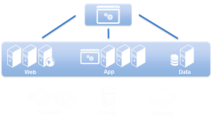



Service Provider Foundation (SPF)
REST-based Odata API
Enables Hosted IaaS
Features
VM management
Service management
Self-service VM networks
Multi-tenancy / Multi-stamp
Self-service tenant administration
Enterprise identity for SPF
Extensibility for hosted cloud API
Usage Metering via SCOM
Virtual Machines
Virtual Machine
Manager
Service Templates
Virtual Machine
Manager
VM networks
Virtual Machine Manager
Automation
Orchestrator
  2012

Slide 26
Multi-tenant IaaS Cloud Architecture
  Tenant / Self Service User creates and operates VMs
Management
Portal
Management Portal Tenant and Service Admin UI
Service
Admin
Portal
Tenant
Portal
Service
Management API
Service Management API Governs routing and access to resources
Service
Admin API
Tenant
API
Public
Endpoint
Service Provider
Foundation
SPF multi-tenant REST Odata API for System Center IaaS
SPF Web Server
SPF DB
Stamp1
Stamp2
  Stamp scale unit each with management and host capacity
VMM Server 1
VMM Server 2
Storage
VMs
Storage
Compute
Network
Compute
Network

Slide 27
Zero to IaaS Cloud in… 6 steps
1. Configure Fabric
2. Create & Configure Cloud
3. Configure Accounts in SPF
4. Connect Service Management API to SPF
5. Offer Plan with Cloud to Tenant User
6. Tenant Subscribes to Plan and Creates VM
Pre-step: Basic installations of VMM, SPF, Windows Azure Pack
VMM
SPF
Azure Pack

Slide 28
Useful Tips on Setting Accounts Up in SPF
AppPool
  Ensure SPF VMM IIS Application Pool identity running as domain user (not network service account)
  SPF AppPool identity needs admin access to VMM and admin access on the SPF SQL DB
  When using a service account as AppPoolIdentity, login to the SPF server with this account once
  IIS W3WP AppPool recycles by default every 29 hours. You can customize it if desired.
Local User
  SPF integration with Windows Azure Pack through Basic Authentication method
  Create Local User on SPF Server, add it to SPF Local Groups (VMM, Admin, Provider, Usage)
  Use the Local User to register with the Azure Pack’s Service Management Portal and API (do not use a domain user)
Tenant Accounts
  No need to create any tenants from the SPF PowerShell cmdlets, this is handled automatically when users sign up for a subscription.
  User roles created on VMM or SPF without going through Windows Azure Pack will not be exposed on the Tenant / Admin portal.

Slide 29
Demo:
Configure SPF to Connect
Cheng Wei, Program Manager

Slide 30
Windows Azure Pack
Vybava Ramadoss, Program Manager

Slide 31
Multi-tenant IaaS Cloud Architecture
  Tenant / Self Service User creates and operates VMs
Management
Portal
Management Portal Tenant and Service Admin UI
Service
Admin
Portal
Tenant
Portal
Service
Management API
Service Management API Governs routing and access to resources
Service
Admin API
Tenant
API
Public
Endpoint
Service Provider
Foundation
SPF multi-tenant REST Odata API for System Center IaaS
SPF Web Server
SPF DB
Stamp1
Stamp2
  Stamp scale unit each with management and host capacity
VMM Server 1
VMM Server 2
Storage
VMs
Storage
Compute
Network
Compute
Network

Slide 32
Key Windows Azure Pack Concepts
Resource Provider : REST API-driven service that creates and manages resource types (VMs, websites, databases)
Plans : Collections of services and quotas per service that are offered to tenants. Represents a tier of service.
Users : Identities are managed via AD and ASP.NET membership. ADFS can also be set up to federate to other identities providers
Subscriptions : Users sign up for a subscription to a plan. Each subscription has a unique ID. Users can access resources (VMs, websites, databases) via their subscription.
  Resource providers govern specific access controls and quota limits via the subscription
  It is a billing entity that can be charged for tier of service as well as resource consumption
Add-Ons: Collections of services and quotas per service that allows users to add quotas to their existing subscriptions

Slide 33
Zero to IaaS Cloud in… 6 steps
1. Configure Fabric
2. Create & Configure Cloud
3. Configure Accounts in SPF
4. Connect Service Management API to SPF & Register VMM server
5. Offer Plan with Cloud to Tenant User
6. Tenant Subscribes to Plan and Creates VM
Pre-step: Basic installations of VMM, SPF, Windows Azure Pack
VMM
SPF
Azure Pack

Slide 34
Configuring IaaS for Windows Azure Pack
Admin
Tenant
Configure Fabric in VMM and Create
Cloud
Create Template, HW Profile
Admin
Portal
Tenant
Portal
User Identities
4
Plan
6
5
Plans
Subscriptions
Service Management
API
Subscription
Configure Accounts in SPF
Connect Service Management API to
SPF & Register VMM server
Offers
Stamps
User Roles
SPF
3
Offer
Offer Plan with Cloud to Tenant User
Tenant Subscribes to Plan and Creates
VM
1
VMM
VMM
2

Slide 35
Multi-tenancy across Layers
Admin
Tenant
Admin
Portal
Tenant
Portal
Service Management
API
Plan
Users
Subscriptions
Quota, Actions
Resources
SPF
Tenants
VMM
VMM
TA User Role

Slide 36
Demo:
Configure Windows Azure Pack
Vybava Ramadoss, Program Manager

Slide 37
Key Takeaways
Multi-tenant IaaS cloud uses Virtual Machine Manager, Service Provider Foundation, and Windows Azure Pack components
6 steps to Cloud - You can get started with minimal investment in time and resources
Download and install 2012 R2 Preview Release NOW:
    http://www.microsoft.com/hosting/en/us/services.aspx

Slide 38
Wow, you totally ROCK!! You set up our Private Cloud in just one day.

Slide 39
Related Sessions
MDC-B206 | System Center 2012 R2 Overview
MDC-B357 | What’s New in System Center 2012 R2 – Virtual Machine Manager
MDC-B202 | Running and Managing Linux and UNIX with Hyper-V and Microsoft System Center
MDC-B203 | Deploying Applications in Microsoft System Center 2012 – Virtual Machine Manager using Services
MDC-B318 | Enabling Multi-Tenant IaaS Clouds in Microsoft System Center and Windows Server
MDC-B344 | Storage Management: Spanning the Enterprise to Low Cost Scalable Solutions
MDC-B350 | How to Design and Configure Networking in Microsoft System Center - Virtual Machine Manager and HyperV (Part 1 of 2)
MDC-B351 | How to Design and Configure Networking in Microsoft System Center - Virtual Machine Manager and HyperV (Part 2 of 2)
MDC-B364 | Enabling on-premises IaaS solutions with Windows Azure Pack

Slide 40

Resources
Learning
  Sessions on Demand
  Microsoft Certification & Training Resources
http://channel9.msdn.com/Events/TechEd
www.microsoft.com/learning
TechNet
msdn
  Resources for IT Professionals
  Resources for Developers
http://microsoft.com/technet
http://microsoft.com/msdn

Slide 41
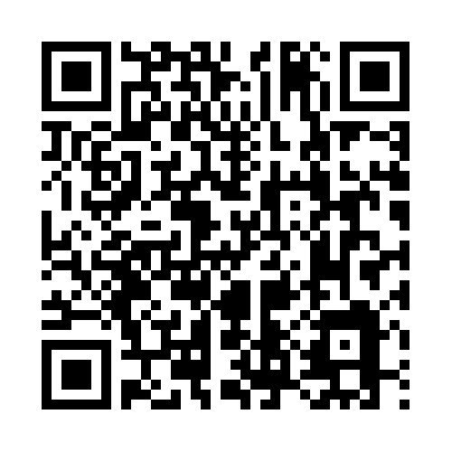
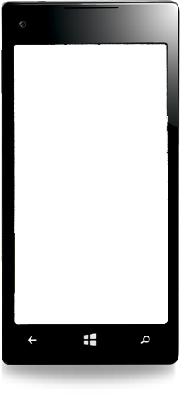

Evaluate this session
Required Slide
*delete this box when your slide is finalized
Your MS Tag will be inserted here during the final scrub.
Scan this QR code to
evaluate this session.

Slide 42
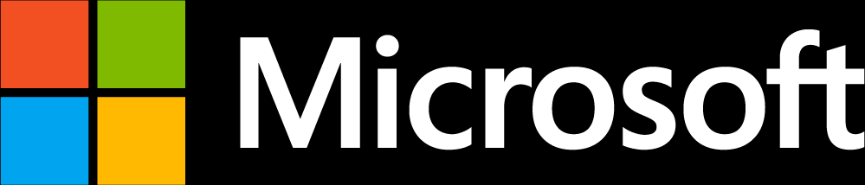
© 2013 Microsoft Corporation. All rights reserved. Microsoft, Windows and other product names are or may be registered trademarks and/or trademarks in the U.S. and/or other countries.
The information herein is for informational purposes only and represents the current view of Microsoft Corporation as of the date of this presentation. Because Microsoft must respond to changing market conditions, it should not be interpreted to be a commitment on the part of Microsoft, and Microsoft cannot guarantee the accuracy of any information provided after the date of this presentation. MICROSOFT MAKES NO WARRANTIES, EXPRESS, IMPLIED OR STATUTORY, AS TO THE INFORMATION IN THIS PRESENTATION.

Slide 43
Appendix

Slide 44
Checklist for VMM steps
Add a host.
Create a logical network
  Add a network site associated with VLAN 0
Create a port profile - uplink
Create a logical switch
  Add uplink port profile to it
Create a VM Network

Slide 45
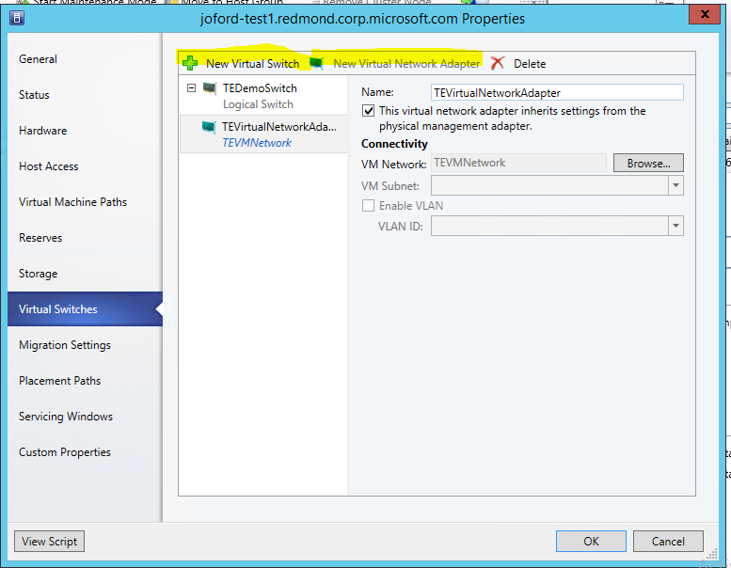
Checklist for VMM steps (cont)
Add network to host – both switch & adapter:

Slide 46
Checklist for VMM (cont)
Create a cloud
Add the spf account as a full administrator.
Create hardware profiles (small, medium, large)
Create a VM template
  Use a VHD that is bootable and has been uploaded to the library
Create virtual machine on your cloud using the template to test everything.

