Slide 2
Lessons learned from implementing Windows Server 2012 and System Center 2012 SP1 for Service Providers
MDC-B321
Ricardo Machado, Architect, Center of Excellence
Anders Ravnholt, Program Manager Windows Server & System Center

Slide 3
Objectives
Explain how Windows Server and System Center can be implemented at Service Providers
Explain some of the challenges that are different from the enterprise
Show challenges from the field and how they were solved

Slide 4
Agenda
Service Provider challenges in the Datacenter
Design Patterns for Windows & System Center
What we learned
    Windows Server (Fabric) & Service Providers
    System Center & Service Providers
Tools to help Service Providers

Slide 5
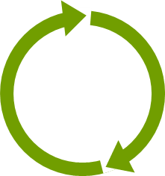
The Cloud OS
Modern platform for the world’s apps
CUSTOMER
Transforms
the datacenter
Empowers
people-centric IT
1
CONSISTENT
PLATFORM
WINDOWS AZURE
SERVICE PROVIDER
Unlocks insights
on any data
Enables
modern apps
DEVELOPMENT
MANAGEMENT
DATA
IDENTITY
VIRTUALIZATION

Slide 6
Bringing our learnings to your datacenter
Windows Server
High performance
storage on industry-
standard hardware
File and storage services
Offloaded data transfer
Storage spaces
Multi-tenant environments
with isolation
Server core
Hyper-V network virtualization
Websites and VMs
Software-defined networking
Hyper-V network virtualization
Network QoS
Cross-premises connectivity
Policy based automation
Cluster aware updates
Dynamic optimization
Application elasticity
Service templates
Windows Azure
And many others….

Slide 7
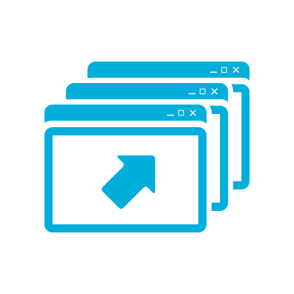

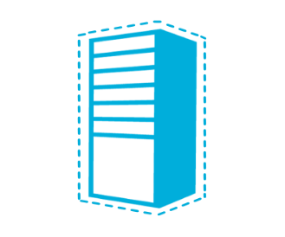
Multi-Tenant Cloud Key Requirements
Secure Isolation between Tenants
Resource
Metering
Quality of
Service (QoS)
VM Mobility

Slide 8


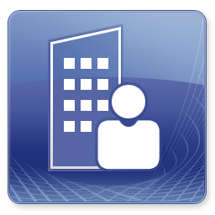
Race to the bottom, Drive down cost
Price pr VM in $
Systems Management
Advanced Workloads
SP, Exchange, Lync
Simple Service
SQL, WEB, VM
Private Cloud
VM Hosting
Customer Value / Complexity

Slide 9
Multi Tenancy : Concepts
  One of essential attributes of Cloud Computing where a software architecture is designed in such a way that a single logical instance serves multiple client organizations (Tenants) at the same time while upholding service levels in terms of:
    Data security and privacy
    Performance
    Scale

Slide 10
Dedicated Tenancy
The Road to Multi Tenancy : Architecture Types
Share Nothing
Tenant 1
Tenant 2
Tenant 3
Share Fabric Only
Tenant 1
Tenant 2
Tenant 3
App
App
App
App
App
App
Data
Data
Data
Data
Data
Data
Fabric
Fabric
Fabric
Fabric
Infrastructure Tenancy
Separate DATA
Tenant 1
Tenant 2
Tenant 3
Share Everything
Tenant 1
Tenant 2
Tenant 3
App
App
Data
Data
Data
Data
Fabric
Fabric
Application Tenancy
Shared Tenancy

Slide 11
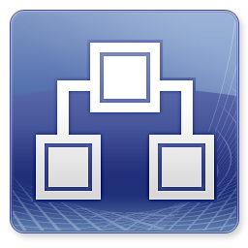
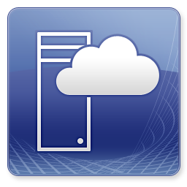

The way we build clouds...
Building the Fabric
Building the Management
ACCESS & PROVISIONING
(SELF SERVICE)
Compute
System Center
App. Controller
Network
Management
WAP
Storage

Slide 12
IaaS Design Patterns
Fabric

Slide 13
Product Line Architecture Design Patterns
Rulebook
Microsoft evolves the Product Line Architecture as we capture learnings from customer deployments and support incidents to continuously improve the architecture and our deployment practices.
The Benefits of using the PLA include:
  Proven deployment model
  Deployed right the first time
  Reduced time to deployment
  Predictable and achievable SLA’s
  The best user experience
  All workload capabilities realized
The PLA delivers the highest quality deployment by following design principles to support/enable …
Supportability
Quality
Performance
Disaster Recovery
Scalability
Manageability
Portability
Interoperability
Resilience

Slide 14
Non-Converged Infrastructure: FC/iSCSI

Slide 15
Converged Infrastructure

Slide 16
Continuous Availability over SMB Storage
Shared SAS/Storage Spaces
SOFS Connected to SAN
SMB3 Enabled Storage

Slide 17
Fabric Infrastructure
What we learned

Slide 18
Network topologies – a Poll
Popularity Contest
Mix of 1Gb and 10 Gb
Multiple
10 Gb
Multiple
1Gb

Slide 19
Networking
Most Service Providers still default to VLANs
    Creating automation challenges
    Increasing risk in production – Constant changes to the production networks
There is increasing demand to connect clouds
Software Defined Networking is seen as the way to move forward
    Tenants want to control their own networks

Slide 20


Software Defined Networking
Customers want
  Secure and Scalable multi-tenant infrastructure
  VM mobility
  Simplified setup and management
Microsoft’s SDN Solution
  Run multiple virtual networks on shared infrastructure
  Extensible platform fostering partner innovation
  Unified management with System Center
WHAT’S REALLY HAPPENING
Blue sees
Orange sees
SQL Server
Web
Storage
SQL Server
Web
Storage
Hyper-V Host A
Hyper-V Host B
SQL Server
SQL Server
Web
Storage
Web
Storage

Slide 21
Networking Challenges
Combining LBFO and the Hyper-V Virtual Switch
  Create any VLAN ports only on the Virtual Switch
  Add-VMNetworkAdapter -ManagementOS -Name “VLANx" -SwitchName “My Virtual Switch"
  Set-VMNetworkAdapterVlan -ManagementOS -Access -VlanId X -VMNetworkAdapterName “VLANx"
  Optional: Set-VMNetworkAdapter -ManagementOS -Name “VLANx” -MinimumBandwidthWeight 20
vNIC1
VLAN x
vNIC2
VLAN y
vNIC1
VLAN x
vNIC2
VLAN y
Virtual Switch
tNIC1
VLAN x
tNIC2
VLAN y
Virtual Switch
Virtual Switch
tNIC1
VLAN x
tNIC2
VLAN y
LBFO
LBFO
LBFO
LBFO
NIC1
NIC2
NIC1
NIC2
NIC1
NIC2
NIC3
NIC4

Slide 22
Networking - conclusions from the field
Failover Clusters have evolved
  QoS is still not included in “default” design conversations
  Different ways to setup Failover Cluster networking configuration
Multiple service providers still run iSCSI over 2-4 1Gb links. 10Gb is not always seen as necessary.
  Beware of HW lifecycle and growth expectations
Internet facing networks are run on 1Gb links

Slide 23
Storage connectivity – a Poll
Popularity Contest
SMB3
iSCSI
FC

Slide 24
Storage – SMB3
The larger the Service Provider, the more they love SMB3
    File based storage provides a much simplified configuration approach as you scale compute
    Less resistance to pilot or deploy Storage Spaces with CiB and Shared SAS
No pushback if already using NFS
SMB3 brings availability and performance
    Multichannel and SMB-Direct (RDMA)
    Limited to no drawbacks for Service Providers
SOFS used to front-end existing SAN investments

Slide 25
Storage - iSCSI
Well understood scenario
Design challenges for customers running teamed adapters with Hyper-V Virtual Switch
    MPIO and the Hyper-V Switch is now supported – Create multiple virtual networks on the Management OS and associated iSCSI initiator configuration
Limited use of iSCSI boot support

Slide 26
Storage - FC
Limited use in our program
Used by Service Providers creating “Premium” offers that replicate typical Enterprise on-prem environments
SAN investment is already in place
    SMB3 SOFS used to minimize FC access costs

Slide 27
Challenges
SMB3 Active Directory requirements
    Did we say that Service Providers like VLAN’s and the “Isolation” they provide?
Storage Spaces with dual JBOD scenarios
    Enclosure Awareness
    Disk majority
Support for ODX and SMI-S

Slide 28
Compute – a Poll
Popularity Contest
Converged
Mix of Blades and Rack Mounted
Rack Mounted

Slide 29
Compute
Service Providers are spread over blades and traditional servers
    Service providers used all types of form factors and vendors
    Fully Converged blades scenarios to self-built rack mounted servers
Smaller service providers are not that concerned with extreme standardization
Provisioning through imaging is common, PXE booting is not so common

Slide 30
Design Patterns
Management

Slide 31
System Center & Hosting Service Providers
Challenges & Drivers
Automation
Standardization
Solution
Management Cluster
VMM
Orchestrator
Operations Manager
Solution (Phase 2)
WASWS & App. Controller
Configuration Manager
Data Protection Manager
Service Manager

Slide 32
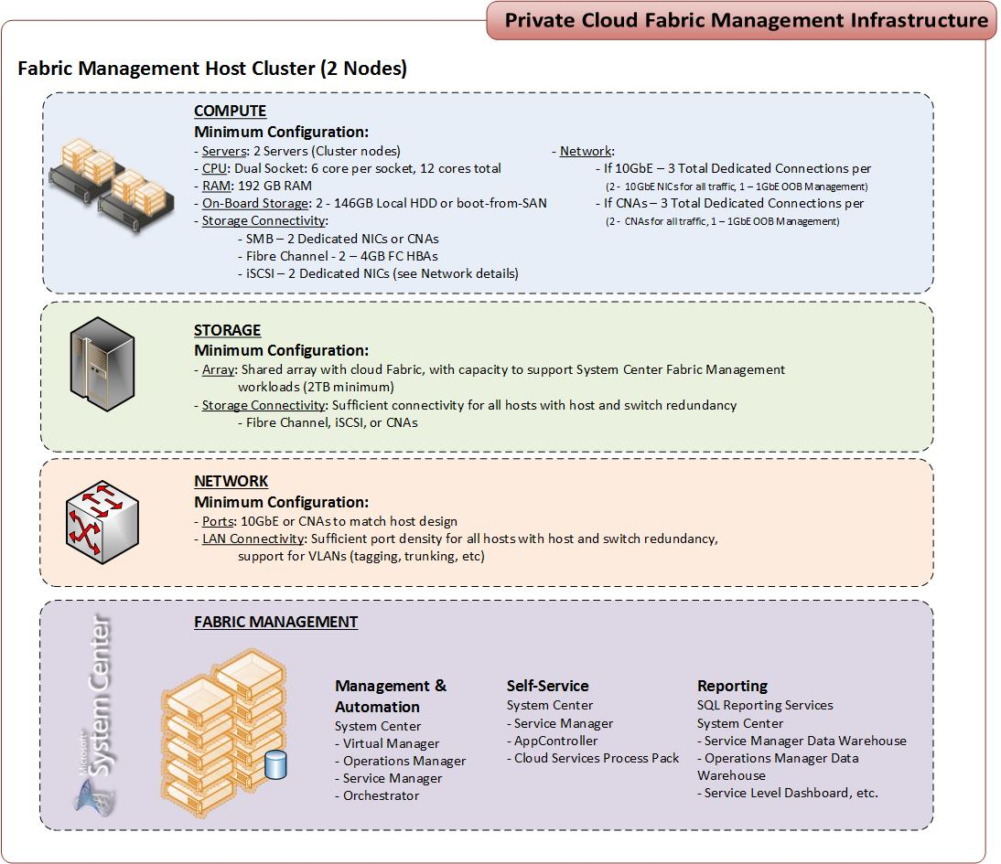
Management Cluster
Resource pools should be physically separate from the systems that provide management
This model helps make sure that the availability of the fabric is separated from fabric management

Slide 33
Management
What we learned

Slide 34
Active Directory
Active Directory is a challenge in multi-tenant environments
Trust may not be possible between tenants
System Center uses AD to Authenticate
Keep fabric and System Center in the same domain forest or provide trust between them

Slide 35
SQL Server Availability
Recommend Failover Cluster Instances for large environments
Consider SQL Server AlwaysON if you understand the scale and failover requirements

Slide 36
Management
System Center Considerations
Use VMM & Orchestrator for Fabric to automate fabric provision
Automate the deployment of Physical servers storage and network as much as possible
Use Performance Reporting to optimize your resource consumption for the fabric

Slide 37
Design Patterns
Self-Service

Slide 38
Enabling Service Providers to Offer IaaS
App Controller or WASWS
https
Service Provider Foundation
Aggregation
Automation
REST OData API
Fabric Stamps (VMM)

Slide 39


Managing Services in Multiple Clouds
System Center 2012 - App Controller
Private
Private
Public
Public
On Premises
Service Provider Foundation
Windows Azure
Virtual Machine Manager
Virtual Machine Manager
Hyper-V
vmware
Xen
Hyper-V
vmware
Xen

Slide 40
App Controller
Deployment
  Common experience across public and private clouds
  Platform as a Service application
  Windows Azure virtual machine
  Operations
  Start, stop, remote desktop
  Scale, upgrade
Migration (SP1)
  VMM to Windows Azure

Slide 41
Finished services
Service Management Portal
Service Management API
Web Sites
Web Sites
High density and scalable
Easy deployment and administration
Fully self-service
Controller
(Web farm framework)
Service Provider Foundation API
Third Party
Zuora
Parallels
Apprenda
and more
Virtual Machines
Offer preconfigured workloads
Windows and Linux
Fully self-service
Third Party Modules
Virtual Machines
Third Party
Web Farm
Front-end/Workers
(Application Request Routing/Dynamic Windows Process Activation Service )
System Center
(Virtual Machine Manager Component)
Windows Server
Windows Server
Windows Server

Slide 42
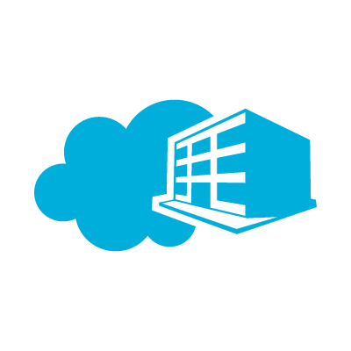






Bringing Windows Azure Services to Windows Server
Private
Service Provider
Windows Azure
Web Sites
Service
Web Sites
Web Sites
Apps
Databases
Self Service Portal Moves On-Premises
Apps
Plans
Service
Admin
Apps
VMs
Self-Service
Portal
VMs
Self-Service
Portal
Users
VMs
Subscriber Self-Service
Portal
Database
Subscriber Self-Service
Portal
VMs
Common Mgt. Experience
Service Management API
Service Management API
Cloud-Enabled Services Move On-Premises
Web
Sites
VMs
SQL
Shared Cloud Services
Service Bus,
etc.
Worker
Role
Web
Sites
VM
Role
SQL
Service
Bus
Caching
Other
Services
CDN.
Media,, etc.
Workload Portability
SP1 w/ Service Provider Foundation
Consistent Dev. Experience

Slide 43
Customer Solution Example
Azure
DMZ
Customer
SPF
App.
Controller
WAP Tenant
Fabric
Management
Fabric Cluster
WAP Admin
Fabric Network
Fabric Storage
Management Cluster

Slide 44
App. Controller, WASWS & SPF
Many Service providers has their own portal and would like to continue using it.
Service Providers would like to use Standard web-services if they have their own portal.
WAP is a good starting point, if a new portal is needed.
SPF solves the authentication challenge between Tenants and Service Provider back-end system.

Slide 45
Tools that can help you

Slide 46


Infrastructure-as-a-Service Product Line Architecture Guidance
http://go.microsoft.com/fwlink/?LinkId=299335
http://go.microsoft.com/fwlink/?LinkId=299331

Slide 47
PowerShell Deployment Toolkit
The PowerShell Deployment Toolkit is a set of scripts and knowledge to automate deployment of System Center 2012 SP1, including SQL, all prerequisites and all automatable post-setup integration
Supports cluster HA for System Center
Highly Automated and Fast install, a real time saver
http://blogs.technet.com/b/privatecloud/archive/tags/deployment+track/

Slide 48
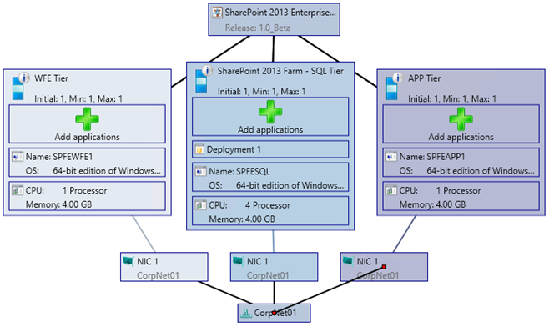
MS Workloads deployment
Automated example how to install SharePoint using System Center
Multi-tier Workload Deployment Into a Private Cloud
SQL Tier deployment and customization
Execution of pre and post PowerShell scripts to install a workload
Synchronous and ordered execution of a workload deployment leveraging the service template technology within VMM
http://blogs.technet.com/b/privatecloud/archive/tags/application+management+track/

Slide 49
MAT - the MVMC Automation Toolkit
The MVMC Automation Toolkit is a collection of PowerShell scripts that will automate conversions using MVMC and it is back ended by a SQL instance
You can use it to convert several machines at once, on a single server – or scale it out and execute conversions on many servers at the same time
http://blogs.technet.com/b/privatecloud/archive/2013/04/08/meet-mat-the-mvmc-automation-kit.aspx

Slide 50

Related content
MDC-B322: Automating Microsoft System Center Deployment with the PowerShell Deployment Toolkit
MDC-B347: Migrating from VMware: Tools and Tips
MDC-B364: Enabling On-Premises IaaS Solutions with the Windows Azure Pack
Building Clouds blog: http://blogs.technet.com/b/privatecloud/
Find Me Later at Building Clouds booth

Slide 51
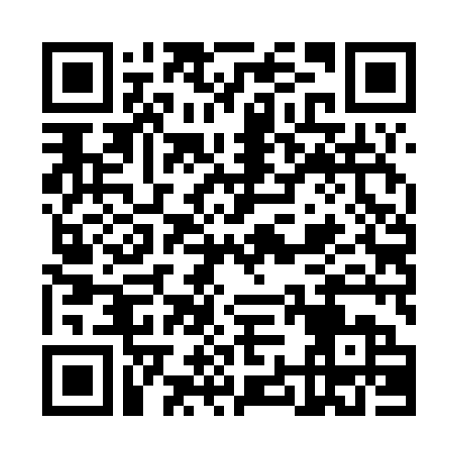
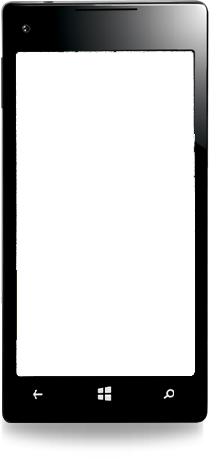

Evaluate this session
Required Slide
*delete this box when your slide is finalized
Your MS Tag will be inserted here during the final scrub.
Scan this QR code to
evaluate this session.

Slide 52

© 2013 Microsoft Corporation. All rights reserved. Microsoft, Windows and other product names are or may be registered trademarks and/or trademarks in the U.S. and/or other countries.
The information herein is for informational purposes only and represents the current view of Microsoft Corporation as of the date of this presentation. Because Microsoft must respond to changing market conditions, it should not be interpreted to be a commitment on the part of Microsoft, and Microsoft cannot guarantee the accuracy of any information provided after the date of this presentation. MICROSOFT MAKES NO WARRANTIES, EXPRESS, IMPLIED OR STATUTORY, AS TO THE INFORMATION IN THIS PRESENTATION.

