Slide 2
Effective Capacity Planning of Your Infrastructure Resources with Microsoft System Center 2012 Operations Manager Reporting
MDC-B329
Gordon McKenna
SCCDM – MVP
CEO - Inframon

Slide 3
Agenda
Analysis of Issues
What is capacity planning?
Collecting the Data
  DEMO: Operations Manager
Measuring & Publishing the Data
  DEMO: Operations Manager DW\SQL Server Analysis Services
  DEMO: Operations Manager Dashboards\PerformancePoint Services
Forecasting
  DEMO: SharePoint PerformancePoint Services
  DEMO: Third-Party Offerings

Slide 4
An Analysis of Issues
Budget Overruns
No Capacity Planning Function
Cannot measure, scorecard or predict future performance
Non fact based investment decisions
Budget Under Runs

Slide 5
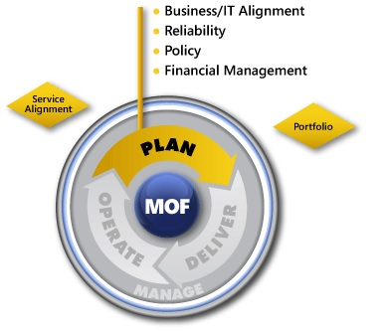
What is Capacity Planning
The capacity plan outlines the strategy for assessing overall service and component performance and uses this information to develop the acquisition, configuration, and upgrade plans. It provides management with a clear statement of resource and service capacity; an assessment of current capacities; a list of resources to be upgraded or acquired; and a projection of future capacity requirements*
Types of Capacity Planning:
Business capacity planning
Service capacity planning
Component capacity planning
*Taken from MOF V4. See www.microsoft.com/mof/ for more details

Slide 6
Key Questions
What are the future business and IT plans for growth, mergers, and acquisitions that may affect the capacity requirements for this service?
Are there business peaks or other time-based variations in demand that can affect the capacity requirements? How can we maximize use of quiet times?
What historical trend data can we analyze to evaluate current capacity and how can we use this data to model capacity against various scenarios?
How can we meet the capacity predictions of the organization in the simplest, most cost-effective way?*
*Taken from MOF V4. See www.microsoft.com/mof/ for more details

Slide 7
Capacity Planning Strategies
Lead Strategy
  Guestimates and what ifs – Affects budget, can affect service delivery, typically over provision
Lag Strategy
  Reactive – Affects service delivery
Match Strategy
  Forecasting and Trending

Slide 8
The Management Challenge
Intranets
Email
Extranets
Active Directory
VOIP
Virtual Desktops
Bespoke Applications

Slide 9
Service Components? It’s Complicated….
Service
Multiple Physical Locations
Multiple Tiers
Mixed Applications Services
Mixed Operating Systems
Across Private and Public Clouds
Front End
Middle Tier
Back End
New York
London
Tokyo
Service
Service
Service
Apache Tomcat
JBOSS
Oracle i7
IIS7
SQL Server Service
SQL Server 2012
IIS7
SQL Server Service
SQL Server 2012
Windows Server 2008 R2
Windows Server 20012
SuSE Linux
Windows Server 2008 R2
Windows Server 2012
Windows Server 2012 SP1
Windows Server 2008 R2
Windows Server 2012
Windows Server 2012 SP1
Private Cloud
Public Cloud
Hybrid
Cloud
Manage and Protect

Slide 10
Microsoft Operations Manager…The Perfect Tool!
Why Use Microsoft Operations Manager?
    Proactive monitoring framework spanning applications, servers and network devices
    Faster problem resolution
Operations Manager Architecture
    Agents
    Management Packs
    Distributed Applications
    Synthetic Transactions
    Service Level Tracking
    Inbuilt Reports
    Service Level Dashboards
    Operations Manager Data Warehouse
    SharePoint integration

Slide 11
Operations Manager Architecture
Monitored
Clients
Operational DB
Monitored Servers
Data Warehouse

Slide 12
Collecting the Data
DEMO: Operations Manager

Slide 13
Capacity Planning Steps
Collect
Measure
D
Forecast
B
A
C
Publish
System Center Operations Manager
SQL Server Analysis Services 2012
SharePoint Server 2013
SQL Server Analysis Services 2012

Slide 14
Building a Self Service Portal
OpsMgr
Default Reports
SharePoint 2013
IT Operators
Custom Reports
SSRS
Data Warehouse
IT Analysts
SSAS
Performance Point
Analysis
IT Managers
OpsMgr Dashboards
Executives

Slide 15
Building Blocks
Operations Manager
SharePoint PerformancePoint Services
SQL Server Analysis Services

Slide 16
Microsoft Operations Manager 2012
Live Data Warehouse
Multiple Aggregates
  Raw
  Hourly
  Daily
Choosing the right aggregate; Gotcha!
Alerts
State
Data Warehouse
Perf
Events

Slide 17
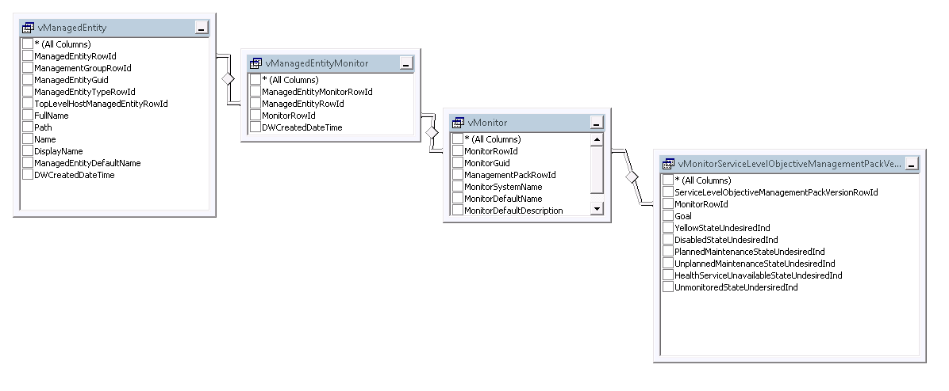
Managed Entities (State)
How does Operations Manager store state information?

Slide 18
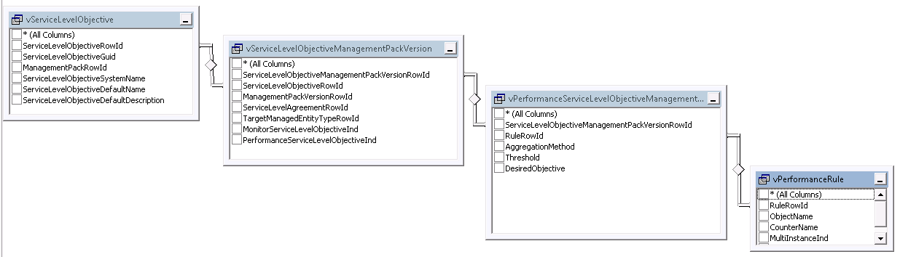
Managed Entities (Collection)
How does Operations Manager store entities it manages?

Slide 19
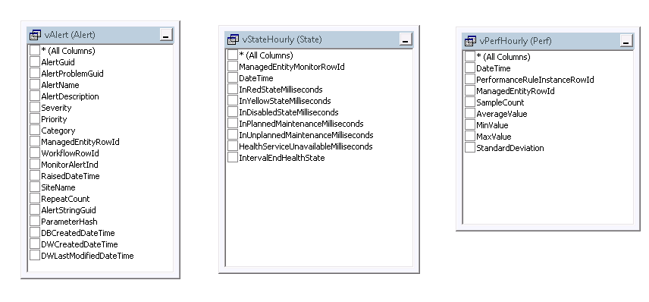
Fact Tables
What are Operations Manager’s Fact tables?

Slide 20
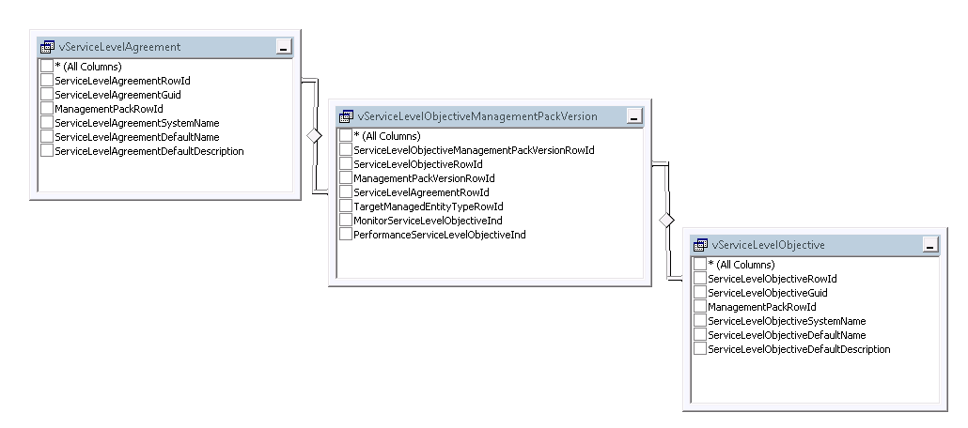
Service Level Objectives
How does Operations Manager store Service Level information?

Slide 21
Linking Distributed Apps to contained entities
Look in vManagedEntity, Distributed apps have a managed entity type of %_service or inherit from Microsoft.SystemCenter.ServiceDesigner.Service
Stored Procedure to extract base type hierarchy
dbo.ManagedEntityBaseTypeHierarchy
Stored procedure to extract hierarchy Microsoft_SystemCenter_DataWarehouse_Report_Library_ReportObjectListParse
Gotcha! Can’t use stored proc in data SSAS source view.

Slide 22

SQL Server Analysis Services 2012
Core Component of SQL Server
Hosts OLAP Cubes
Designed for large data volumes and quick aggregation
Contains Statistical Algorithms including Forecasting

Slide 23
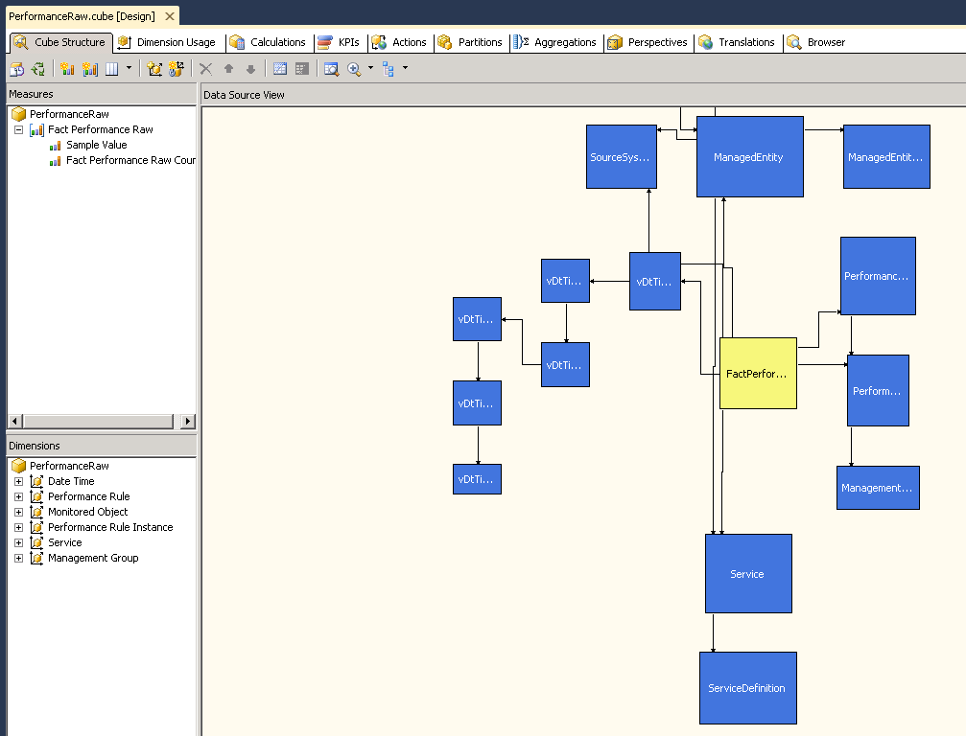
Cube Components
Measures Groups
  Numeric Values
  Calculated Values
  E.g % Time In Critical
Dimensions
  Attributes of the measures
  E.g Monitor Object Path
  Pre aggregated and optimized for Slice and Dice

Slide 24
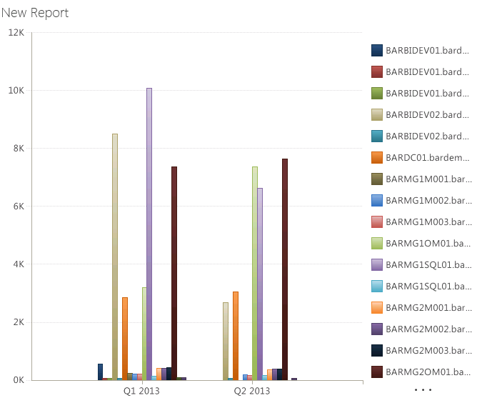
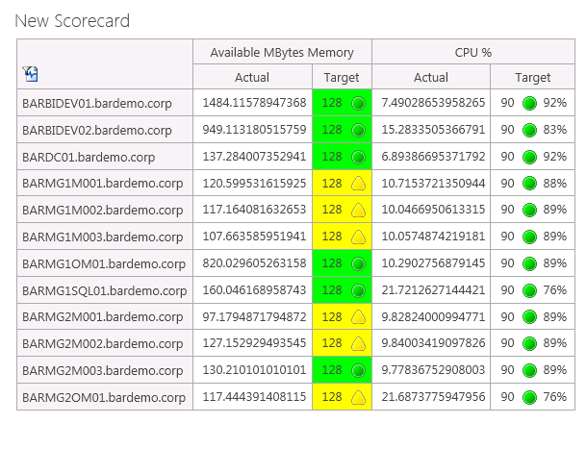
SharePoint PerformancePoint Services 2013
Why PerformancePoint?
Embedded into SharePoint
Slice and Dice tool
Click Once Easy Design for End Users

Slide 25
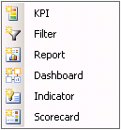
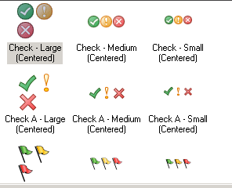
PerformancePoint Components
Compares actuals against a goal and displays indicators
Filters Data
Graphs, Pie Charts, Data Tables or Visio Diagrams
Contains Filters, Reports and Scorecards and is published to SharePoint as aspx page
Contains KPIs against dimensions (e.g Computer)

Slide 26
Measuring & Publishing the Data
DEMO: Operations Manager Dashboards\PerformancePoint Services

Slide 27
Forecasting the Data
DEMO:
SharePoint PerformancePoint Services
Opslogix Capacity Planning MP
Savision
Veeam v6 MP for Vmware

Slide 28

Conclusion
Capacity Planning as a core function
  To keep you CIO Happy
  To avoid budget over-runs and under-runs
  Make right investment decisions
  Keep IT in the know
Key Steps
  Collect
  Measure
  Publish
  Forecast

Slide 29
Video

Slide 30

Resources
Learning
  Sessions on Demand
  Microsoft Certification & Training Resources
http://channel9.msdn.com/Events/TechEd
www.microsoft.com/learning
TechNet
msdn
  Resources for IT Professionals
  Resources for Developers
http://microsoft.com/technet
http://microsoft.com/msdn

Slide 31



Evaluate this session
Required Slide
*delete this box when your slide is finalized
Your MS Tag will be inserted here during the final scrub.
Scan this QR code to
evaluate this session.

Slide 32

© 2013 Microsoft Corporation. All rights reserved. Microsoft, Windows and other product names are or may be registered trademarks and/or trademarks in the U.S. and/or other countries.
The information herein is for informational purposes only and represents the current view of Microsoft Corporation as of the date of this presentation. Because Microsoft must respond to changing market conditions, it should not be interpreted to be a commitment on the part of Microsoft, and Microsoft cannot guarantee the accuracy of any information provided after the date of this presentation. MICROSOFT MAKES NO WARRANTIES, EXPRESS, IMPLIED OR STATUTORY, AS TO THE INFORMATION IN THIS PRESENTATION.

