Slide 2
Cluster in a Box in 2013:
How Real Customers Are Making Their Businesses Highly-Available with Windows Server 2012
MDC-B336
John Loveall
Principal Program Manager
Microsoft

Slide 3

Agenda
Cluster in a Box: Why “CiB”?
What new CiB solutions are available in 2013?
Customers and CiB
What’s new for CiB in Windows Server 2012 R2?

Slide 4
Cluster in a Box
Volume Platform for Availability

Slide 5
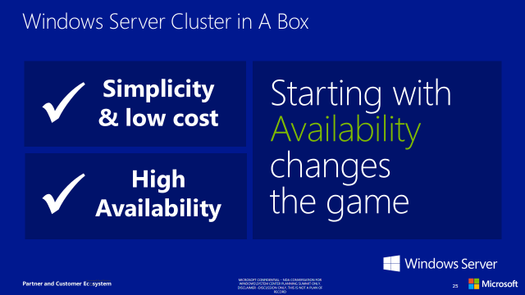
Looking back to Windows Server 2012
“Continuous Availability” identified by customers as critical
Major investments made throughout Windows Server
Problem: High-Availability server hardware is costly and too difficult to buy, install, and manage.
Solution: “Cluster in a Box” (CiB) program
Microsoft works with our hardware partners to enable their release of new highly-available systems for a volume market

Slide 6

“Comprehensive
and DEEP.”
- Al Gillen, IDC
Windows Server 2012:
“Takes your breath away… Features will be a boon for enterprises creating private clouds.”
– Jonathan Hassel, Computerworld
200+ customers participated in Windows Server TAP
175,000+
Beta downloads
“Server 2012 is as big a leap over 2008 R2 as 2008 R2 was over 2003.”
– Trevor Pott, The Register
“Windows Server 2012 – can you say
cloud?”
– Richard Fichera, Forrester Research

Slide 7
Customer demand for Continuous Availability
2+ years
of research
6,000+ customers
6000+ Voice of the Customer Statements
Continuous availability of the OS, applications, and data was ranked by customers WW (US, Germany and Japan) as a must have feature
900+ Customer Prioritized Buckets
200 Customer Focused
Design Sessions
22 Areas of Investigation
Customer Focused Design (CFD) & Areas of Investigation

Slide 8
Extending the market for Continuous Availability
New systems expand choices of cost and features
Features
Existing markets
High Availability
Simple OOBE
Storage Spaces configurations
HW RAID capability
SSD perf capability
Market expansion with CiB
Scale out Server Cluster
Cluster in a Box
Storage Arrays
(iSCSI/FC, SMB/NFS)
Optional JBOD
storage expansion
Extended scale out
Advanced replication
Advanced power management
Advanced performance options
…
Single node servers
Target markets for Cluster in a Box solutions
SMB
Branch
Private Cloud
JBOD storage
$$
IT
Expertise
IT Generalist
IT Specialist
PB 1 - 3
PB 4+

Slide 9
Cluster in a Box design considerations
Design Example (with Direct-Attached SAS)
Availability
At least one node and storage always available, despite failure or replacement of any component
Dual power domains
1/10G E or Infiniband
1/10G E or Infiniband
Network
Network
Server Enclosure
x8 PCIe
x8 PCIe
Server A
Server B
CPU
1/10G Ethernet cluster
connect (through midplane)
CPU
Simplicity
Pre-wired, internal interconnects between nodes, controllers, and storage
x8 PCIe
x8 PCIe
Storage Controller
x4 SAS (through midplane)
Storage Controller
x4 SAS
x4 SAS
SAS Expander
0
1
23
B ports
SAS Expander
A ports
…
Flexibility
PCIe slots for flexible LAN options
External SAS ports for JBOD expansion
Office-level power, cooling, and acoustics
to fit under a desk
External JBOD
SAS Expander
1
B ports
SAS Expander
0
…
23
A ports
Additional JBODs …

Slide 10





CiB Component Guidelines*
Storage Server
Virtualization Appliance
Entry to Medium configurations: Single CPU/node
Performance with Dedup
  Consider 2nd CPU for large, active datasets (>1GB/s throughput)
PCIe
  Entry: 1 available x8 slot
  Performance: 2-3 available x8 slots
Entry: 8 cores (per server node)
For large capacity: 16+ cores (per server node)
PCIe
    Entry to medium capacity: 1 available x8 slot
CPU
Recommend 64GB per node
    Entry configuration: 32GB
Consider additional memory for large, active datasets (>1GB/s throughput)
Entry: 128GB
For large capacity: >128GB
Memory
Heartbeat connection
  Recommend 10GbE
  Entry: 1GbE
External
  10+GbE or IB, with RDMA
  2x per server node
Heartbeat connection
  Recommend 10GbE
  Entry: 1GbE
External
  Entry: 2x 1GbE
  Large capacity: 2x 10GbE (also for scale out scenarios)
Network
SAS
Entry: HDDs acceptable
Recommend addition of SSDs
SAS
HDDs acceptable
Consider SSDs for I/O intensive workloads
Drives
* Note: These are guidelines only. System results are significantly dependent on the specific workloads and overall system configurations.

Slide 11
What new CiB solutions are available in 2013?
Partner updates, announcements, and launches

Slide 12
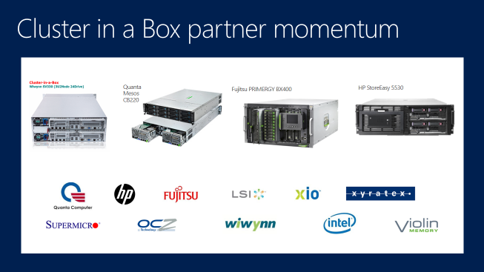
Windows Server 2012: The starting line
Initial CiB products under development from HP, Fujitsu, Quanta, and WiWynn
Clustered RAID controller under development from LSI
Partnerships announced with leading storage platform providers
Partnerships announced with leading platform component providers

Slide 13
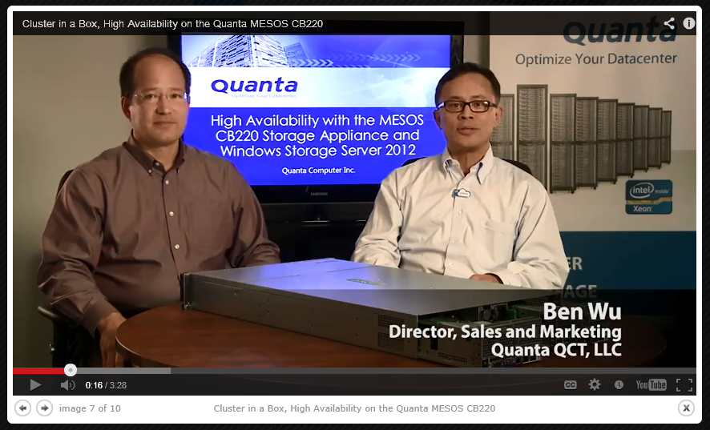
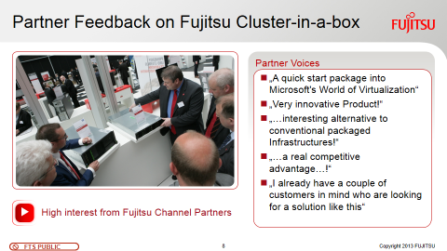
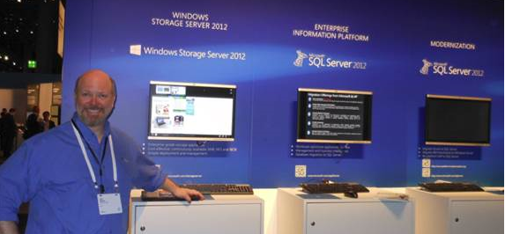

Windows Server 2012
CiB products launch

Slide 14
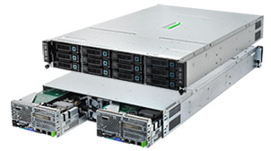


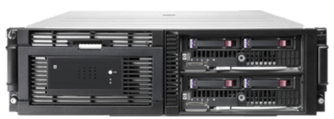
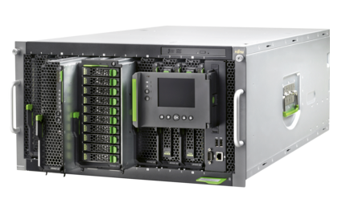
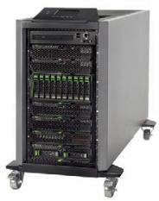

Product updates for 2013
Partner | Status | Product
Quanta | Released
 | Released
 | Released
Quanta Mesos CB220
Windows Storage Server
LSI
Fujitsu
Quanta
Violin
?HP
HP StoreEasy 5530
Windows Storage Server
Fujitsu Cluster-in-a-box based on BX400

Slide 15
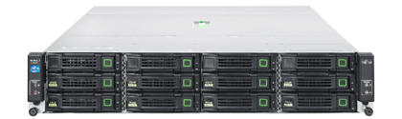
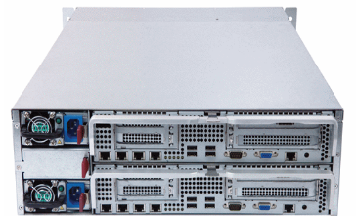

Product updates for 2013, continued
Partner | Status | Product
Quanta | Released
 | Evaluation
Fujitsu Cluster-in-a-box based on CX420
WiWynn SV330
Windows Storage Server

Slide 16
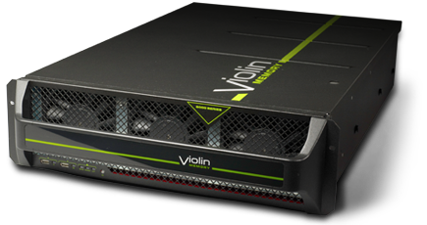
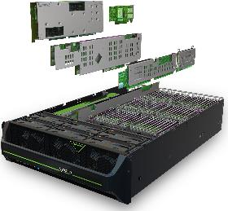

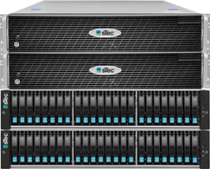

Announcing at TechEd 2013…
Partner | Status | Product
Quanta | Announcing
 | Announcing
Violin VM6000
Windows Storage Server
sTec™ s3000 storage appliance
Windows Storage Server

Slide 17
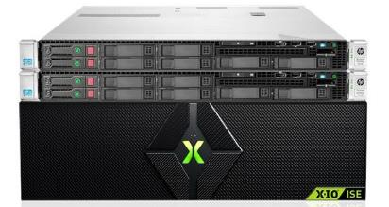

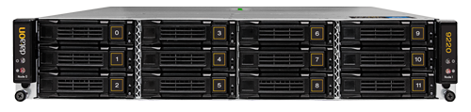
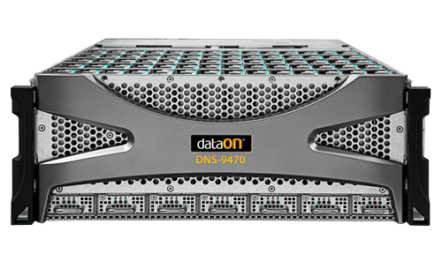

Announcing at TechEd 2013…
Partner | Status | Product
Quanta | Announcing
 | Announcing
X-IO File Storage Controller 2200
Windows Storage Server
DataON Cluster in a Box
DNS-9220
DNS-9470
Windows Storage Server

Slide 18

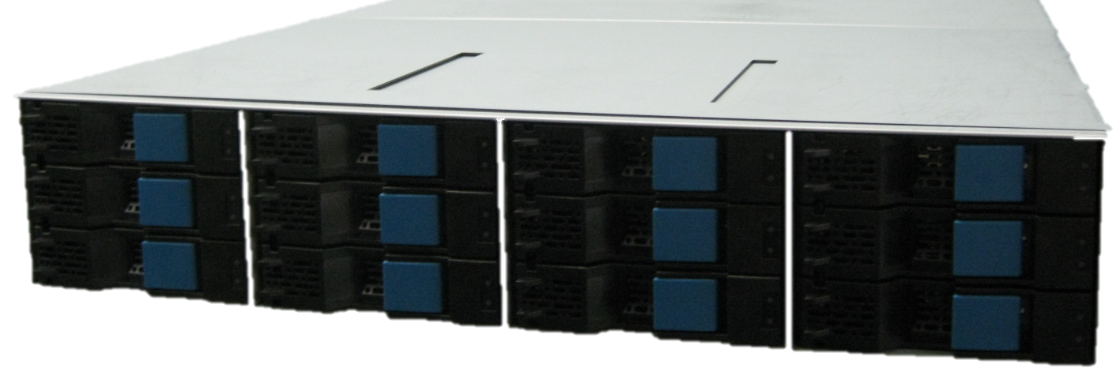
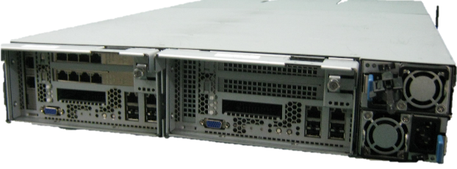

Announcing at TechEd 2013, continued
Quanta | Windows Server Cluster in a Box Solution partner Hitachi “CiBS-12/24” prototype under development
 | Windows Server Cluster in a Box Solution partner

Slide 19
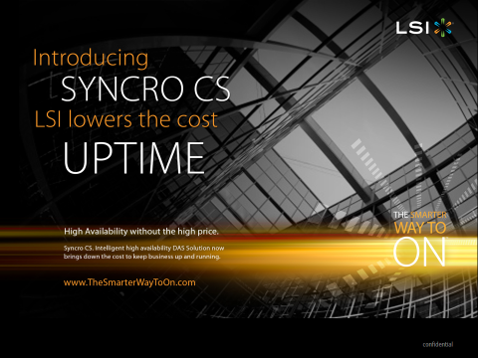
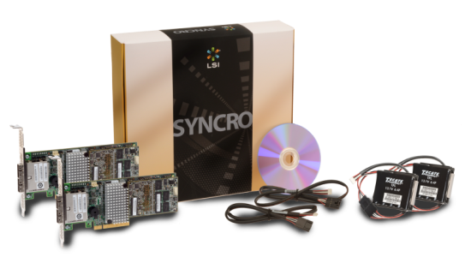
Launching at TechEd 2013…
LSI Syncro CS
High-availability, clustered RAID controller for Windows Server 2012
LSI
Fujitsu
Quanta
Violin
?HP
Graphics by LSI Corporation

Slide 20
Clustered RAID controllers
Meeting Windows Server requirements
Design Example (with Direct-Attached SAS)
Function | Goals | Requirement
RAID | Continue operation with single-component failures and robust handling of node failure, without data loss | RAID levels 1, 5, 6 or 10 (or equivalent) RAID “write hole” solution
Windows Failover Clustering | Continuous Availability depends on Windows Failover Clustering to survive node failure | SPC-3 Persistent Reservation support Shared LUNs accessible from all nodes
LUN access after failover | Transparent failover at the application layer requires data integrity and prevention of read/write timeouts | Preserve data for all acknowledged writes 5 seconds maximum blocking time for up to 100 LUNs All I/O requests must complete within 25 seconds
Minimum active mode | Customer expectation is active use of all nodes | Dual-Active (non-shared LUN access)
Recovery Processing | Transparent failover should not require IT admin attention to continue normal operation | Recovery processing resulting from node failure completes automatically
1/10G E or Infiniband
1/10G E or Infiniband
Network
Network
Server Enclosure
x8 PCIe
x8 PCIe
Server A
Server B
CPU
1/10G Ethernet cluster
connect (through midplane)
CPU
x8 PCIe
x8 PCIe
Storage Controller
x4 SAS (through midplane)
Storage Controller
x4 SAS
x4 SAS
SAS Expander
0
1
23
B ports
SAS Expander
A ports
…
External JBOD
SAS Expander
1
B ports
SAS Expander
0
…
23
A ports
Additional JBODs …
LSI Syncro CS application in Cluster in a Box

Slide 21
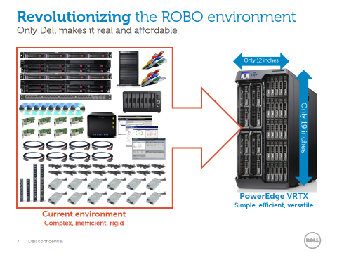
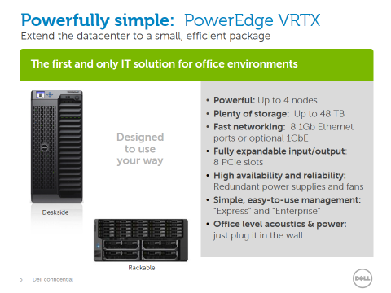
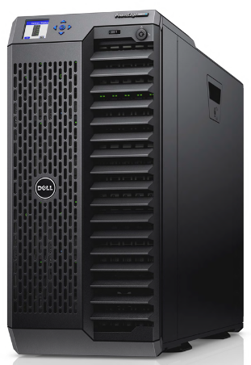
Launching at TechEd 2013…
Dell PowerEdge VRTX
4-node Windows Server Cluster in a Box
Office level acoustics and power
Graphics by Dell

Slide 22
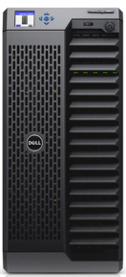
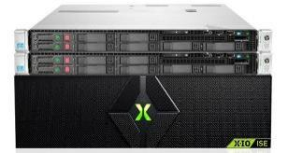
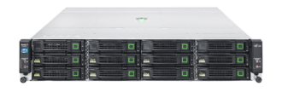
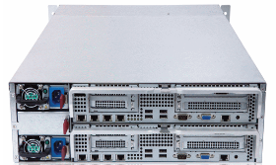

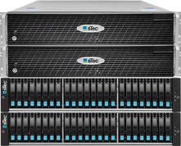
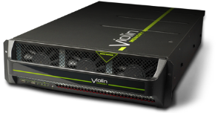








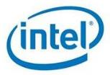


Cluster in a Box in 2013
Building the vision of availability “wherever you buy a server”
Quanta Mesos CB220
HP StoreEasy 5530
X-IO FSC2200
Dell PowerEdge VRTX
Fujitsu PRIMERGY CX420 S1
WiWynn SV330
Fujitsu PRIMERGY BX400
sTec s3000
DataON DNS-9220
Violin VM6000
DataON DNS-9470
All logos trademarks or registered trademarks of the respective partners

Slide 23
Customers and Cluster in a Box

Slide 24
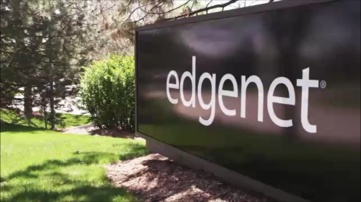
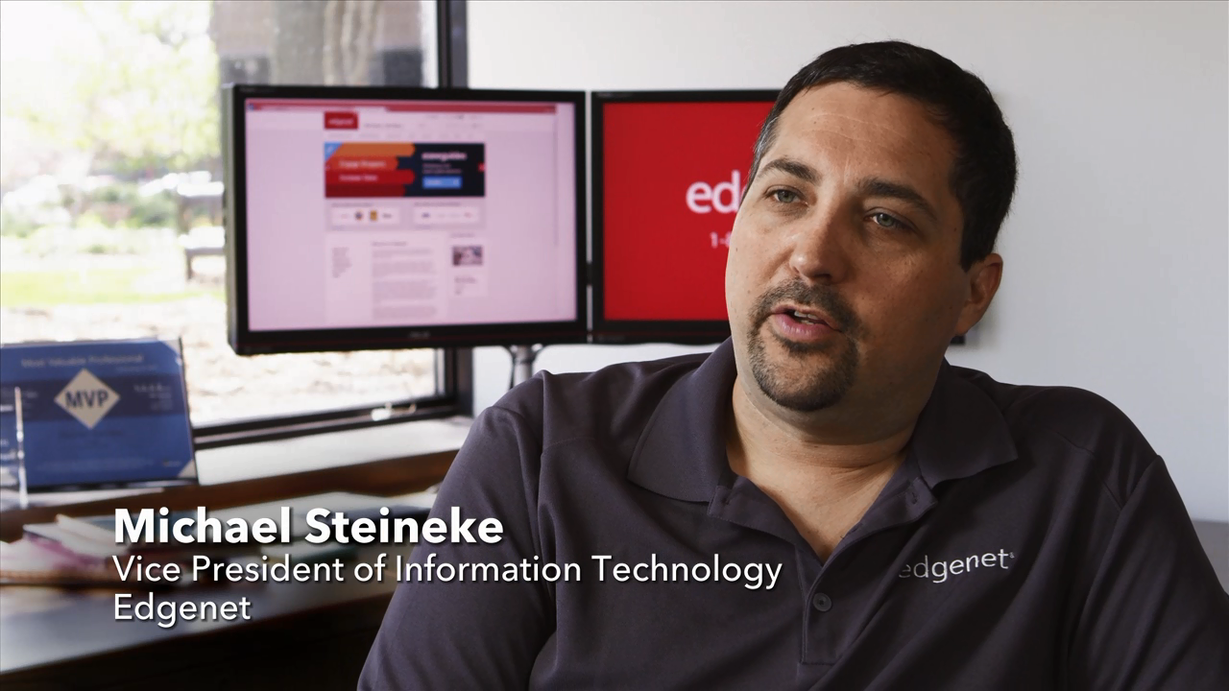
Case study: Edgenet
“Branch in a Box” scenario
Quanta CB220 Cluster in a Box with LSI Syncro CS
Video by LSI Corporation and Edgenet, Inc..

Slide 25

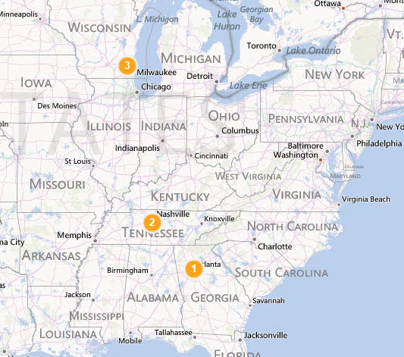
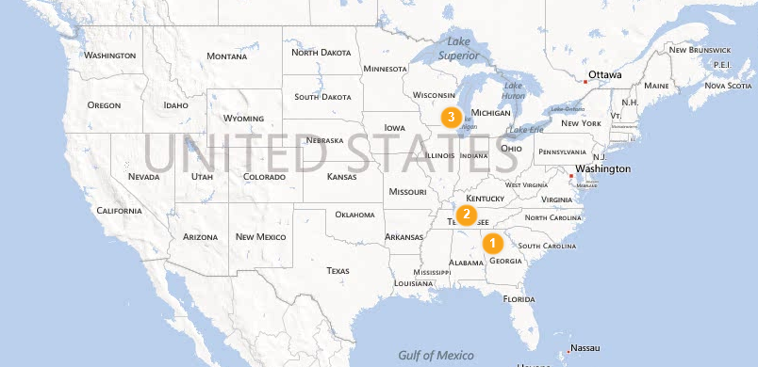
Edgenet profile
Manages and distributes product information
  Covering over 4,000 companies, 8,000 brands and 6,000,000+ products
Customers: Top retailers, distributors, suppliers
  Offices in Atlanta, Nashville and Milwaukee
Maps by Bing

Slide 26




Edgenet branch office application
Workload and environment
Domain Controllers – DNS, DHCP
Print Server
Visual Studio Team Foundation Server Proxy
Win 7 & Win 8 Workstations
SQL 2012 Server
IIS server
RedHat Linux Server
Cluster in a Box implementation
1 – Quanta CB220
with LSI Syncro CS
Windows Server 2012
Existing implementation
2 – Dell R610 1U servers – Hyper-V
1 – HP EVA 4400 – Base 12 drives
2 – 8 Gb FibreChannel switches

Slide 27








Targeted customer scenarios
IT Admin
Infrastructure
Workload
Examples
Part-time (IT not primary job function)
Generalist
May get assistance from VAR
Office environment equipment room
ISP network connection
Hyper-V appliance supporting all business apps and data, e.g., point of sale, inventory, documents/records
Doctor’s office
Individual retail store
Lawyer’s office
Design / Architecture consulting office
“Business in a Box”
Virtualization Appliance
Centralized at HQ
Primarily remote support
Local assistance as required
Office environment equipment room
Domain-connected to main office
Hyper-V appliance running replicated branch workloads, with LOB applications, file server, and cached data
Retail chain stores
Bank branches
“Branch in a Box”
Virtualization Appliance
Specialists
Onsite and remote
Highly leveraged (expensive resource)
Enterprise equipment room
Switched network
High-performance
NAS server supporting variable workloads, hosted LOB apps and data
Cloud solution
builders
Hosters
Enterprise datacenters
Cloud/Datacenter
Storage Server

Slide 28









Solution spotlight:
Dell PowerEdge VRTX
“Business in a Box”
Remote and branch offices
Government
Small business & healthcare
Retail & hospitality
Education
“Branch in a Box”
Affordably extends the datacenter with centralized control
Address datacenter sprawl while empowering remote users and agencies
Power the office with better performance, manageability, reliability and security
Real-time and reliable management of every part of the business
Empower points of education with security and governance
Virtualization Appliance
Graphic by Dell

Slide 29




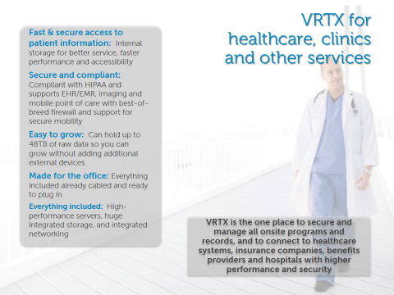
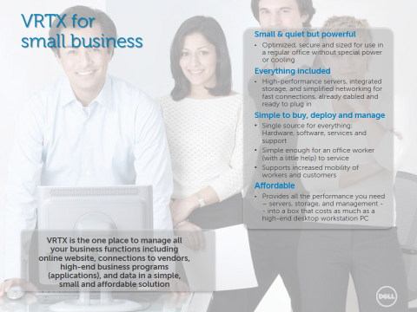
Example customer applications
Dell PowerEdge VRTX
“Business in a Box”
“Branch in a Box”
Graphics by Dell

Slide 30
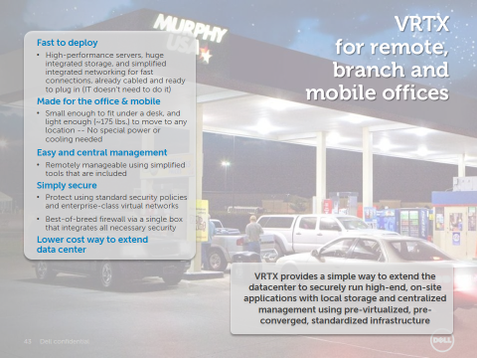
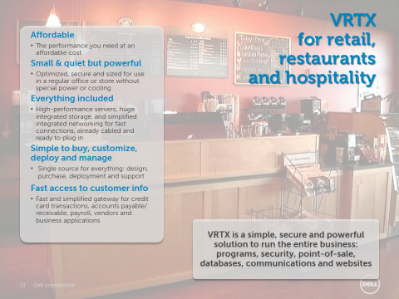
Example customer applications Dell PowerEdge VRTX, continued
“Business in a Box”
“Branch in a Box”
Graphics by Dell

Slide 31
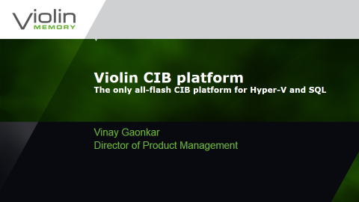
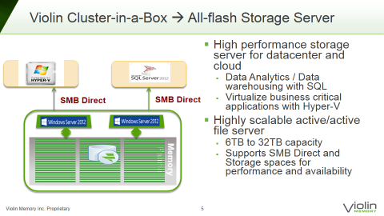
Solution spotlight:
Flash-based Cluster in a Box solutions
Cloud/Datacenter
Storage Server
Violin VM6000
Windows Storage Server
Partner focusing on customer scenarios demanding the highest levels of performance
Graphics by Violin Memories

Slide 32
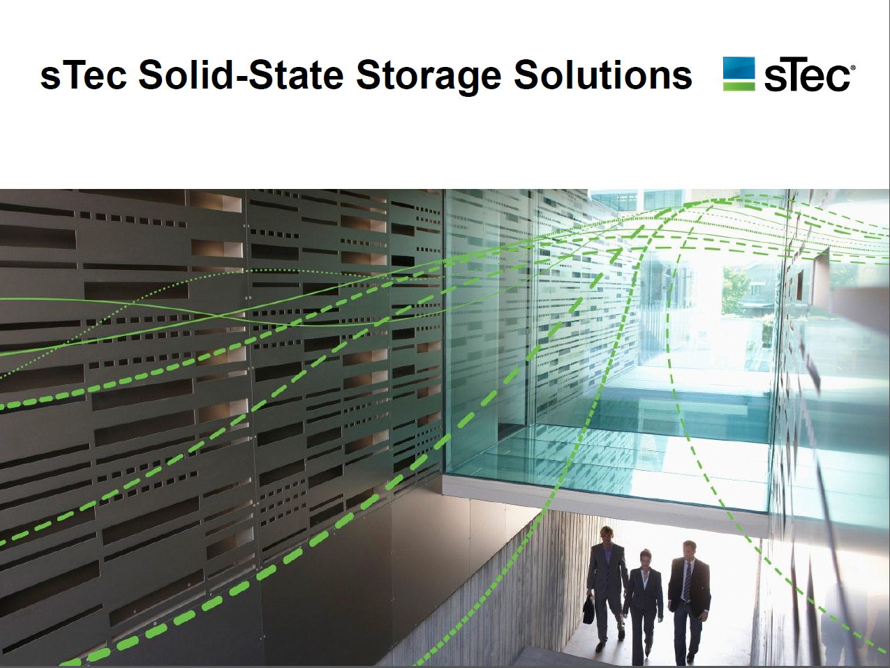
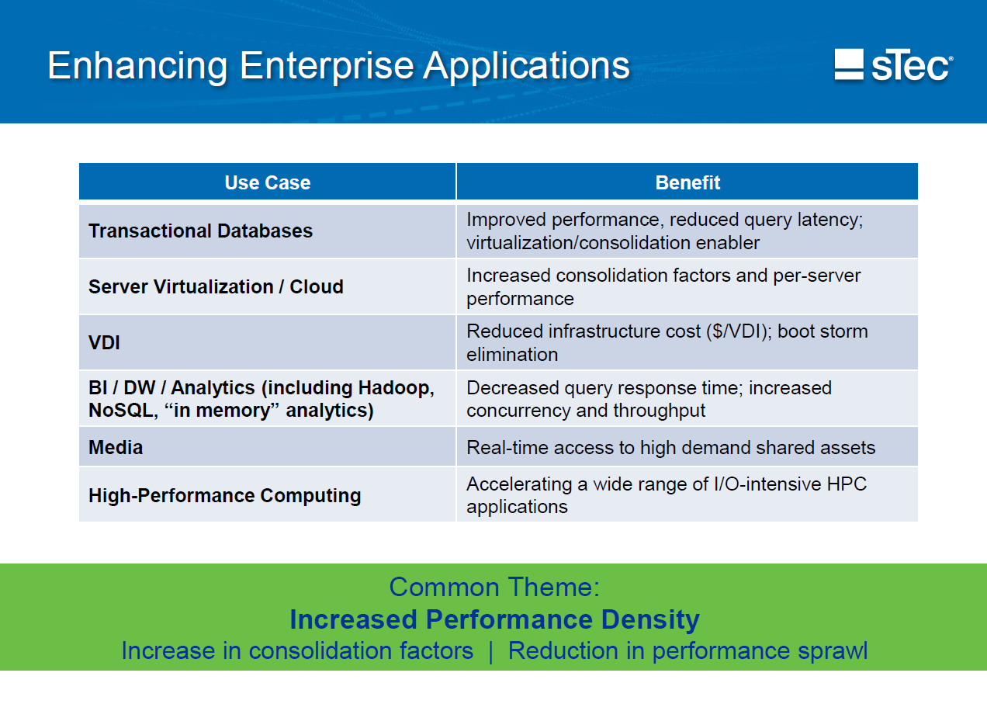
Solution spotlight:
Flash-based CiB solutions, continued
Cloud/Datacenter
Storage Server
Partner focusing on specific customer use cases demanding the highest levels of performance
sTec™ s3000 storage appliance
Windows Storage Server
Graphics by sTec

Slide 33
What’s new for CiB in Windows Server 2012 R2?

Slide 34
Windows Server 2012 R2 Cluster in a Box
Simple Guidance for Hardware Partners
Opportunity for Customers
  Build on the same hardware platform
  Certify against the same requirements
  Release with Windows Server 2012 R2
    Supports new configurations
    New features enhance customer scenarios
  Watch for more solutions coming to market
  Evaluate new hardware configurations enabled using Windows Server 2012 R2
Preserves hardware design investment
Extends value to new configurations

Slide 35




Windows Server 2012 R2 Cluster in a Box
Target the primary Cluster in a Box customer scenarios
Build on Windows Server Cluster in a Box as the volume platform for availability
Cloud/Datacenter
“Business in a Box”
“Branch in a Box”
Windows Storage Server 2012 R2
Virtualization Appliance
OOBE 4–node support
Storage Spaces clustering enhancements (parity, SSDs)
Leverage these Windows Server 2012 R2 features to deliver up to 4 node systems with enhanced storage and scale-out capabilities
Scale-out File Server rebalancing
SMB performance and per-share scale out
Deduplication optimized for VDI on CSV

Slide 36
Key new scenarios:
Storage Spaces clustering enhancements
New clustered configurations using Parity Spaces and/or SSDs
Cloud/Datacenter
“Business in a Box”
“Branch in a Box”
Windows Server 2012
Windows Server 2012 R2
Windows Storage Server 2012 R2
Virtualization Appliance
OOBE 4–node support
Mirrored Space
Parity Space
Mirrored Space
Storage Spaces clustering enhancements (parity, SSDs)
Scale-out File Server rebalancing
SSDs
SMB performance and per-share scale out
HDDs
Deduplication optimized for VDI on CSV
Spaces pool
Spaces pool

Slide 37
Example configurations
Building on Storage Spaces clustering enhancements
Configuration #1: Capacity optimized
All HDDs
  12 drives, single pool, two 8 column, single parity Spaces, or
  24 drives, single pool, four 8 column, single parity Spaces
  (all interleave 256)
87% effective drive capacity
vs. 50% for 2-way mirrored Spaces
Windows Failover Cluster
Parity Space
Parity Space
All HDDs
Spaces pool

Slide 38
Configuration #1: Capacity optimized
Example implementations
Per node performance results*
Load | Block Size | IOPS | MB/s
Sequential Read | 256K | 3484 | 871
Sequential Write | 256K | 212 | 53.0
Random Read | 8K | 3415 | 26.7
Random Write | 8K | 170 | 1.33
12 HDDS
Quanta MESOS CB220 (Value SKU)
  Per blade
  2 x Intel(R) Xeon(R) E5-2630 @ 2.3GHz
  128GB memory
  LSI SAS Adapter 9207-8i
  (2) 2.5" internal SATA for OS installation
  Drives
  (12) SEAGATE ST9300605SS, 10K RPM
  or
  (24) SEAGATE ST9300605SS, 10K RPM
  with JBOD
Load | Block Size | IOPS | MB/s
Sequential Read | 256K | 3790 | 947
Sequential Write | 256K | 240 | 60.0
Random Read | 8K | 5608 | 43.8
Random Write | 8K | 274 | 2.14
24 HDDs
* Note: Results are examples only – performance will vary with configurations and workloads. Workload is SQLIO Disk Subsystem Benchmark Tool, available at http://www.microsoft.com/en-us/download/details.aspx?id=20163

Slide 39


Example configurations
Building on Storage Spaces clustering enhancements
Configuration #2: Balanced
Using SSDs for write-back cache
HDDs + SSDs
  10 HHDs + 2 SSDs, single pool, two 8 column, single parity Spaces
  or
  22 HHDs + 2 SSDs, single pool, four 8 column, single parity Spaces
    (all interleave 256)
Approximately 8x improvement in random write performance over HDD-only configuration
    Balanced for random write performance
Windows Failover Cluster
Parity Space
Parity Space
SSDs
HDDs
Spaces pool

Slide 40
Configuration #2: Balanced
Example implementations
Per node performance results*
Load | Block Size | IOPS | MB/s
Sequential Read | 256K | 3091 | 773
Sequential Write | 512K | 431 | 107
Random Read | 8K | 2272 | 17.7
Random Write | 8K | 1752 | 13.68
10 HDDs
2 SSDs
Quanta MESOS CB220 (Value SKU)
  Per blade
  2 x Intel(R) Xeon(R) E5-2630 @ 2.3GHz
  128GB memory
  LSI SAS Adapter 9207-8i
  (2) 2.5" internal SATA for OS installation
  Drives
  (10) SEAGATE ST9300605SS, 10K RPM
  or
  (22) SEAGATE ST9300605SS, 10K RPM
  with JBOD
  (2) OCZ TALOS2, 200GB
Load | Block Size | IOPS | MB/s
Sequential Read | 256K | 3666 | 916
Sequential Write | 256K | 926 | 231
Random Read | 8K | 4228 | 33.0
Random Write | 8K | 2065 | 16
22 HDDs
2 SSDs
* Note: Results are examples only – performance will vary with configurations and workloads. Workload is SQLIO Disk Subsystem Benchmark Tool, available at http://www.microsoft.com/en-us/download/details.aspx?id=20163

Slide 41
Cluster in a Box calls to action
Understand your plans for high-availability servers
Investigate new CiB solutions
  Current configurations that can benefit from R2 features
  New configurations enabled by R2
Participate in Windows Server 2012 R2 early evaluation opportunities
  Evaluate Preview release to validate scenarios
Provide feedback on what works and what doesn’t work for your business
  We’re are developing additional customer case studies

Slide 42
CiB partner information
Partner | Product | Contact / Reference
DataON | DataON DNS-9220/9470 CiB | http://www.dataonstorage.com/cluster-in-a-box.html
Dell | Dell PowerEdge VRTX | www.dell.com/poweredge/vrtx
Fujitsu | Fujitsu Cluster in a Box based on BX400 or CX420 | www.Fujitsu.com
Hitachi | Hitachi “CiBS-12/24” | www.hitachi.com
HP | HP StoreEasy 5530 | www.hp.com
LSI | LSI Syncro CS | www.TheSmarterWayToOn.com
Quanta | Quanta Mesos CB220 | www.QuantaQCT.com
sTec | sTec s3000 storage appliance | www.stec-inc.com
Violin Memory | Violin VM6000 | www.vmem.com
X-IO | X-IO File Storage Controller 2200 | xiostorage.com/products/FSC-2200
WiWynn | WiWynn SV330 | www.wiwynn.com/en/ps_01.html#anchor9
Microsoft | Developer information and contacts for CiB | http://technet.microsoft.com/en-us/windowsserver/jj542413.aspx
Edgenet | Customer case study | http://www.edgenet.com

Slide 43
Cluster in a Box in 2013
Building the vision of availability “wherever you buy a server”
Building the vision of availability “wherever you buy a server”
Quanta Mesos CB220
HP StoreEasy 5530
X-IO FSC2200
Dell PowerEdge VRTX
Fujitsu PRIMERGY CX420 S1
WiWynn SV330
sTec s3000
DataON DNS-9220
Fujitsu PRIMERGY BX400
Violin VM6000
DataON DNS-9470
All logos trademarks or registered trademarks of the respective partners

Slide 44

Related content
Breakout Sessions
  MDC-B218 Storage Spaces: What’s New In Windows Server 2012 R2
  MDC-B394 Shouldn’t All of Your Storage Be Highly Available?
  MDC-B305 Continuous Availability: Deploying and Managing Clusters Using Windows Server 2012 R2
  MDC-B335 Understanding the Hyper-V over SMB Scenario, Configurations, and End-to-End Performance
  MDC-B337 Failover Cluster Networking Essentials
  MDC-B349 Upgrading the Platform - How to Get There! Part 4: Your Fileservers and Storage Options
  MDC-B342 Reduce Storage Costs with Data Deduplication

Slide 45
Track resources
Learn more about Windows Server 2012 R2 Preview, download the datasheet and
evaluation bits on
http://aka.ms/WS2012R2
Learn more about System Center 2012 R2 Preview, download the datasheet and evaluation bits on
http://aka.ms/SC2012R2

Slide 46

Resources
Learning
  Sessions on Demand
  Microsoft Certification & Training Resources
http://channel9.msdn.com/Events/TechEd
www.microsoft.com/learning
TechNet
msdn
  Resources for IT Professionals
  Resources for Developers
http://microsoft.com/technet
http://microsoft.com/msdn

Slide 47



Evaluate this session
Required Slide
*delete this box when your slide is finalized
Your MS Tag will be inserted here during the final scrub.
Scan this QR code to
evaluate this session.

Slide 48

© 2013 Microsoft Corporation. All rights reserved. Microsoft, Windows and other product names are or may be registered trademarks and/or trademarks in the U.S. and/or other countries.
The information herein is for informational purposes only and represents the current view of Microsoft Corporation as of the date of this presentation. Because Microsoft must respond to changing market conditions, it should not be interpreted to be a commitment on the part of Microsoft, and Microsoft cannot guarantee the accuracy of any information provided after the date of this presentation. MICROSOFT MAKES NO WARRANTIES, EXPRESS, IMPLIED OR STATUTORY, AS TO THE INFORMATION IN THIS PRESENTATION.

