Slide 2
Windows Server 2012/2012 R2 Hyper-V
MDC-B338
Jeff Woolsey
Principal Program Manager
Windows Server

Slide 3
Thank You!

Slide 4
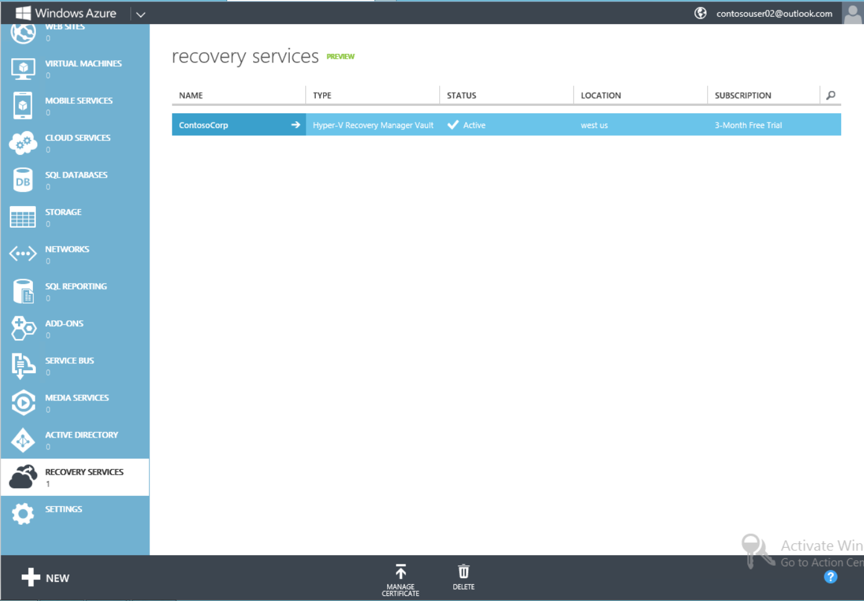
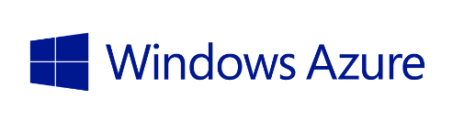
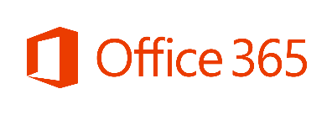


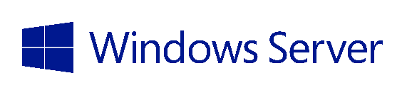
Microsoft Cloud OS Vision
Public Cloud
Azure Virtual Machines
Windows Azure Pack
1
Windows Azure Pack
Consistent
Platform
Private Cloud
Service Providers
DEVELOPMENT
MANAGEMENT
DATA
IDENTITY
VIRTUALIZATION

Slide 5
What we delivered in Windows Server 2012

Slide 6
Hyper-V host scale and scale-up workload support
System | Resource | Maximum number |  | Improvement factor
 |  | Windows 2008 R2 | Windows Server 2012
Host | Logical processors on hardware | 64 | 320 | 5×
 | Physical memory | 1 TB | 4 TB | 4×
 | Virtual processors per host | 512 | 2,048 | 4×
Virtual machine | Virtual processors per virtual machine | 4 | 64 | 16×
 | Memory per virtual machine | 64 GB | 1 TB | 16×
 | Virtual disk capacity | 2 TB | 64 TB | 32x
 | Active virtual machines | 384 | 1,024 | 2.7×
Cluster | Nodes | 16 | 64 | 4×
 | Virtual machines | 1,000 | 8,000 | 8×
6
Notes:
6

Slide 7
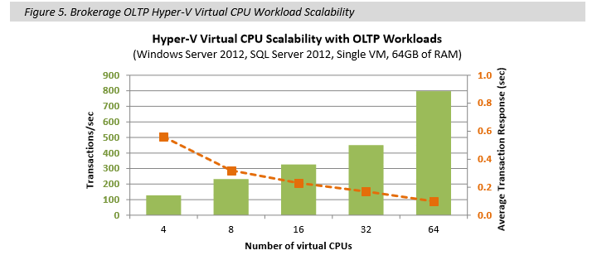
Linear Performance & Scale with SQL
ESG Labs Validation: Windows Server 2012 with SQL Server 2012
The sum of the number of transactions processed per second and the average response time for the 10 transaction types were monitored as virtual CPUs were added from 4-64. The OLTP workload and concurrent user counts remained constant. The number of brokerage transactions per second scaled linearly up to 64 virtual processors.

Slide 8
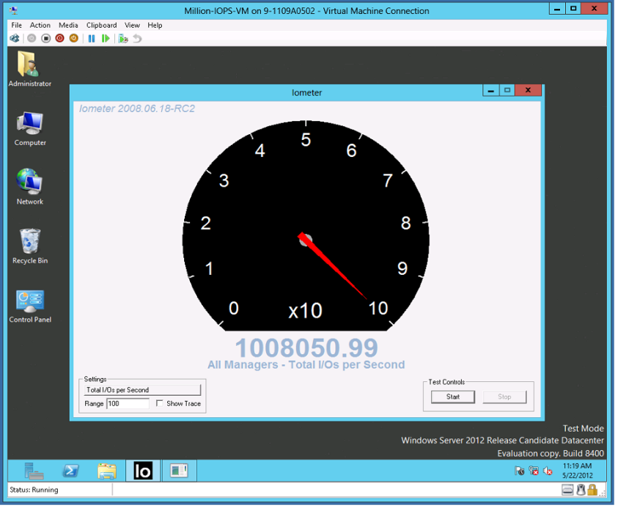
Hyper-V: Over 1 Million 4k IOPs from a Single VM
Industry Leading IO Performance
  VM storage performance on par with native
  Performance scales linearly with increase in virtual processors
  Windows Server 2012 Hyper-V can virtualize over 99% of the world’s SQL Server.
Windows Server 2008 R2 | Windows Server 2012
250,000 4k IOPs | 1,000,000+ 4k IOPs

Slide 9
Dynamic, High Performance Storage
Live Storage Migration
New VHDX Format
  Up to 64 TB per disk
  Auto-Alignment with SAN storage
  Major performance improvements
Native 4K Disk Support
Online Meta Operations
  Live virtual disk merge
  Live new parent
Virtual Fibre Channel
  Virtual FC HBA presented in VM
Offloaded Data Transfer (ODX)
Automatic Trim/Unmap
  Allows storage subsystem to automatically reclaim/reuse storage deleted from a VM
  Only Hyper-V provides this
Support for VMs on CA File Servers via SMB 3.0
  SMB Multi-Channel, SMB Scale Out
  SMB Transparent Failover, Encryption

Slide 10


NetBackup for Hyper-V
NetBackup Product Management
Amit Sinha: amit_sinha@symantec.com

Slide 11
NetBackup for Hyper-V Overview
Support for Windows Server 2012 Hyper-V
  NetBackup 7.5.0.6 - mid – late June’13
Up to 90% less back-end storage (disk, tape, VTL, etc.).
  NetBackup offers media storage optimization deduplication
Flexible backup and recovery
  Restore single file from any incremental or full backup
Simple and faster, disaster recovery
  Restore entire virtual machine with a few mouse clicks

Slide 12
NetBackup for Hyper-V - Features and Benefits
Feature | Benefits
Scalable Enterprise Class Data Protection | Backup and Recovery of thousands of VMs
Efficient Deduplication | Maximize storage and network utilization by using Media Server or Client Side
Flexible Deployment Models | Flexible configuration via either NetBackup agent on the host or on a Proxy server
Advance Recovery Options | P2V or V2P, BMR Recovery
Simplified Recovery | Recover a VM, a single file in a Windows or Linux VM
System Center Integration | Monitor and manage NetBackup backup and recovery operations via System Center
Self Service Recovery | Recovery Hyper-VMs or a single file within a VM from System Center

Slide 13
Hyper-V Data Protection Demo
Amit Sinha, Symantec

Slide 14
De-Mystifying Storage Appliances

Slide 15
Demystifying Storage Appliances
What’s in a storage appliance?
  x86/x64 Processors
  Memory
  Network Adapters
  Storage HBAs
Sound familiar?
Let’s have a closer look…
SAS
Clustered
Multiple physical interfaces; Pools disks, presents LUNs, Simple, Mirrored, Parity etc.
Multiple physical interfaces; Pools disks, presents LUNs, Simple, Mirrored, Parity etc.
“Back”
Presents interfaces:
iSCSI, FC, FCoE, NFS, SMB
Presents interfaces:
iSCSI, FC, FCoE, NFS, SMB
“Front”
Ethernet: 1Gb/10Gb
FC: 1/2/4/8/16 Gb
Deploy two or more for a Scale Out CA Solution
Servers
Servers
Servers
Servers
Servers
Servers
Servers
Servers

Slide 16
Windows Server 2012 R2 File Server & Spaces
SAS
Clustered
Multiple physical interfaces; Pools disks, presents LUNs, Simple, Mirrored, etc.
Multiple physical interfaces; Pools disks, presents LUNs, Simple, Mirrored, etc.
Windows Server 2012 Spaces
New in R2: Automatic Tiering →
Windows Server 2012 File Server →
Presents interfaces:
iSCSI, NFS, SMB
Presents interfaces:
iSCSI, NFS, SMB
SMB3/Ethernet: 1Gb/10Gb
40Gb/56 Gb RDMA
Deploy two or more for a Scale Out CA Solution
Servers
Servers
Servers
Servers
LEARN
MORE
MDC-B333 Software-Defined Storage in Windows Server R2 & System Center 2012 R2
Servers
Servers
Servers
Servers

Slide 17
Cloud Deployment Storage
Hyper-V
SMB
Configuration highlights
  Flexibility (Migration, shared storage)
  Simplicity (File Shares, permissions)
  Low acquisition and operations cost
  Storage is Fault Tolerant
  Hyper-V VMs are highly available
  File Server is Continuously Available
Scale-out File Server
Spaces-Based
Virtualized
Storage
Block
Storage

Slide 18
“Deploying a Microsoft Private Cloud with the Scale out File Server looks great. Can you show me what an ideal networking and storage configuration looks like?”

Slide 19
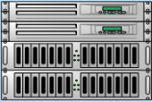
Non- Clustered VM
Guest Cluster Node
Guest Cluster Node
VM VLAN Trunk
Live Migration
Cluster/CSV
iSCSI
Virtual Switches
Hyper-V
Parent Partition
VLAN Trunk
VM LANs, LM, CSV, iSCSI, Host Mgmt
NIC Teaming/VLAN Trunk(s)
SMB Multi-Channel / Transparent Failover
10 Gb/E
10 Gb/E
10 Gb/E with RDMA
10 Gb/E with RDMA
10 Gb/E Top of Rack LAN RDMA
Highly available at every layer.
Scale-Out File Cluster

Slide 20
VM Mobility
Complete mobility. Simply the best.
Live Migration with High Availability
  Live Migrate among servers in a failover cluster
SMB Live Migration
  Live Migrate VMs among servers with SMB storage
Live Storage Migration
  Live Migrate VM storage from one volume to another without downtime
Share Nothing (SNO) Live Migration
  Live Migrate VMs among servers with nothing, but an Ethernet connection

Slide 21
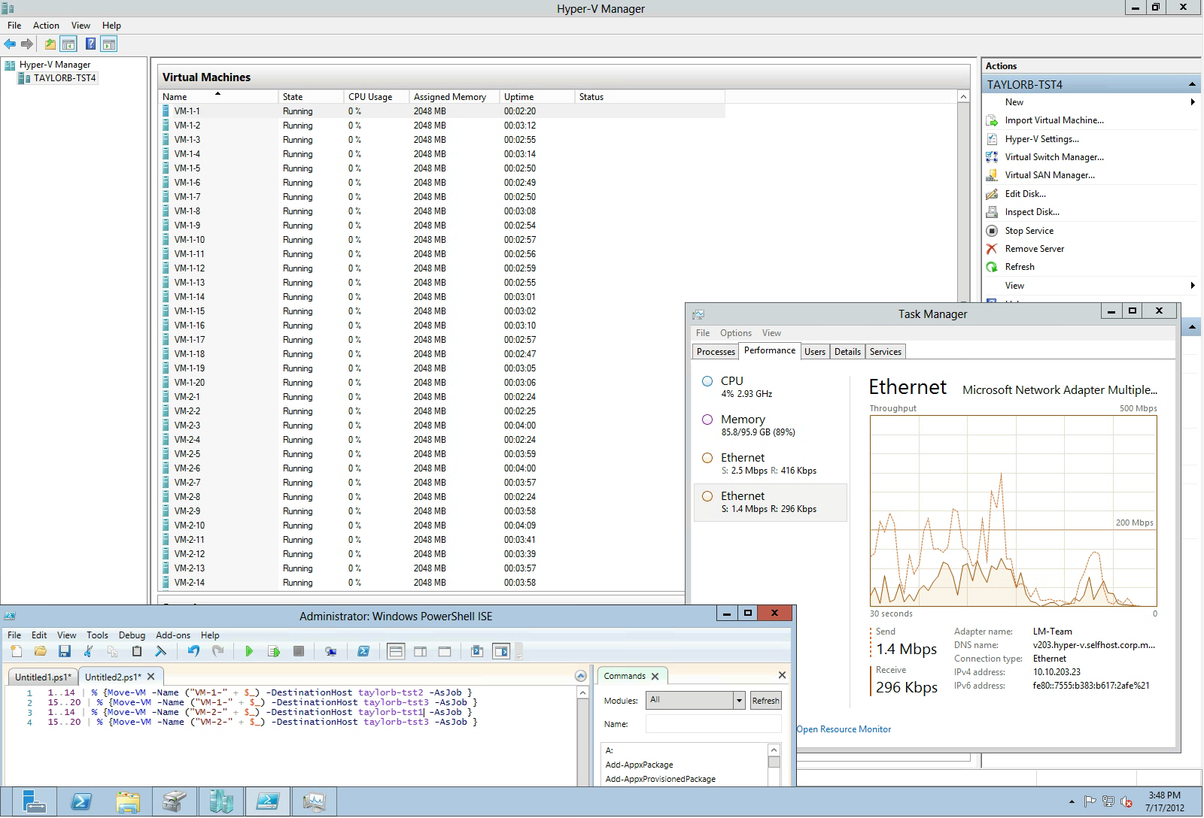
Windows Server 2012 Hyper-V Live Migrating 40 VMs Simultaneously…

Slide 22
Taking those learnings to Windows Server 2012 R2

Slide 23
Your Feedback
Datacenter licensing is great, activation is a challenge
PXE Boot/OS Deployment
  Thanks for not implementing a memory tax
  The Emulated NIC works, but it’s another thing to manage
WS2012 Storage investments are great, more please…
Guest Clustering is difficult
  Maximize your investment
  Let’s build the best cloud together

Slide 24

Cloud Service Providers & Activation
Service Providers activate their hosts with their infrastructure
How do tenant VMs/Services activate?
Tenant 1 Network
Tenant 2 Network
Tenant VMs/Services
Cloud Service Provider Infrastructure
Compute
Storage
Networking
Hoster Network

Slide 25
Automatic VM Activation with 2012 R2
  Windows Server Datacenter provides unlimited guest OS instance for Windows Server
  With activated hosts, automatically activates guest OS
  Eases deployments for cloud service providers and EE
  Host Requirement
    Windows Server 2012 R2 Datacenter with Hyper-V
  Guest Requirements
    Windows Server 2012 R2 Standard/Datacenter/Essentials
    Channel Independent: OEM, VL, FPP, MSDN

Slide 26
Hyper-V VMs…

Slide 27
Hyper-V VMs Today…
PXE Boot
  Only from the emulated NIC
Traditional PC-AT BIOS
  Limited to 2.2 TB Boot Volume
  Boots from virtual IDE only
This VM has been highly optimized, but we want to do more.
It’s time to advance the state of the art.

Slide 28
New Hyper-V VMs: Generation 2 VMs
Ease of Management and Operations
  Gen 2 VMs PXE boot VMs using the optimized virtual NIC; (Emulated NIC removed)
  Reduced infrastructure network requirements (managing two MAC/IP addresses); Less possibility of erroneous configurations
Dynamic, Flexible Storage
  Use UEFI firmware and can boot from virtual SCSI (virtual IDE removed)
  Support GPT partitioned disks >2.2 TB OS boot disks
  OS boot disk can be dynamically resized with Windows Server 2012 R2 Online disk resizing
  Hot Add/Remove DVD
Security
  Now supports Secure Boot

Slide 29
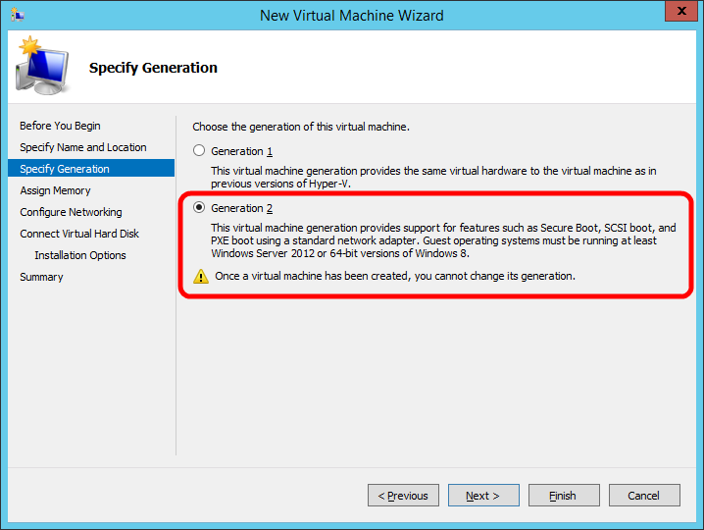
Creating a Generation 2 VM
Create a New VM
Choose type
  Generation 1
  Generation 2
  Note: Once a VM has been created you cannot change its generation.

Slide 30
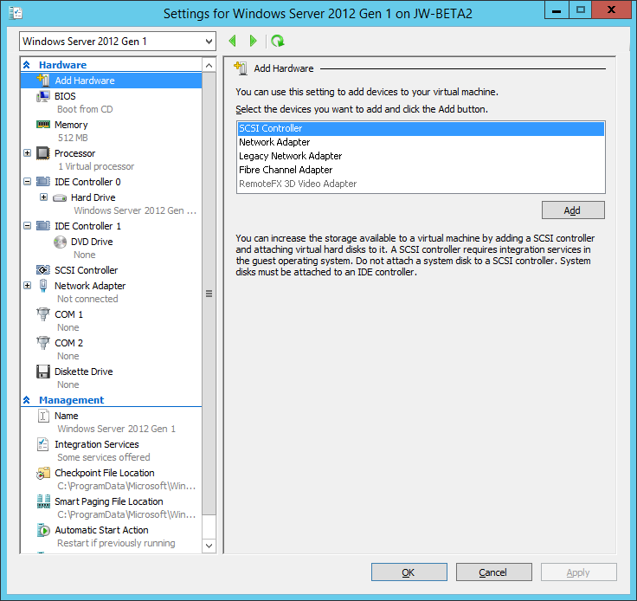
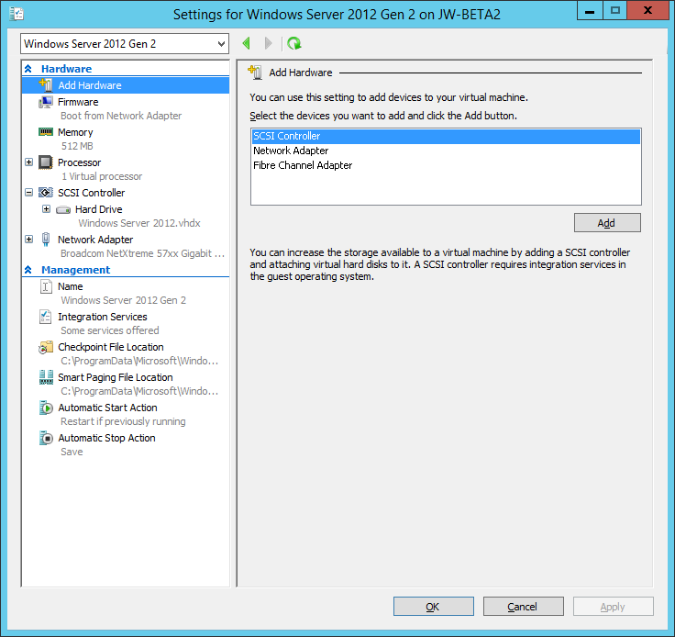
VM Settings: Gen 1 & Gen 2
Generation 1
Generation 2

Slide 31
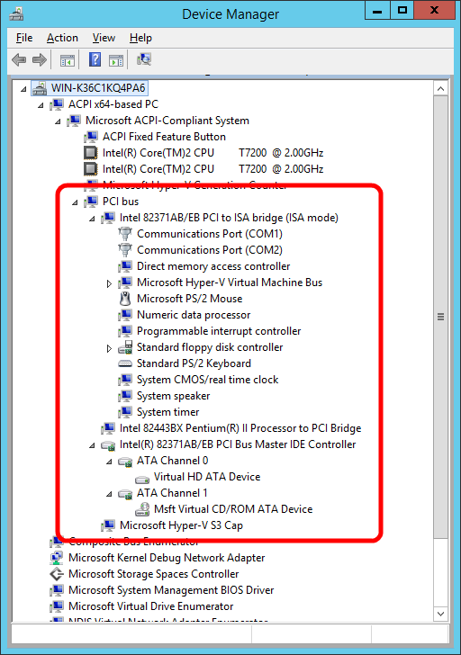
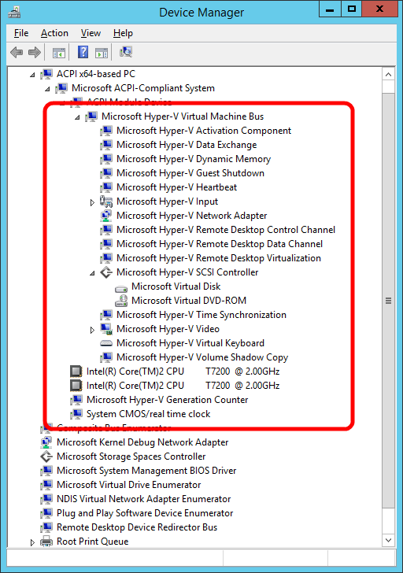
New VMs: Generation 2 VMs
PCI Bus
PCI to
ISA Bridge
COM Ports
Floppy
Controller
Processor to
PCI Bridge
IDE
Controller
Generation 1
Generation 2

Slide 32
Generation 2 Virtual Machine Hardware
Legacy Devices Removed | Replacement Devices | Enhancements
IDE Controller | Virtual SCSI Controller | Boot from VHDx (64TB max size, online resize)
IDE CD-ROM | Virtual SCSI CD-ROM | Hot add/remove
Legacy BIOS | UEFI firmware | Secure Boot
Legacy NIC | Synthetic NIC | Network boot with IPv4 & IPv6
Floppy & DMA Controller | No floppy support
UART (COM Ports) | Optional UART for debugging | Faster and more reliable
i8042 keyboard controller | Software based input | No emulation – reduced resources
PS/2 keyboard | Software based keyboard | No emulation – reduced resources
PS/2 mouse | Software based mouse | No emulation – reduced resources
S3 video | Software based video | No emulation – reduced resources
PCI Bus | VMBus
Programmable Interrupt Controller (PIC) | No longer required
Programmable Interrupt Timer (PIT) | No longer required
Super I/O device | No longer required

Slide 33
New VMs: Generation 2 VMs
Not for Everyone
  x64 VMs only
  Guest support:
    Windows 8/2012 and later
    Support for Linux underway
Your investment in Hyper-V is safe
    All your existing Hyper-V VMs will run without modification on WS2012 R2
    Gen 1 and Gen 2 VMs run great together

Slide 34
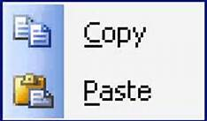

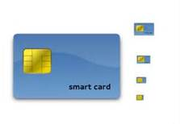
Enhanced VM Interaction
Remote Desktop over VMBus
Full remote desktop capabilities
  Shared clipboard
  Audio redirection
  Enhanced login
  and more….
Enabled even when the network is down
  Integrates with Remote Desktop Gateway
Integrated into Hyper-V Management experience
(Yes, all of this just works with Live Migration…)

Slide 35
Your Feedback on Storage
We would like to dynamically resize virtual storage
We need to manage storage to an SLA
  Keep making more storage investments
  Help us protect against the “noisy neighbor”
Guest Clustering is difficult to manage
De-dupe is great for VM libraries but we need more…
  We want to maintain separation between the cloud infrastructure and tenants
  A top reason for VDI deployment failures. Lack of IOPs and immense storage requirements.

Slide 36
Hyper-V Storage
  Online Virtual Disk Resize
    Dynamically Grow or Shrink SCSI VHDX Virtual Disks on the fly…

Slide 37
Noisy neighbors
Scenario:
  Cloud Service Provider has storage that provides 1000 IOP/s
  10 customers, with 10 VMs. Everything is running fine
  Customer 1 running VM 1 Fires up a SQL Server consuming 950 IOPs. Customer 1 is thrilled.
  Customers 2-10 are not. Their performance has fallen off a cliff. They are calling support demanding to know what’s wrong and calling sales to demand an immediate refund.
950+ IOPs
Tenant VMs/Services
Cloud Service Provider Infrastructure
Compute
Storage
Networking

Slide 38
Noisy neighbors
Outcome:
  Cloud Service Provider needs to resolve situation quickly
  Turns off Customer 1 VM
950+ IOPs
Tenant VMs/Services
Cloud Service Provider Infrastructure
Compute
Storage
Networking

Slide 39
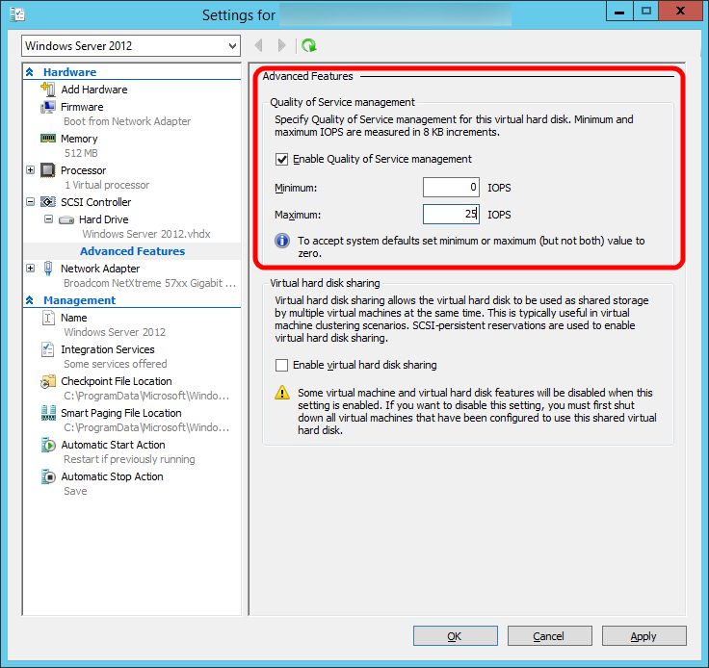
Storage QoS
Bandwidth Management allows you to set hard caps on a per virtual disk basis
Great solution for “noisy neighbors”
Dynamically configurable
Work with:
  Virtual IDE, virtual SCSI
  Gen 1 or Gen 2

Slide 40

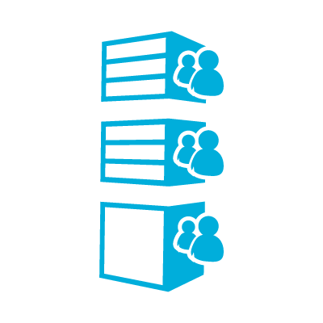

Hyper-V Online Resizing and Storage QoS
VHDX Resize
Grow or shrink a virtual disk with no downtime
Hyper-V
Storage QoS
Maximum Bandwidth – Strict Policies
Policy to throttle IO to a given VHD/VHDX to a maximum IO threshold
Minimum Bandwidth – Threshold Warnings
Policy to alert when specified minimum IOPS are not met for a VHD/VHDX
QoS
VM Metrics
Storage attributes added to VM Metrics
Average normalized IOPS
Average latency
VHDX

Slide 41
Challenges of Guest Clustering
Infrastructure Administrators
  Focused on uptime, agility, performance and lowering cost
  VMs and Services are provisioned, but physical resources are opaque to users
Customers demand high availability for their applications
Guest Clustering requires opening a hole to present a LUN from physical infrastructure
Tenant VMs/Services
Cloud Service Provider Infrastructure
Compute
Storage
Networking

Slide 42
Solving the Challenge of Guest Clustering
Introducing Shared VHDX Virtual Disks
  Virtual disks that can be shared without presenting real LUNs to tenants
Enabling Guest Clustering
  Eases operations and management
  Provides a business opportunity
Tenant VMs/Services
Cloud Service Provider Infrastructure
Compute
Storage
Networking

Slide 43
Guest clustering with shared virtual disks
Guest Clustering
Guest Clustering with commodity storage
Sharing VHDX files provides shared storage for Hyper-V Failover Clustering
Maintains separation between infrastructure and tenants
  Cluster Shared Volumes (CSV)
  on block storage
  Scale-Out File Server
  for file based storage
Block Storage
File Based Storage
Virtual SAS
VM presented a shared virtual SAS disk
Appears as shared SAS disk to VM
VHDX
VHDX
Learn more: MDC-B311 - Application Availability Strategies for the Private Cloud

Slide 44
Deduplication with Running VMs!
Hyper-V VDI
Optimize open VHD/VHDX files on remote VDI storage
CSV volume support
Provides:
  Increased VDI storage density
  Faster read/write of optimized files
  Improved optimization speed
  Advanced caching of duplicated data
  More space savings
SMB
Scale-out File Server
Dedup
VHD
Cluster Shared Volumes

Slide 45
Hyper-V 2012 R2: 1.6+ Million 8k IOPs from a Single VM
Industry Leading IO Performance
  VM storage performance on par with native
  Performance scales linearly with increase in virtual processors
  Windows Server 2012/2012 R2 Hyper-V can virtualize over 99% of the world’s SQL Server.
Windows Server 2008 R2 | Windows Server 2012 | Windows Server 2012 R2
250,000 4k IOPs | 1,000,000+ 4k IOPs | 1,600,000+ 8k IOPs
1,600,000+

Slide 46
Solving Tough Problems…
Scenario: You get an error in production. What do you do?
You’re left with two options:
    Option 1: Take the service down and investigate
    Option 2: Leave the service running and hope it was transient
R2: Live Export of a VM (Live Cloning)
  New Option 3: Take a live clone and go have a look; debug offline
You can:
  Export a complete copy – including memory state
  Export any snapshot of a virtual machine

Slide 47
Your Input on HA/Mobility/Replica
Windows Server 2012 NIC Teaming is great, keep improving network HA.
Make it easier to upgrade the cloud infrastructure
  Uptime is paramount.
  We want to take advantage of new infrastructure features as soon as possible
Hyper-V Live Migration is awesome. Push it further.
Hyper-V Replica is awesome. Can we configure the replication frequency?
  No tradeoffs.
  We have good network connectivity and are willing to use more for replication…

Slide 48
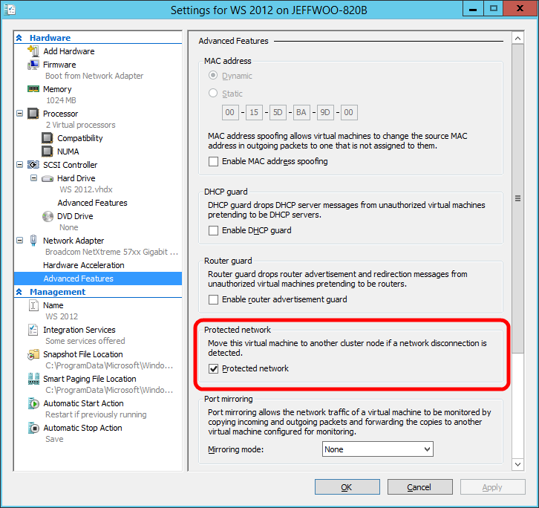
Protecting VMs from Network Outages
  Taking HA to the network
  Detects network failure
    Cable unplugged
    Network Adapter failure
    Works with Windows Server NIC Teaming

Slide 49
Virtual RSS (vRSS)
Get near line rate to a VM on existing hardware
Virtualize traditionally physical workloads that required high network performance
Maximize ROI by being able to optimally utilize bandwidth available
49

Slide 50
Faster Live Migration
Compression
  Over 2x improvement in live migration time
  No hardware changes are required
  Enabled by default
SMB Direct
  Utilizes existing and new high-end networks
  Enables super high-speed live migrations
  Supports SMB Multichannel to leverage multiple interfaces

Slide 51
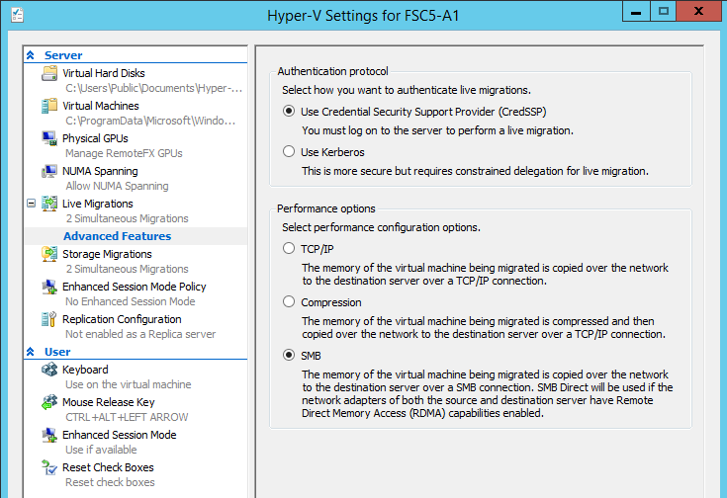
Hyper-V Live Migration over SMB
SMB as a transport for Live Migration of VMs
Delivers the power of SMB to provide:
  RDMA (SMB Direct)
  Steaming over multiple NICs (SMB Multichannel)
Provides highest bandwidth and lowest latency
Live Migration can take advantage of high speed networking
Live migration can stream over multiple networks for improved bandwidth
RDMA enables offloading CPU resources to NIC during live migration

Slide 52
Faster Live Migration
Simple guidance:
If your live migration network is….
10 Gbit or less – use compression
Over 10 Gbit – use SMB / SMB Direct

Slide 53
Zero-downtime infrastructure upgrade
Live migrate virtual machines from
Windows Server 2012 to Windows Server 2012 R2
Includes shared nothing live migration
Learn more: MDC-B331 – Upgrading Your Private Cloud

Slide 54
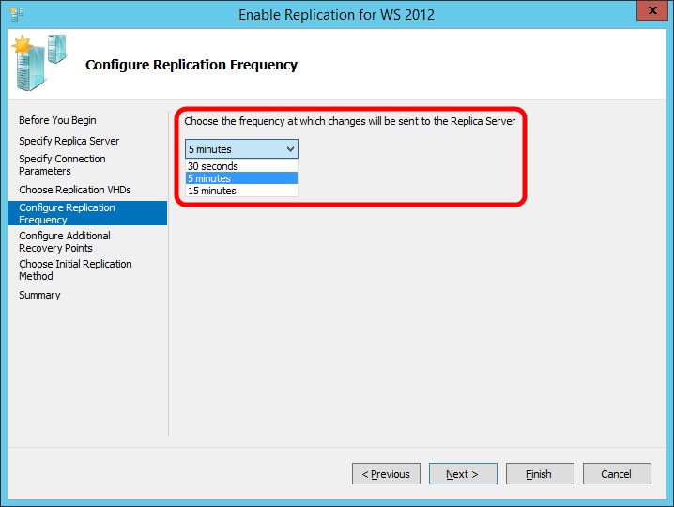
Near Synchronous Replication
Top Replica Request
  Default is still 5 minutes
New Options:
  30 seconds
  15 minutes

Slide 55
Windows Server 2012 Replica…
Integrated VM Replication
  Customers Love It
Service Provider Opportunity
  One challenge though…
Fail
Replication
Customer
Service Provider

Slide 56
Windows Server 2012 R2 Replica…
Even Better for Cloud Service Providers
Tertiary Replication in the Box
Fail
Replication
Replication
Customer
Service Provider Site 1
Service Provider Site 2

Slide 57
Microsoft Hyper-V Server 2012

Slide 58
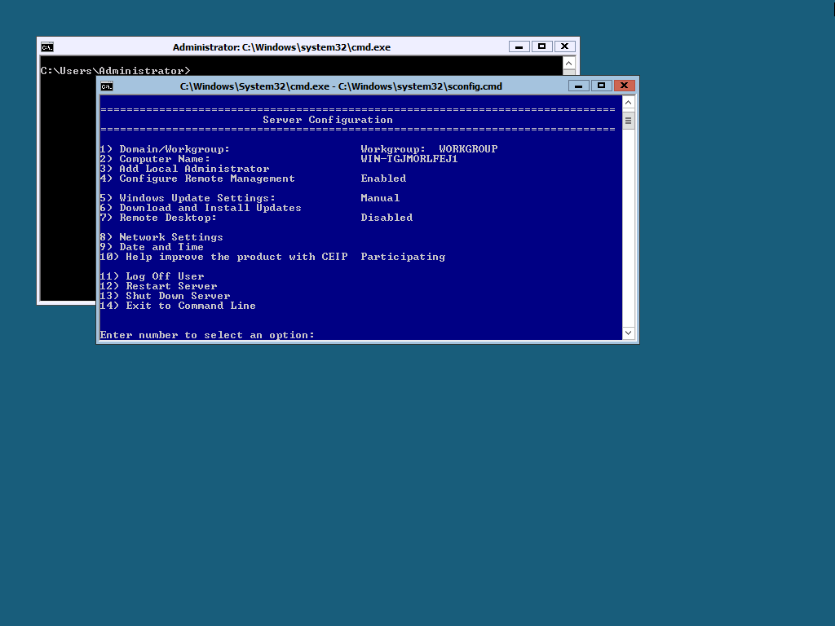
What is Microsoft Hyper-V Server?
Enterprise-class, Microsoft hypervisor
  Local Command Line Interface
  Does not include guest OS licenses
Standalone Hyper-V
Free ISO download from Microsoft.com website
Designed for remote management
Contains all Hyper-V features

Slide 59
Great Reasons to use MS Hyper-V Server
Linux VM Consolidation
VDI platform
Hoster virtualization platform

Slide 60
MS Hyper-V Server 2012 Q&A (1/2)
Is this an evaluation version? Is their Activation?
  No and No. Enterprise class hypervisor for everyone.
Is this supported in production?
  Yes, since day one.
Does Hyper-V Server have reduced/limited scale?
  No.
Is System Center required for Live Migration or Live Storage Migrate VMs?
  No. You can manage using free RSAT tools, or System Center or via PowerShell

Slide 61
MS Hyper-V Server 2012 Q&A (2/2)
Is clustering included with Hyper-V Server 2012?
  Yes. It has been since Hyper-V Server 2008 R2.
Does Hyper-V Server include Live Migration?
  Yes. Yes. Yes.
Shared Nothing Live Migration?
  Yes. Yes. Yes.
Does Hyper-V Server include the Extensible Switch?
  Yes. Yes. Yes.
Does Hyper-V Server include Hyper-V Replica?
  Yes. Yes. Yes.

Slide 62
Microsoft Hyper-V Server 2012
 | VMware ESXi | Microsoft Hyper-V Server 2012
Cost: | Free Download | Free Download
Physical Processor Support: | Can’t find, but irrelevant, limited by host memory restriction. | Up to 64 processors
Physical Memory Support: | Up to 32 GB per server | Up to 4 TB per server
Virtual Processors | Up to 4 per VM | Up to 64 per VM
Virtual Machine Memory Support: | Limited by host max support of 32 GB | 1 TB of memory per VM
Live Migration/High Availability: | No | Yes
Live Storage Migration: | No | Yes
Shared Nothing Live Migration: | No | Yes
Storage Virtualization: | No | Yes
VM Replication | No | Yes, Hyper-V Replica
SR-IOV with Live Migration | No | Yes
HVS 2012: Customer Driven: More Features, Scale, Availability, Mobility…

Slide 63
VMware ESXi 5.1 vs MS Hyper-V Server 2012
VMware ESXi 5.1 (Free Version)
Microsoft Hyper-V Server 2012
Scale
  Limited to 4 vCPUs in VM
  Limited Host RAM to 32 GB
  Limited VM Memory Support
No Enterprise level features
  No vMotion
  No Storage vMotion
  No High Availability
  No Extensible Switch
  No VM Replication
Scale
  Up to 64 VPs per VM
  Up to 4 TB of memory per Host RAM
  Up to 1 TB of memory per VM
Enterprise level features included
  Shared Nothing Live Migration
  Live Storage Migration
  High Availability via Clustering
  Hyper-V Replica (Unlimited VM Replication)
  Storage Spaces
  …much more…

Slide 64
One More Thing…

Slide 65
Announcing: Microsoft Hyper-V Server 2012 R2

Slide 66
New in MS Hyper-V Server 2012 R2
Generation 2 VMs
Networking
  VM Network Protection
  Virtual RSS
Storage
  Online Disk Resize
  Storage QoS
  Shared VHDX
  Spaces Storage Tiering
Live Export
Live Migration
  Compression
  SMB Direct
Hyper-V Replica
  Configurable Replication
  Tertiary Replication
  Manageable SCVMM & Azure Recovery Manager

Slide 67
“I’m getting ready to purchase new storage for cloud infrastructure. What should I look for?”

Slide 68
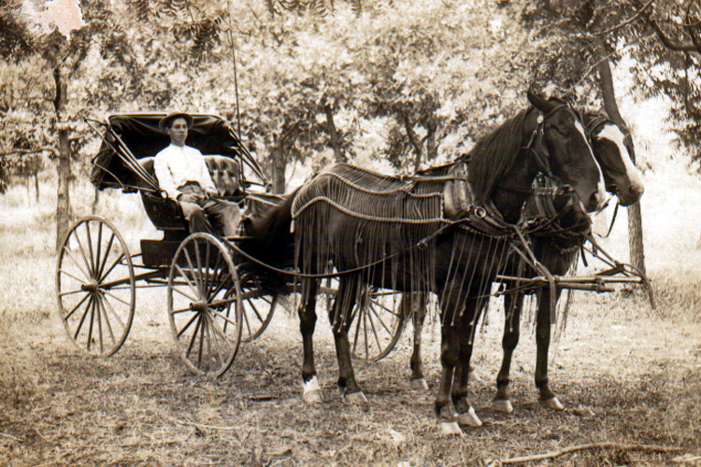
File Based Storage Features to Look For:
SMB 3.0
  Not SMB 1.x/2.x
SMB Direct/RDMA
  Superior performance File Server and Hyper-V without additional CPU utilization
  Microsoft investing heavily in this technology
Spaces Certified JBOD
  You can find these on the Windows Server Catalog

Slide 69
SAN Array Features to Look For:
Offloaded Data Transfer (ODX)
  Secure, copy offload
NPIV
  If you’re going to use virtual fibre channel this is required
  Make sure it’s certified hardware and on the Windows Server Catalog
Trim/Unmap
SMI-S Support

Slide 70
Networking Features to Look For:
VMQ
  Virtual RSS requires NICs to support VMQ
NV-GRE
  Flexibility between clouds.
SR-IOV
Open Management Infrastructure (OMI)
  Look fors support in switches and routers
Plugins for System Center
  Virtual Machine Manager and Operations Manager

Slide 71
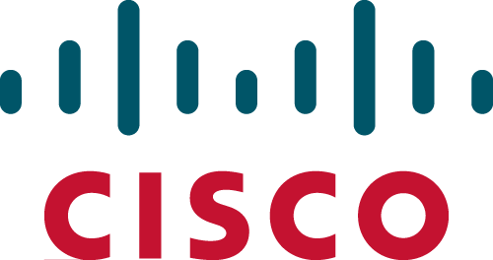






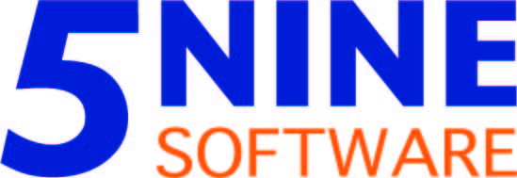

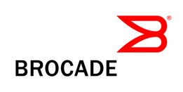


Networking partner ecosystem
Gateway appliances
OMI-based
top-of-rack switch
Hyper-V switch
extensions
Chipset
extensions

Slide 72
The Best Platform for Microsoft Apps
If you’re creating a virtualization or cloud infrastructure, the best platform for…
  Microsoft Dynamics
  Microsoft Exchange
  Microsoft Lync
  Microsoft SharePoint
  Microsoft SQL Server
  …is Microsoft Windows Server with Microsoft Hyper-V managed by Microsoft System Center.
This is the best tested, best performing, most scalable solution and is supported end to end by Microsoft.

Slide 73

Related content
MDC-B331 – Upgrading Your Private Cloud
MDC-B345 - Windows Server 2012 Hyper-V Storage Performance
MDC-B311 - Application Availability Strategies for the Private Cloud
MDC-B373 - Understanding Hyper-V Replica: Performance, Networking and Automation
Find Me Later At Hyper-V Booth in the MSE

Slide 74
Q&A
?
?
?
?
?
?

Slide 75

Resources
Learning
  Sessions on Demand
  Microsoft Certification & Training Resources
http://channel9.msdn.com/Events/TechEd
www.microsoft.com/learning
TechNet
msdn
  Resources for IT Professionals
  Resources for Developers
http://microsoft.com/technet
http://microsoft.com/msdn

Slide 76



Evaluate this session
Required Slide
*delete this box when your slide is finalized
Your MS Tag will be inserted here during the final scrub.
Scan this QR code to
evaluate this session.

Slide 77
Thank You!

Slide 78

© 2013 Microsoft Corporation. All rights reserved. Microsoft, Windows and other product names are or may be registered trademarks and/or trademarks in the U.S. and/or other countries.
The information herein is for informational purposes only and represents the current view of Microsoft Corporation as of the date of this presentation. Because Microsoft must respond to changing market conditions, it should not be interpreted to be a commitment on the part of Microsoft, and Microsoft cannot guarantee the accuracy of any information provided after the date of this presentation. MICROSOFT MAKES NO WARRANTIES, EXPRESS, IMPLIED OR STATUTORY, AS TO THE INFORMATION IN THIS PRESENTATION.

