Slide 2
Windows Server 2012 Deployment and Ongoing Management: Why Server Core Is Right for You
MDC-B339
Yigal Edery
Principal Program Manager
Windows Server
Benjamin Herila
Program Manager
Windows Server

Slide 3
< = >
less is more

Slide 4
Agenda
Deploying Server Core
The why and how of moving to Server Core.
Features on Demand
What is this new feature, why is it important, and how do I leverage it best?
Managing Servers with Server Manager
How do I get the most of Server Manager, by customizing it to work better in my environment?

Slide 5
Server Core
“Simplicity is the ultimate sophistication.”
Leonardo da Vinci

Slide 6
What is Server Core?
Windows Server, without the GUI
The default deployment option of Windows Server 2012
… Everything a server needs, but not more

Slide 7
Why Server Core?
Reduced Footprint (5GB vs. 12GB)
Reduced Patching (75% less) & Reboots (50% assuming critical patches only)
Reduced Attack Surface
Helps increase VM density
Servers don’t need local GUI !

Slide 8
Transitioning Between Deployment Options
Server with a GUI
Classic “Full Server”
Full Modern-Style GUI shell
Install Desktop Experience to run Modern apps
Server Core (default option)
Reduced Attack Surface / Patching
Increased VM density
Remote Management - RSAT / PowerShell
More supported Roles / Features
New
~4GB
Server Core

Slide 9
Introducing – Minimal Server Interface
Server with a GUI
Classic “Full Server”
Full Modern-Style GUI shell
Install Desktop Experience to run Modern apps
~300MB
- IE
- Explorer
Minimal Server Interface
Server Core (default option)
Reduced Attack Surface / Patching
Increased VM density
Remote Management - RSAT / PowerShell
More supported Roles / Features
NEW Minimal Server Interface
Reduced Attack Surface / Patching
Server Core + Management
MMC, Server Manager, and some Control Panel
Server with a GUI – (Explorer, IE and associated files)
~4GB
- Server Manager
- MMC
- CPLs*
~3.7GB
Server Core

Slide 10
Limitations of the Minimal Server Interface
Not all Common Dialog boxes are fully functional
UI dependent on Shell Namespace Extensions will not work
Certain CPLs are namespace extensions, e.g. Networking
No Internet Explorer
Links in UI won’t work
Help isn’t available – calls to HTML Help API will return NULL!
Some file associations and protocol handlers are not available
http:// file:// *.chm

Slide 11
Demos: Transitioning from Server Core to Server Graphical Shell

Slide 12
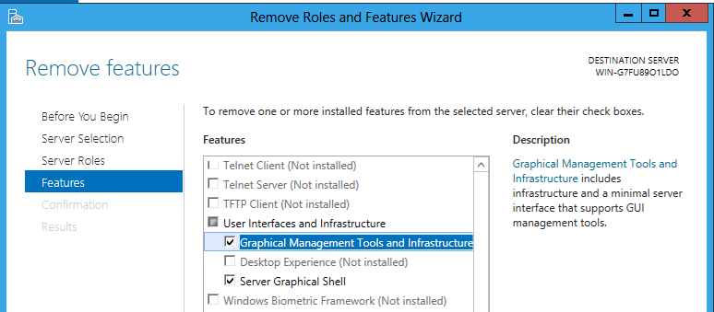
Transitioning between Server and Server Core
Server Manager

Slide 13
User Interface Feature Names
PowerShell Cmdlets
Full Server to Server Core
PS> Get-WindowsFeature
Server Manager | PowerShell
User Interfaces and Infrastructure | User-Interfaces-Infra
- Graphical Management Tools and Infrastructure | Server-Gui-Mgmt-Infra
- Server Graphical Shell | Server-Gui-Shell
- Desktop Experience | Desktop-Experience

Slide 14
Transitioning between Server and Server Core
PowerShell Cmdlets
Full Server to Server Core
Server Core to Full Server
PS> Uninstall-WindowsFeature Server-Gui-Mgmt-Infra,Server-Gui-Shell -Restart
Single reboot required
PS> Install-WindowsFeature Server-Gui-Mgmt-Infra,Server-Gui-Shell -Restart
Install multiple features

Slide 15
Transitioning to/from Minimal Server Interface
PowerShell Cmdlets
Server with a GUI to Minimal Server Interface
Minimal Server Interface to Server with a GUI
Server Core to Minimal Server Interface
PS> Uninstall-WindowsFeature Server-Gui-Shell -Restart
PS> Install-WindowsFeature Server-Gui-Shell -Restart
PS> Install-WindowsFeature Server-Gui-Mgmt-Infra -Restart

Slide 16
Demos: Minimal Server Interface and transitioning to Server Core

Slide 17
Summary of Local Shell Capabilities
 | Server Core | Minimal Server Interface | Server with a GUI | Desktop Experience
Command Prompt | a | a | a | a
PowerShell/.NET | a | a | a | a
Server Manager | x | a | a | a
MMC | x | a | a | a
Control Panel | x | x | a | a
CPL Applets | x | Some | a | a
Explorer Shell | x | x | a | a
Taskbar | x | x | a | a
System Tray | x | x | a | a
Internet Explorer | x | x | a | a
Help | x | x | a | a
Themes | x | x | x | a
Start screen (Modern) | x | x | a | a
Modern-style apps | x | x | x | a
Media Player | x | x | x | a

Slide 18
Server Core Improvements Journey
 | WS 2008 | WS 2008 R2 | WS 2012 / 2012 R2
Flexibility -
Transition between Server Core and Full Server | x | x | a (Defaults to Core)
Manageability-
PowerShell cmdlets | x | 230 | ~2400
Remote install/ config of roles | x | x | a
Remote GUI | x | x | a (Server Manager)
Windows Server Roles
# of supported roles | 9 | 10 | All except Fax

Slide 19
What runs on Server Core?
Windows Server Roles
Everything except the fax role
Microsoft applications
SQL Server
Dynamics NAV Server
Most of System Center server components (with UI remoted)
Biz Talk Host Integration Services
Forefront Endpoint Protection
Working with the eco-system to enable more 3rd party apps

Slide 20
Server Core for Developers
Test your applications for your specific DLL dependencies!
If you do need UI, test on the Minimal Server Interface!
Check for dependencies or delay loads might fail!
DUMPBIN (Windows SDK)
Dependency Walker (http://www.dependencywalker.com, freeware)
Detecting GUI State using the Registry
HKLM\SOFTWARE\Microsoft\Windows NT\CurrentVersion\Server\ServerLevels
Detecting GUI State using WMI
Win32_ServerFeature class for installed roles/features http://msdn.microsoft.com/en-us/windows/cc280268
Server-Gui-Shell has an ID of 99
Server-Gui-Mgmt-Infra has an ID of 478
 | Server Core | Minimal Server Interface | Server Graphical Shell
ServerCore = 1 | Set | Set | Set
ServerGuiMgmt = 1 | Not Set | Set | Set
ServerGuiShell = 1 | Not Set | Not Set | Set

Slide 21
Features on Demand
“Perfection is achieved, not when there is nothing more to add, but when there is nothing left to take away.”
Antoine de Saint-Exupery

Slide 22
Feature Installation in Windows Server
Features are put in the Windows Side by Side Store
All Roles and Features are copied to \windows\winsxs during Setup
Allows to easily add/remove/service any server features
Consumes disk space for binaries that may never be installed
How can we minimize disk space and still allow to easily install/remove?

Slide 23
New : Features on Demand
Administrator can remove unneeded roles and features
Files for removed roles and features are deleted from the Side by Side store
Minimizes disk footprint (VHD size)
WS 2012 R2: Optional Components Compression
http://technet.microsoft.com/en-us/library/jj127275

Slide 24
Installation Sources for FoD
Possible locations
Windows Update (requires Internet access)
Windows Install Media (WIM)
Running Server’s \windows\winsxs folder
Copy (or captured WIM) of \windows\winsxs on network share
Location can be specified via Group Policy:
Computer Configuration > Administrative Templates > System > “Specify settings for optional component installation and component repair”

Slide 25
How to use it?...
Removing Roles and Features
Server Manager - No remove option (use PowerShell)
PowerShell
Detecting removed Features
PowerShell - show as ‘Removed’ (Get-WindowsFeature)
DISM - show as ‘Disabled with Payload Removed’
Removing all uninstalled Features
PS> Uninstall-WindowsFeature <FeatureName> -Remove
PS> $toRemove = Get-WindowsFeature | Where InstallState -EQ Available PS> Uninstall-WindowsFeature $toRemove -Remove

Slide 26
Demo: Reducing disk footprint using Features on Demand

Slide 27
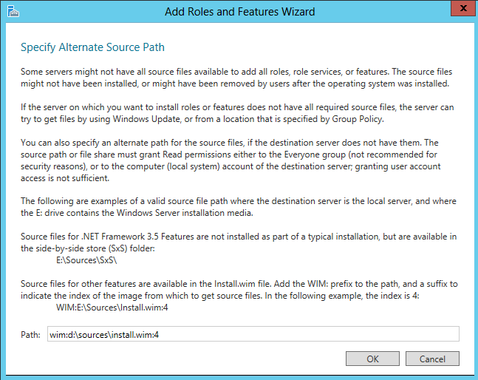
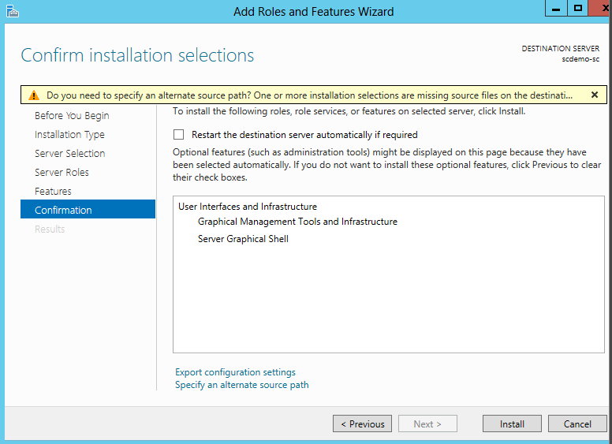
Reinstalling Roles and Features
Server Manager
PowerShell
PS> Install-WindowsFeature <FeatureName> -Source <Source>

Slide 28
Using the WIM as the Source
Install role or feature specifying a source of WIM:<path>:4
PS> Install-WindowsFeature <features> –Source wim:<drive>:\sources\install.wim:4
:4 for datacenter edition
:2 for standard edition

Slide 29
Demo: Reinstalling removed features using Features on Demand

Slide 30
Servicing FoD Sources using a running server
Run Windows Update on Installation Source Server
Note: WU will only patch enabled features
Install all features that will be needed to be used as a source.
Share the SxS folder
Server Manager requires machine account read permissions on WinSxS share. Recommend making a copy to avoid changing permissions on system folders.
Can also capture this server as a WIM and just share the image.
New-WindowsImage -CaptureDir C:\ -ImageFile Z:\share\install.wim -Name MyImage

Slide 31
Servicing a WIM offline using updates from the MU catalog
Download desired updates from the catalog (http://catalog.update.microsoft.com)
Create a folder to mount the WIM in (e.g. c:\mount)
Mount the WIM file:
Install the update package(s)
Commit the WIM
PS> Mount-WindowsImage –ImagePath <drive>:\sources\install.wim –Index <#>
-Path c:\mountdir
PS> Add-WindowsPackage –PackagePath c:\downloads\kb999999.msu –Path c:\mount
PS> Save-WindowsImage –Path c:\mountdir

Slide 32
FoD and .NET 3.5
Not included in the Windows Server 2012 image
Application Compatibility shim will prompt to install if running an application that requires .NET 3.5
Installation sources
Windows Update
Install media \sources\sxs
Whitepaper on .NET 3.5 in Windows Server 2012
http://technet.microsoft.com/en-us/library/hh831809#BKMK_FoD
http://msdn.microsoft.com/library/windows/hardware/hh975396
Covers Client and Server

Slide 33
Server Manager
“It's not the notes you play, it’s the notes you don't play”
Miles Davis

Slide 34
Managing using Server Manager
GUI is good! (Just not on the server…)
Manage Multiple Remote Servers
Glance-able, Relevant, Actionable Views
Manage by Technology, Can Span Servers
Designed for the IT Admin – Manage My Servers

Slide 35
Evolving Deployment Choice
Improvements in WS2012 (and later)
Consolidate Role and Feature deployment
Simplify initial server configuration
New deployment options
Uses and supports Features-On-Demand
Deploy to offline VHD
Deployment configuration templates
Batch deploy via automation
Distributed deployments (RDS)

Slide 36
Server Manager: Core Functionalities
Dashboard
Roles
All Servers
GROUPS
DATA
Events Services Performance BPA
Server Pool
Inventory
Detail Views
VIEWS
REMOTE SERVERS
REMOTE SERVERS

Slide 37
Server Manager: Customization concepts
Dashboard
Group Taxonomy
Roles
User Custom
All Servers
Server Set
Data Query
GROUPS
Data Sets + Query
DATA
Events Services Performance BPA
Server Pool
Inventory
Detail Views
Dashboard Filter
VIEWS
REMOTE SERVERS

Slide 38
Demo – Server Manager “Orientation” and Custom Groups

Slide 39
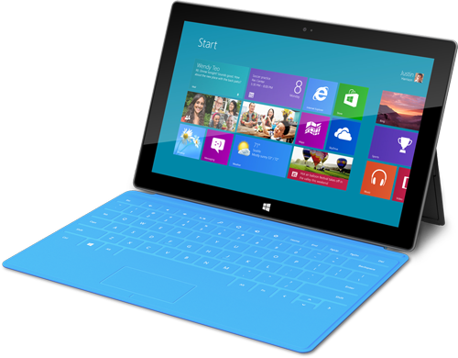
What are the implications of all this data?
Confidence in data
How does this impact my servers?
What is the load on my network?
Behind the scenes…
Data time-stamping
Configurable poll interval
Provider side caching
Data query optimization
Δt
Cache

Slide 40
Query optimization: Events
Query – SvrDemo1
Period | Levels | Log
T-24hr | Critical Error Warning | Application Setup System
 | All Servers
Event Data Query | Levels: Critical Error Warning
 | Period: 24 hours
 | Logs: Application Setup System
SvrDemo1 | ✓
SvrDemo2 | ✓
SvrDemo3 | ✓
SvrDemo4 | ✓
Next query will include timestamp of last event

Slide 41
Query optimization: Events
Query – SvrDemo1
Period | Levels | Log
T-24hr | Critical Error Warning | Application Setup System
T-12hr | Critical Error Warning Informational | Role-X Logs
 | All Servers | Role-X
Event Data Query | Levels: Critical Error Warning | Levels: Critical Error Warning Informational
 | Period: 24 hours | Period: 12 hours
 | Logs: Application Setup System | Logs: <Defined by Role>
SvrDemo1 | ✓ | ✓
SvrDemo2 | ✓
SvrDemo3 | ✓ | ✓
SvrDemo4 | ✓
Next query will include timestamp of last event

Slide 42
Query optimization: Events
Query – SvrDemo1
Period | Levels | Log
T-3d | Critical Error | Application AppLogA AppLogB
T-24hr | Critical Error Warning | Application Setup System
 | Warning | Application
T-12hr | Critical Error Warning Informational | Role-X Logs
 | All Servers | Role-X | Custom1
Event Data Query | Levels: Critical Error Warning | Levels: Critical Error Warning Informational | Levels: Critical Errors
 | Period: 24 hours | Period: 12 hours | Period: 3 days
 | Logs: Application Setup System | Logs: <Defined by Role> | Logs: Application AppLogA AppLogB
SvrDemo1 | ✓ | ✓ | ✓
SvrDemo2 | ✓ |  | ✓
SvrDemo3 | ✓ | ✓
SvrDemo4 | ✓
Next query will include timestamp of last event

Slide 43
Personalizing your experience
Using Server Manager as your central portal.
Launching your favorite scripts and tools from Server Manager
PowerShell scripts launching
Organizing your many tools
Using Server Manager across devices
ServerList.xml – server pool, custom groups
User.config – layout preferences, custom queries/filters

Slide 44
Demo Custom Tools in Server Manager

Slide 45
Recap
“If I had more time, I would have written less.”
Mark Twain(?)

Slide 46
Resources
Server Core
TechNet Library – Configure and Manage Server Core Installations
http://technet.microsoft.com/en-us/library/jj574091.aspx
Detecting State - Win32_ServerFeature class
http://msdn.microsoft.com/en-us/windows/cc280268
Installing SQL Server on Server Core
http://msdn.microsoft.com/en-us/library/hh231669.aspx
Features on Demand
TechNet Library - Configure Features on Demand in Windows Server
http://technet.microsoft.com/en-us/library/jj127275
Blog- Using Features on Demand with Updated Systems and Patched Images
http://blogs.technet.com/b/server_core/archive/2012/11/05/using-features-on-demand-with-updated-systems-and-patched-images.aspx
TechNet Library - .NET 3.5 and Features on Demand
http://technet.microsoft.com/en-us/library/hh831809#BKMK_FoD
Server Manager
Blog – Server Manager Overview
http://blogs.technet.com/b/servermanager/archive/2012/06/27/server-manager-power-of-many-simplicity-of-one.aspx
TechNet Library – Server Manager Troubleshooting (3 part series)
http://social.technet.microsoft.com/wiki/contents/articles/13443.windows-server-2012-server-manager-troubleshooting-guide-part-i-overview.aspx
Blog – Customize Tools Menu
http://blogs.technet.com/b/servermanager/archive/2012/07/09/customize-tools-menu-in-server-manager.aspx

Slide 47
Track resources
Learn more about Windows Server 2012 R2 Preview, download the datasheet and evaluation bits on http://aka.ms/WS2012R2
Learn more about System Center 2012 R2 Preview, download the datasheet and evaluation bits on http://aka.ms/SC2012R2

Slide 48
Resources
Learning
Sessions on Demand
Microsoft Certification & Training Resources
http://channel9.msdn.com/Events/TechEd
www.microsoft.com/learning
TechNet
msdn
Resources for IT Professionals
Resources for Developers
http://microsoft.com/technet
http://microsoft.com/msdn

Slide 49
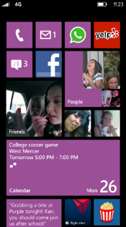
Evaluate this session
Required Slide
*delete this box when your slide is finalized
Your MS Tag will be inserted here during the final scrub.
Scan this QR code to
evaluate this session.

Slide 50
© 2013 Microsoft Corporation. All rights reserved. Microsoft, Windows and other product names are or may be registered trademarks and/or trademarks in the U.S. and/or other countries.
The information herein is for informational purposes only and represents the current view of Microsoft Corporation as of the date of this presentation. Because Microsoft must respond to changing market conditions, it should not be interpreted to be a commitment on the part of Microsoft, and Microsoft cannot guarantee the accuracy of any information provided after the date of this presentation. MICROSOFT MAKES NO WARRANTIES, EXPRESS, IMPLIED OR STATUTORY, AS TO THE INFORMATION IN THIS PRESENTATION.

