Slide 2
StorSimple Enabling Windows Azure Storage for Enterprise Workloads
MDC-B341
Burzin Patel Jai Desai
Director, StorSimple GTM Worldwide TSP
Microsoft Microsoft

Slide 3
Session Objectives And Key Takeaways
Overview of storage challenges
Solid understanding of the StorSimple solution
View end-to-end demo
Considerations when adopting HCS

Slide 4
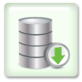
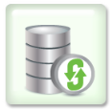
Storage Challenges Are Broad
Equipment Sprawl
Data Growth & Footprint
Data Management Complexity
Backup Issues
Untested Disaster Recovery
Primary
Storage
Archival Storage
Disk-based Backup Storage
Tape Infrastructure & Management
Replicated Storage for DR
Offsite Facility for
Geo-resilience
Storage Today = Complex & Expensive

Slide 5
Hybrid Cloud Storage (HCS) Can Help
Azure + StorSimple = 60–80% Lower TCO
Cloud-integrated SAN Storage
Automated Cloud-as-a-Tier
Thin, Reduced Snapshots
Cloud Snapshots
Recover from Cloud to any DC
Primary
Storage
Archival Storage
Disk-based Backup Storage
Tape Infrastructure & Management
Replicated Storage for DR
Offsite Facility for
Geo-resilience

Slide 6
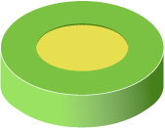
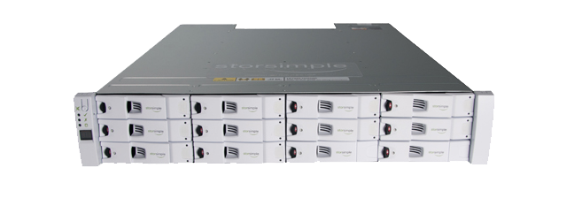
StorSimple Solution Overview Connects Windows Servers to Azure Storage in minutes with no application modification
Applications in Physical or Virtual Servers
F:
StorSimple iSCSI Cloud Volume
Benefits
Fast on-ramp to the cloud
Seamlessly integrates cloud based archive, backup, DR with primary storage
Reduce enterprise storage TCO by 60-80%

Slide 7
StorSimple Demo
Jai Desai

Slide 8
StorSimple Demo
1
2
3
Cloud-based Backup/Restores & Disaster Recovery
Five Minutes to Azure Storage
Instant multi-TB
Storage Volume

Slide 9
Challenges With Cloud Storage
Integration
HTTP/REST API
Integration with existing backup applications & processes
Performance
WAN latency performance impact
WAN bandwidth costs
Traditional WAN optimization does not work with public clouds
Security
Data security & compliance risk
Application Servers
HTTPS/REST

Slide 10
Targeted Applications & Workloads
Target Use Cases
File Share
CapEx, OpEx of traditional storage
File servers
NAS
CIFS
NFS
SharePoint
Collaboration
Content & records management
Business intelligence
Cloud Storage
Data grows exponentially (50–60% Annually)
Capacity
CapEx, OpEx of StorSimple
Archives
Media
Engineering
Logs, records
EMR/PACS
Legal
Construction
However, most I/O happens to the “Working Set” data
VMs
Local Storage
VM sprawl
VM archives
Regional office storage
Time

Slide 11
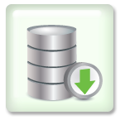
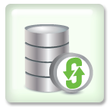
StorSimple Solution Operation
SSD
Linear Tier
A
B
C
A
B
D
E
SSD Deduplicated
E
SAS
Deduplicated
Compressed
C
D
E
Cloud
Deduplicated
Compressed
Encrypted
D
E

Slide 12
Seamless Scalability & Rapid Recovery
Cloud
Snapshots
Production Data
Production Data
Enterprise Data Center 1
Enterprise Data Center 2
Connect many servers to cloud storage and scale data sets with StorSimple solution
Rapidly recover to any data center (location independent) via mounting the cloud

Slide 13
Industry-leading Security for Data Stored in Cloud
Multiple layers of obfuscation through the system
Encrypt everything before sending to the cloud
Encryption keys stay only with the customer
Encrypted, compressed, obfuscated blocks stored in Azure
Applications Servers
Obfuscated
Deduplicated
Compressed
Blocks encrypted with customer key
SSL communication
Data in Windows Azure is Deduplicated, Compressed, Encrypted

Slide 14
Cloud Snapshots: Up to 100x Faster RTO
Application Recovery Times from offsite Backups in case of a Disaster
90 Days
Regular Cloud Backup with 100 Mbps WAN Link
30 Days
Recovery Time
7 Days
Tape
1 Day
StorSimple Cloud Snapshots with 50 Mbps WAN Link
1 Hour
15 Min.
1 TB
5 TB
20 TB
50 TB
100 TB
Primary Data Size

Slide 15
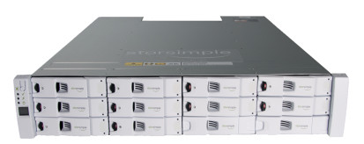
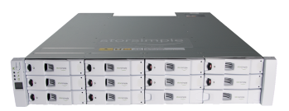
StorSimple Appliance Models
7520
20-100TB* usable local
500TB max capacity
Scalability / Performance
5520
10-50TB* usable local
300TB max capacity
7020
4-20TB* usable local
200TB max capacity
5020
2-10TB* usable local
100TB max capacity
Capacity
* Denotes usable local storage capacity with compression and de-duplication, varies by use case
* Additional details about appliance specifications can be found at: http://storsimple.xyratex.com/storsimple/specifications

Slide 16
Storage Analyst Perspectives
“The operational basics of CiS are easy to grasp—everything (primary active storage, archive, backup, and DR) is managed in one well-utilized appliance, with flexibility and a user-suitable range of capabilities.”
“StorSimple is a notable early innovator in this market.”
“Cloud-integrated enterprise storage is a new category of technology that will tackle the misalignment between cloud access characteristics and the demands of enterprise storage by delivering enterprise-class primary storage first. Then, deeply integrated cloud technology will make this storage uniquely.”
“At the forefront today is clearly StorSimple, and they are the only one yet delivering true CES for core business data.”

Slide 17
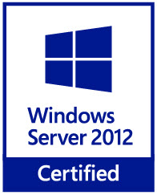
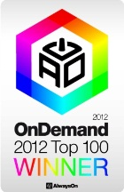
StorSimple Is Globally Certified & Recognized
Windows Server 2012/Windows Server 2008 R2/VMware-ready™ Certified: Only Cloud Storage Solution
Recognized Globally for Cloud Storage Innovation

Slide 18
Customer Case Study: Semiconductor Company
Customer
Needs
Large data storage footprint for storing engineering docs and chip designs for various products
Rapid data growth (1.8TB/month @ single location)
95% of data not used
Eliminate expensive on-premise storage
Total data size = 300TB
Total data size = 300TB
Vol1
Vol2
…
VolN
…
DR site
Vol1
Vol2
VolN
7520
appliance
7520
appliance
7520
appliance
Proposed
Solution
3x 7520 StorSimple systems with Azure
Systems in two different locations for providing file share/archive across multiple volumes (~600TB)
5-week PoC
Chandler, AZ
Austin, TX
Phoenix, AZ
Live archives
Automatic Backup
Disaster Recovery
Impact
$900K Azure commit over 3 years
Dramatic cost savings, ease-to-use, secure data storage in Azure
Adoption of additional use cases

Slide 19
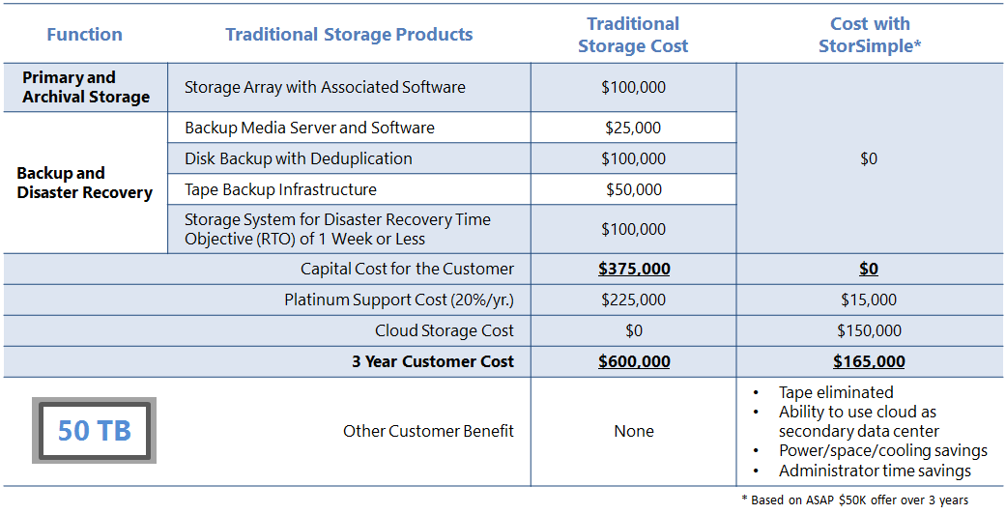
Compelling Economics: Traditional Storage vs. StorSimple

Slide 20
ASAP Offers
$50K for ~50TB¹
with 7020 appliance² (no additional cost)
$100K for ~100TB¹
with 7020 appliance² OR
7520 appliance² (no additional cost)
$50K/year on Azure EA for storage
Covers ~50TB of Azure storage through StorSimple solution for a wide range of use cases
$100K/year on Azure EA for storage
Covers ~100TB of Azure storage through StorSimple solution for a wide range of use cases
What customers are paying for
7020 appliance (worth $70K)
Gold support for the appliance for 1 year with Next Business Day (NBD) parts
Option-1: 7020 appliance (worth $70K)
Gold support for the appliance for 3 years with NBD parts
Option-2: 7520 appliance (worth $120K)
Gold support for the appliance for 1 year with NBD parts
What customers get at NO additional cost
$5,000 per year for Gold support for the appliance in years 2 & 3
Additional $2,500 per year for upgrade to platinum support for the appliance
Additional $10,000 for upgrade from 7020 to 5520
Option-1 – 7020 with 3 years of Gold support
Additional $7,500 for upgrade to platinum support for the appliance for 3 years
Additional $10,000 for upgrade from 7020 to 5520
Option-2 – 7520 with 1 year of Gold Support
$7,500 per year for Gold support for the appliance in years 2 & 3
Additional $2,500 per year for upgrade to platinum support for the appliance
Additional costs
¹ Provides geo-replicated storage for a wide range of use cases. The actual storage available may vary by discount, use case and use of other Azure services
² Appliance built and distributed by Xyratex

Slide 21
You know you need StorSimple when you…
Need to manage explosive storage growth by leveraging cloud storage for on-demand capacity and high availability
Dramatically reduce storage costs and complexity of storage management
Simplify Storage by using a single box for all your enterprise storage needs
Replace tape for offsite data protection
Manage VM Sprawl in your environment and optimize primary storage utilization

Slide 22
Related content
www.storsimple.com
www.storsimple.xyratex.com
Find us Later at Server-Cloud-Tools area on Expo floor
Contact:
Burzin Patel – burzinp@microsoft.com
Jai Desai - jaidesai@microsoft.com

Slide 23
Resources
Learning
Sessions on Demand
Microsoft Certification & Training Resources
http://channel9.msdn.com/Events/TechEd
www.microsoft.com/learning
TechNet
msdn
Resources for IT Professionals
Resources for Developers
http://microsoft.com/technet
http://microsoft.com/msdn

Slide 24
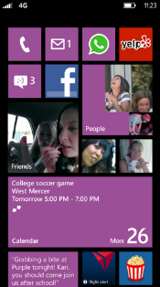
Evaluate this session
Required Slide
*delete this box when your slide is finalized
Your MS Tag will be inserted here during the final scrub.
Scan this QR code to
evaluate this session.

Slide 25
© 2013 Microsoft Corporation. All rights reserved. Microsoft, Windows and other product names are or may be registered trademarks and/or trademarks in the U.S. and/or other countries.
The information herein is for informational purposes only and represents the current view of Microsoft Corporation as of the date of this presentation. Because Microsoft must respond to changing market conditions, it should not be interpreted to be a commitment on the part of Microsoft, and Microsoft cannot guarantee the accuracy of any information provided after the date of this presentation. MICROSOFT MAKES NO WARRANTIES, EXPRESS, IMPLIED OR STATUTORY, AS TO THE INFORMATION IN THIS PRESENTATION.

