Slide 2
Intel and Microsoft Software-Defined Networking Initiatives and Platforms
MDC-B346
Glenn Ward

Slide 3
Session Objectives and Takeaways
Session Objective(s)
  Understand the key needs in cloud networks
  Understand the value of Network Virtualization in building scalable multi-tenant clouds
  Understand the Intel strategies and component technologies for Software Defined Networking
Key Takeaways
  Network Virtualization is deployable in today’s datacenter
  Network Virtualization revolutionizes multi-tenant clouds (private, hybrid, public)
  Software Defined Networking brings datacenter flexibility, control, & automation

Slide 4



Evolution of the datacenter
Dedicated
Servers
Server Virtualization
Cloud
VM
VM
VM
VM
VM
VM
VM
VM
VM
Increased scalability
10 years ago
5 years ago
Today
Windows Server* 2003
Intel® Xeon® processor
(Single-core)
Windows Server 2008
Intel Xeon processor
(Quad-core)
Windows Server 2012
Intel Xeon processor
(8 plus-core)
Increased virtualization capability
Intel® Virtualization Technology (introduced in 2005)

Slide 5










Growth & IT challenges drive need for cloud computing
Growth
IT Challenges
>3B
connected users by 2015¹
Improve Agility Reduce service delivery times, improve TCO
2X growth
in information every two years²
Greater Efficiencies Reduce complexity & deploy new workloads
15B
connected devices by 2015³
>11X
increase in mobile data traffic by 2015⁴
Gain Better Insights
Via intelligent analytics
Up to 2X or $27B⁵
in additional power costs by 2015
Avoid Lock-In
Seek interoperable solutions & services
1 Cisco Global Cloud Index Nov 2011
2 IDC Extracting Value from Chaos June 2011
3 Intel ECG – One Smart Network device forecast
4 Cisco Visual Networking Index: Global Mobile Data Traffic Forecast Update, 2011–2016, Feb 2012
5 Datacenter Dynamics Global Datacenter Energy Demand 2012 forecast http://www.datacenterdynamics.com/research/energy-demand-2011-12; projected to 2015 by Intel; Assume $0.10/kWh

Slide 6


Cloud adoption growing & delivers benefits
IT Survey Results
    Hybrid Cloud
    Private
    Cloud
    Public
    Cloud
Today: 14%
2014: 42%
    Private
    Cloud
    Public
    Cloud
Today: 7%
2014: 23%
35% by 2015²
>40% of IT operations¹
>40% of IT operations¹
Intel IT example³
Traditional IT – 2009
Private cloud - 2011
Resource provisioning
90 days
45 minutes
Virtualized Platforms
12%
65%
Asset Utilization
10-20%
>60%
Capacity
Silos
Shared globally
Cost Savings
$9M in savings in 2 years
1 ODCA global member survey, Oct 2011, N=63
2 Gartner, Dec 2010, N=55 The Road Map From Virtualization to Cloud Computing (G00210845)
3 Source: Intel IT- http://premierit.intel.com/docs

Slide 7



Barriers to cloud adoption
Cultural/
Organizational
Risk Aversion
Technology Maturity
Compliance
Quality of Service
Lock In
Security
Scale & Automation
Standards
Structure
New roles
Skills development
Scaling the Infrastructure
Cloud Security: Lack of control, manual auditing, identity theft
Resource Orchestration: Complex/management silos
Servers
Storage
Networking
Unpredictable demand
Space/power constrained
Massive data growth
Inflexible, hard to scale
Lack flexibility
Complex management

Slide 8
Evolving datacenter capabilities
2012
2013
2014
Server
Performance & efficiency optimized
Increasing application performance, reliability, scale, serviceability
Storage
Scalable converged storage servers + storage apps
SSD and NVM for low latency/high bandwidth
Enhanced distributed storage & file systems, erasure code
Add’l core data protection
NVM acceleration
Data mgmt optimizations
Network
Programmable network equipment, open interfaces
10GbE Unified Networking
Virtualization
Programmable control plane & 10/40GbE ToR switch
Management APIs
10/40/100GbE platform with CPU based network apps
Security
Automated controls, data protection, multi-tenant
Hardware-based data and multi-tenant workload integrity
Dynamic integrity assurance and recovery
Orchestration
Automated density/ efficiency
DC efficiency and density tuning via deep power and resource usage instrumentation
Increased intelligence on platform & VM resource usage /optimizations

Slide 9






Windows Server 2012 R2
Cloud optimize your IT
Beyond
virtualization
Scale and secure workloads, cost-effectively build a private cloud, and securely connect to cloud services.
The power of
many servers, the
simplicity of one
Efficiently manage infrastructure while maximizing uptime and minimizing failures and downtime.
Every app,
any cloud
Build on an open and scalable web platform that supports applications across premises.
Modern workstyle,
enabled
Support a mobile and flexible work style.

Slide 10
Transforming the network for the cloud
Deliver networking as part of pooled, automated infrastructure
Ensure multitenant isolation, scale and performance
Expand datacenter capacity seamlessly as per business needs
Reduce operational complexity

Slide 11
What is Software-defined Networking (SDN)?
Enables software to dynamically manage the network
Abstracting the physical network with virtual networks
Spanning policies across physical and virtual networks
Controlling datacenter traffic flow

Slide 12
Microsoft’s approach to SDN
End-to-end solution
Promote industry innovation in software & hardware
Open, extensible and standards-based
Flexibility
Control
Automation

Slide 13
Delivering on SDN with Windows Server & System Center
Flexibility
Control
Automation
Virtual network abstraction with multitenant isolation
BYOIP for tenant onboarding & workload mobility
Secure cross-premises connectivity
Integrated control plane to co-relate workload placement and virtual network policy
Dynamic traffic control policies with Network QoS
Traffic monitoring and flow control with switch extensions
Dynamic, policy-driven network (re)configuration
Consistent, profile-based deployment of SDN traffic policies through distributed virtual switch
Provision load balancers, site-to-site VPNs and gateways

Slide 14

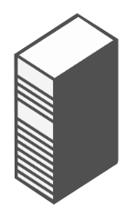












Application storage support – SMB 3.0
ENTERPRISE-CLASS FEATURES ON LESS EXPENSIVEHARDWARE
Hyper-V cluster
Microsoft SQL Server
  Highly available, shared
  data store for SQL
  Server databases and
  Hyper-V workloads.
  Increased flexibility,
  easier provisioning
  and management.
  Ability to take advantage
  of existing network infrastructure.
  No application downtime
  for planned maintenance
  or unplanned failures with failover clustering.
  Near line rate performance for both small and large IOs.
  Can work with existing storage investments.
  Built-in encryption support.
SMB
Single logical server \\foo\share
File server cluster
Single file system namespace
Cluster shared volumes
RAID
array
RAID
array
RAID
array
Windows
virtualized
storage
SAN
Storage space
Storage space
Storage space
Tiered physical
storage
SSD
Storage pool
Storage pool
HDD

Slide 15
Using the speed of 10Gb Ethernet for storage
Hyper-V Cluster
Server Message Block (SMB) 3.0
Store Hyper-V files in shares over the Server Message Block (SMB) 3.0 protocol
Works with both standalone & clustered servers
Automatic configuration to detect and use multiple paths
Highlights
Increases flexibility
Eases provisioning, management & migration
Leverages converged network
Reduces CapEx and OpEx
Hyper-V
Hyper-V
Hyper-V
SQL
Server
SQL
Server
SQL
Server
IIS
IIS
IIS
VDI
Desktop
VDI
Desktop
VDI
Desktop
File Server
Cluster
Shared
Storage
Software and workloads used in performance tests may have been optimized for performance only on Intel microprocessors. Performance tests, such as SYSmark* and MobileMark*, are measured using specific computer systems, components, software, operations and functions. Any change to any of those factors may cause the results to vary. You should consult other information and performance tests to assist you in fully evaluating your contemplated purchases, including the performance of that product when combined with other products.

Slide 16
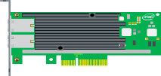
Sharing the load get 10Gb per second performance
Without Multichannel
With Multichannel
  Only one TCP/IP connection
  Only one CPU core engaged
  Receive Side Scaling (RSS) helps distribute load across CPU cores
CPU utilization per core
CPU utilization per core
Core 1
Core 2
Core 3
Core 4
Core 1
Core 2
Core 3
Core 4
Can’t use full 10Gbps
Full 10Gbps available

Slide 17
Combining LBFO teaming with multichannel for SMB 3.0
NIC Teaming with LBFO
Without Multichannel
NIC Teaming with LBFO
With Multichannel
LBFO
LBFO
LBFO
LBFO
Automatic NIC failover
But…
Can’t use full bandwidth
Only one NIC engaged
Only one CPU core engaged
Automatic NIC failover
With…
Combined NIC bandwidth available
Multiple NICs engaged
Multiple CPU cores engaged

Slide 18
Server Message Block (SMB) 3.0 multichannel performance
Source: Microsoft Sept 2012 white paper provides full details
See http://go.microsoft.com/fwlink/p/?LinkId=227841
Software and workloads used in performance tests may have been optimized for performance only on Intel microprocessors. Performance tests, such as SYSmark* and MobileMark*, are measured using specific computer systems, components, software, operations and functions. Any change to any of those factors may cause the results to vary. You should consult other information and performance tests to assist you in fully evaluating your contemplated purchases, including the performance of that product when combined with other products.

Slide 19



Comparing networking connections physical vs. virtualized servers
Physical Servers
Virtualized Servers
Microsoft* Windows Server 2012 with Hyper-V
VM
VM
Servers/Storage
Server Adapters
PG -A
PG -B
PG - Storage
PG - vMotion
PG - Mgmt
Management OS
Access Switch
Virtual Switch
VMBus
VMBus
Switch Uplinks
Aggression Switch

Slide 20
Windows Server 2012 Virtual Switch Features
Tenant Isolation
Traffic Shaping
Security
Performance
Diagnostics
Network Controllers
Port ACL
Bandwidth
Minimum
DHCP
Guard
Dynamic
VMQ
Port
Mirroring
Stateless Offloads
PVLAN
Router
Guard
Event
Tracing
(ETW)
Virtual Machine Queues
Bandwidth
Cap
Trunk
mode
IPsec Task
Offload
Unified
Tracing
(UT)
SR-IOV Hypervisor Bypass

Slide 21

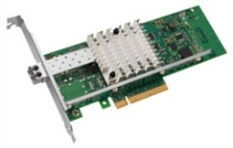
Microsoft* Windows* Server 2012 with Hyper-V* provides multiple options for 10GbE networking
Parent Partition
Child Partitions
Windows Server
VM 1
VM 2
Windows Kernel
Windows Kernel
Windows Kernel
Virtual Service Provider (VSP)
VSC
VSC
Miniport
VF Driver
Miniport Driver
Hyper-V
VMBus
Virtual Machine Bus (VMBus)
Intel® VT-d
PCI Express
Intel® Ethernet with VT-c Support
Default
Queue
Rx
Tx
Rx
Tx
VMQ1
Queue
VMQ2
Queue
Rx
Tx
Rx
Tx
Virtual Function
Rx
Tx
Rx
Tx
Virtual Function
Rx
Tx
Rx
Tx
Rx
Tx
Rx
Tx
Rx
Tx
Rx
Tx
Rx
Tx
Rx
Tx
Rx
Tx
Virtual Ethernet Bridge and Classifier (L2 Switch)
Dynamic Virtual Machine Queues (DVMQ)
Example: VM1 is traffic is assigned to VMQ1
SR-IOV¹ for VM Direct Assignment
Example: VM2 is directly assigned to a virtual function
¹PCI-SIG Single Root I/O Virtualization and Sharing (SR-IOV)

Slide 22
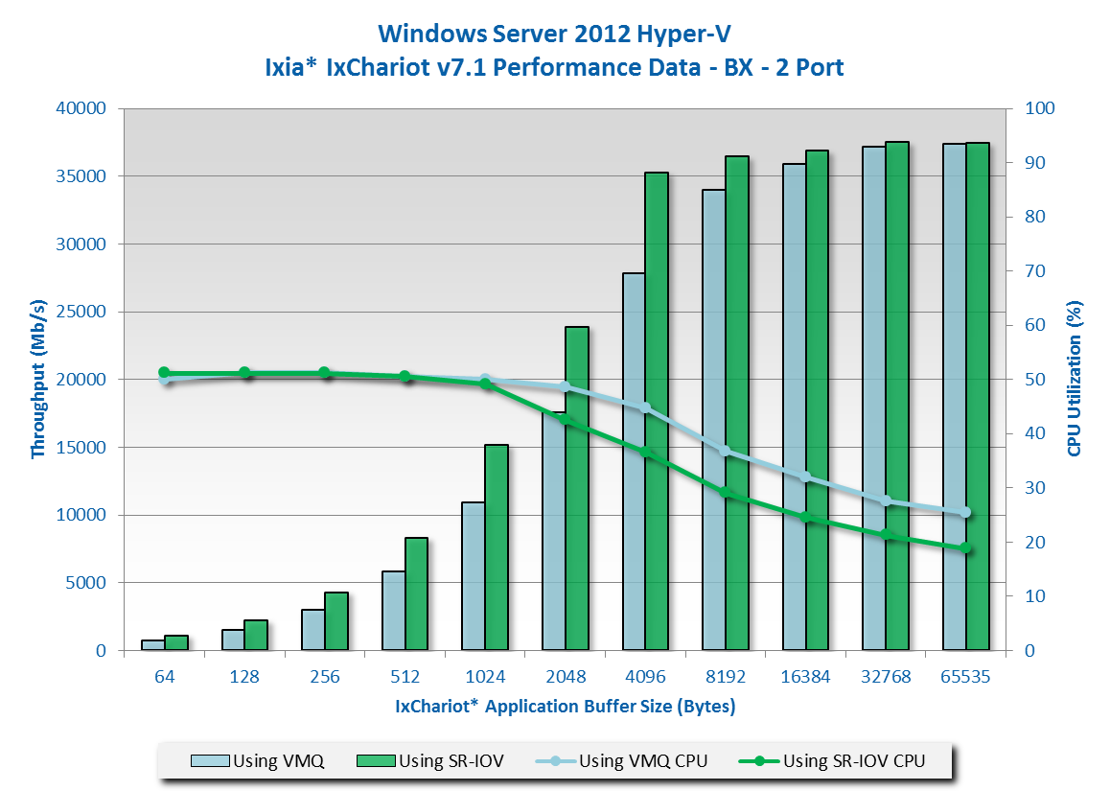


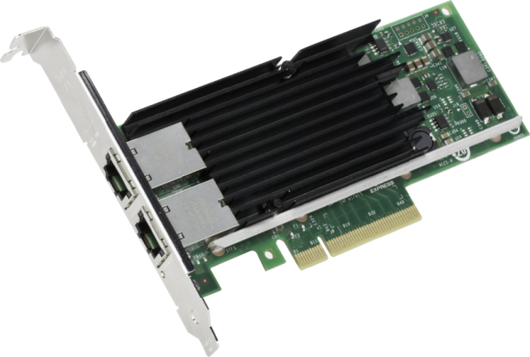
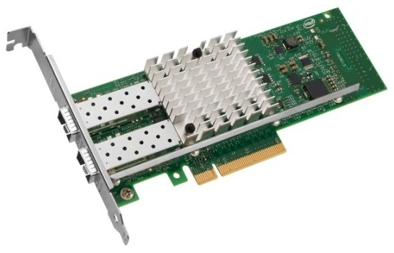
Higher throughput & lower CPU utilization
Intel® Ethernet Converged Network Adapter X520 using SR-IOV in Microsoft* Windows* Server 2012 with Hyper-V
Using SR-IOV can
improve Performance
Up to
47%
Up to
26%
Increase
in Throughput (Mb/s)
(64 Bytes)
Reduction
in CPU Utilization
(65535 Bytes)
LAD SW Performance Lab
July 2012
SUT Configuration |  | Client Configuration
Platform | Intel® Server Board S2600GZ | Client Platform | Supermicro* 6016TT-TF (10GbE clients)
OS | Windows Server 2012 Hyper-V | OS | Windows Server 2008 R2 x64
Processor | Intel® Xeon® processor E5-2690 (8C/16T, 20M Cache, 2.90 GHz, 8.00 GT/s Intel® QPI) | Processor | Intel® Xeon® Processor X5680 (12M Cache, 3.33 GHz, 6.40 GT/s Intel® QPI)
QPI Speed | 8.0 GT/s | Memory | 12GB DDR3 @1333 MHz
Memory | 128 GB @ 1333 MHz | BIOS | 2.0b
BIOS Version | SE5C600.86B.01.02.0006 | NIC | Intel® Ethernet CNA X520-T2 (Iron Pond)
NIC | Intel 82599 10 Gigabit Ethernet Controller | NIC Driver | 2.11.114.0
NIC Driver | ixn63x64-3.1.42.0 | Switch Configuration
NIC EEPROM | 0x18bf0001 | Switch Type | Force10 Networks* ExaScale* E1200i
System Slot # | PCI Slot 2 Bus 9 | Config | Each NIC port in it's own VLAN
Chipset | Intel® C602 Chipset
BIOS Changes | Power management disabled.
OS / Kernel Changes | Added Hyper-V role, for the VMQ tests, SR-IOV was not enabled in the Virtual Switch
Notes | used 8 VMs per port, for the WS2012 tests, the VMs were WS2012 build 8400
Intel® Ethernet Converged
Network Adapter X540
Intel® Ethernet Converged
Network Adapter X520
Software and workloads used in performance tests may have been optimized for performance only on Intel microprocessors. Performance tests, such as SYSmark* and MobileMark* are measured using specific computer systems, components, software, operations and functions. Any change to any of those factors may cause the results to vary. You should consult other information and performance tests to assist you in fully evaluating your contemplated purchases, including the performance of that product when combined with other products.

Slide 23
Challenges of traditional networking
Increasing operational complexity
Server and network provisioning
Controlling datacenter traffic flow

Slide 24
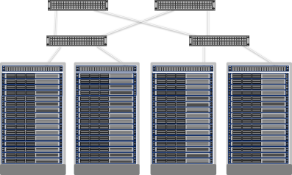
What is the next step?
VM
VM
Blue VM
Red VM
Blue network
Red network
Virtualization
Physical
server
Physical
network
Server virtualization
  Multiple virtual servers on a physical server
  Each VM has illusion it is running as a physical server
Network virtualization
  Multiple virtual networks on a physical network
  Each virtual network has illusion it is running as a physical network

Slide 25



Using VLANs to isolate VM traffic
Aggregation Switches
Top of Rack Switch (ToR)
VLAN tags
VM
VM
VM
VM
VM
VM
VM
VM
VM
Network Admin
VM
VM
VM
VM
VM
VM
Server Admin
Requires Network Admins to configure VLANs and Subnets

Slide 26
Hyper-V network virtualization benefits
To Workload Owners
Seamless migration to the cloud
Move n-tier topology to the cloud
Preserve policies, VM settings, IP addresses
To Enterprises
Private Cloud datacenter consolidation and efficiencies
Extension of datacenter into hybrid cloud
Incremental integration of acquired company network infrastructure
To Hosters
Bring Your own IP
Bring Your network topology
To Private/Public Cloud Datacenter Admins
Flexible VM placement without reconfiguration
Decoupling of server and network admin roles increases agility
Scalable multi-tenancy

Slide 27

Standards-based encapsulation - NVGRE
Better network scalability by sharing PA among VMs
Explicit Virtual Subnet ID for better multi-tenancy support
192.168.4.11➔
192.168.4.22
GRE Key 5001
MAC
10.0.0.5 ➔
10.0.0.7
192.168.4.11➔
192.168.4.22
GRE Key 6001
MAC
10.0.0.5 ➔
10.0.0.7
192.168.4.11
Provider Addresses
192.168.4.22
Virtual Switch
Virtual Switch
VM1
VM1
VM2
VM2
10.0.0.5
10.0.0.5
Customer Addresses
10.0.0.7
10.0.0.7
10.0.0.5➔
10.0.0.7
10.0.0.5➔
10.0.0.7
10.0.0.5 ➔
10.0.0.7
10.0.0.5➔
10.0.0.7

Slide 28
Using NVGRE for network virtualization
Provider Network
Encapsulated Traffic
datacenter Policy
Blue
VM₁: MAC₁, CA₁, PA₁
VM₂: MAC₂, CA₂, PA₃
VM₃: MAC₃, CA₃, PA₅
VM₄: MAC₁, CA₄, PA₇
VM₅: MAC₂, CA₅, PA₈
VM
VM
VM
VM
VM
VM
VM
VM
VM
Red
VM₁: MAC_{X}, CA₁, PA₂
VM₂: MAC_{Y}, CA₂, PA₄
VM₃: MAC_{Z}, CA₃, PA₆
VM
VM
VM
VM₄: MAC_{Z}, CA₃, PA₉
Green
VM₁: MAC_{a}, CA₁, PA₁
VM₂: MAC_{b}, CA₂, PA₂
VM₃: MAC_{c}, CA₃, PA₅

Slide 29
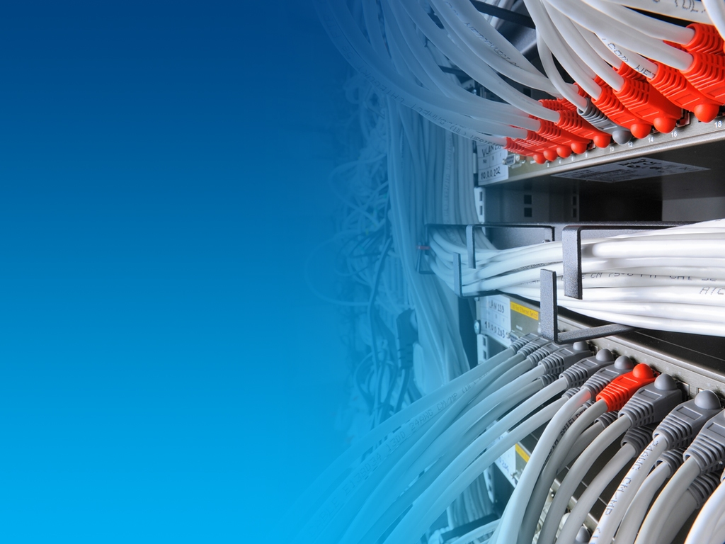
Why is SDN important in the Cloud?

Slide 30

Software Defined Networking
Three key virtues
  Decoupled
  Control and data planes are decoupled
Centralized
  Network intelligence and state are centralized
Abstracted
  Network infrastructure is abstracted from the applications

Slide 31
Property management
Rental House
Apartment
Hotel
# of Tenants | One | Several | Many
Change | Infrequent | Occasional | Daily
$$ | Long term | Utilization, low turnover | Utilization, low OPEX
Management | Individual | Building Manager | Staff, Systems, & Automation

Slide 32
Bringing it back to the datacenter
VM
VM
VM
VM
VM
VM
VM
VM
VM
Dedicated
Servers
Server Virtualization
Cloud
# of Tenants | One | Several | Many
Change | Infrequent | Occasional | Daily
$$ | Long term | Utilization, low turnover | Utilization, low OPEX
Management | Individual | Building Manager | Staff, Systems, & Automation

Slide 33
Benefits of Software Defined Networking
Programmability, automation and control
  Increased scale and flexibility
  Easily adaptable to new business needs
Significant reduction in OpEx and CapEx
  Provides centralized view of the network (at large scale)
  Automates mapping of network resources to changing workflows
  Supports uniform control of multi-vendor network environments

Slide 34
Evolution: Dis-aggregated network
App
App
App
Network Controller
App
App
App
App
App
App
Operating
System
Dis-aggregated Control Plane
Dis-aggregated Control Plane
Operating
System
App
App
App
Standard Switching Hardware
Operating
System
Standard Switching Hardware
Dis-aggregated Control Plane
App
App
App
Dis-aggregated Control Plane
Standard Switching Hardware
Operating
System
Standard Switching Hardware
App
App
App
Operating
System
Dis-aggregated Control Plane
Standard Switching Hardware

Slide 35

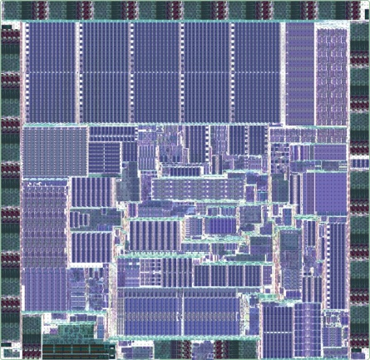
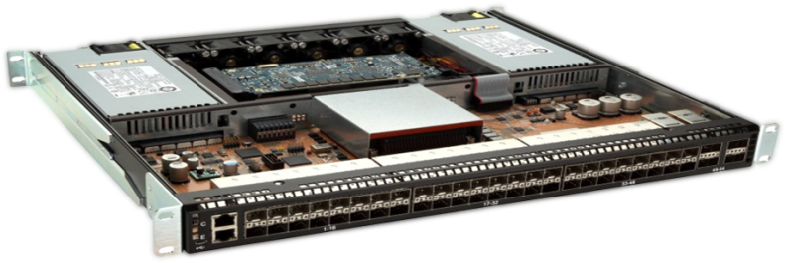


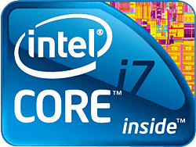

Intel® Open Network Platform Switch Reference Design
SDN Controller
SP App
OEM App
ISV App
Wind River* Open Network Software (ONS)
Software
HW
Hardware
Intel Architecture
Intel Communications
Chipset 89xx Series
Intel Ethernet FM6700 Switch
Intel Product
Wind River Product
3rd Party
*Other names and brands may be claimed as the property of others.

Slide 36
Switch silicon designed for SDN
Simultaneously supports legacy and SDN networks
Designs can be optimized for flexibility or scale
Offers flexible tagging and overlay networks
Delivers uncompromising performance
Intel® Ethernet Switch
FM6000 Series

Slide 37
Intel® FlexPipe™ Technology
Parser
Mapper
Channels
CM &
Sched
Modify
Header
TCAM &
BST
Nexthop
Table
L3
Actions
L2
Lookup
Global
Ports
Egress
Actions
Atomic Tables
Configurable Logic
Statistics
Sample Programmable Protocols
Tunneling TRILL, MPLS, NAT
Network Overlays VXLAN, NVGRE
Virtualization EVB, VEPA, VEPA+, VN-Tag
Proprietary Customer defined headers
Mux &
Transform
Mux &
Transform
CAM
Action
RAM
CAM
Action
RAM
Multiple Stages
Programmable and deterministic up to 960Mpps

Slide 38
Using gateways to bridge virtual and physical network
Intel® Open Network Platform Switch Reference Design
HW NVGRE gateway
VM
VM
VM
VM
VM
VM
VM
VM
VM
VM
VM
VM
Provider Network
VLAN tags
Encapsulated Traffic

Slide 39
Standards based switch management
CIM enabled switch
Automate deployment and management of both the tenant network and the hoster network
Standards based CIM model / schema to communicate with switch

Slide 40
Delivering Software-Defined Networking (SDN)
Windows Server 2012
  Hyper-V Network Virtualization
  Hyper-V Extensible Switch
System Center 2012 SP1
Intel® Ethernet Building Blocks
  Optimizations for Hyper-V Switch
  Network Virtualization gateways
  Intel® Open Network Platforms
Flexibility
Control
Automation

Slide 41
Summary
Network Virtualization is deployable today
Network Virtualization revolutionizes
multi-tenant clouds (private, hybrid, public)
Software Defined Networking brings datacenter flexibility, control, and automation

Slide 42

Related content
Intel and Microsoft Server and Cloud Platform Resources
Intel white paper “Game-Changing Capability for Your datacenter—and a Solid Foundation for Your Cloud”
http://www.intel.ie/content/dam/www/public/us/en/documents/white-papers/cloud-computing-xeon-e5-server-2012-paper.pdf
Intel solution brief “Microsoft Windows Server* 2012 and the Intel® Xeon® processor E5 family” http://www.intel.com/content/www/xa/en/cloud-computing/cloud-computing-xeon-e5-microsoft-server-solution-brief.html
Intel Cloud Computing Technology and Vision
http://www.intel.com/content/www/us/en/cloud-computing/intel-s-cloud-computing-vision.html
Intel Cloud Computing Solutions
http://www.intel.com/content/www/us/en/cloud-computing/intel-cloud-based-solutions.html
Intel® Xeon® Processor E5 Family
http://www.intel.com/content/www/xa/en/processors/xeon/xeon-processor-5000-sequence.html
Microsoft* Server and Cloud Platform (Windows Server, System Center, Azure)
http://www.microsoft.com/en-us/server-cloud/cloud-computing/
Microsoft Windows Server* 2012
http://www.microsoft.com/en-us/server-cloud/windows-server/
Find me at the Intel booth or on Twitter @thehevy

Slide 43
Track resources
Breakout Sessions
MDC-B350 How to Design and Configure Networking in Microsoft System Center - Virtual Machine Manager and HyperV Part 1
MDC-B351 How to Design and Configure Networking in Microsoft System Center - Virtual Machine Manager and HyperV Part 2
MDC-B380 Deep dive on Hyper-V Network Virtualization in Windows Server 2012 R2
MDC-B216 What’s new in Windows Server 2012 R2 Networking

Slide 44
Track resources
Learn more about Windows Server 2012 R2 Preview, download the datasheet and
evaluation bits on
http://aka.ms/WS2012R2
Learn more about System Center 2012 R2 Preview, download the datasheet and evaluation bits on
http://aka.ms/SC2012R2

Slide 45

Resources
Learning
  Sessions on Demand
  Microsoft Certification & Training Resources
http://channel9.msdn.com/Events/TechEd
www.microsoft.com/learning
TechNet
msdn
  Resources for IT Professionals
  Resources for Developers
http://microsoft.com/technet
http://microsoft.com/msdn

Slide 46

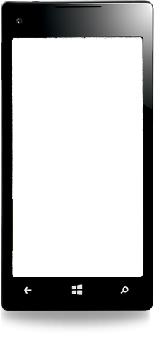

Evaluate this session
Required Slide
*delete this box when your slide is finalized
Your MS Tag will be inserted here during the final scrub.
Scan this QR code to
evaluate this session.

Slide 47
Summary of Intel Enablement and Optimization of Windows Server* 2012
Microsoft Pillar | Intel Technology | Windows Server* 2012 Technology | IT Benefit
Beyond Virtualization
Dynamic Resource Control | Virtual Machine Device Queues (VMDq) | Dynamic Virtual Machine Queue (DVMQ) | I/O virtualization with optimized balance of performance and IT control
 | PCI-SIG Single Root I/O Virtualization (SR-IOV) | SR-IOV | Alternative I/O virtualization option for lower latency and CPU utilization
Power of Many Servers, Simplicity of One
Continuous Availability | Machine Check Architecture (MCA) Recovery | Windows* Hardware Error Architecture (WHEA) Also supported in Hyper-V*, Microsoft SQL Server* 2012 | Recovery from uncorrectable errors for robust reliability. Delivered by Intel® Xeon® processor E7 family with MCA Recovery
 | Intel® Advanced Encryption Standard New Instructions (Intel® AES-NI) Intel® Secure Key Technology Intel® OS Guard Intel® XD Bit | Microsoft Crypto Next Generation* (CNG*) library | Fast, low-overhead encryption High-quality keys Enhanced protection from escalation of privilege attacks Secure key storage Reduce platform attack surface
Unified Networking | Fibre Channel over Ethernet (FCoE) datacenter Bridging (DCB) iSCSI with intelligent offloads | FCoE and iSCSI software initiators | Unified 10 GbE networking: High-bandwidth, low-latency Low cost Ethernet fabric
Breakthrough Storage Economics | Intel® Xeon® processor E5 family 10 Gb Intel® Converged Network Adapters NetEffect™ Ethernet Server Cluster Adapters (for RDMA) | Server Message Block (SMB) 3.0 SMB 3.0 Direct for remote direct memory access (RDMA) | SAN-like storage using low-cost file servers and disk arrays
Energy Efficiency | Intel® Intelligent Power Technology Intel® Node Manager 2.0 | Kernel optimizations Logical processor idling | 15 percent greater efficiency versus Windows Server 2008 R2 Improved power budgeting

Slide 48
Empower Windows Server* 2012 with
Intel® Xeon® Processors
Windows Server* 2012 designed for cloud-optimized IT
      A cloud-optimized IT environment with support for multitenancy, dynamic resource control, unified 10 Gb networking, and breakthrough storage economics
Intel® Xeon® processor E5 family
      Enhanced security through fast, low-overhead encryption with Intel® Advanced Encryption Standard New Instructions (Intel® AES-NI) and associated Intel security technologies
      Superior energy efficiency via Intel® Intelligent Power Technology and Intel® Node Manager 2.0
10 Gigabit Intel® Ethernet Converged Network Adapter family
      Better I/O performance via Intel® Virtualization Technology for Connectivity (Intel® VT-c) (Virtual Machine Device Queues [VMDq] and Single Root I/O Virtualization [SR-IOV])
Intel® Open Network Platform family
      Intel® Ethernet Switch silicon, reference architectures and software for SDN & network virtualization to enable the network architecture transformation

Slide 49


Slide 50

© 2013 Microsoft Corporation. All rights reserved. Microsoft, Windows and other product names are or may be registered trademarks and/or trademarks in the U.S. and/or other countries.
The information herein is for informational purposes only and represents the current view of Microsoft Corporation as of the date of this presentation. Because Microsoft must respond to changing market conditions, it should not be interpreted to be a commitment on the part of Microsoft, and Microsoft cannot guarantee the accuracy of any information provided after the date of this presentation. MICROSOFT MAKES NO WARRANTIES, EXPRESS, IMPLIED OR STATUTORY, AS TO THE INFORMATION IN THIS PRESENTATION.

