Slide 2
Networking Infrastructure and Management
MDC-B348
Upgrading the Platform - How to Get There!
Rick Claus
Sr. Technical Evangelist
@RicksterCDN
Joey Snow
Sr. Technical Evangelist
@JoeySnow

Slide 3
What part of your IT Infrastructure are you the most concerned with upgrading?
* note: My completely unsubstantiated informal TWPoll: http://twtpoll.com/uuk37y

Slide 4
Question for ya….
What is the most important networking service in your environment?

Slide 5
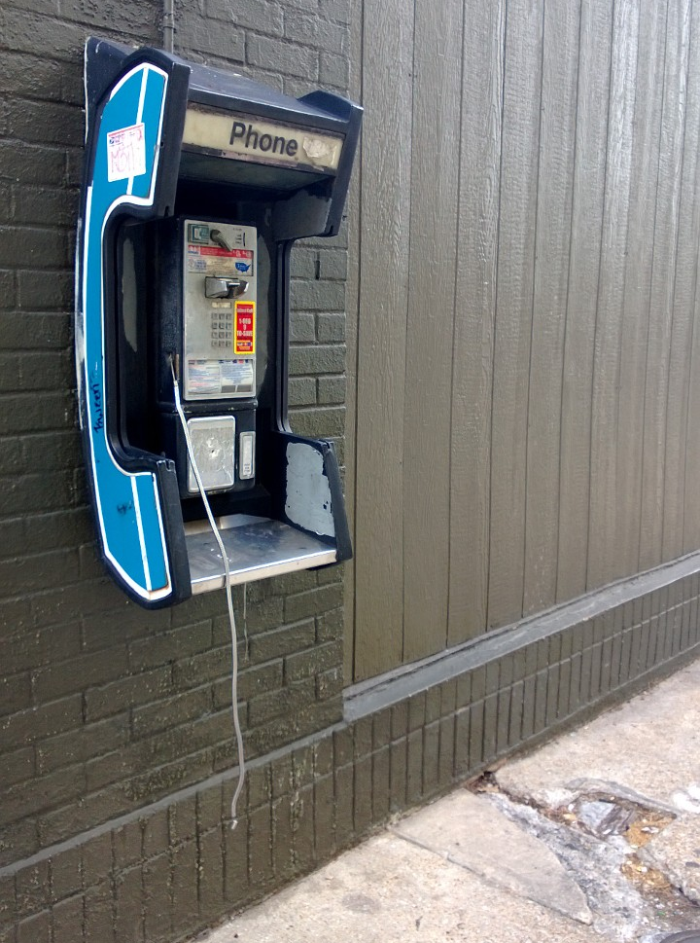
We Expect Dial Tone

Slide 6
Your needs and challenges
NEEDS
CHALLENGES
Simplified networking infrastructure
Guaranteed high levels of service level agreement (SLA)
Better manageability, greater control, and more extensibility
Continuously available and resilient network infrastructure
More flexible and agile solutions
Keep services resilient to underlying hardware failures
Manage complex network management solutions
Maximize use of resources in a multitenant environment
Support new hardware technologies
Deliver better performance, higher density, lower power consumption, and hardware offloading

Slide 7
Why Windows Server 20120 networking infrastructure
You Get: Resiliency of IP Addressing
Getting out of Paper/Spreadsheet management
First step towards better IP management
Delegation, forms, auditing, Searching/simplifying tasks
WSUS – we all have to patch, right?

Slide 8
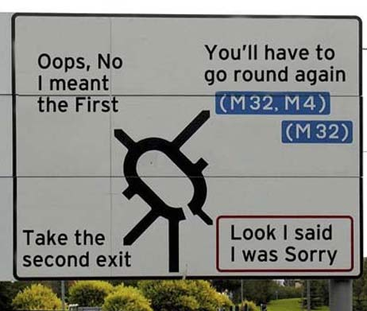
How do I get there?

Slide 10
Windows Server Migration tools
Get-SmigServerFeature | Discovers features available for migration and features in the migration store available for import
Export-SmigServerSetting | Exports specified role, feature and OS settings to a migration store
Import-SmigServerSetting | Imports specified role, feature and OS settings from a migration store
Send-SmigServerData | Transfers data and shares preserving local and domain permissions
Receive-SmigServerData | Receives transferred data

Slide 11
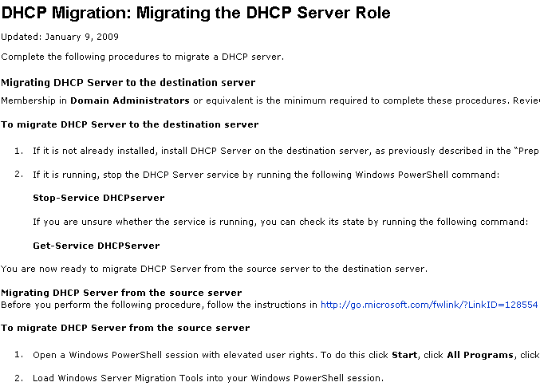
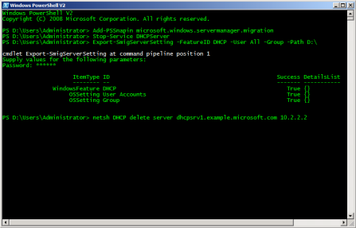
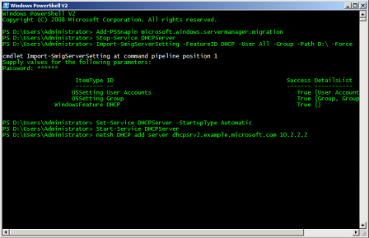
Migration Process
?
TechNet Migration Portal
Migration Guidelines
Discover
Prepare
Temp Storage
Export
Settings
Import
Settings
Source Server
Destination Server
Transfer Configuration and Shares
Export-SmigServerSetting
Send-SmigServerData
Import-SmigServerSetting
Receive-SmigServerData

Slide 12
Built In Migration Tools

Slide 13
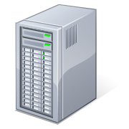
DHCP Server Migration
DHCP
DHCP
2003R2
2008
2008R2
2012

Slide 14
DHCP Migration

Slide 15
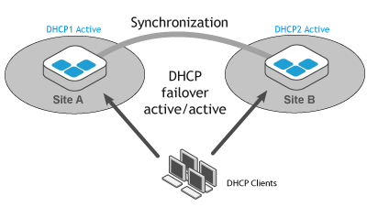
The New World of DHCP in WS2012
No Clustering Required!

Slide 16
Implementing DHCP Failover

Slide 17
How do you TRACK your IP Addresses?
Commercial appliances
Spreadsheets
.
In-house tools
.
.
.
.
No CapEx investment
Simple to use for small networks….at first
Automation
High degree of customization
Automation
Rich feature set
Integration with own and MS DHCP/DNS
.
.
.
Cons Pros
Maintenance cost
Relies on in-house support model
Expensive to add new capabilities
High acquisition and support costs
Labor intensive estimated (~$10 per address per annum)
Only performs address mgmt.
Inflexible and does not scale

Slide 18
Windows Server 2012 IPAM Overview
Address space mgmt
(ASM)
Organize, assign, monitor and manage static and dynamic IPv4/v6 addresses
.
Network discovery
Automatic discovery of DC, DHCP and DNS servers, and dynamic IP addresses in use
In-box solution that complements – and seamlessly integrated with – MS DHCP and DNS offerings
WS 2012
IPAM
.
Multi-server mgmt
(MSM)
Centralized configuration and update of MS DHCP/DNS servers
Visibility & audit
Track and audit changes and provide real-time view of status

Slide 19
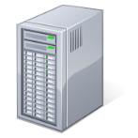
WS 2012 IPAM – Components and Interactions
IPAM Client
External System
Win 8 (RSAT) & WS 2012
DHCP Server
IPAM
Administrators
DNS Server
IPAM Server
Agentless architecture
IPAM ASM
Administrators
WID
DC Server
WS 2012 in-box
IPAM MSM
Administrators
Role-based access control
NPS Server
IPAM
Users
WS08; WS08 R2 & SPs; WS 2012
IPAM Server
IPAM Audit
Administrators
WID
WID – Windows Internal Database is a relational data store for Windows Server components
Distributed deployment, scale, and DR

Slide 20
Implementing IPAM

Slide 21
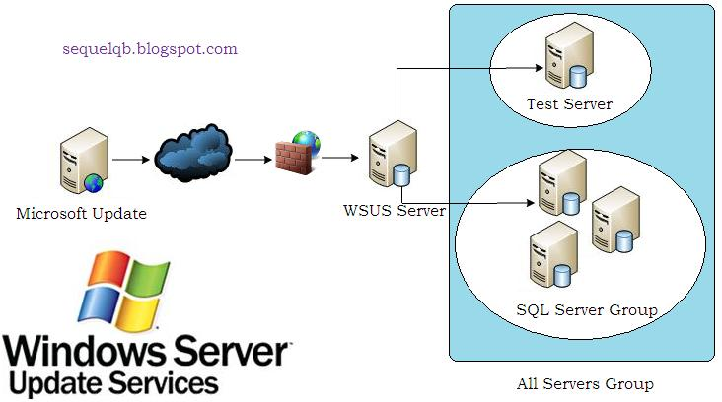
Migrating WSUS

Slide 22
Related content
(MDC-B323) Re-Architecting Your Infrastructure with Windows Server 2012 and Microsoft System Center 2012 SP1
(WCA-B336) Reimagining and Migrating Your Active Directory
(MDC-B348) Networking Infrastructure and Management
(MDC-B349) Your Fileservers and Storage Options

Slide 23
Resources
Learning
Sessions on Demand
Microsoft Certification & Training Resources
http://channel9.msdn.com/Events/TechEd
www.microsoft.com/learning
TechNet
msdn
Resources for IT Professionals
Resources for Developers
http://microsoft.com/technet
http://microsoft.com/msdn

Slide 24
Evaluate this session
Required Slide
*delete this box when your slide is finalized
Your MS Tag will be inserted here during the final scrub.
Scan this QR code to
evaluate this session.

Slide 25
© 2013 Microsoft Corporation. All rights reserved. Microsoft, Windows and other product names are or may be registered trademarks and/or trademarks in the U.S. and/or other countries.
The information herein is for informational purposes only and represents the current view of Microsoft Corporation as of the date of this presentation. Because Microsoft must respond to changing market conditions, it should not be interpreted to be a commitment on the part of Microsoft, and Microsoft cannot guarantee the accuracy of any information provided after the date of this presentation. MICROSOFT MAKES NO WARRANTIES, EXPRESS, IMPLIED OR STATUTORY, AS TO THE INFORMATION IN THIS PRESENTATION.

