Slide 2
How to Design and Configure Networking in Microsoft System Center
Part 1 of 2
MDC-B350
Greg Cusanza
Senior Program Manager, Microsoft

Slide 3
Agenda
MDC-B350: Part 1
Room: You are in it
Time: Now
What we introduced in SP1 recap
How to setup your datacenter networking from scratch
What’s new in R2
MDC-B351: Part 2
Room: Same
Time: 5:00pm
Hybrid Networking
  Configuring network fabric for Network Virtualization
  Network Virtualization Gateways
  Tenant self service

Slide 4
VMM 2012 SP1 review
Connectivity
Capability
Multi-tenancy
Isolation
Mobility
Bring your own IP
Quality of service (QOS)
Security
Optimizations
Monitors
Extensiblity
Teaming
Result: VM Networks
Result: Logical Switch

Slide 5




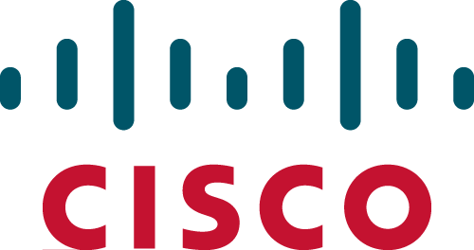










Partner Ecosystem

Slide 6
Step One…

Slide 7
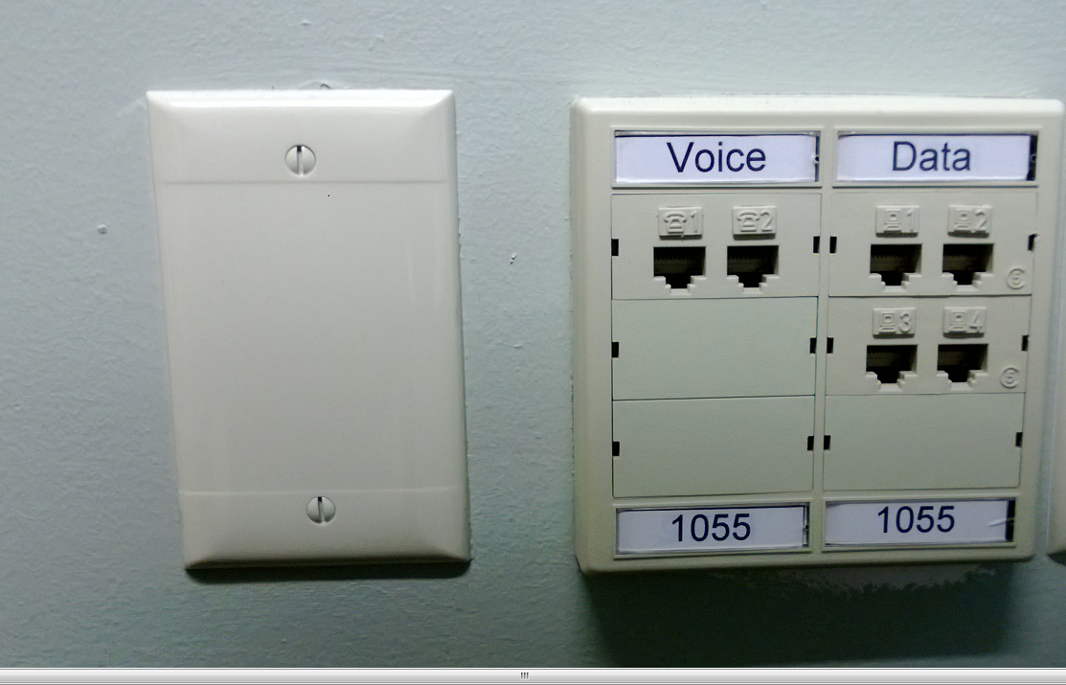
Lots of question
Where do I start, what do I do next?
How do I offer networking to my virtualization workloads?
How do I make my network resilient to failure?
How do I provide tenant self service?
How can I provide isolation?
How do I maintain consistency in large datacenters?
Takeaways
The ability to answer these questions and configure VMM networking in your data center
Preparedness for what’s in R2

Slide 8
Steps to a successful deployment
Design
Draw your network requirements.
Ask questions up front and get answers.
Hardware
Use hardware that supports your design.
Iterate back on your design.
Configure hardware.
VMM configuration
Create logical objects
Configure hosts
Add tenants
Deploy workloads

Slide 9
Network Design

Slide 10
Public Internet
1st question: how do I provide isolation?
Datacenter isolation – separation of infrastructure traffic as security boundar and for QOS
Tenant isolation – keeping tenants from each other and protect the infrastructure
Network Overview
Corporate
Management
Gateway
Windows Azure Pack
VMM
SQL
SPF, etc.
Tenant 1
Tenant 2
LM, Cluster, Storage
Hyper-V hosts
Tenant 1 VMs
Tenant 2 VMs

Slide 11
Isolation
Physical separation
Physical switches and adapters for each type of traffic
Layer 2:
VLAN
Tag is applied to packets which is used to control the forwarding
Layer 2:
Private VLAN (PVLAN)
Primary and Secondary tags are used to isolate clients while still giving access to shared services.
Network Virtualization
Isolation through encapsulation. Independence from physical address space.

Slide 12
One more type of isolation
Physical separation
Physical switches and adapters for each type of traffic
Layer 2:
VLAN
Tag is applied to packets which is used to control the forwarding
Layer 2:
Private VLAN (PVLAN)
Primary and Secondary tags are used to isolate clients while still giving access to shared services.
Network Virtualization
Isolation through encapsulation. Independence from physical address space.
External
Isolation is implemented by switch extension.
Technology is opaque to VMM.
All isolation types are abstracted away under a VM network

Slide 13
VLAN Isolation
Defines a layer 2 broadcast domain, achieved by tagging packets to tell switch where it can go.
Why use?
Very mature and reliable technology
Universally adopted
Well understood
Why not?
Limited VLAN capacity on each switch and port (4095 max)
Limited machine capacity on each VLAN
Limits migration of machines
High management overhead

Slide 14
Private VLAN (PVLAN) Isolation
VLAN pairs used to provide isolation with small numbers of VLANs.
VMM 2012 SP1 and R2 only supports creation of isolated PVLAN VMs
Primary
VLAN
Promiscuous
Secondary
VLANs
Isolated
Community
Net.Virt.

Slide 15

Network Virtualization
Production Network
Exchange server, AD
192.168.1.0/24
Development Network
192.168.1.0/24
Customer Address
Spaces
Corporate
192.168.2.0/24
Provider Address
Space
Network Virtualization
Gateway
10.0.1.0/24
10.0.2.0/24
Physical Hosts

Slide 16
No Isolation
Why
Provides direct access to the logical network
VMM picks the right VLAN based on placement
Upgrade to SP1
Pre-SP1 VMs have direct connectivity to the logical network by default.
Direct access to infrastructure
Think of the System Center in a VM scenario.
Public Shared
Shared internet network.

Slide 17
Where should you use what?
Infrastructure networks
VLAN or No isolation
Load balancer back end and internet facing
PVLAN
Tenant networks
Network virtualization or
External

Slide 18
Address spaces
Size based on broadcasts and address utilization
Can be DHCP and Static
IPv4 and IPv6
Who
Defines
What?
Logical network | Address space defined by | Example
Corp | Corp IT | 172.30.0.0/16
Internet | ICANN | 65.55.57.0/24
Management | Datacenter Admin | 10.0.0.0/24
Net. Virt. Provider | Datacenter Admin | 10.0.1.0/24
Cluster/Storage/etc… | Datacenter Admin | 10.0.2.0/24
Tenant N | Tenant | 192.168.1.0/24

Slide 19
Hardware considerations

Slide 20
Single root IO virtualization (SR-IOV)
Why?
Virtual switch bypass for high performance workloads
Why not?
You need bandwidth controls
Physical adapters don’t support it
Limited number of VMs that can use it per host
You lose the capabilities of the vSwitch
Must be enabled when virtual switch is created
Must be enabled as needed on port profile
Limited support for intelligent placement

Slide 21
Remote Direct Memory Access (RDMA) Adapters
Why?
High performance access from hosts to SMB3 based file servers
Why not?
No teaming
No virtual switch
Can also be used for live migration, management, clustering

Slide 22

Teamed Adapters
Three basic patterns for configuration
Non-converged
Converged
Converged with RDMA
VM1
VMN
VM1
VMN
VM1
VMN
Live Migration
Management
Storage
Cluster
Manage
Storage/LM/Cluster
Live Migration
Storage
Cluster
Manage
HBA/
10GbE
1GbE
1GbE
1GbE
10GbE
10GbE each
10GbE each
RDMA 10GbE each
10GbE each

Slide 23
Connecting hosts to the data center
External (Corp,
Internet, etc.)
Data center Edge
Aggregator
Switches
Access
Switches
RDMA
Virtual Switch
Hyper-V Host
Team
VM
VM

Slide 24
VMM configuration

Slide 25
Physical and logical in VMM
In VMM
Logical Network
Models the physical network
Separates like subnets and VLANs into named objects that can be scoped to a site
Container for fabric static IP address pools
VM networks are created on logical network
Logical Switch
Central container for virtual switch settings
Consistent port profiles across data center
Consistent extensions
Compliance enforcement

Slide 26
Creating logical networks for infrastructure demo

Slide 27
Fabric Configuration – New in R2
All network devices* and services are now “network services”
  New interfaces
    Network manager: Separation of Virtual Switch and Network management
    Physical switch
Microsoft IPAM as a network manager
  In-box plugin for Microsoft IPAM
  Exchange logical networks, sites and subnets
Network Service
Virtual Switch Extension
Network Manager
Net. Virt. Policy
Gateway
Physical Switch
*except load balancers

Slide 28
VMM - Microsoft IPAM integration
Tenant Admin
Inventory of CA space, subnets, Pools
Subnets, Pools for VN
Tenants create VM Networks
VN Layer
Address utilization tracking of CA (stats & trends)
Pool utilization, meta-data…
IP address, meta-data…
VMM Admin
Network Admin
IPAM
SCVMM
Configure Address Space, Subnets, Pools, VLAN
Subnets, Pools for NS / LN
Associate Host Groups to LN
LN, NS, Isolation settings…
Associate MAC Pools to LN
Fabric Layer
Pool utilization, meta-data…
Address utilization tracking (stats & trends)
IP address, meta-data…
Conflict detection, notification and updates
Changes – Pools, VLANs, Address and meta-data
Compliance status

Slide 29
Physical Switch Management– New in R2
Plugin model for:
In-box plugin for the Standards-based (CIM) Network Switch Profile
CIM profile implemented and shipping with Arista EOS 4.12 which is a common binary across all Arista switching platforms.
Host to TOR port discovery
Port compliance
Remediation

Slide 30
Arista switch managed by VMM

Slide 31
Logical Switch
Why?
Automatic team creation
Configuration for DC on a single object
Compliance
Access to hyper-v port settings
3rd party extension management
Updates get applied to all hosts
Why not?
More up-front configuration
Limits live migration

Slide 32
How the logical switch works
Hyper-V host #1
Mgmt
Virtual Switch
!
Logical Switch in VMM
Switch settings
Switch settings
Hyper-V host #2
Port Profiles
(Uplink)
Port Profiles
(Virtual)
Mgmt
Virtual Switch
!
Corp
Clust.
Mgmt
Non-compliant
→ Remediate

Slide 33
Host configuration… with teaming
Several ways to get there:
Bare metal deployment
Consistent deployment
Use host profile
Can re-deploy
Manual configuration in host properties
Already deployed hosts
Updating an existing configuration
Manual configuration in Hyper-V
For hosts brought into VMM with an existing workload
Will appear as a “Standard switch”
Logical Switch
Standard Switch

Slide 34
VM configuration
VM Networks
  All virtual adapters now only connect to VM networks
Port classifications
  Container for port profile settings
    For Hyper-V switch port settings and extension port profiles
  Reusable
  Exposed to tenants through cloud

Slide 35
Using a logical switch demo

Slide 36
How the logical switch works
Extension manager
Hyper-V host #1
Mgmt
Virtual Switch
Logical Switch in VMM
Switch settings
Switch settings
Hyper-V host #2
Port Profiles
(Uplink)
Port Profiles
(Virtual)
Mgmt
Virtual Switch
Corp
Clust.
Mgmt
Extensions
Extensions
Extensions

Slide 37
External Isolation
Network
Admin
Logical Network
“Not connected”
(VSEM)
Network Sites
(VSEM)
External VM Network 1
Network Sites
(VSEM)
External VM Network 1
Network Sites
(VSEM)
VM Network
(External)
Virtual Switch Extension
Manager
Logical Network
“Not connected”
Network Sites
(VSEM)
External VM Network 1
Network Sites
(VSEM)
External VM Network 1
Network Sites
(VLAN)
VM Network
(VLAN)
VMM
Admin
Logical Network
“Connected”
Network Sites
(VSEM)
External VM Network 1
Network Sites
(VSEM)
Hyper-V Network Virtualization
VM Network
(HNV)
Network Sites

Slide 38

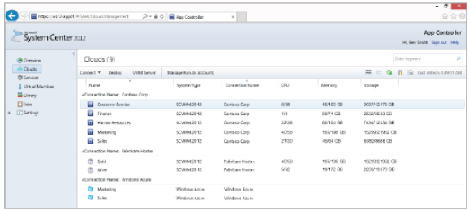
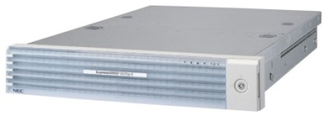






SCVMM and NEC ProgrammableFlow SDN
Microsoft
System Center
Virtual Machine Manager
⌃
OpenFlow/SDN Solution for
Windows Server and System
Center Virtual Machine Manager
ProgrammableFlow
Controller (PFC)
Simple network and VM
provisioning
Secure multi-tenant networks
Dynamic traffic control with Network QoS
Central control, including physical and virtual networks
Virtual Tenant
Network
VLAN
VM1
VM2
VM2
Windows Server 2012
Hyper-V Host 1
Windows Server 2012
Hyper-V Host 2

Slide 39
NEC ProgrammableFlow SDN demo

Slide 40
Forwarding extensions in R2
Hyper-V network virtualization and forwarding extensions can coexist
Enable network virtualization by the forwarding extension itself

Slide 41
External VM networks
Network
Admin
Logical Network
“Not connected”
(VSEM)
Network Sites
(VSEM)
External VM Network 1
Network Sites
(VSEM)
External VM Network 1
Network Sites
(VSEM)
VM Network
(External)
Virtual Switch Extension
Manager
Logical Network
“Not connected”
Network Sites
(VSEM)
External VM Network 1
Network Sites
(VSEM)
External VM Network 1
Network Sites
(VLAN)
VM Network
(VLAN)
VMM
Admin
Logical Network
“Connected”
Network Sites
(VSEM)
External VM Network 1
Network Sites
(VSEM)
Hyper-V Network Virtualization
VM Network
(HNV)
Network Sites

Slide 42
External VM networks in R2
Network
Admin
Network Sites
(VSEM)
External VM Network 1
Network Sites
(VSEM)
External VM Network 1
Network Sites
(VSEM)
VM Network
(External)
Virtual Switch Extension
Manager
Logical Network
“Not connected”
Network Sites
(VSEM)
External VM Network 1
Network Sites
(VSEM)
External VM Network 1
Network Sites
(VLAN)
VM Network
(VLAN)
External VM Network 1
HNV
VM Network (HNV)
VMM
Admin
Logical Network
“Connected”
Network Sites
(VSEM)
Network Sites
(VSEM)
Network Sites
(VSEM or VLAN)
External VM Network 1
External
VM Network (External NV)

Slide 43
Preview of Cisco Nexus 1000v with R2

Slide 44
Takeaways from this session
Plan first, deploy second
New in R2: Network managers, IPAM, Physical switch management
Better forwarding extension integraiton

Slide 45
Scenes from the next episode…
Enabling network virtualization with VMM
Gateway deployment
Windows Server tech behind the gateway
Tenant experience

Slide 46
Related content
MDC-B210 | Everything You Need to Know about the Software Defined Networking Solution from Microsoft
MDC-B311 | Application Availability Strategies for the Private Cloud
MDC—B321 | Lessons Learned from Implementing Windows Server 2012 and System Center 2012 SP1 for Hosters (Service Providers)
MDC-B327 | Monitoring and Managing the Network and Storage Infrastructure with Microsoft System Center 2012 - Operations Manager
MDC-B354 | What's New in Microsoft System Center 2012 SP1
MDC-IL301 | Transform the Datacenter Immersion, Part 1 of 4: Infrastructure Foundation
MDC-B205 | Windows Server Session to be Announced
MDC-B215 | Windows Server and System Center Session to be Announced
MDC-B216 | Windows Server Networking Session to be Announced
MDC-B331 | System Center Session to be Announced
MDC-B312 | Windows Server Session to be Announced
MDC-B375 | Microsoft Private Cloud Fast Track v3: Private Cloud Reference Architecture Based on Windows Server 2012 and Microsoft System Center 2012 SP1

Slide 47

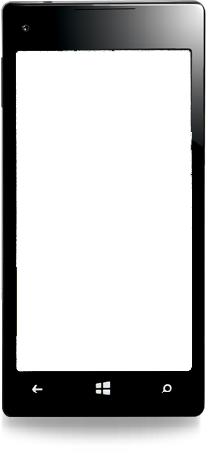

Evaluate this session
Required Slide
*delete this box when your slide is finalized
Your MS Tag will be inserted here during the final scrub.
Scan this QR code to
evaluate this session.

Slide 48

© 2013 Microsoft Corporation. All rights reserved. Microsoft, Windows and other product names are or may be registered trademarks and/or trademarks in the U.S. and/or other countries.
The information herein is for informational purposes only and represents the current view of Microsoft Corporation as of the date of this presentation. Because Microsoft must respond to changing market conditions, it should not be interpreted to be a commitment on the part of Microsoft, and Microsoft cannot guarantee the accuracy of any information provided after the date of this presentation. MICROSOFT MAKES NO WARRANTIES, EXPRESS, IMPLIED OR STATUTORY, AS TO THE INFORMATION IN THIS PRESENTATION.

