Slide 2
Hybrid Networking Offerings in Windows Azure
MDC-B360
Ganesh Srinivasan

Slide 3

Agenda
Overview of Azure Virtual Networks & Security
Windows Azure Virtual Network Point-to-Site
Windows Azure Virtual Network Site-to-Site
Hybrid E2E Scenarios

Slide 4



Windows Azure Virtual Network
Windows Azure
Extend your infrastructure
Networking on-ramp for migrating apps and services
Your “virtual” branch office / datacenter in the cloud
Run “hybrid” apps that span cloud and your premises
Secure private networks fully contained in Windows Azure
Virtual Network
Active Directory
SharePoint
SQL
Server
Internet
Your
Datacenter

Slide 5
Virtual Network
Logical isolation with control over network
Create Subnets, use your private IP addresses
Stable and persistent private IP addresses
DNS options – BYO, Azure-provided
Extend your trust boundary - IaaS and PaaS better together
Secure VMs with endpoint ACLs
Azure
<subnet X>
<subnet Y>
<subnet Z>
DNS Server
Virtual Network

Slide 6
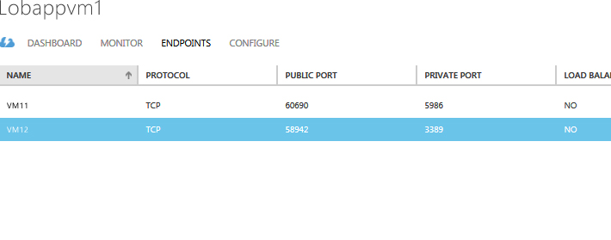
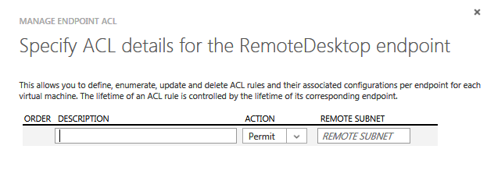
Tighten Security with Public Endpoint Access Control Lists
End Point ACL
Virtual
Machines
P
IP: 128.250.---.---
IP: 128.250.---.---
IP: 111.111.---.---
IP: 111.111.---.---
P
IP: 101. 121.11.22
IP: 101.121.11.22
IP: 131.201.3.0/24
IP: 131.201.3.0/24

Slide 7
Hybrid Networking in Azure

Slide 8
Hybrid solutions in Windows Azure
CLOUD
ENTERPRISE
Data
Synchronization
SQL Data Sync
Application-Layer
Connectivity & Messaging
Service Bus
Secure Machine-to-Machine Network Connectivity
Windows Azure Connect
Secure Point-to-Site Network Connectivity
Windows Azure Virtual Network
Secure Site-to-Site
Network Connectivity
Windows Azure Virtual Network

Slide 9
Point-to-Site Connectivity & DEV-TEST Scenarios

Slide 10
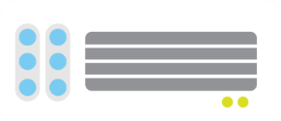

Point-to-Site VPNs
Windows Azure
<subnet 1>
<subnet 2>
<subnet 3>
Virtual Network
DNS Server
Site-to-Site
VPN
On-premises
VPN
Gateway
VPN Gateway
Route-based
VPN
Point-to-Site
VPN
Your datacenter
Individual
computers behind
corporate firewall
Remote workers

Slide 11

Virtual Networks & P2S Connectivity
Windows Azure
S2S VPN
Connect from anywhere securely
No software installation required!
Easy to setup and use
Ideal for prototyping, development, demos
P2S and S2S coexist
Active Directory
SharePoint
SQL
Server
P2S
VPNs
Existing
Datacenter

Slide 12
Develop, test, run your apps
Service consumers
(intranet and internet)
Takes minutes to setup and get going
Pay for what you use
Use existing development tools & languages
Secure sandbox environment
Access on-premise resources if necessary
Developers using
Visual Studio
Building applications

Slide 13
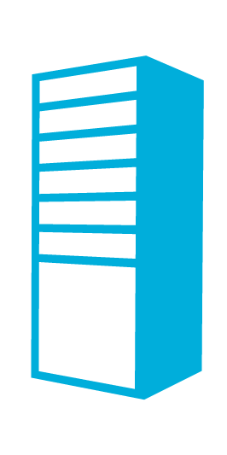

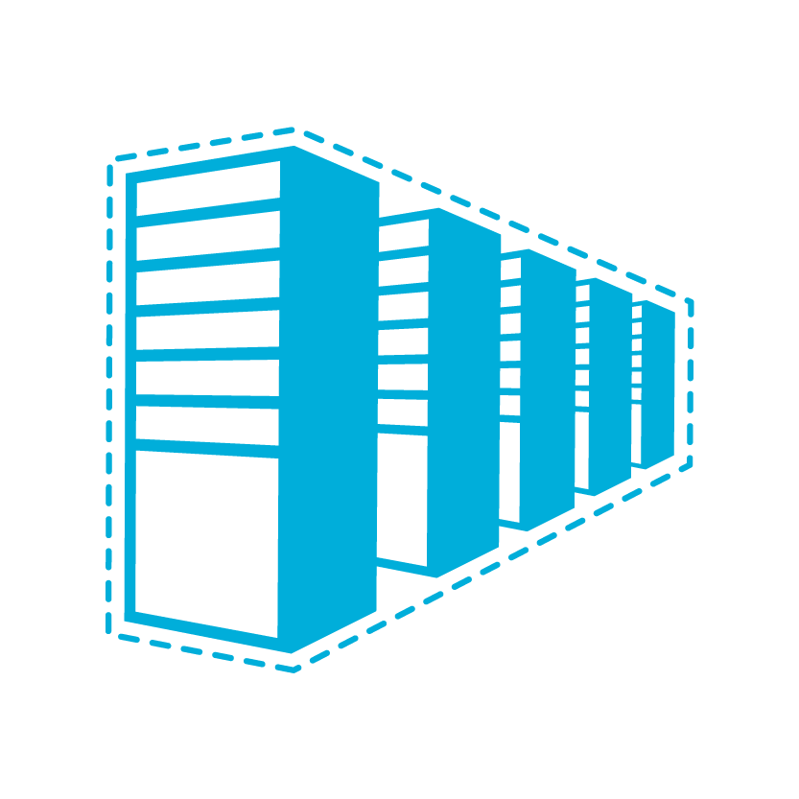
Configuration steps
Windows Azure Portal (API)
VPN device config script
VPN Profile
Configuration Tool
Network Admin
Network configuration
Deployment
package
IT Admin
ContosoVNet (10.1.0.0/16) MyAffinityGroup
ContosoCorpOffice (10.0.0.0/16)
GatewaySubnet
(10.1.0.0/29)
FrontEndSubnet
(10.1.1.0/24)
ADSubnet
(10.1.2.0/24)
VPNClientAddressPool
(10.1.200.0/24)
S2S VPN device
131.57.23.45
GW IP
65.57.23.45
SQLSubnet
(10.1.3.0/24)
BESubnet
(10.1.4.0/24)
DNS2
10.0.0.21
DNS1
10.0.0.20

Slide 14
Demo: Setting up
Point-to-Site VPNs

Slide 15
Site-to-Site Connectivity Scenarios

Slide 16
Site-to-Site Connectivity
Windows Azure
Extend your premises to the cloud securely
On-ramp for migrating services to the cloud
Use your on-prem resources in Azure (monitoring, AD, …)
<subnet 1>
<subnet 2>
<subnet 3>
Virtual Network
DNS Server
Site-to-Site
VPN
On-premises
VPN
Gateway
VPN Gateway
Hardware VPN or
Windows RRAS
Your datacenter

Slide 17

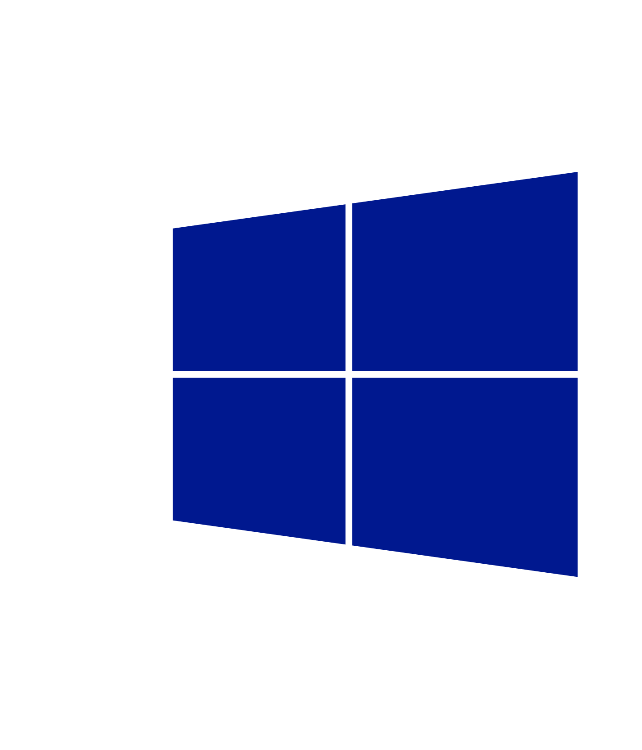



Bring it.
We run it.
Migrate services to Azure
Lift and shift
Apps split between the premises and Azure
Use your on-prem AD for identity
Manage with tools you know
Virtual
Machines
Virtual
Network
Business Application
Windows Server
Active Directory
SQL Server
Internet
Windows Server
Active Directory
System Center
Operations Manager
Windows Server
Business Users
On-premises
Windows Azure
Business Users

Slide 18

Real time,
flexible lab,
dev and test and
training sandbox
Develop.
Scale.
Unlock Hybrid.
Robust infrastructure for SQL Server
Full SQL Server compatibility
AlwaysOn for high availability
Move existing SQL Server apps
Shared databases in Azure
Virtual
Machines
Virtual
Network
Web Application
SQL Server
Internet
Customers
On-premises
Windows Azure
Your Customers

Slide 19

Customize.
Collaborate.
Maintain.
SharePoint Server
on Windows Azure
Design, implement, and develop on SharePoint 2010/2013 without upfront hardware costs
Develop custom internet sites and collaboration apps not supported in software as a service model
Burst compute, storage, and database for your SharePoint farm when you need it
Custom Collaboration Site
Virtual
Machines
Virtual
Network
Windows Server
Active Directory
SharePoint Server
Internet
Windows Server
Active Directory
Remote Workers
On-premises
Windows Azure
Remote Workers

Slide 20
What’s new
Windows Azure
Exciting capabilities
Route-based VPN
Support for Windows Server 2012 RRAS Server
Enhanced security with IKE v2 and AES 256 support
More VPN devices options
S2S VPN
Active Directory
SharePoint
SQL
Server
P2S
VPNs
Existing
Datacenter
On-premise

Slide 21



More Options for Getting Your Virtual Network Started
New: Software based
VPN gateway
Windows Server
Routing and Remote Access Service (RRAS)
Generic VPN devices
must support
IKE v1, IKE v2
AES 128, 256
SHA1, SHA2

Slide 22
Demos
Exposing intranet sites hosted in Azure
DR across 2 sites and on-prem
Highly available cross-prem connectivity

Slide 23
Demo Setup
Windows Azure
Front End
Back End
SQL HA
US East Virtual Network
AD / DNS
VPN
Gateway
Customer premises
VPN Gateway
Windows Azure
Site-to-Site
VPN
Front End
Back End
SQL HA
US West Virtual Network
AD / DNS
VPN
Gateway
VPN Gateway

Slide 24
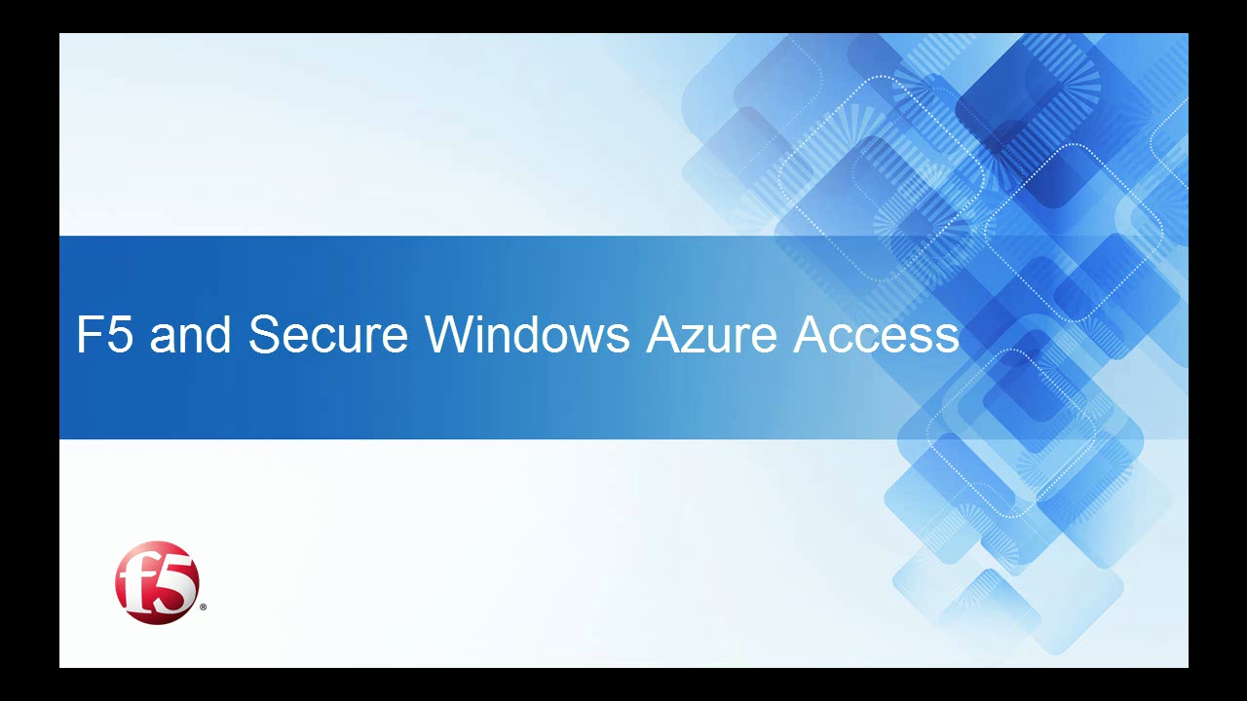
Virtual Network connectivity with F5 Big IP

Slide 25
In Summary
Extend Enterprise Networks to Azure
Deploy “hybrid” applications that span cloud and enterprise networks or branches Provide IPv4 connectivity between Windows Azure and your premises securely over S2S VPNs
Connect from Anywhere Securely
From dev. offices, labs, coffee shops, hotels, airports, branch offices, customer sites, conference centers, exhibition venues, … DEV/TEST/Lab, demo/prototyping, small, remote branch connectivity
Site-to-Site VPN Connectivity
Standard IPsec VPN protocols Support both hardware- & software-based VPNs Windows Server 2012 RRAS Citrix, F5, WatchGuard Cisco, Juniper
Point-to-Site VPN Connectivity
Standard VPN protocol (SSTP) Secure (certificate-based authentication) No software installation Uses built-in VPN client in Windows

Slide 26
Call To Action
Sign up for Virtual Network P2S preview and provide feedback to vnetfeedback@microsoft.com
Try tutorials and how to guides online
Migrate services to Windows Azure
Useful Documents Online
  Overview of Windows Azure Virtual Network
  Virtual Network Tutorials
  Setting up point-to-site connectivity
  All about site-to-site connectivity
  Virtual Network FAQs

Slide 27

Related content
MDC-B377: Windows Azure in the Enterprise
MDC-B212: Infrastructure Services on Windows Azure: Virtual Machines and Virtual Networks with Mark Russinovich
WAD-B402: Windows Azure Internals
MDC-B360: Hybrid Networking offerings in Windows Azure
MDC-B370: Building Your Lab, Dev, and Test Scenarios in Windows Azure Infrastructure Services
MDC-B371: Building Reliable and Resilient Apps on Windows Azure Infrastructure Services
MDC-B213: Hosting a Microsoft SharePoint 2013 Farm on Windows Azure
MDC-B406: Achieve High Availability with Microsoft SQL Server on Windows Azure Virtual Machines
DBI-B306: Microsoft SQL Server High Availability and Disaster Recovery on Windows Azure
MDC-B405: Crash Course on "Automating deployments in Windows Azure Virtual Machines". How and which tools?
MDC-B361: Best Practices from Real Customers: Deploying to Windows Azure Infrastructure Services (IaaS)
WAD-B305: Take Control of the Cloud with the Windows Azure PowerShell Cmdlets

Slide 28
Track resources
Learn more about Windows Server 2012 R2 Preview, download the datasheet and
evaluation bits on
http://aka.ms/WS2012R2
Learn more about System Center 2012 R2 Preview, download the datasheet and evaluation bits on
http://aka.ms/SC2012R2

Slide 29

Resources
Learning
  Sessions on Demand
  Microsoft Certification & Training Resources
http://channel9.msdn.com/Events/TechEd
www.microsoft.com/learning
TechNet
msdn
  Resources for IT Professionals
  Resources for Developers
http://microsoft.com/technet
http://microsoft.com/msdn

Slide 30
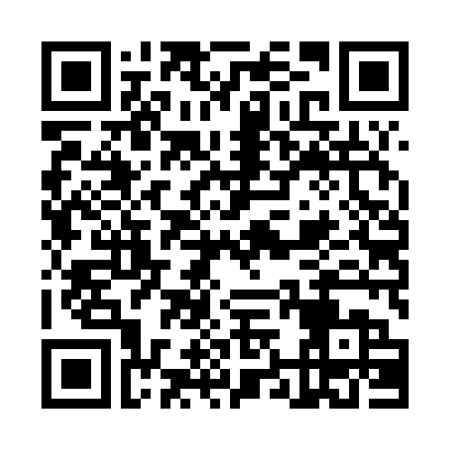


Evaluate this session
Required Slide
*delete this box when your slide is finalized
Your MS Tag will be inserted here during the final scrub.
Scan this QR code to
evaluate this session.

Slide 31

© 2013 Microsoft Corporation. All rights reserved. Microsoft, Windows and other product names are or may be registered trademarks and/or trademarks in the U.S. and/or other countries.
The information herein is for informational purposes only and represents the current view of Microsoft Corporation as of the date of this presentation. Because Microsoft must respond to changing market conditions, it should not be interpreted to be a commitment on the part of Microsoft, and Microsoft cannot guarantee the accuracy of any information provided after the date of this presentation. MICROSOFT MAKES NO WARRANTIES, EXPRESS, IMPLIED OR STATUTORY, AS TO THE INFORMATION IN THIS PRESENTATION.

