Slide 2
Understanding Hyper-V Replica: Performance, Networking and Automation
MDC-B373
Vijay Tandra Sistla
Senior Program Manager
Windows Server & System Center
Microsoft Corporation

Slide 3
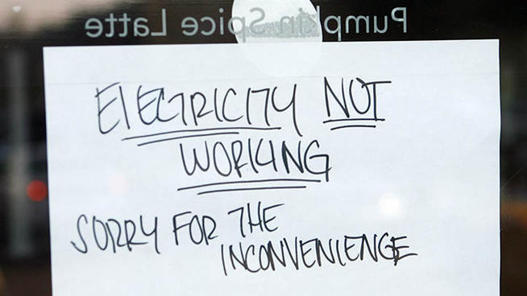
http://www.nbcconnecticut.com/news/local/Biz-Owners-Angry-over-Losses-Due-to-Outages-133320143.html

Slide 4
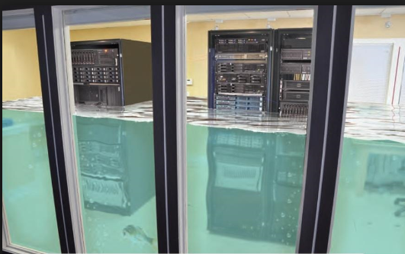
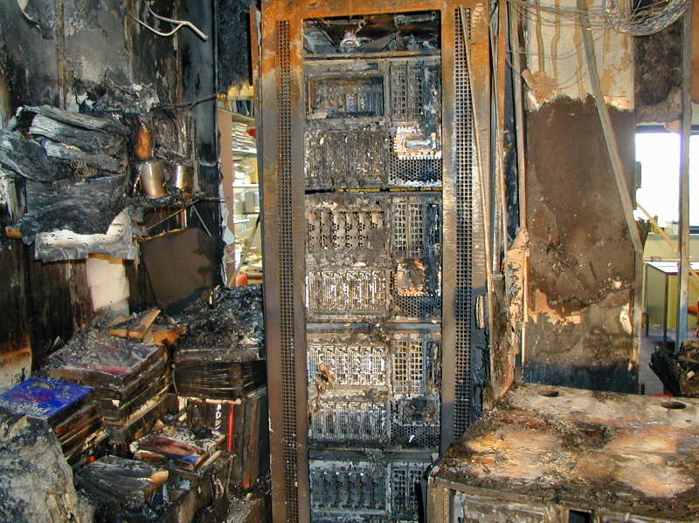
http://www.convergedigest.com/2012/10/datagrams-nyc-data-center-taken-down-by.html
http://ucp.totfarm.com/pics/pic_12073492466573.jpg

Slide 5
DR Journey
“By using Hyper-V Replica, Sberbank will save US$100,000”
“Hyper-V Replica is very flexible; And it is included in the operating system with integrated management, which is important for us”
“It’s so reassuring to know that if our primary server goes down for any reason, we can be back up and running within 20 minutes. Hyper-V Replica works like magic.”
Hyper-V Replica
2012

Slide 6
DR Journey
Hyper-V Recovery Manager (HRM)
Hyper-V Replica
Hyper-V Replica 2012 R2
2012
2012 R2

Slide 7
Session Objectives and Takeaways
Overview of Hyper-V Recovery Manager
Deep dive on Hyper-V Replica
Planning – Capacity and Network
Administration

Slide 8
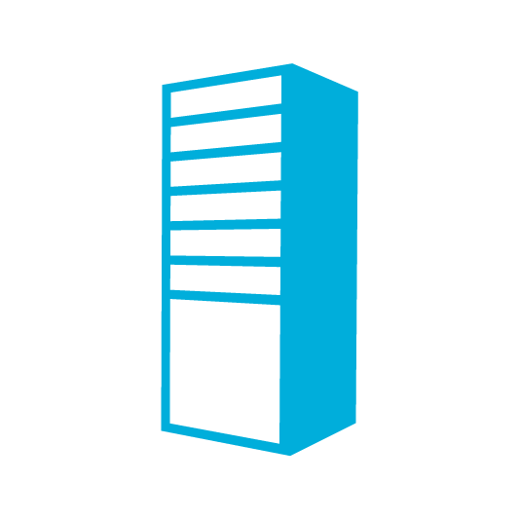
Hyper-V Recovery Manager (HRM)
Hyper-V Recovery Service
DR Orchestration
DR Orchestration
SCVMM
SCVMM
DRP
DRP
Hyper-V Replica
Compute
Storage
Networks
Compute
Storage
Networks
Primary Site
Secondary Site

Slide 9
Hyper-V Recovery Manager Features
Configuring hosts for replication
Auth, Firewalls, Networks at Cloud Level
Protection of VMs
SLA based
Recovery Plans
Ordered failover of multiple VMs
Learn more: MDC-B306 - Implementing Enterprise-Scale Disaster Recovery with Hyper-V Replica, Windows Network Virtualization and Microsoft System Center 2012 SP1

Slide 10
Hyper-V Replica

Slide 11
Hyper-V Replica
Inbox Replication
DR Scenarios
Application Agnostic
Storage Agnostic
Simple
Affordable
Flexible

Slide 12
Summary of New Features in R2
30 Sec Replication
Extended Replication
Linux VM Enhancements
Seamless Upgrade

Slide 13
Deployment Scenarios R2
Service Provider
Primary
Site
Secondary Site
Primary
Site
Secondary Site
Tertiary Site or
Service Provider
Customer 1
Customer 2

Slide 14
Demo
Enabling Hyper-V Replica

Slide 15
Failover Scenarios
Primary
Secondary
Primary
Secondary
Primary
Secondary
Test Failover
Planned Failover
Unplanned Failover

Slide 16
Demo
Failover Demo
http://blogs.technet.com/b/privatecloud/archive/2013/02/11/automation-orchestrating-hyper-v-replica-with-system-center-for-planned-failover.aspx

Slide 17
Failover Considerations
IP setting of VMs
Static IP or
DHCP or
Network Virtualization
DNS update
Split brain scenarios

Slide 18
Protection post Failover
Failback
Resync or Full Sync
Continue protection to Extended Replica
Primary
Replica
Extended Replica

Slide 19
Planning - Capacity

Slide 20
Customer Asks
How much network bandwidth is required?
How much storage is required?
Is my IOPS provisioning sufficient?
Does Hyper-V Replica impact CPU, Memory?
Capacity Planner
http://www.microsoft.com/en-us/download/details.aspx?id=39057

Slide 21
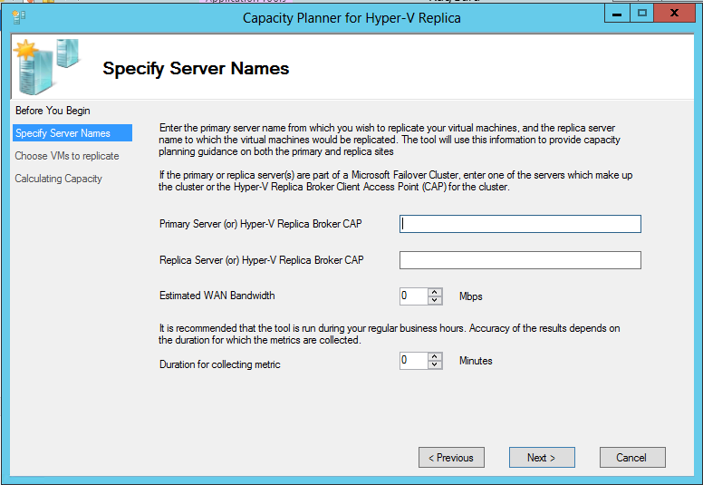
Capacity Planner

Slide 22
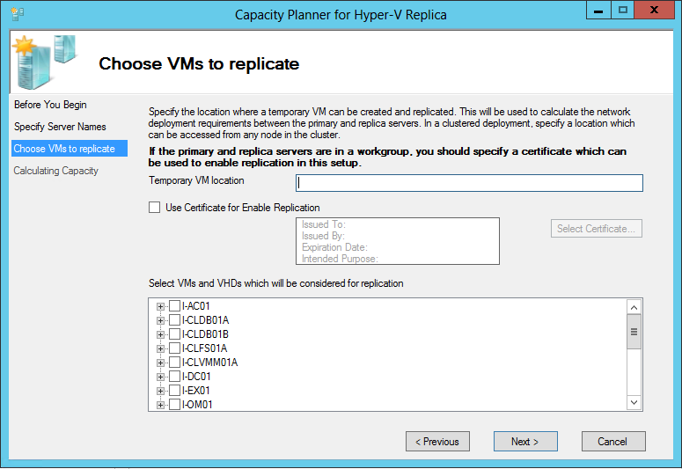
Capacity Planner

Slide 23
Capacity Planner Output
Attribute | WS 2012 | WS 2012 R2
Primary storage | Linear to churn in the VM | Same
Primary IOPS | < 1.5 X write IOPS of the workload | Same
Replica storage | Each recovery point ~10% of the base VHD size) | Linear to churn in the VM
Replica IOPS | 1 to 5 X write IOPS | 1 to 2 X write IOPS of the workload
Network bandwidth | Linear to the churn in the VM | Same

Slide 24
Planning – Network

Slide 25
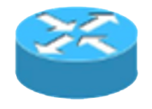
Network Topology
Primary
Replica
Replica VM
Primary VMs
AD
AD
NAT
Hyper-V Replica Broker
& Cluster
Primary
Replica
Primary VMs
Replica VMs
AD
S2S VPN Tunnel
AD
VPN Gateway
VPN Gateway
Learn more: MDC-B312 – Building Hosted Clouds using WS2012R2

Slide 26
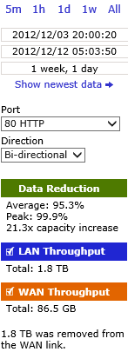
Network Compression
Compression on by default
WAN optimizers on top of built-in compression
Whitepaper available at http://www.microsoft.com/en-us/download/details.aspx?id=36786

Slide 27
Network Throttling
How do I use specific bandwidth for replica traffic?
Use Windows Server 2012 QoS to throttle replication traffic
Throttling based on the destination subnet
New-NetQosPolicy “Replication Traffic to 10.0.0.0/8” –DestinationAddress 10.0.0.0/8 –MinBandwidthWeightAction 40
Throttling based on the destination port
New-NetQosPolicy “Replication Traffic to 8080” –DestinationPort 8080 –ThrottleRateActionBitsPerSecond 100000

Slide 28
Administration Replication Heath and Outage Migration VM Lifecycle Seamless Upgrade

Slide 29
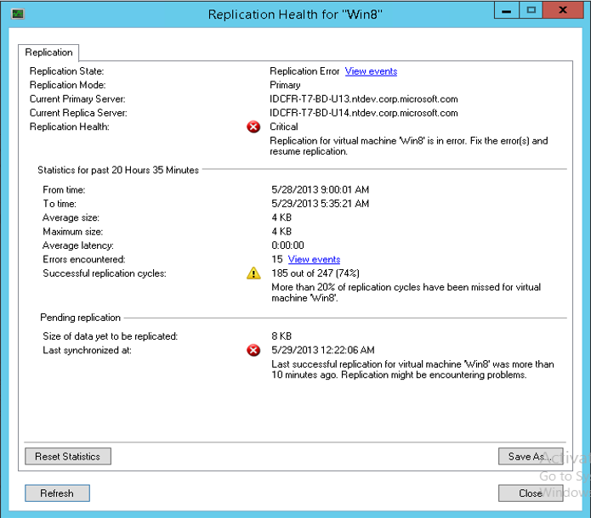
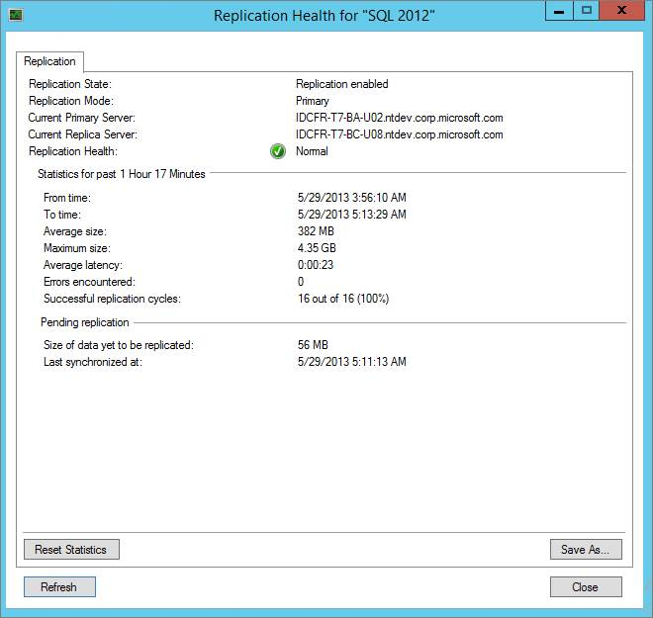
Replication Health
How should I monitor replication?
Replication Health and State
Last Synchronized Time
Average Replication Latency
Perfmon counters and Event logs

Slide 30
Replication Outage
Network Disconnects
Automatic retry
Pause and Resume semantics
Out of sync
Resynchronization
Automatic or Scheduled

Slide 31
Migration
Storage Migration
Replication metadata migrates automatically
VM Migration
Seamless within cluster
Across cluster
Primary should be authorized on Replica
Redirect replication to new Replica

Slide 32
VM LifeCycle
Online Resize
Application Patching
Backup of VMs

Slide 33
Administration – Seamless Upgrade

Slide 34
Continued Protection - Upgrade
Cross Version Migration
Replica 2012
Primary 2012
Replica 2012 R2
Primary 2012 R2

Slide 35
Demo
Upgrade
Learn more: MDC-B330 - Hyper-V – What’s New in WS2012 R2
Learn more: MDC-B331 – Upgrading Your Private Cloud with WS2012R2

Slide 36
Positioning – What Hyper-V Replica isn’t?
Solution | Use Cases | Replica Position
SAN Replication | High availability with zero data loss | DR for Virtualized workloads 30 Sec – 15 min
Live Migration | Load balancing Server Patching | Multi site Complements
Storage Migration | Storage out of space Storage upgrade | Ongoing Replication Complements
Guest Clustering | Guest application patching Guest application failure | Not compatible
Backup solutions | Data recovery Archival for compliance, auditing | Disaster Recovery only
System Center + HRM | Manage @ Scale | Platform component of Enterprise DR

Slide 37
Call to Action
Plan your DR strategy
Test Hyper-V Replica R2
Check out the hands-on lab
Preview Hyper-V Recovery Manager
Happy Deployment and Thank You!!!

Slide 38
Related content
MDC-B330 - Hyper-V – What’s New in Windows Server 2012 R2
MDC-B306 - Implementing Enterprise-Scale Disaster Recovery with Hyper-V Replica, Windows Network Virtualization and Microsoft System Center 2012 SP1
MDC-H203 and MDC-312 - Hands-on lab
Find Me Later at the Microsoft Booth

Slide 39
Track resources
Learn more about Windows Server 2012 R2 Preview, download the datasheet and evaluation bits on http://aka.ms/WS2012R2
Learn more about System Center 2012 R2 Preview, download the datasheet and evaluation bits on http://aka.ms/SC2012R2

Slide 40
Resources
Learning
Sessions on Demand
Microsoft Certification & Training Resources
http://channel9.msdn.com/Events/TechEd
www.microsoft.com/learning
TechNet
msdn
Resources for IT Professionals
Resources for Developers
http://microsoft.com/technet
http://microsoft.com/msdn

Slide 41
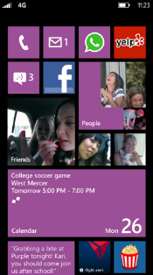
Evaluate this session
Required Slide
*delete this box when your slide is finalized
Your MS Tag will be inserted here during the final scrub.
Scan this QR code to
evaluate this session.

Slide 42
© 2013 Microsoft Corporation. All rights reserved. Microsoft, Windows and other product names are or may be registered trademarks and/or trademarks in the U.S. and/or other countries.
The information herein is for informational purposes only and represents the current view of Microsoft Corporation as of the date of this presentation. Because Microsoft must respond to changing market conditions, it should not be interpreted to be a commitment on the part of Microsoft, and Microsoft cannot guarantee the accuracy of any information provided after the date of this presentation. MICROSOFT MAKES NO WARRANTIES, EXPRESS, IMPLIED OR STATUTORY, AS TO THE INFORMATION IN THIS PRESENTATION.

