Slide 2
Failover Clustering: Quorum Model Design for Your Private Cloud
MDC-B403
Amitabh Tamhane
Senior Program Manager
Windows Server Clustering

Slide 3

Session Objectives And Takeaways
Session Objective(s):
  Walk-through Cluster Quorum Fundamentals
  New Quorum Features in Windows Server 2012 & R2
  Configuration of cluster quorum
  Insight into disaster recovery multi-site quorum
Key Takeaway(s):
“Simplified” Cluster quorum configuration
Dynamic Quorum – Increases availability of cluster
Step by step configuration of DR multi-site quorum

Slide 4
Quorum Basics

Slide 5




Cluster challenges
Site Power Outage
Network Disconnect
Node Crash
1
2
3
4
5
Quorum Witness Failure
Node Shutdown for Patching
Add/Evict Node
How do I make sure my Cluster stays up ??...

Slide 6
Why Quorum
Faster Start & Recovery of Cluster
Effective quorum policy helps faster start of cluster
Determines the set of nodes that have latest cluster database
Identifying point when to start workload
Determines the point when cluster can host applications
Effective quorum policy prevents unnecessary downtime
Addressing split-brain
Prevent two disjointed instances of the same cluster

Slide 7
Windows Server 2012+R2: Quorum Goals
Simplify Quorum Configuration
Quorum shouldn’t affect number of nodes in cluster
Simplified quorum witness selection
Updated wizard for quorum configuration
Increase Cluster High Availability
Cluster more resilient to node/witness failures
Cluster can now survive with <50% majority nodes with Dynamic Quorum
Cluster can now survive even split 50% nodes
Enable more disaster recovery quorum scenarios

Slide 8
Voting Elements in Quorum
Nodes
Witness
Every cluster node has 1 vote
User configurable per node
Witness has 1 vote
  Disk Witness
  File Share Witness
User configurable
  Single witness per cluster
Cluster needs majority of participating votes to survive
More about this in later slides…

Slide 9
Disk Witness Considerations
Dedicated LUN for internal cluster use
Quorum Disk
Used as arbitration point
Stores a copy of cluster database
Recommendations:
Small disk at least 512 MB in size
Dedicated LUN
NTFS or ReFS formatted
No need for drive letter

Slide 10

File Share Witness Considerations
Simple Windows File Server
Easy to deploy
Single File Server can be used for multiple clusters
Unique File Share per clusters
CNO requires write permissions on the File Share
File Server Location
Recommended at 3rd separate site
Not on a node in the same cluster
Not inside VM running in the same cluster
HA File Server configured in a separate cluster
  File Share Witness
  No copy of cluster database
  Minimal network traffic – Cluster membership change only

Slide 11


Partition In Time: Disk Witness
Latest cluster database copy on Disk Witness
Cluster
Started with latest database
Cluster
Database
Updated
Updates
Cluster
database
1
2

Slide 12
Partition In Time: File Share Witness
Prevents node with stale database from forming cluster
Cluster
Not Started! No latest database
Only
Time-stamp
Updated
Updates
Cluster
database
1
2

Slide 13

Deciding Which Witness to Use
Witness: Disk vs. File Share
 | Disk | File Share
Prevents Split-Brain | P | P
Prevents Partition-in-Time | P | P
Solves Partition-in-Time | P
Arbitration Type | SCSI Persistent Reservation | Witness.log file on SMB Share
Recommended: Use Disk Witness if you have shared storage

Slide 14

Key Points to Remember
Quorum enables cluster to survive
Determines the point at which cluster is successfully formed
Voting Elements
Each node has 1 vote and (if configured) witness has 1 vote
Look for updated guidance with Dynamic Witness
Witness selection: Disk or File Share
Disk Witness (recommended) – Stores Cluster DB
File Share Witness – Multisite cluster with replicated storage

Slide 15
Node Vote Weights

Slide 16
Node Vote Weights
Granular control of which nodes have votes
Directly affects quorum calculations
Limit impact on cluster quorum
Cluster quorum does not change if nodes with no vote go down
Nodes with No-Vote continue to be part of the cluster
Receive cluster database updates
Ability to host applications

Slide 17
Why modify Node Vote?
Not all nodes in your cluster are equally important
Typically nodes from Disaster Recovery Backup site
Primarily used for multi-site clusters
Recommended only for manual failover across sites
More about this in later slides …
Vote
Vote
Vote
No Vote
No Vote
1
2
3
4
5
Site A
Site B

Slide 18

Adjusting majority votes using Node Votes
Original: Total Votes = 4 Majority Votes = 3
Updated: Total Votes = 3 Majority Votes = 2
Vote
Vote
Vote
No Vote
Quorum Maintained!
Cluster Survives!
1
2
3
4

Slide 19
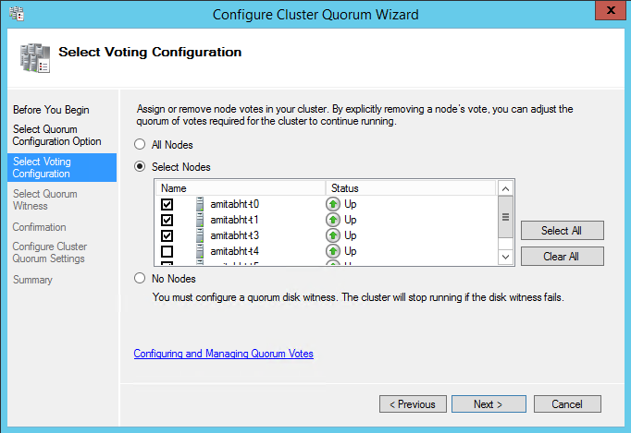
Adjusting Node Vote Weights
Granular control of which nodes have votes
Configurable per cluster node
Can be modified with no downtime
Use PowerShell or Configure Quorum Wizard
NodeWeight
Default = 1
Remove Vote = 0 Cluster Assigned = 1
(Get-ClusterNode <name>).NodeWeight = 0

Slide 20
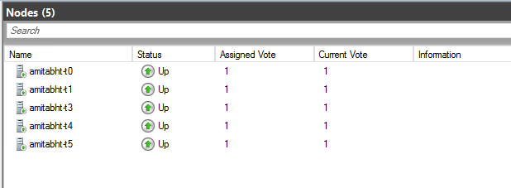
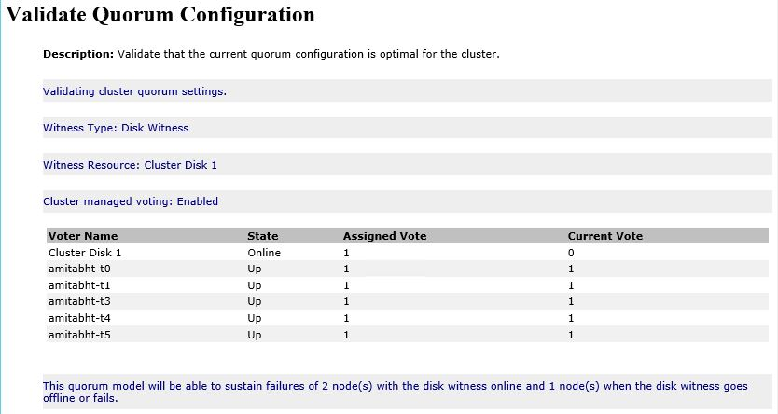
UI: Viewing Node Vote Weights
Updated Nodes Page For Easy Viewing
User configured node vote weights in “Assigned Vote” column
Cluster assigned dynamic vote weights in “Current Vote” column

Slide 21
Dynamic Quorum

Slide 22
Dynamic Quorum
Automatic Node Vote Adjustment
Automatic adjustment of Node Vote based on node’ state
Active Node : Dynamic Vote = 1
Down Node : Dynamic Vote = 0
No change for node with no assigned vote
Dynamic Quorum Majority
Quorum majority is dynamically determined by active cluster nodes
Increase High Availability of Cluster Itself
Sustain sequential node failures or shutdowns
Enables cluster to survive with <50% active nodes

Slide 23
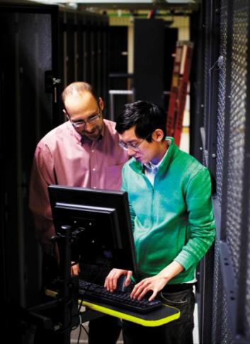
Dynamic Quorum Functionality
Last Man Standing
Cluster can now survive with only 1 node
64-node cluster all the way down to 1 node
Seamless Integration
With existing cluster quorum features & configurations
With multisite disaster recovery deployments
Enabled By Default
Configurable via PowerShell

Slide 24

Dynamic Quorum for Witness
Automatic Witness Vote Adjustment
Automatic adjustment of Witness Vote based on active cluster membership
Even Active Nodes with Dynamic Vote of 1 : Witness Dynamic Vote = 1
Odd Active Nodes with Dynamic Vote of 1 : Witness Dynamic Vote = 0
Cluster now has the smarts to determine when to use Witness Vote!
State of Witness
Witness Offline or Failed will automatically make Witness Dynamic Vote = 0
New Recommendation
Always configure a witness with Windows Server 2012 R2
Clustering will determine when it is best to use the Witness
Configure Disk Witness if shared storage, otherwise FSW

Slide 25
User Configurable Quorum Properties
DynamicQuorum
NodeWeight
Cluster Common Prop
Default: Enabled
1: Enabled
0: Disabled
Node Common Prop
Default: Vote assigned
1: Cluster Managed
0: Disable Vote
PowerShell
(Get-Cluster).DynamicQuorum = 1
(Get-ClusterNode “name”).NodeWeight = 1

Slide 26
Cluster Managed Quorum Properties
DynamicWeight
WitnessDynamicWeight
Node Common Prop
Value Adjusted by Cluster
1: Node Has Vote
0: Node Has No Vote
Cluster Common Prop
Value Adjusted By Cluster
1: Witness Has Vote
0: Witness Has No Vote
PowerShell
(Get-ClusterNode “name”).DynamicWeight (read only)
(Get-Cluster).WitnessDynamicWeight (read only)

Slide 27
Dynamic Quorum : Node Scenarios
Node Shutdown
Node removes its own vote
Node Crash
Remaining active nodes remove vote of the downed node
Node Join
On successful join the node gets its vote back

Slide 28
Dynamic Quorum : Witness Scenarios
Witness Offline
Witness vote gets removed by the cluster
Witness Failure
Witness vote gets removed by the cluster
Witness Online
If necessary, Witness vote is added back by the cluster

Slide 29


Tie Breaker
Cluster will survive simultaneous loss of 50% votes
Especially useful in multi-site DR scenarios with even split
Cluster always ensures total number of votes are Odd
One site automatically elected to win
By default, cluster randomly selects a node to take its vote out
LowerQuorumPriorityNodeID cluster common property identifies a node to take its vote out
Cluster
Site1
Site2

Slide 30
Last Man Standing: Witness Configured
4 Nodes + Witness Configured (N = Number of Votes)
Vote
Vote
Vote
Vote
Vote
Vote
Last Man Standing!
Cluster
Survives!
1
2
3
4
N = 3
Majority = 2
N = 3
Majority = 2
N = 3
Majority = 2
N = 5
Majority = 3

Slide 31
Last Man Standing: No Witness
5 Nodes + No Witness Configured (N = Number of Votes)
Vote
Vote
Vote
Vote
Vote
Last Man Standing!
Cluster
Survives!
1
2
3
4
5
N = 1
Majority = 1
N = 2
Majority = 2
N = 3
Majority = 2
N = 3
Majority = 2
N = 5
Majority = 3

Slide 32
No Witness: Last Two Active Nodes
Cluster dynamically removes one node’s vote
Cluster can sustain communication loss between the last two nodes
Cluster can sustain crash of node with no vote
Random selection of the node whose vote gets removed
Cluster survives graceful shutdown of either node
 | Node 1 | Node 2
State | UP | UP
NodeWeight | 1 | 1
DynamicWeight | 1 | 0

Slide 33
Dynamic Quorum
DEMO

Slide 34
Dynamic Quorum Considerations
Simultaneous Loss of Majority Nodes
Need existing majority votes to update new majority votes
Custer cannot sustain simultaneous loss of majority nodes
Always Configure Witness
Witness helps cluster to sustain one extra node failure
Witness helps in giving equal opportunity to survive in DR scenarios (more details later)
Cluster running with <50% majority nodes
The remaining <50% nodes become more important
“Last Man Standing” node becomes necessary for cluster start
Helps prevent partition in time

Slide 35
Dynamic Quorum vs. Disk Only Quorum
Dynamic Quorum
Helps achieve true “Last Man Standing”
Increases cluster availability by making cluster resilient
Disk Only Quorum
No flexibility around vote adjustment (1 vote of disk witness)
Disk Witness is single point of failure
With Dynamic Quorum, no need for Disk Only Quorum
Why lose the cluster when storage is lost?

Slide 36

Key Points to Remember
Dynamic Quorum increase Availability of Cluster
Automatic adjustment of dynamic vote of nodes & witness
Dynamic Quorum enables “Last Man Standing”
Cluster can survive with only 1 node remaining
Node Vote Adjustment
Only with Manual Failover to DR site; Remove vote of nodes from DR site
Simplified witness selection with Dynamic Witness
Best practice guidelines to always configure quorum witness

Slide 37
Configuring Cluster Quorum

Slide 38
Intuitive Quorum Configuration
Updated Cluster UI Experience
Simplified quorum configuration with updated quorum wizard
Updated Nodes Page
Ability to view node’s user configured vote & cluster managed vote
Updated Quorum Validation
Simplified guidance & warning text
Nodes & witness vote information is captured in detail
Simplified Terminology
Removed legacy concepts of ‘quorum modes’
It is all about witness selection:
“File Share Witness” or “Disk Witness” or “No Witness”

Slide 39
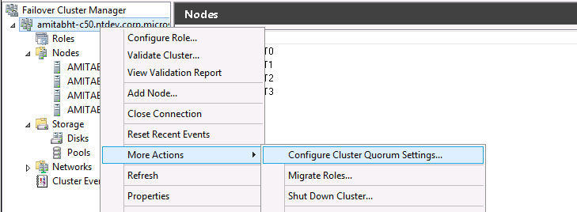
Configured via Cluster Manager GUI and PowerShell
Cluster Quorum Wizard
Updated PowerShell
PowerShell
Set-ClusterQuorum –NoWitness
Set-ClusterQuorum –DiskWitness “DiskResourceName”
Set-ClusterQuorum –FileShareWitness “FileShareName”
Set-ClusterQuorum –DiskOnly “DiskResourceName”

Slide 40
New Quorum Wizard
DEMO

Slide 41




Recovery Actions

Slide 42
Force Quorum
Manual Override
Allows to start cluster without majority votes
Cluster starts in a special “forced quorum” mode
Remains in this mode till majority votes achieved
Cluster automatically switches to normal functioning
Caution
Always understand why quorum was lost
Split-brain between nodes possible
    You are now in control!
Prevent Quorum Flag
Command Line: net start clussvc /ForceQuorum
PowerShell: Start-ClusterNode –ForceQuorum

Slide 43
Prevent Quorum
Helps prevent nodes with vote to form cluster
Nodes started with ‘Prevent Quorum’ always join existing cluster
Applicable to cluster in “Force Quorum”
Always start remaining nodes with ‘Prevent Quorum’
Helps prevent overwriting of latest cluster database
Forward progress made by nodes in ‘Force Quorum’ is not lost
Prevent Quorum Flag
Command Line: net start clussvc /PQ
PowerShell: Start-ClusterNode –PreventQuorum
Most applicable in multisite DR setup

Slide 44

Force Quorum Resiliency
Cluster detects partitions after a manual Force Quorum
Cluster has the built-in logic to track Force Quorum started partition
Partition started with Force Quorum is deemed authoritative
Other partitions automatically restart up on detecting a FQ cluster
Restarted nodes in other partition join the FQ cluster
Cluster automatically restarts the nodes with Prevent Quorum
Cluster
Manual Override with ForceQuorum
Site1
Site2
Nodes Restarted
When Site2 partition detected

Slide 45
Multi-Site DR Quorum
Considerations of Quorum with DR solutions

Slide 46
Types of Multi-Site DR Configurations
What are you Service Level Agreements (SLA’s)?
In the event of a disaster, how do you want to switch to your DR site?
Automatic Failover
Manual Failover
Services automatically failover to recovery site in the event of a disaster
All sites equal
Services manually failover to recovery site in the event of a disaster
Primary & Backup (DR) sites

Slide 47
Automatic Failover Considerations
All Sites Equal
Allow cluster to sustain failure of any one site
Allow automatic failover of workload to the surviving site
Node Vote Weight Adjustments
All nodes equally important
No need to modify node vote weights
Number of Nodes per Site
Keep equal number of nodes in both sites
Helps cluster sustain failure of any site
  Otherwise the site with more nodes would become Primary site

Slide 48
Automatic Failover: Witness Considerations
Always Configure File Share Witness (recommended)
File Server running at a separate site
The separate site must be accessible from the workload sites
  Allows cluster to sustain communication loss between sites
Witness Selection
Highly Available File Server, for witness, in a separate cluster
Disk Witness can be used as directed by storage vendor

Slide 49

Automatic Failover: 2-Site Cluster
Failover Example
Site 3
Vote
Site-2 Down!!!
Site-1 can reach FSW! Cluster
Survives!
Vote
Vote
Vote
Vote
1
2
3
4
Site 1
Site 2

Slide 50
Automatic Failover: WAN Link Issues
Witness Dynamic Vote & Tie Breaker
Cluster
removes
Witness
Vote
Site 3
Vote
Site-2 Down!!!
Site-1 Wins!!!
Cluster
Survives!
Vote
Vote
Vote
Vote
Cluster
removes
Node 3’s
Vote
1
2
3
4
Site 1
Site 2

Slide 51
Manual Failover Considerations
All Sites Not Equal
Cluster cannot sustain failure of Primary site
Allow cluster to sustain failure of the Backup site
Do Not Push
Node Vote Weight Adjustments
Disallow nodes in Backup site in affecting cluster quorum
Remove node vote weight of nodes in Backup site
Number of Nodes per Site
No requirement to keep equal number of nodes in both sites

Slide 52
Manual Failover: Workload Considerations
Workload Management
Use Preferred Owners to prioritize keeping workload on Primary site
Recovery Actions
Primary site failure would require “Force Quorum” on Backup site
Recover Primary site nodes using “Prevent Quorum”

Slide 53
Manual Failover: Witness Considerations
Always Configure Witness
File Server running at a separate site (recommended)
File Server running local in Primary Site may be Ok (consider recovery scenarios)
Witness Selection
Highly Available File Server, for witness, in a separate cluster
Asymmetric Disk Witness can be used as well (consider recovery scenarios)

Slide 54

Asymmetric Disk Witness
Disk Witness accessibility
Subset of nodes can access the disk
Witness can come online only on subset of nodes
1
2
3
4
SAN
Most applicable in multi-site clusters
Disk only seen by primary site
Witness can come online only on primary site
Cluster recognizes asymmetric storage topology
Uses this to place cluster quorum group

Slide 55
Manual Failover: 2-Site Cluster
Backup Site Down
Witness Site
Vote
Backup Site Down!!!
No effect on Quorum! Cluster
Survives!
Vote
Vote
No Vote
No Vote
1
2
3
4
Primary Site
Backup Site

Slide 56
Manual Failover: Temporary Outage
Recommended Recovery
Witness Site
3
Successful Join to Force Quorum Backup nodes
Vote
1
Force Quorum Cluster Start!
Not enough
Votes!!!
Cluster Down!!
2
Start nodes with Prevent Quorum!
Vote
Vote
No Vote
No Vote
Primary Site Down!!!
4
Cluster
Starts!
Not in
Force Quorum
1
2
3
4
Primary Site
Backup Site

Slide 57
Manual Failover: Long Term Outage
Recommended Recovery
Witness Site
Remove
Votes from
Old Primary Site
Start these nodes with “Prevent Quorum”
Vote
Force Quorum Cluster Start!
Not enough
Votes!!!
Cluster Down!!
Assign Votes to Nodes in Backup Site
Vote
Vote
No Vote
No Vote
No Vote
No Vote
Vote
Vote
Primary Site Down!!!
New
Backup Site!
New
Primary Site!
1
2
Cluster
Not in
Force Quorum
3
4
Primary Site
New Primary Site
New Backup Site
Backup Site

Slide 58

Key Points to Remember
Identify your SLA’s for multisite clusters
Automatic vs. Manual Failover
Automatic Failover
Keep nodes equal in both sites
Configure File Share Witness at separate site
Manual Failover
Remove votes of nodes in DR site
Remember the order of recovery actions
Configure asymmetric disk witness or FSW as per votes

Slide 59

In Review: Session Objectives And Takeaways
Session Objective(s):
  Walk-through Cluster Quorum Fundamentals
  New Quorum Features in Windows Server 2012
  Configuration of cluster quorum
  Insight into disaster recovery multi-site quorum
Key Takeaway(s):
“Simplified” Cluster quorum configuration
Dynamic Quorum – Increases availability of cluster
Step by step configuration of DR multi-site quorum

Slide 60

Related content
Breakout Sessions
MDC-B305 Continuous Availability: Deploying and Managing Clusters Using Windows Server 2012 R2
MDC-B311 Application Availability Strategies for the Private Cloud
MDC-B331 Upgrading Your Private Cloud with Windows Server 2012 R2
MDC-B333 Storage and Availability Improvements in Windows Server 2012 R2
MDC-B336 Cluster in a Box 2013: How Real Customers Are Making Their Business Highly Available…
MDC-B337 Failover Cluster Networking Essentials
MDC-B375 Microsoft Private Cloud Fast Track v3: Private Cloud Reference Architecture…
MDC-B403 Failover Clustering: Quorum Model Design for Your Private Cloud
Hands-on Labs
MDC-H303 Configuring Hyper-V over Highly Available SMB Storage
Find Me Later at the Storage Booth

Slide 61

Resources
Learning
  Sessions on Demand
  Microsoft Certification & Training Resources
http://channel9.msdn.com/Events/TechEd
www.microsoft.com/learning
TechNet
msdn
  Resources for IT Professionals
  Resources for Developers
http://microsoft.com/technet
http://microsoft.com/msdn

Slide 62



Evaluate this session
Required Slide
*delete this box when your slide is finalized
Your MS Tag will be inserted here during the final scrub.
Scan this QR code to
evaluate this session.

Slide 63

© 2013 Microsoft Corporation. All rights reserved. Microsoft, Windows and other product names are or may be registered trademarks and/or trademarks in the U.S. and/or other countries.
The information herein is for informational purposes only and represents the current view of Microsoft Corporation as of the date of this presentation. Because Microsoft must respond to changing market conditions, it should not be interpreted to be a commitment on the part of Microsoft, and Microsoft cannot guarantee the accuracy of any information provided after the date of this presentation. MICROSOFT MAKES NO WARRANTIES, EXPRESS, IMPLIED OR STATUTORY, AS TO THE INFORMATION IN THIS PRESENTATION.

