Slide 2
Office 365 security
OUC-B205
Daryl Gwyn
Vijay Kumar

Slide 3
Todays IT Collaboration

Slide 4



Key trends affecting security
Consumerization of IT
Targeted
attacks
Identity-centric environment
Cloud
computing
Regulatory/
compliance issues

Slide 5
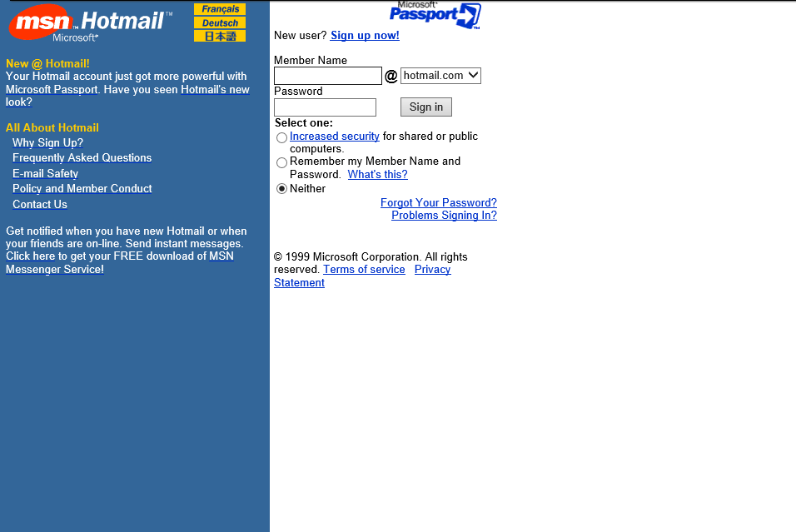

Slide 6








Microsoft experience and credentials
1989
1995
2000
2005
2010
1st Microsoft
Data Center
Windows
Update
Xbox
Live
BillG
Memo
Malware
Protection
Center
Active
Update
Global
Foundation
Services
(GFS)
Microsoft Security
Engineering Center/
Security Development
Lifecycle
Microsoft Security
Response Center
(MSRC)
SAS-70
Certification
ISO 27001
Certification
FISMA
Certification
Trustworthy
Computing
Initiative (TwC)
One of the world’s largest cloud providers & datacenter/network operators

Slide 7
Office 365 security
Independently verified
ISO
Compliance
Advanced encryption
Microsoft security best practices
24-hour monitored physical hardware
Office 365 built-in security
Office 365
customer controls
Automated operations
Isolated customer data
User access
Anti-virus/anti-spam
Office 365 independent verification & compliance
HIPAA
EU model clauses
Encrypted data
Secure network
FISMA/fedRAMP

Slide 8
Office 365 built-in security
Microsoft security best practices
24-hour monitored physical hardware
Automated operations
Isolated customer data
Encrypted data
Secure network

Slide 9

GFS Clip

Slide 10




24-hour monitored physical hardware
Perimeter security
Seismic bracing
24x7 onsite security staff
Days of backup power
Tens of thousands of servers
Fire suppression
Controlled access
Extensive monitoring

Slide 11
Isolated customer data
Logical data separation
Office 365 supports logical isolation of data that multiple customers store in same physical hardware.
Active Directory’s organizational units keep Customer A’s data isolated from Customer B’s data
Consumer services are physically isolated from our commercial services

Slide 12

Secure network
Internal network
External network
Network Separated
Data Encrypted
Networks within the Office 365 data centers are segmented.
Physical separation of critical, back-end servers & storage devices
from public-facing interfaces.
Edge router security allows ability to detect intrusions and signs of vulnerability.

Slide 13
Encrypted data
Office 365 allows encryption of data both at rest & during transit. Data unreadable to unauthorized parties.
Encryption of data at rest and in transit
BitLocker 256bit AES Encryption of messaging content
  Includes mailbox database files, mailbox transaction log files, search content index files, transport database files, transport transaction log files, and page file OS system disk tracing/message tracking logs.
  Transport Layer Security (TLS)/ Secure Sockets Layer (SSL)
  And third-party technology such as PGP

Slide 14
Automated operations
Office 365
datacenter network
Microsoft
corporate network
Lock box:
Role based
access control
Grants temporary privilege
O365 Admin
requests
access
Grants least privilege required to complete task.
Verify eligibility by checking if
Background Check Completed
Fingerprinting Completed
Security Training Completed

Slide 15



Microsoft security best practices
Security development lifecycle
24-hour
monitored physical hardware
Microsoft security best practices
Automated
operations
Throttling to prevent DoS attacks
Automated operations
Isolated customer data
Prevent breach
Encrypted data
Secure network
Mitigate breach

Slide 16
Security development lifecycle
Reduce vulnerabilities, limit exploit severity
Education
Process
Accountability
Administer and track
security training
Guide product teams to meet
SDL requirements
Establish release criteria & sign-off as part of FSR
Incident
response
(MSRC)
Training
Requirements
Design
Implementation
Verification
Release
Response
Core security
training
Est. Security
requirements
Create quality
gates / bug bars
Security
& privacy
risk assess.
Establish design
requirements
Analyze
attack surface
Threat
modeling
Use approved
tools
Deprecate
unsafe functions
Static analysis
Dynamic
analysis
Fuzz testing
Attack surface
review
Incident
response plan
Final security
review
Release archive
Execute incident
response plan
Ongoing process improvements

Slide 17
Throttling to prevent DoS attacks
Exchange Online baselines normal traffic & usage
Ability to recognize DoS traffic patterns
Automatic traffic shaping kicks in when
spikes exceed normal
Mitigates:
Non-malicious excessive use
Buggy clients (BYOD)
Admin actions
DoS attacks

Slide 18
Prevent breach
Port scanning
and remediation
Perimeter
vulnerability scanning
OS Patching
Network level
DDoS detection
and prevention
MFA for service access
Auditing of all operator access and actions
Zero standing permissions
in the service
Just in time elevations
Automatic rejection of non-background check employees to high privilege access
Scrutinized manual approval for background checked employees
Automatic account deletion
When employee leaves
When employee moves groups
Lack of use
Automated tooling for routine activities
  Deployment, Debugging, Diagnostic collection, Restarting services
Passwords encrypted
in password store
Isolation between
mail environment
and production access environment for all employees

Slide 19
Mitigate breach
Detect
Response
Audit
More

Slide 20
Office 365 security
Independently verified
ISO
Compliance
Advanced encryption
Microsoft security best practices
24-hour monitored physical hardware
Office 365 built-in security
Office 365
customer controls
Automated operations
Isolated customer data
User access
Anti-virus/anti-spam
Office 365 independent verification & compliance
HIPAA
EU model clauses
Encrypted data
Secure network
FISMA/fedRAMP

Slide 21




Advanced encryption using RMS
Data protection
in motion
Data protection
in motion
Information can be protected with RMS at rest or in motion
Data protection at rest
Data protection at rest
Data protection at rest
Data protection at rest

Slide 22
RMS Demo

Slide 23
RMS over standard approaches
Functionality | RMS in Office 365 | S/MIME | ACLs (Access Control Lists) | BitLocker
Data is encrypted in the cloud | ● | ● |  | ●
Encryption persists with content | ● | ●
Protection tied to user identity | ● | ● | ●
Protection tied to policy (edit, print, do not forward, expire after 30 days) | ●
Secure collaboration with teams and individuals | ● | ●
Native integration with my services (Content indexing, eDiscovery, BI, virus/malware scanning) | ●
Helps meet compliance requirements | ● | ●
Lost or stolen hard disk |  |  |  | ●

Slide 24
User access
Integrated with Active Directory, Azure Active Directory, and Active Directory Federation Services
Enables additional authentication mechanisms:
Two-factor authentication –
including phone-based 2FA
Client-based access control based
on devices/locations
Role-based access control

Slide 25
Compliance: Data Loss Prevention (DLP)
Prevents sensitive data
from leaving organization
Provides an alert when data such as social security & credit card number is emailed.
Alerts can be customized
by Admin to catch
intellectual property
from being emailed out.
Empower users to manage
their compliance
Contextual policy education
Doesn’t disrupt user workflow
Works even when disconnected
Configurable and customizable
Admin customizable text and actions
Built-in templates based
on common regulations
Import DLP policy templates from security partners or build your own

Slide 26
DLP Demo

Slide 27

Compliance: email archiving and retention
Preserve
Search
In-Place Archive
Governance
Hold
eDiscovery
Secondary mailbox with separate quota
Managed through EAC
or PowerShell
Available on-premises, online, or through EOA
Automated and
time-based criteria
Set policies at item
or folder level
Expiration date shown
in email message
Capture deleted and edited email messages
Time-based in-place hold
Granular query-based
in-place hold
Optional notification
Web-based eDiscovery Center and multi-mailbox search
Search primary, in-place archive, and recoverable items
Delegate through roles-based administration
De-duplication after discovery
Auditing to ensure controls
are met

Slide 28


Anti-spam/anti-virus
Comprehensive protection
  Multi-engine antimalware protects against 100% of known viruses
  Continuously updated anti-spam protection captures 98%+ of all inbound spam
  Advanced fingerprinting technologies that identify and stop new spam and phishing vectors in real time
Easy to use
  Preconfigured for ease of use
  Integrated administration console
Granular control
  Mark all bulk messages as spam
  Block unwanted email based on language or geographic origin

Slide 29
Independent verification & compliance
Independently verified
ISO
Compliance
Advanced encryption
Microsoft security best practices
24-hour monitored physical hardware
Office 365 built-in security
Office 365
customer controls
Automated operations
Isolated customer data
User access
Anti-virus/anti-spam
Office 365 independent verification & compliance
HIPAA
EU model clauses
Encrypted data
Secure network
FISMA/fedRAMP

Slide 30
Why get independently verified?
“I need to know Microsoft is doing the right things”
Alignment and adoption of industry standards ensure a comprehensive set of practices and controls in place to protect sensitive data
While not permitting audits, we provide independent third-party verifications of Microsoft security, privacy, and continuity controls
Microsoft provides transparency
This saves customers time and money, and allows Office 365 to provide assurances to customers at scale

Slide 31
Certifications
Certification status
Cert | Market | Region
SSAE/SOC | Finance | Global
ISO27001 | Global | Global
EUMC | Europe | Europe
FERPA | Education | U.S.
FISMA | Government | U.S.
PCI | CardData | Global
HIPAA | Healthcare | U.S.
HITECH | Healthcare | U.S.
ITAR | Defense | U.S.
HMG IL2 | Government | UK
CJIS | Law Enforcement | U.S.
HIPAA
HMG IL2
FedRAMP
EUMC
FERPA
TC260/MLPS
ISO
SOC

Slide 32
Summary
Security and information protection is critical to Office 365
Built in security
Customer controls
3rd party verification and certification
32

Slide 33
Resources
Office 365 Trust Center (http://trust.office365.com)
Office 365 privacy whitepaper (new!)
Office 365 security whitepaper and service description
Office 365 standard responses to request for information
Office 365 information security management framework
33

Slide 34

Track resources
Office 365 Blog: http://blogs.office.com/b/microsoft_office_365_blog/
Office Technology Blog: http://blogs.office.com/b/office365tech/
Follow: https://twitter.com/Office365
Connect: http://www.linkedin.com/groups/Microsoft-Office-365-3724282
Check out:
Garage Series for IT Pros: www.microsoft.com/garage
Office 365 FastTrack: http://fasttrack.office.com//

Slide 35

Resources
Learning
  Sessions on Demand
  Microsoft Certification & Training Resources
http://channel9.msdn.com/Events/TechEd
www.microsoft.com/learning
TechNet
msdn
  Resources for IT Professionals
  Resources for Developers
http://microsoft.com/technet
http://microsoft.com/msdn

Slide 36



Evaluate this session
Required Slide
*delete this box when your slide is finalized
Your MS Tag will be inserted here during the final scrub.
Scan this QR code to
evaluate this session.

Slide 37

© 2013 Microsoft Corporation. All rights reserved. Microsoft, Windows and other product names are or may be registered trademarks and/or trademarks in the U.S. and/or other countries.
The information herein is for informational purposes only and represents the current view of Microsoft Corporation as of the date of this presentation. Because Microsoft must respond to changing market conditions, it should not be interpreted to be a commitment on the part of Microsoft, and Microsoft cannot guarantee the accuracy of any information provided after the date of this presentation. MICROSOFT MAKES NO WARRANTIES, EXPRESS, IMPLIED OR STATUTORY, AS TO THE INFORMATION IN THIS PRESENTATION.

