Slide 2
The new Outlook Web App
UOC-B207
Eduardo Melo
Paul Limont

Slide 3
Session objectives and takeaways
To answer the questions
  What’s new in Outlook Web App 2013, and why?
  Why should I upgrade or switch to Outlook Web App 2013?
To also demonstrate
Anytime, anywhere, any device
With offline, great as a primary client
More manageable, more extensible

Slide 4
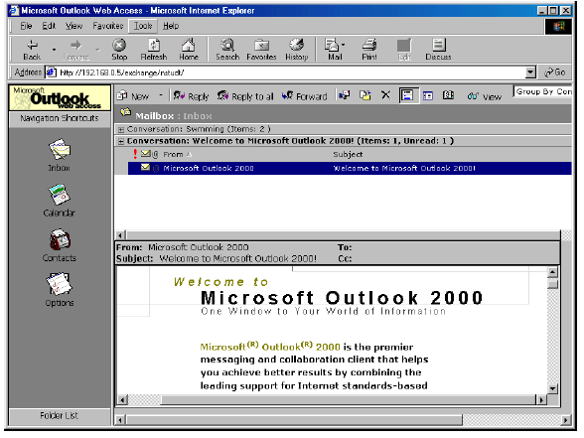
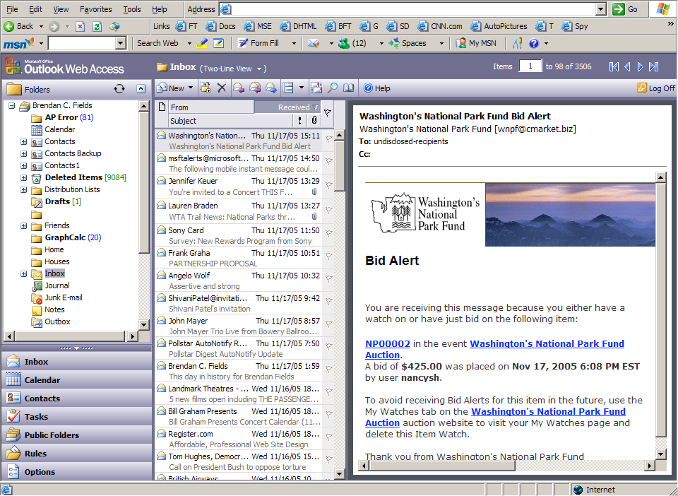
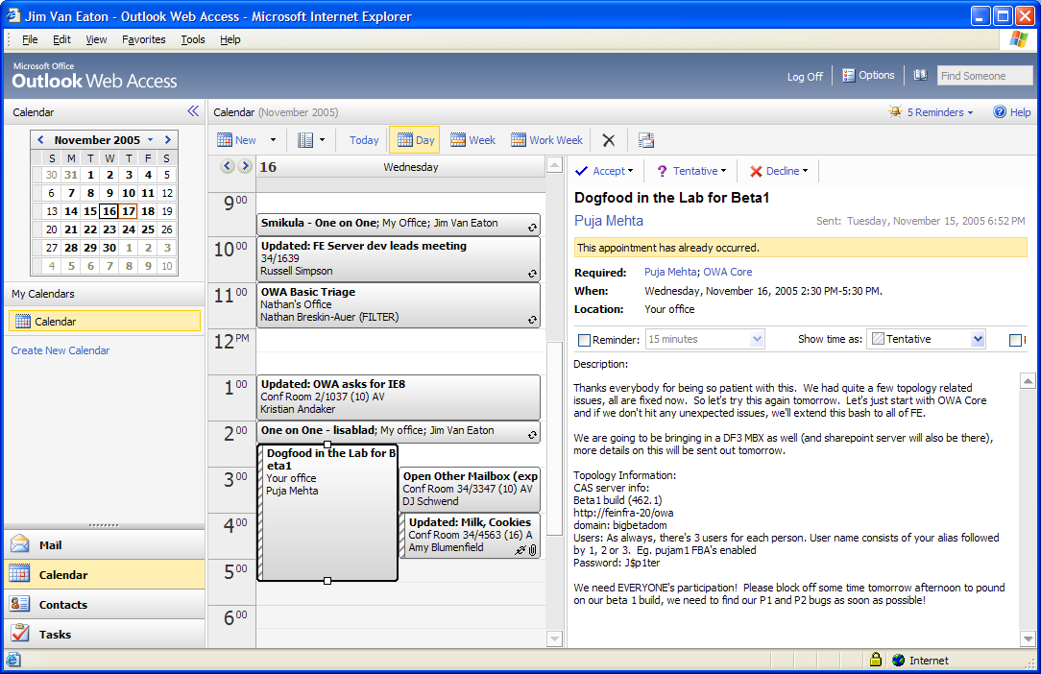
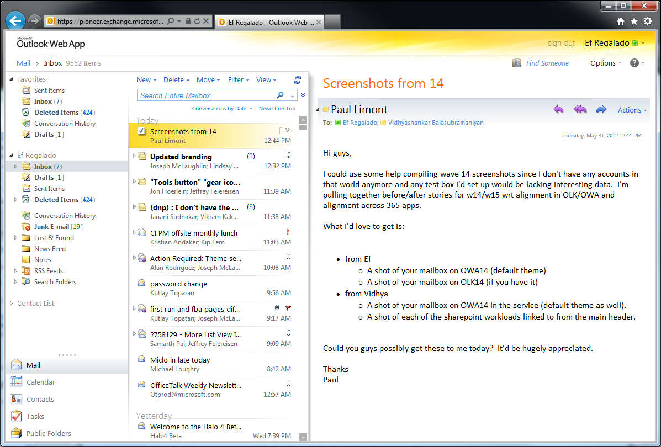
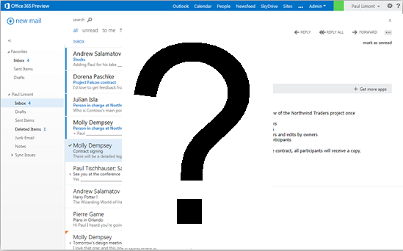
Outlook Web App Over the Years

Slide 5
Outlook Web App User Experience Goals
Fresh, Clean, Modern
Alignment to Windows 8 design language
Lighter, open feel focused on communication content
Built for Touch, Too
  Outlook Web App slate and phone UX is built from the ground up for touch and tablet/phone screen sizes.
Works like Outlook on any screen
Feel at home & productive wherever you are

Slide 6
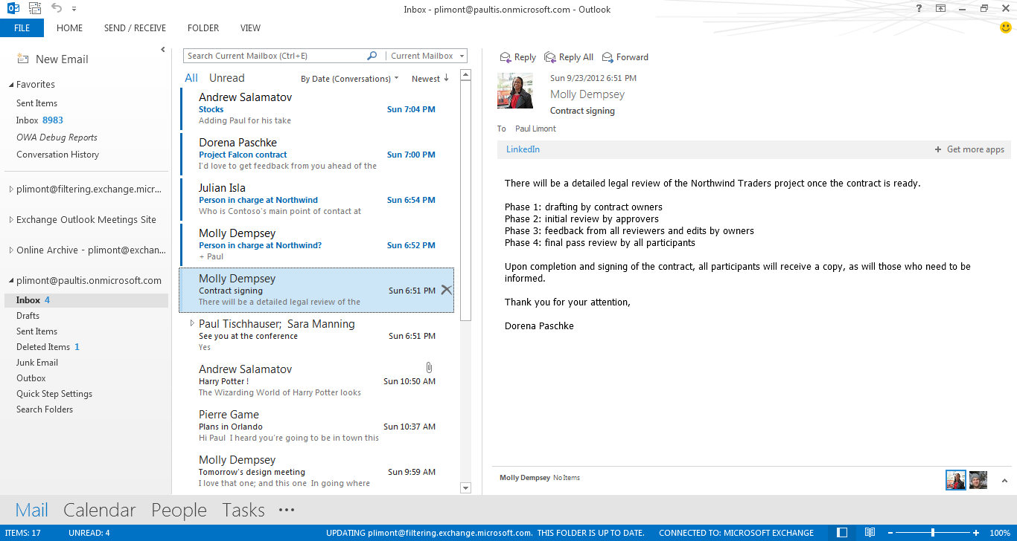
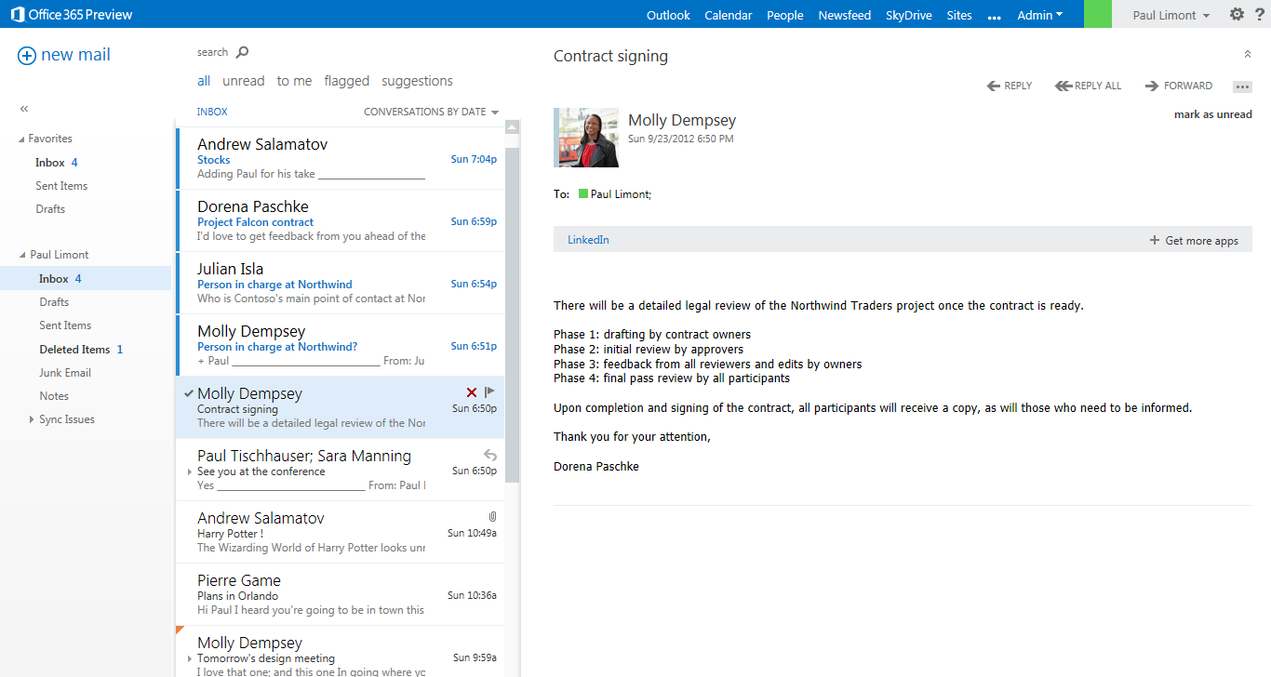
Outlook Web App + Outlook 2013
Notes:
6

Slide 7
Anytime, Anywhere, Any Device
One experience across screens
Visually & functionally - feel at home and productive with whatever device you’re using
Offline or online
Stay productive whether you are connected or not
Platform
Access the 3rd party content that makes your communications more effective & efficient
…All built on an Office365 datacenter hardened architecture & monitoring system

Slide 8
Across Any Device

Slide 9
Demo
Tour de Outlook Web App

Slide 10
Mail Highlights
New – Win8 look, built for mobile
Streamlined- inline compose, hover actions, pivots
Integrated- Office Web Apps, people search

Slide 11
Calendar Highlights
Rich – month+agenda, overlay, schedule
Quick – type, peek, drag, repeat
Useful – location, sharing

Slide 12
People Highlights
Unified – one view, linking
Beautiful – photos everywhere
Connected – Lync, LinkedIn

Slide 13
App Platform

Slide 14
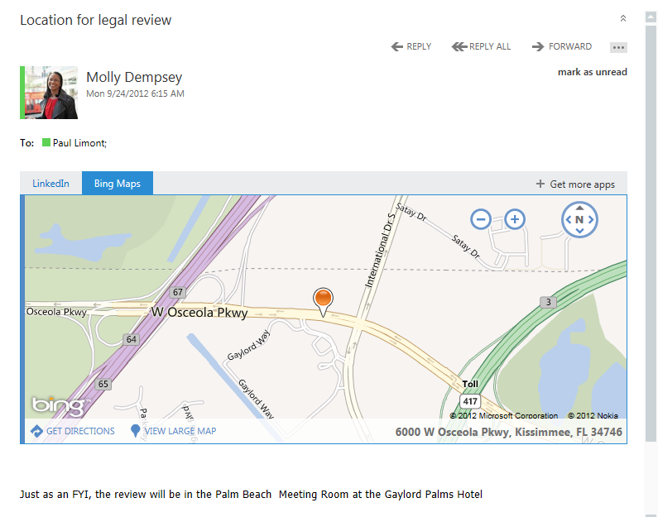
Mail apps
Built with web technologies
Contextual activation
Write once, run everywhere
Build your own LOB apps

Slide 15
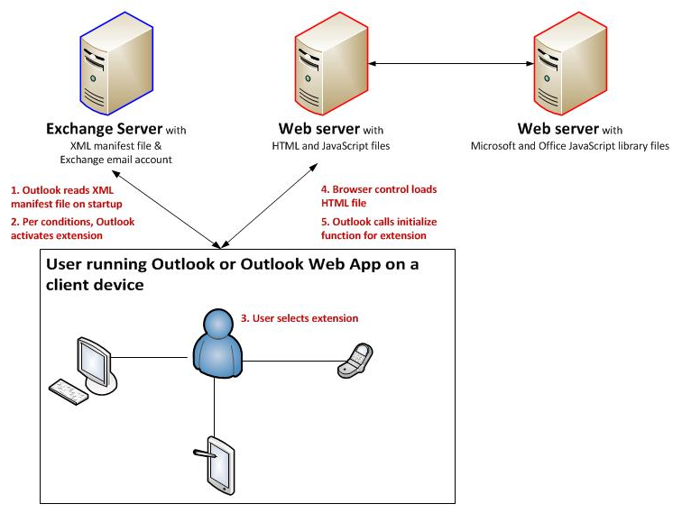
How it works
Exchange hosts manifest
Client creates frame to app
App loads Office JS library
Get started via MSDN here and here
Get apps here

Slide 16
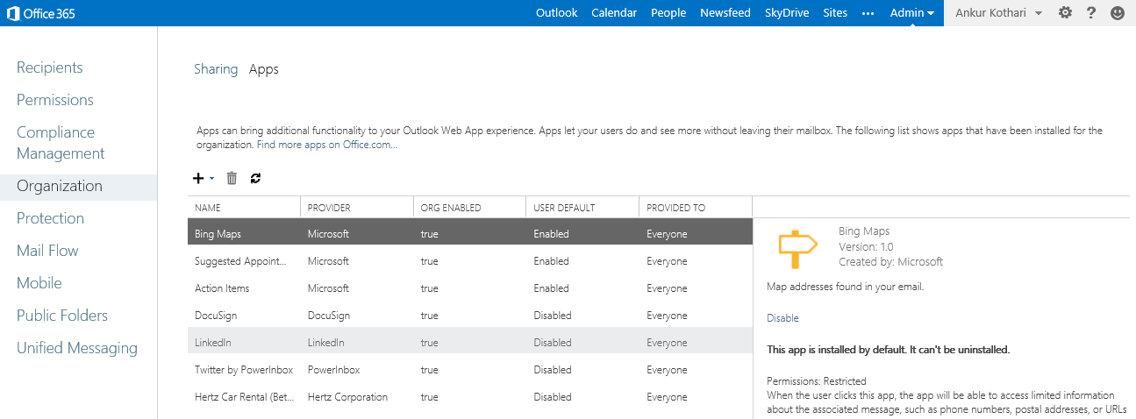
Managing apps
//Install a mandatory app for all users
New-App –OrganizationApp –Url “https://server.com/manifest.xml” -DefaultStateForUser AlwaysEnabled
//Set a marketplace app enabled for some users
Get-App –OrganizationApp |fl displayname,AppID
Set-App –OrganizationApp –Identity [AppId] –DefaultStateForUser enabled –ProvidedTo specificusers –UserList alias1,alias2,alias3
//Remove an organization app
Remove-App –OrganizationApp –Identity [AppId]
End-users can…
  Install apps from marketplace
  Enable/disable apps installed by admins
Admins can…
  Install apps from marketplace, or individual manifests
  Install apps for entire org, or individual users (PS)
  Block users from installing apps (PS)
  Manage apps straight from the Exchange Administration Center

Slide 17
Offline

Slide 18
Why?
Further our “Anytime, Anywhere” commitment
Evolve with the browser,
evolve with the web

Slide 19
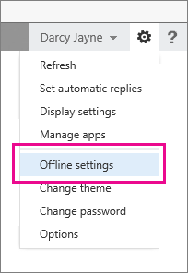
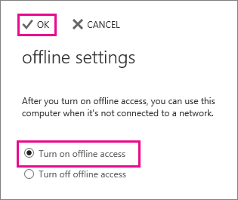
What Does the User See?
More info available here

Slide 20

How Does It Work?
OWA Client
  Data is sourced locally
  Activity is queued & replayed
  Server updates are copied as they happen
Exchange
Server
1
Offline Store
3
2

Slide 21
Storage
What
150-400 items per folder
Inbox, Drafts, recently used
All Contacts
A year of calendar
How
AppCache
IndexedDB or WebSQL
Where
Browser’s choice
Per URL, browser, user, machine
Browser
Outlook
Web
App
UI
JSON
Offline Store +
Business Logic
Folders & Items
Views
Notifications
Queued Actions
In IE:
%username%\
Local Settings\
Microsoft\
Internet Explorer\
Indexed DB\
Internet.edb
DB Abstraction
WebSQL
IDB

Slide 22
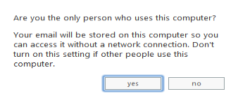
Data security
Browser DB is an emerging standard
Specific to a Windows user account
  User sees
  Admins can
Set-OwaMailboxPolicy –AllowOfflineOn [NoComputers|AllComputers|PrivateComputers]
Set-OwaVirtualDirectory –AllowOfflineOn [NoComputers|AllComputers|PrivateComputers]

Slide 23
Deployment and Monitoring

Slide 24
Things to be aware of
Spellcheck via the browser, not the server
  For IE users that means IE10
Features only supported in Outlook 2013 for now
  Public Folders (but existing Public Folders can be added under Favorites)
  S/MIME
  Shared email folders
  DL moderationCreate/edit Personal Distribution Lists
Pay attention to the Browser Support Matrix
  IE7 now gets OWA Light
Office 365 Policy: IE8 Not Supported After April 2014
  More info here

Slide 25
Deployment
Lync
Meet Pre-Req:
  Install Unified Communications Managed API 4.0
Enable IM
  Set-OwaVirtualDirectory –InstantMessagingType OCS – InstantMessagingEnabled $true
Add keys
<add key="IMCertificateThumbprint" value="<Exchange Certificate thumbprint>" />
<add key="IMServerName" value="<Lync server FQDN>" />
to OWA web.config on MBX server
Recycle the OWAAppPool
Office Web Apps
Enable
  Set-OrganizationConfig –WACDiscoveryEndpoint “<Office Web App Server URL>
Know the roles
Stateless CAS
Processing and storage on Mailbox Server
Get help
  2013 Deployment Assistant
Configure IM, Office Web Apps

Slide 26
Monitoring Overview
A new suite of probes that
  Run automatically via MSExchangeHM service
  Recover automatically when possible
    restart the application pool
    restart service
    restart the server
    escalate
We use it in Office 365!

Slide 27
Monitoring Tests
OwaSelfTest
  Verifies that the app pool is up and able to process requests (no user logon)
  1 instance per MBX server
OwaDeepTest
  Full logon through Outlook web App from the MBX server
  1 instance per MDB
OwaProxyTest
  Verifies that app pool is up and able to process and route requests
OwaCtp
  Runs from the CAS machines, validates Outlook Web App end-to-end
  1 instance per CAS server

Slide 28
Wrap

Slide 29
What’s new*
Mail
People
Calendar
Apps
Compose
Inline compose
List view draft management
Triage
Unread/Flagged/… filters
List view inline delete
List view preview text
Attachments
Win8 style filmstrip
Photo preview
Open in Office Web Apps
Search
Suggestions drop-down
Refiners
Hit highlighting
People-Centric
High-definition photos
Hover card
Person card
People search
Simplify Collecting People
People Hub
Contact Linking
Socially Connected
Connect to LinkedIn*
Connect to Facebook*
Capture and View Activities
Month+Agenda view
Overlaid calendars
Peeks
Natural input
Simplified recurrence
Schedule and Share
Improved scheduling
Location Card*
Simplified sharing
+ Windows 8 Design, Touch, Offline
* Office 365 only

Slide 30

Track resources
Office 365 Blog:
http://blogs.office.com/b/microsoft_office_365_blog/
Twitter:
Follow @ https://twitter.com/Office365
Connect:
http://www.linkedin.com/groups/Microsoft-Office-365-3724282
Check out:
Garage Series for IT Pros: www.microsoft.com/garage
Office 365 FastTrack: http://fasttrack.office.com//

Slide 31

Resources
Learning
  Sessions on Demand
  Microsoft Certification & Training Resources
http://channel9.msdn.com/Events/TechEd
www.microsoft.com/learning
TechNet
msdn
  Resources for IT Professionals
  Resources for Developers
http://microsoft.com/technet
http://microsoft.com/msdn

Slide 32



Evaluate this session
Required Slide
*delete this box when your slide is finalized
Your MS Tag will be inserted here during the final scrub.
Scan this QR code to
evaluate this session.

Slide 33

© 2013 Microsoft Corporation. All rights reserved. Microsoft, Windows and other product names are or may be registered trademarks and/or trademarks in the U.S. and/or other countries.
The information herein is for informational purposes only and represents the current view of Microsoft Corporation as of the date of this presentation. Because Microsoft must respond to changing market conditions, it should not be interpreted to be a commitment on the part of Microsoft, and Microsoft cannot guarantee the accuracy of any information provided after the date of this presentation. MICROSOFT MAKES NO WARRANTIES, EXPRESS, IMPLIED OR STATUTORY, AS TO THE INFORMATION IN THIS PRESENTATION.

