Slide 2
Microsoft Office 365 Education: Overview and Upgrades
OUC-B209
Jim Lucey
Sr. Technical Product Mgr
jlucey@Microsoft.com

Slide 3
The new Office
Productivity and collaboration in education

Slide 4


Technology shifts in education
Architects
Instruction
Educators
Institutions
Own the classroom experience – Look to be unique and innovative
Integrating technology seamlessly with teaching practices delivering impact to learning outcomes

Slide 5







Introducing | Your Modern Office
Devices
Cloud
Social
Control
Fast and fluid experience with touch, pen, mouse & keyboard
Immersive touch-optimized Windows 8 apps
Support for Windows phone, iOS & Android phones
Office - on demand, roaming & up-to-date
New cloud app development model
Enterprise-grade reliability and standards
Newsfeeds & microblogging
Pervasive social capabilities across Office
Multiparty HD video & Skype federation
DLP, data retention & unified eDiscovery
Reimagined deployment model for Office apps
Common management experience across Office 365

Slide 6









Office 365 At a Glance
Familiar and full Office user experience
Fast deployment and broad management controls
Works with your on premises email and storage
Per-user licensing
Online meeting with desktop sharing
IM & Presence across firewalls
GAL search with contact card
Windows Live federation
Access documents offline
Document-level permissions
My Sites to manage and share documents
Share documents securely with Extranet Sites
Free/busy coexistence
Integrated personal archiving
Retention policies and legal hold
25Gb mailbox with voicemail & unified messaging

Slide 7



Office 365 ProPlus
The Best Office Client Experience
Office 365
ProPlus
Office as a Service
User Across Devices
Office on Demand
Click To Run
Save to Cloud
Upgrades Included
See FAQ for Office 365 Pro Plus upgrade requirement

Slide 8

The Office 365 platform
Integrated best-of-breed solutions
LMS
SIS
ERP
MOOC
Recruitment
Grants
etc…
APIs and Web Services
Identity
Messaging
Voice & Video
Content
Management
Enterprise
Social
Reporting
& Analytics

Slide 9
Demo
Office 365 Education

Slide 10
Service Upgrades

Slide 11
Office 365 Upgrade Cadence
Monthly RTW
Upgrades may include small features/product changes built entirely in that window
More releases will ship with features turned off
Minor Upgrade
Major Upgrade
Features that take longer to implement are in progress simultaneously
11

Slide 12




Office 365 service upgrade in 2013
It’s not a big IT project
  All services will be upgraded in the background
  Minimal desktop remediation required
No end-user disruption
  Email clients—from PCs to mobile phones—stay connected
  Only Portal and OWA show immediate post-upgrade change
Upgrade on your terms
  Upgrade rich clients and SharePoint sites at your own pace
  “Pilot” the service upgrade and postpone if you want

Slide 13


Live@edu to Office 365 upgrade
Get more with Office 365
  Group collaboration, instant messaging, and conferencing through Lync Online and SharePoint Online, compliment the existing Exchange Online service for communication
No end-user disruption
  Email clients—from PCs to mobile phones—stay connected
  Outlook Web App interface generally unchanged
Prepare for Office 365
  All services will be upgraded automatically
  Work required to prepare for federation, identity and provisioning requirements on Office 365

Slide 14
Live@edu Upgrade Experience Overview
1
Prepare customer space in Office 365
  Start the Upgrade
Admin | Action: None Impact: Tasks unavailable for Domain management Co-branding Institution address and phone Enabling SSO | Action: Communicate to users. Start the upgrade prior to scheduled date or wait for Microsoft to start the upgrade automatically. Ensure ready to move to new provisioning and federation technology.
End User | Action: None Impact: None | Action: None Impact: Connecting through new URL
Microsoft | Action: Prepare customer in Office 365 Create tenant in Office 365 and sync all Exchange Online objects into Office 365 directory store. | Action: Upgrade customer to Office 365 Enroll tenant in Office 365 Exchange Online Plan 1 subscription Assign Office 365 licenses Decouple from Windows Live Enable Office 365 admin account

Slide 15
Upgrade experience: by workload
Email | Upgrading to Office 365 for education doesn’t require moving any email, calendars, or contacts
Windows Live | All windows live services are de-coupled and end users take ownership of account and content
Password | End users sign in to Office 365 with the same password used on Live@edu. Passwords are copied from Windows Live.
 | Customers moving to federation bypass the password experience
Provisioning | Run the OLMA/OLSync cleanup tool post upgrade Deploy Office 365 provisioning tools: DirSync (AD), MSOMA (non-AD) or PowerShell
Single Sign-On | SSO Toolkit limited support Move to supported federation technologies: ADFS 2.0 or Shibboleth
Office 365 service upgrade | The service upgrade for institutions will begin after the move to Office 365 and is automatic. There is nothing school administrators or users need to do.

Slide 16

Dual identity: end-user experience
A self-managed personal Microsoft account, with continued access post-graduation.
An organization managed Office 365 account
Before Upgrade
After Upgrade
Windows
Windows
Office 365
Microsoft account
Skype
Microsoft account
Skype
MSOID
SkyDrive
Live@edu Outlook Live
SkyDrive
Exchange Online
Tenant
Live@edu Identity
Microsoft account – Managed
ID: sarah@contoso.edu
PWD: APassWord!
WLID PUID: 1234
Personal Identity
Microsoft account – Consumer
ID: sarah@contoso.edu
PWD: APassWord!
WLID PUID: 1234
Institution Identity
Organization ID – Managed
ID: sarah@contoso.edu
PWD: APassWord!
OrgID PUID: 5678

Slide 17
Upgrade experience: system requirements
Client | Internet Explorer 9 or newer supported Windows XP and Windows Vista will be supported until end of 2013.
Desktop | Office 2007 and newer supported
Provisioning | Upgrade to Office 365 supported provisioning tool If using Outlook Live Management Agent (OLMA) or OLSync, run a clean up script post upgrade. If using OLMA/OLSync with ILM, install Windows Directory Synchronization (DirSync) or use custom PowerShell.
Single Sign On | ADFS 2.0 or Shibboleth Federation services replaces the Single Sign On Toolkit. Note: Single Sign-On Toolkit 4.5 available for existing SSO Toolkit organizations
The following changes will be required:
Update URL from outlook.com to outlook.com/[domain_name]
Learn more: http://go.microsoft.com/fwlink/?LinkID=296592&clcid=0x409

Slide 18
Office 365 for education: licensing
Voice
EES or MOSA service agreement needed post upgrade to add on a stand-alone or suite subscription
Plan A4
Includes:
Exchange Plan 2
SharePoint Plan 2
Lync Plan 3
Office ProPlus
Office Web Apps
Lync Plus (Voice)
Office Pro Plus
Plan A3
Includes:
Exchange Plan 2
SharePoint Plan 2
Lync Plan 2
Office ProPlus
Office Web Apps
Voicemail & Compliance Archiving
Access, Excel, Forms,
Visio Services
Office Web Apps
Plan A2
Includes:
Exchange Plan 1
SharePoint Plan 1
Lync Plan 2
Office Web Apps
IM & Presence
Collaboration Portal
Conferencing
Upgrade from Live@edu
Email, calendar, AV/AS, Personal Archive
Exchange Plan 1
Students | Free |  | Free | $2.50/month | $3/month
Faculty/Staff | Free |  | Free | $4.50/month | $6/month
Estimated retail prices listed above per user, per month

Slide 19
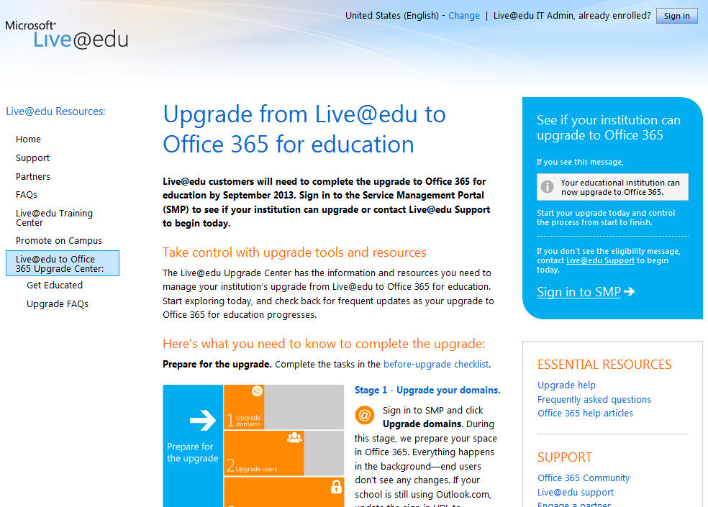
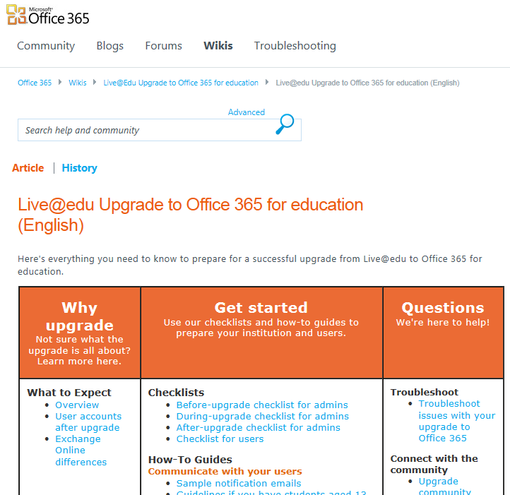


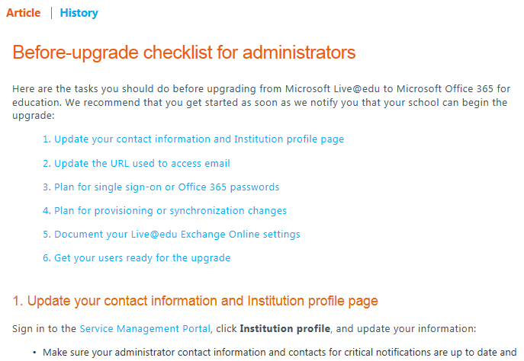
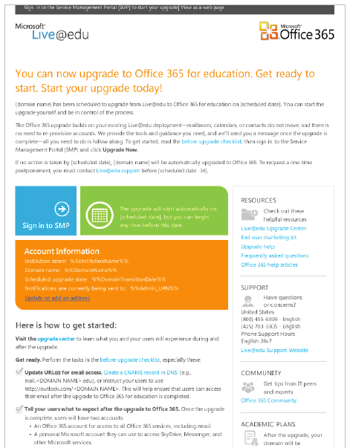
Resources and Support Available
In Person
Live@edu Upgrade Center
Partners
Phone
Online
Support
Upgrade FAQs
Link to online support and partners
Got questions?
Forum/ Help content (wiki) / Technical blog
Customer Communications
Community
E-mail
19

Slide 20




Educational Value of Your Modern Office
Best experience across devices
Anytime, anywhere learning
Security without compromise
Run it on your terms

Slide 21

Resources
Learning
  Sessions on Demand
  Microsoft Certification & Training Resources
http://channel9.msdn.com/Events/TechEd
www.microsoft.com/learning
TechNet
msdn
  Resources for IT Professionals
  Resources for Developers
http://microsoft.com/technet
http://microsoft.com/msdn

Slide 22



Evaluate this session
Required Slide
*delete this box when your slide is finalized
Your MS Tag will be inserted here during the final scrub.
Scan this QR code to
evaluate this session.

Slide 23

© 2013 Microsoft Corporation. All rights reserved. Microsoft, Windows and other product names are or may be registered trademarks and/or trademarks in the U.S. and/or other countries.
The information herein is for informational purposes only and represents the current view of Microsoft Corporation as of the date of this presentation. Because Microsoft must respond to changing market conditions, it should not be interpreted to be a commitment on the part of Microsoft, and Microsoft cannot guarantee the accuracy of any information provided after the date of this presentation. MICROSOFT MAKES NO WARRANTIES, EXPRESS, IMPLIED OR STATUTORY, AS TO THE INFORMATION IN THIS PRESENTATION.

