Slide 2
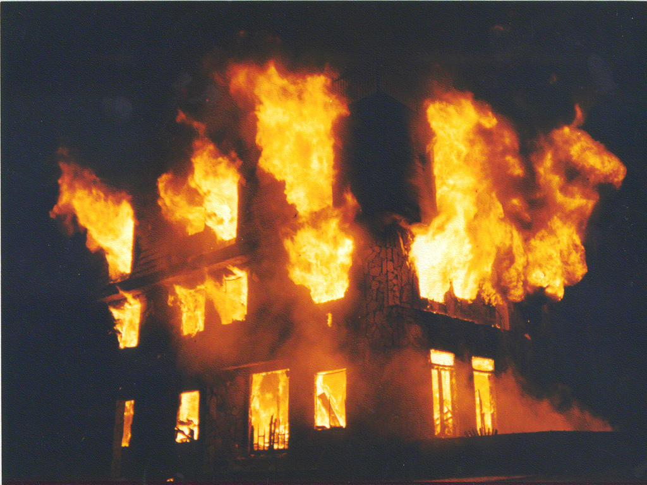
Source:
deviantart.com

Slide 3
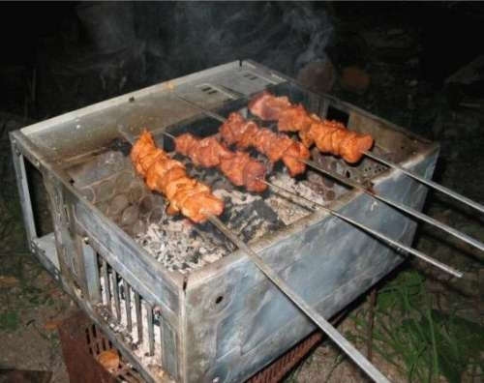
Source:
green.cx

Slide 4
Source:
knowyourmeme.com

Slide 5
Source:
tumblr.com

Slide 6
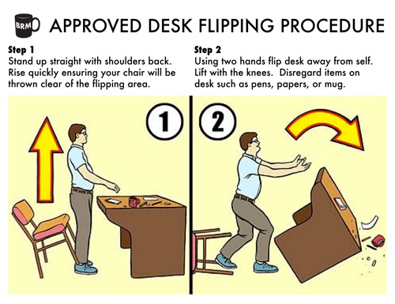
Source:
mergerecords.com

Slide 7
Source:
wallpapersuggest.com

Slide 8
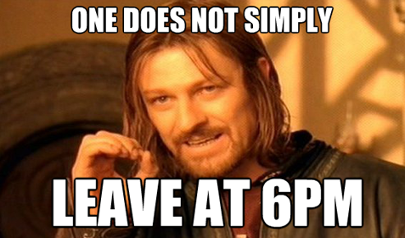
Source:
moroch.com

Slide 9
Source:
visualphotos.com

Slide 10
Source:
makingitreallywork.com

Slide 11
Source:
froot.nl

Slide 12
Source:
hcocinc.com

Slide 13
Source:
dawnkinzer.com

Slide 14
Source:
highestfive.com and virtualcareeradvice.com

Slide 15
Source:
newslacostera.com

Slide 16
Designing for High Availability and Disaster Recovery in Microsoft Lync Server 2013
OUC-B303
Justin Morris
Lync MVP and Senior Consultant
Modality Systems

Slide 17
Agenda

Slide 18
Agenda
Defining High Availability & Disaster Recovery in Lync Server 2013
The story so far – what was available previously?
Changes in Front End Server Architecture
Hardware and DNS Load Balancing
New Pool Back End Resiliency Features
New Site Resiliency Features
Scenarios that are no longer supported
File Share High Availability
Persistent Chat Resiliency
Edge Server Resiliency
Branch Office Resiliency
Key Takeaways

Slide 19
Defining High Availability & Disaster Recovery in Lync Server 2013

Slide 20
Defining HA and DR in Lync Server 2013
High Availability
Quick, usually automated recovery of an application or service
Automatic failover of data/server unit
Each component within the same data center is resilient
Disaster Recovery
Only activated when things have really gone bad
Manually activated failover/recovery of an entire pool or site
Outside of the primary data center

Slide 21
The Story So Far

Slide 22
The Story So Far
Office Communications Server 2007 R2
Enterprise Edition Pool - HA
Metropolitan Site Resiliency Solution – HA/DR
Recovering from backup was most organizations only real option
Lync Server 2010
Enterprise Edition Pool - HA
Metropolitan Site Resiliency Solution – HA/DR
Backup Registrar – voice resiliency was priority – HA
Restoring non-voice workloads required recovering from backup

Slide 23
What did Metropolitan Site Resiliency Look Like?
2 Data Centers
Under 20 ms network latency
1 Gbps bandwidth
Stretched VLAN
SQL Cluster
Synchronous SAN Replication
Source:
Modality Systems

Slide 24
Changes in Front End Server Architecture

Slide 25
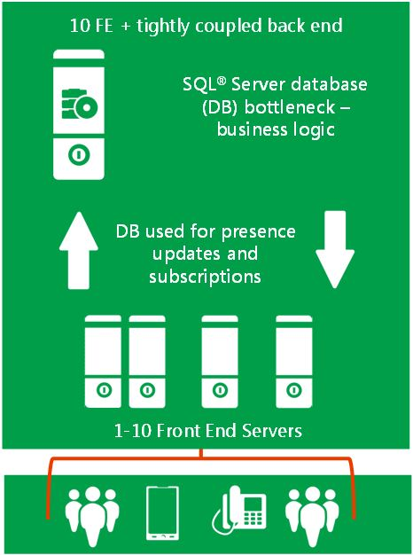
Front End Pool Architecture in Lync Server 2010
Centralized design with Front Ends tightly coupled to SQL databases
All user data stored in SQL. Every transaction has to be committed
Hard limit of 10 Front End servers in a pool
Source:
Microsoft

Slide 26
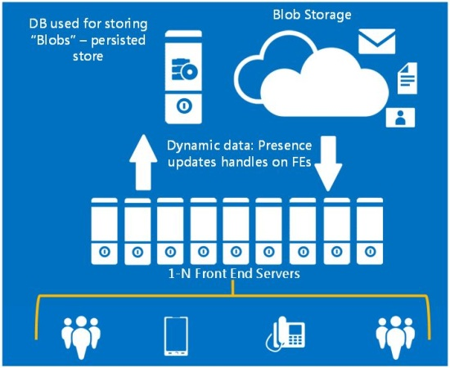
Front End Pool Architecture in Lync Server 2013
User and presence data now stored on FE servers
Lync users are automatically mapped to “UserGroups”
Each UserGroup is dynamically assigned to 3 Front End servers within a Pool (a Primary, a Secondary and a Tertiary)
Source:
Microsoft

Slide 27
Front End Pool Architecture in Lync Server 2013
All user data in RtcLocal database on 3x FEs (User Group). Replicated by Windows Fabric
Sync Agent backs up data from RtcLocal DB on FEs to RtcXds XML blob store in back end every 30 seconds (lazy backup)
= far less dependency on backend SQL

Slide 28
Front End Pool Architecture in Lync Server 2013
Pool Quorum – all nodes need to be able to connect to 50% of the pool. Backend holds quorum
Recommended minimum number of Front End servers in a pool is three
Total number of Front End servers in the pool | Number of servers that must be running for pool to be functional
1-2 | 1
3-4 | 2
5-6 | 3
7-8 | 4
9-10 | 5
11-12 | 6

Slide 29
Front End Pools with Two Front End Servers
If one of the two Front End Servers goes down, bring it back up ASAP
If you need to take both down at once, plan this carefully. Front Ends check Back End for start up order
If you can’t deploy a Front End Pool with 3 Front End servers, consider paired Standard Edition servers

Slide 30
Hardware and DNS Load Balancing

Slide 31
Hardware and DNS Load Balancing
Provides node level resiliency
DNS load balancing introduced in Lync Server 2010
DNS LB load balances all SIP/media traffic for Front End, Director, Edge, Mediation Server pools

Slide 32
Hardware and DNS Load Balancing
HLB traditionally a pain point for Lync deployments
HLB still required for Front End/Director web traffic
HLB required for new Office Web Apps farm
HLB required for backwards compatibility with OCS/Exchange 2010 (Pre SP1)

Slide 33
New Pool Back End Resiliency Features

Slide 34
New Pool Backend Resiliency Features
SQL Mirroring now supported!
Principal + Mirror Nodes in Active/Passive
In-site deployment supported only. Cannot stretch across data centers
Deploy an optional witness for automatic failover
RTO/RPO of 5 minutes

Slide 35
How Lync 2013 utilizes SQL Mirroring
Synchronous mirroring (high safety mode)
All databases (including CMS) can be mirrored
Principal and mirror servers must be same version and edition of SQL Server
A single witness can be used for multiple pools
Witness can be different version, including SQL Express

Slide 36
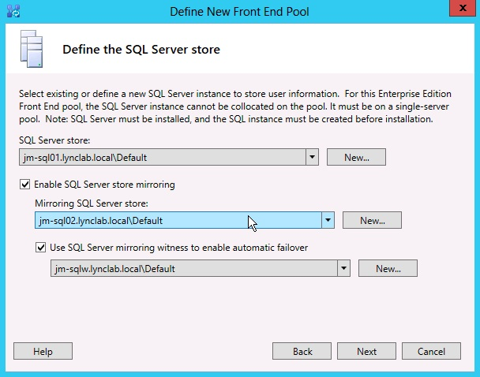
How is SQL Mirroring setup?
Deployed and configured within Lync Server Topology Builder
No configuration in SQL Management Studio required
Management via cmdlets in LSMS
Can be configured after initial deployment
Source:
Modality Systems

Slide 37
Failing over a Mirrored Database
Can be controlled on a per database type basis
Witness deployed? Sit back and relax. ☺
No witness requires manual intervention:
First check which server currently hosts the databases
Then invoke a manual failover of the user, CMS and application databases

Slide 38
Manually failing over a mirrored database
Get-CsDatabaseMirrorState -PoolFqdn <poolFQDN>
Invoke-CsDatabaseFailover -PoolFqdn <poolFQDN> -DatabaseType User -NewPrincipal mirror
Invoke-CsDatabaseFailover -PoolFqdn <poolFQDN> -DatabaseType Application -NewPrincipal mirror
Invoke-CsDatabaseFailover -PoolFqdn <poolFQDN> -DatabaseType CentralMgmt -NewPrincipal mirror

Slide 39
Backend Server Failover - Before
Front End Servers are connected to the SQL Principal Node.
Mirror node is up to date with database state.
Source:
Modality Systems

Slide 40
Backend Server Failover - After
With witness:
SQL witness detects Principal node failure and fails over databases to the Mirror node
Front End servers detect failure and redirect SQL connectivity to Mirror node
Without witness:
Administrator must manually invoke failover
Source:
Modality Systems

Slide 41
User Experience During Backend Server Failure
If a witness is configured
Failover happens automatically and the user shouldn’t see much change to service
If no witness is configured
Administrator must manually invoke failover
Sessions will continue for 30 minutes until client realizes the back end is unavailable, at which point Lync will go into resiliency mode

Slide 42
Failing back a mirrored database
Get-CsDatabaseMirrorState -PoolFqdn <poolFQDN>
Invoke-CsDatabaseFailover -PoolFqdn <poolFQDN> -DatabaseType User -NewPrincipal primary
Invoke-CsDatabaseFailover -PoolFqdn <poolFQDN> -DatabaseType Application -NewPrincipal primary
Invoke-CsDatabaseFailover -PoolFqdn <poolFQDN> -DatabaseType CentralMgmt -NewPrincipal primary

Slide 43
Why Backend Database Mirroring Rocks
Makes SQL database/server maintenance easy
Monitoring and management of database failover/failback is owned by Lync admins, not SQL team
No more dependency on shared storage

Slide 44
Demo – SQL Database Mirroring

Slide 45
New Site Resiliency Features

Slide 46
New Site Resiliency Features
Front End Pool Pairing
Provides full disaster recovery of Lync functionality across data centers
User data is shared across both Front End pools
Paired pools should be located in the same world region (e.g. both in North America or Europe)
Backup Service installed on each Front End server replicates user data

Slide 47
Front End Pool Pairing Requirements
Pair only two pools of the same version e.g. Enterprise + Enterprise or Standard + Standard
Physical with physical, virtual with virtual
Best practice: size each pools to take the load of both
RTO/RPO of 30 minutes

Slide 48
User Experience During Pool Failover
Clients are logged out
Users cannot log back in until failover is invoked by admin
Will be in resiliency mode until failover is completed
Once failover is completed, clients recover from Limited Functionality Mode

Slide 49
Front End Pool Failover - Before
All users connected to their primary pool
User data is being replicated between the paired pools
Source:
Modality Systems

Slide 50
Front End Pool Failover - After
Clients re-register with backup pool
Users are not re-homed to the backup pool, rather are “temporarily serviced” by the backup pool
Source:
Modality Systems

Slide 51
Invoking a Pool Failover
Invoke-CsPoolFailover –PoolFQDN <PoolFQDN> -DisasterMode
Process will take several minutes to complete (depending on number of users)
Same cmdlet for failover and failback
Pool failback takes longer because data from the backup pool needs to be backed up to the recovered primary pool before failover can occur

Slide 52
Understanding the new Backup Service
Installed by Deployment Wizard after pool pair is created in Topology Builder
Synchronizes all user and conference data between paired pools
Runs on every Front End server
Cmdlets to monitor/manage:
Get-CsBackupServiceConfiguration / Set-CsBackupServiceConfiguration
Get-CsBackupServiceStatus
Invoke-CsBackupServiceSync

Slide 53
Understanding the new Backup Service
Backup Agent writes from RtcXds DB in primary pool to file share
Data is copied to backup pool
Sync Agent on backup pool writes data into RtcLocal DB on FE servers

Slide 54
Demo – Pool Pair Failover

Slide 55
Scenarios That Are No Longer Supported

Slide 56
Scenarios That Are No Longer Supported
SQL clustering no longer supported – path is to migrate to SQL mirroring
Migrated Lync 2010 pools (not OCS 2007 R2) can still use SQL clustering
Metropolitan Site Resiliency Solution no longer supported - path is to migrate to Front End pool pairing
No longer supported because of quorum. If one site fails, 50% of the pool is gone and all Front End servers will shut themselves down

Slide 57
File Share High Availability

Slide 58
File Share High Availability
Distributed File System (DFS) supported
Replication within a single data center only
Best effort
Clustered File Server still supported
Keep a backup ☺

Slide 59
Persistent Chat Resiliency

Slide 60
Persistent Chat Resiliency
Stretched Persistent Chat pool across sites
SQL mirror pair in one site, backup DB in the other using log shipping
Two topology options:
Two data centers with high bandwidth, low latency links
Two data centers with low bandwidth, high latency links

Slide 61
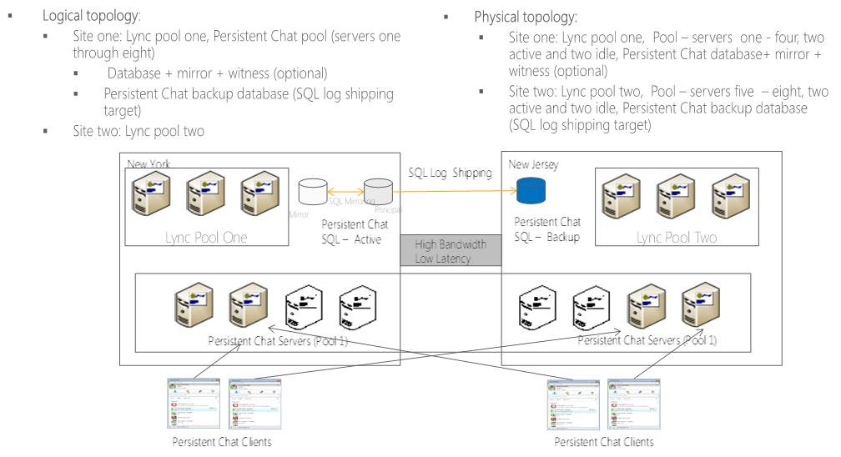
High Bandwidth, Low Latency Topology
Source:
Microsoft

Slide 62
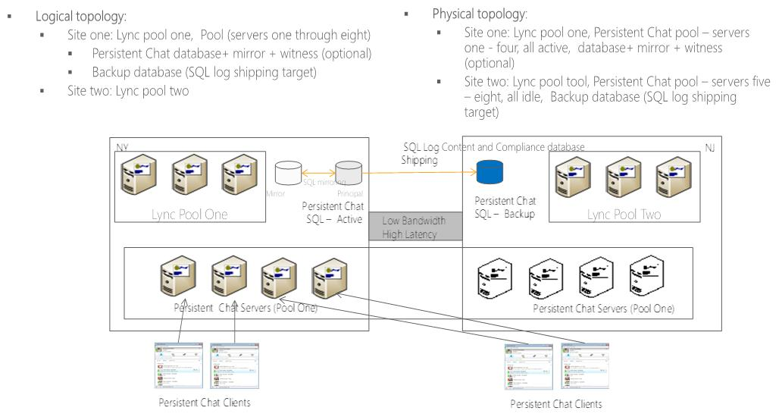
Low Bandwidth, High Latency Topology
Source:
Microsoft

Slide 63
Edge Server Resiliency

Slide 64
Edge Server Resiliency
Determine your HA requirements for remote access, federation and PIC
Deploy a multiple computer Edge Server pool in each site with DNS load balancing
Some route modifications required in Topology Builder when failures occur
Global Server Load Balancing an option

Slide 65
Branch Office Resiliency

Slide 66
Branch Office Resiliency
Survivable Branch Appliance
Provide local Registrar and Mediation services for voice in the end of WAN failure
For 25 – 1000 users
Survivable Branch Server + Gateway
For 1000 - 2000 users
Configure failover voice routes
Backup Registrar
Functionality is still many to one (many SBAs to one Front End pool)

Slide 67
Branch Office Resiliency
New Remote Branch Appliance
Branch survivability using 3G/4G failover
SBA v2 Specifications
<25 users
Virtualization

Slide 68
Key Takeaways

Slide 69
Key Takeaways
Determine your HA requirements before deploying
High Availability in Lync Server 2013 has stepped up a gear – SQL mirroring and pool pairing
Front End Architecture has changed radically
More resiliency intelligence built into the product
Persistent Chat has its own specific HA requirements

Slide 70
Q&A

Slide 71
Related content
Breakout Sessions (session codes and titles)
Hands-on Labs (session codes and titles)
Book - Lync Server 2013 Unleashed
Related Certification Exam
Find Me Later At the Lync both in TechExpo and on twitter @justimorris

Slide 72
Resources
Learning
Sessions on Demand
Microsoft Certification & Training Resources
http://channel9.msdn.com/Events/TechEd
www.microsoft.com/learning
TechNet
msdn
Resources for IT Professionals
Resources for Developers
http://microsoft.com/technet
http://microsoft.com/msdn

Slide 73
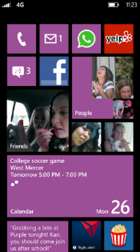
Evaluate this session
Required Slide
*delete this box when your slide is finalized
Your MS Tag will be inserted here during the final scrub.
Scan this QR code to
evaluate this session.

Slide 74
© 2013 Microsoft Corporation. All rights reserved. Microsoft, Windows and other product names are or may be registered trademarks and/or trademarks in the U.S. and/or other countries.
The information herein is for informational purposes only and represents the current view of Microsoft Corporation as of the date of this presentation. Because Microsoft must respond to changing market conditions, it should not be interpreted to be a commitment on the part of Microsoft, and Microsoft cannot guarantee the accuracy of any information provided after the date of this presentation. MICROSOFT MAKES NO WARRANTIES, EXPRESS, IMPLIED OR STATUTORY, AS TO THE INFORMATION IN THIS PRESENTATION.

