Slide 2
Exchange in the cloud. Scared of losing your job?
OUC-B312
Jaap Wesselius

Slide 3
Agenda
Introduction
Public Cloud vs Private Cloud
Identities & Migration
Coexistence
Understanding Single Sign-on
Summary

Slide 4
Introduction

Slide 5
Introduction
Jaap Wesselius
System Architect at Amsio
Exchange Server MVP
Author of the book “Exchange Server 2010 – A practical approach”
Frequent blogger
Frequent speaker at major events

Slide 6
Starting point
You’re an Exchange Administrator
You’re responsible for running Exchange (on-premises)
You do a pretty good job (you think ☺)
Your manager heard about ‘the cloud’
And wants it!
Now what…. Afraid? Changes? Opportunities?

Slide 7
Misunderstanding about the Cloud
I’m going to lose my job
The cloud means less IT Staff
Every loser can become an IT administrator
Everything is moving to the Cloud
The Cloud is much cheaper
Even the IT Manager can manage the Cloud

Slide 8
Definition of Cloud Technology
National Institute of Standards Technology (NIST)
NIST definition is used by Microsoft
NIST definition lists five essential characteristics:
On-demand self service
Broad network access
Resource pooling
Rapic elasticity or expansion
Measured service

Slide 9
NIST Service Models
NIST also lists three "service models“:
Software as a Service (SaaS) – Office 365
Platform as as Service (PaaS) - Azure
Infrastructure as a Service (IaaS) – Plain servers
Where does PaaS stop and where does IaaS start?

Slide 10
NIST Deployment Models
Private Cloud – dedicated for one customer
Can be located on-premises or in hoster datacenter
Public Cloud – available to everyone
Compare to electricy from wall outlet
Community Cloud – shared amongst multiple organizations or users
Hybrid Cloud – Combination of these three models
Office 365 can be hybrid, combination of Public Cloud and Private Cloud

Slide 11
Exchange in the cloud?
Public (Hybrid) Cloud – Office 365 or local hoster
x number of mailboxes in shared platform
On-demand self service
Federated with on-premises Exchange (if needed)
Private Cloud – local hoster
Azure officially does not support installing Exchange server
X number of servers
On-demand self service
Dedicated Exchange environment
Connected to on-premises Active Directory (if needed)

Slide 12
Exchange in Private Cloud
Exchange in Private Cloud is ‘extension’ of local network
Can be on-premises or in (hoster) datacenter
IaaS → you are still responsible for OS, Exchange and all services
Paas → Service Provider is responsible for OS, you are reponsible for Exchange and all services
Very flexible, self-service and measured

Slide 13
Exchange in Public Cloud
Exchange is shared platform
Can be Office 365 or local Service Provider
Often combined with other services
Exchange is (large) shared platform
Provider is responsible for OS, Exchange and all services
You are responsible for Identies, Mailboxes and Migration of data and end-user support

Slide 14
Key take aways
Definition of Cloud according to NIST
Characteristics
Service Models
Deployment Models
Cloud technology means flexibility
Private Cloud (Azure) is dedicated
Exchange Administrator job not likely to change much
Public Cloud (Office 365) is shared
Exchange Administrator job very likely to change

Slide 15
Identities & Migrations

Slide 16
Understanding Identities
Cloud Identity
Federated Identity
Separate credential from on-premises credential
Authentication occurs via cloud directory service
Password policy is stored in Office 365
Does not require on-premises server deployment
Same credential as on-premises credential
Authentication occurs via on-premises directory service
Password policy is stored on-premises
Requires on-premises DirSync server
Requires on-premises ADFS server

Slide 17
Understanding Identities
 | Cloud Identity | Cloud Identity + DirSync | Federated Identity
Scenario | Smaller organizations with or without on-premises Active Directory | Medium to Large organizations with Active Directory on-premises | Large enterprise organizations with Active Directory on-premises
Benefits | Does not require on-premises server deployment | “Source of Authority” is on-premises Enables coexistence | Single Sign-On experience “Source of Authority” is on-premises 2 Factor Authentication options Enables coexistence
Limitations | No Single Sign-On No 2 Factor Authentication options Two sets of credentials to manage Different password policies | No Single Sign-On No 2 Factor Authentication options Two sets of credentials to manage Different password policies Requires on-premises DirSync server deployment | Requires on-premises ADFS server deployment in high availability scenario Requires on-premises DirSync server deployment

Slide 18
Provision Identies
Manually using Control Panel
Batched via CSV file (Control Panel)
Directory Synchronization (DirSync)

Slide 19
Directory Synchronization
What is DirSync
Application that synchronizes on-premises Active Directory with Office 365
Synchronizes adds/deletes/modifications of users, groups, and contacts from on-premise to Office 365
New version released: also performs password synchronization!
Designed as a software based “appliance”
“Set it and forget it”
x64 version based on FIM 2010
Bundled with SQL Server 2008 R2 Express Edition

Slide 20
Purpose of DirSync
Enables “run state” administration and management of users, groups, and contacts
Synchronizes adds/deletes/modifications of users, groups, and contacts from on-premise to Office 365
Enabler for Single Sign-On
Not intended as a single use bulk upload tool

Slide 21
Standard Microsoft migration options
IMAP Migration
Supports wide range of email platforms
Email only (no calendar, contacts, or tasks)
Cutover Exchange Migration (CEM)
Good for fast, cutover migrations
No migration tool or computer required on-premises
Staged Exchange Migration (SEM)
No migration tool or computer required on-premises
Requires Directory Synchronization with on-premises AD
 | IMAP migration | Cutover migration | Staged migration | 2010 Hybrid | 2013 Hybrid
Exchange 5.5 | ■
Exchange 2000 | ■
Exchange 2003 | ■ | ■ | ■ | ■
Exchange 2007 | ■ | ■ | ■ | ■ | ■
Exchange 2010 | ■ | ■ |  | ■ | ■
Exchange 2013 | ■ | ■ |  |  | ■
Notes/Domino | ■
GroupWise | ■
Other | ■
Simple Migrations
Hybrid Deployment
Manage users on-premises and online
Enables cross-premises calendaring, smooth migration, and easy off-boarding
Hybrid
* Additional options available with tools from migration partners

Slide 22
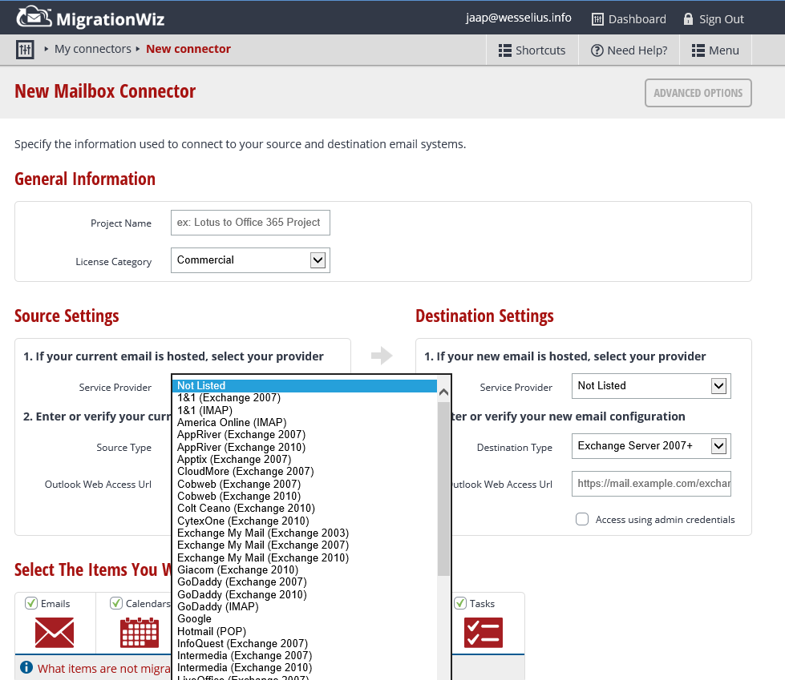
3rd Party migration options
Migrationwiz (www.migrationwiz.com)
Real cloud migration service

Slide 23
Cutover Exchange Migration

Slide 24
Cutover Exchange Migration (CEM)
Simple and quick migration solution
High-fidelity solution – all mailbox content is migrated
Typically best suited to small and medium organizations
Up to 1,000 mailboxes
Users are provisioned automatically during migration
Works with Exchange 2003 and newer
Works with on-premises or hosted Exchange systems

Slide 25
CEM - Architecture
On-premises Exchange Org
Office 365
Users, Groups, Contacts via Outlook Anywhere (NSPI)
Mailbox Data via Outlook Anywhere (RPC over HTTP)
Exchange 2003 or later

Slide 26
CEM – Accounts and Passwords
Accounts Provisioning
Migration creates users, mailboxes, DLs and contacts
Migration enables replies to migrated messages (i.e. provision process brings over the Legacy DNs)
Passwords
No access to passwords from source directory
New passwords created for all users
A link to download passwords is sent to admin
Users must change password on their first login

Slide 27
CEM – User Experience
Admin needs to distribute new passwords to users
Users create their new Outlook profile using O365 username and new passwords (Autodiscover)
All mail is downloaded from the Office 365 mailbox (i.e. the OST file must be recreated)

Slide 28
Staged Exchange Migration

Slide 29
Staged Exchange Migration (SEM)
Simple and flexible migration solution
High-fidelity solution – all mailbox content is migrated
Typically best suited to medium and large organizations
Users are provisioned with Directory Sync prior to migration
No limit on the number of mailboxes
Works with Exch 2003 and 2007 only, on-premises or hosted
Identity management on-premises
On-premises migration tool is not required

Slide 30
SEM - Architecture
On-premises Exchange Org
Office 365
Users, Groups, Contacts via DirSync
Office 365 Directory Synchronization
App
Mailbox Data via Outlook Anywhere (RPC over HTTP)
Exchange 2003 or 2007

Slide 31
SEM – Accounts and Passwords
Accounts Provisioning
For every on-premises mailbox to be migrated there needs to be a MEU or Mailbox in Office 365
Migration tool relies on DirSync to do provisioning
Passwords
Target mailbox passwords must be specified for all the users
Administrators can force users to change passwords on first login

Slide 32
SEM – User Experience
Admin needs to distribute new passwords to users
Users create their new Outlook profile using O365 username and new passwords (Autodiscover)
All mail is downloaded from the Office 365 mailbox (i.e. the OST file must be recreated)

Slide 33
Key take aways
Cloud Identities versus Federated Identies
Three different migration solutions:
IMAP or 3rd party migration → Non Exchange source platform
CEM → Big bang for smaller organizations
SEM → Staged migration with DirSync
What does this mean for Exchange admin?
Migration work
Less dedicated Exchange related activities
More Identity and network related activities

Slide 34
Coexistence and Hybrid

Slide 35
What is coexistence
Some users are provisioned in Office 365 while the remaining users are provisioned in the on-premises environment
Office 365 users see the same objects in the Global Address List as the on-premises users
Email messages are routed seamlessly from Office 365 users to on-premises users, and vice-versa

Slide 36
Simple Coexistence Deployment
Uses Directory Synchronization for GAL synchronization
Enables mail routing between on-premises and Office 365 using a shared DNS namespace
Provides a unified GAL experience
Can be used with cloud identities or federated identities
Does not require an on-premises Hybrid server

Slide 37
Hybrid Deployment
Uses Directory Synchronization for GAL synchronization
Enables mail routing between on-premises and Office 365 using a shared DNS namespace
Provides a unified GAL experience
Can be used with cloud identities or federated identities

Slide 38
Hybrid Coexistence Feature Example
Cross-Premises Free/Busy and Calendar Sharing
Creates the look and feel of a single, seamless organization for meeting scheduling and management of calendars
Works with any supported Outlook client

Slide 39
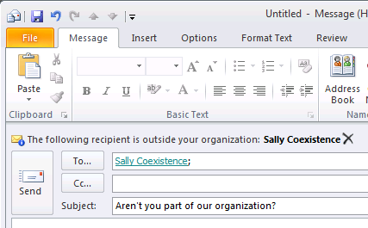
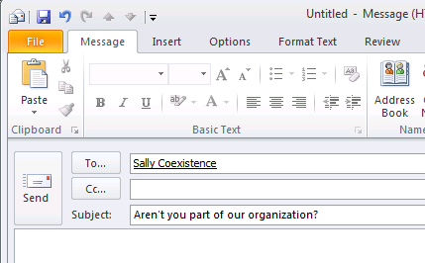
Hybrid Coexistence Feature Example
Cross-Premises MailTips
Correct evaluation of “Internal” vs. “External” organization context
Allows awareness and correct Outlook representation of MailTips

Slide 40
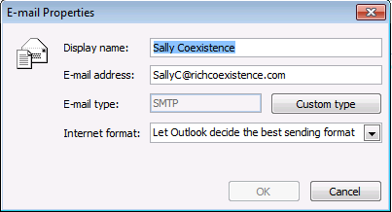
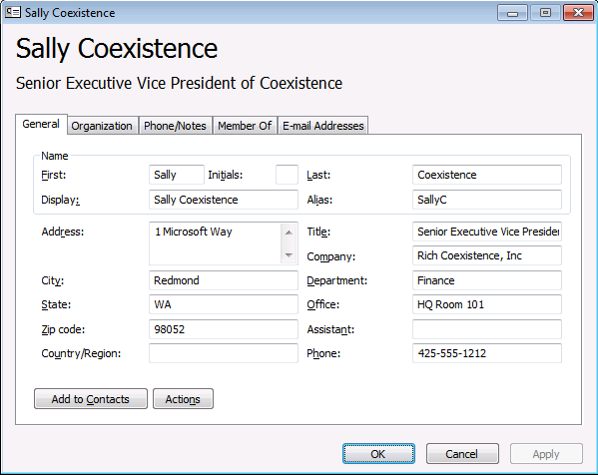
Hybrid Coexistence Feature Example
Cross-Premises Mail Flow
Preserves internal organizational headers (e.g. auth header)
Message is considered “trusted” and resolve the sender to rich recipient information in the GAL (not SMTP address)
Restrictions specified for that recipient are honored

Slide 41
Hybrid – Architecture
On-premises Exchange Org
Office 365
Office 365 Directory Synchronization
App
Users, Groups, Contacts via DirSync
Secure Mail Flow
Sharing (free/busy, MailTips, archive, etc.)
Mailbox Data via MRS
Existing Exchange 2007 or later
Exchange 2013 CAS and MBX

Slide 42
Exchange 2013 Hybrid Deployment
Clients
Office 365
1. Prepare
Install Exchange SP and/or updates across the ORG Prepare AD with E2013 schema
autodiscover.contoso.com
mail.contoso.com
5
Autodiscover & EWS
SMTP
2. Deploy Exchange 2013 servers
Install both E2013 MBX and CAS servers
Install E2010 EDGE servers
Set an ExternalUrl for the Exchange Web Services vdir
1
2
4
Exchange 2010 or 2007 Servers
E2010 or 2007 Hub
E2010 or 2007 CAS
E2013 CAS
E2010 EDGE
3. Obtain and Deploy Certificates
Obtain and deploy certificates on E2013 MBX and CAS servers & E2010 EDGE servers
3
SP/RU
SP/RU
4. Publish protocols externally
Create public DNS A records for the EWS and SMTP endpoints
Validate using Remote Connectivity Analyzer
Intranet site
6
5. Switch autodiscover namespace to E2013 CAS
Change the public autodiscover DNS record to resolve to E2013 CAS
E2010 or 2007 MBX
7
E2013 MBX
Internet facing site
6. Run the Hybrid Configuration Wizard
7. Move mailboxes

Slide 43
Hybrid – User Experience
If configured for SSO, users login with their AD credentials.
Otherwise, admin needs to distribute new passwords to users.
User’s current Outlook profile is updated with the Exchange Online server name via Autodiscover.
Offline files (OST files) do not have to be recreated

Slide 44
Understanding Single Sign-on

Slide 45
Purpose of Single Sign-on
Enables users to access both the on-premises and cloud-based organizations with a single user name and password
Provides users with a familiar sign-on experience
Allows administrators to easily control account policies for cloud-based organization mailboxes by using on-premises Active Directory management tools.

Slide 46
Benefits of Single Sign-on
Policy Control
Access Control
Reduced Support Calls
Security
Support for Strong Authentication
http://technet.microsoft.com/en-us/library/hh237448(WS.10).aspx

Slide 47
Office 365 Desktop Setup
Installs operating system and client software updates required for connectivity with Office 365
Automatically configures Internet Explorer and rich clients for use with Office 365
Note: Office 365 Desktop Setup is not an authentication or sign-in service and should not be confused with single sign-on

Slide 48
Microsoft Online Sign-in assistant
Can be installed automatically by Office 365 Desktop Setup or manually
Enables authentication support by obtaining a service token from Office 365 and returning it to a rich client (e.g. Lync)
Required for on-premises computers connecting to Office 365 (e.g. DirSync, Exchange, ADFS, PowerShell)

Slide 49
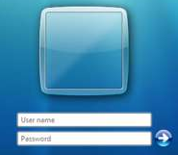
Authentication Flow – Active Profile
Customer
Microsoft Online Services
User
Source ID
Logon (SAML 1.1) Token
UPN:user@contoso.com
Source User ID: ABC123
Auth Token
UPN:user@contoso.com
Unique ID: 254729
Basic Auth Credentials
Username/Password

Slide 50
Important components
Directory synchronization
Claims based authentication → ADFS
ADFS must be redundant and highly available

Slide 51
Key take aways
Coexistence & Hybrid is Exchange on-prem and Office 365 together
Seamless user experience
Think about redundancy
Exchange administrator job will shift to Identity Management!

Slide 52
Summary
Office 365, afraid of losing your job?
Job description will change
Smaller organizations: less worries
Large organizations: shift from messaging to identity management
To stand still is to regress!

Slide 53
Thank You
OUC-B312
Jaap Wesselius
www.jaapwesselius.com
mail@jaapwesselius.com

Slide 54
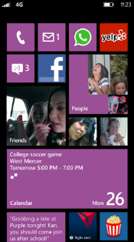
Evaluate this session
Required Slide
*delete this box when your slide is finalized
Your MS Tag will be inserted here during the final scrub.
Scan this QR code to
evaluate this session.

Slide 55
© 2013 Microsoft Corporation. All rights reserved. Microsoft, Windows and other product names are or may be registered trademarks and/or trademarks in the U.S. and/or other countries.
The information herein is for informational purposes only and represents the current view of Microsoft Corporation as of the date of this presentation. Because Microsoft must respond to changing market conditions, it should not be interpreted to be a commitment on the part of Microsoft, and Microsoft cannot guarantee the accuracy of any information provided after the date of this presentation. MICROSOFT MAKES NO WARRANTIES, EXPRESS, IMPLIED OR STATUTORY, AS TO THE INFORMATION IN THIS PRESENTATION.

