Slide 2
Microsoft Exchange Server 2013 Sizing
OUC-B317
Jeff Mealiffe

Slide 3
Agenda
Overview of the sizing process
What has changed (and why)
Impact of the new architecture
Role specific requirements
Using the calculator
Other tools & resources
Q&A

Slide 4
The sizing process

Slide 5
A brief history of Exchange sizing
We’ve been doing this a long time
Sizing guidance historically has come from test labs and production deployments
Exchange dogfood, MSIT, customer & field feedback
IOPS guidance comes from isolated user profiles to generate points on a line
Focus on IOPS reduction means we are experts at measuring IO
Always open to changing guidance as we learn new things about the product

Slide 6
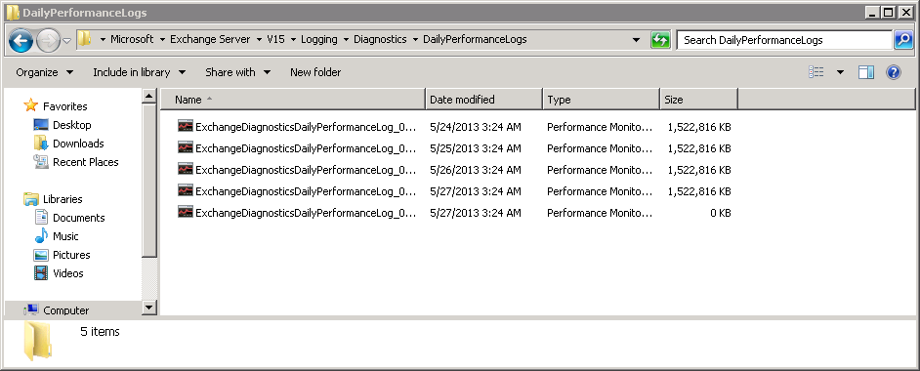
Data to the rescue
Recently, we’ve begun to focus on production measurement over lab tests
Exchange 2013 contains built-in performance monitoring components: Exchange Diagnostics Service (EDS)
We collect this performance data for our own deployments and use it for many purposes
Capacity planning
Sizing guidance
Performance bug detection
You can use this data as well
Check out Exchange Server\V15\Logging\Diagnostics\DailyPerformanceLogs

Slide 7
We don’t cover everything
Sizing data is limited to the deployments we use to build our models
Not all client types or versions are covered
3rd party solutions generally not included
LOB applications
Hardware variations
Ongoing product changes
Feature enablement/usage

Slide 8
Sizing without guidance & tools
Lab testing with simulated workloads may be an option
Be conservative: overdeploy!
Consider extra safety margins when targeting “max” CPU
Consider a pilot
Minimize overdeployment
Size for high availability requirements (failure domains!), then migrate slowly while monitoring
Add more hardware as necessary based on monitoring

Slide 9
Start to finish
Collect data on existing deployment
User profile (messages sent+received per day)
Define constraints based on customer requirements
# of copies
Average message size
Backup requirements
Storage architecture
SafetyNet duration
Virtualization
Growth plans
3rd party products
Read/understand sizing, scalability, capacity guidance
Documentation on technet, Exchange team blog, etc.

Slide 10
Start to finish
Input profile data and design constraints into calculator tool (or calculate manually)
Always use the latest calculator
Consider impact of various options provided by sizing results
Cost
Finalize design
Storage calculator provides configuration scripts
Rebuild times
Impact on high availability
Archive the calculator as documentation of the sizing process

Slide 11
Changes in Exchange

Slide 12
Review of architectural changes
Exchange 2013 targets balanced use of hardware
Consider hardware platforms that provide the right balance of resources
Mailbox role consolidates most Exchange components
Similar to Exchange 2010 multi-role
Client Access Server (CAS) role is an efficient stateless proxy
Roles are loosely coupled, scaled independently
3 roles for sizing: Mailbox, CAS, Active Directory
Enterprise Network
Forefront
Online Protection for Exchange
CAS Array
DAG
AD
Edge Transport
Routing and AV/AS
CAS
MBX
CAS
MBX
Layer 4LB
External
SMTP servers
CAS
MBX
CAS
MBX
Mobile
phone
CAS
MBX
Web
browser
Line of
business
application
Outlook
(remote user)
Phone system (PBX or VOIP)
Outlook (local user)

Slide 13
Minimum requirements
Memory requirements have increased in Exchange 2013
Minimum CPU requirements follow published OS guidelines
Disk space requirements on install drive increased dramatically (lots of new logging turned on by default)
Mailbox or multi-role (Mailbox+CAS) | 8GB minimum RAM
CAS | 4GB minimum RAM

Slide 14
Impact of new Mailbox role
New Mailbox role provides many benefits
Simplified deployment & connectivity model
Cache efficiencies
Hardware efficiencies (balanced resource utilization)
Unit of scale for capacity planning
Considerations
Tradeoffs result in some increased resource usage
Cache sizing is different
Everything interacts (and workload management mediates)
Managed availability has a measurable impact on the system
New content indexing architecture impacts performance
Unified Messaging enabled on all Mailbox servers

Slide 15
Storage capacity requirements
Size for mailbox size on disk, content indexes, log space
Method for computing space requirement similar to Exchange 2010, with some important changes
20% database overhead is now 0%
CI size is now 20% of EDB
Plus space for additional index set per volume (master merge)
Note that impact of space for master merge is reduced with multiple DBs per-volume
RTM max of 50 databases per-server, back up to 100 in CU2!

Slide 16
IOPS Requirements
As in previous releases, Exchange 2013 reduced IOPS requirements (~33% reduction compared to 2010)
We have seen higher reduction in various tests, guidance is conservative and based on production observations
No separate guidance for HA vs. non-HA databases
Checkpoint depth is now consistent for all scenarios, so IOPS requirements are the same

Slide 17
Storage bandwidth requirements
Bandwidth between host and storage may become a concern with some storage solutions
Background database maintenance (BDM) is often the cause of bottlenecks in this area
BDM in 2013 now consuming ~1MB/sec/DB copy, significant reduction from 2010

Slide 18
Transport storage requirements
Transport capacity requirements include queue and Safety Net
Guidance shows method for calculating capacity requirements
Transport queue database takes advantage of ESE IO improvements to reduce IOPS
Microsoft production observations show ~1 DB IO per 75KB message
Low IOPS suggest that placing transport queue on system/install volume is now feasible in many scenarios
Significant transport throughput benefit seen from a protected write cache disk controller, set to 100% write cache

Slide 19
Processor requirements
As in Exchange 2010, mcycle requirements are per-user for active & passive copies
Per-passive multiplier on the active has been removed in 2013
Guidance includes a multi-role mcycle requirement for the active copy – simplifies sizing
Messages sent or received per mailbox per day | Mcycles per User, Active DB Copy or Standalone (MBX only) | Mcycles per User, Active DB Copy or Standalone (Multi-Role) | Mcycles per User, Passive DB Copy
50 | 2.13 | 2.66 | 0.69
100 | 4.25 | 5.31 | 1.37
150 | 6.38 | 7.97 | 2.06
200 | 8.50 | 10.63 | 2.74
250 | 10.63 | 13.28 | 3.43
300 | 12.75 | 15.94 | 4.11
350 | 14.88 | 18.59 | 4.80
400 | 17.00 | 21.25 | 5.48
450 | 19.13 | 23.91 | 6.17
500 | 21.25 | 26.56 | 6.85
Note: Baseline platform for CPU guidance changed in 2013. Mcycle requirements in 2010 and 2013 cannot be directly compared.

Slide 20
Hyperthreading & Exchange 2013
Turn off hyperthreading (SMT)!
SMT provides gain in processor throughput, but overall the gain is not worth the “cost” based on our lab measurements
Significant impact to some Exchange service memory footprints

Slide 21
Impact of GC architecture
Memory is allocated within heaps
.NET garbage collector has different “modes” which optimize for different allocation scenarios
Workstation GC
Uses common heap and cleanup process (can be concurrent or not)
Server GC
Allocates a heap and thread per logical proc
Server GC results in dramatically larger memory requirements at rest when SMT is enabled

Slide 22
Tuning .NET for store
Best practice to install KB 2803754 or 2803755
http://support.microsoft.com/kb/2803754 (Windows Server 2008 R2)
http://support.microsoft.com/kb/2803755 (Windows Server 2012)
Reduces memory consumption in each store worker
No impact to sizing guidance
Memory is available for use by other processes
Decreases CPU spent in .NET garbage collector
Benefits Mailbox & multi-role
Enable by installing hotfix and setting regkey:
HKLM\Software\Microsoft\.NETFramework\DisableRetStructPinning (REG_DWORD) = 1

Slide 23
Memory requirements
Memory on the Mailbox role sized based on ESE cache requirements
Cache requirements have remained constant from 2010
Overall cache sized to 25% of RAM, so guidance (based on total system memory) is 4x of 2010 cache sizing recommendation
Messages sent or received per mailbox per day | Mailbox role memory per active mailbox (MB)
50 | 12
100 | 24
150 | 36
200 | 48
250 | 60
300 | 72
350 | 84
400 | 96
450 | 108
500 | 120

Slide 24
Memory requirements
Multi-role servers require additional memory for CAS based on user concurrency during worst-case failure
Minimum memory requirements based on database count must be observed to ensure optimal ESE cache utilization
$$\text{2}\text{GB}\text{ + }\left(\text{2}\text{GB} × \frac{\left(\text{worst}\text{−}\text{case} \text{active} \text{DBs} \text{per}\text{−}\text{server}×\text{users} \text{per}\text{−}\text{DB}×\text{mbx} \text{mcycles} \text{per}\text{−}\text{user}\right) × 0.25}{\text{per}\text{−}\text{core} \text{mcycles}}\right)$$
Per-server DB copies | Minimum physical memory (GB)
1-10 | 8
11-20 | 10
21-30 | 12
31-40 | 14
41-50 | 16

Slide 25
Mailbox role network requirements
Seeding of multiple databases per disk may benefit from increased bandwidth between servers
Avoid bottlenecking on network
Plan for reseed operations, particularly in JBOD deployments
10GB Ethernet expected to become more common for Exchange infrastructure
Cost has dropped, many customers are standardizing on 10GB Ethernet in their datacenters

Slide 26
Unified messaging
UM is sized using a concurrency model
Plan for a maximum of 100 concurrent calls per server
Note that UM in 2013 is a component of the Mailbox role, may need to adjust user distribution to optimize UM utilization/concurrency
Voicemail transcription is a heavy consumer of CPU
Plan for 1 CPU core per concurrent transcription
If server is CPU starved, voicemail transcription may be skipped (voicemail delivered without transcription)

Slide 27
Impact of new CAS role
New CAS role provides many benefits
Stateless
Connection scalability
Low CPU & memory footprint
Load balancing optimizations
Namespace optimizations
Considerations
Low resource utilization makes multi-role deployment (or virtualization) attractive
CAS is a net-new role in 2013, adding performance “cost”
Shift of processing resources from LB layer to CAS may negate new resource demand

Slide 28
CAS processor requirements
CAS CPU is sized using a percentage of Mailbox CPU active user requirements
2013 CAS requires 25% of Mailbox active-user mcycles, down from 75% in 2010
Given significant reduction, ensure that enough CAS servers are deployed to handle failures and provide high availability

Slide 29
CAS memory requirements
CAS memory is sized using a simple formula of 2GB + 2GB per-CPU core.
The per-core value assumes utilized CPU cores at peak (worst case failure), so this can get a little complicated
Note no CAS memory reduction from 2010, but decreased CAS server count should result in overall memory reduction
$$\text{Per}\text{−}\text{server} \text{CAS} \text{memory}=\text{2}\text{GB}+\text{2}\text{GB}×\left(\frac{\frac{\text{total} \text{user} \text{count}}{\text{CAS} \text{server} \text{count} \text{in} \text{worst} \text{case}}×\text{Mailbox} \text{mcycles} \text{per}\text{−}\text{user}×0.25}{\text{mcycles} \text{per}\text{−}\text{core}}\right)$$

Slide 30
Multi-role: why not?
Very few reasons not to consider multi-role deployment
Multi-role simplifies deployment, can reduce server count
Benefit of increased availability at the CAS layer
Issues remain with Windows NLB
Certificate management may be a concern

Slide 31
Active Directory requirements
Recommend deploying 1 AD GC core for every 8 Mailbox cores handling active load (assuming 64-bit GCs
Size memory such that the entire NTDS.DIT can be contained within RAM for optimal query performance

Slide 32
Using the calculator

Slide 33
Background on the calculator
Role Requirements Calculator turns published sizing guidance into a modeling tool
Try out various failure scenarios
Understand the impact of different hardware & storage choices
Provides scripts for DAG, database & copy creation
Many new features
CAS sizing
Transport storage sizing
Multiple databases per-volume (JBOD) support
High availability architecture improvements
http://aka.ms/E2013Calc
Note: Baseline platform for CPU guidance changed in 2013. Don’t directly compare results from 2010 & 2013 calculators.

Slide 34
Demo
Exchange 2013 Role Requirements Calculator
http://aka.ms/E2013Calc

Slide 35
Other tools & resources

Slide 36
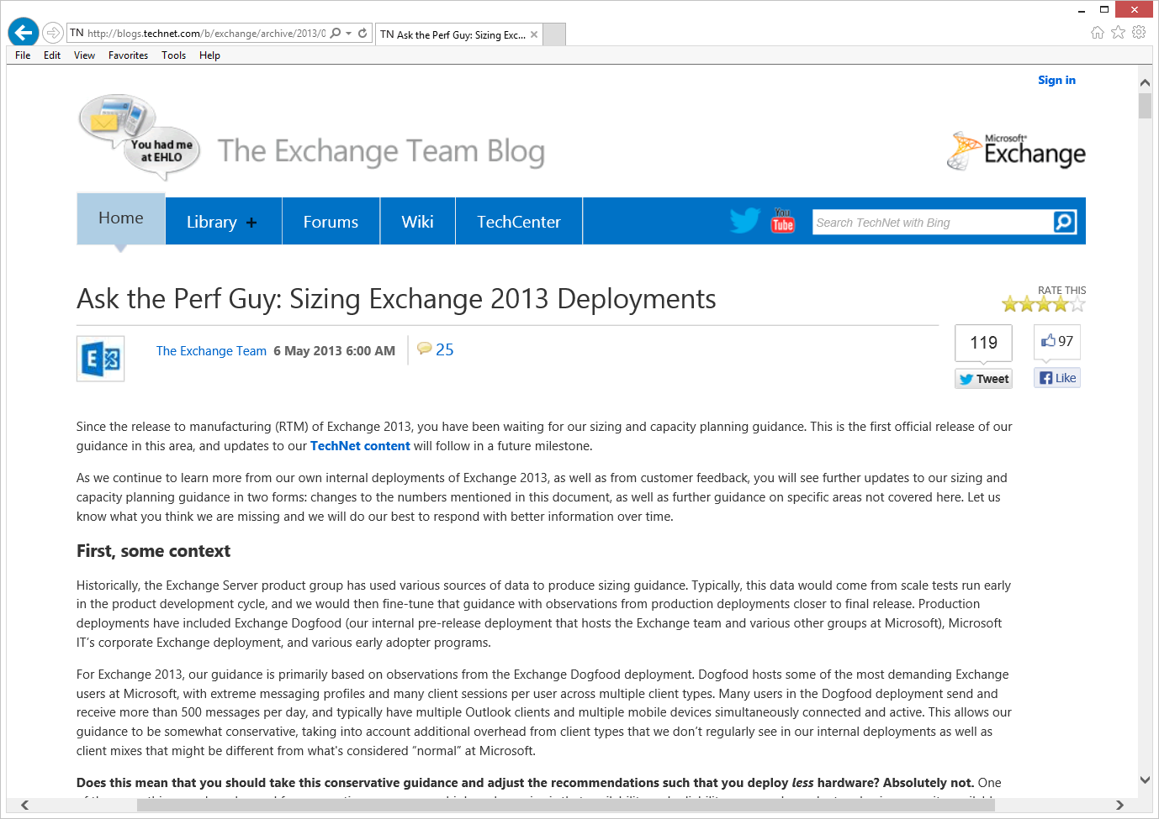
More details available on the blog
http://aka.ms/Exchange2013SizingGuidanceBlog

Slide 37
Processor Query Tool
Quickly look up SPECint benchmark for a particular processor type
Takes average across multiple vendor submissions
Provides specific value to insert into Role Requirements Calculator
http://aka.ms/ExProcQueryTool

Slide 38
Jetstress & Exchange Solution Reviewed Program
Jetstress 2013 released March 2013
Event log captured
Errors associated with specific volumes
Threads controlled globally instead of per-DB, better automatic tuning
Use Jetstress to validate all Exchange capacity before service ready
Validates storage performance & reliability
http://aka.ms/Jetstress2013
ESRP Storage v4.0 released in May to storage partners
TechNet content coming soon

Slide 39
Loadgen 2013
Updated Loadgen tool under development
Support for protocol & connection changes in Exchange 2013
Stability
Many bug fixes
Release planned for later this calendar year
Stay tuned to the Exchange Team Blog for more details

Slide 40
Related content
Breakout Sessions
OUC-B316 Microsoft Exchange Server 2013 On-Premises Upgrade and Coexistence
OUC-B314 Microsoft Exchange Server 2013 High Availability and Site Resilience
OUC-B319 Microsoft Exchange Server 2013 Transport Architecture
OUC-B313 Microsoft Exchange Server 2013 Client Access Server Role
OUC-B326 Virtualization in Microsoft Exchange Server 2013
Find Me Later At...
Ask the Experts

Slide 41
Track resources
Exchange Team Blog:
http://blogs.technet.com/b/exchange/
Twitter:
Follow @MSFTExchange
Join the conversation, use #IamMEC
Check out:
Microsoft Exchange Conference 2014: www.iammec.com
Office 365 FastTrack: http://fasttrack.office.com//
Technical Training with Ignite: http://ignite.office.com/

Slide 42
Resources
Learning
Sessions on Demand
Microsoft Certification & Training Resources
http://channel9.msdn.com/Events/TechEd
www.microsoft.com/learning
TechNet
msdn
Resources for IT Professionals
Resources for Developers
http://microsoft.com/technet
http://microsoft.com/msdn

Slide 43
Evaluate this session
Required Slide
*delete this box when your slide is finalized
Your MS Tag will be inserted here during the final scrub.
Scan this QR code to
evaluate this session.

Slide 44
Questions?

Slide 45
© 2013 Microsoft Corporation. All rights reserved. Microsoft, Windows and other product names are or may be registered trademarks and/or trademarks in the U.S. and/or other countries.
The information herein is for informational purposes only and represents the current view of Microsoft Corporation as of the date of this presentation. Because Microsoft must respond to changing market conditions, it should not be interpreted to be a commitment on the part of Microsoft, and Microsoft cannot guarantee the accuracy of any information provided after the date of this presentation. MICROSOFT MAKES NO WARRANTIES, EXPRESS, IMPLIED OR STATUTORY, AS TO THE INFORMATION IN THIS PRESENTATION.

