Slide 2
Planning and Deploying your Enterprise Voice
OUC-B324
Thomas Binder

Slide 3
Session Objectives And Takeaways
Session Objective(s):
  Options to provide Enterprise Voice
  Understand Network Assessment requirements
  Plan for pilot
Necessary steps to provide Enterprise Voice
And meet business/company/user requirements

Slide 4
Agenda
Why Lync?
Lync Voice Integration
Deploy Enterprise Voice Features
Lync and your network
Devices
Pilot
Lync Voice Support

Slide 5





About me
Austria, Vienna
tbinder
@microsoft.com
Field hockey
Since 2007
MCM, MCSM
Communications CoE
UC Voice Architect

Slide 6
Why Lync?

Slide 7
Get support for your project
Executive Sponsor
Someone with
  organizational power (and budget)
  to make the transformation happen
Needs to be appropriate and accountable
  For the next phase of deployment
  Are they accountable to achieve the ROI of project?

Slide 8
Business requirements
What are the business drivers for Lync?
What are the goals for the business for the next year?
How will communication look like in one, three or five years?
Mobile workforce
Operationalcosts
Productivity
Travel costs
Shorten sales cycle
Attractive workplace
UC enable your business
Infrastructure consolidation
Communication costs

Slide 9
Lync Capabilities Deliver Value
Capability | Lync Server
Save 5%-30%
Reduce Travel Expenses ²
Reduce costs through converged communications
Reduce travel via A/V/W conferencing | Yes
Reduce audio conferencing service charges | Yes
Reduce PSTN calling charges via VoIP | Yes
Retire separate PBX systems (some or all) | Yes
Shared workplace, home and mobile communications support | Yes
Reduce Audio Conferencing Charges ²
Save 30%-95%
Reduce Telephony Charges ²
Save 50%-70%
Reduce Cost of Communications Systems ²
Save 40%-60%
Lower Real Estate and Facilities Costs ²
Save 15%-30%
Drive adoption through ease of use and Microsoft Office
Instant messaging and presence in Office and SharePoint | Yes
Click to communicate, seamless escalation | Yes
Ad hoc A/V/W conferencing (inter-organization) | Yes
Click to call via VoIP | Yes
Skills-based people search in Lync client | Yes ¹
Improve End User Productivity
Up to 30 min/day
Resolve Customer Issues Faster
Up to 50%
Attract and Retain Employees
¹ With SharePoint on-premises
Varies by customer
Deployment, migration, interoperability, extensibility
Embed communications in LOB applications | Yes
Embed communications in Server applications | Yes
Integration with on-premises room video systems | Yes
Integration of voice capabilities | Yes
Consolidate management of communications functions | Yes
Complete Projects Faster
By 10%-20%
Shorten Sales Cycle
Up to 20%
Reduce IT Admin, Migration Costs ²
Varies by customer
² savings amounts based on actual customers. www.microsoft.com/casestudies

Slide 10
Lync Voice Integration

Slide 11
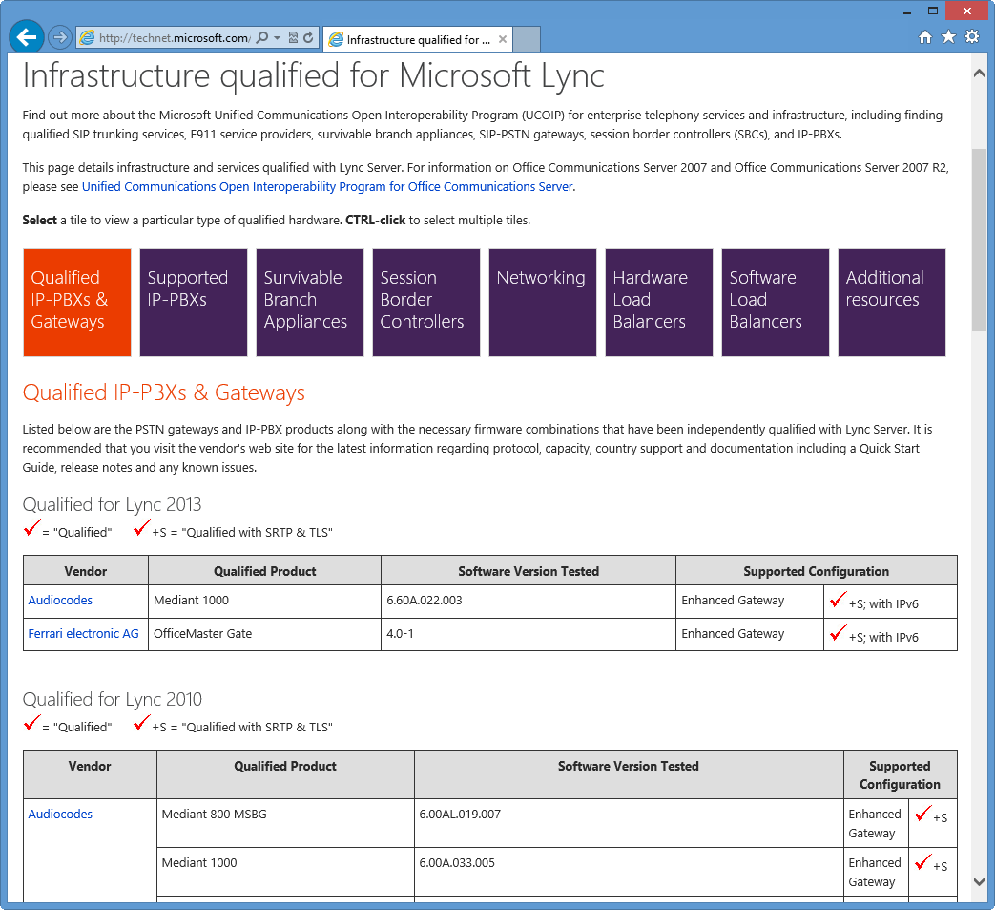
Open Interoperability Program
http://technet.microsoft.com/ucoip
Testing and qualification of third party solutions for interoperability with Microsoft UC
Independent testing by third party labs based on standards based open documentation
Rich scope of program
  SIP-PSTN gateways
  Direct SIP with IP-PBX
  SIP trunking with carriers
Enhanced gateways
  Audio quality certification
  REFER support
  TLS/SRTP

Slide 12
PSTN Integration Options
Lync connected to Legacy PBX
Connect Lync to PSTN
“Drop and insert”
Lync to connect PSTN and PBX

Slide 13


Lync connected to Legacy PBX
Benefits
  PBX owns number plan
  User can keep own number
  Internal calling at no cost
  Benefit from the existing PBX infrastructure
  Benefit from existing trunk capacity
Disadvantages
  PBX Dependencies
  Additional PBX cost
  Requires PBX configuration
  What happens when migration is done?
  Migrating a user = changes in the PBX
Existing
PBX
Lync 2013

Slide 14
Connecting to the PBX
Direct SIP
Only for supported PBX systems (UCOIP)
Interop between IP-PBX and Lync Server 2013
Provides voice capabilities between endpoints on either call control server
Simplest method of interoperability, relying on standard SIP protocols
Via a Gateway
Use supported gateways (UCOIP)
Use gateway as intermediary in scenarios such as SIP to TDM/H323, or to nonqualified third-party call control
Allows gateway to act as B2BUA/transcoding resource for calls between Lync Server 2013 and third party

Slide 15
Connect directly to the PSTN
Benefits?
  Easy and fast
  No additional PBX investments and configuration
Disadvantages
  New numbers for the end-user
  How about internal calling
  Need additional trunk capacity
  Migrating a user = changes at the Provider
Existing
PBX
Lync 2013

Slide 16
Connecting to the PSTN via gateway
Use supported gateways (UCOIP)
A gateway is a physical device that connects two incompatible networks
A gateway translates signaling and media between Lync and the PSTN
Allows gateway to act as B2BUA/transcoding resource for calls between Lync Server 2013 and the PSTN
TDM Trunking benefits
  More broadly understood
  No WAN dependency
  Local carrier choice
  Branch resiliency

Slide 17
Connecting to the PSTN via SIP trunk
Use supported SIP Trunking Provider (UCOIP)
IP connection that establishes a SIP communications link between your organization and an Internet telephony service provider (ITSP) beyond your firewall
SIP Trunking benefits
Consolidation & Numbering flexibility
Disaster recovery
Provides end-to-end SIP call flow to enable
features and supplementary services
Can deploy central trunking for management
or routing purpose
Eliminates per-channel model to provide
more flexibility in trunk provisioning
no need for intermediary gateway
Note
Topologies may vary depending on Service Provider. For example SBC’s are frequently deployed on Customer Site

Slide 18

“Drop and Insert”
Benefits
  Gateway routes based on AD
  Phase out PBX
  Easy to migrate users
  User can keep own number
  Internal calling at no cost
  Benefit from existing trunk capacity
Disadvantages
  Gateway needs to be sized for internal calls
  Migrating a user = changes in the PBX
Existing
PBX
Lync 2013

Slide 19
Lync to connect PSTN and PBX
Benefits?
  Lync owns dialplan
  Phase out PBX
  Easy to migrate users
  User can keep own number
  Internal calling at no cost
Disadvantages
  PBX topology changes
  Gateway for PSTN and PBX
  Migrating a user = changes in the PBX
Existing
PBX
Lync 2013

Slide 20
Session-Management
New in Lync 2013
Allows to route calls from an incoming trunk to an outgoing trunk
By enabling inter-trunk routing, the following routing paths
(among others) are enabled:
    Incoming PSTN calls to an IP-PBX system via Lync
    Outgoing IP-PBX calls to a PSTN network via Lync
    Outgoing IP-PBX calls to another IP-PBX system via Lync

Slide 21
Inter Trunk Routing
Routing of IP-PBX Calls to Another IP-PBX System via Lync
      Incoming call from the PBX trunk
      Validate incoming trunk associated PSTN usages
      Determine a route
      Apply outbound translation rules
      Route to outgoing PBX trunk via Lync
Routing of IP-PBX Calls to PSTN via Lync
      Incoming call from the PBX trunk
      Validate incoming trunk associated PSTN usages
      Determine a route
      Apply outbound translation rules
      Route to outgoing gateway trunk

Slide 22
Planning for voice resiliency
Voice automatically fails over to paired pool
  User will be in reduced functionality mode
Manual failover to paired pool
  Will restore full functionality
Survivable Branch Appliance (SBA) and Survivable Branch Server (SBS) as branch solutions

Slide 23
Branch solutions
SBA/SBS
  Will allow Lync telephony even if connection to pool is lost
Does your branch require resiliency?
  Is the WAN redundant?
  How many users are in the site?
  How important is telephony?
  Is there local PSTN connectivity?
SBA qualified via OIP

Slide 24
Size your Mediation Servers
Non-media-bypass calls
  Collocated Mediation Server: 150 calls
  Dedicated Mediation Server: 1,500 calls
Media bypass is not applied
  For dial-in/dial-out conferencing
  Remote users
  If CAC is enabled: other sites

Slide 25
Media bypass
SIP
G.711
PSTN
Media
SIP

Slide 26
Deploy enterprise voice features

Slide 27
Enterprise Voice Features
Voice Mail
Call Admission Control
Emergency Calling
Delegation
More…

Slide 28
Exchange UM
Voice mail solution for Lync
Single Store for email and voicemail
Call Answering, Missed Call Notifications, Active Directory Based Auto-Attendant, Outlook Voice Access, Play on Phone
Exchange Topologies
  On Premise
  Partner/O365 hosted

Slide 29
Using Call Admission Control
Limit number of calls
Provide better user experience
Manages bandwidth for audio and video
Based on subnet of endpoint
  Enforce policies on links between sites
  Seamless support for roaming users moving between different sites
    Rerouting behavior when bandwidth limited exceeded
Additional calls will be
  Rerouted via Edge Servers
  Rerouted via PSTN
  Blocked

Slide 30
Emergency Calling
Determine your requirements
  What are the local legal requirements?
Lync offers different options
  Calls can be routed depending on Location
  “E911” for North America
  ELIN gateways might meet your requirements
User education might be an alternative

Slide 31
Delegation
Boss/admin
Built-in functionality sufficient?
Tools available to manage on behalf
Some “Other compatible phones” offer delegation functionality as well

Slide 32
More…
Understand the Voice Requirements
Response groups
Unassigned numbers
Legal requirements
Third party solutions
  CEBP – Communications Enabled Business Processes
  Recording and compliance
  Integrated solutions
    E.g. Lync enabled door opener
    …
Fax

Slide 33
Lync and your network

Slide 34
Network
Network very important component
Will impact user experience
Users expect phones to work
Will impact success of your Lync project

Slide 35
How to Assess the Network
Discovery
Bandwidth planning
Simulation
Adjust environment

Slide 36
Discovery
Required network information
  Peak usage over past 3 month
  Busy hour traffic
QoS strategy
  How is traffic tagged
  QoS classes
  Bandwdith allocation
Network topology
  Star topology, Inter-site links

Slide 37
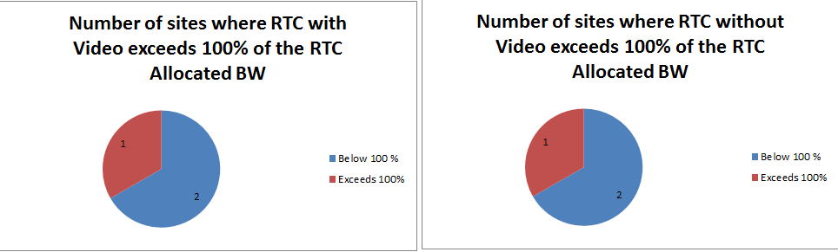
Bandwidth planning
User information
  User per location
  Modalities per user
  Usage statistics
Use bandwidth calculator
  http://www.microsoft.com/en-us/download/details.aspx?id=19011
Estimate expected usage

Slide 38
Simulation
Run in production environment
During production hours
Collect relevant network information
  Jitter
  Packet loss
  Latency
  QoS
Network conditions | Acceptable quality | Optimal quality
Interarrival packet jitter (avg) | ≤ 5 ms | ≤ 2 ms
Interarrival packet jitter (max) | ≤ 40 ms | ≤ 20 ms
Packet loss rate (avg) | ≤ 5% | ≤ 3%
Network latency | ≤ 200ms | ≤ 120ms

Slide 39
Adjust environment
Improve network
  QoS settings
  Bandwidth
Adjust Lync
  Limit modalities
  Call Admission Control
  Deploy local pools

Slide 40
What is a Network Assessment?
Microsoft Consulting Services offering
  Provides an application-centric assessment that pinpoints problems that could affect your future Microsoft unified communications solution
Discovery Session
Understand what network environment exists
Usage Modelling
Model proposed bandwidth using user profiles, and usage patterns
Traffic Simulation
Using a UC Traffic simulator apply real traffic to production network and monitor factors that affect the quality of UC traffic, Delay, Jitter, and Packet Loss
Recommendations
Analyze factors affecting quality, and produce a full report with recommendations

Slide 41
Network Assessment - Benefits
Validates an Enterprise’s Readiness for UC
Quantitative assessment of current Infrastructure metrics that impact UC
Reduces deployment risk
Highlights areas that might impact UC readiness
Protects customer’s investment in UC
Promotes the best possible end user experience

Slide 42
Devices

Slide 43
Lync devices
http://technet.microsoft.com/en-us/lync/gg278164.aspx
USB headsets
IP Phones
  “Optimized for” vs. “Other compatible IP phones”
  Different user experience and functionality
  Plan for 20%
  Give users a choice
Plan also for
  Common area phones and hot-desking
  Analogue phones

Slide 44
Pilot

Slide 45
Pilot
PoC: Proof of concept
  Validates that specific scenarios work from a technical point of view
  E.g. integration in specific Legacy PBX
Pilot: Have real users working with Lync
  Test in production environment and situations
  Seed new technology
  Validates your scenarios

Slide 46
How to do a successful pilot
Choose the right users
Focus on user scenarios
Define goals and how to measure it
Plan for communications
Ask for feedback (and use it)
Use the “Rollout and Adoption Success Kit”
  http://aka.ms/LyncRASK
Pilot is a good opportunity for marketing Lync!

Slide 47
Who should be in the pilot?
A broad spectrum of skill levels
Representatives from a variety of roles
Enthusiastic individuals willing to participate and provide feedback
Users for every targeted workload/scenario
Individuals located near a Lync Champion
Remote users with a higher technical skill

Slide 48
Lync voice support

Slide 49
Lync Support Strategy
Lync is more than just another Microsoft product
  Devices
  Network
  Gateways
  PBX
  Session Border Controller
  SIP Trunk
  …
Single point of contact?

Slide 50
Lync Certified Support Partners
http://technet.microsoft.com/en-us/lync/hh965532.aspx
~100 certified partners
Some regional, some worldwide

Slide 51
Session Objectives And Takeaways
Session Objective(s):
  Options to provide Enterprise Voice
  Understand Network Assessment requirements
  Plan for pilot
Necessary steps to provide Enterprise Voice
And meet business/company/user requirements

Slide 52

Related content
Breakout Sessions
  OUC-B303 - Designing for High Availability and Disaster Recovery in Microsoft Lync Server 2013
  OUC-B305 - Enterprise Network Requirements for Microsoft Lync Server 2013
  OUC-B401 - Microsoft Lync Server 2013 Dial Plan and Voice Routing Deep Dive
Find Me Later At: Lync 2013 Booth

Slide 53

Resources
Learning
  Sessions on Demand
  Microsoft Certification & Training Resources
http://channel9.msdn.com/Events/TechEd
www.microsoft.com/learning
TechNet
msdn
  Resources for IT Professionals
  Resources for Developers
http://microsoft.com/technet
http://microsoft.com/msdn

Slide 54
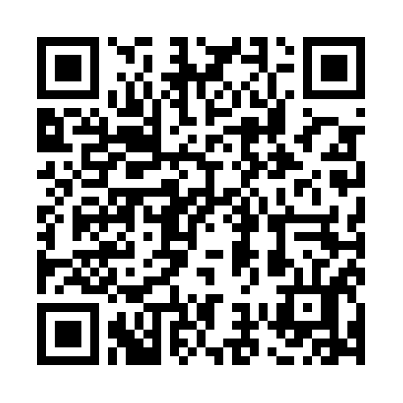


Evaluate this session
Required Slide
*delete this box when your slide is finalized
Your MS Tag will be inserted here during the final scrub.
Scan this QR code to
evaluate this session.

Slide 55

© 2013 Microsoft Corporation. All rights reserved. Microsoft, Windows and other product names are or may be registered trademarks and/or trademarks in the U.S. and/or other countries.
The information herein is for informational purposes only and represents the current view of Microsoft Corporation as of the date of this presentation. Because Microsoft must respond to changing market conditions, it should not be interpreted to be a commitment on the part of Microsoft, and Microsoft cannot guarantee the accuracy of any information provided after the date of this presentation. MICROSOFT MAKES NO WARRANTIES, EXPRESS, IMPLIED OR STATUTORY, AS TO THE INFORMATION IN THIS PRESENTATION.

