Slide 2
Virtualization in Microsoft Exchange Server 2013
OUC-B326
Jeff Mealiffe

Slide 3
Agenda
Why virtualize? Why not?
Exchange 2013 virtualization supportability
Sizing recommendations
Problem areas, and how to avoid them

Slide 4
Why virtualize?
Server consolidation
Homogenous infrastructure
Deployment optimizations
Management optimizations
Monitoring optimizations
Hardware utilization
Cost

Slide 5
Why not?
Complexity
Additional deployment steps
Additional management layer
Additional monitoring layer
Performance impact
Workload incompatibility/unsupportability
Cost

Slide 6
Is there a clear answer for me?
Customers should pick the simple solution
Physical is often the simple solution, but won’t be for every customer
We support virtualized Exchange because it absolutely makes sense for a subset of our customers
Customers that virtualize Exchange should be able to get something out of virtualizing

Slide 7
Exchange 2013 virtualization supportability

Slide 8
Windows Server 2012
Server 2012 Hyper-V adds many new features
Many deployment-blocking limits removed
Removal of 4 vCPU per-VM limit fantastic for Exchange
Increased memory per-VM important for Exchange 2013
Customers who virtualize Exchange Server 2013 (and size correctly) will have a great experience on Server 2012 Hyper-V
Important to be aware of what does & doesn’t work (and supportability limits)

Slide 9
Exchange and Hyper-V
Without question, the most tested hypervisor for Exchange
Every day, thousands of Exchange test machines run on Hyper-V
Feedback loop between Exchange and Hyper-V
Ongoing cross-group engineering relationship

Slide 10
Supported
Hypervisors
Windows Server 2008 R2
Hyper-V Server 2008 R2
Windows Server 2012
Hyper-V Server 2012
Third-party hypervisors (SVVP)
Exchange roles
All Exchange 2013 roles supported for virtualization
Storage
Block-level
Same requirements as Exchange 2010 *
Host-based clustering
All Exchange 2013 roles supported
Migration
All Exchange 2013 roles supported
Jetstress testing in guests
Yes, on supported Windows hypervisors or ESX 4.1 (or newer)
http://aka.ms/e2013virt

Slide 11
What’s up with the asterisk?
Exchange 2013 supports VHD storage on SMB 3.0 file shares
Can be shares presented from Windows Server 2012 or other implementations of SMB 3.0
Specific to VHD storage – no direct access to shares from Exchange
SMB 3.0 provides the ability to survive hardware failures that would otherwise impact file access
Design for HA & failure handling
No change to our support of downlevel SMB & NFS

Slide 12
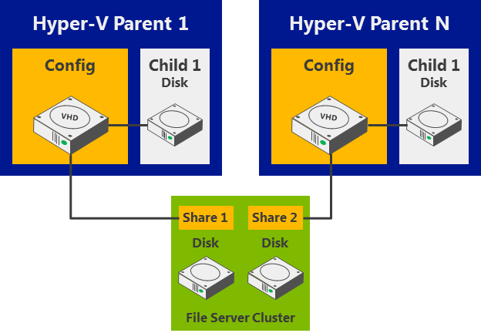
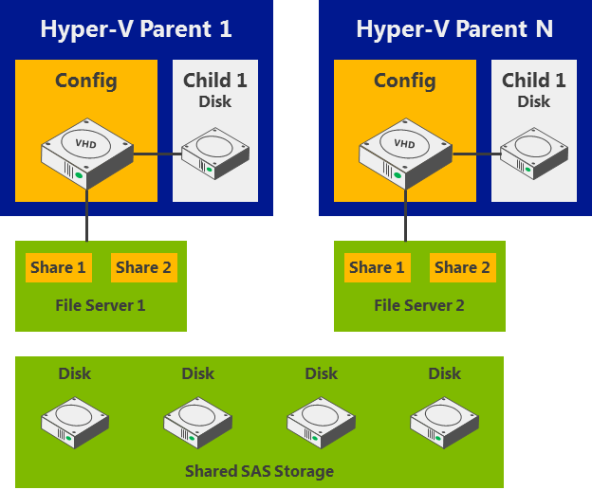
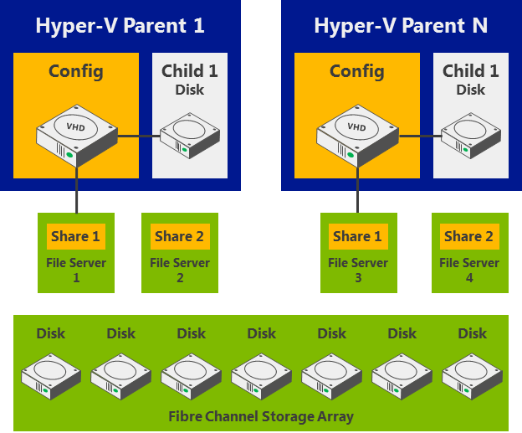
Windows Server 2012 and SMB 3.0
Great platform for inexpensive, simple storage of Hyper-V virtual machines
Scalable to meet various levels of demand
Can use Exchange’s favorite “large low-cost disks” and take advantage of full functionality in the virtualization stack

Slide 13
Why not NFS?
Performance
Particular NFS implementations have shown significant performance issues historically, and Exchange is very sensitive to high IO latencies
Reliability
Particular NFS implementations have shown reliability issues that can result in database corruption and necessitate reseed
NFS is a standard – there are many implementations, some better than others
Given that there are a number of alternatives for presenting storage to a hypervisor, we don’t support NFS (or older versions of SMB) at all

Slide 14
Migration
Confusion exists about what we do/don’t support with migration
We absolutely support Live Migration and similar 3rd-party technologies with all Exchange roles
Don’t use Hyper-V’s Quick Migration or any other solution that saves point-in-time state to disk: VM has to remain online during migration

Slide 15
Not Supported
Dynamic memory, memory overcommit, memory reclamation
Not supported for any Exchange 2013 role
Configure static memory for all Exchange VMs
Hypervisor snapshots
Not supported for any Exchange 2013 role
Differencing/delta disks
Not supported for any Exchange 2013 role
Apps on the root
Only deploy management, monitoring, AV, etc.
Significant processor oversubscription
Limited to 2:1, best practice is 1:1
http://aka.ms/e2013virt

Slide 16
Hyper-V replica
Replica provides DR for “any” VM via log shipping to a remote hypervisor
Not supported for Exchange
Use DAG to obtain better HA & DR with Exchange 2010 & 2013
Replica makes sense for apps that don’t have DR capability built-in to the product

Slide 17
Sizing recommendations

Slide 18
CPU impact of virtualization
Plan to add additional CPU overhead on Exchange VMs
~10% for Hyper-V
Follow vendor guidance for 3rd-party
Best way to size for this is using Role Requirements Calculator
http://aka.ms/e2013calc
Note “Server Role Virtualization” and “Hypervisor CPU Adjustment Factor”

Slide 19
Other resource impacts
Memory generally not impacted
Exchange is not NUMA aware, but will take advantage of OS optimizations
Storage should be optimized for IO latency and high availability
Take advantage of hypervisor networking flexibility to provide availability and performance
In general: size using guidance for physical, apply to virtual

Slide 20
Co-location with other VMs
Use reservation options to ensure that Exchange gets the resources it needs
Allows other workloads to take advantage of overcommit
As a best practice, never overcommit any resources in a way that could impact Exchange VMs

Slide 21
Users per host
Avoid extreme scale-up to ensure high availability of Exchange service
Modern hypervisors are capable of hosting hundreds of VMs per host
Plan for a small number of Exchange 2013 mailbox VMs per-host
Use remaining capacity for other workloads

Slide 22
Problem areas, and how to avoid them

Slide 23
Dude. Don’t kill all of my servers.
Understanding failure domains is critical for virtualized Exchange design
Placing multiple mailbox DB copies on the same infrastructure impacts availability
Placing any dependencies of Exchange on the same infrastructure also impacts availability
Active Directory
Witness servers
Stuff fails – embrace failure and prepare for it with redundancy and multiple paths to infrastructure

Slide 24
Belt and suspenders
Host Based Failover Clustering “High Availability”
Using Host Based Failover Clustering and automatically failing VMs to an alternate cluster node in the event of a critical hardware issue
What you need to be aware of:
Not an Exchange Aware Solution
Only protects against server hardware/network failure
No HA in the event of storage failure / data corruption
Requires a shared storage deployment
If you are going to deploy this, combine with Exchange DAG when possible

Slide 25
The memory mess
Hyper-V’s Dynamic Memory and VMware’s Ballooning are fantastic for lab environments
For production Exchange servers, just don’t do it!
Exchange code doesn’t deal well with disappearing memory
End result for the mailbox role is cache served from the page file or very small DB cache
Best practice: static memory configuration for Exchange VMs

Slide 26
Dynamic memory at work

Slide 27
Dynamic memory at work

Slide 28
Can you hear me now?
Migration of Mailbox servers can result in cluster heartbeat timeouts
Result is eviction of server from cluster (DAG) and failover of active DB copies
Minimize brownout period
Consider carefully adjusting heartbeat timeout settings
Import-module FailoverClusters
(Get-Cluster).SameSubnetThreshold=5
(Get-Cluster).SameSubnetDelay=1000

Slide 29
Time traveling
Hypervisor snapshots make lab testing much easier
Resist the temptation to use hypervisor snapshots in production – they aren’t supported!
Aspects of the Exchange system do not handle time travel well (log shipping)
Use caution with snapshots in the lab (multiple machines may need to roll back simultaneously)

Slide 30
Too much work, too little time
Hypervisors are pretty cool… but they don’t make CPU appear out of thin air
While oversubscription can help with hardware consolidation, it doesn’t help provide reliable high-performance Exchange services
Proper Exchange sizing ensures that resources are available on-demand, so don’t allow hypervisors to yank those resources away
CPU constrained Exchange servers will experience reduced throughput:
Delivery throughput reduction = queue growth
Content indexing throughput reduction = increased IOPS
Store ROP processing throughput reduction = RPC latency & end-user pain

Slide 31
A moving target
Exchange 2013 contains a workload management component
WLM dynamically adjusts background tasks to ensure that resources are being consumed efficiently
WLM monitors resource consumption and makes decisions based on resource availability
Inconsistent resource assignment results in bad WLM decisions

Slide 32
Summary
Virtualization of Exchange 2013 is supported with few limitations
It’s important to understand when to virtualize Exchange – it’s not always the right choice
Don’t oversubscribe
Exchange uses lots of memory – size properly and don’t rely on hypervisor “magic”
Processor resources are critical for Exchange client experience – ensure that Exchange always gets what it needs
Not all hypervisor features make sense for Exchange
Consider whether similar/same functionality built-in to Exchange may provide better availability or performance

Slide 33
Related content
Breakout Sessions
MDC-B338 Overview of Windows Server 2012 Hyper-V
MDC-B335 Understanding the Hyper-V over SMB Scenario, Configurations, and End-to-End Performance
MDC-B324 Key Metrics and Practices for Monitoring Virtualization Platforms
MDC-B345 Windows Server 2012 Hyper-V Storage Performance
MDC-B353 Comparing Windows Server Hyper-V and VMware vSphere
Find Me Later At...
Ask the Experts

Slide 34
Track resources
Exchange Team Blog:
http://blogs.technet.com/b/exchange/
Twitter:
Follow @MSFTExchange
Join the conversation, use #IamMEC
Check out:
Microsoft Exchange Conference 2014: www.iammec.com
Office 365 FastTrack: http://fasttrack.office.com//
Technical Training with Ignite: http://ignite.office.com/

Slide 35
Resources
Learning
Sessions on Demand
Microsoft Certification & Training Resources
http://channel9.msdn.com/Events/TechEd
www.microsoft.com/learning
TechNet
msdn
Resources for IT Professionals
Resources for Developers
http://microsoft.com/technet
http://microsoft.com/msdn

Slide 36
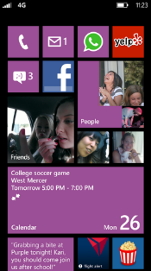
Evaluate this session
Required Slide
*delete this box when your slide is finalized
Your MS Tag will be inserted here during the final scrub.
Scan this QR code to
evaluate this session.

Slide 37
Questions?

Slide 38
© 2013 Microsoft Corporation. All rights reserved. Microsoft, Windows and other product names are or may be registered trademarks and/or trademarks in the U.S. and/or other countries.
The information herein is for informational purposes only and represents the current view of Microsoft Corporation as of the date of this presentation. Because Microsoft must respond to changing market conditions, it should not be interpreted to be a commitment on the part of Microsoft, and Microsoft cannot guarantee the accuracy of any information provided after the date of this presentation. MICROSOFT MAKES NO WARRANTIES, EXPRESS, IMPLIED OR STATUTORY, AS TO THE INFORMATION IN THIS PRESENTATION.

