Slide 2
Mobile Devices Deep Dive Microsoft Lync Server 2013
OUC-B330
Korneel Bullens

Slide 3







About me
KBullens
@microsoft.com
Houten, The Netherlands
MCS Voice CoE
UC Voice Architect
Since 2011
MCSM: Communications
MCM

Slide 4
Agenda
What’s new in Lync Server Mobility?
How to plan, deploy & manage mobility in Lync Server 2013?
What’s the high-level architecture and flow for key scenarios?

Slide 5
Mobility: Overview

Slide 6
Lync Server 2013 – Mobility Goals
Cross Platform support
Power Real-Time Communications
Optimize for Mobile constraints
Simplify Deployment

Slide 7
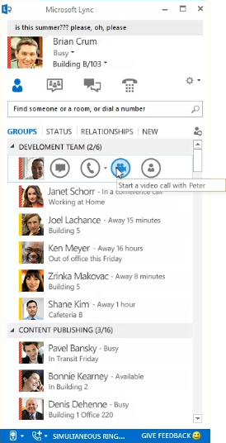
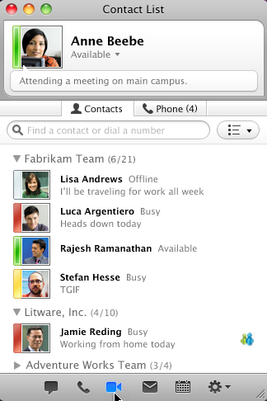
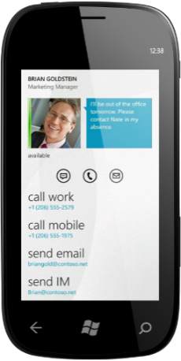
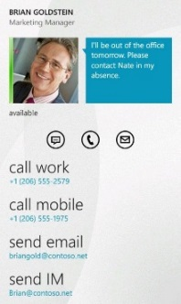
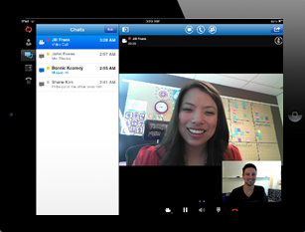
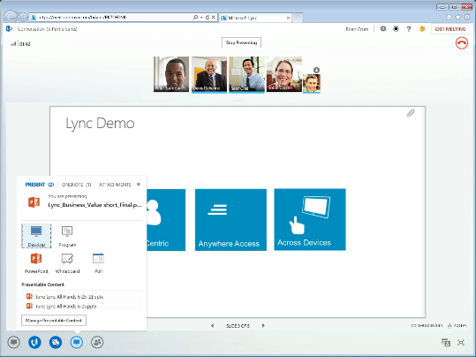
The new Lync works across platforms
PC
Mac
Smartphone
Tablet
Browser

Slide 8


Mobile Constraints
Disconnected Apps
Low Battery Budget
Affordable Data Plan

Slide 9
Mobility / Web updates at a glance
Nov, 2011:
Lync Server 2010, Mobility Service
June, 2012:
Lync Server 2010, Mobile Update
Oct, 2010:
Lync Server 2010
Oct, 2012:
Lync Server 2013
Feb, 2013:
Lync Server 2013,
Communicator Mobile for WM 6.x, Nokia devices
Contacts & Groups
Presence
IM
Call-via-Work
PowerPoint Viewing (in iPad)
UCWA/ Lync Web App with
VoIP
Video/ Multi-View
App/ Desktop Sharing
Data Collaboration
UCWA/ Lync Mobile with
VoIP
Video (H264)
App/ Desktop Sharing (iPad only)
PowerPoint viewing (iPad only)

Slide 10


What’s new in Lync Server 2013 Mobility (1 of 2)
 | Lync Server 2010 | Lync Server 2013
 | 3 day Registration | Longer lived registration
 | No availability across server restarts | Support for High availability
 | IM, Call-via-Work, PowerPoint Viewing | IM, Call-via-Work, VoIP, Video, Desktop/App-sharing and PowerPoint Viewing
 | Incoming notifications via Push Notifications (WP/ iOS), P-GET Event Channel | VoIP socket for iOS, Incoming notifications via Push for WP, P-GET Event Channel for Android
 | Missed conversations due to 15 sec auto-accept time | Improved accept experience with 25 sec auto-accept time
 | Limited roster experience for IM | Rich Roster experience for conversations
 |  | Support for joining meetings with 250+ users
Availability
Communications

Slide 11

What’s new in Lync Server 2013 Mobility (2 of 2)
 | Lync Server 2010 | Lync Server 2013
 | Mobility Services and Lync Autodiscover Services in a separate Add-On Microsoft Installer Package (MSI) | Web API and Infrastructure built-in Lync Server Integrated Setup and Simplified deployment
 | Level 7 HLB needed to support cookie based persistence | Lower TCO with Level 4 HLB. No cookie persistence anymore, Managed by Lync Web Infra
 | Policies for mobility and outside voice | New policies to manage VoIP/ Video on mobile
 |  | Capacity planning tool update to include mobility
 | Photos from AD | HD photos from Exchange 2013 on-premise/ online using server-to-server auth
 |  | Unified contacts and groups with Exchange 2013 on-premise/ online
Mobile Setup & Deployment
Server-to-Server Auth

Slide 12
Mobility: Deployment &
Management

Slide 13
Mobility Deployment Goals
Common API and Infrastructure for Mobile and Web
Integrated setup with Lync Server deployment
Abstract Lync topology complexities for on-premise and online
Support new topologies such as Split-domain
Provide common architecture for security, performance and resiliency

Slide 14



Lync Server 2013 Mobility Deployment
PSTN/ GSM
Internet
MPNS
Exchange Online
Forward Proxy
Reverse Proxy
EDGE (SIP)
EDGE (SIP)
DMZ
SIP Federation (push.lync.com)
Enterprise
Media Gateway
PNCH Services
FE Pool 1, Mediation Server
FE Pool 2,
Mediation Server
FE Pool 3,
Mediation Server
Lync Server
(with Lync Web Components: UC Web API, Discovery)
HTTP
SIP

Slide 15
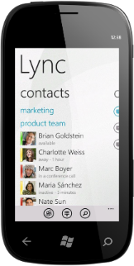

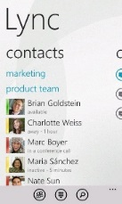
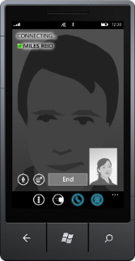
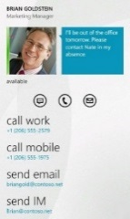
Client – Server Interop (1 of 2)
Client
Device *
Server **
Lync 2010 for Windows Phone
Windows Phone 7.5 “Mango”
Lync Server 2010
Lync 2013 for Windows Phone
Lync Server 2013
Windows Phone 8 “Apollo”
* Note: This scenario highlights Windows Phone support, though the same scenarios apply to Android and iOS (Ex: iPad version 1 doesn’t support iOS6)
** Or Lync Online / Office 365 service environment

Slide 16
Client – Server Interop (2 of 2)
 | Lync Server 2010 with Mobility Service | Lync Server 2013 (prior to February 2013 update) | Lync Server 2013, February 2013 – Mobility Enabled | Lync Server 2013, February 2013 – Mobility Disabled
Lync 2010 mobile clients |  |  | Notification to upgrade to the latest version of the mobility client. | Error: “Can’t sign in because you are not setup to use Lync 2013. Please contact your support team.””
Lync 2013 mobile clients | Error: “You can't sign in with this version of Lync. Please install Lync 2010.” | Error: “You can't sign in with this version of Lync. Please install Lync 2010.” |  | Error: “Can’t sign in because you are not setup to use Lync 2013. Please contact your support team.””

Slide 17
Mobility Policies and Preferences – IT Admin
Configure Enterprise Voice for mobile users
Block push notifications
Limit VoIP usage on Wi-Fi only networks: Mobility Policy => RequireWIFIForIPAudio
PushNotificationConfiguration global policy for Microsoft Push Notifications Service: EnableMicrosoftPushNotificationService
Disable saving history on mobile device
Disable logging of call information: ClientPolicy: EnableCallLogAutoArchiving
Disable logging of IM conversation: ClientPolicy: EnableIMAutoArchiving
Enabling/ disabling these policies would affect conversation history across all clients
Limit Video usage on Wi-Fi only networks: Mobility Policy => RequireWIFIForIPVideo
Disabling would affect the ability to receive VoIP/ IM calls when application is in background
Control mobility rollout
Mobility policy controls available for users at global, site and user level: Mobility Policy => EnableMobility
Limit data usage by employees
Mobility Policy controls available to disabling VoIP (e.g. for hosting partners): Mobility Policy => EnableVoIP
Mobility Policy controls to disable outside voice i.e. Call-via-work and Single Number Reach for users: Mobility Policy => EnableOutsideVoice

Slide 18
Mobility Controls and Preferences – Mobile User
Limit Data Usage
Manage Notifications
Require Wi-Fi for Voice
Require Wi-Fi for Video
Require Wi-Fi for Sharing (iPad only)
Push Notifications on/ off for VoIP and IM (Windows Phone only)
Contacts
Phonebook access on/ off
Photos on/ off
Control Outside Voice
Specify Mobile Number
Accessibility
TTY mode on/ off

Slide 19
Capacity Planning – Mobility Workflow
1
2
3
4
Estimate mobility usage
Measure current capacity
Plan additional capacity
Monitor KHIs
  User model
  Number of mobile users
  Mobile devices per user
  Number of Lync users
  Number of FE
  Available memory per FE
  CPU
  Required min memory = .5 + (Active users)/2000
  Additional CPU = Active users * 0.0044
  Plan for failover
  Concurrent active sessions
  Available memory
  CPU

Slide 20
Capacity Planning – Contoso Scenario Walkthrough
Current capacity
8000 Lync users
Mobility requirement
Mobility for all Lync users
Capacity Plan*
Based on current capacity:
Front End pool with 2 servers
One device per user
User Model similar to Lync Server 2010 capacity user model
Recommendation:
3 FE per pool (i.e. add one FE)
CPU ~ 80%
Per FE
4000 users
6 GB available memory per FE
CPU <60%
Per FE
4000 Mobile Users
4000 mobile users/ FE
2.5 GB (minimum memory for mobility/ FE)
Issue:
1.8 GB (minimum memory for mobility/ FE)
On FE Failover:
4000 mobile users/ FE
CPU ~ 80%
Equal distribution across all devices
18% (additional CPU)
CPU ~ 70%; 12% additional CPU
2.5 GB min memory usage
2667 mobile users/ FE
Cannot handle failover
* For illustrations purpose only, for up to date information see mobility documentation for Lync Server 2013

Slide 21
Mobility Deployment Steps
Install Update
Set Mobility Policy
Configure Push
Lync Server 2013 February 2013 Update on all FE & Director (if present)
Enable Mobility/ VoIP/ Video/ Outside voice
For WP8
For Lync 2010 mobile clients (iOS/ WP)
Validate Deployment
Using Synthetic transaction
Lync On-premise
Lync Online
  No specific deployment steps needed for mobility

Slide 22
Monitoring
Performance Counters
Alerts
Synthetic Transactions
Session related counters e.g. concurrent active sessions, active poll count etc.
Voice calls e.g. inbound/ outbound success, failures, decline
Requests succeeded/ failed
Current count per modality IM, Voice, Video, Sharing
Exchange related - Request succeeded/ failure/ latencies
Presence/ Photo requests
Push Notifications counters
Available Memory
UCWA initialization failures
Push notification connectivity failures
UCWA Unhandled Exception warnings
UCWA conference for Mobility
Connectivity to Lync Push Notifications Service in Office 365
Total requests In Processing (Web Throttling and Auth)

Slide 23
Mobility: Architecture
Deep-Dive

Slide 24
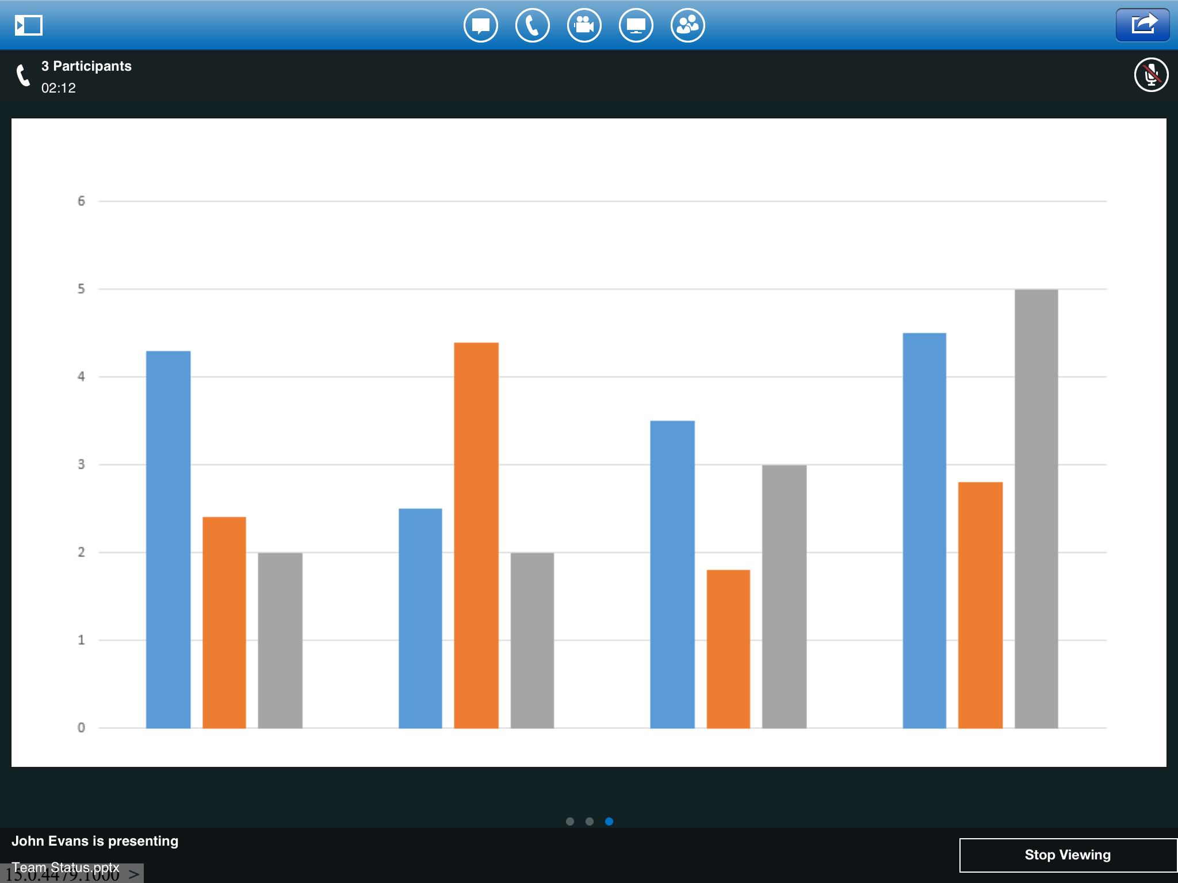
Real-time communications on HTTP
API
Security: AUTH/throttling
2
UCWA Conversations REST API
(Chat, VoIP, SDP …)
1
Auto-Discovery API
Web Proxy
3
Real-time UCWA Event API
(Urgent updates, SDP …)
Web Ticket
UCWA
Discover
Other web components
4
HTTP
Media Flow
Mobile Client App - Layer
UCMA
AVMCU
Media Manager/ Media Stack
Lync Mobile App
SIP
RTC
SIP PROXY
Lync Home Server
HTTP
SIP
Media

Slide 25

Lync Discover
Lync Discover is the process used by any client to discover Lync Server entry points such as Web URLs FQDN/Ports
Where is UCWA?
On premises
Hybrid
Online only
..
?
Alice@contoso.com

Slide 26


Discoverability: Hybrid topology sample
Alice@contoso.com
Webdir.online.lync.com
Lyncdiscover.contoso.com
GeoDNS
Webdir0a-ext.online.lync.com
REVERSE PROXY
EDGE (AP)
EDGE (AP)
EDGE (web Infra)
Federation
push.lync.com
LB
Pool1.contoso.com
LB
LB
Alice Home Server
dirSync (Hybrid only)
Contoso.com
Lync.com

Slide 27

Mobile Presence
In Lync Server 2013, UCWA persists user’s registration for longer periods of time via Static Registration.
User Offline
No activities for 3 days?
Alice@contoso.com
(Lync Server 2010 Mobile client)

Slide 28
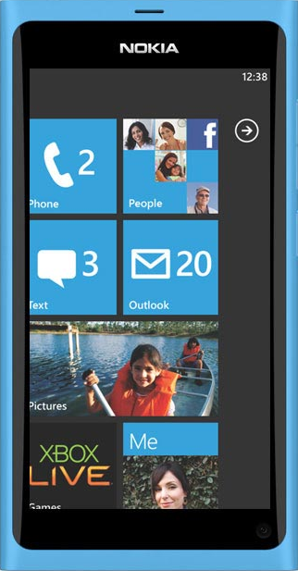

Lync Server 2010 – Mobile Presence
Alice@contoso.com
Available - Mobile
Inactive - Mobile
Offline
Away - Mobile
Alice’s is signed out of the mobile app and her presence changes to ‘Offline’ if mobile is her only active client after 3 days of inactivity within the mobile app
Alice navigates away from the app which changes her presence to ‘Inactive’ after 5 min
Alice presses home button
Alice’s presence changes to ‘Away’ after another 5 min of inactivity within the mobile app
Bob@contoso.com
Sign-in
Mobility
Service
Bob invites Alice
No activities for 3 days?
Lync Server
(Home Pool)
User
unavailable
Create
Delete
endpoint
User end point
Alice@Contoso.com
X
1 app = 1 endpoint ➔ Resource consuming

Slide 29
Lync Server 2013 – Mobile Presence
Alice@contoso.com
In a call - Mobile
Away - Mobile
Available - Mobile
Inactive - Mobile
Alice’s stays signed in up to 15 days of inactivity within the mobile app
Alice’s presence changes to ‘Away’ after another 5 min of inactivity within the mobile app
Alice navigates away from the app which changes her presence to ‘Inactive’ after 5 min
Alice presses home button
Bob@contoso.com
Sign-in
UCWA
Wake up client-app
Lync Server
(Home Pool)
No activity for 10 days?
Bob invites Alice
Delete
Create
Re-create
User end point
Alice@Contoso.com
X
Static registration
User end point
Alice@Contoso.com
1 static registration per user/ device

Slide 30
VoIP on Mobile
UCWA supports different notification mechanisms across varied mobile platforms
Notification channels?
P-Get Event Channel
VoIP socket
Push Notification
Alice@contoso.com

Slide 31


Receive VoIP call
PSTN/ GSM
Internet
Alice@contoso.com
MPNS
Accept call
Exchange Online
Media Flow
Forward Proxy
Reverse Proxy
EDGE (SIP)
EDGE (SIP)
DMZ
SIP Federation (push.lync.com)
Enterprise
Media Gateway
Bob@contoso.com
Incoming Call Notification
P-Get Event Channel
PNCH Services
Make call
Call accepted
Mediation Server
Pool 1
Pool 2
Pool 3
Lync Web Components (UCWA, AutoD)
HTTP
SIP
Media
Lync Server

Slide 32

Receive VoIP call – Push Notification
PSTN/ GSM
Alice@contoso.com
Send push to device
Internet
MPNS
Accept Call
Exchange Online
Media Flow
Forward Proxy
Reverse Proxy
EDGE (SIP)
EDGE (SIP)
DMZ
SIP Federation (push.lync.com)
Enterprise
Media Gateway
Bob@contoso.com
Send push to Lync Online
PNCH Services
Make call
Call accepted
Mediation Server
Pool 1
Pool 2
Pool 3
Lync Web Components (UCWA, AutoD)
HTTP
SIP
Media
Lync Server

Slide 33
Voice call preferences
UCWA enables user to receive incoming call over their preferred network
Call Preferences?
Wi-Fi/ Cellular Data/ PSTN
Alice@contoso.com

Slide 34
Voice Call Preferences: Require WiFi
PSTN/ GSM
Alice@contoso.com
(Moves from WiFi to LTE)
Internet
Alice’s setting: RequireWi-FiforVoIP
MPNS
Exchange Online
Media Flow
Forward Proxy
Reverse Proxy
EDGE (SIP)
EDGE (SIP)
DMZ
SIP Federation (push.lync.com)
Enterprise
Media Gateway
Bob@contoso.com
PNCH Services
Make call
Fallback to PSTN
Mediation Server
Pool 1
Pool 2
Pool 3
Lync Web Components (UCWA, AutoD)
HTTP
SIP
Media
PSTN
Lync Server

Slide 35
Rich Roster on Mobile
UI Virtualization in UCWA enables apps to display information on-demand and conserve data
Rich Roster views vs. bandwidth?
Participants,
Modalities,
Large meetings,
Active Speaker
Alice@contoso.com

Slide 36
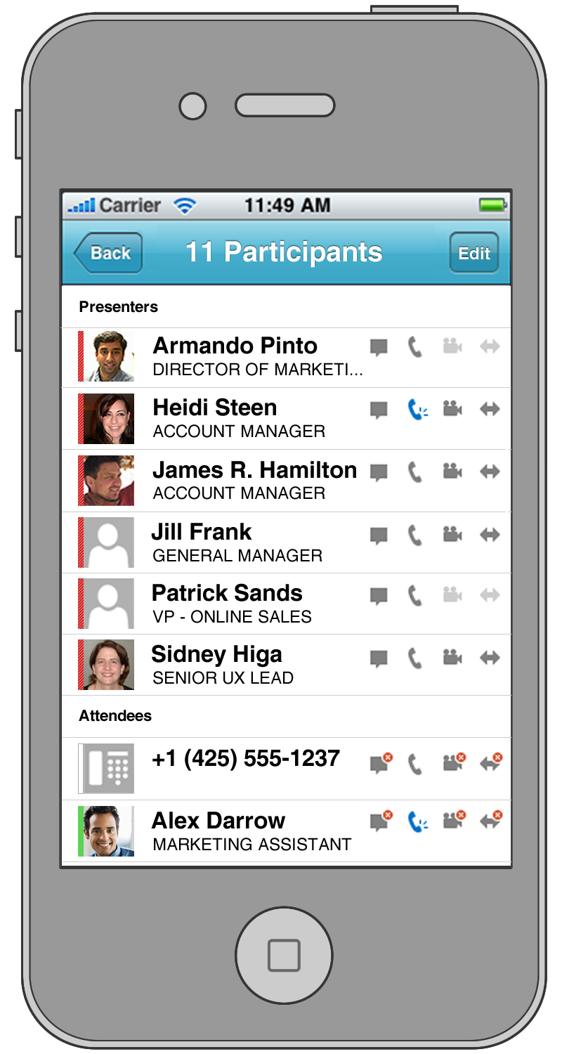
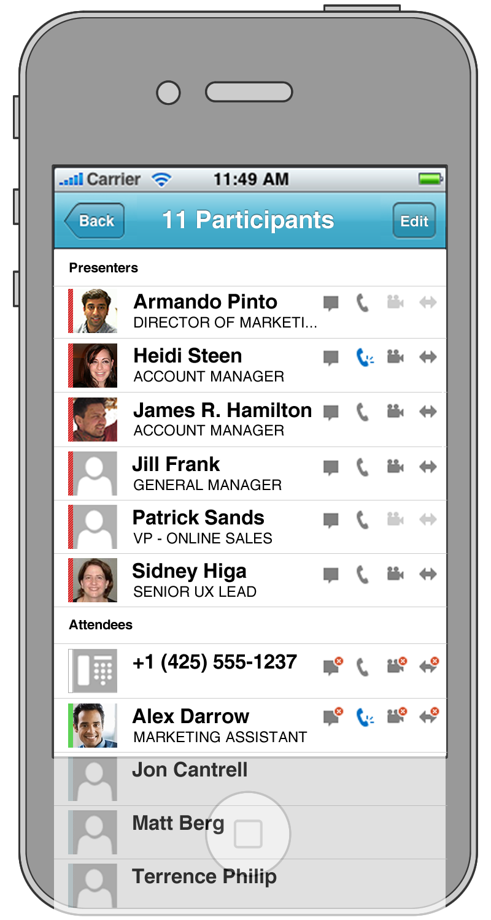
UI Virtualization
Clients receive Metadata Roster updates
Rich Roster Experience
LB
Roster – 11 Participants
Armando Pinto | Director of Marketing | ““../participants/ArmandoP”
… | … | …
Alex Darrow | Marketing Assistant | “../participants/AlexD”
Jon Cantrell | -- | “../participants/JCantrell”
Matt Berg | -- | “../participants/MattB”
Terrence Phillip | -- | “../participants/TPhillip”
Home
Server 1
(UCWA)
Home
Server 2
(UCWA)

Slide 37
Lync Server 2013 Mobility Updates Summary
- Longer lived registration as opposed to 3 day sign out
- Support for High availability
- Added support for VoIP, Video, Desktop/App-sharing & Powerpoint viewing (iPad only)
- VoIP socket for incoming call notifications on iOS clients
- Improved accept experience with 25 sec auto-accept time
- Rich Roster experience for conversations
- Support for joining meetings with 250+ users
- Web API and Infrastructure built-in Lync Server Integrated Setup and Simplified deployment
- Lower TCO with Level 4 HLB. No cookie persistence anymore, Managed by Lync Web Infra
- Policies to manage VoIP/ Video on mobile
- Capacity planning tool updates
- HD photos from Exchange 2013 on-premise/ online using server-to-server auth
- Unified contacts and groups with Exchange 2013 on-premise/ online

Slide 38
Backup

Slide 39
Push Notifications Clearing House
Online Service to light up background application on WP8 to deliver messages and VoIP calls
Serve both On-Prem and Online customers
Scenarios
    Incoming VoIP calls
    New IM invite/messages
    Message Waiting Indicator
    Missed Call notification
Providers
    Microsoft Push Notifications (MPNs)
Administration
    Configure Edge Server to setup hosting provider federation with push.lync.com
    Enable/Disable for Microsoft
    Control of Push Notifications done via policies
    On-prem: turned OFF by default - Online: turned ON by default
  User can enable/disable Push notification from Lync mobile client

Slide 40
Troubleshooting
Client logs
  Enable client logs and share via Email
  Snooper for analyzing client logs
Server logs
  Use CLS logger
  Collect logs for UCWA, Web Infra, Collab, S4

Slide 41
Q&A

Slide 42

Related content
Breakout Sessions
  Deep Dive into New UCWA of Lync 2013
Related Certification Exams
  70-336
  70-337
Find Me Later At: Lync 2013 Booth

Slide 43

Resources
Learning
  Sessions on Demand
  Microsoft Certification & Training Resources
http://channel9.msdn.com/Events/TechEd
www.microsoft.com/learning
TechNet
msdn
  Resources for IT Professionals
  Resources for Developers
http://microsoft.com/technet
http://microsoft.com/msdn

Slide 44
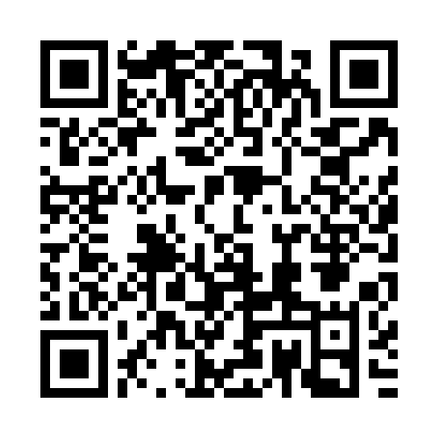


Evaluate this session
Required Slide
*delete this box when your slide is finalized
Your MS Tag will be inserted here during the final scrub.
Scan this QR code to
evaluate this session.

Slide 45

© 2013 Microsoft Corporation. All rights reserved. Microsoft, Windows and other product names are or may be registered trademarks and/or trademarks in the U.S. and/or other countries.
The information herein is for informational purposes only and represents the current view of Microsoft Corporation as of the date of this presentation. Because Microsoft must respond to changing market conditions, it should not be interpreted to be a commitment on the part of Microsoft, and Microsoft cannot guarantee the accuracy of any information provided after the date of this presentation. MICROSOFT MAKES NO WARRANTIES, EXPRESS, IMPLIED OR STATUTORY, AS TO THE INFORMATION IN THIS PRESENTATION.

