Slide 2
0 to 60: Developing Apps for Microsoft Office 2013
SES-B201
Richard diZerega – Microsoft
Israel Vega – InkBlot Consulting

Slide 3
Session Objectives
Illustrate the power and value of the new app model
Discuss the different app types and their purpose
Demonstrate patterns and practices for building apps

Slide 4
Things You Will Say After This Talk
I didn’t think A___S could do that, impressive!
PPS
I have never seen so many A___S in one room
PPS
There is nothing like the smell of A___S in the morning
PPS
Hey, can I show you my A___S?
PPS
I can’t wait to go home and play with A___S!
PPS

Slide 5
Demo
Apps for Office Overview

Slide 6
App Basics

Slide 7
Why Apps?
Traditional Office plug-ins are installed and executed on client (crippled upgrades)
Inconsistent experience across desktop, browser, and phone (ex: OWA, WAC, etc)
Required specialized skillset and tools to develop, package, and deploy

Slide 8
Anatomy of an App for Office
Each App for Office is based on XML-based manifest
Manifest points to a Web page
Manifest defines the type of the App for Office
Manifest defines which Office applications it supports
Manifest defines required capabilities
App for Office
Catalog Server
Web Server
<iframe>
</iframe>
App for Office
App for Office
Manifest
<XML>
Web
Page
HTML+JS

Slide 9
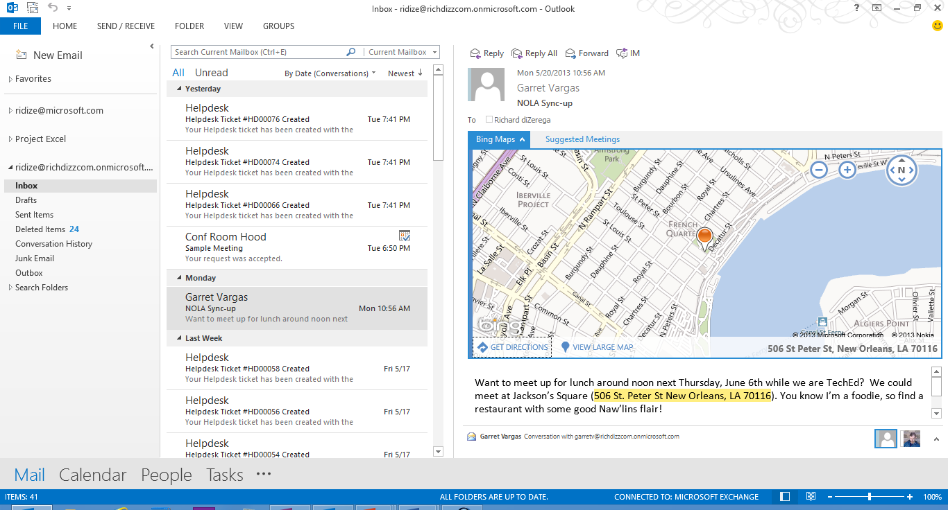
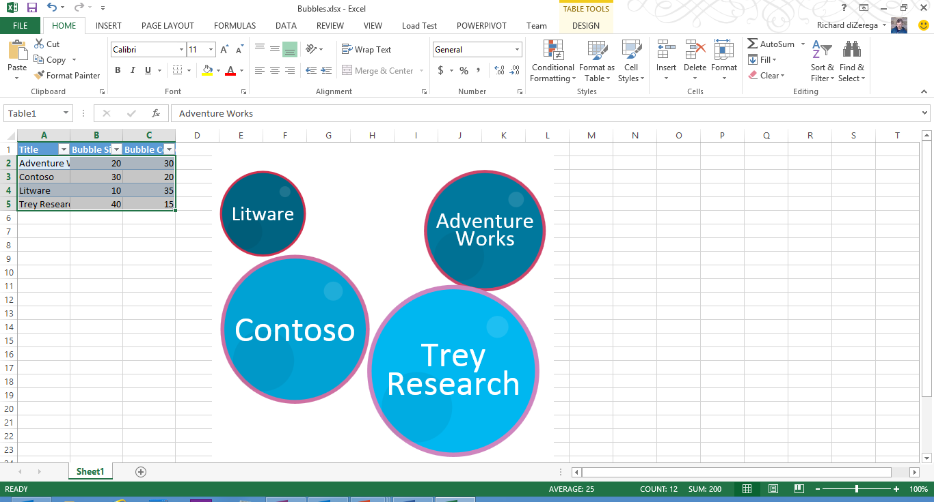
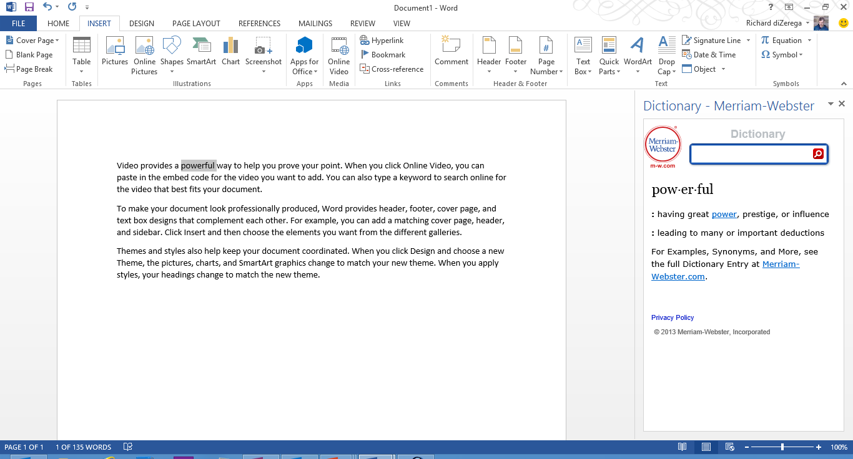
Types of Apps
Task Pane App for Office (Document-centric)
Assists user working with one or more documents
Works in Word, Excel and Project
Content App for Office (Document-centric)
Adds embedded content/functionality into document
Only used in Excel Application and Excel Web Application
Mail App for Office (Mailbox-centric)
Used in Outlook Application and Outlook Web App (OWA)
Extends Outlook items with custom UI and behaviors
Outlook items can be messages and events
Mail Apps require Exchange 2013

Slide 10
Client Experience Matrix
 | Office Application | Office Web Application
Task Pane Apps
Content Apps
Mail Apps
PowerPoint

Slide 11
UX Guidelines
DOs
Leverage Office.css styles
Avoid ALL scrollbars on content apps
Avoid horizontal scrollbars on mail and task pane apps
Design with resizing in mind
Consider informational messages in markup (opposed to alerts)
Leverage the context menu in top-right corner
Consider touch in your design elements (ex: hover flyouts)
DON’Ts
Expect hyperlinks to open in app window (blocked)
Trap users with poor app navigation
Use alerts for messaging

Slide 12
Building Apps

Slide 13
Reading and writing to a document
Office.context.document point entry for I/O
getSelectedDataAsync
setSelectedDataAsync
addHandlerAsync
SelectionChanged
Data types for reading/writing documents
Text
Matrix
Table
HTML (Word)
OOXML (Open Office XML - Word)

Slide 14
Demo
Reading and writing to document

Slide 15
Creating bindings
Office.context.document point entry for bindings
Adding a binding (addFromPromptAsync, addFromSelectionAsync, addFromNamedItem)
Referencing a binding (getAllAsync, getByIdAsync, Office.Select)
Removing a binding (releaseByIdAsync)
Binding event handler to binding (addHandlerAsync)
Types of bindings
Text
Matrix
Table

Slide 16
Demo
Bindings and content apps for Excel

Slide 17
Mail Apps
Require Exchange 2013
Exchange Server 2013 hosts users mailbox
Exchange Server 2013 hosts app manifest files
Web server hosts HTML for Mail App
Mail App can make callback to Web server
Mail App can call Exchange Web Services (EWS)
EWS calls can be brokered through Web server
Activation rules run whenever user selects item
Rules are defined in the manifest
Multiple rules can be combined with AND/OR operators for complex activation
Rules can access “known entities” (ex: meeting suggestion) or defined using regular expressions
Activation only makes the app available to the user in the UI…does NOT run the app

Slide 18
Outlook APIs
Accessing item properties:
Accessing user profile info:
Access to regex matches:
Access to extracted entities:

Slide 19
Demo
Building Mail Apps

Slide 20
Demo
Combining Apps for Office and SharePoint

Slide 21
Deployment and Catalogs
Deploy
Deploy web assets to the web server(s) of choice
Set absolute source location in manifest
Deploy manifest to a catalog
Catalogs
The Office Store – public marketplace for Office apps
SharePoint App Catalog – SharePoint site collection which makes apps available to private network
File Share App Catalog – Windows file share which has be configured to contain app manifests
Exchange App Catalog – Exchange 2013 catalogs to store mail app manifests

Slide 22
Session Objectives and Takeaways
Illustrate the power and value of the new app model
Discuss the different app types and their purpose
Demonstrate patterns and practices for building apps

Slide 23
Related content
SES-B202 0 to 60: Developing Apps for Microsoft SharePoint 2013
SES-B305: Developing Apps for Microsoft SharePoint 2013 with Visual Studio 2013
SES-B301: Advanced Patterns in Cloud-Hosted Apps for Microsoft SharePoint 2013
SES-H303: Building Content Apps for Microsoft Office 2013
SES-H307: Building Task Pane Apps for Microsoft Office 2013
Find us later at MOD Booth, Garage, and Ask the Experts

Slide 24
Resources
Learning
Sessions on Demand
Microsoft Certification & Training Resources
http://channel9.msdn.com/Events/TechEd
www.microsoft.com/learning
TechNet
msdn
Resources for IT Professionals
Resources for Developers
http://microsoft.com/technet
http://microsoft.com/msdn

Slide 25
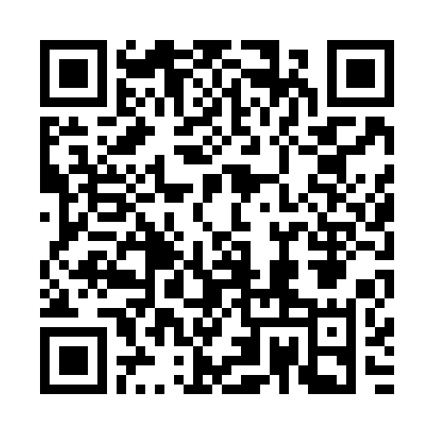
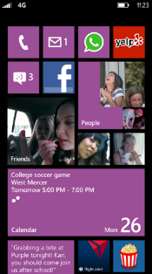
Evaluate this session
Required Slide
*delete this box when your slide is finalized
Your MS Tag will be inserted here during the final scrub.
Scan this QR code to
evaluate this session.

Slide 26
© 2013 Microsoft Corporation. All rights reserved. Microsoft, Windows and other product names are or may be registered trademarks and/or trademarks in the U.S. and/or other countries.
The information herein is for informational purposes only and represents the current view of Microsoft Corporation as of the date of this presentation. Because Microsoft must respond to changing market conditions, it should not be interpreted to be a commitment on the part of Microsoft, and Microsoft cannot guarantee the accuracy of any information provided after the date of this presentation. MICROSOFT MAKES NO WARRANTIES, EXPRESS, IMPLIED OR STATUTORY, AS TO THE INFORMATION IN THIS PRESENTATION.

