Slide 2
Advanced Patterns in Cloud-Hosted Apps for SharePoint
SES-B301
Richard diZerega – Microsoft
Nathan Miller – Microsoft

Slide 3
Session Objectives
Discuss complex challenges for delivering cloud-hosted apps
Demonstrate advanced patterns and practices for the new app model
Illustrate solutions that leverage the full breadth of the new app model

Slide 4
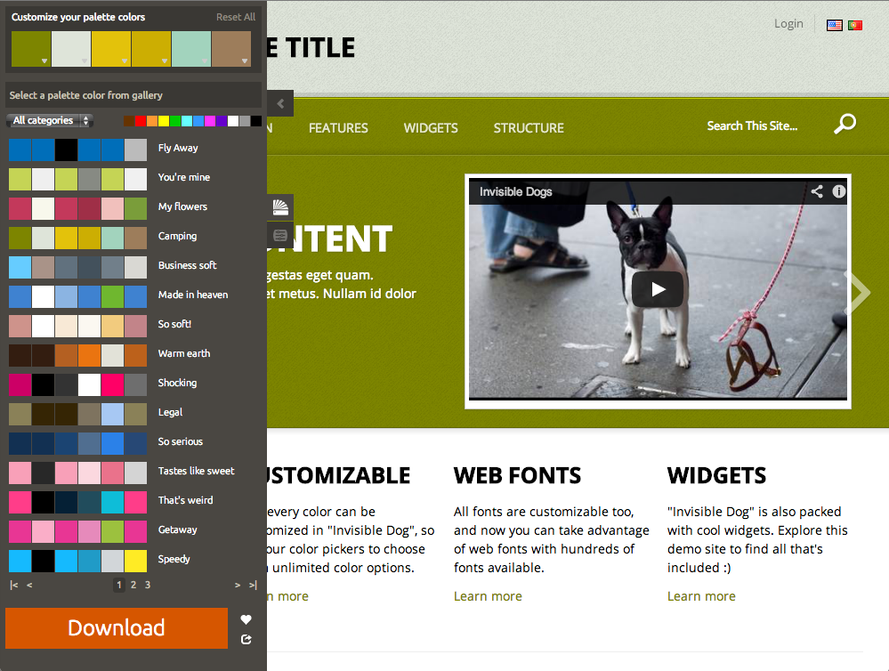
Free SharePoint
or Office 365
theme for good
questions!!!
Download when done

Slide 5
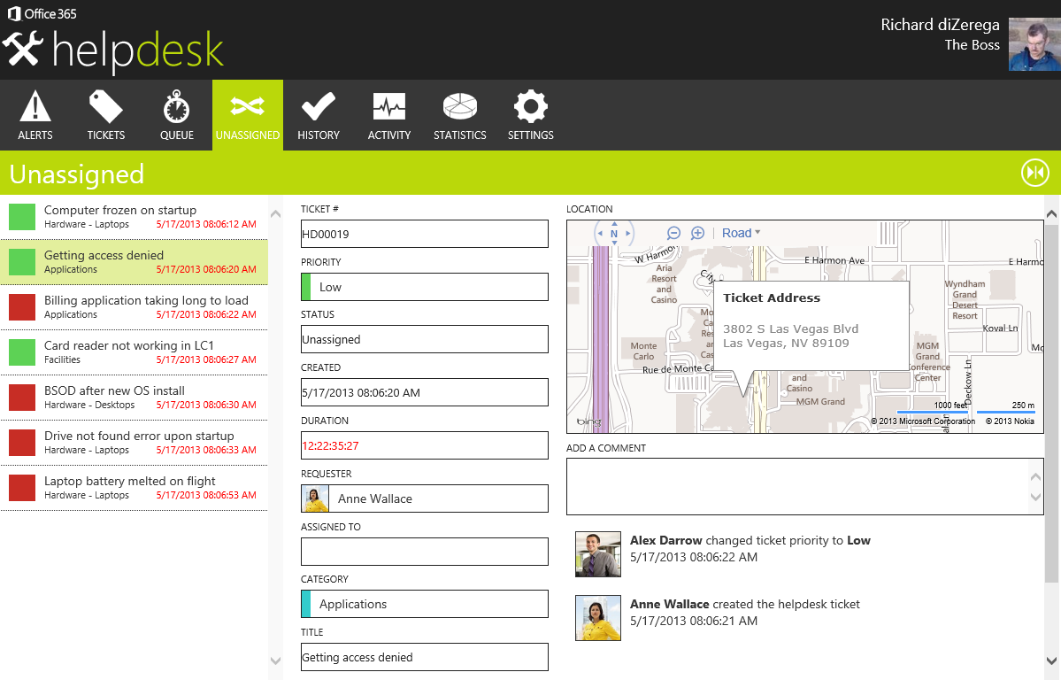
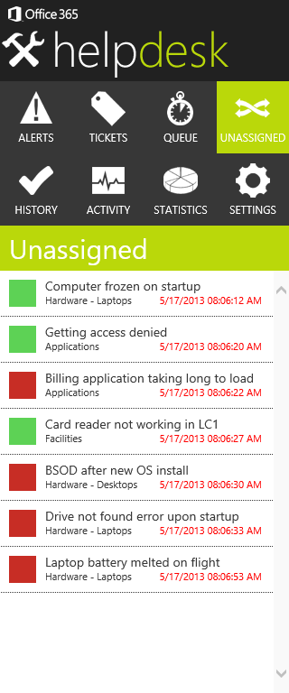
Introducing Helpdesk!

Slide 6
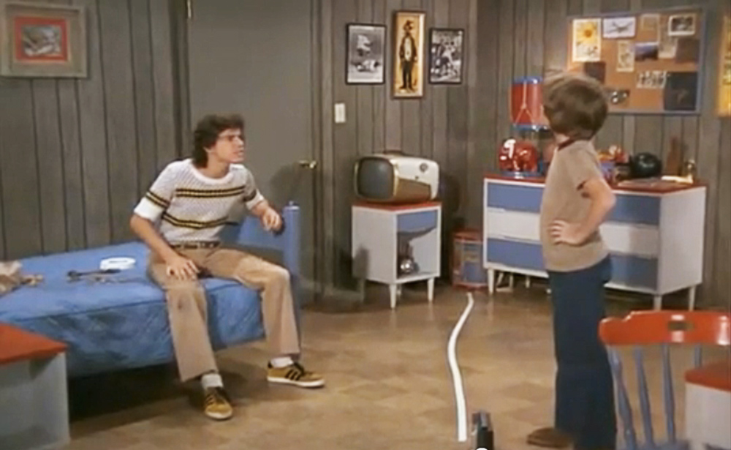
Tenancy
Isolated app resources
Each tenant has their own web application and/or database
Likely includes a Tenancy database to keep track of tenants and redirect to the tenant’s “space”
Shared app resources
All tenants share the same web application and database
Tenant data is separated by a TenantId on ALL database tables
All services and must be hardened to prevent cross-tenant hacks
Cost vs. Security
Helpdesk vs. HIPAA or Financial

Slide 7
Demo
App Installation and Provisioning

Slide 8
Trials
Limited access or time-bomb
Utility.GetAppLicenseInformation
Validate the app license token with Office Store (WCF or REST)
Getting started wizard
Hand-hold user through the process of configuring critical app settings
Facilitate role selection through followed/followers
Demo data
Great for a quick start, training, or demos
Allow purge of demo data

Slide 9
Demo
HelpDesk - Getting Started

Slide 10
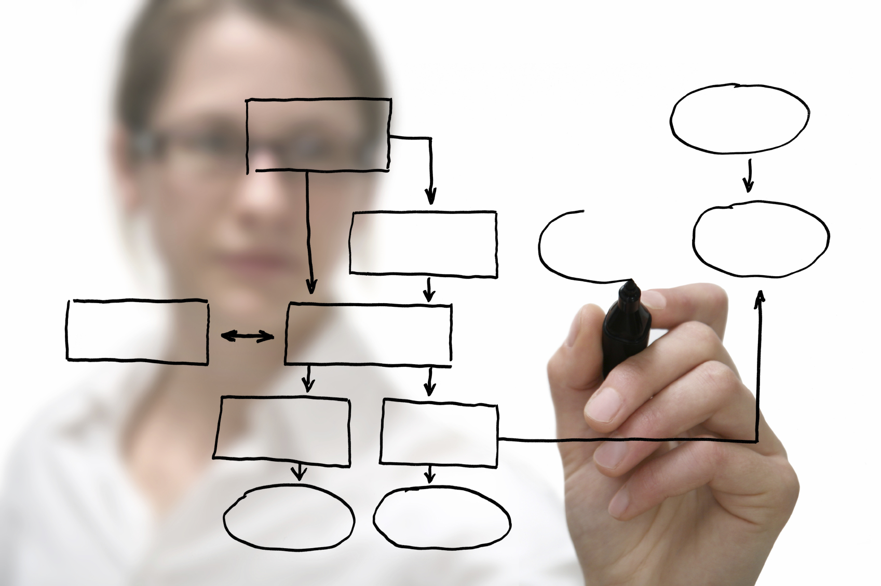
Architecture – Data and Services
Entity Framework
Decide on entities first or database first
SQL Azure
Still consider localdb during debugging
Be cautious of functional differences
SQL Azure requires IP configuration in administration
REST enabled WCF
All services perform “Tenant check” and require context
Most services are exposed with public and private end-points
GET and POST for most services

Slide 11
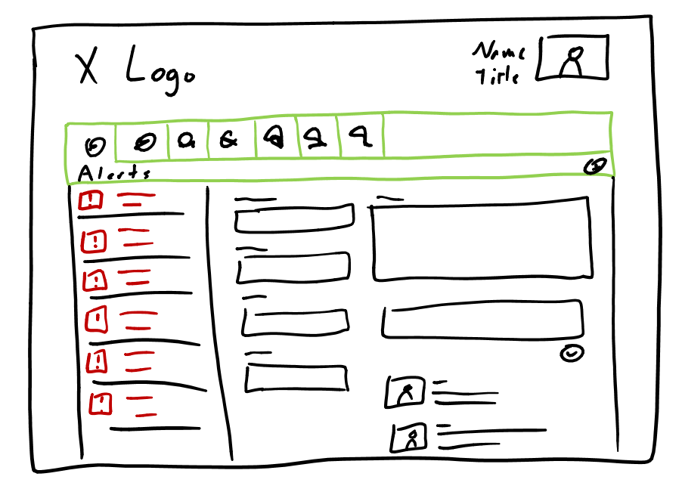
Architecture – UI and Branding
JavaScript libraries
helpdesk.common.js
helpdesk.data.js
helpdesk.ui.js
helpdesk.ui.templates.js
Chrome control vs. brand
Add link back to host web without chrome control
Responsive UI and touch-first
Heavy use of <ul></ul> layout
320px sections for easy mobile adaptation (even modals)
Large buttons and dirty flag navigation
AppParts
Surface useful info to native SharePoint sites (ex: Alerts)

Slide 12
Architecture – Security and Roles
GetTenant
The concept of a tenant should be complete transparent to tenants
Prevent cross-tenant hacks
User vs. Engineer
Both UI and Services should be security trimmed by role
UI should be Engineer-aware, but not dependent on client-side variable
People-Pickers
Provide a familiar experience for selecting users
Post-back only operations
Critical operations not exposed as REST services
Reset Tenant, Load Demo Data, etc

Slide 13
Demo
HelpDesk Architecture

Slide 14
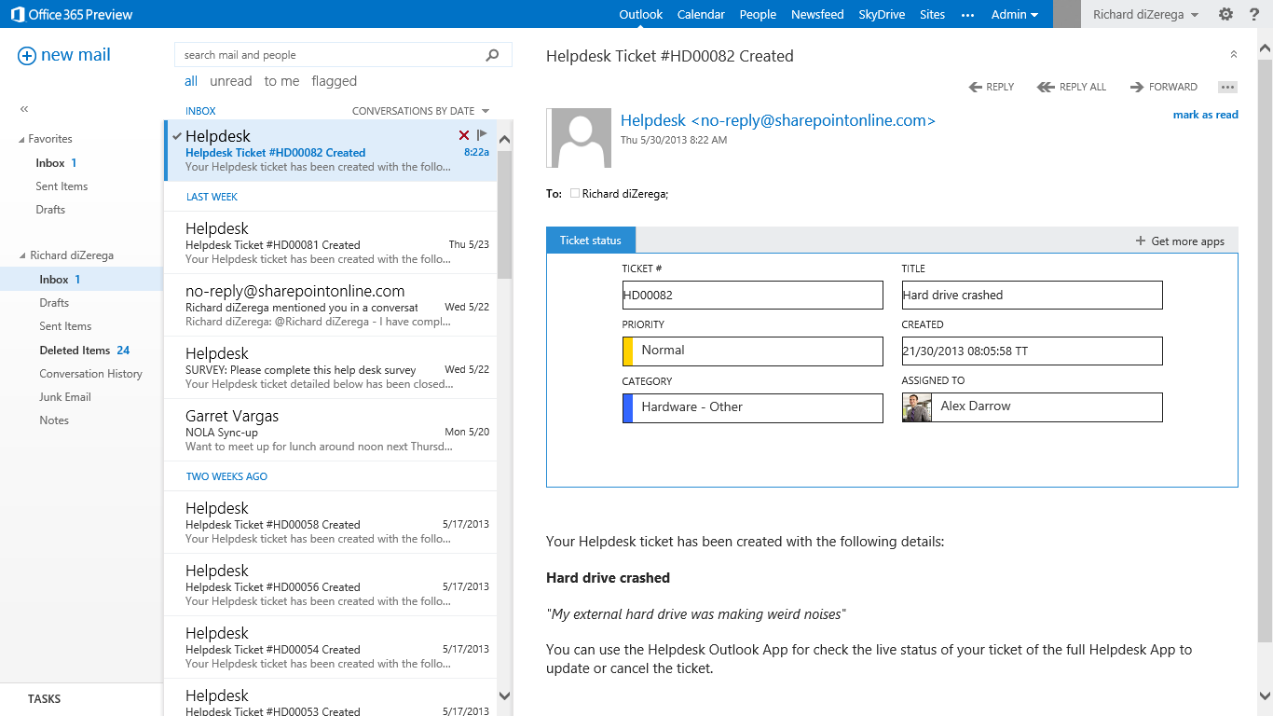
Mail Apps
Project structure
Add to full solution or develop as separate project
SharePoint calls
The SharePoint app needed “app-only” permissions to allow Outlook to call SharePoint APIs
Develop UI first
When possible, get app functional outside of Outlook to make debugging easier

Slide 15
Demo
Closing a Ticket and Mail Apps

Slide 16
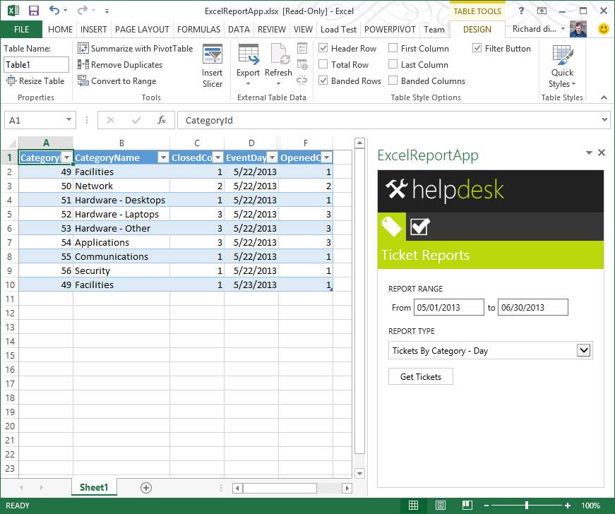
Excel App
Identity and Context
Host Excel document (containing app) from the AppWeb
Leverage Office.context.document.url to determine tenancy
JSON → Office table
Developed generic way to convert JSON data to Office table
Allows Excel users to import raw ticket data and report against it

Slide 17
Demo
Statistics and Excel Apps

Slide 18
Additional Tips and Tricks
Richard’s Tips
Consider scenarios where users navigate directly to the app without a context token and leverage the app redirect in SharePoint for getting context
Think about authentication to other areas you will leverage (ex: AppWeb and MySiteHost)
Keep a hackers mind when delivering predominately client-driven UI
Nathan’s Tips
Start with multiple tenants so tenancy issues are apparent from the very beginning
Make sure you thinking through security hardening specific to your tenancy approach
Make the effort to streamline provider-hosted publishing early on

Slide 19
Session Objectives
Discuss complex challenges for delivering cloud-hosted apps
Demonstrate advanced patterns and practices for the new app model
Illustrate solutions that leverage the full breadth of the new app model

Slide 20
Related content
SES-B305: Developing Apps for Microsoft SharePoint 2013 with Visual Studio 2013
SES-B301: Advanced Patterns in Cloud-Hosted Apps for Microsoft SharePoint 2013
SES-B311: Step by Step: Search Development in Microsoft SharePoint
SES-H302: Building an Autohosted App
SES-H306: Building SharePoint Hosted Apps with Napa
SES-H309: Building Windows 8 Apps with Microsoft SharePoint 2013
Find us later at MOD Booth, Garage, and Ask the Experts
http://blogs.msdn.com/b/richard_dizeregas_blog

Slide 21
Resources
Learning
Sessions on Demand
Microsoft Certification & Training Resources
http://channel9.msdn.com/Events/TechEd
www.microsoft.com/learning
TechNet
msdn
Resources for IT Professionals
Resources for Developers
http://microsoft.com/technet
http://microsoft.com/msdn

Slide 22
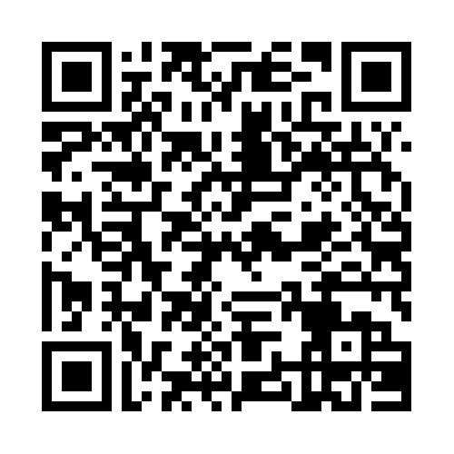
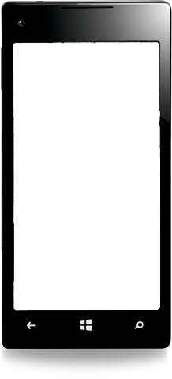
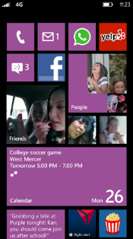
Evaluate this session
Required Slide
*delete this box when your slide is finalized
Your MS Tag will be inserted here during the final scrub.
Scan this QR code to
evaluate this session.

Slide 23
© 2013 Microsoft Corporation. All rights reserved. Microsoft, Windows and other product names are or may be registered trademarks and/or trademarks in the U.S. and/or other countries.
The information herein is for informational purposes only and represents the current view of Microsoft Corporation as of the date of this presentation. Because Microsoft must respond to changing market conditions, it should not be interpreted to be a commitment on the part of Microsoft, and Microsoft cannot guarantee the accuracy of any information provided after the date of this presentation. MICROSOFT MAKES NO WARRANTIES, EXPRESS, IMPLIED OR STATUTORY, AS TO THE INFORMATION IN THIS PRESENTATION.

